Slide 1
Module One: In the Beginning
(4,600 Million BCE-1513 CE)
Professor Ryan Lancaster

Slide 2
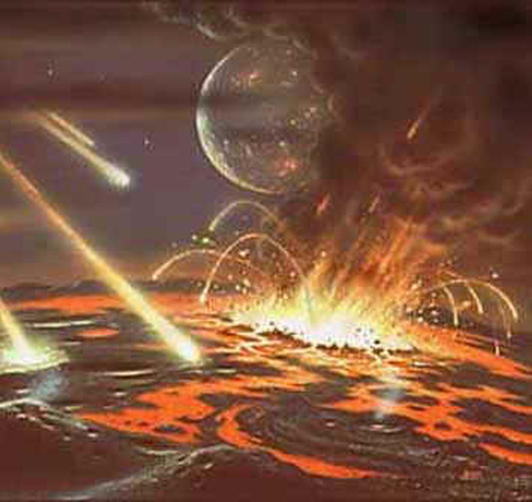
Precambrian Era (4,600,000,000 BCE)
Refers to the whole period of Earth's history before forming the oldest rocks with identifiable fossils in them.
The Earth is estimated to be approximately 4.6 billion years old—an age obtained by dating meteorites.
The Precambrian covers almost 90% of the entire history of the Earth and comprises all geologic time before 600 million years ago.

Slide 3
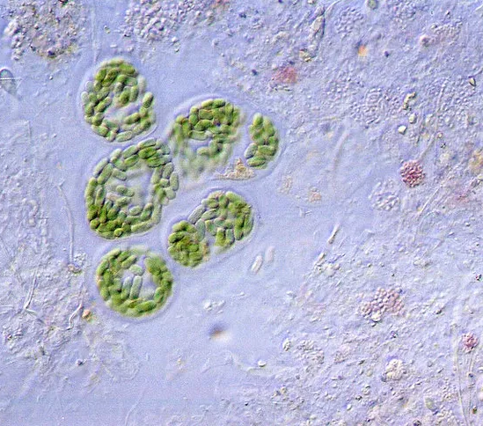
Precambrian Era (4,600,000,000 BCE)
The oldest known eukaryotes lived around 1.4 billion years ago during the Precambrian near Beck Spring, California.
These were photosynthetic organisms and produced oxygen as a byproduct of their physiology.
The Beck Spring eukaryotes and other Precambrian photosynthesizers released the oxygen that now makes the planet's atmosphere breathable.

Slide 4
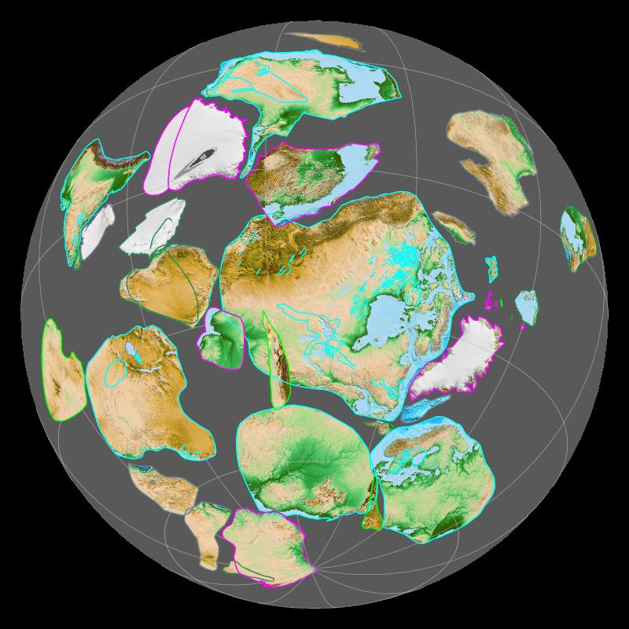
Precambrian Era (4,600,000,000 BCE)
The appearance of the first eukaryotic cells in the fossil record were relatively followed by evidence of complicated multicellular life.
Rocks in Nevada dating back to a billion years ago preserve trace fossils left behind by worms as they burrow below the sediment.
The remainder of the Precambrian period saw the formation of a supercontinent, which geologists call Rodinia, about 1.1 billion years ago, and its eventual breakup about 750 million years ago.
Preserved remnants of the continental collisions that formed this supercontinent are found widely across modern North America, but very few of these elements are recognizable in the United States.

Slide 5
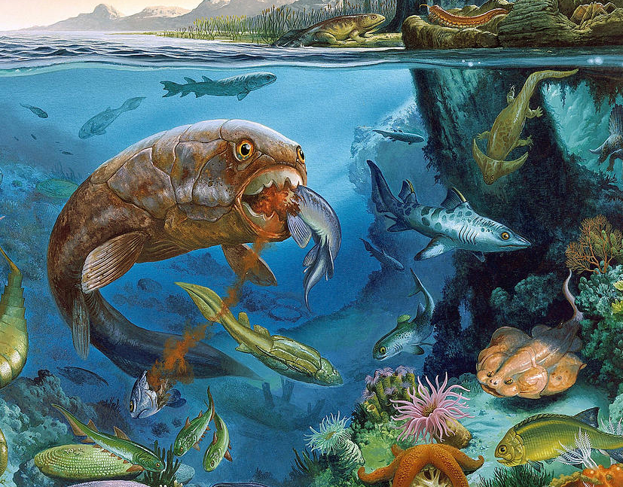
Paleozoic Era (541,000,000 BCE)
The area that now comprises California, Oregon, Washington, and western Nevada did not exist as part of the North American continent
The shore moved eastward over time as sea level rose, covering much of the western US under a shallow sea
At the end of the era, global temperatures and sea levels fell abruptly.
As a result of these environmental changes, major mass extinction of marine life took place at this time.
Sea level continued to rise and fall throughout the first half of the Paleozoic.
All known life was aquatic, so areas of the United States above sea level would have been sterile wastelands.
Trilobites are the most common kind of animal in the Cambrian fossil record.

Slide 6
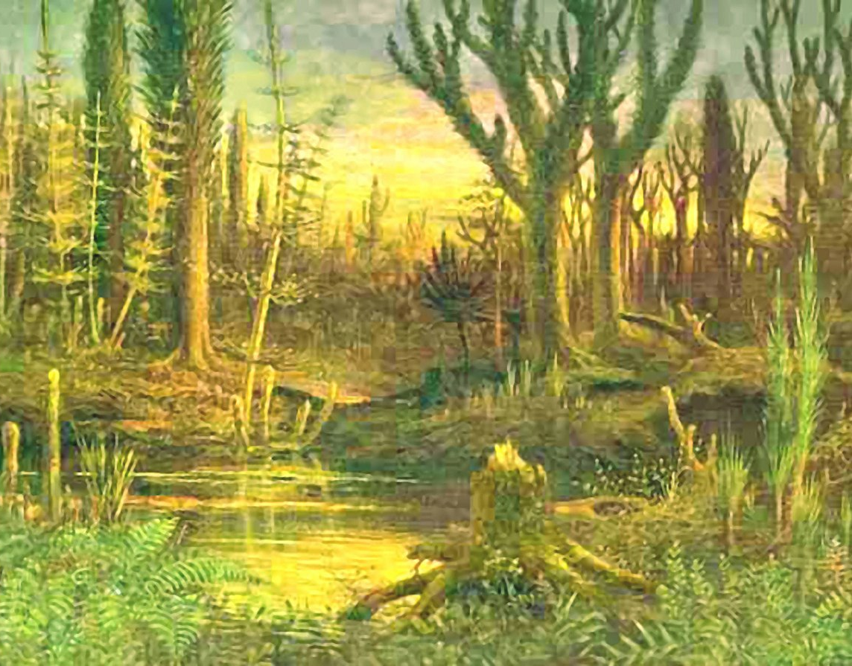
Paleozoic Era (541,000,000 BCE)
The plants responsible for leaving behind the local fossil seeds may have been seed ferns, who reproduce through seeds instead of spores
Then 323 million years ago, the northward drift of Gondwanaland finally joined the southeastern United States to North America as Pangaea began to form.
Mountain building raised the Ancestral Rockies in Colorado, Utah, and Wyoming.
Seawaters left the interior of the country.
Densely vegetated swamps were widespread.

Slide 7
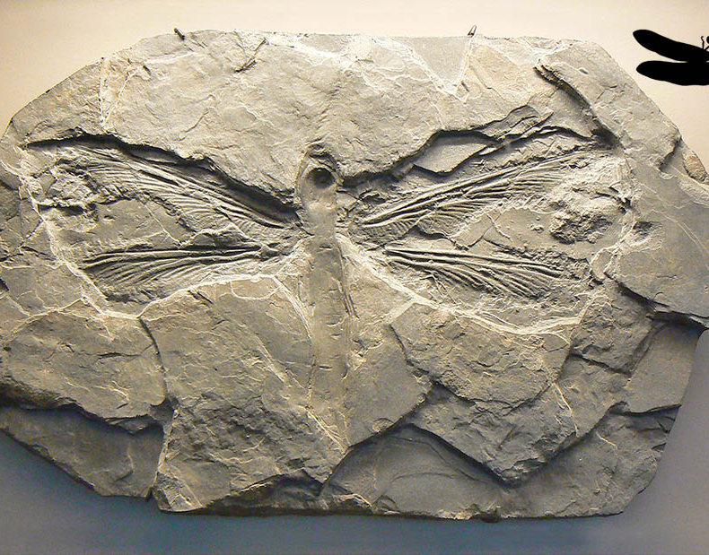
Paleozoic Era (541,000,000 BCE)
The largest insects in geologic history lived during this time.
Giant salamander-like amphibians left behind footprints near Lawrence, Kansas, that would later fossilize.
The world's continents were joined as Pangaea roughly 298 million years ago.
The waters of Texas were home to massive reefs
Seas that had previously covered Kansas, New Mexico, and Texas began drying up and left behind salt deposits.

Slide 8
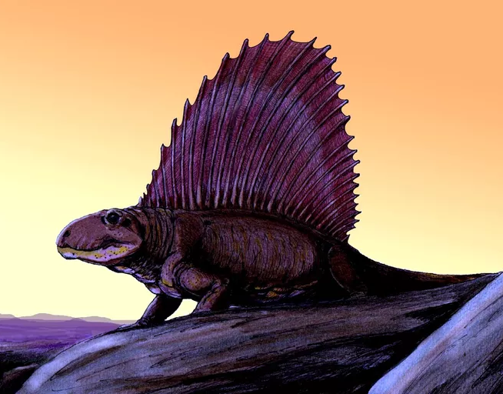
Paleozoic Era (541,000,000 BCE)
The inner portions of the western United States had a hot, dry climate.
Dunes were prevalent throughout the country. The insects of the time were common and diverse.
Large amphibians were not rare in the southwestern United States but were unable to stray too far from water bodies. Reptiles were becoming common during this time.
Texas was also home to the Dimetrodon.
Ended with the most destructive mass extinction in all the Earth's history (298 million BCE).
Globally up to 96% of all species may have disappeared.

Slide 9
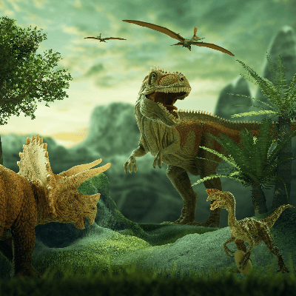
Mesozoic Era (252,000,000 BCE)
The eastern United States was part of Pangaea's interior for most of the Triassic Period of the Mesozoic era, roughly 250 million years ago.
Reptiles first began claiming the ecological dominance of marine, terrestrial and aerial habitats during the Triassic that would earn the Mesozoic the nickname "the Age of Reptiles".
The oldest dinosaur remains in the eastern US and is about 225 million years old.
As the Triassic ended, Pangaea was breaking up into separate continents again. Rift valleys formed along the east coast as the North American and became the young Atlantic Ocean.
At the end of the Triassic, another mass extinction occurred. Globally, this extinction event wiped out roughly one-quarter of amphibians and reptiles became extinct.

Slide 10
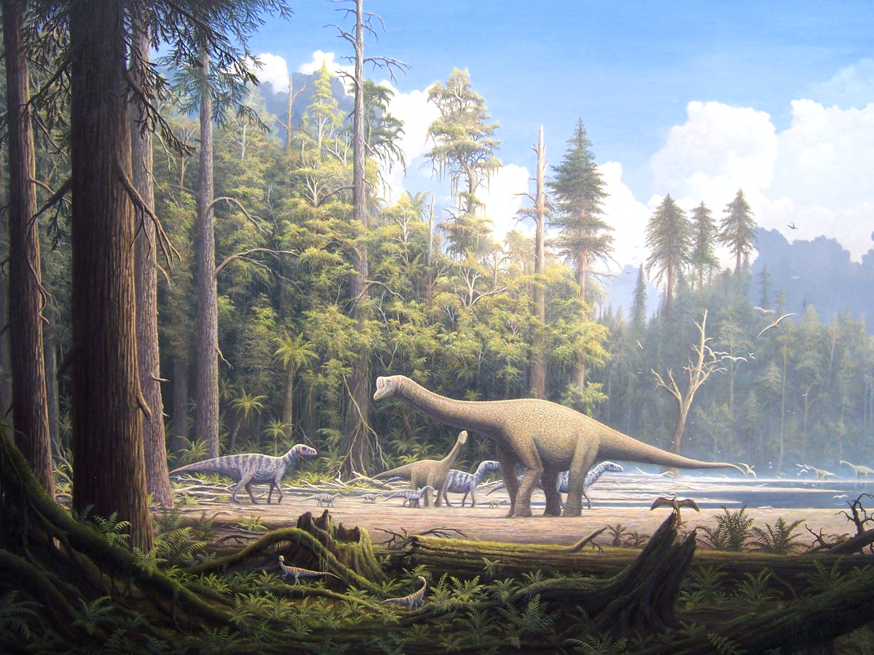
Mesozoic Era (252,000,000 BCE)
The eastern coast of the US became warmer and wetter during the Early Jurassic.
The newly formed Atlantic Ocean brought it into contact with more humid air.
The Pacific Plate forced its way under the North American plate, triggering geologic upheaval, on the west coast.
Local mammals diversified significantly during the Jurassic, some 145 million years ago.
Local dinosaurs included the sauropods Apatosaurus and Diplodocus, and the theropod Allosaurus.
Unlike many periods of geologic history, the Jurassic did not end in mass extinction. There were; however, lesser extinction events going on at the time.

Slide 11
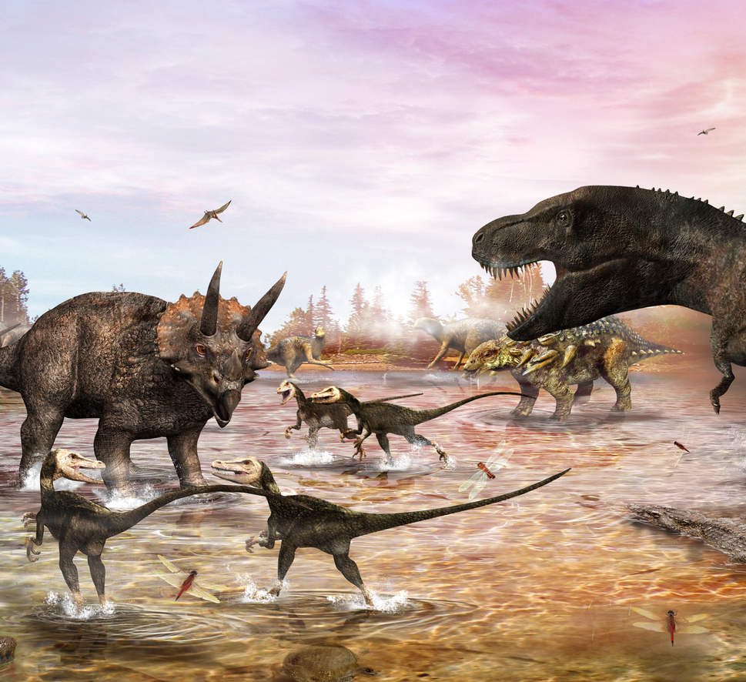
Mesozoic Era (252,000,000 BCE)
During the Late Cretaceous (70 million years ago), the Gulf of Mexico had expanded through North America until reaching Alaska.
Up to half of the continent's new surface area may have been submerged by this sea. This is called the Western Interior Seaway. It covered most states like Texas, New Mexico, Oklahoma, Colorado, Kansas, the Dakotas, and Wyoming.
At the time, Montana was home to some of the most famous dinosaurs, creatures like Triceratops and Tyrannosaurus.
The Cretaceous ended with another mass extinction.
This one was the second most devastating in geologic history.
Roughly half of all animal families became extinct.
The most popular explanation for the mass extinction at the end of the Cretaceous is that it resulted from a meteorite impact.

Slide 12
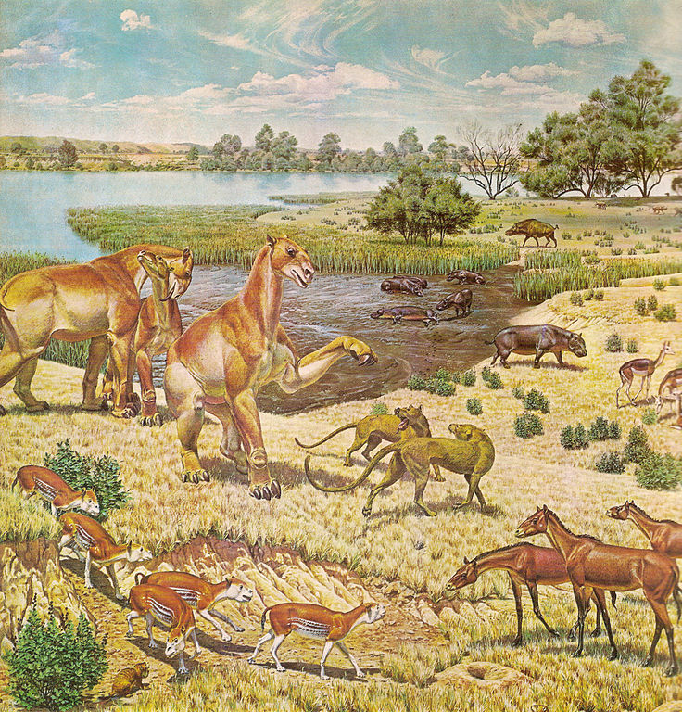
Cenozoic Era (66,000,000 BCE)
The global climate of the early portion of the Cenozoic Era, some 66 million years ago, was much warmer than it is today.
The overall environment of the Earth was much more consistent regardless of proximity to the equator.
The Cenozoic Era is also known as the Age of Mammals because of the extinction of many giant mammals, allowing smaller species to thrive and diversify because their predators no longer existed.
The beginning of the Paleogene Period was time for the mammals that survived from the Cretaceous Period.
Later in this period, rodents and small horses, , are common, and rhinoceroses and elephants appear. As the period ends, dogs, cats, and pigs become commonplace.
Other than a few birds classified as dinosaurs, most notably the Titanis, the dinosaurs were gone. Large flightless birds thrived.

Slide 13
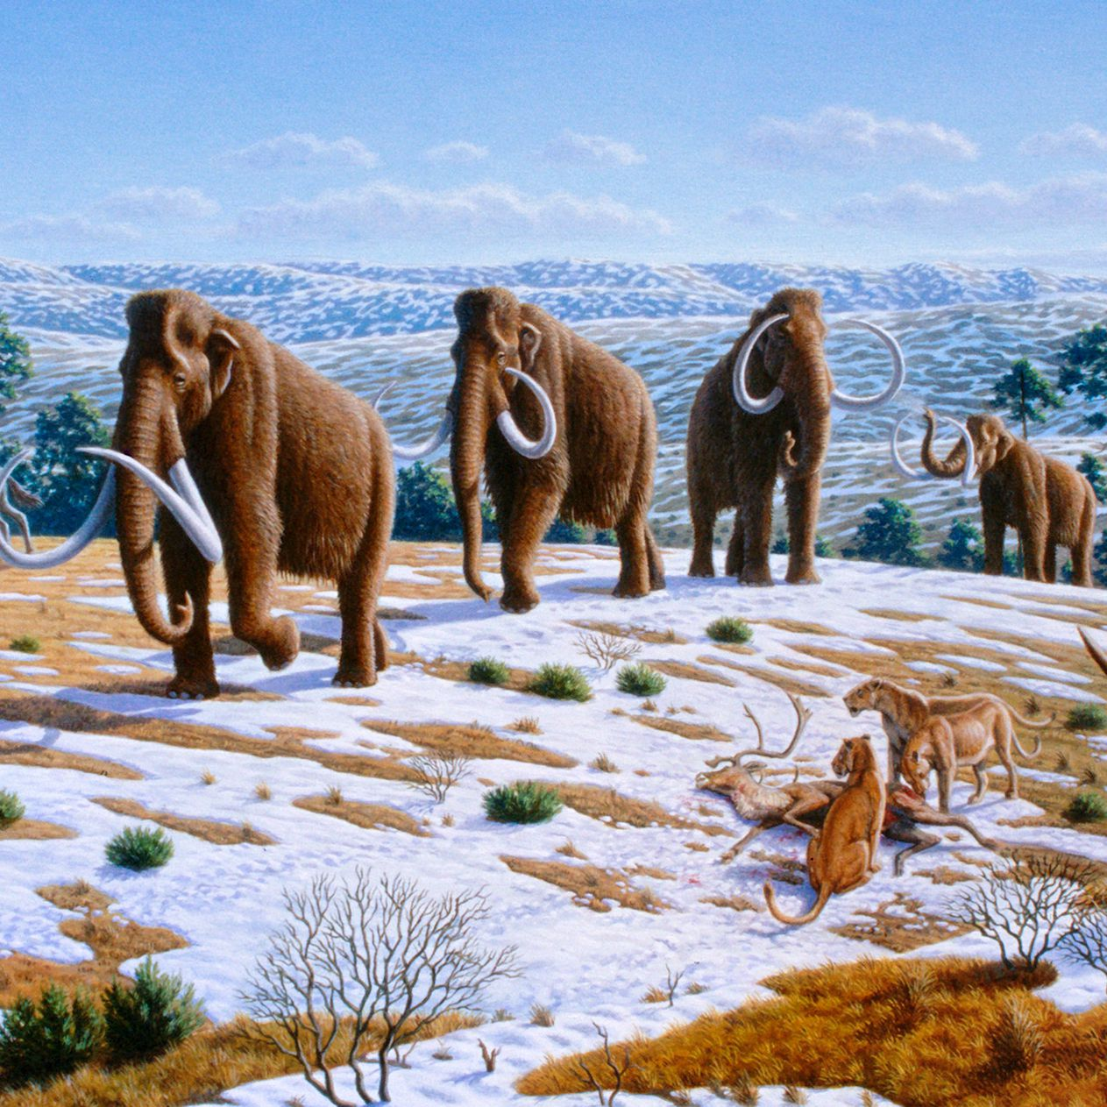
Cenozoic Era (66,000,000 BCE)
23 million years ago gives rise to early primates, including early humans.
Bovids, including cattle, sheep, goats, antelope, and gazelle, flourish during this period.
Cave lions, saber-toothed cats, cave bears, giant deer, woolly rhinoceroses, and woolly mammoths were dominant species.
Without the dinosaurs, plant life had an opportunity to flourish during the Cenozoic Era.

Slide 14
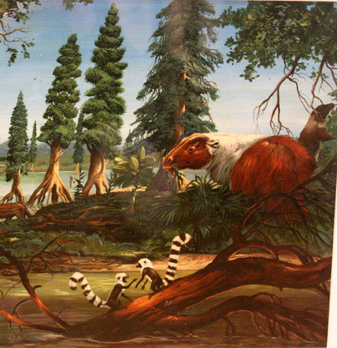
Cenozoic Era (66,000,000 BCE)
Nearly every plant living Today had its roots in the Cenozoic Era. During the early part of the era, forests overran most of North America.
As the climate cooled, forests died off, creating open land.
The Great Lakes that formed in the western United States during were the perfect home for bass, trout and other freshwater species.
As the forests thinned, grasses began to spread out over the plains of North America, and savannas covered the land in the middle of the continent.
Among the ordinary plant life were pines, mosses, oaks, and grasses. Flowering plants and edible crops dominate the landscape in the latter part of this era as humans cultivate it.

Slide 15
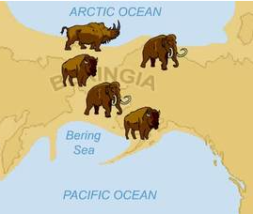
Land Bridge (14,480 BCE)
It is believed that a small human population of at most a few thousand arrived in Beringia from eastern Siberia before expanding into the settlement of the Americas sometime after 14,480 BCE.
This would have occurred as the American glaciers blocking the way southward melted, but before the bridge was covered by the sea, about roughly 9000 BCE.
The Paleo-Indian stage lasted from the first arrival of people in the Americas until about 5000 to 3000 BCE (in North America).
Three major migrations occurred, as traced by linguistic and genetic data

Slide 16
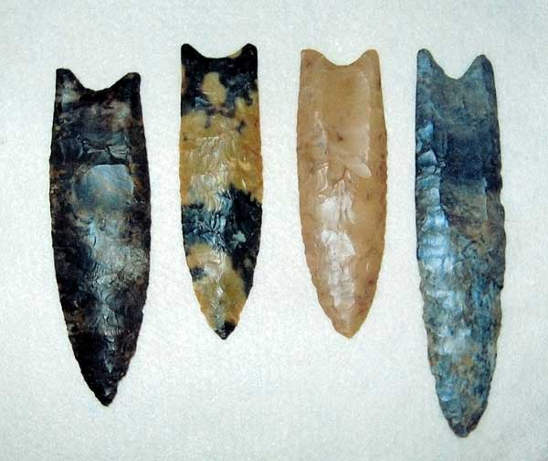
Land Bridge (14,480 BCE)
The early Paleoamericans soon spread throughout the Americas, diversifying into many hundreds of culturally distinct nations and tribes.
By 8000 BCE, the North American climates were very similar to today.
The Clovis culture, a megafauna hunting culture, is primarily identified by using fluted spear points.
The culture is identified by the distinctive Clovis point, a flaked flint spear-point with a notched flute, by which it was inserted into a shaft.

Slide 17
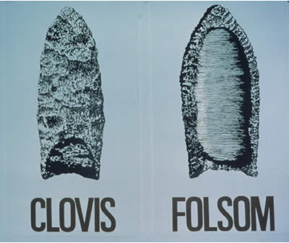
Land Bridge (14,480 BCE)
The Folsom Tradition was characterized using Folsom points.
Folsom tools were left behind between 9000 BCE and 8000 BCE.
Na-Dene-speaking peoples entered North America starting around 8000 BCE, reaching the Pacific Northwest by 5000 BCE, and migrating along the Pacific Coast and into the interior.
They were the earliest ancestors of historical Navajo and Apache.
They constructed large multi-family dwellings in their villages, which were used seasonally.

Slide 18
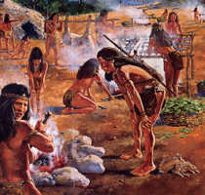
The Archaic Period (8,000 BCE)
The primary characteristic of Archaic cultures is a change in subsistence and lifestyle
their Paleo-Indian predecessors were highly nomadic, specialized hunters and gatherers who relied on a few species of wild plants and game
Archaic peoples lived in larger groups, were sedentary for part of the year, and partook of a highly varied diet that eventually included some cultivated foods.
Archaic peoples also created several tools not seen before in the Americas.

Slide 19
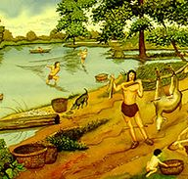
The Archaic Period (8,000 BCE)
Basketry and netting augmented the collection and storage of fresh plant foods while grinding stones made hard seeds readily edible.
Hunting was supplemented with the development of tanged and side-notched projectile points, birding and small game nets, and fishhooks.
As a more reliable subsistence base allowed the congregation of larger groups, people became more sedentary, and social complexity increased.

Slide 20
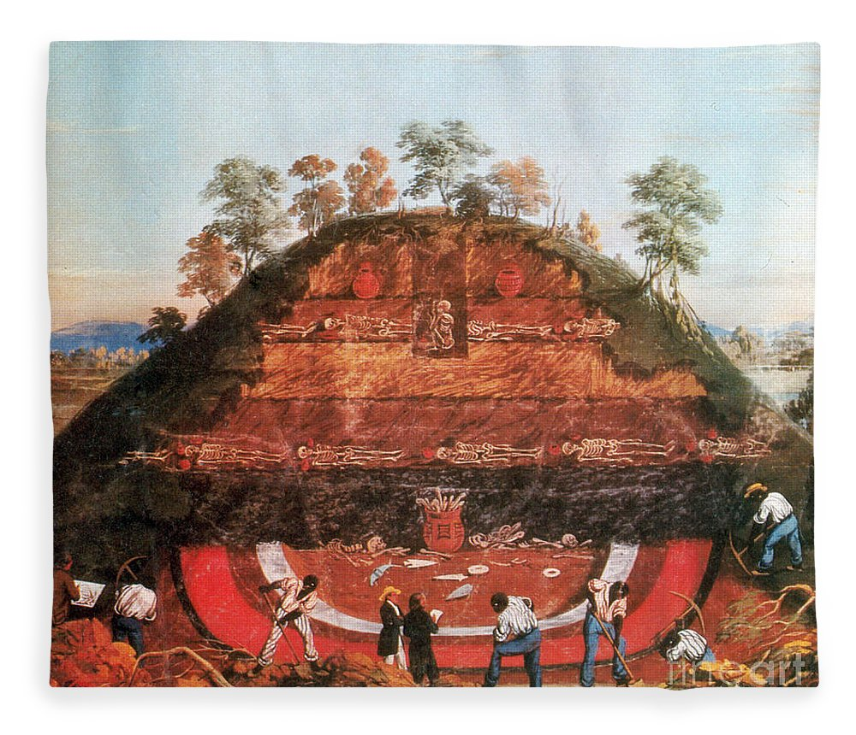
The Archaic Period (8,000 BCE)
A significant culture of the Archaic stage was the Mound builders, who stretched from the Great Lakes to the Mississippi and Ohio rivers.
Since the 1990s, archeologists have explored and dated eleven Middle Archaic sites in present-day Louisiana and Florida at which early cultures-built complexes with multiple earthwork mounds
They were societies of hunter-gatherers rather than the settled agriculturalists believed necessary according to the theory of Neolithic Revolution to sustain such large villages over long periods.

Slide 21
Post-Archaic Period (1,000 BCE)
The Post-Archaic stage includes the Formative, Classic, and Post-Classic stages.
The Formative stage lasted from 1000 BCE until about 500 CE, the Classic from about 500 CE to 1200 CE, while the Post-Classic refers to 1200 CE until the present day.
It also includes the Woodland period of North American pre-Columbian, whose culture refers to the period from roughly 1000 BCE to 1,000 CE in the eastern part of North America.
The term "Woodland" was coined in the 1930s and referred to prehistoric sites dated between the Archaic period and the Mississippian cultures.

Slide 22
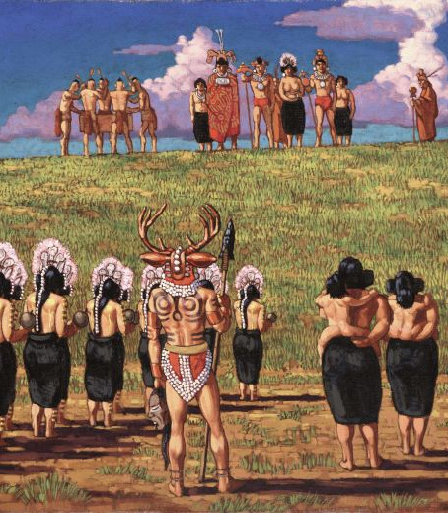
Post-Archaic Period (1,000 BCE)
The Hopewell tradition is the term for the common aspects of the Woodland period culture that flourished along rivers in the Eastern Woodlands from 200 BCE to 500 CE.
The Hopewell tradition was not a single culture or society, but a widely dispersed set of related populations connected by a shared network of trade routes, known as the Hopewell Exchange System.
At its greatest extent, the Hopewell exchange system ran from the Southeastern Woodlands into the northern shores of Lake Ontario.
Within this area, societies participated in a high degree of exchange; most activities were conducted along the waterways that served as their primary transportation routes.
The Hopewell exchange system traded materials from all over North America.

Slide 23
Post-Archaic Period (1,000 BCE)
Around 300 BCE, people of the central and southeastern areas of Mesoamerica began to gather into larger settlements.
Teotihuacan was the largest urban center of Mesoamerica before the Aztecs, almost 1000 years before their epoch.
The city was already in ruins by the time of the Aztecs. For many years, archaeologists believed it was built by the Toltec.

Slide 24
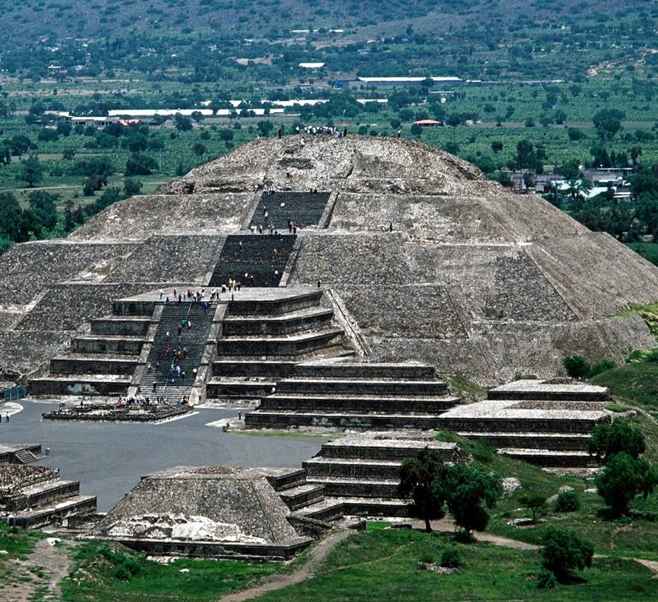
Post-Archaic Period (1,000 BCE)
The Pyramid of the Sun is the largest building in Teotihuacan, and one of the largest in Mesoamerica.
Found along the Avenue of the Dead the pyramid is part of a large complex in the heart of the city.
The name Pyramid of the Sun comes from the Aztecs, who visited the city of Teotihuacan centuries after it was abandoned.
It was constructed in two phases. The first construction stage, around 200 CE, brought the pyramid to nearly the size it is today.
The second round of construction resulted in its completed size of 738 feet across and 246 feet high, making it the third-largest pyramid in the world, though still just over half the height of the Great Pyramid of Giza.
The second phase also saw the construction of an altar atop the pyramid, which has not survived into modern times.

Slide 25
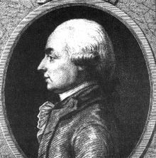
The White Myth (1735 CE)
It’s important to know the history of these amazing structures and the people that built them.
Some chose to argue that that the mounds of the United States were not Native American constructions at all but rather the work of ancient—and white—Europeans.
Travels in Upper Pennsylvania and the State of New York by French-American J. Hector St. John de Crèvecoeur manufactures a new nation's new history, replacing fact with a myth of an ancient and lost white civilization that thrived in North America and left the mounds as proof.
This story made the displacement of the natives a homecoming for white Europeans—a just reclaiming of the continent from barbarians.

Slide 26
The White Myth (1735 CE)
Europe and Asia had their ancient peoples, and the United States needed people every bit their equals.
Allegedly, ancient Europe had flourished with civilization for 'thousands of ages.’
The 'lost race' theory solved the problem at a single stroke. It excused the existence of 'savages' as interlopers.
It created a history for America as old as Europe's, with people as warlike as the Romans and as architecturally ambitious as the Egyptians.

Slide 27
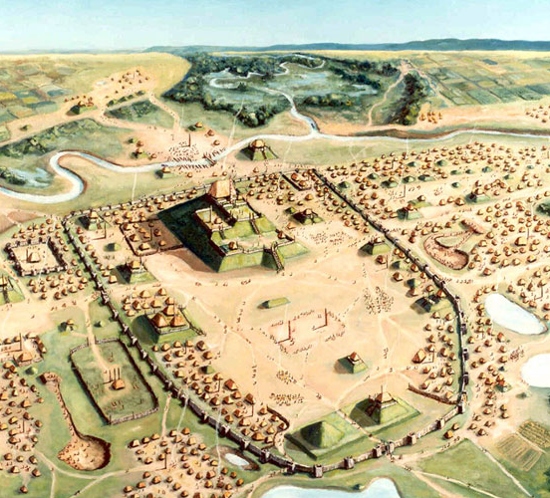
The White Myth (1735 CE)
The myth grew. The soldier, physician, and banker James H. McCulloh, wrote Researches on America with one version published before the War of 1812 and others afterward.
McCulloh took those scattered claims of an albino or white race and built entirely new prehistory for America, stretching from the foundations of most ancient India through a great race war, whereby these ancient white people were destroyed, and their superior culture hijacked by swarthy people.
Historians draw a line from the race-war rhetoric of this popular narrative to the anti-indigenous violence of such U.S. leaders as Andrew Jackson.

Slide 28
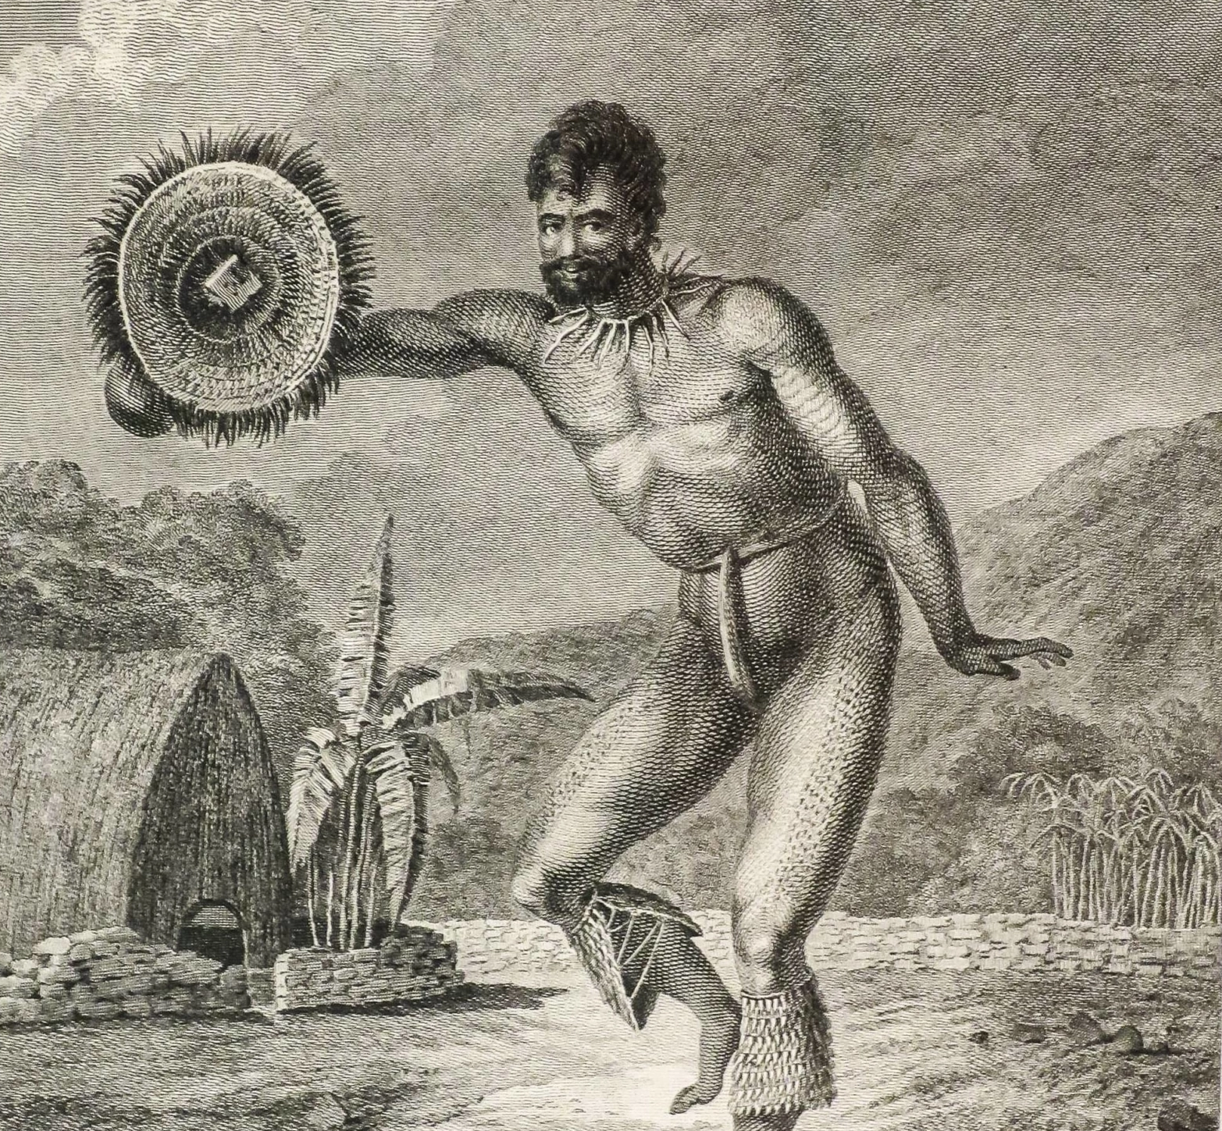
Colonization of Hawaii (300 CE)
The Hawaiian Islands had been uninhabited for millions of years, until around 300 to 600CE.
The Polynesians from the Marquesas Islands were the first to reach the Hawaiian Islands.
Settling by the waters, these natives started small farming systems that became some of their primary food sources.
Another group of settlers arrived in hundreds of years later. This second wave of immigrants was the Tahitians, who were also of Polynesian descent.
The Tahitians oppressed the first settlers from the Marquesas, calling them commoners and forcing them to run off and live in the mountains.
It was the Polynesians from Tahiti who came to inhabit much of the Hawaiian Islands before the first Westerners landed on the Islands in the late 1700s.

Slide 29
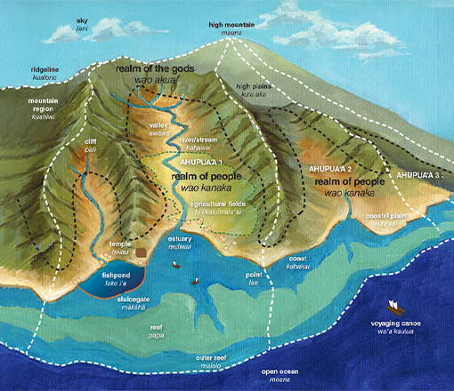
Colonization of Hawaii (300 CE)
Farming and fishing were both essential aspects of Hawaiian life.
The Polynesians who first inhabited the Hawaiian Islands brought several plants and animals that became staples in their diet, from sugarcane and taro to chickens and pigs.
Agriculture became a significant industry that fueled Hawaii's economy for a long time.
The land was divided through the ahupua’a ('ahoo-poo-ah-ah') system, a way of sharing the area among the chieftains and their people.
Each ahupua'a was a wedge-shaped piece of land running the tops of the mountains and widening toward the shoreline.
Most of the farming took place in areas between the mountaintops and the coastline
Ahupua-a were appointed by the king depending on rank and standing and how resource-rich the land was.

Slide 30
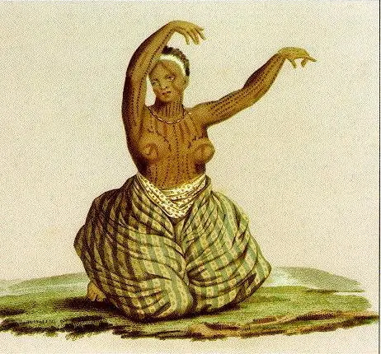
Colonization of Hawaii (300 CE)
Another aspect of culture that the Hawaiians excelled in is their recreational activities and physical skills.
One of the main reasons Hawaiians excelled in arts, crafts, and expertise is because they often have competitions to showcase their talents and entertain one another.
From canoe races and swimming displays to war games and other athletic endeavors, the Hawaiians have grand tournaments and competitions spanning neighboring regions and neighboring islands.
Spectators often gamble on the outcomes of these competitions

Slide 31
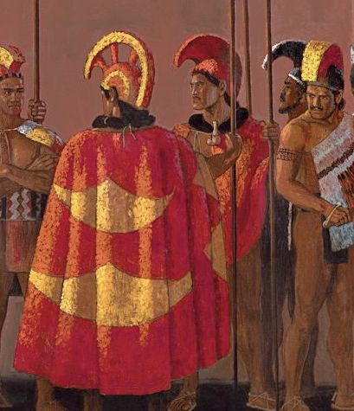
Colonization of Hawaii (300 CE)
One of the most recognized and well-known Hawaiian art is the hula.
Hula is not just danced for enjoyment.
The truth is, the dances and chants of hula are usually based on traditions, myths, tales, history, religious rites, and the general philosophy of the Hawaiians.
These poetic celebrations of life and culture convey stories about who the Hawaiians are and what the Hawaiians are all about.

Slide 32
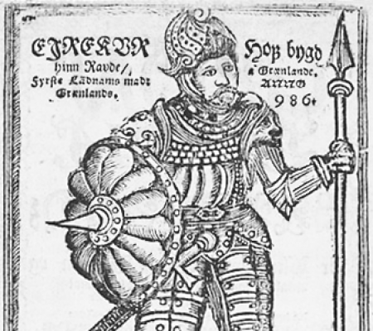
Norse Colonization of North America (980 CE)
The Norse colonization of North America began in the late 10th century CE when Norsemen explored and settled areas of the North Atlantic, including the northeastern fringes of North America.
Remains of Norse buildings were found near the northern tip of Newfoundland in 1960.
While voyages, for example, to collect timber, are likely to have occurred for some time, there is no evidence of any lasting Norse settlements on mainland North America.
In 980 CE, Erik the Red, having been banished from Iceland for manslaughter, explored the uninhabited southwestern coast of Greenland during the three years of his banishment.
He made plans to entice settlers to the area, naming it Greenland to assume that "people would be more eager to go there because the land had a good name."

Slide 33
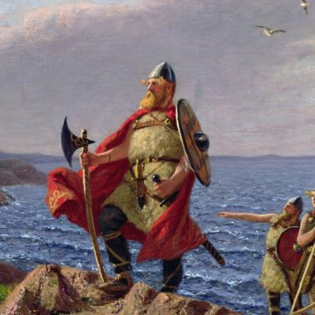
Norse Colonization of North America (980 CE)
In 985 CE, while sailing from Iceland to Greenland with a migration fleet, a merchant was blown off course, and after three days' sailing, he sighted land to the west.
He described his discovery to Leif Erikson.
Using the routes, landmarks, currents, rocks, and winds that had been described to him, Leif sailed from Greenland westward with a crew of 35—sailing the same boat the merchant had used to make the voyage.
Leif wanted his father, Erik the Red, to lead this expedition and talked him into it. However, he fell off his horse as it slipped on the wet rocks near the shore; thus, he was injured and stayed behind.
Leif wintered in 1001 CE, probably on the northern tip of Newfoundland.
Squashberries, gooseberries, and cranberries all grew wild in the area.
There are different explanations for Leif describing fermented berries as "wine."
Hence the new world would new named “Vinland” after all the goodies that grew on vines.

Slide 34
Norse Colonization of North America (980 CE)
Settlements in continental North America aimed to exploit natural resources such as furs and lumber, which was in short supply in Greenland.
It is unclear why the short-term settlements did not become permanent, though it was likely partly because of hostile relations with the indigenous peoples, referred to as Skrælings by the Norse.
In 1009, "Thorfinn the Valiant," supplied three ships with livestock and 160 men and women.
A sign of peaceful relations between the indigenous peoples and the Norsemen is noted here. The two sides swapped with furs and gray squirrel skins for milk and red cloth, which the natives tied around their heads as a sort of headdress.
There are conflicting stories, but one account states that a bull belonging to Thorfinn came storming out of the wood, so frightening the natives that they ran to their skin-boats and rowed away. They returned three days later, in force.
The Norsemen retreated. Leif Erikson's half-sister Freydís was pregnant and unable to keep up with the retreating Norsemen.
She called out to them to stop fleeing from such “pitiful wretches”, adding that if she had weapons, she could do better than that.
Freydís seized the sword belonging to a man who had been killed by the natives.
She pulled one of her breasts out of her bodice and struck it with the sword, frightening the natives, who fled.

Slide 35
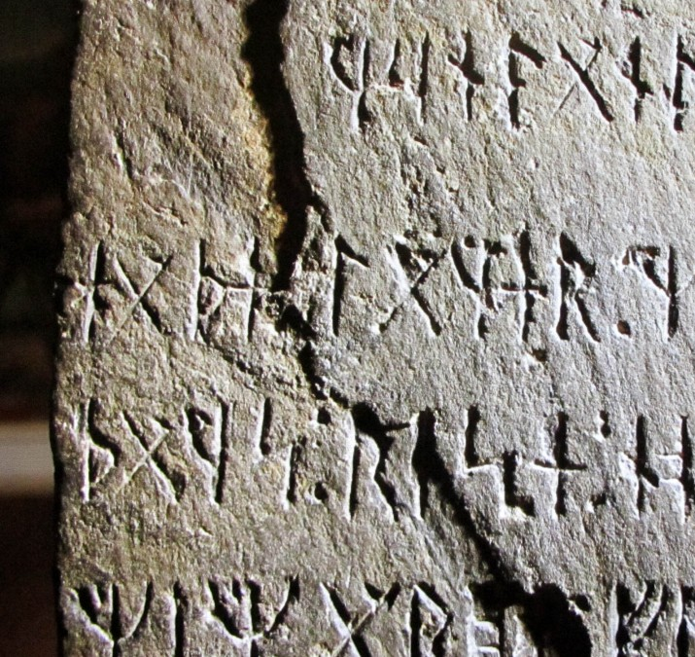
Norse Colonization of North America (980 CE)
Purported runestones have been found in North America, most famously the Kensington Runestone.
Swedish immigrant Olof Ohman said that he found the stone late in 1898 while clearing land he had recently acquired of trees and stumps before plowing.
The stone was said to be near the crest of a small knoll rising above the wetlands, lying face down and tangled in the root system of a stunted poplar tree, estimated to be from less than 10 to about 40 years old.
The artifact weighs 200 pounds.
Ohman's ten-year-old son, Edward Ohman, noticed some markings, and the farmer later said he thought they had found an "Indian almanac."
A copy of the inscription made its way to the University of Minnesota.
A Scandinavian Languages and Literature professor in the Scandinavian Department declared the stone to be a forgery and published a discrediting article.
Much like the mounds of indigenous culture, Americans of Scandinavian ancestry set out to prove their people were the first to “settle” the new world, regardless if they were or not.

Slide 36
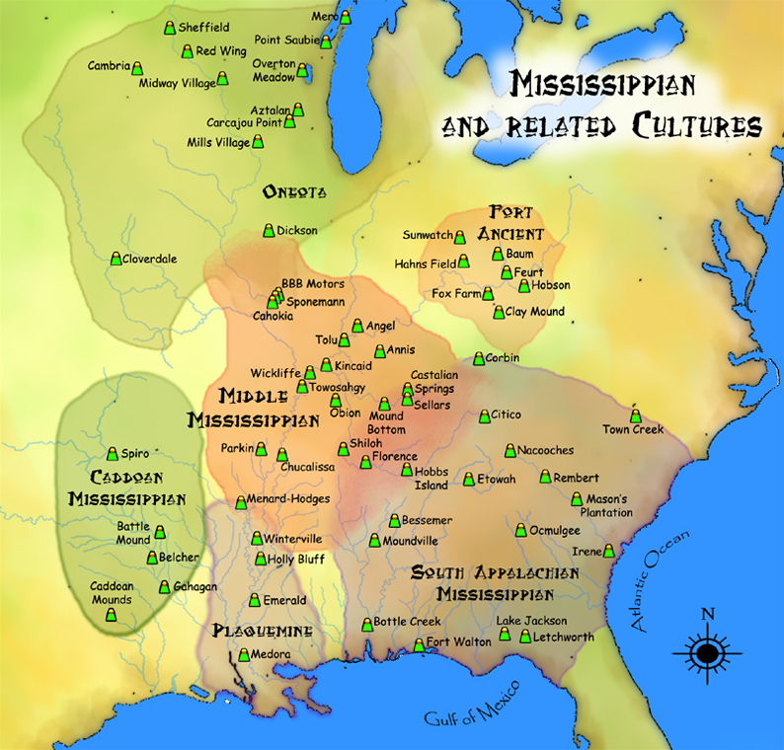
Mississippian Culture (950 CE)
The Mississippian culture, which extended throughout the Ohio and Mississippi valleys and built sites throughout the Southeast, created the most substantial earthworks in North America north of Mexico, most notably at Cahokia, on a tributary Mississippi River in present-day Illinois.
Archaeologists use the term Mississippian because many of the major centers of this new way of life occur in the Mississippi River valley.
The ten-story Monks Mound at Cahokia has a larger circumference than the Pyramid of the Sun at Teotihuacan or the Great Pyramid of Egypt.
The 6 square mile city complex was based on the culture's cosmology; it included more than 100 mounds, positioned to support their sophisticated knowledge of astronomy, and built with the understanding of varying soil types.
The society began building at this site about 950 CE and reached its peak population in 1,250 CE of 20,000–30,000 people, which was not equaled by any city in the present-day United States until after 1800.
Cahokia was a major regional chiefdom, with trade and tributary chiefdoms located in a range of areas from bordering the Great Lakes to the Gulf of Mexico.

Slide 37
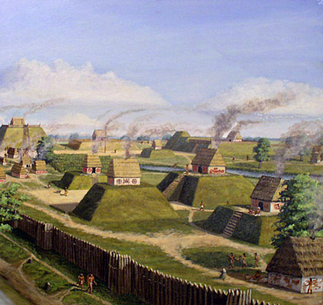
Mississippian Culture (950 CE)
A typical Mississippian town was built near a river or creek.
It covered about ten acres of ground and was surrounded by a barrier, a fence made of wooden poles placed upright in the field.
A typical Mississippian house was rectangular, about 12 feet long and 10 feet wide.
The walls of a house were built by placing wooden poles upright in a trench in the ground.
The poles were then covered with a woven cane matting.
The cane matting was then covered with plaster made from mud.
The roof of the house was made from a steep "A" shaped framework of wooden poles covered with grass woven into a tight thatch.

Slide 38
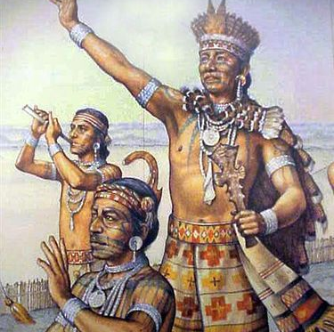
Mississippian Culture (950 CE)
Many archaeologists believe the region experienced a sharp population decline around 1450 CE.
Why this happened is a mystery.
A change in climate may have affected their crops, or neighboring cities may have started fighting over land in the fertile river bottoms.
An epidemic of some illness may have broken out, spread from town to town on the trade networks.
However, most Southeastern Indian nations are certainly the descendants of Mississippian people in general.
Some symbols found in Mississippian art seem to show up in the oral traditions of some Southeastern Indians
. The Cherokee, Choctaw, Creek, and other nations built platform mounds for their council houses.
And they still regard mounds found in their ancestral territory as sacred places.

Slide 39
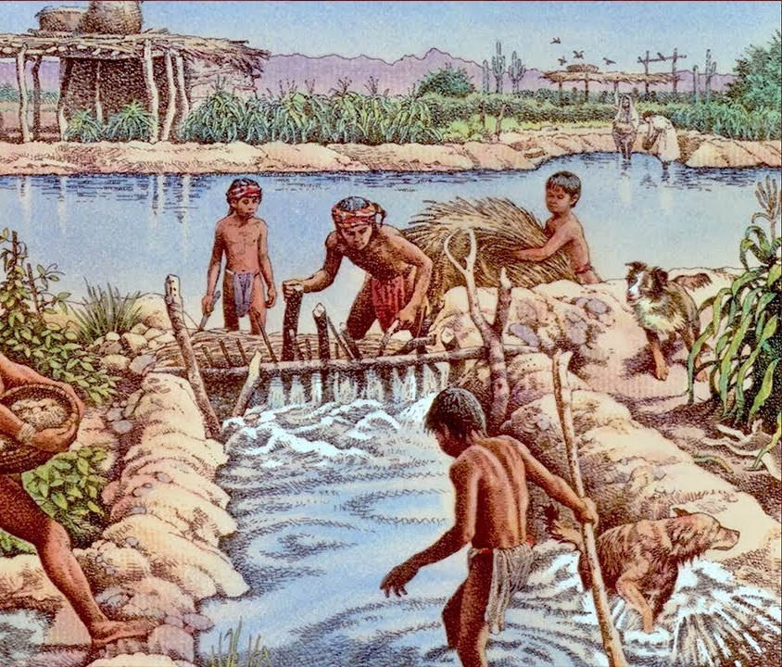
The Hohokam Culture (1300 CE)
The Hohokam culture was centered along the American Southwest.
The culture covered present-day Four Corners region of the United States, comprising southern Utah, northern Arizona, northwestern New Mexico, and southwestern Colorado.
They lived in a range of structures that included small family pit houses, larger clan type structures, grand pueblos, and cliff sited dwellings.
The Hohokam seemed to appear in Arizona quite suddenly to build a sophisticated irrigation system to water their crops.
In arid desert environment there was not enough rainfall to grow plants.
To meet their needs, the Hohokam engineered the largest and most sophisticated irrigation system in the Americas.
Irrigating up to 110,000 acres by 1300CE, the Hohokam irrigation systems supported the largest population in the prehistoric Southwest.

Slide 40
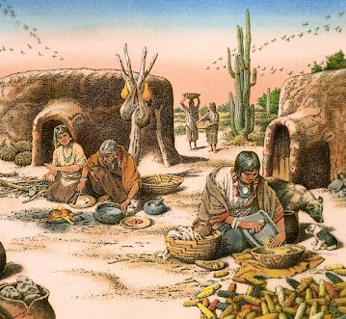
The Hohokam Culture (1300 CE)
Life for the Hohokam focused, to a large extent, on agriculture and growing crops.
The canals required the organization and labor of thousands of people to build, maintain, and operate.
The Hohokam held large community gatherings at ballcourts and temple mounds.
Here, people would trade goods, and young people could meet potential marriage partners from other villages.
The Hohokam organized their villages to separate and coordinate different activities.
Houses clustered into residential areas.
To keep the village neat, the Hohokam disposed of trash in pits and piles within specific regions.
They used large open spaces in the village for messy activities, including the use of large earth ovens, which measured 6 to 10 feet across and 6 to 8 feet in depth, were used to pit bake the hearts of agave plants and other foods such as corn and possibly squash.

Slide 41
The Hohokam Culture (1300 CE)
In Hohokam society, you live in a group with your parents and your brother's and sister's families.
This extended family functioned as a fundamental social and economic unit, sharing resources and daily chores.
One of the most intriguing questions concerning the Hohokam focuses on the collapse when evidence of the Hohokam is no longer seen in the archaeological record.
Researchers have suggested that floods, salt buildup on the fields, and warfare are causes of decline
The Hohokam deterioration is part of a larger pattern of abandonment seen throughout the American Southwest.
Recent studies suggest that people began migrating toward the south during a significant drought in the Four Corners area in the 1200s.
From 1200 CE to 1450 CE, large portions of the prehistoric Southwest were largely abandoned.

Slide 42
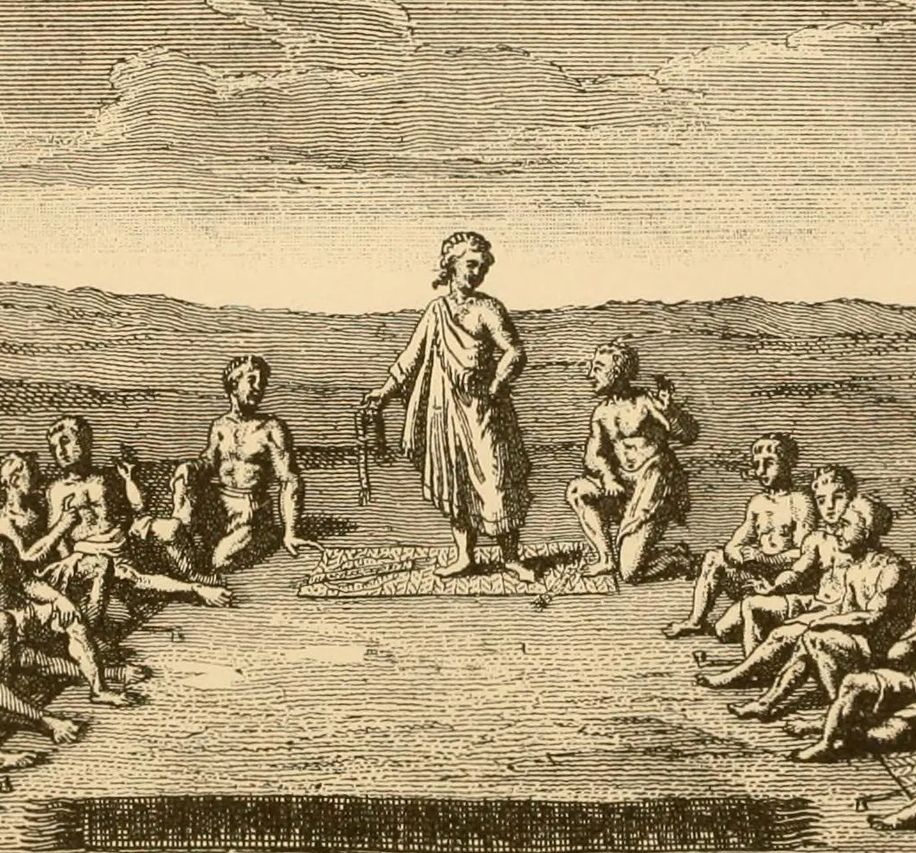
Iroquois Nation (1450 CE)
The Iroquois League was established before European contact, with the banding together of five of the many Iroquoian peoples who had emerged south of the Great Lakes.
Many archaeologists and anthropologists believe that the League was formed about 1450 CE though arguments have been made for an earlier date.
One theory argues that the League formed shortly after a solar eclipse on August 31, 1142, an event thought to be expressed in the oral tradition about the League's origins.
Comprised of five tribes: the Mohawk, Oneida, Onondaga, Cayuga, and Seneca

Slide 43
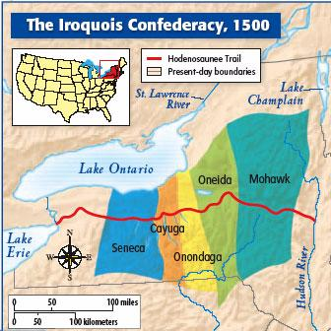
Iroquois Nation (1450 CE)
The Iroquois subsequently created a highly egalitarian society.
With the formation of the League, internal conflicts were minimized.
The council of fifty ruled on disputes, seeking consensus in their decisions.
Raids within the member tribes ended, and they directed warfare against competitors.
This allowed the Iroquois to increase in numbers while their rivals declined.
The Iroquois's political cohesion rapidly became one of the most influential forces in 17th- and 18th-century northeastern North America.
The confederacy did not speak for all five tribes, which continued to act independently.
Around 1678, the council began to exert more power in negotiations with the colonial governments of Pennsylvania and New York.
The Iroquois became adept at diplomacy, playing off the French against the British

Slide 44
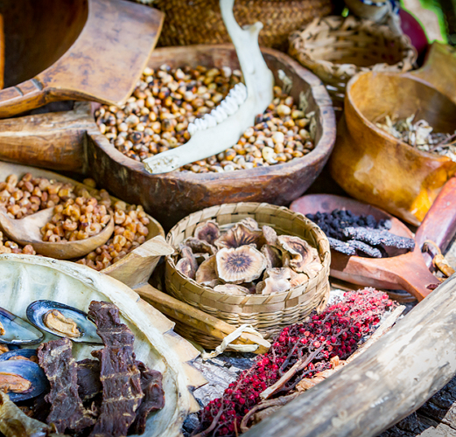
Birth of American Food
As the Americas cover an extensive range of biomes and over 500 currently recognized Native American tribes in the US alone, Native American cuisine can vary significantly by region and culture.
The essential staple foods of the Indigenous peoples of the Eastern Woodlands have traditionally been corn, beans, and squash
Known as "The Three Sisters" because they were planted interdependently: the seeds grew up the tall stalks of the corn, while the squash spread out at the base of the three plants and provided protection and support for the root systems.
Maple syrup is another essential food staple of the Eastern Woodlands peoples.
When the sap starts to thicken, it can be poured into the snow to make taffy.

Slide 45
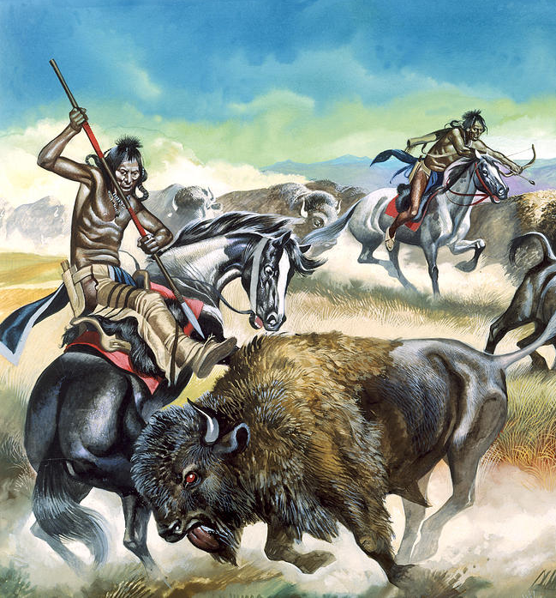
Birth of American Food
Southeastern Native Americans traditionally supplement their diets with meats derived from the hunting of native game.
Venison has always been a critical meat staple, due to the abundance of white-tailed deer.
Aside from the more commonly consumed parts of the animal, it is also traditional to eat organ meats such as liver, brain, and intestine.
Many of the early settlers were taught Southeastern Native American cooking methods.
Indigenous peoples of the Great Plains and Canadian Prairies or Plains Indians have historically relied heavily on American bison as a staple food source.
One traditional method of preparation is to cut it into thin slices and then dry it, either over a slow fire or in the hot sun, until it is hard and brittle.
In this form, it can last for months, making it the main ingredient combined with other foods, or eaten on its own.
The animals that Great Plains Indians consumed, like bison, deer, and antelope, were grazing animals.

Slide 46
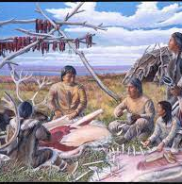
Birth of American Food
In the Pacific Northwest, traditional diets include salmon and other fish, seafood, mushrooms, berries, and meats such as deer, duck, and rabbit.
The generally mild climate led to the development of an economy based on year-round abundant food supplies, rather than having to rely upon seasonal agriculture.
Game meat and freshwater fish such as Rio Grande cutthroat trout and rainbow trout are also traditional foods.
Ancestral Puebloans are also known for their basketry and pottery, indicating an agricultural surplus that needs to be carried and stored, and clay pot cooking.
Grinding stones have been used to grind maize into meals for cooking.
Alaska native cuisine consists of nutrient-dense foods such as seal, salmon, and moose.
Seal, walruses, and polar bears are other large game that Alaska Natives hunt. The smaller game includes whitefish and arctic hares.
Due to weather, edible plants like berries are only available to be consumed in the summer, so the people have a diet very high in fat and protein, but low in carbohydrates.
The intestines of large mammals are used to make waterproof clothing, and caribou fur is used to make warm clothing.

Slide 47
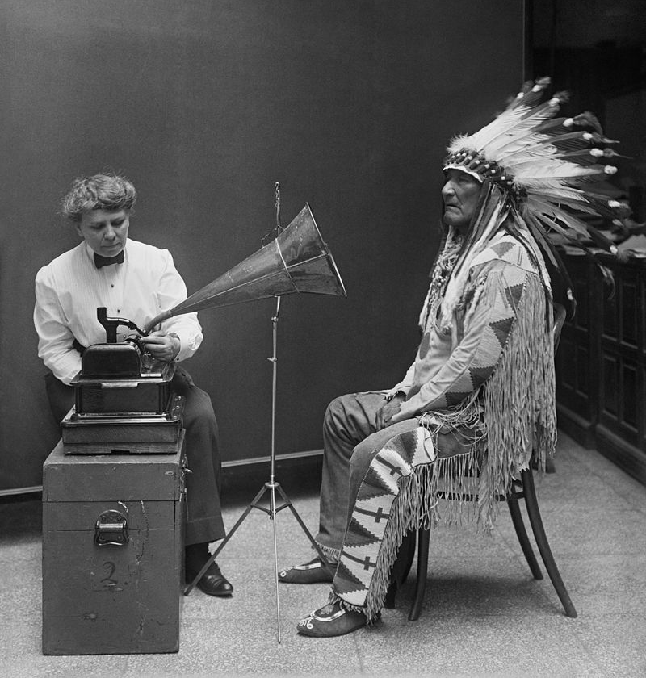
The First Musicians
Native American music plays a vital role in history and education, with ceremonies and stories orally passing on ancestral customs to new generations.
Native American ceremonial music is traditionally said to originate from deities or spirits, or particularly respected individuals.
Rituals are shaped by every aspect of the song, dance, and costuming.
Native Americans perform stories through song, music, and dance, and the historical facts, thus propagated, are an integral part of Native American beliefs.
Epic legends and stories about culture heroes are a part of tribal music traditions, and these tales are often an iconic part of local culture.
They can vary slightly from year to year, with leaders recombining and introducing slight variations.

Slide 48
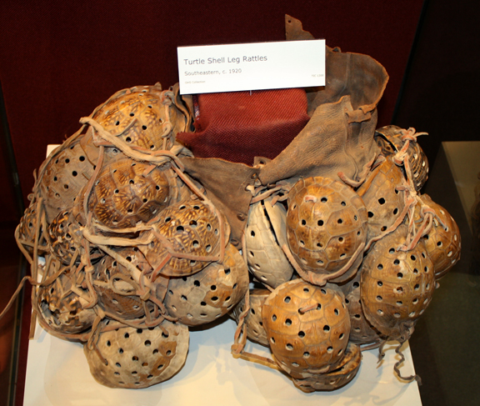
The First Musicians
Music and history are tightly interwoven in Native American life.
A tribe's history is always told and retold through music, which keeps alive an oral narrative of history.
These historical narratives vary widely from tribe to tribe and are an integral part of tribal identity.
However, their historical authenticity cannot be verified; aside from supposition and some archaeological evidence, the earliest documentation of Native American music came with European explorers' arrival.
Musical instruments and pictographs depicting music and dance have been dated as far back as the 7th century.
However, archaeological evidence shows that musical instruments in North America date to at least the Archaic period, including instruments such as turtle shell rattles.
However, the earliest written documentation comes from European explorers' arrival on the American continent, and the earliest academic research comes from the late 19th century.

Slide 49
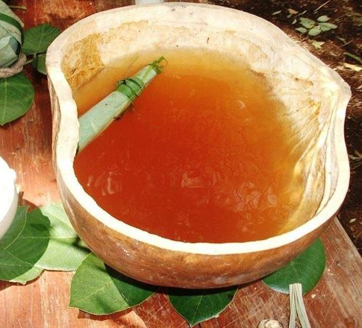
Drugs and Mesoamerican Culture (250 BCE)
The Maya consumed an intoxicating drink called "balché" during a ritual in which they tried to communicate with spirits.
The Maya made the drink by mixing an infusion from the bark of a plant together with honey produced by bees fed on a type of a morning glory plant which is thought to have psychedelic properties.
In the ritual, intoxicated Mayan people aimed to communicate with spirits to predict the future or make sense of events that were difficult for them to accept and understand.
Such activities included illnesses, changes in fortune, bad weather, poor harvests, and wars.
Drinking balché was also often accompanied by smoking tobacco and performing ritual enemas using substances that contained alcohol, sometimes mixed with other psychoactive substances.
The enemas were applied using syringes made of gourd and clay, and they were performed to help people attain more intense trance states more quickly.

Slide 50
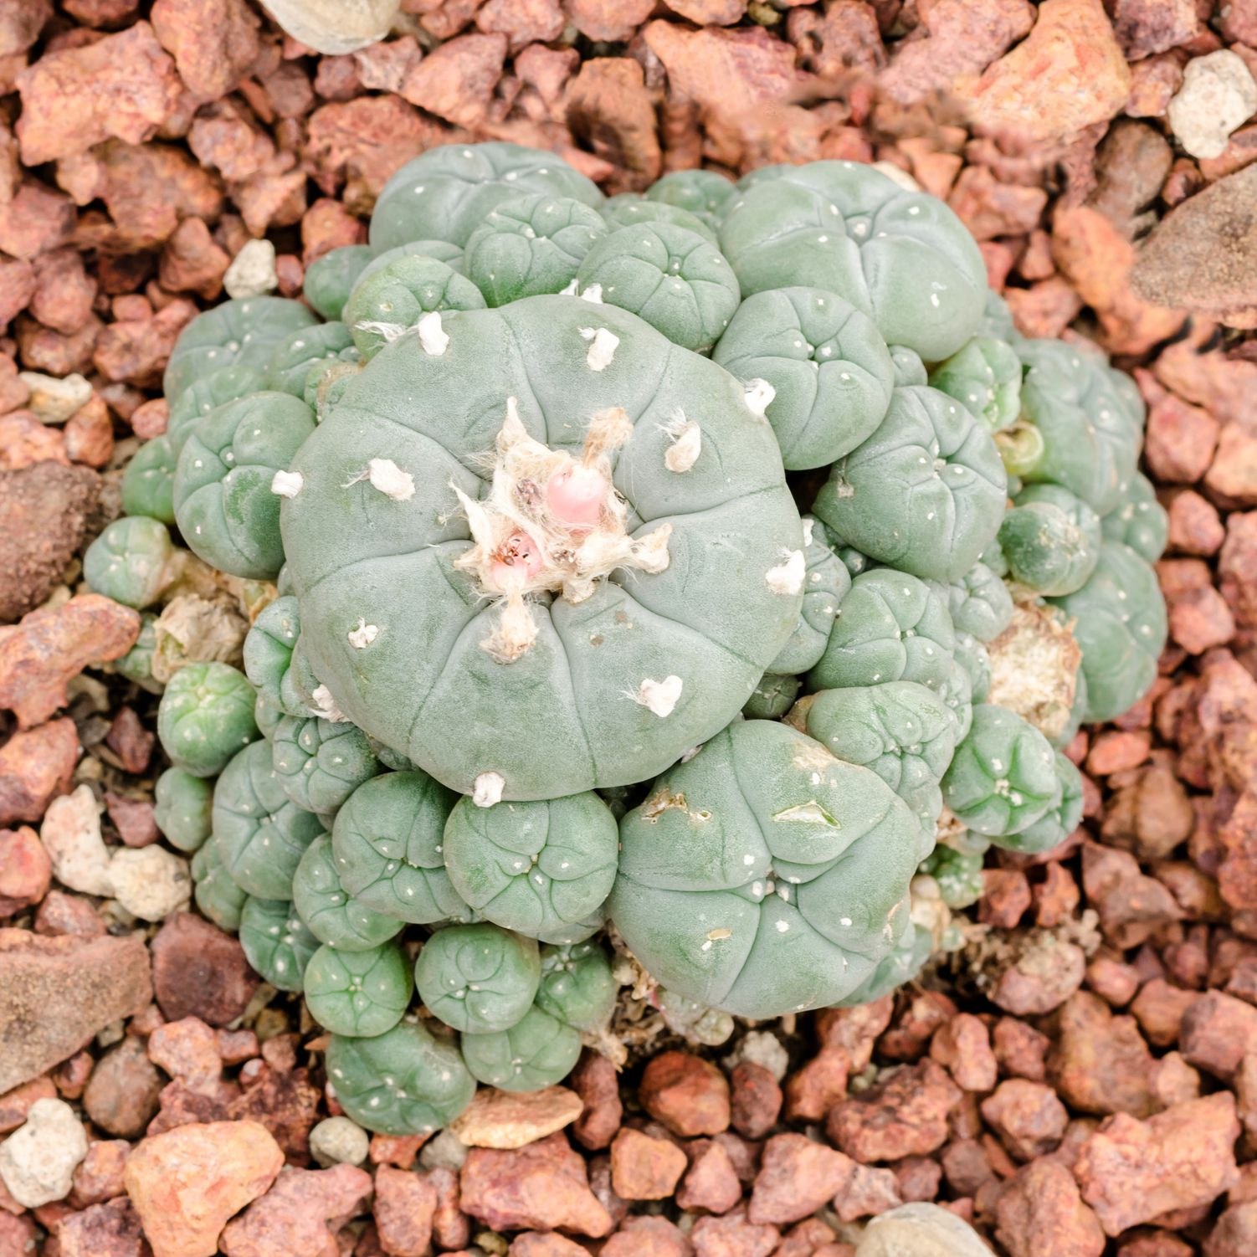
Drugs and Mesoamerican Culture (250 BCE)
Another source of intoxicating substances in Mesoamerica was peyote, a cactus containing more than 60 hallucinogenic compounds, including the primary one, mescaline.
Mescaline is found within nodules of peyote cacti, which can be chewed or made into an infusion that people can drink.
Ritual use of peyote in the Americas dates back more than 5,000 years, to prehistoric times.
People who ingest peyote have reported colorful visual hallucinations of kaleidoscopic visions, a sensation of weightlessness, and altered perception of time and space.
Peyote can also cause increased body temperature and heart rate, uncoordinated movements, and profound sweating and flushing.

Slide 51
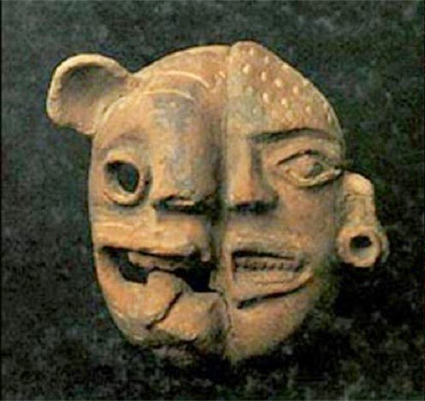
Drugs and Mesoamerican Culture (250 BCE)
One of the most unusual drugs in Mesoamerica was sourced from toads.
The salivary glands of the toad produce toxic substances called bufotoxins, which also have psychoactive properties.
Reports by 16th-century historians say that the Maya added tobacco and the dried skins of a common toad to their alcoholic beverages to make the drinks more potent.
Toloache is a type of plant called "devil's herb," and has been used for centuries in Mesoamerica to treat wounds and combat pain.
But it was also used in rites of passage, as a consciousness-altering drug during rituals.
It has been hypothesized that during ritual human sacrifices, some prisoners and those people that would be sacrificed were drunk with some consciousness-altering beverages, probably ones including Toloache.
Were-Jaguar

Slide 52
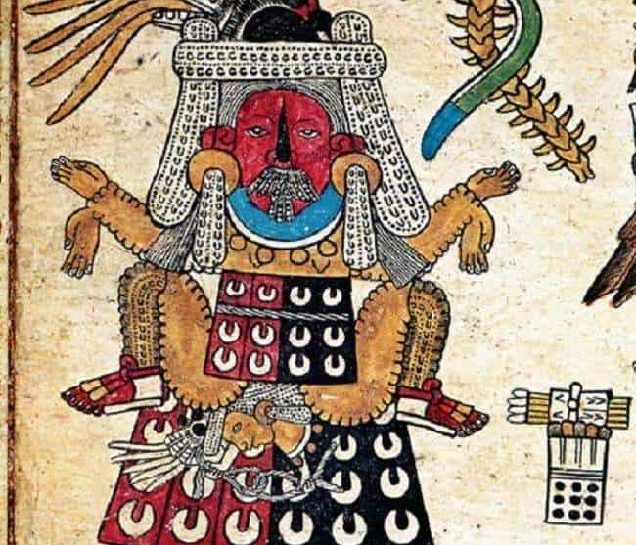
Sex and Mesoamerican Culture (250 BCE)
Gender roles in Mesoamerica were complementary, meaning that men and women had separate but equally essential functions in society.
Evidence also suggests the existence of gender ambiguity and fluidity in pre-Columbian Mesoamerican civilizations.
Gender relations and roles varied among different Mesoamerican cultures and communities, through time, and depending on social status.
Although pre-Columbian Mesoamerican art contained depictions of the body as male or female as represented by genitalia or secondary sex characteristics, it also included representations of bodies with exposed chests and waists but no visible sexual features.
Depictions of rituals conducted by elite Mesoamericans have included women dressed in the traditional costume of men and men dressed in the traditional costume of women.
Classic Maya text also includes situations where gender is not marked or where gender is marked as male for a speaker who appears to be a woman or vice versa.
This evidence suggests considerable fluidity between the genders in some pre-Columbian Mesoamerican societies.
An illustration with a stylized Aztec depiction of pregnancy.

Slide 53
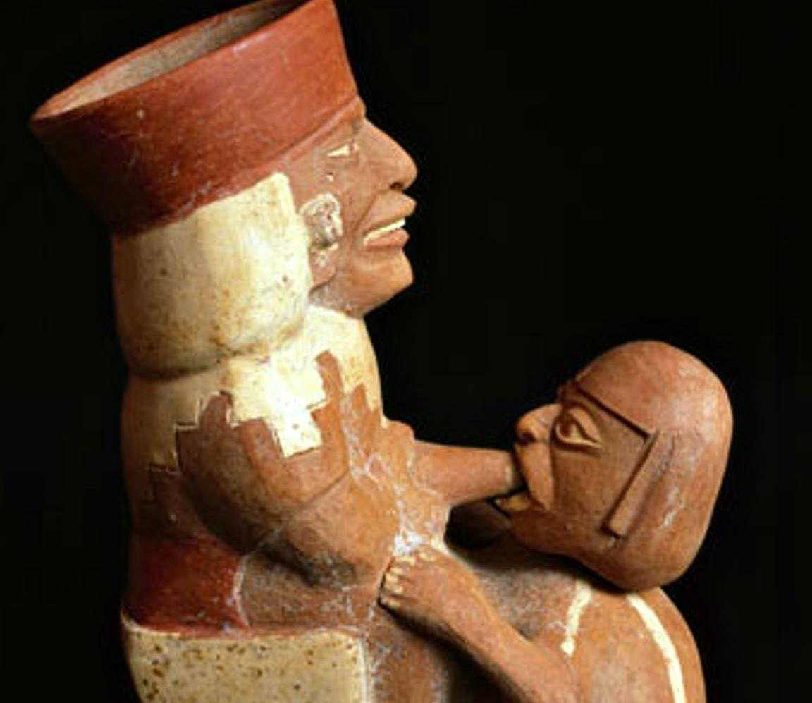
Sex and Mesoamerican Culture (250 BCE)
Before all those taboos about sexuality arrived with the Spanish conquest and were spread through Christianity, Pre-Columbian peoples understood sex as a natural part of humanity that couldn't be anything but sacred.
The unique sensation of reaching climax, pleasure, and the magical ability to bear the successors that would carry your legacy generation after generation: everything was surrounding the sexual act was shrouded with mysticism, and sex itself was mystical.
Beyond simple penetration, the Aztecs, Mayans, and Incas were fascinated by the idea of creation through sex, so the act was conceived as something magical.
They believed that just like the fertilized seed that can give birth to a new plant, female and male reproductive organs carried the same onus.

Slide 54
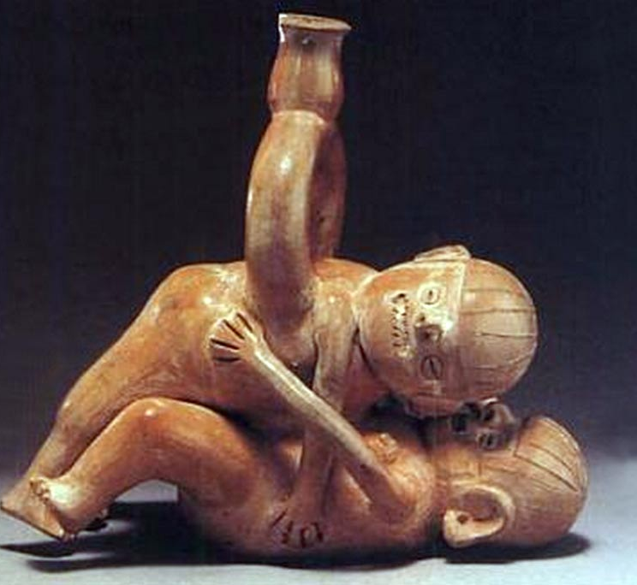
Sex and Mesoamerican Culture (250 BCE)
Various myths and traditions acknowledge how sexuality and masturbation were widespread practices in Latin-America before the Spanish conquest.
In the southern regions of Mexico and Central America, the Maya people would carve wooden objects to masturbate with them.
These masturbating rituals were a powerful custom in all Central America.
The mystical aspect of sex was an important point of all pre-Columbian civilizations.
Not only did it represent their deep relationship with nature, but it was also an element that maintained the natural order of everything.
Sexuality, far from being a perversion or an offense against God, was a way for humanity to honor life.
A sex-themed vessel found in Peru

Slide 55
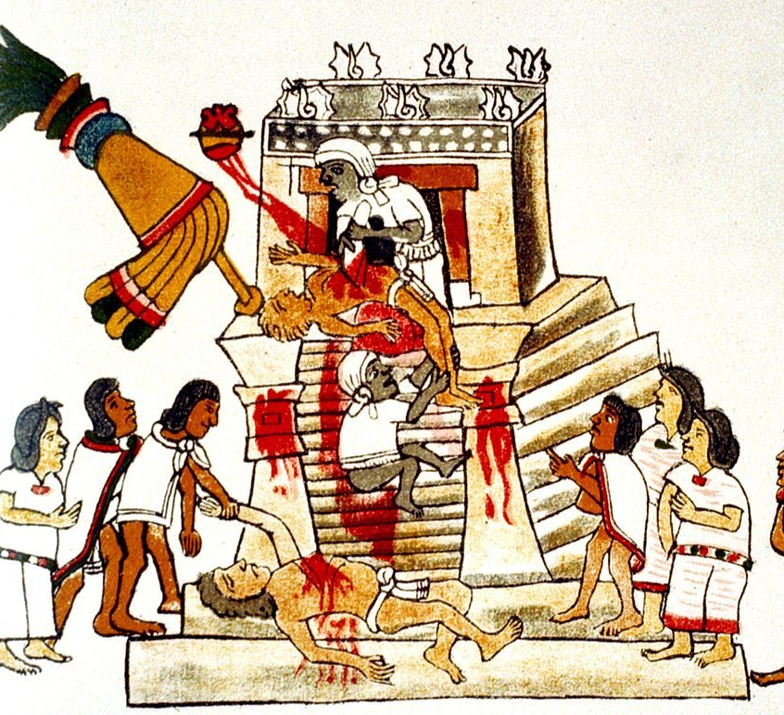
Human Sacrifice in Mesoamerican Culture (1521 CE)
Human sacrifice was collectively in many parts of Mesoamerica, so the rite was nothing new to the Aztecs when they arrived at the Valley of Mexico, nor was it something unique to pre-Columbian Mexico.
What distinguished Maya and Aztec human sacrifice were how it was embedded in everyday life and believed to be necessary.
These cultures also notably sacrificed elements of their population to the gods.
In 1521, Spanish explorers such as Hernán Cortés conquered the Aztec capital of Tenochtitlan, made observations, and wrote reports about the practice of human sacrifice.
Bernal Díaz del Castillo, who participated in the Cortés expedition, made frequent mention of human sacrifice in his memoir True History of the Conquest of New Spain.
There are several second-hand accounts of human sacrifices written by Spanish friars, that relate to the testimonies of native eyewitnesses.
The literary accounts have been supported by archeological research.

Slide 56
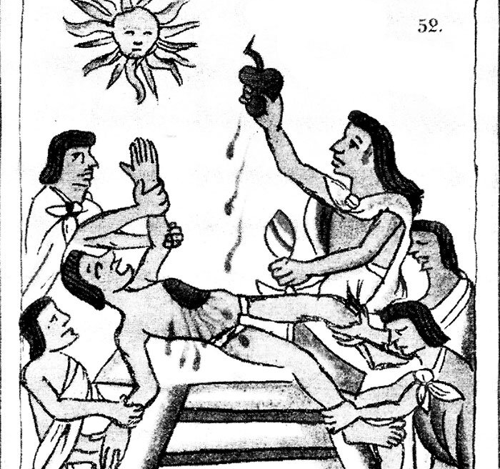
Human Sacrifice in Mesoamerican Culture (1521 CE)
Sacrifice was a common theme in the Aztec culture. In the Aztec "Legend of the Five Suns," all the gods sacrificed themselves so that humanity could live.
Some years after the Spanish conquest of Mexico, the Franciscans' body confronted the remaining Aztec priesthood.
It demanded, under threat of death, that they desist from this traditional practice.
Human sacrifice was the highest level of an entire array of offerings through which the Aztecs sought to repay their debt to the gods.
Even the "stage" for human sacrifice, the massive temple-pyramids, was an offering mound: crammed with the land's most exquisite art, treasure, and victims, then buried underneath for the deities.
Additionally, animals' sacrifice was a common practice, for which the Aztecs bred dogs, eagles, jaguars, and deer.
The cult of Quetzalcoatl required the sacrifice of butterflies and hummingbirds.

Slide 57
Human Sacrifice in Mesoamerican Culture (1521 CE)
Self-sacrifice was also quite common; people would offer horns, tainted with their blood, and provide blood from their tongues, ear lobes, or genitals.
It is debated whether these rites functioned as a type of atonement for Aztec believers.
Some scholars argue that the role of sacrifice was to assist the gods in maintaining the cosmos, and not as an act of appeasement.
Human sacrifice rituals were performed at the appropriate times each month with the proper number of living bodies and other goods.
These individuals were previously chosen to be sacrificed or members of an enemy party which had been captured and prepared to be sacrificed.

Slide 58
Human Sacrifice in Mesoamerican Culture (1521 CE)
Even the Aztecs' enemies understood their roles as sacrifices to the gods since many also practiced the same type of religion.
For many rites, the victims were expected to bless children, greet and cheer passers-by, hear people's petitions to the gods, visit people in their homes, give discourses and lead sacred songs, processions, and dances.
Before and during the killing, priests and audience gathered in the plaza below, stabbed, pierced and bled themselves as auto-sacrifice.
Hymns, whistles, spectacular costumed dances, and percussive music marked different phases of the rite.
The body parts would then be disposed of, the viscera fed to the zoo's animals, and the bleeding head was placed on display on the skull rack.
When the consumption of individuals was involved, the warrior who captured the enemy was given the meaty limbs while the most critical flesh, the stomach, and chest, were offerings to the gods.
The victim could also be shot with arrows, die in gladiatorial style fighting, be sacrificed as a result of a ballgame, burned, flayed after being slaughtered, or drowned.

Slide 59
Christopher Columbus (1492 CE)
Columbus's early life is somewhat obscure, but scholars generally agree that he was born in the Republic of Genoa.
Though largely self-educated, Columbus was widely read in geography, astronomy, and history.
He formulated a plan to seek a western sea passage to the East Indies, hoping to profit from the lucrative spice trade.
The young navigator's logic was sound, but his math was faulty. He argued incorrectly that the circumference of the Earth was much smaller than his contemporaries believed it was; accordingly, he found that the journey by boat from Europe to Asia should be not only possible but comparatively easy via an as-yet-undiscovered Northwest Passage.
He presented his plan to officials in Portugal and England. Still, it was not until 1492 that he found a sympathetic audience: the Spanish monarchs Ferdinand of Aragon and Isabella of Castile.
Ferdinand and Isabella wanted the same and the opportunity to export Catholicism to lands across the globe. Columbus, a devout Catholic, was equally enthusiastic about this possibility.

Slide 60
Christopher Columbus (1492 CE)
On August 3, 1492, Columbus and his crew set sail from Spain in three ships: the Niña, the Pinta, and the Santa Maria.
On October 12, the ships made landfall—not in the East Indies, as Columbus assumed, but on one of the Bahamian islands, likely San Salvador.
For months, Columbus sailed from island to island in what we now know as the Caribbean, looking for the "pearls, precious stones, gold, silver, spices, and other objects and merchandise whatsoever" that he had promised to his Spanish patrons, but he did not find much.
In January 1493, leaving several dozen men behind in a makeshift settlement on present-day Haiti and the Dominican Republic, he left for Spain.
He kept a detailed diary during his first voyage.
Christopher Columbus's journal was written between August 3, 1492, and November 6, 1492, and mentions everything from the wildlife he encountered, like dolphins and birds, to the weather to the moods of his crew.

Slide 61
Christopher Columbus (1492 CE)
More troublingly, it also recorded his initial impressions of the local people and his argument for why they should be enslaved.
"They … brought us parrots and balls of cotton and spears and many other things, which they exchanged for the glass beads and hawks' bells, …They willingly traded everything they owned … They were well-built, with good bodies and handsome features …They do not bear arms, and do not know them, for I showed them a sword, they took it by the edge and cut themselves out of ignorance. They have no iron …They would make fine servants … With fifty men, we could subjugate them all and make them do whatever we want."

Slide 62
Christopher Columbus (1492 CE)
Following his first voyage, Columbus was appointed Viceroy and Governor of the Indies. In practice, this primarily entailed the administration of the colonies on the island of Hispaniola, whose capital was established in Santo Domingo.
By the end of his third voyage, Columbus was physically and mentally exhausted. His body was wracked by arthritis.
In October 1499, he sent two ships to Spain, asking the Court of Spain to appoint a royal commissioner to help him govern.
By this time, accusations of tyranny and incompetence on the part of Columbus had also reached the Court.
Queen Isabella and King Ferdinand responded by removing Columbus from power and replacing him with Francisco de Bobadilla.
Bobadilla, who ruled as governor from 1500 until he died in a storm in 1502, had also been tasked by the Court with investigating the accusations of brutality made against Columbus.

Slide 63
Christopher Columbus (1492 CE)
Bobadilla reported to Spain that Columbus regularly used torture and mutilation to govern Hispaniola.
The 48-page report, found in 2006 in the Spanish national archives, contains testimonies from 23 people, including both enemies and supporters of Columbus, about the treatment of colonial subjects by Columbus and his brothers during his seven-year rule.
According to the report, Columbus once punished a man found guilty of stealing corn by having his ears and nose cut off and then selling him into slavery.
Testimony recorded in the report stated that Columbus congratulated his brother Bartolomeo on "defending the family" when the latter ordered a woman paraded naked through the streets and then had her tongue cut out for suggesting that Columbus was of lowly birth.
The document also describes how Columbus put down native unrest and revolt: he first ordered a brutal crackdown in which many natives were killed, and then paraded their dismembered bodies through the streets to discourage further rebellion.

Slide 64
Christopher Columbus (1492 CE)
Because of their gross mis-governance, Columbus and his brothers were arrested and imprisoned upon returning to Spain from the third voyage.
They lingered in jail for six weeks before King Ferdinand ordered their release.
There, the royal couple heard the brothers' pleas, restored their freedom and wealth, and, after much persuasion, agreed to fund Columbus's fourth voyage.
In 1502, cleared of the most serious charges but stripped of his noble titles, the aging Columbus persuaded the Spanish crown to pay for one last trip across the Atlantic.
This time, Columbus made it all the way to Panama—just miles from the Pacific Ocean—where he had to abandon two of his four ships after damage from storms and hostile natives.
Empty-handed, the explorer returned to Spain, where he died in 1506.

Slide 65
Christopher Columbus (1492 CE)
The debate over Columbus's legacy continues.
He was widely revered in the centuries after his death.
Still, public perception has fractured in recent decades.
Scholars give more considerable attention to the harm committed under his governance, particularly the near extermination of the indigenous Taino population from mistreatment and European diseases.
There is good evidence that Columbus's regime brutally subjugated and enslaved the Taino to aid the Spanish quest for gold.
Some other allegations, such as tyrannical rule over the Spanish colonists, are murkier: a contemporaneous, persistent smear campaign called the "black legend" makes the extent of Columbus's blame uncertain.

Slide 66
The Columbian Exchange (1492 CE)
Millions of years ago, continental drift carried the Old World and New Worlds apart, splitting North and South America from Eurasia and Africa. That separation lasted so long that it fostered divergent evolution, such as the development of rattlesnakes on one side of the Atlantic and vipers on the other.
After 1492, human voyagers, in part, reversed this tendency.
With the meeting of two worlds, animals, insects, and plants were carried from one to the other, both deliberately and by chance, in what is called the Columbian Exchange.
Sheep, pigs, horses, and cattle were all Old-World animals introduced to contemporary Native Americans who never knew such animals.
In the 16th century, Spaniards and other Europeans brought horses to Mexico. Some of the horses escaped and began to breed and increase their numbers in the wild.
Native Americans benefited from the reintroduction of horses.
The reintroduction of the horse to North America had a profound impact on Native American culture. They used horses to take goods for exchange with neighboring tribes, to hunt game, especially bison, and to conduct wars and horse raids.

Slide 67
The Columbian Exchange (1492 CE)
When Europeans first touched the Americas' shores, Old World crops such as wheat, barley, rice, and turnips had not traveled west across the Atlantic.
New World crops such as maize, white potatoes, sweet potatoes, and manioc had not traveled east to Europe.
Except for the llama, alpaca, dog, a few fowl, and guinea pig, the New World had no equivalents to the domesticated animals associated with the Old World, nor did it have the pathogens related to the Old World's dense populations of humans and such associated creatures as chickens, cattle, and black rats.
Among these germs were those that carried smallpox, measles, chickenpox, influenza, malaria, and yellow fever.
Amerindian plants that have crossed oceans—for example, maize to China and the white potato to Ireland—have been stimulants to population growth in the Old World. The latter's crops and livestock have had much the same effect in the Americas—for example, wheat in Kansas and the Pampa, and beef cattle in Texas and Brazil.

Slide 68
The Columbian Exchange (1492 CE)
The Europeans who settled on the east coast of the United States cultivated crops like wheat and apples, which they had brought with them.
European weeds, which the colonists did not cultivate and, in fact, preferred to uproot, also fared well in the New World.
One of these, a plantain, was named "Englishman's Foot" by the Amerindians of New England and Virginia. They believed that it would grow only where the English had trodden and was never known before the English came into this country.
Thus, as they intentionally sowed Old-World crop seeds, the European settlers unintentionally contaminating American fields with weed seeds.
More importantly, they were stripping and burning forests, exposing the native minor flora to direct sunlight and the hooves and teeth of Old-World livestock. The native flora could not tolerate the stress.
The imported weeds could because they had lived with large numbers of grazing animals for thousands of years.

Slide 69
The Columbian Exchange (1492 CE)
Indigenous peoples suffered from white brutality, alcoholism, the killing and driving off the game, and the expropriation of farmland, but all these together are insufficient to explain the degree of their defeat.
The crucial factor was not people, plants, or animals, but germs.
The history of the United States begins with Virginia and Massachusetts, and their accounts begin with epidemics of unidentified diseases.
The disease was so strange that they neither knew what it was nor how to cure it.
When the Pilgrims settled at Plymouth, Massachusetts, in 1620, they did so in a village and nearly cleared of Amerindians by a recent epidemic on a coast.
Smallpox was the worst and the most spectacular of the infectious diseases mowing down the Native Americans.
The first recorded pandemic of that disease in British North America detonated among the Algonquin of Massachusetts in the early 1630s: William Bradford of Plymouth Plantation wrote that the victims "fell down so generally of this disease as they were in the end not able to help one another, no not to make a fire nor fetch a little water to drink, nor any to bury the dead."

Slide 70
Ponce Deleon and Friends (1513 CE)
The first confirmed landing in the continental US was by a Spaniard, Juan Ponce de León, who landed in 1513 at a lush shore of Florida.
Within three decades of Ponce de León's landing, the Spanish became the first Europeans to reach the Appalachian Mountains, the Mississippi River, the Grand Canyon, and the Great Plains.
He may not have been the first European to reach Florida. At least one native that he encountered in Florida in 1513 could speak Spanish.
Florida probably was first sighted by Portuguese navigators, or perhaps by the John Cabot’s sailing from England.
Either way, it started appearing on maps as early as 1500. By 1510, its distinctive peninsular shape had emerged clearly on charts in Europe.

Slide 71
Ponce Deleon and Friends (1513 CE)
Ponce was searching for the Fountain of Youth, a fabled wellspring thought to give everlasting life to whoever bathed in or drank from it.
But new scholarship contradicts the old fable and suggests that Ponce was interested not in longevity but political gain. No mention of a Fountain of Youth occurs in any known documents from Ponce's lifetime, including contracts and other official correspondence with the Crown.
Ponce's name did not become connected with the Fountain of Youth until many years after his death, and then only thanks to a Spanish court chronicler out to discredit him.
He left and might never have returned but for the news that Cortés had found gold in Mexico. In 1521 Ponce made the fatal mistake of trying his Florida luck again. Ponce himself was struck by an arrow.
The wound wasn't severe, but the Spaniards were indifferent to septic
Instead, he died of fever in Havana, having discovered nothing, founded nothing, and achieved nothing.

Slide 72
Ponce Deleon and Friends (1513 CE)
In 1540 Hernando de Soto undertook an extensive exploration of the present US, developing expeditions in Georgia, The Carolinas, Tennessee, Alabama, Mississippi, Arkansas, Oklahoma, Texas, and Louisiana.
In the same year, Francisco Vásquez de Coronado led 2,000 Spaniards and Mexican Indians across today's Arizona–Mexico border.
Coronado traveled as far as central Kansas, close to the exact geographic center of what is now the continental United States.
He was the first European that saw the Canyon's Colorado. Spaniards probed half of today's lower 48 states before the first English colonization attempt (Roanoke Island, 1585).
The Spanish didn't just explore, they settled, creating the first permanent European settlement in the continental United States, at St. Augustine, Florida in 1565.
Santa Fe, New Mexico also predates Jamestown, Virginia and Plymouth Colony.

Slide 73
Ponce Deleon and Friends (1513 CE)
Hernando de Soto's expedition was one of the most elaborate efforts made by the Spanish to explore North America's interior.
De Soto and his men were the first to thoroughly examine most of the southern half of the modern United States.
He is credited as being the first European to discover and cross the great Mississippi River.
It is essential to note the unfortunate negative impact made by the Spanish explorer.
The indigenous peoples encountered by de Soto and his men were exposed to European diseases such as measles, smallpox, and chickenpox.
They had no immunity, causing massive loss of life amongst the Native Americans.
Nevertheless, de Soto's records and maps added to Europe's knowledge of the New World.
They provided information on the practices and culture of Native Americans before the arrival of Europeans.

Slide 74
Ponce Deleon and Friends (1513 CE)
Hernando de Soto's expedition was one of the most elaborate efforts made by the Spanish to explore North America's interior.
De Soto and his men were the first to thoroughly examine most of the southern half of the modern United States.
He is credited as being the first European to discover and cross the great Mississippi River.
It is essential to note the unfortunate negative impact made by the Spanish explorer.
The indigenous peoples encountered by de Soto and his men were exposed to European diseases such as measles, smallpox, and chickenpox.
They had no immunity, causing massive loss of life amongst the Native Americans.
Nevertheless, de Soto's records and maps added to Europe's knowledge of the New World.
They provided information on the practices and culture of Native Americans before the arrival of Europeans.

Slide 75
Ponce Deleon and Friends (1513 CE)
Spanish claims to Alaska and the west coast of North America date to the papal bull of 1493, and the Treaty of Tordesillas.
In 1513, this claim was reinforced by Spanish explorer Vasco Núñez de Balboa, the first European to sight the Pacific Ocean.
Balboa came from the ranks of that lower nobility whose sons often sought their fortunes in the Indies.
Balboa eventually had organized a series of gold- and slave-hunting expeditions into the Indian chiefdoms of the area.
His Indian policy combined the use of barter, every kind of force, including torture, to extract information, and the tactic of divide and conquered by forming alliances with certain tribes against others.
The Indians were not formidable foes and often fled at the approach of the Spaniards.
The Spanish arsenal included their terrible war dogs, sometimes used by Balboa as executioners to tear Indian victims to pieces.

Slide 76
Ponce Deleon and Friends (1513 CE)
The Spaniards were told by Indians that to the south lay a sea and a province infinitely rich in gold—a reference to the Pacific and perhaps the Inca empire.
Balboa hastened to send emissaries to Spain to request reinforcements; the news they brought created much excitement, and a large expedition was promptly organized.
But Balboa was not given command. Charges brought against him by his enemies had turned King Ferdinand against him.
As commander of the armada and governor of Darién, the king sent out the elderly, powerful nobleman Pedrarias.
The expedition, numbering 2,000 persons, left Spain in April 1514.

Slide 77
Ponce Deleon and Friends (1513 CE)
Meanwhile, Balboa, without waiting for reinforcements, had sailed on September 1, 1513 at the narrowest part of the isthmus.
Accompanied by 190 Spaniards and hundreds of Indian porters, he marched south across the isthmus through dense jungles, rivers, and swamps and on September 25, 1513, he sighted the Pacific.
Turning inland, Balboa penetrated almost to the site of present-day Panama City before returning across the isthmus in January 1514.

Slide 78
Ponce Deleon and Friends (1513 CE)
Relations between the two men were, from the first, troubled by the distrust and jealousy of the ailing, ill-natured Pedrarias toward the younger man.
The suspicious Pedrarias pursued a tortuous policy designed to frustrate Balboa at every turn.
Still, he, at last, gave Balboa grudging permission to explore the South Sea.
Balboa had a fleet of ships built and transported in pieces across the mountains to the Pacific shore, where he explored the Gulf of San Miguel .
Meantime, the stream of charges of misconduct and incapacity leveled against Pedrarias by Balboa and others had finally convinced the Crown of Pedrarias's unfitness to govern.
Pedrarias doubtless feared that Balboa's presence and testimony would contribute to his total ruin and decided to get rid of his rival.
Summoned home on the pretext that Pedrarias wished to discuss matters of common concern, Balboa was seized and charged with rebellion, high treason, and mistreatment of Indians, among other misdeeds.
After a farcical trial Balboa was found guilty, condemned to death, and beheaded with four alleged accomplices in January 1519.
Although Balboa suffered a premature death, his actions and deeds are remembered by history as the first European to cross America.

