Slide 1
Module Ten: A Woman's Place
(1848 CE-1853 CE)

Slide 2
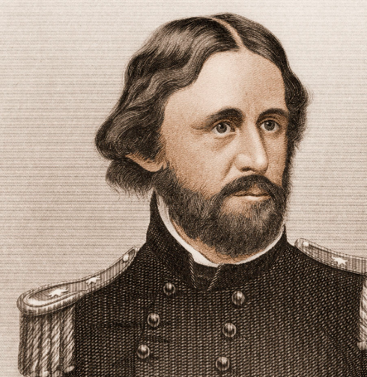
John Fremont
John Charles Fremont was an explorer of the Western United States, military officer, and politician.
In the 1840s, Frémont led five expeditions into the Western United States.
While on the third expedition, he and his men committed several massacres against Native Americans in California. During the Mexican–American War, Frémont, a major in the U.S. Army, took control of California from the California Republic in 1846.
Frémont was convicted in a court-martial for mutiny and insubordination after a conflict over the rightful military governor of California. After his sentence was commuted and President Polk reinstated him, Frémont resigned from the Army.
Afterward, Frémont settled in California at Monterey while buying cheap land in the Sierra foothills. When gold was found on his Mariposa ranch, Frémont became a wealthy man during the California Gold Rush.
Frémont became one of the first two U.S. senators elected from the new state of California in 1850.
Frémont was the first presidential candidate of the new Republican Party, carrying most of the North. He lost the 1856 presidential election to Democrat James Buchanan when Know-Nothings split the vote.

Slide 3
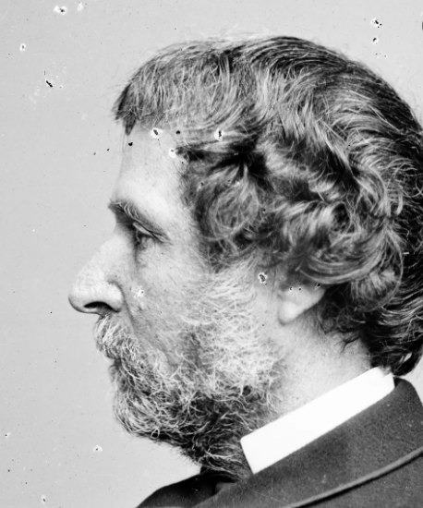
John Fremont
At the beginning of the American Civil War in 1861, he was given command of the Department of the West by President Abraham Lincoln.
Although Frémont had successes during his brief tenure there, he ran his department autocratically and made hasty decisions without consulting President Lincoln or Army headquarters.
He issued an unauthorized emancipation edict and was relieved of his command for insubordination by Lincoln.
After a brief service tenure in the Mountain Department in 1862, Frémont resided in New York, retiring from the Army in 1864.
Frémont was nominated for president in 1864 by the Radical Democracy Party, a breakaway faction of abolitionist Republicans, but he withdrew before the election.
After the Civil War, Frémont lost much of his wealth in the unsuccessful Pacific Railroad in 1866 and lost more in the Panic of 1873.
Frémont served as Governor of Arizona from 1878 to 1881. After his resignation as governor, Frémont retired from politics and died destitute in New York City in 1890.

Slide 4
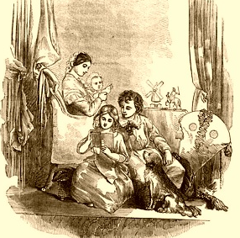
Cult of Domesticity
The Cult of Domesticity is a term used by historians to describe what they consider a prevailing value system among the upper and middle classes during the 19th century in the United States.
This value system emphasized new ideas of femininity, the woman's role within the home, and work and family dynamics.
"True women," according to this idea, were supposed to possess four cardinal virtues: piety, purity, domesticity, and submissiveness.
The argument revolved around the woman being the center of the family; she was considered "the light of the home."
The women and men who most actively promoted these standards were generally white and Protestant; the most prominent of them lived in New England and the Northeastern United States.
Although all women were supposed to emulate this ideal of femininity, black, working-class, and immigrant women were often excluded from the definition of "true women" because of social prejudice.

Slide 5
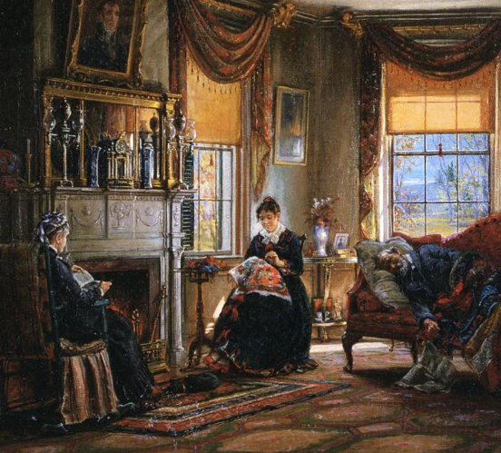
Cult of Domesticity
"True Women" were to hold and practice the four cardinal virtues:
Piety: Religion was valued because—unlike intellectual pursuits—it did not take a woman away from her "proper sphere," the home, and because it controlled women's longings.
Purity – Virginity, a woman's greatest treasure, must not be lost until her marriage night, and a married woman has to remain committed only to her husband.
Submission – True women were required to be submissive and obedient "as little children" because men were regarded as women's superiors "by God's appointment."
Domesticity: A woman's proper place was in the home, and her role as a wife was to create a refuge for her husband and children. The care of her home supposedly made her feminine, and she depended on men to protect her within the shelter of it.
Prescriptive literature advised women on how to transform their homes into domestic sanctuaries for their husbands and children.
Magazines also stressed fashion because a woman had to stay up to date to please her husband.

Slide 6
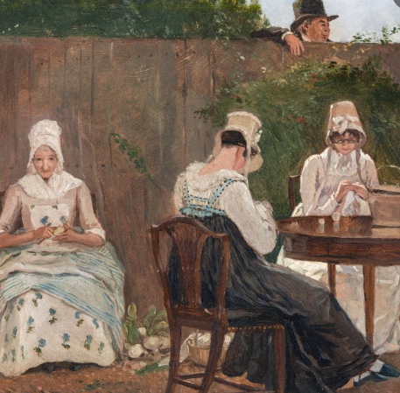
Cult of Domesticity
"True Women" were supposed to devote themselves to unpaid domestic labor and refrain from paid, market-oriented work. Consequently, in 1890, 4.5% of all married women were "gainfully employed," compared with 40.5% of single women.
However, women's complete financial dependence upon their husbands proved disastrous when wives lost their husbands through death or desertion and were forced to fend for themselves and their children.
In society, particularly in political and economic arenas, women's power declined.
The legal implications of this ideology included the passage of protective labor laws, which also limited women's employment opportunities outside the home.
Women's working hours were limited, and night work for women was prohibited, costing many female workers their jobs and excluding them from many occupations.
Arguments of significant biological differences between the sexes led to pronouncements that women were incapable of effectively participating in politics, commerce, or public service.
One of the first public jobs for women was teaching. One estimate says that, with the growth of public education in the northern tier of states, one-quarter of all native-born Massachusetts women between 1825 and 1860 were schoolteachers at some point in their lives.

Slide 7
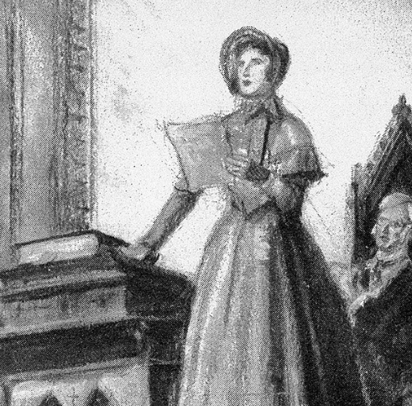
Seneca Falls Convention (1848 CE)
The Seneca Falls Convention was the first women's rights convention in the United States.
Held in July 1848 in Seneca Falls, New York, the meeting launched the women's suffrage movement, which more than seven decades later ensured women the right to vote.
From July 19 to 20, 1848, the meeting was held at the Wesleyan Chapel in Seneca Falls, New York.
Despite scarce publicity, 300 people—mainly area residents—showed up. Only women were allowed to attend (the second day was open to men).
The convention proceeded to discuss the 11 resolutions on women's rights.
The five women who organized the Seneca Falls Convention were also active in the abolitionist movement, which called for an end to slavery and racial discrimination.
They included: Elizabeth Cady Stanton, Lucretia Mott, Mary M'Clintock, Martha Coffin Wright, and Jane Hunt

Slide 8
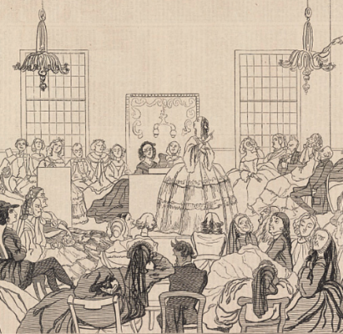
Seneca Falls Convention (1848 CE)
In the United States, women's rights reformers had already begun contending for women's rights to speak out on moral and political issues beginning in the 1830s.
Around the same time in New York, where Stanton lived, legal reformers had been discussing equality and challenging state laws prohibiting married women from owning property.
By 1848, equal rights for women were a divisive issue.
Together, the five women drafted a notice to announce, "a Convention to discuss Woman's social, civic and religious condition and rights.”
The Declaration of Sentiments was the Seneca Falls Convention's manifesto that described women's grievances and demands.
Written primarily by Elizabeth Cady Stanton, it called on women to fight for their Constitutionally guaranteed right to equality as U.S. citizens.
"We hold these truths to be self-evident; that all men and women are created equal," the document stated.

Slide 9
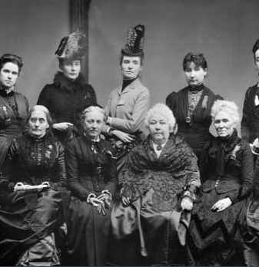
Seneca Falls Convention (1848 CE)
Inspired by the Declaration of Independence, the Declaration of Sentiments asserted women's equality in politics, family, education, jobs, religion, and morals.
The declaration began with 19 "abuses and usurpations" that were destined to destroy a woman's "confidence in her powers, to lessen her self-respect, and to make her willing to lead a dependent and abject life."
Because women didn't have the right to vote—a right given to "the most ignorant and degraded men"—they were forced to submit to laws to which they did not consent.
The convention's leaders continued to campaign for women's rights at state and nationwide events in the following years. Reformers frequently referred to the Declaration of Sentiments campaigning for women's rights.
Between 1848 and 1862, the participants of the Seneca Falls Convention used the Declaration of Sentiments to "employ agents, circulate tracts, petition the State and national Legislatures, and endeavor to enlist the pulpit and the press in our behalf."

Slide 10
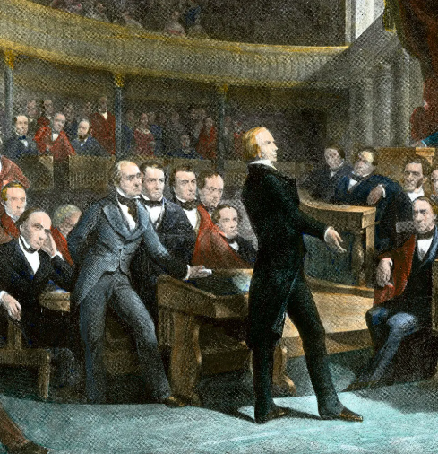
The Compromise of 1850
The Compromise of 1850 was a package of five separate bills passed by the United States Congress in September 1850 that defused a political confrontation between slave and free states on territories acquired in the Mexican–American War.
It also set Texas's western and northern borders and included provisions addressing fugitive slaves and the slave trade.
The compromise was brokered by Whig Senator Henry Clay and Democratic senator Stephen A. Douglas, with the support of President Millard Fillmore.
Three major types of issues were addressed by the Compromise of 1850: A variety of boundary issues, the status of territory issues, and the issue of slavery
While capable of analytical distinction, leadership included the boundary and territory issues in the overarching issue of slavery.
Pro-slavery and anti-slavery interests were each concerned with the amount of land on which slavery was permitted and the number of States in the slave or free camps.
Since Texas was a slave state, not only the residents of that state but also both camps on a national scale had an interest in the size of Texas.

Slide 11
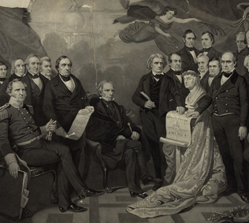
The Compromise of 1850
A debate over slavery in the territories had erupted during the Mexican–American War.
Many Southerners sought to expand slavery to the newly-acquired lands, and many Northerners opposed any such expansion.
The debate was further complicated by Texas's claim to all former Mexican territory north and east of the Rio Grande, including areas it had never effectively controlled.
These issues prevented the passage of organic acts to create organized territorial governments for the land acquired in the Mexican–American War.
In early 1850, Clay proposed a package of eight bills that would settle most of the pressing issues before Congress.
Clay's proposal was opposed by President Zachary Taylor, anti-slavery Whigs like William Seward, and pro-slavery Democrats like John C. Calhoun, and congressional debate over the territories continued.
The debates over the bill were the most famous in Congressional history, and the divisions devolved into fistfights and drawn guns on the floor of Congress.

Slide 12
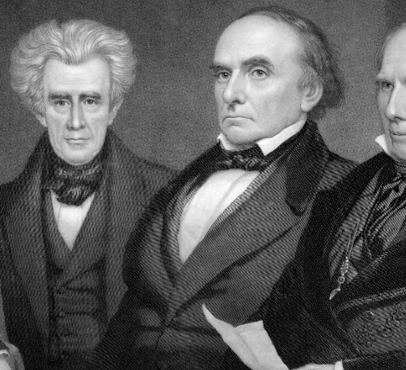
The Compromise of 1850
After Taylor died and was succeeded by Fillmore, Douglas took the lead in passing Clay's compromise through Congress as five separate bills.
Under the compromise, Texas surrendered its claims to present-day New Mexico and other states in return for federal assumption of Texas's public debt.
The law was so completely pro-slavery as to prohibit the admission of the testimony of a person accused of being an escaped slave into evidence at the judicial hearing to determine the status of the accused escaped slave.
Thus, if free Blacks were claimed to be escaped slaves, they could not resist returning to slavery by truthfully telling their actual history.
Furthermore, the federal commissioners overseeing the hearings were paid $5 for ruling a person was free but were paid $10 for determining they were a slave, thus providing a financial incentive to always rule in favor of slavery regardless of the evidence.
The law further exacerbated the problem of free Blacks being kidnapped and sold as slaves.

Slide 13
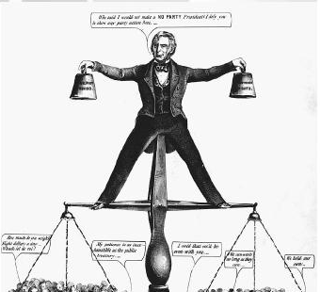
The Compromise of 1850
The Fugitive Slave Act was essential to meet Southern demands.
In terms of public opinion in the North, the necessary provision was that ordinary citizens were required to aid slave catchers and made it a crime to assist a fugitive.
Many Northerners deeply resented these requirements.
Resentment towards the Act further heightened tensions between the North and South, which were inflamed further by abolitionists such as Harriet Beecher Stowe.
Her novel, Uncle Tom's Cabin, stressed the horrors of recapturing escaped slaves and outraged Southerners.
A statute enacted as part of the compromise prohibited the slave trade in Washington, DC, but not slave ownership.
Alarmed and outraged, Southerners in Congress were unanimous in opposing the provision, seen as a concession to the abolitionists and a bad precedent, but they were outvoted.

Slide 14
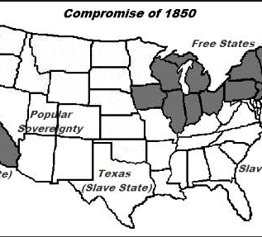
The Compromise of 1850
However, Washington's residents could still easily buy and sell slaves in the nearby states of Virginia and Maryland.
The issue of slavery in the territories would be re-opened by the Kansas–Nebraska Act, but the Compromise of 1850 played a significant role in postponing the American Civil War.
California was admitted as a free state, while leadership organized the remaining portions of the Mexican Cession into New Mexico Territory and Utah Territory.
Under the concept of popular sovereignty, the people of each territory would decide whether slavery would be permitted.
Perhaps the most crucial part of the Compromise received the least attention during debates.
Enacted September 18, 1850, it is informally known as the Fugitive Slave Law or the Fugitive Slave Act.

Slide 15
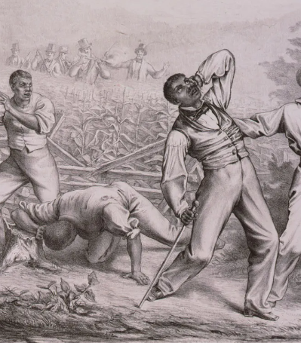
The Fugitive Slave Act of 1850
The Fugitive Slave Act was passed by the United States Congress on September 18, 1850, as part of the Compromise of 1850 between Southern interests in slavery and Northern Free-Soilers.
It required that all escaped slaves, upon capture, be returned to the slaver and that officials and citizens of free states had to cooperate.
Abolitionists nicknamed it the "Bloodhound Bill" after the dogs used to track down fugitives from slavery.
By 1843, several hundred enslaved people a year escaped to the North successfully, making slavery an unstable institution in the border states.

Slide 16
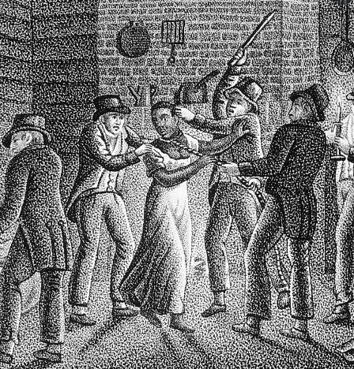
The Fugitive Slave Act of 1850
The Missouri Supreme Court routinely held with the laws of neighboring free states that enslaved people who their enslavers had voluntarily transported into free states, with the intent of the enslavers' residing there permanently or indefinitely, gained their freedom as a result.
In response to the weakening of the original Fugitive Slave Act, the Fugitive Slave Act of 1850 penalized officials who did not arrest someone allegedly escaping from slavery and made them liable to a fine of $1,000 (equivalent to $31,110 in 2020).
Law enforcement officials everywhere were required to arrest people suspected of escaping enslavement on as little as a claimant's sworn testimony of ownership.
Habeas corpus was declared irrelevant, and the Commissioner before whom officials brought the fugitive from slavery for a hearing—no jury was permitted, and the alleged refugee from enslavement could not testify —was compensated $10 if he found that the individual was proven a fugitive and only $5 if he determined the proof to be insufficient.

Slide 17
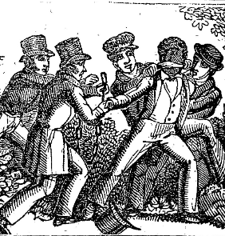
The Fugitive Slave Act of 1850
In addition, any person aiding a fugitive by providing food or shelter was subject to six months imprisonment and a $1,000 fine.
Since a suspected enslaved person was not eligible for a trial, the law resulted in the kidnapping and conscription of free Blacks into slavery, as suspected fugitive slaves had no rights in court and could not defend themselves against accusations.
The Fugitive Slave Law brought the issue home to anti-slavery citizens in the North, as it made them and their institutions responsible for enforcing slavery.
Where before many in the North had little or no opinions or feelings on slavery, this law seemed to demand their direct assent to the practice of human bondage, and it galvanized Northern sentiments against slavery.
Moderate abolitionists were faced with the immediate choice of defying what they believed to be an unjust law or breaking with their consciences and beliefs. Harriet Beecher Stowe wrote Uncle Tom's Cabin in response to the law.

Slide 18
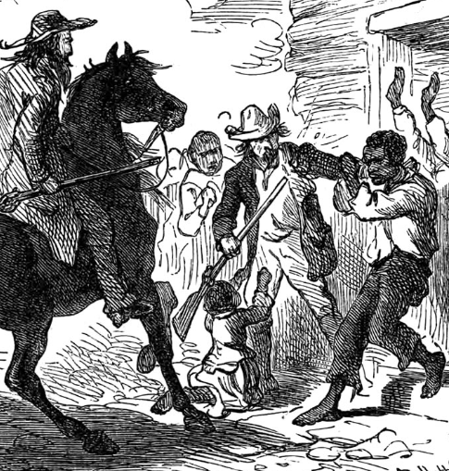
The Fugitive Slave Act of 1850
Many abolitionists openly defied the law. Reverend Luther Lee, the pastor of the Wesleyan Methodist Church of Syracuse, New York, wrote in 1855: I never would obey it. I had assisted thirty slaves in escaping to Canada during the last month. If the authorities wanted anything of me, my residence was at 39 Onondaga Street. I would admit that, and they could take me and lock me up in the Penitentiary on the hill; but if they did such a foolish thing as that, I had friends enough on Onondaga County to level it to the ground before the following day.
The black population of Canada increased from 40,000 to 60,000 between 1850 and 1860, and many reached freedom through the Underground Railroad.
By 1855, an estimated 3,500 people among Canada's black population were fugitives from American slavery. In Pittsburgh, for example, during the September following the law’s passage, organized groups of escaped people, armed and sworn to "die rather than be taken back into slavery," set out for Canada, with more than 200 men leaving by the end of the month.
The black population in New York City dropped by almost 2,000 from 1850 to 1855.

Slide 19
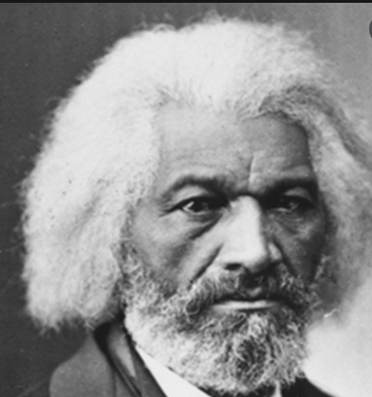
Fredrick Douglass (1852 CE)
Frederick Douglass was an escaped slave who became a prominent activist, author, and public speaker.
Frederick Douglass was born into slavery in or around 1818 in Talbot County, Maryland. Douglass himself was never sure of his exact birth date.
By the time he was hired out to work, he had taught other enslaved people to read using the Bible.
As word spread of his efforts to educate fellow enslaved people, Thomas Auld took him back and transferred him to a farmer known for his brutal treatment of the enslaved people in his charge.
Roughly 16 at this time, Douglass was regularly whipped. After several failed attempts at escape, Douglass finally left in 1838, first boarding a train to Maryland.

Slide 20
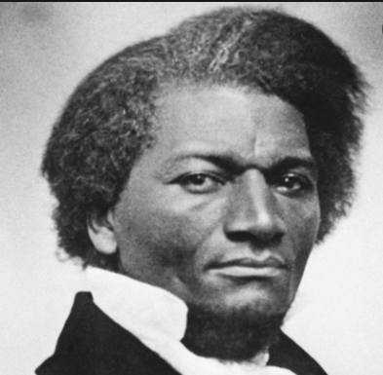
Fredrick Douglass (1852 CE)
Douglass began attending meetings of the abolitionist movement.
By 1843, Douglass had become part of the American Anti-Slavery Society's "Hundred Conventions" project, a six-month tour through the United States.
Douglass was physically assaulted several times during the tour by those opposed to the abolitionist movement.
In 1860, Douglass published the first and most famous autobiography, Narrative of the Life of Frederick Douglass, an American Slave.
he wrote: "From my earliest recollection, I date the entertainment of a deep conviction that slavery would not always be able to hold me within its foul embrace… spirit of hope departed not from me but remained like ministering angels to cheer me through the gloom… Thus, is slavery the enemy of both the slave and the slaveholder.”

Slide 21
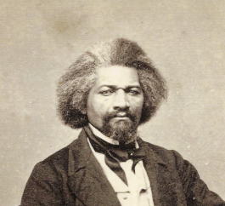
Fredrick Douglass (1852 CE)
When he returned to the United States in 1847, Douglass began publishing his North Star's abolitionist newsletter.
He also became involved in the movement for women's rights.
He was the only African American to attend the Seneca Falls Convention, a gathering of women's rights activists in New York, in 1848.
In 1852, he delivered another of his more famous speeches, which later came to be called "What to a slave is the 4th of July?"
In one section of the speech, Douglass noted, "What, to the American slave, is your 4th of July? I answer a day that reveals to him, more than all other days in the year, the gross injustice and cruelty to which he is the constant victim. To him, your celebration is a sham..."

Slide 22
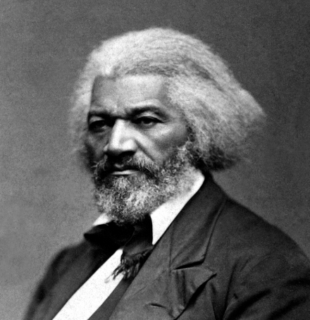
Fredrick Douglass (1852 CE)
Although he supported President Abraham Lincoln in the early years of the Civil War, Douglass would fall into disagreement with the politician after the Emancipation Proclamation of 1863, which effectively ended the practice of slavery.
Douglass was disappointed that Lincoln didn't use the proclamation to grant formerly enslaved people the right to vote, mainly after fighting bravely alongside soldiers for the Union army.
In the post-war Reconstruction era, Douglass served in many official positions in government, including as an ambassador to the Dominican Republic, thereby becoming the first Black man to hold high office.
Douglass' wife Anna died in 1882, and he married white activist Helen Pitts in 1884.
In 1888, he became the first African American to vote for President of the United States during the Republican National Convention. Ultimately, though, Benjamin Harrison received the party nomination.
Douglass remained an active speaker, writer, and activist until he died in 1895.

Slide 23
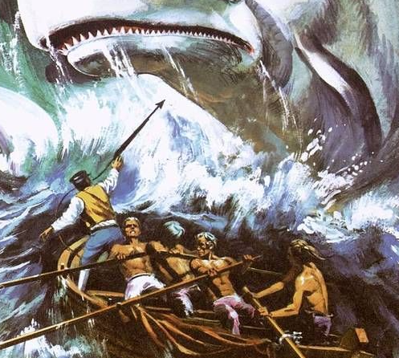
Moby Dick (1851 CE)
Moby-Dick is an 1851 novel by American writer Herman Melville. Its opening sentence, "Call me Ishmael," is among world literature's most famous.
The book is the sailor Ishmael's narrative of the obsessive quest of Ahab, captain of the whaling ship Pequod, for revenge on Moby Dick, the giant white sperm whale that on the ship's previous voyage bit off Ahab's leg at the knee.
A contribution to the literature of the American Renaissance, Moby-Dick was published to mixed reviews, was a commercial failure, and was out of print at the time of the author's death in 1891.
Its reputation as a "Great American Novel" was established only in the 20th century, after the centennial of its author's birth.
Melville began writing Moby-Dick in February 1850 and finished 18 months later, a year longer than he had anticipated.
The white whale is modeled on the notoriously hard-to-catch albino whale Mocha Dick, and the book's ending is based on the sinking of the whaleship Essex in 1820.

Slide 24
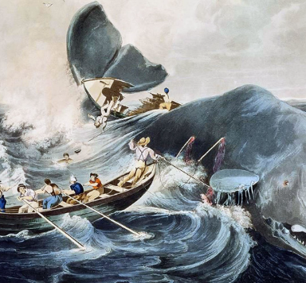
Moby Dick (1851 CE)
His literary influences include Shakespeare and the Bible.
The book was first published (in three volumes) as The Whale in London in October 1851 and under its definitive title in a single-volume edition in New York in November.
Reviewers in Britain were largely favorable, though some objected that the tale was told by a narrator who perished with the ship, as the British edition lacked the Epilogue recounting Ishmael's survival.
American reviewers were more hostile.
Moby-Dick was born in the pre-Civil War churn of a very tense American consciousness.
While it wasn't a critical or popular success upon publication, historians note that after World War I, Americans here and abroad came to understand that it contained the genetic code for much of what happens in the country where it was written.

Slide 25
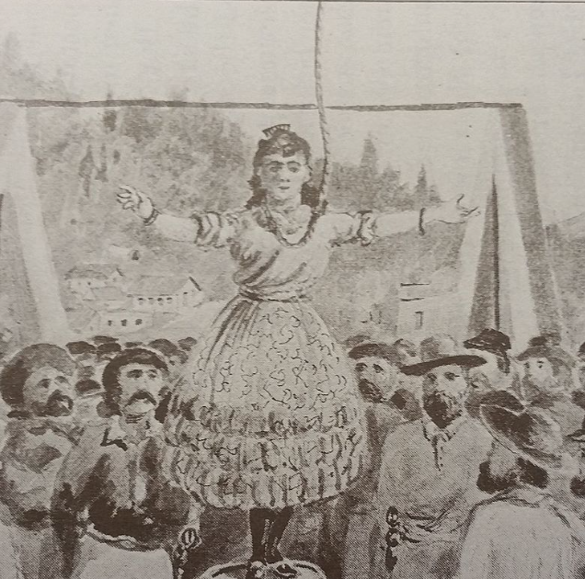
Anti-Mexican Violence (1851 CE)
It is estimated that at least 597 Mexican Americans were lynched between 1848 and 1928.
Most of these lynchings were not instances of "frontier justice"—of the 597 total victims; only 64 were lynched in areas that lacked a formal judicial system.
Most lynching victims were denied access to a trial, while others were convicted in unfair practices.
Josefa Segovia was a Mexican-American woman executed by hanging in Downieville, California, on July 5, 1851.
She was found guilty of murdering a local miner, Frederick Cannon.
She is known to be the first and only pregnant woman to be hanged in California.
Not much is known about the early life of Josefa Segovia. The date of her birth is unknown.
She lived with a Mexican gambler, José, in a small house on the town's main street. It is not completely clear if they were married or not. Josefa was probably not married to José, but she did live with him. Therefore, she received a bad reputation.

Slide 26
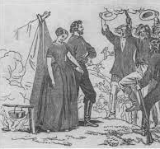
Anti-Mexican Violence (1851 CE)
Juanita had accompanied her partner to Downieville from Mexico, and both lived in an adobe house.
Celebrating the Fourth of July, Cannon and his companions were returning at a late hour, with Cannon staggering from the influence of liquor.
Along the way, he stumbled through the door of the adobe hut. His friends quickly pulled him back outside, and they proceeded home.
Mortified the following day of his embarrassing blunder, he moved to the house to apologize in Spanish.
This did not go well with the couple, and Josefa grew angry. In a rage, she drew a knife and stabbed Cannon.
The American mining population in Downieville was enraged by Cannon's death.
Josefa was put on trial the next day, and the jury consisted of Cannon's friends and companions while the rest of Downieville waited for the results.
Supposedly, a physician, Dr. Cyrus D. Aiken, testified that Josefa was not fit to be hanged. Protests immediately followed the doctor's testimony, forcing him from the stand and the town.

Slide 27
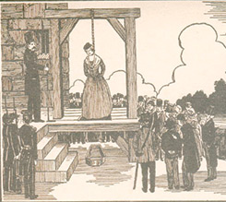
Anti-Mexican Violence (1851 CE)
Moments later, Josefa was found guilty of the murder of Cannon.
A lawyer from Nevada attempted to testify against the execution of Josefa but was beaten off the stand. He asked for a fair trial for her to see if a murder had been committed.
For the lynching, a scaffold was constructed on the bridge over the Yuba River. The town came to stand on the riverbanks and watch her execution.
It was an important event to lessen the anger of the townspeople over Cannon's death. Josefa was hanged immediately following the trial, and some accounts say that her last words before she was executed were "Adiós Señores."
She adjusted the noose to her neck, raising her long, loose braids carefully to fix the rope firmly in its place, and then, with a smile and wave of her hand to the bloodthirsty crowd present, she stepped calmly from the plank.
Singularly enough, her body rests side by side, in the cemetery on the hill, with that of the man whose life she had taken.
She is widely known to be the first woman to be executed by hanging in California.

Slide 28
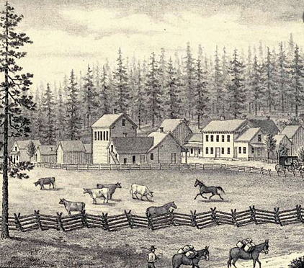
Ranchos
Rancho is a Spanish word with many meanings, but most refer to a place where people gather.
During the Spanish colonial period in the Americas, it became associated with a place for raising cattle and other livestock.
In Spanish and Mexican California, a rancho mainly meant a cattle farm.
Most ranchos in California originated as land that the Mexican government awarded to people.
the Mexican government distributed lands under the control of the missions to private individuals.
It did this through a process of land grants from the territorial government in Alta California.
Over 60 years, the Spanish and Mexican governments made about 500 land grants for ranchos in California.
The purpose of the ranchos was to raise livestock, primarily cattle, and provide food.

Slide 29
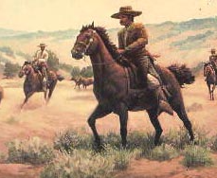
Ranchos
After Mexican independence, the ranchos mainly provided a livelihood for the people that owned and worked on them.
Over the years, raising cattle and other livestock became the main activity in Alta California and created the rancho economy.
Rancheros were people who had been loyal to Spain or Mexico and had shown that they could farm the land in a productive way.
The first rancheros were soldiers who had come to the region as early as 1769.
After Mexican independence, they called themselves Californios because they felt closely connected to the land of California.
Working on a rancho could be very hazardous. There were accidents and injuries when dealing with large domestic animals like horses and cattle, but there were many wild animals to contend with.
Grizzly bears roamed the foothills and valleys of California and often preyed on cattle, while smaller animals like rattlesnakes were just as deadly.
Sometimes, hostile Native American groups would raid livestock herds. This often led to violence when the rancheros pursued the Indians to recover their livestock.

Slide 30
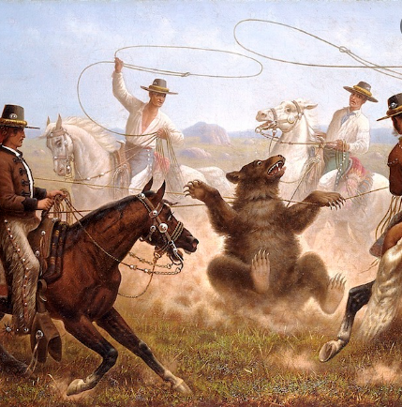
Ranchos
The era of California ranchos ended shortly after the U.S.-Mexico War.
A sharp decline in cattle prices, the floods of 1861, and droughts of 1863 also forced many of the overextended rancheros to sell their properties to Americans.
When California became part of the United States, rancho owners needed to prove to the U.S. government that the land belonged to them.
Because it was very costly to hire lawyers to defend their property, most rancheros sold off their land to pay their expenses.
In many cases, they had to sell or give the title to a portion of their land to pay for defense fees or gave attorneys land instead of payment.
By the end of the 1860’s, most of the ranchos in California had been broken up and sold to new owners.

Slide 31
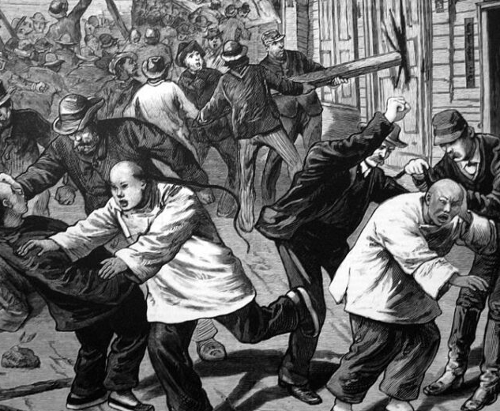
Chinese Americans
In the 19th century, Chinese–US maritime trade began the history of Chinese Americans. At first, only a handful of Chinese came, mainly as merchants and former sailors. The first Chinese people of this wave arrived in the United States around 1815.
Subsequent immigrants from the 1820s up to the late 1840s were mainly men.
From the outset, European Americans met them with the distrust and overt racism of settled European populations, ranging from massacres to pressuring Chinese migrants into what became known as Chinatowns.
Laws were made to restrict them, including exorbitant special taxes, prohibiting them from marrying white European partners to prevent men from marrying at all, increasing the population, and barring them from acquiring US citizenship.
Only merchants were able to take their wives and children overseas. Most Chinese immigrants were peasants, farmers, and artisans.
Young men, usually married, left their wives and children behind since they intended to stay in America only temporarily.

Slide 32
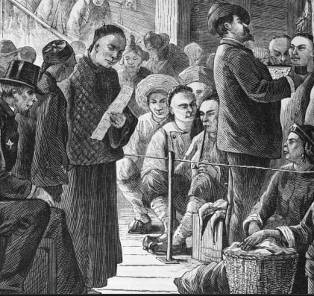
Chinese Americans
Wives also remained behind to fulfill their traditional obligation to care for their husbands' parents.
From the beginning of the California gold rush until 1882—when an American federal law ended the Chinese influx—approximately 300,000 Chinese arrived in the United States.
This "credit-ticket system" meant that the funds advanced by the agencies to cover the cost of the passage were to be paid back by wages earned by the laborers later during their time in the US.
Indentured migrants had long used the credit-ticket system from South China who left to work in the South Seas, the region to the south of China, including the Philippines, the former Dutch East Indies, the Malay Peninsula, and Borneo, Thailand, Indochina, and Burma.
Unlike European immigrants, the government withheld the possibility of naturalization from the Chinese.

Slide 33
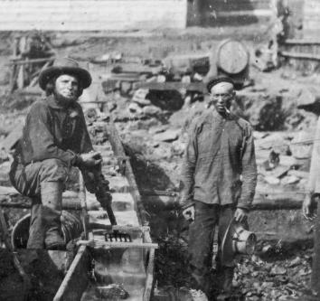
Chinese Americans
The Chinese immigrants neither spoke nor understood English and were unfamiliar with western culture and life; they often came from rural China and had difficulty adjusting to and finding their way around large towns such as San Francisco.
Many other factors hindered their assimilation, most notably their appearance.
Under Qing dynasty law, Han Chinese men were forced under the threat of beheading to follow Manchu customs, including shaving the front of their heads and combing the remaining hair back.
Because Chinese immigrants returned as often to China to see their families, they could not cut off their often-hated braids in America and then legally re-enter China.
In 1850, the Chinese community of San Francisco consisted of 4,018 men and only seven women.
By 1855, women made up only two percent of the Chinese population in the United States, and even by 1890, this had only increased to 4.8 percent.

Slide 34
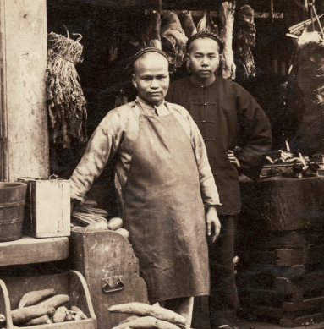
Chinese Americans
The lack of visibility of Chinese women, in general, was due partially to the cost of making the voyage when there was a lack of work opportunities for Chinese women in America.
Other cultural factors such as having bound feet and not leaving home.
Another critical consideration was that most Chinese men were worried that by bringing their wives and raising families in America, they too would be subjected to the same racial violence and discrimination they had faced.
With the heavily uneven gender ratio, prostitution increased, and the Chinese sex trade and trafficking became a lucrative business.
Documents from the 1870 US Census show that 61 percent of 3,536 Chinese women in California were classified as prostitutes as an occupation.

Slide 35
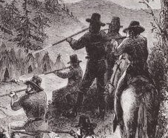
California Genocide
Between 1846 and 1873, it is estimated that American settlers murdered thousands of California natives, and acts of enslavement, kidnapping, rape, child separation, and displacement were widespread.
State authorities and militias encouraged, tolerated, and carried out these acts.
The state of California used its institutions to favor white settlers' rights over indigenous rights, dispossessing natives.
It is also estimated that the indigenous population of California decreased from perhaps as many as 150,000 in 1848 to 30,000 in 1870.
The decline was caused by disease, starvation, killings, and massacres. California Native Americans, particularly during the Gold Rush, were targeted in killings.
Before Spanish arrival, California was home to an indigenous population thought to have been as high as 300,000.
The largest group was the Chumash people, with around 10,000.

Slide 36
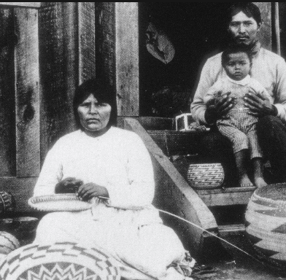
California Genocide
The region was highly diverse, with numerous distinct languages spoken.
While there was great diversity in the area, archeological findings show little evidence of intertribal conflicts.
Spanish missionaries, led by Franciscan administrator Junípero Serra did not reach this area until 1769.
The military constructed outposts alongside the missions to house the soldiers sent to protect the missionaries.
As the missions grew, California's native population of Indians began a catastrophic decline.
Most deaths stemmed from imported diseases and the disruption of traditional ways of life, but violence was expected, and some historians have charged that life in the missions was close to slavery.

Slide 37
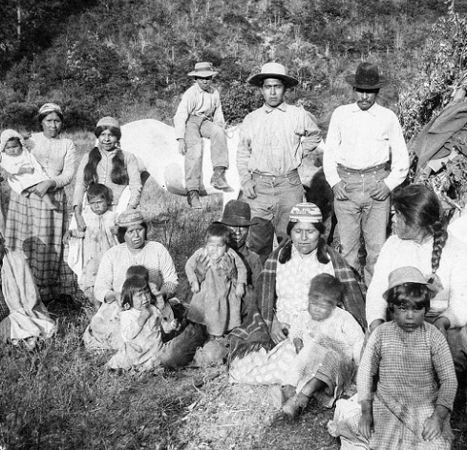
California Genocide
In the latter half of the 19th century, California state and federal authorities incited, aided, and financed miners, settlers, ranchers, and people's militias to enslave, kidnap, murder, and exterminate a significant proportion of displaced Native Americans.
Many of the same violence policies were used against the indigenous population as the United States had done throughout its territory.
Simultaneous with the ongoing extermination, reports of the decimation of Native Americans were made to the rest of the United States and internationally.
The California Act for the Government and Protection of Indians was enacted in 1850.
This law provided for "apprenticing" or indenturing Indian children to Whites and also punished "vagrant" Indians by "hiring" them out to the highest bidder at a public auction if the Indian could not provide sufficient bond or bail.
This legalized a form of slavery in California.
White settlers took 24,000 to 27,000 California Native Americans as forced laborers, including 4,000 to 7,000 children.

Slide 38
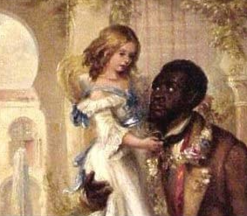
Uncle Tom’s Cabin (1852 CE)
Uncle Tom's Cabin is an antislavery novel by American author Harriet Beecher Stowe.
Published in two volumes in 1852, the book had a profound effect on attitudes toward African Americans and slavery in the US and is said to have helped lay the groundwork for the American Civil War."
A Connecticut-born woman of English descent, Stowe was part of the religious Beecher family.
A teacher at the Hartford Female Seminary and an active abolitionist, she featured the character of Uncle Tom in the novel, a long-suffering enslaved Black person around whom the stories of other characters revolve.
Uncle Tom's Cabin was the best-selling novel and the second best-selling book of the 19th century, following the Bible.
It is credited with helping fuel the abolitionist cause in the 1850s. The first year after it was published, publishers sold 300,000 copies of the book in the United States; publishers sold one million copies in Great Britain.
The impact attributed to the book is significant, reinforced by an apocryphal story that when Abraham Lincoln met Stowe at the start of the Civil War, he declared, "So this is the little lady who started this great war.“

Slide 39
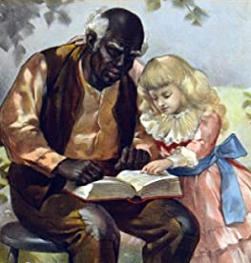
Uncle Tom’s Cabin (1852 CE)
The book and the plays it inspired helped popularize several stereotypes about black people.
These include the affectionate, dark-skinned mammy; the pickaninny stereotype of black children; and the namesake character type of "Uncle Tom," describing a dutiful, long-suffering servant faithful to his white master or mistress.
Uncle Tom's Cabin is dominated by a single theme: the evil and immorality of slavery.
Because Stowe saw motherhood as the ethical and structural model for American life and believed that only women had the moral authority to save the United States from the demon of slavery, Uncle Tom's Cabin's central theme is the moral power sanctity of women.
While later critics have noted that Stowe's female characters are often domestic clichés instead of realistic women, Stowe's novel reaffirmed the importance of women's influence.
It helped pave the way for the women's rights movement in the following decades.

Slide 40
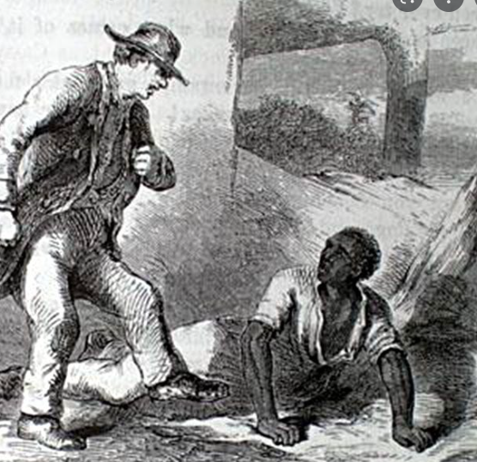
Uncle Tom’s Cabin (1852 CE)
Uncle Tom's Cabin outraged people in the American South.
Reactions ranged from a bookseller in Mobile, Alabama, being forced to leave town for selling the novel to threatening letters sent to Stowe, including a package containing an enslaved person's severed ear.
Some critics highlighted Stowe's lack of life experience relating to Southern life, which led her to create inaccurate descriptions of the region.
For instance, she had never been to a Southern plantation. However, Stowe always said she based the characters of her book on stories runaway slaves told her in Cincinnati.
Scenes she watched on the Ohio River, including seeing a husband and wife being sold apart and newspaper and magazine accounts and interviews, contributed material to the emerging plot.
In response to these criticisms, in 1853, Stowe published A Key to Uncle Tom's Cabin, an attempt to document the integrity of the novel's depiction of slavery.

Slide 41
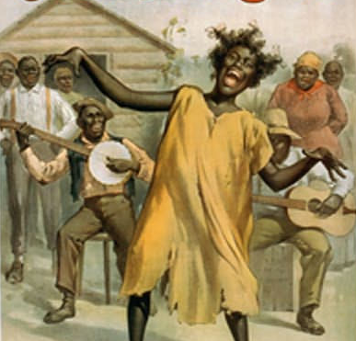
Uncle Tom’s Cabin (1852 CE)
Some modern scholars and readers have criticized the book for condescending racist descriptions of the black characters' appearances, speech, and behavior and the passive nature of Uncle Tom in accepting his fate.
As a result, the book, along with illustrations from the book and associated stage productions, was accused of playing a significant role in permanently ingraining such stereotypes into the American psyche.
Stowe intended Tom to be a noble hero and a Christ-like figure who, like Jesus at his crucifixion, forgives the people responsible for his death.
These negative associations have to some extent, obscured the historical impact of Uncle Tom's Cabin as a vital antislavery tool.
In recent years, however, scholars have re-examined Uncle Tom's Cabin, stating that the book is a central document in American race relations and a significant moral and political exploration of the character of those relations.

Slide 42
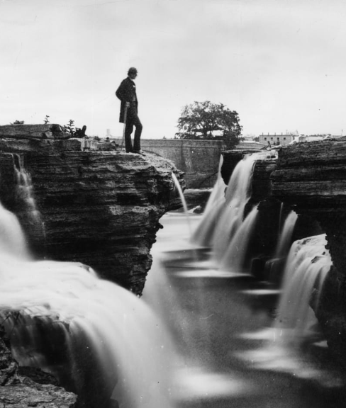
Transcendentalism
Transcendentalism is a 19th-century school of American theological and intellectual thinking that mixed regard for nature and autonomy with Unitarianism and German Romanticism components.
Writer Ralph Waldo Emerson was the primary practitioner of the crusade, which existed loosely in Massachusetts in the early 1800s before becoming an organized group in the 1830s.
Transcendentalism has its origins in New England in the early 1800s and the birth of Unitarianism.
It was born from a debate between "New Light" theologians, who believed that religion should focus on an emotional experience, and "Old Light" opponents, who valued reason in their religious approach.
These "Old Lights" became known first as "liberal Christians" and then as Unitarians and were defined by the belief that there was no trinity of father, son, and holy ghost as in traditional Christian faith and that Jesus Christ was a mortal.
The ideas that would become Transcendentalism split from Unitarianism over its perceived rationality and instead embraced German Romanticism to seek a more spiritual experience.

Slide 43
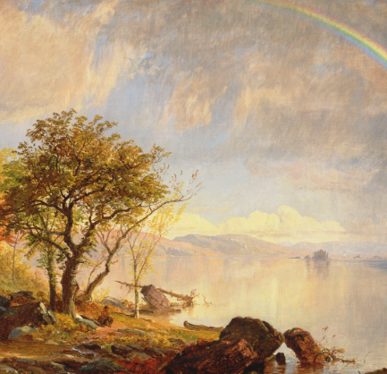
Transcendentalism
Transcendentalists endorsed the idea of personal knowledge of God, believing that no arbitrator was required for spiritual understanding. They welcomed idealism, focusing on nature and fighting materialism.
By the 1830s, literature began to appear that bound the Transcendentalist ideas together in a cohesive way and marked the origins of a more organized movement.
On September 12, 1836, four Harvard University alumni—writer and Bangor, Maine, minister Frederic Henry Hodge, Ralph Waldo Emerson, and Unitarian ministers George Ripley and George Putnam—left a celebration of the bicentennial of Harvard to meet at Willard's Hotel in Cambridge.
The purpose was to follow up on correspondence between Hodge and Emerson and to talk about the state of Unitarianism and what they could do about it.
There would be 30 more meetings of "the Transcendental Club" over the next four years.
Emerson's essay "Nature," published in 1836, presented Transcendentalist philosophy as it had formed in the club meetings.

Slide 44
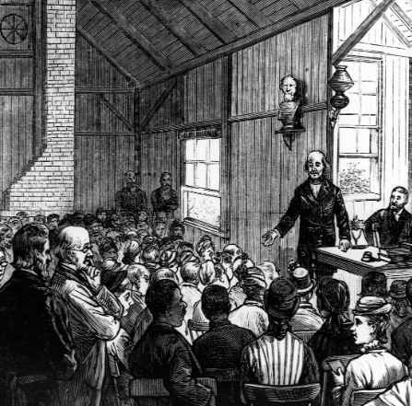
Transcendentalism
In 1841, a small group, including author Nathaniel Hawthorne, moved to Brook Farm in West Roxbury, Massachusetts.
The farm was run by members buying shares for life-long membership, guaranteeing an annual return on their investment, and allowing members who could not afford a share to compensate with work.
As farmers, they were newcomers, but Hawthorne was thrilled by the physicality of farming life.
There was also a boarding school onsite that was the farm's primary income source.
There were over 100 residents.
In 1844, following a restructuring that brought further growth, the commune began to fall into a slow decline, with members disillusioned by its mission, financial challenges, and other problems and squabbling amongst themselves.
Though its members remained active in the public eye following the failure of Brook Farm, it never again materialized as a cohesive group.

Slide 45
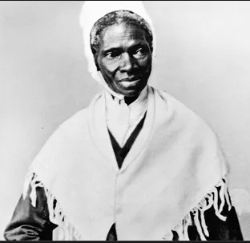
Sojourner Truth
Born Isabella "Belle" Baumfree, Sojourner Truth was an American abolitionist and women's rights activist.
Truth was born into slavery in New York but escaped with her infant daughter to freedom in 1826.
She had to leave her other children behind because their masters did not legally free them in the emancipation order until they had served as bound servants into their twenties.
Truth learned that her son Peter, then five years old, had been sold by Dumont and then illegally resold to an owner in Alabama.
She took the issue to court, and in 1828, after months of legal proceedings, she got back her son, who had been abused by those enslaving him.

Slide 46
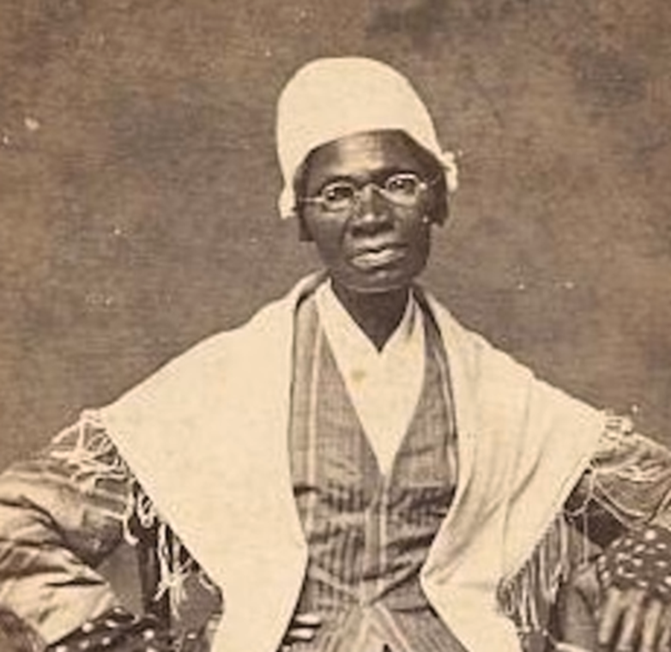
Sojourner Truth
Truth became one of the first black women to court against a white man and won the case.
She gave herself the name Sojourner Truth in 1843 after she became convinced that God had called her to leave the city and go into the countryside, "testifying the hope that was in her.“
Truth dedicated her life to fighting for an equal society for African Americans and women, including abolition, voting, and property rights.
When Black women like Truth spoke of ownership, they mixed their ideas with challenges to slavery and racism.
On September 3, 1857, she sold all her possessions, new and old, to Daniel Ives and moved to Battle Creek, Michigan
Antislavery activities had begun early in Michigan and Ohio. Here, she also joined the nucleus of the Michigan abolitionists, the Progressive Friends, some of whom she had already met at national conventions.

Slide 47
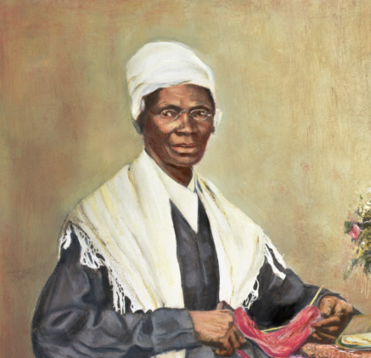
Sojourner Truth
In 1858, someone interrupted a speech and accused her of being a man; Truth opened her blouse and revealed her breasts.
Truth helped recruit black troops for the Union Army during the Civil War.
Truth spoke about abolition, women's rights, and prison reform and preached to the Michigan Legislature against capital punishment.
Not everyone welcomed her lecturing and speeches, but she had many friends and staunch support from many influential people at the time.
Truth died early on November 26, 1883, at her Battle Creek home.
Some of the notable citizens of Battle Creek acted as pallbearers; nearly one thousand people attended the service.

Slide 48
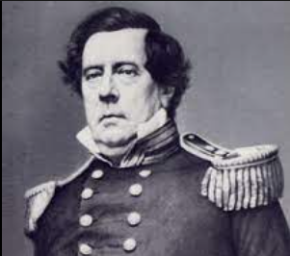
Commodore Perry (1853 CE)
The Perry Expedition was a diplomatic and military excursion to the Tokugawa Shogunate, concerning two distinct voyages by warships of the United States Navy in 1853.
Perry's primary goal was to end Japan's 220-year-old policy of isolation and open Japanese ports to American trade through gunboat diplomacy if required.
Although he is often credited with opening Japan to the western world, Perry was not the first westerner to visit the islands.
Portuguese, Spanish, and Dutch traders engaged in regular trade with Japan in the 16th and 17th centuries.
The combination of the opening of Chinese ports to regular trade and the annexation of California, creating an American port on the Pacific, ensured that there would be a steady stream of maritime traffic between North America and Asia.
As American traders in the Pacific replaced sailing ships with steam ships, they needed to secure coaling stations, where they could stop to take on provisions and fuel while making the long trip from the United States to China.
The combination of its advantageous geographic position and rumors that Japan held vast deposits of coal increased the appeal of establishing commercial and diplomatic contacts with the Japanese.

Slide 49
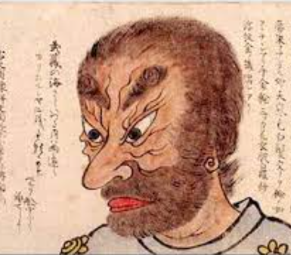
Commodore Perry (1853 CE)
Additionally, the American whaling industry had pushed into the North Pacific by the mid-18th century, and sought safe harbors, assistance in case of shipwrecks, and reliable supply stations.
In the years leading up to the Perry mission, several American sailors found themselves shipwrecked and stranded on Japanese shores, and tales of their mistreatment at the hands of the unwelcoming Japanese spread through the merchant community and across the United States.
In 1851, President Millard Fillmore authorized a formal naval expedition to Japan to return shipwrecked Japanese sailors and request that Americans stranded in Japan be returned to the United States.
He sent Commodore John Aulick to accomplish these tasks, but before Aulick left China for Japan, he was relieved of his post and replaced by Commodore Matthew Perry.
A lifetime naval officer, Perry had distinguished himself in the Mexican-American War and was instrumental in promoting the United States Navy’s conversion to steam power.
He sailed to Edo (Tokyo) Bay, carrying a letter from the U.S. President addressed to the Emperor of Japan.

Slide 50
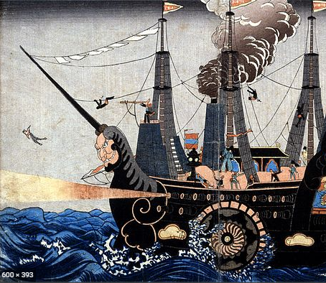
Commodore Perry (1853 CE)
By addressing the letter to the Emperor, the United States demonstrated its lack of knowledge about the Japanese government and society.
At that time, the Japanese emperor was little more than a figurehead, and the true leadership of Japan was in the hands of the Tokugawa Shogunate.
Perry arrived in Japanese waters with a small squadron of U.S. Navy ships.
He and others believed the only way to convince the Japanese to accept western trade was to display a willingness to use its advanced firepower.
At the same time, Perry brought along a variety of gifts for the Japanese Emperor, including a working model of a steam locomotive, a telescope, a telegraph, and a variety of wines and liquors from the West, all intended to impress upon the Japanese the superiority of Western culture.
Displaying his audacity and readiness to use force, Perry’s approach into the forbidden waters around Tokyo convinced the Japanese authorities to accept the letter.

Slide 51
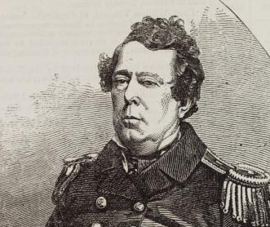
Commodore Perry (1853 CE)
The following spring, Perry returned with an even larger squadron to receive Japan’s answer.
The Japanese grudgingly agreed to Perry’s demands, and the two sides signed the Treaty of Kanagawa on March 31, 1854.
According to the treaty’s terms, Japan would protect stranded seamen and open two ports for refueling and provisioning American ships.
Japan also gave the United States the right to appoint consuls to live in these port cities, a privilege not previously granted to foreign nations.
This treaty was not a commercial treaty, and it did not guarantee the right to trade with Japan.
Still, in addition to providing for distressed American ships in Japanese waters, it contained a most-favored-nation clause so that all future concessions Japan granted to other foreign powers would also be granted to the United States.
As a result, Perry’s treaty provided an opening to allow future American contact and trade with Japan.

