Slide 1
Module Twelve: The Brothers' War
(1861 CE - 1865 CE)

Slide 2
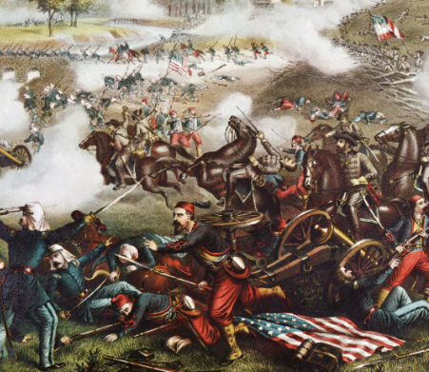
First Battle of Bull Run (1861 CE)
The First Battle of Bull Run, also known as the Battle of Manassas, marked the first major land battle of the American Civil War.
On July 21, 1861, Union and Confederate armies clashed near Manassas Junction, Virginia.
The engagement began when about 35,000 Union troops marched from the federal capital in Washington, DC, to strike a Confederate force of 20,000 along a small river called Bull Run.
After fighting on the defensive for most of the day, the rebels rallied and broke the Union right flank, sending the Federals into a chaotic retreat towards Washington.
The Confederate victory gave the South confidence and shocked many in the North, who realized the North would not win the war as quickly as they had hoped.
By July 1861, two months after Confederate troops opened fire on Fort Sumter to begin the Civil War, the northern press and public were eager for the Union Army to advance on Richmond ahead of the planned meeting of the Confederate Congress there on July 20.
Encouraged by early victories by Union troops in western Virginia and by the war fever spreading through the North, President Abraham Lincoln ordered Brigadier General Irvin McDowell to mount an offensive that would hit quickly and decisively at the enemy and open the way to Richmond, thus bringing the war to a mercifully quick end.

Slide 3
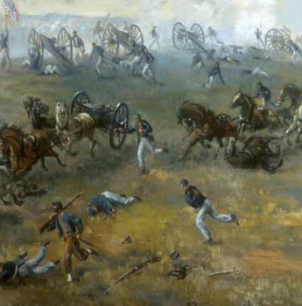
First Battle of Bull Run (1861 CE)
The offensive would begin with an attack on more than 20,000 Confederate troops under the command of General PGT Beauregard camped near Manassas Junction, Virginia, along a little river known as Bull Run.
The cautious McDowell, then in command of the 35,000 Union volunteer troops gathered in the Federal capital, knew that his men were ill-prepared and pushed for a postponement of the advance to give him time for additional training.
But Lincoln ordered him to begin the offensive nonetheless, reasoning that the rebel army consisted of similarly amateur soldiers. McDowell’s army began moving out of Washington on July 16; its slow movement allowed Beauregard to call on his fellow Confederate General Joseph E Johnston for reinforcements.
In command of some 11,000 rebels in the Shenandoah Valley, Johnston could outmaneuver a Union force in the region and march his men towards Manassas.
McDowell’s Union force struck on July 21, shelling the enemy across Bull Run while more troops crossed the river at Sudley Ford to hit the Confederate left flank.
Over two hours, 10,000 Federals gradually pushed back 4,500 rebels across the Warrington turnpike and up Henry House Hill.
Reporters, members of Congress, and other onlookers who had traveled from Washington and were watching the battle from the nearby countryside prematurely celebrated a Union victory.

Slide 4
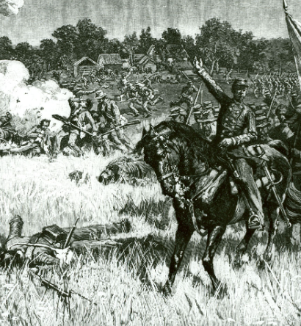
First Battle of Bull Run (1861 CE)
Still, reinforcements from both Johnston’s and Beauregard’s armies soon arrived on the battlefield to rally the Confederate troops. Both sides traded attacks and counterattacks near Henry House Hill in the afternoon.
On Johnston and Beauregard’s orders, more and more Confederate reinforcements arrived, even as the Federals struggled to coordinate assaults made by different regiments.
By four o’clock in the afternoon, both sides had an equal number of men on the battlefield (about 18,000 on each side were engaged at Bull Run), and Beauregard ordered a counterattack along the line.
Screaming as they advanced the “rebel yell” that would become infamous among Union troops, the Confederates managed to break the Union line.
As McDowell’s Federals retreated chaotically across Bull Run, they ran headlong into hundreds of Washington civilians watching the battle while picnicking on the fields east of the river, now making their hasty retreat.
Southern General Barnard Bee told his men to take heart and look at Jackson standing there “like a stone wall.”
In the battle, he earned his enduring nickname, “Stonewall” Jackson.

Slide 5
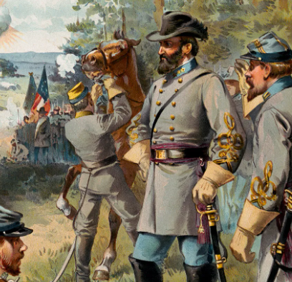
First Battle of Bull Run (1861 CE)
The First Battle of Bull Run cost 3,000 Union casualties, compared with 1,750 for the Confederates.
Its outcome sent northerners who had expected a quick, decisive victory reeling and gave rejoicing southerners a false hope that they could pull off a swift victory.
Despite their success, Confederate troops were too disorganized to press their advantage and pursue the retreating Yankees, who reached Washington by July 22.
Both sides would soon have to face the reality of a long, grueling conflict that would take an unimaginable toll on the country and its people.
On the Confederate side, accusations flew between Johnston, Beauregard, and President Jefferson Davis over who was to blame for failing to pursue and crush the enemy after the battle.
For the Union, Lincoln removed McDowell from command.
He replaced him with George B McClellan, who would retrain and reorganize Union troops defending Washington into a disciplined fighting force known as the Army of the Potomac.

Slide 6
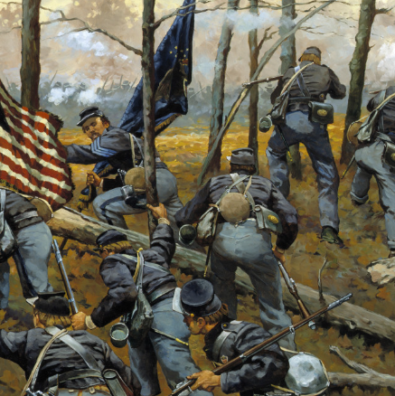
Shiloh (1862 CE)
The Battle of Shiloh allowed Union troops to penetrate the Confederate interior.
The South's defeat at Shiloh ended the Confederacy's hopes of blocking the Union's advance into Mississippi and doomed the Confederate military initiative in the West. With the loss of their commander, Gen. Albert Sidney Johnston, in battle, Confederate morale plummeted.
After the Union victories at Fort Henry and Fort Donelson in February 1862, Confederate general Johnston withdrew from Kentucky and left much of the western and middle Tennessee to the Federals.
This permitted Major General Ulysses S Grant to push his troops toward Corinth, Mississippi, the strategic intersection of the Mobile and Ohio Railroad and the Memphis and Charleston Railroad and a vital troop and supply conduit for the South.
Alerted to the Union army's position, Johnston intercepted the Federals 22 miles northeast of Corinth at Pittsburg Landing.
After Shiloh, both sides realized the magnitude of the conflict, which would be longer and bloodier than they could have imagined.
To consolidate his forces and prepare for operations against Grant, Johnston marshals his forces at Corinth.

Slide 7
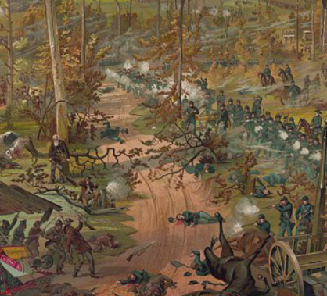
Shiloh (1862 CE)
The Confederate retreat is welcomed by Grant, whose Army of Tennessee needed time to prepare for its offensive up the Tennessee River.
Grant's army camps at Pittsburg Landing, where it spends time drilling recruits and awaiting Major General Don Carlos Buell's Army of Ohio.
Grant is ordered not to engage the Confederates until he has been reinforced by Buell's army, marching overland from Nashville to meet him. Once combined, the two militaries will advance south on Corinth.
Anticipating a Federal move against Corinth, Johnston and his 44,000-man Army of Mississippi plans to smash Grant's army at Pittsburg Landing before Buell can arrive with more Union troops.
On April 3, Johnston placed his troops in motion, but heavy rains delayed his attack. By nightfall on April 5, his army is deployed for battle only four miles southwest of Pittsburg Landing, and pickets from both sides nervously exchange gunfire in the dense woods that evening.
At daybreak, three corps of Confederate infantry storm out of the woods and sweep into the southernmost Federal camps, catching Grant's men unprepared.

Slide 8
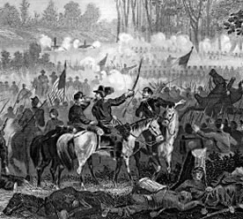
Shiloh (1862 CE)
Intense fighting centers around Shiloh Church as the Confederates sweep the Union line from that area.
Despite heavy fire on their position, Union troops counterattack but slowly lose ground and fall back northeast toward Pittsburg Landing.
Throughout the morning, Confederate brigades force Grant's troops into defensive positions at Shiloh Church, the Peach Orchard, Water Oaks Pond, and a treacherous thicket of oaks posthumously named the Hornets' Nest by fortunate survivors.
That afternoon, while leading an attack on the left end of the Union's Hornets' Nest line, Johnston is shot in the right knee.
The bullet severs an artery, and the commander bleeds to death.
Gen. Pierre G T Beauregard is appointed the new Confederate commander.
Believing his army victorious, Beauregard calls a halt to the attacks as darkness approaches.

Slide 9
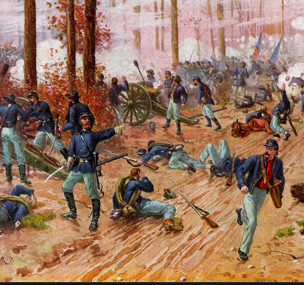
Shiloh (1862 CE)
He is unaware that overnight, Buell arrives with reinforcements for Grant.
The Union army now has nearly 54,000 men near Pittsburgh Landing and outnumbers Beauregard's army of around 30,000.
Grant's army launches their attack at 6:00 am. Beauregard immediately orders a counterattack.
The Confederates are ultimately compelled to retreat and regroup all along their line. Beauregard demands a second counterattack, halting the Federals' advance but ending in a stalemate.
The timberclads USS Tyler and USS Lexington provide naval artillery support to Grant's left flank from the Tennessee River.
At about 3:00 pm, Beauregard realizes he is outnumbered and retreats toward Corinth, having already suffered tremendous casualties.
On April 8, Grant dispatched Brigadier General William T Sherman and Brigadier General Thomas J Wood to ascertain the Confederates' position.

Slide 10
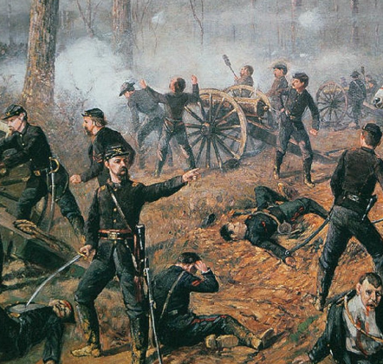
Shiloh (1862 CE)
At Fallen Timbers, six miles south of the battlefield, they encounter Rebel cavalry under Colonel Nathan Bedford Forrest.
Forrest charges into the Federals ahead of his troops and is shot by Federal infantry at point-blank range.
Although he will later require complex surgery to remove the life-threatening bullet, Forrest's reckless aggression pays off.
Federal forces flee toward Pittsburg Landing, allowing the Confederates to escape.
Johnston's death damaged Confederate morale, particularly for President Jefferson Davis, who held Johnston high in personal and professional esteem.
Grant, though victorious, was vilified in the press after being caught unprepared at Pittsburg Landing on April 6.
Critics called for him to be dismissed, but Abraham Lincoln defended his general, declaring, "I can't spare this man. He fights.“
Corinth fell to the Union by the end of May, allowing Grant to focus on gaining control of the Mississippi River.

Slide 11
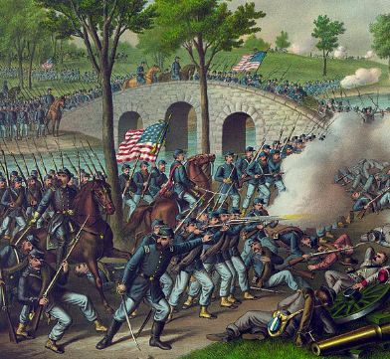
Antietam (1862 CE)
The Battle of Antietam occurred on September 17, 1862, at Antietam Creek near Sharpsburg, Maryland.
It pitted Confederate General Robert E Lee's Army of Northern Virginia against Union General George McClellan's Army of the Potomac.
It was the culmination of Lee's attempt to invade the north.
The battle's outcome would be vital to shaping America's future, and it remains the deadliest one-day battle in all of American military history.
By mid-summer 1862, President Abraham Lincoln had the Emancipation Proclamation—a document declaring freedom for all enslaved people in the so-called rebellious states—ready to go.
Lincoln's cabinet feared releasing the Emancipation Proclamation at that time would seem desperate and be difficult to enforce, so Lincoln decided to wait until another decisive Union victory.
Frustrated with Lincoln's policies and the war's course, Democrats launched an anti-war campaign, hoping to take over the U.S. House of Representatives.

Slide 12
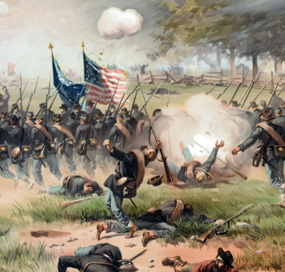
Antietam (1862 CE)
General Robert E Lee also recognized dissent among Lincoln's ranks and hoped a battle victory on Union land might topple Lincoln's congressional support and help secure the Confederacy.
After Lee thwarted the plan of General George B McClellan to lay siege to Richmond—the capital of the Confederate States of America—in the Peninsula Campaign in the spring and summer of 1862, McClellan retreated.
Hoping to take advantage of the Union's low morale and seeming ineptitude, Lee chose to push his army north across the Potomac and into Maryland, where they soon occupied the town of Frederick.
After the Confederates abandoned their campsite around Frederick, McClellan's army moved in.
On September 13, two Union soldiers, Private Barton W. Mitchell and Sergeant John M Bloss discovered a copy of Special Order 191 with detailed Confederate troop movements, allegedly wrapped around three cigars.
And when Lee heard a copy of Special Order 191 was missing, he knew his scattered army was vulnerable and rushed to reunite its units.

Slide 13
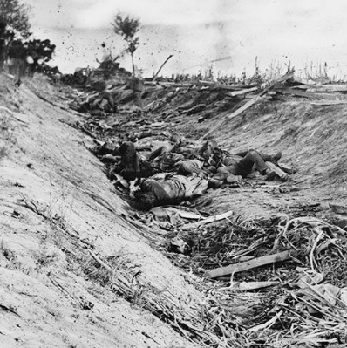
Antietam (1862 CE)
On September 14, at the base of South Mountain near Sharpsburg, Confederate Generals DH Hill's and James Longstreet's units encountered Union resistance and sustained heavy casualties.
Lee planned to retreat to Virginia but changed his mind after hearing Confederate General Thomas Jonathan Jackson—better known as Stonewall Jackson—had captured Harper's Ferry.
The Battle of Antietam began at dawn on September 17 as the fog lifted.
Longstreet's and Hill's units formed the Confederate right and center flanks west of Antietam Creek, while Jackson's and Brigadier General John G Walker's units formed the Confederate left side.
All of Lee's troops were worn out and hungry, and many were sick.
Union forces outnumbered Confederates by two to one, although McClellan thought Lee's forces were much more significant.

Slide 14
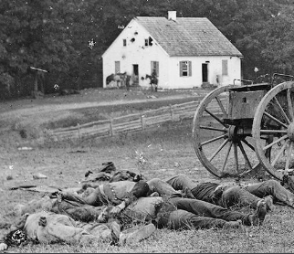
Antietam (1862 CE)
Troops from both sides faced off across a 30-acre cornfield. Confederate troops ferociously fought off offensive after offensive to prevent being overrun, turning the cornfield into a massive killing field. Just eight hours in, there were over 15,000 casualties.
Near the center of the battlefield, another site of slaughter was a farm lane known as the "Sunken Road," where Hill's division of approximately 2,600 men had piled fence rails along the road's embankment to fortify their position against Union Major General William H French's 5,500 approaching troops.
When the French's troops arrived, fighting ensued at close range. Three hours later, Union troops had pushed the Confederates back, and over 5,000 men were either dead or injured.
The action was so gory Sunken Road earned a new name: Bloody Lane.
For more than three hours, fewer than 500 Confederate soldiers held Lower Bridge against multiple assaults by Union General Ambrose Burnside's Ninth Corps.
After Burnside's troops finally took the bridge and had the Confederate right flank in sight, Confederate reinforcements arrived and pushed them back.

Slide 15
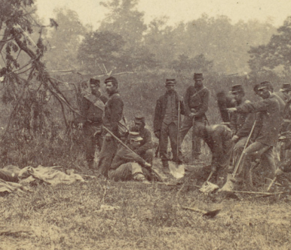
Antietam (1862 CE)
As night fell, thousands of bodies littered the Antietam battlefield, and both sides regrouped and claimed their dead and wounded.
Just twelve hours of intense and often close-range fighting with muskets and cannons had resulted in around 23,000 casualties, including an estimated 3,650 dead.
The next day, as Lee began the painstaking job of moving his ravaged troops back to Virginia, McClellan, surprisingly, did nothing.
Despite having the advantage, he allowed Lee to retreat without resistance.
President Lincoln, however, was displeased. He thought McClellan missed an excellent opportunity to kick the Army of Northern Virginia while they were down and potentially end the war.
After the war-weary general repeatedly refused Lincoln's orders to pursue Lee's retreating troops, Lincoln removed McClellan from command on November 5, 1862.
The Union claimed victory. And keeping Confederates in their southern box enabled President Lincoln to release his Emancipation Proclamation on September 22, 1862, finally.
The Union's claim of victory at Antietam and Lincoln's Emancipation Proclamation is thought to be why Republicans held the House in the 1862 mid-term elections.

Slide 16
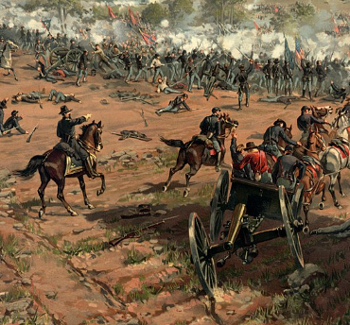
Gettysburg (1863 CE)
The Battle of Gettysburg marked the turning point of the Civil War. With more than 50,000 estimated casualties, the three-day engagement was the bloodiest single battle of the conflict.
Gettysburg ended Confederate General Robert E Lee's ambitious second quest to invade the North and bring the Civil War to a swift end.
The loss there dashed the hopes of the Confederate States of America to become an independent nation.
After a year of defensive victories in Virginia, Lee's objective was to win a battle north of the Mason-Dixon line in the hopes of forcing a negotiated end to the fighting.
Instead, the defeated general fled south with a wagon train of wounded soldiers straining toward the Potomac.
Union general Meade failed to pursue the retreating army, missing a critical opportunity to trap Lee and force a Confederate surrender.
Early that morning, a Confederate division under Major General Henry Heth marched toward Gettysburg to seize supplies.

Slide 17
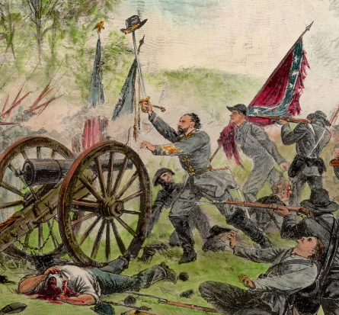
Gettysburg (1863 CE)
In an unplanned engagement, they confront Union cavalry.
Brigadier General John Buford slows the Confederate advance until the infantry of the Union I and XI Corps under Major General John F Reynolds arrives. Reynolds is killed in action.
Soon, Confederate reinforcements under generals A P Hill and Richard Ewell reach the scene.
By late afternoon, the wool-clad troops are battling ferociously in the sweltering heat.
Thirty thousand Confederates overwhelm 20,000 Federals, who fall back through Gettysburg and fortify Cemetery Hill south of town.
On the second day of battle, the Union defends a fishhook-shaped range of hills and ridges south of Gettysburg.
The Confederates wrap around the Union position in a long line.

Slide 18
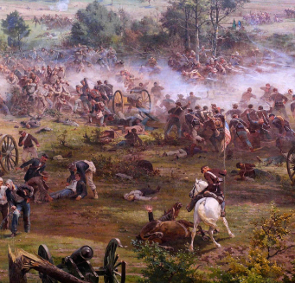
Gettysburg (1863 CE)
That afternoon Lee launched a heavy assault commanded by Lieutenant General James Longstreet on the Union left flank.
Fierce fighting rages at Devil's Den, Little Round Top, the Wheatfield, the Peach Orchard, and Cemetery Ridge as Longstreet's men close in on the Union position.
Using their shorter interior lines, Union II Corps commander Major General Winfield S Hancock and others move reinforcements quickly to blunt Confederate advances.
On the Federal right, Confederate demonstrations escalated into full-scale assaults on East Cemetery Hill and Culp's Hill.
Although the Confederates gain ground on both ends of their line, the Union defenders hold strong positions as darkness falls.
Believing his enemy to be weakened, Lee seeks to capitalize on the previous day's gains with renewed attacks on the Union line.
Heavy fighting resumes on Culp's Hill as Union troops attempt to recapture ground lost on the last day. Cavalry battles flare to the east and south.
Still, the main event is a dramatic infantry assault by 12,500 Confederates commanded by Longstreet against the center of the Union position on Cemetery Ridge.

Slide 19
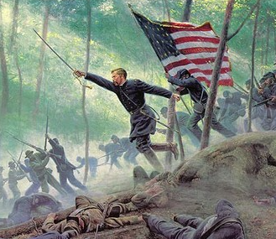
Gettysburg (1863 CE)
Though understaffed, the Virginia infantry division of Brigadier General George E Pickett constitutes about half of the attacking force.
Pickett, ordered by Lee to advance his division toward the enemy through a mile of unprotected farmland, replies, "General, I have no division," but the order stands.
During Pickett's Charge, as it is famously known, only one Confederate brigade temporarily reaches the top of the ridge—afterward referred to as the High Watermark of the Confederacy.
This daring strategy ultimately proves a disastrous sacrifice for the Confederates, with casualties approaching 60 percent.
They are repulsed by close-range Union rifle and artillery fire, and the Confederates retreat.
Lee withdraws his army from Gettysburg late on the rainy afternoon of July 4 and limps back to Virginia with severely reduced ranks of wasted and battle-scarred men.

Slide 20
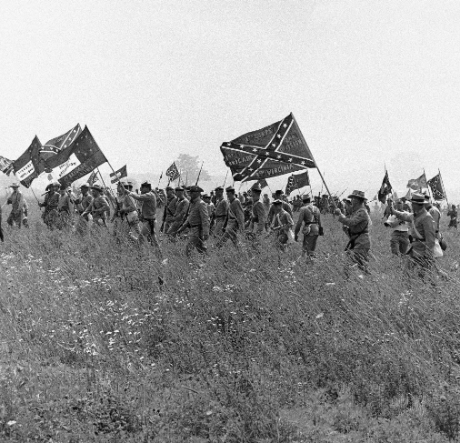
Gettysburg (1863 CE)
As many as 51,000 soldiers from both armies were killed, wounded, captured, or missing in the three-day battle.
The carnage is overwhelming, but the Union victory buoys Lincoln's hopes of ending the war.
With Lee running South, Lincoln expected that Meade would intercept the Confederate troops and force their surrender.
Meade has no such plan. Even as Lee's escape is hampered by flooding on the Potomac, Meade does not pursue them.
When Lincoln learns of this missed opportunity on July 12, he laments, "We had only to stretch forth our hands & they were ours."
Months later, in November 1863, a portion of the Gettysburg battlefield became a final resting place for the Union dead.

Slide 21
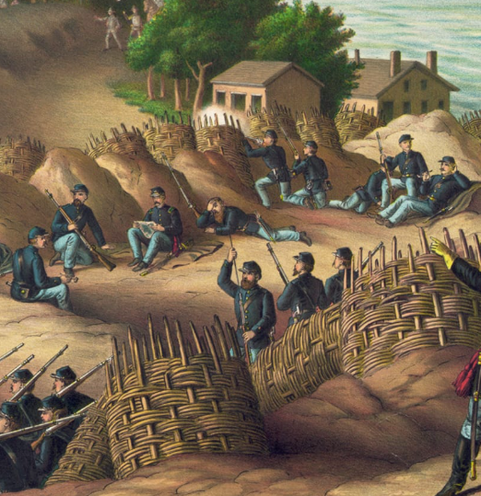
Vicksburg (1863 CE)
The Battle of Vicksburg, Mississippi was the culmination of a long land and naval campaign by Union forces to capture a key strategic position during the American Civil War.
President Abraham Lincoln recognized the significance of the town situated on a 200-foot bluff above the Mississippi River.
On May 19, Grant ordered Sherman's corps to attack along the Graveyard Road northeast of town, hoping for a quick victory over a defeated foe.
Pemberton, the engineer, had developed a series of solid works around Vicksburg, and the Federals were repulsed by the defenders of Stockade Redan, suffering 1,000 casualties.
Three days later, Union leaders made coordinated assaults: Sherman along the Graveyard Road, Major General James McPherson hitting the center from the Jackson Road, and Major General John McClernand attacking from the south along the lines of the Baldwin Ferry Road and the Southern Railroad of Mississippi.
Although McClernand's men briefly penetrated what was called the Railroad Redoubt, all three columns were repulsed, with a total loss of over 3,000 men.

Slide 22
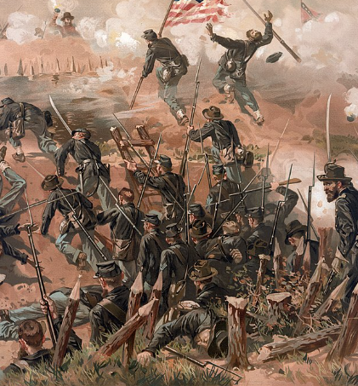
Vicksburg (1863 CE)
These losses and the substantial Confederate defensive works convinced Grant to take the town by siege, cutting it off from all supplies.
Reinforced to over 70,000 strong, for weeks, his men dug trenches that zigged and zagged but steadily brought them closer to Pemberton's positions.
One group tunneled underneath the Third Louisiana Redan, named for its defenders, and on June 25 detonated barrels of black powder that blasted a hole in the works.
Union soldiers surged into the breach only to be met by a counterattack.
Desperate hand-to-hand fighting ensued for hours before the attackers were driven out.
That same day, Joe Johnston finally sent a relief force from reoccupied Jackson toward Vicksburg, but it was too late and did not play a role in the fighting.
Inside Vicksburg, civilians huddled in caves to avoid the cannon shells being fired daily from Grant's artillery around the town and the guns on the fleet in the river.

Slide 23
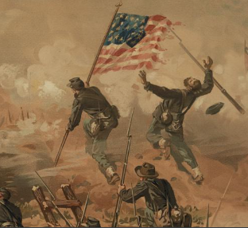
Vicksburg (1863 CE)
Rebels had cut off food and other supplies from outside for a month and a half.
Horses, dogs, cats, and reportedly even rats became part of the diet for soldiers and civilians alike.
On July 3, Pemberton rode out to discuss surrender terms with Grant.
Although he had been dubbed "Unconditional Surrender" Grant after his demands to the garrison at Tennessee's Fort Donelson the previous year, the Union commander agreed to parole Pemberton's men.
The following day, July 4, Confederate soldiers began marching out and stacking their guns.
Despite the prolonged shelling they'd endured, the Confederates' losses during the siege had been light. Some 29,500 surrendered.
With the fall of Confederate Gibraltar, the last remaining Southern stronghold on the Mississippi, Port Hudson, also capitulated.

Slide 24
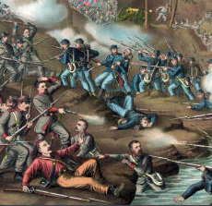
Vicksburg (1863 CE)
That same July 4, Robert E Lee's army was retreating toward Virginia after defeating in the Battle of Gettysburg; Helena, Arkansas, fell to Union forces; and General William S. Rosecrans forced the Confederate Army of Tennessee to withdraw from the Middle Tennessee area to Chattanooga, just north of the Georgia state line.
The Confederacy had been divided east and west.
Pemberton found the Confederate government was no longer willing to entrust him with the high command, and, remarkably, he resigned his commission and attempted to re-enlist as a private.
Southern president Jefferson Davis commissioned him as a lieutenant colonel of artillery instead.
Joseph Johnston briefly attempted to hold Jackson, but the Federals reoccupied it.
The destruction there was so complete that it became known as "Chimneyville—virtually all that was left.

Slide 25
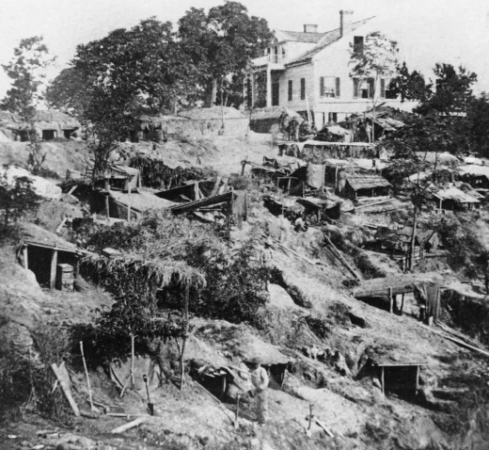
Vicksburg (1863 CE)
Johnston would lead the Army of Tennessee during most of the Atlanta Campaign and again following the Southern debacle at Franklin and Nashville in the winter of 1864.
He surrendered his army to Sherman near Bentonville, North Carolina, days after Robert E Lee surrendered the Army of Northern Virginia.
Grant's reputation as a fighter who won tough battles was cemented at Vicksburg, and by the following summer, he would be in command of all Union armies in the field. He came to regret his decision to parole the Vicksburg garrison, however.
Most of its men re-enlisted without being exchanged for Union prisoners, as was the custom, putting thousands more rifles back into the Southern ranks.
As a result, Grant would virtually halt prisoner exchanges when he was promoted to command all armies, a decision that perhaps shortened the war but also condemned thousands of prisoners north and south to prolonged incarceration and death in the unsanitary conditions of overcrowded prisoner of war camps.

Slide 26
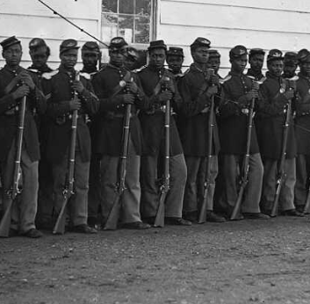
African Americans and the Civil War
Tens of thousands of enslaved African Americans of all ages escaped to Union lines for freedom.
Contraband camps were set up in some areas, where blacks started discovering to read and write. Others traversed with the Union Army.
By the War's end, more than 180,000 African Americans, mainly from the South, battled with the Union Army and Navy as US Colored Troops and sailors.
Contraband was typically used in the United States military during the American Civil War to define a new status for individual escaped enslaved people or those affiliated with Union forces.
They used many laborers to sustain Union efforts and soon began to pay them earnings. The formerly enslaved people set up camps near Union forces, and the Army permitted support and educate adults and children among the refugees.
Thousands of men from these camps enlisted in the United States Colored Troops when recruitment started in 1863.

Slide 27
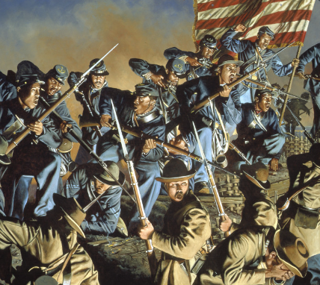
African Americans and the Civil War
At War's end, more than 100 contraband camps existed in the South, including the Freedmen's Colony of Roanoke Island, where 3500 formerly enslaved people operated to develop an autonomous society.
The status of Southern-owned enslaved people after Confederate states had engaged in the American Civil War became an issue early in 1861, not long after hostilities began.
At Fort Monroe in Virginia's Hampton Roads, Major General Benjamin Butler, commander, learned that three enslaved people had made their way across Hampton Roads harbor from Confederate-occupied Norfolk County and delivered themselves at Union-held Fort Monroe.
General Butler declined to return the fled enslaved people to slaveholders who defended the Confederacy.
This amounted to categorizing them as "contraband," although another officer's first use of that terminology in military records appears to have been.
The three enslaved people, Frank Baker, James Townsend, and Sheppard Mallory, had been leased by their masters to the Confederate Army to help construct defense batteries at Sewell's Point, across the mouth of Hampton Roads from the Union-held Fort Monroe.
They escaped at night and rowed a boat to Old Point Comfort, pursuing asylum at Fort Monroe.

Slide 28
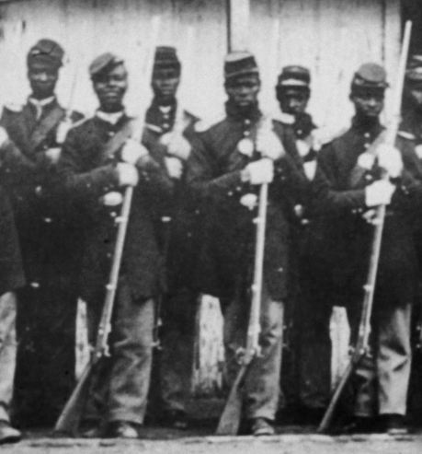
African Americans and the Civil War
Before the War, the owners of the enslaved people would have been legally entitled to request their return and likely would have done so under the federal 1850 Fugitive Slave Act.
But Virginia had announced that it no longer was part of the United States. General Butler, familiarized as an attorney, believed that if Virginia thought itself a foreign power to the US, he was under no duty to return the three men; he would hold them as contraband of War.
Butler denied the request when Confederate Major John B Cary demanded their return.
Because the practice virtually acknowledged the seceded states as foreign entities, President Abraham Lincoln disapproved of it.
General Butler did not pay the escaped slaves wages for work they began to embark on, and he continued to refer to them as enslaved people.
On September 25, 1861, the Secretary of the Navy Gideon Welles administered to give persons of color in the hire of the Union Navy pay at the rate of $10 per month and a full day's ration.
Three weeks later, the Union Army followed suit, paying male "contrabands" at Fort Monroe $8 a month and females $4, distinctive to that command.

Slide 29
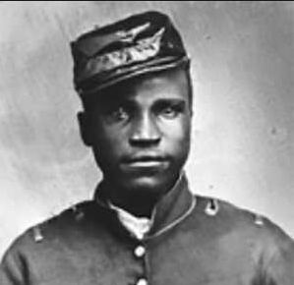
African Americans and the Civil War
In August, the US Congress passed the Confiscation Act of 1861, which declared that any property used by the Confederate military, including enslaved people, could be seized by Union forces.
The following March, its Act Prohibiting the Return of Slaves prohibited returning enslaved people to Confederate enslavers or the military.
The word spread fast among southeastern Virginia's slave societies. While becoming a "contraband" did not mean total autonomy, many enslaved people believed it a step.
After Butler's conclusion, many more escaped enslaved people found their way to Fort Monroe and pleaded to become contraband.
As the number of formerly enslaved people grew too large to be accommodated inside the fort, the contrabands pitched housing outside the congested base from the burned ruins of the City of Hampton.
They called their new settlement Grand Contraband Camp. By the end of the War in April 1865, less than four years later, a calculated 10,000 escaped enslaved people had applied to gain "contraband" status, with many living nearby.
Across the South, Union forces managed more than 100 contraband camps, although not all were as large. From a base on Roanoke Island that started in 1862, Horace James formed the Freedmen's Colony of Roanoke Island.
Established by the Union Army, James was a Congregational chaplain who, with the freedmen, tried to create a self-sufficient colony on the island.

Slide 30
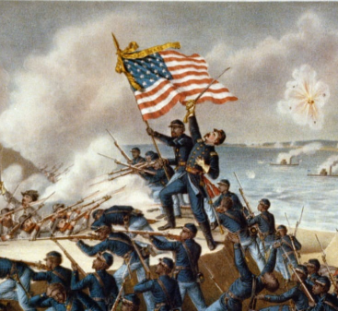
African Americans and the Civil War
Near Fort Monroe, but beyond its protective walls, the pioneering teacher Mary S Peake taught adult and child contrabands to read and write.
She was the first black teacher employed by the American Missionary Association, sending multiple Northern white teachers to the South to teach.
This area of Elizabeth City County later became part of the campus of Hampton University, a historically black college.
Defying a Virginia law against educating enslaved people, Peake and other teachers held classes outdoors under a large oak tree.
In 1863, President Lincoln read the Emancipation Proclamation to the contrabands and free blacks there, for which the tree was named the Emancipation Oak.
For most contrabands, total emancipation did not occur until the Thirteenth Amendment to the United States Constitution repealing slavery was confirmed in late 1865.
On July 18, 1863, The Second Battle of Fort Wagner began when the 54th Regiment Massachusetts Volunteer Infantry, an African American military unit led by white Colonel Robert Gould Shaw, attacked a Confederate fort at Morris Island, South Carolina.

Slide 31
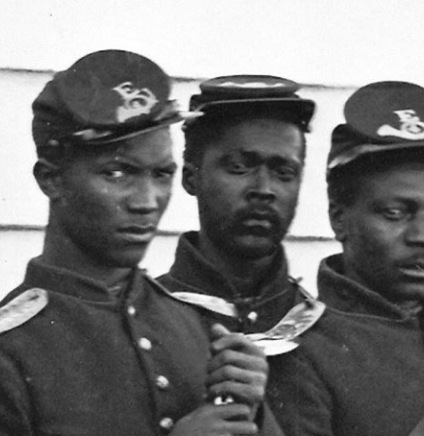
African Americans and the Civil War
The attack on Fort Wagner by the 54th Regiment Massachusetts Volunteer Infantry failed to take the defense, and Gould was slain in the battle.
However, the Confederates relinquished the fort on September 7, 1863, after many could not stand the continuous weeks of bombardment and the smell of dead Union black soldiers sickening them.
About 1,515 Union soldiers were killed, caught, or wounded in the assault of July 18, although this number has never been accurately documented.
General Hagood, the commander of Fort Wagner on the morning of July 19, stated in his report to General P G T Beauregard that he buried 800 bodies in mass graves in front of Wagner.
Only 315 men were left from the 54th after the battle. Thirty were killed in action, including Colonel Shaw and Captains Russel and Simpkins, and buried together in a single grave.

Slide 32
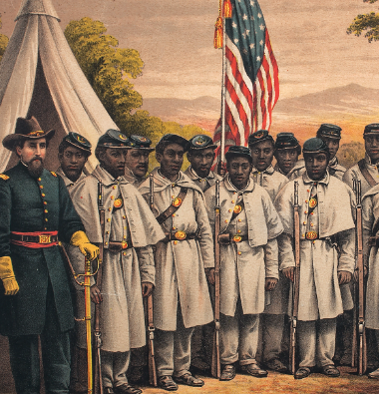
African Americans and the Civil War
Twenty-four later died of wounds, fifteen were captured, and fifty-two were reported missing after the battle and never seen again.
The men of the 54th Massachusetts were hailed for their bravery.
William Carney, an African American sergeant with the 54th, is considered the first black recipient of the Medal of Honor for his actions that day in retrieving and returning the unit's US Flag to Union lines.
Their conduct enhanced the prominence of African Americans as soldiers, leading to greater Union recruitment of African Americans, which boosted the Northern states' numerical advantage.
In addition, the South recognized for the first time that captured African American soldiers were to be treated as enemy combatants and not prisoners.
Confederate casualties numbered 174. A portrayal of the battle is the climax of the 1989 film Glory.

Slide 33
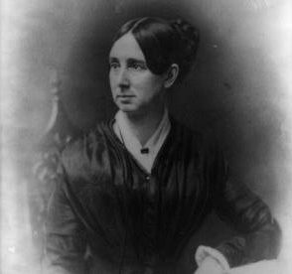
Women and the Civil War
At the start, southern women supported men going off to war. They saw the men as guardians and imbued laboriously in the utopian idea of men fighting to protect the integrity of their land, household, and way of life.
Mothers and wives could reach their loved ones who had chosen to enlist by writing them letters.
On the other hand, African American women had encountered the breakup of families for years and were again dealing with this matter at the outburst of war.
During the American Civil War, Dorothea Dix served as the Union's Superintendent of Female Nurses.
She led all-female nurses working in army hospitals, which were over 3,000 nurses.
Dix set policies for nurse candidates.
Enlistees were to be aged 35 to 50 and plain-looking.

Slide 34
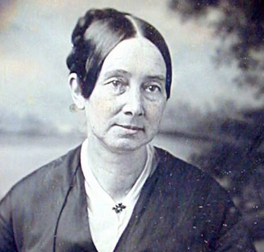
Women and the Civil War
They had to wear unhooped black or brown dresses with no jewelry or cosmetics.
Dix wanted to bypass dispatching vulnerable, beautiful young women into the hospitals, where she worried the men would manipulate them.
Dix often fired volunteer nurses she hadn't personally prepared or hired.
At odds with Army doctors, Dix feuded with them over managing medical facilities and hiring and dismissing nurses.
Many doctors and surgeons did not want any female nurses in their hospitals.
To solve the dilemma, the War Department introduced Order Number 351 in October 1863.
It gave the Surgeon General and the Superintendent of Army Nurses the power to appoint female nurses.
As superintendent, Dix directed the Federal army nursing program, in which over 3,000 women would ultimately serve.

Slide 35
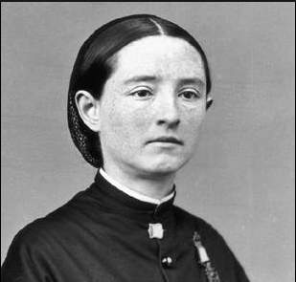
Women and the Civil War
On April 2, 1863, in the Confederate capital of Richmond, Virginia, about 5,000 people, mostly poor women, smashed into shops and began taking food, clothing, shoes, and even jewelry before the militia arrived to restore order.
Tens of thousands of dollars worth of items were looted. No one died, and a few were wounded.
The riot was arranged and prompted by Mary Jackson, a peddler and the mother of a soldier.
President Jefferson Davis implored the women and even threw them money from his pockets, asking them to dissipate.
The mayor read the Riot Act; the governor called out the militia and restored order.
The work practices of privileged white women modified radically after the Civil War. Women over 50 changed least, insisting they needed servants and resuming their formal administrative roles.
The next generation, containing the young wives and mothers during the Civil War, relied much less on black servants and displayed greater flexibility toward household work.

Slide 36
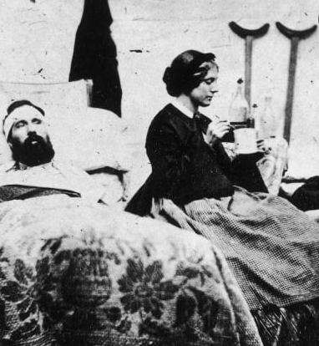
Women and the Civil War
The youngest generation, which matured during the war and Reconstruction, did many of their domestic duties.
Some sought paid jobs outside the household, especially teaching, which allowed an escape from household assignments and coerced marriage.
About 250,000 Southern soldiers never came home, or 30% of all white men aged 18 to 40 in 1860.
Widows who were devastated often deserted the farm and integrated into the households of relatives or even became refugees living in camps with high rates of disease and death.
They were an "old maid" who unsettled the women and their families of the Old South.
Now it has become almost a benchmark. Some women received the liberty of not having to marry.
Divorce, while never entirely tolerated, became more common. The "New Woman" notion appeared—she was self-sufficient and autonomous and stood in sharp distinction from the "Southern Belle" of antebellum myth.

Slide 37
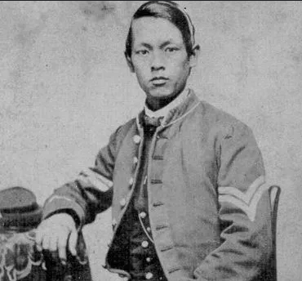
Asian Americans and the Civil War
Approximately 70 Chinese and Filipinos enlisted in the Union Army and Navy during the American Civil War.
Smaller numbers serve in the armed forces of the Confederate States of America.
Of those who did, only a handful received the honor of their pension, benefits, or citizenship service.
An anomaly was Ching Lee, who took the alias Thomas Sylvanus and served in the 81st Pennsylvania Regiment.
Thomas Sylvanus, a citizen of Hong Kong, was a highly decorated veteran of the Civil War.
He was the only Chinese soldier to draw a Civil War pension. Little is known about Sylvanus's early life or parentage.
Born on July 4, 1845, in Hong Kong, he was known in his youth as Aw Yee Way.

Slide 38
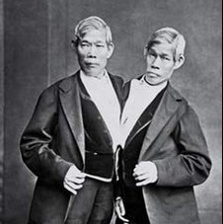
Asian Americans and the Civil War
Chang and Eng Bunker were Siamese American conjoined twin brothers whose fame drove the phrase "Siamese twins" to become interchangeable with conjoined twins.
They were widely displayed as novelties and were two of the nineteenth century's most studied human beings.
In today's Thailand, the brothers were born of Chinese ancestry and were brought to the United States in 1829.
Physicians examined them as they became known to American and European audiences in freak shows.
In early exhibitions, they appeared exotic and portrayed their athleticism; later, they would converse in English in a more distinguished parlor setting.
Newspapers and the public were originally compassionate to them, and within three years, they left the control of their managers, who they thought were defrauding them, and traveled on their own.
The twins quit touring in 1839 after a decade of financial success and settled near Mount Airy, North Carolina.

Slide 39
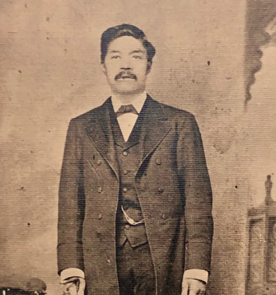
Asian Americans and the Civil War
They became American citizens, married local sisters, and bought enslaved people.
They fathered 21 children, several of whom chaperoned them once they continued touring. Chang's and Eng's families lived in two separate houses, taking alternating three-day stays.
The twins became wealthy businessmen but lost part of their wealth and enslaved people after the Civil War.
They died at age 62, and an autopsy indicated that their livers were fused in the ligament, joining their sternums.
Christopher Wren Bunker and his brother Stephen Bunker, Chang, and Eng Bunker’s eldest sons joined different Confederate cavalry units.
During the Civil War, the North Carolina's Bunker family backed the Confederacy, including giving Confederate soldiers medical aid.
In 1864, Christopher Wren Bunker was captured and sent to Camp Chase.

Slide 40
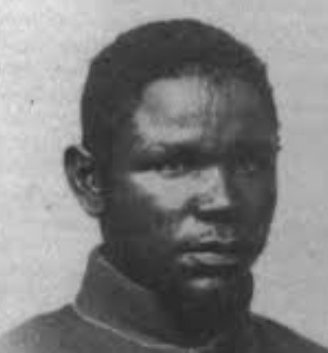
Muslims and the Civil War
While many minority groups have acknowledged their contributions and achievements during the Civil War, one group of Americans has received little attention.
Muslim Americans are rarely the focus of Civil War scholars and are typically viewed as a demographic relevant only to more modern history.
It has been theorized that as many as 292 Muslim last names appear in muster rolls. Further, as many as 15% of enslaved Africans brought to America are thought to have practiced Islam.
Massachusetts Senator Charles Sumner—famous for his caning on the Senate floor at the hands of South Carolina Senator Preston Brookes—even quoted the Qur'an on several occurrences during his orations bashing slavery.
Estimations varying from a dozen to two hundred and ninety-two Muslims served in the Union military during the American Civil War, including Private Mohammad Khan.

Slide 41
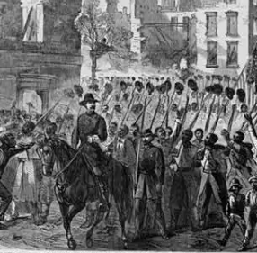
Muslims and the Civil War
During the American Civil War, the "scorched earth" policy of the North destroyed churches, farms, schools, libraries, colleges, and many other properties.
The libraries at the University of Alabama managed to save one book from the debris of their library buildings.
On the morning of April 4, 1865, when Federal troops reached the campus with an order to eradicate the university, Andre Deloffre, a modern language professor and caretaker of the library, pleaded to the commanding officer to spare one of the finest libraries in the South.
The officer, being compassionate, sent a courier to General Croxton at his headquarters in Tuscaloosa asking permission to save the Rotunda, but the general refused to allow this.
The officer said, "I will save one volume as a memento of this occasion.“
The volume chosen was a rare copy of the Qur'an.

Slide 42
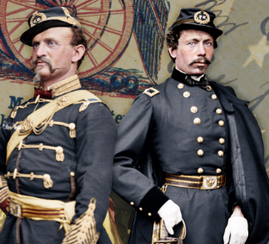
Jews and the Civil War
Roughly 3,000 Jews fought on the Confederate side during the American Civil War, and 7,000 fought on the Union side.
Jews also played leadership roles on both sides, with nine Jewish generals serving in the Union Army.
The Civil War split Jews as it did all Americans.
Southern Jews backed the Confederacy; Northern Jews preferred the Union. Before the war, Jews never took a general mindset on slavery.
Although many shared antislavery opinions, they viewed the Christian-oriented abolitionist movement with suspicion.
Thousands of Jews volunteered, and many died on both sides of the conflict.
An estimate placed the number in the Union forces at about 8,400 and in the Confederate forces at about 10,000.
Six Jewish soldiers in the Union army received the coveted Congressional Medal of Honor for their bravery.

Slide 43
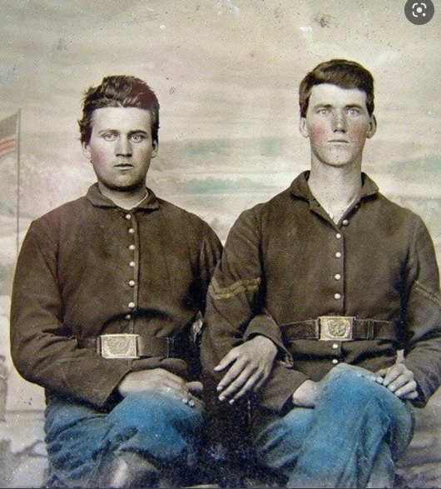
Homosexuals and the Civil War
Civil War historians have argued about the number of gay and lesbian service members during the war.
Some would say that none were dishonorably discharged – although there is a record of three pairs of Navy sailors court-martialed for improper and indecent intercourse with each other.
The Richmond Dispatch reported on May 13, 1862, that since the moving of the Confederacy's capital to Richmond that "loose males of the most abandoned character from other parts of the Confederacy" had moved to Richmond, and "prostitutes of both sexes" openly exhibited themselves in carriages and on sidewalks.
Before the Don't Ask, Don't Tell policy, gay service members were discharged under "honorable conditions" called "Fraudulent Enlistment.“
who were gay service members and who weren't in the American Civil War is a tricky question since the words "homosexual" and "heterosexual" weren't part of the American dictionary until thirty years after the war ended.
Regardless, not having a word like "homosexual" during the Civil War to describe same-sex attraction among soldiers does not nullify its use to define them today.

Slide 44
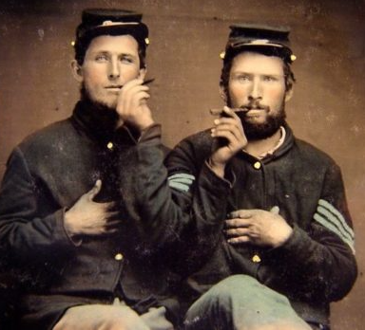
Homosexuals and the Civil War
Using archival records such as court-martial and medical documents, newspaper articles, pornographic books and cards, and letters and diaries of the soldiers, historians focus on addressing the issue of prostitution – straight and gay – and why both the Union and Confederate Armies had to work to stop sexually transmitted infections from disabling their soldiers because sickness was costing more in soldier's health and lives than action on the battlefield.
Men outnumber women, particularly at social events like dances, drummer boys – children as young as nine and ten years old, dressed in drag.
One historian references a ball by a Massachusetts regiment stationed in Virginia in 1864 about young drummer boys dressed as women.
Alphons Richter was a German immigrant, a volunteer in the 56th New York Infantry, a decorated Civil War hero, and a man who formed an intimate relationship with another man.
Richter's bravery under fire was impressive, and he was quickly elevated to lieutenant.

Slide 45
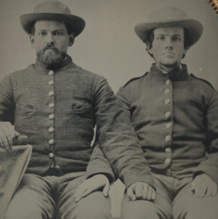
Homosexuals and the Civil War
Richter and Carl Becker praised one another in letters home to their respective families. Their relationship lasted until after the war. The two men journeyed to California together.
They had a falling out over money; Richter eventually married a sharecropper's daughter and farmed to supplement his Civil War pension.
Romantic friendships are one way of understanding these relationships between two same-sex friends, which are often unclear.
It includes a wide range, from nonphysical affection to genuine romantic connections.
Since homosexuality was forbidden and outlawed, men who would now identify as gay or bisexual were not often capable of openly communicating or fully comprehending those emotions.

Slide 46
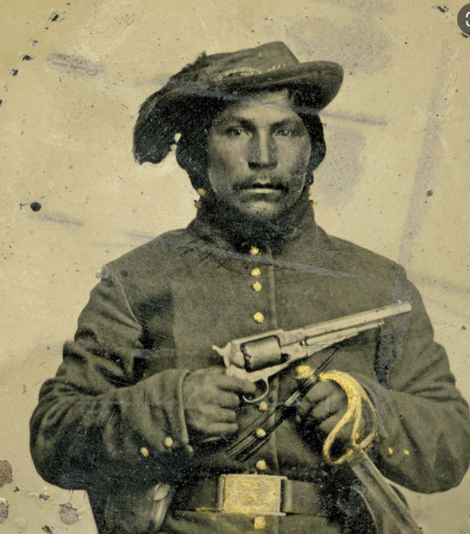
Native Americans and the Civil War
The American Civil War spilled over into Indian Territory; it profoundly divided tribal nations, societies, and households on the western frontier of the war.
A calculated 20,000 Indian soldiers partook in the conflict, fighting for both sides.
At the onset of the war, many nations in the Indian Territory signed treaties with the Confederacy—backed by a minority of wealthy slave-holding Indians within their communities.
But that compassion wasn't monolithic: Many Indians leaned toward abolitionism and supported sovereign autonomy.
As the war advanced, the impetus shifted as three Indian Home Guard regiments appeared to support the Union and defend vulnerable tribal communities from violent guerrilla warfare.
While Native American soldiers went to battle for various reasons—to support or fight slavery, defend tribal autonomy, and protect family and community—the war did little to promote their needs and interests.

Slide 47
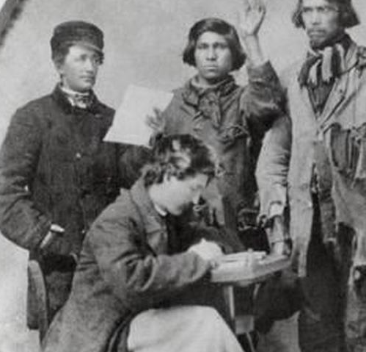
Native Americans and the Civil War
Instead, it deepened longstanding inner tribal strains and devastated the Territory the US government had resettled them to decades earlier, creating a new wave of destitute refugees.
When the Civil War broke out in 1861, Indian Territory encompassed most of the area now populated by the state of Oklahoma.
Ancestral home to tribal nations including Osage, Quapaw, Seneca, and Shawnee, it had also become the mandated home for the Cherokee, Creek, Choctaw, Chickasaw, and Seminole nations.
Between 1830 and 1850, those groups had been forcibly expelled from their ancestral lands in the Southeast and marched hundreds of miles west by the US government.
The relocation, later known as the Trail of Tears, killed thousands.
The Cherokee Nation, politically divided since that turbulent period, demonstrated how tribal nations were further torn apart by the war.

Slide 48
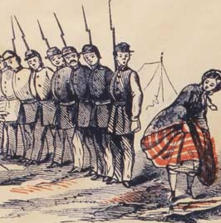
Sex and the Civil War
At camp, "barracks favorites" were available. These were cheap novels of a sexual nature.
Photographs of nudity were also available and bought by both enlisted men and officers.
These twelve-by-fifteen-inch pictures cost $1.20 for a dozen or ten cents for a single image.
These were usually pictures of nude women doing innocent things; naked women engaging in actual sexual activity were usually not white but either black or Native American.
With the soldiers being far away from their wives and sweethearts, it is assumed that these were used for masturbation, not just amusement.
Only three of the novels are still known to exist; they are located at the Kinsey Institute of Indiana University.
Prostitutes were among the camp followers tailing behind marching troops.

Slide 49
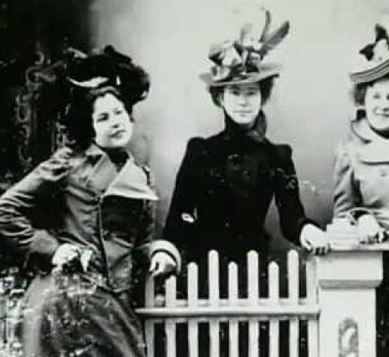
Sex and the Civil War
Popular myth has it that they were so common around the Army of the Potomac when Union general Joseph Hooker was in command that the term "hooker" was coined to describe them; however, the term had been in use since 1845.
The number of prostitutes around Hooker's division only "cemented" the word.
This led to many cases of venereal disease.
There were 74,000 syphilis cases among white Union soldiers and 110,000 gonorrhea cases.
The total rate of venereal disease among the white Union troops was 82 cases per 1000 men, whereas before and after the war, the rate was 87 per 1000. Union black troops, however, had rates of 34 per 1000 for syphilis and 44 per 1000 for gonorrhea.
Cases were most noticeable around larger cities like Nashville, New Orleans, Richmond, and Washington, DC. Numbers for Confederates are unspecified but are considered less due to Confederate soldiers being less likely to be in cities.
Prostitution underwent its most substantial growth during the war.
Some historians have guessed that this growth can be attributed to a recession and the need for women to sustain themselves and their families while their husbands were away at war. Other historians believed the evolution of prostitution led to the women desiring to spread venereal disease to the opposing troops.

Slide 50
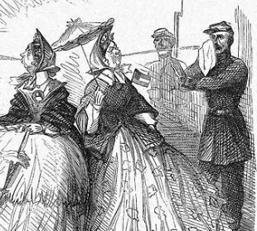
Sex and the Civil War
The term "public women" was coined for the women that became prostitutes.
There was moral rage at this rising career, and law officials categorized the people they arrested as such.
In 1864, there were 450 brothels in Washington and over 75 brothels in nearby Alexandria, Virginia.
A newspaper calculated there were 5000 public women in the district and another 2500 in Alexandria and Georgetown, carrying the total to 7500 by the war's third year.
Regardless, the towns were located outside the camps where prostitution was most noticeable.
These small towns were overspread by the sex trade when army troops set up nearby headquarters.
One soldier wrote to his wife, "It is said that one house in every ten is a bawdy house—it is a perfect Sodom."

Slide 51
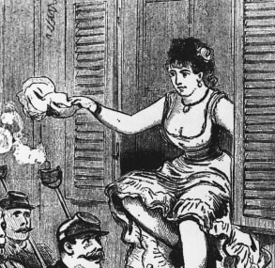
Sex and the Civil War
Before the outbreak of the war, Nashville recorded 207 prostitutes; however, in 1863, reports claimed to have at least 1500 prostitutes.
The area where these prostitutes could be found was Smokey Row. In a notorious campaign to rid the city of the "public women," Lieutenant Colonel George Spalding loaded the women onto the steamboat Idaho.
Officials sent the women to Louisville, where they were not permitted off the ship, and to Cincinnati. Many women became sick due to a lack of food and were forced to turn around and return to Nashville.
Once they arrived back in Nashville, Lieutenant Colonel Spalding made a registration system like European ones. He inadvertently built the first legal system of prostitution.
This is the set of regulations he set up:
A license is given to each prostitute, a record of which was to be kept at this office, together with the number and street of their residence.
That one expert surgeon be selected as a board of examination whose duty it was to be to examine personally, every week, each licensed prostitute, giving certificate wellness to those who were healthy and ordering into hospital those who were in the slightest degree diseased.
That a building appropriate for a hospital for the invalids was to be taken for that goal and that a weekly tax of fifty cents was to be charged on each prostitute to defray the hospital's expense.
That all public women found plying their vocation without a license and certificate were to be at once apprehended and detained in the workhouse for not less than thirty days.
Prostitution encountered significant expansion and spread across the North and South and was one of the few industries to cross enemy lines throughout the war.

Slide 52
Sex and the Civil War
The Confederate records were destroyed, but a perusal of only five percent of Federal records reveals that over thirty court-martial trials were held due to examples of rape, hanging, or firing squad being the usual punishment if condemned.
Occasionally, offering money for sex to a white woman of good standing was considered almost equivalent to rape; in the case of an Illinois private at Camp Dennison, for instance, the perpetrator spent a month at the guardhouse for offering a mother a dollar and her daughter three dollars for sex.
Federal troops who committed rape while invading the Southern states mostly took advantage of black rather than white women. Black soldiers were usually disciplined more harshly for the crime than their white counterparts.
Even so, the fear of rape was ubiquitous among white Southern women facing the possibility of invasion without male defense.
Nevertheless, the exact numbers of victims are hard to trace, and the threat of sexual violence committed by Union soldiers stayed in Southern cultural memory long after the war ended.
On 24 April 1863, Union President Abraham Lincoln signed the Lieber Code, which amongst other things, included one of the first explicit prohibitions on rape.
Paragraphs 44 and 47 of the Lieber Code contained provisions prohibiting several crimes, including 'all rape by an American soldier in a hostile country against its inhabitants under the penalty of death, or such severe punishment as may seem adequate for the gravity of the offense.’
Thus, the only enforcement mechanisms were the military commanders themselves, having the right to execute the soldiers instantly.

Slide 53
Food and the Civil War
During the Civil War, inexperience was the primary culinary concern for the North and the South.
Men of this time were familiarized with the women of the house or enslaved women preparing the food.
For a male army soldier, cooking was an unfamiliar concept.
Thrust into the gloomy reality of war, soldiers were compelled to adjust to a new way of life and eat on the battleground.
In the early stages of the war, the Union soldiers of the North profited from oversight by the United States Sanitary Commission.
Typically known as The Sanitary, it prioritized the soldiers’ health and nourishment.
Even before the start of the war, volunteers in The Sanitary were trained to find and disperse food to soldiers stationed in the field.

Slide 54
Food and the Civil War
They were expected to determine which foods were available each season and how to preserve food items for transportation and storage.
The Sanitary was burdened with schedule and maintaining a constant food supply to soldiers at war.
They had to make do with the food they were given, called rations. Food was not always easy to get because of the war.
Most soldiers were pleased to get food frequently, even if it was the same.
The most common food given to soldiers was bread, coffee, and salt pork.
The typical ration for every Union soldier was about a pound of meat and a pound of bread or flour.
The Confederacy started following the same rules.
The Union blocked southern ports and railroads, which made getting food to Confederate soldiers difficult.

Slide 55
Food and the Civil War
Confederate soldiers were more likely to get cornbread or cornmeal than flour or bread. Corn was a local crop and easier to get.
The primary bread for most Union troops was hardtack. It is made of only flour and water and looks much like a cracker.
It does not rot fast. Lore said that some of the hardtack used during the Civil War was left over from the Mexican American War.
Sometimes, the hardtack might have worms or weevils in it.
The soldiers made do by boiling it in coffee. The weevils floated to the top, and the soldiers scraped them off. This made hardtack more flavorful and solved the bug issue.
Coffee was integral to troops. It gave the soldiers energy after long days of working or marching. It was also the safest thing to drink.

Slide 56
Food and the Civil War
Insufficient drinking water made many people sick.
More soldiers died from disease than battle. They were boiling the water to make coffee killing the bacteria that made them sick. Most soldiers didn’t know about germs and bacteria, but they saw that drinking coffee was scrumptious and safe.
Because the Union blocked imports to the Confederacy, they didn’t always have coffee.
Confederate soldiers made do by boiling a flower root called chicory and other plants they could find to create a warm drink.
Salt pork was the most common meat ration. It was like bacon and held by using a lot of salt. Salt pork was even saltier.
They had to scrape the salt off and soak it in water or partially boil it first to make it palatable.
Soldiers could save the leftover salt for later to season another meal.
Troops sometimes received additional rations like beans, rice, sugar, and dried vegetables or fruit.
Troops on both sides scoured for fresh food from homes and farms.
Some officers also bought food for their company if they were able. But mainly, living on hardtack, coffee, and pork was not very nutritional.
Many soldiers got scurvy, an illness caused by not getting enough vitamins.

Slide 57
Food and the Civil War
Despite this, soldiers got innovative.
They came up with different recipes that used the same ingredients.
Several recipes were printed in military handbooks to help soldiers find variety.
They made stews with hardtack, which would thicken the soup.
If they had it, soldiers used flour to create several things.
They made gravy with leftover grease from cooking meat.
One drummer boy wrote about wrapping dough made of flour and water around his bayonet and cooking it over the fire.
By summer 1861, the Union naval blockade effectively shut down the export of cotton and the import of manufactured goods.
Food that formerly came overland was cut off.

Slide 58
Food and the Civil War
The households were severely hurt by inflation in the cost of everyday items, food shortages, fodder for the animals, and medical supplies for the injured.
But food shortages only deepened, particularly in the towns.
The overall reduction in food supplies, made worse by the collapsing transportation system, leading to severe droughts and high prices in urban areas.
When bacon reached a dollar a pound in 1863, the poor women of Richmond, Atlanta, and many other cities began to riot; they broke into shops and warehouses to seize food.
The women were angry at inefficient state relief efforts, speculators, merchants, and planters.
As wives and widows of soldiers, they were hurt by the flawed welfare system.

Slide 59
Medicine and the Civil War
As was customary in the 19th century, more soldiers died of disease in the Civil War than in battle.
Injuries, illness, and mishaps temporarily hindered even more significant numbers.
The war dramatically affected American medicine, from surgical procedures to hospitals to nursing and research facilities.
Conditions were poor in the Confederacy, where doctors and medical supplies were in short supply.
The hygiene of the training and field camps was inadequate, particularly at the beginning of the war when men who had seldom been far from home being brought together for training with thousands of strangers.
First came epidemics of the childhood diseases of chickenpox, mumps, whooping cough, and, specifically, measles.

Slide 60
Medicine and the Civil War
Operations in the South meant an unsafe new disease environment, carrying diarrhea, dysentery, typhoid fever, and malaria.
The surgeons prescribed coffee, and whiskey.
Harsh weather, bad water, insufficient shelter in winter quarters, poor sanitation within the camps, and dirty camp hospitals took their toll.
This was a common scenario in wars, and the conditions faced by the Confederate Army were even worse.
The Union answered by building army hospitals in every state.
The emergence of skilled, well-funded medical organizers who took aggressive action was unlike in the Union, particularly in the much-enlarged United States Army Medical Department and the United States Sanitary Commission, a new private agency

Slide 61
Medicine and the Civil War
Other new agencies also targeted soldiers' medical and moral needs, including the United States Christian Commission and smaller private agencies such as the Women's Central Association of Relief for Sick and Wounded in the Army
Systematic funding appeals grew public consciousness, as well as millions of dollars. Thousands of volunteers worked in hospitals and rest homes, most famously poet Walt Whitman.
The Sanitary Commission gathered tremendous amounts of statistical data and opened the problems of storing information for fast access and mechanically searching for data patterns.
The pioneer was John Shaw Billings. A senior surgeon in the war, Billings built the Library of the Surgeon General's Office.
Billings figured out how to mechanically examine medical and demographic data by turning it into numbers and punching them onto cardboard cards as developed by his assistant Herman Hollerith, the origin of the computer punch card system that dominated statistical data manipulation until the 1970s

Slide 62
Opium
Opium is a dried, sappy substance harvested from the opioid poppy seed pod.
In its raw form, it had long been observed as a powerful pain reliever, and several of its component alkaloid substances—which include morphine and codeine—would ultimately serve as building blocks for the synthesis of many household drugs, including those for diarrhea, insomnia, bronchitis, and psychosis.
By 1858, 300,000 pounds of opium came to America each year.
Historians record that the American Civil War was the turning point for widespread misuse of opiates.
Opium-based drugs, including morphine, provided powerful relief for veterans suffering from physical pain and mental illness.
Doctors and nurses used opium and morphine to treat soldiers’ pain, stop internal bleeding and mitigate vomiting and diarrhea induced by infectious diseases.
However, this led some soldiers to develop opioid dependences, either during the war or after seeking medical treatment for wartime injuries or illnesses.

Slide 63
Opium
Before the Civil War, doctors prescribed opium pills and laudanum, a mixture of opium and alcohol.
These opiates, or natural opioids, were available in many drugstores without a prescription.
When the war began, the Union and the Confederacy considered it essential to stock their hospitals with drugs.
A Confederate medical handbook said, “Opium is the indispensable drug on the battlefield—important to the surgeon, as gunpowder to the ordnance.”
In addition to opium and laudanum, some Union doctors started using the hypodermic syringe, a relative invention, to inject another opioid—morphine—straight into soldiers’ veins.
These doctors realized that this invention that hadn’t been used widely in the US could now be a godsend in hospitals because it delivers morphine immediately.

Slide 64
Opium
Injectable morphine provided quicker relief than opium pills and laudanum but was more likely to lead to addiction.
In addition to soldiers, Civil War doctors took opioids to treat infectious diseases and deal with the stress of working in army hospitals, leading them to develop addictions before and after the war.
A Union surgeon named JM Richards would later recall how he had developed chronic diarrhea during the war and at last resorted to frequent doses of morphine as the only sure means of controlling the difficulty.
Notably, Black veterans mainly did not develop an opioid addiction, owing to differences in medical care provided to Black and white men.
Black soldiers have systematically been declined the same medical care that white soldiers received.
When veterans returned home after the war, they persisted in taking opium and injectable morphine, which became more available in the 1870s.
The Civil War helped “mainstream” the use of the hypodermic syringe.

Slide 65
Opium
Doctors who used it during the war taught their colleagues about injectable morphine, leading more doctors to prescribe it to veterans and other patients after the war.
Companies took notice and began selling injectable morphine straight to customers.
By the 1870s, virtually every American physician had a hypodermic syringe.
By all accounts, that was the primary driver of the significant increase in opiate addiction in the 1870s, 1880s, and early 1890s.
You can get syringes and morphine quickly; you could even buy them through the mail at Sears and Roebuck, the department store.
Later, the Sears and Roebuck catalog also sold heroin.
The availability of injectable morphine led to a full-fledged opioid addiction crisis by the 1880s.

Slide 66
Robert E. Lee
Born to Revolutionary War hero Henry "Light-Horse Harry" Lee in Stratford Hall, Virginia, Robert Edward Lee seemed fated for military distinction.
Despite financial trouble that caused his father to depart to the West Indies, young Robert ensured an appointment to the United States Military Academy at West Point, where he graduated second in the class of 1829.
Two years later, he married Mary Anna Randolph Custis, a descendant of George Washington's adopted son, John Parke Custis.
Yet, with all his military pedigree, Lee had not set foot on a battlefield.
Instead, he served seventeen years as an officer in the Corps of Engineers, managing and examining the construction of the nation's coastal defenses.
Service during the 1846 war with Mexico. As a member of General Winfield Scott's staff, Lee distinguished himself, emerging from the conflict with the rank of colonel.

Slide 67
Robert E. Lee
From 1852 to 1855, Lee served as superintendent of West Point and was therefore accountable for educating many of the men who would later serve under him - and those who would fight him - on the battlefields of the Civil War.
In 1855, he left the academy to take a position in the cavalry and, in 1859, was called upon to put down abolitionist John Brown's raid at Harpers Ferry.
Because of his prominence as one of the best officers in the United States Army, Abraham Lincoln offered Lee control of the Federal forces in April 1861.
Lee rejected the offer and quit the army when Virginia seceded on April 17, arguing that he could not fight against his people. Instead, he accepted a general's commission in the newly formed Confederate Army.
His first military engagement of the Civil War occurred at Cheat Mountain on September 11, 1861. It was a Union victory, but Lee's stature withstood public objection.
He served as military advisor to President Jefferson Davis until June 1862, when he was given command of the wounded General Joseph E. Johnston's embattled army on the Virginia peninsula.

Slide 68
Robert E. Lee
Lee renamed his command the Army of Northern Virginia, and under his direction, it would become the most famous and successful of the Confederate armies.
Yet despite foiling several attempts to seize the Confederate capital, Lee recognized that the key to ultimate success was a victory on Northern soil.
In September 1862, he launched an invasion into Maryland with the hope of shifting the war's focus away from Virginia.
But when a misplaced dispatch outlining the invasion plan was discovered by Union commander George McClellan the element of surprise was lost, and the two armies faced off at the battle of Antietam.
Though his plans were no longer a secret, Lee nevertheless managed to fight McClellan to a stalemate on September 17, 1862.
Following the bloodiest one-day battle of the war, heavy casualties compelled Lee to withdraw under cover of night.
The attack known as Pickett's charge was a failure, and Lee, realizing that the South lost the battle, ordered his army to retreat.

Slide 69
Robert E. Lee
Taking full blame for the defeat, he wrote Jefferson Davis offering his resignation, which Davis refused to accept.
He recognized that the end of the Confederacy was only a matter of time.
By the summer of 1864, the Confederates had been forced into waging trench warfare outside of Petersburg.
Though President Davis named the Virginian General-in-Chief of all Confederate forces in February 1865, only two months later, on April 9, 1865, Lee was forced to surrender his tired and exhausted army to Grant at Appomattox Court House, effectively ending the Civil War.
Lee returned home on parole and ultimately became the president of Washington College in Virginia.
He remained in this position until his death on October 12, 1870, in Lexington, Virginia.

Slide 70
Ulysses S. Grant
Born Hiram Ulysses Grant in Point Pleasant, Ohio, his name changed due to a clerical error during his first days at the United States Military Academy at West Point.
Yet despite his less-than-exemplary school record, he served well as a captain during the Mexican War, winning two citations for gallantry and one for meritorious conduct.
Only when the fighting stopped and Grant was assigned tedious tasks at remote posts far from his wife and family did he again begin ignoring his work and drinking heavily.
He resigned in 1854 to avoid being removed from the service.
Grant spent the next six years in St. Louis, Missouri, with his wife, Julia Dent Grant. After several short-lived pursuits, including a brief episode as a farmer, he moved to Galena, Illinois, to be a clerk in his family's store.
When the Civil War began in 1861, he jumped at the chance to volunteer for military service in the Union army. His first command was as the colonel of the 21st Illinois Infantry.
His 1862 victories at Fort Henry and Fort Donelson in western Tennessee won him the nickname "Unconditional Surrender" Grant and placed him before the public eye.

Slide 71
Ulysses S. Grant
In March 1864, President Lincoln elevated Grant to the rank of lieutenant general and named him general-in-chief of the Armies of the United States.
Making his headquarters with the Army of the Potomac, Grant was determined to destroy Robert E. Lee and his Army of Northern Virginia at any cost.
Though plagued by unwilling subordinates, petty disputes between generals, and horrendous casualties, the Union forces smacked down Lee
The battles of the Wilderness, Spotsylvania, Cold Harbor, and the following siege of Petersburg effectively obliterated the rebel army, leading to the fall of Richmond and Lee's surrender at Appomattox Court House.
Though Grant's forces had been depleted by more than half during the last year of the War, Lee surrendered in 1865.

Slide 72
Ulysses S. Grant
After the Civil War, President Andrew Johnson named Grant Secretary of War over the newly reunited nation.
In 1868, running against Johnson, Ulysses S. Grant was elected the eighteenth President of the United States.
Unfortunately, though innocent of graft himself, Grant's administration was riddled with corruption and scandal.
To make up for some of his losses, he wrote about his war adventures for Century Magazine.
They proved so popular that he was inspired to write his remarkable autobiography, Personal Memoirs of U.S. Grant.
He finished the two-volume set only a few days before dying of cancer at sixty-three.
Ulysses S. Grant is buried in New York City in the largest mausoleum of its kind in the United States.

Slide 73
George B. McClellan
George McClellan is one of those generals who looks great on paper. McClellan was a great organizer, a West Point-trained engineer who did much to build the Union army almost from scratch.
His work as an observer during the Crimean War gave him insight into the significance of logistics for an industrialized army.
Years spent as the chief of engineering for the Illinois Central Railroad made him aware of the transformative nature of rail transport.
"Little Mac" would be a fantastic organizer who kept his army well supplied, efficiently run, and satisfied.
He was also quite gifted at overvaluing the size of his opponents' armies.
But he was too conservative by nature.
Despite Lincoln's pleas for aggressive action, his Army of the Potomac moved hesitantly.

Slide 74
George B. McClellan
Its commander McClellan persuaded himself that the Southern armies sizably outnumbered him when logic should have told him that it was the North that enjoyed a surplus of resources.
Men and materials the Union could provide its armies.
But there was something that not even New York and Chicago factories could produce, and that was time.
As Lincoln knew, the only way the Union could lose the war was if the North eventually grew tired and agreed to allow the South to secede.
Haste risked casualties and defeats at the hands of a tough opponent like Robert E. Lee and his Army of Northern Virginia.
The alternative was to split the United States apart.
Because he never wanted to face a superior force, he refused to fight.

Slide 75
George B. McClellan
This is a troubling quality when one's title as general-in-chief of the entire Union army.
After months of inaction, McClellan was finally provoked to action by Pres. Abraham Lincoln.
In the early stages of the conflict, troops under McClellan's command scored several vital victories in the struggle for western Virginia.
Lincoln summoned "Young Napoleon," as some called the general, to Washington, D.C., to take control of the Army of the Potomac a few days after its humiliating defeat at the Battle of First Bull Run, Virginia, in July 1861.
Over the next nine months, McClellan capably built a strong army, drilling his troops and making an efficient command structure.
However, he also showed extreme disdain for the president and often ignored Lincoln's suggestions.
McClellan staged an amazing amphibious landing of more than 100,000 troops at Fort Monroe, at the southeast end of the peninsula between the James and York rivers.

Slide 76
George B. McClellan
In stereotypically McClellan fashion, he was promptly checked by a vastly inferior force under John Bankhead Magruder.
Although he outnumbered Magruder's Army of the Peninsula 10-to-1, McClellan settled in for a monthlong siege.
By the end of May 1862, Confederate commanding Gen. Joseph E. Johnston had withdrawn his forces to Richmond, and McClellan was close enough to the Confederate capital to hear its church bells ringing
.Johnston was wounded on the first day of the Battle of Seven Pines, six miles east of Richmond, and Robert E. Lee replaced him
Lee immediately caught McClellan's demeanor, and, during the Seven Days Battles, Lee drove back the Union armies from Richmond's doorstep.
Lincoln relieved McClellan but reinstated him after the devastating Union defeat at the Second Battle of Bull Run.
Once again, McClellan worked his administrative magic, reviving the morale of a shattered Union army.

Slide 77
George B. McClellan
And once again, at the Battle of Antietam, McClellan's terminal case of "the slows" (as Lincoln called it) stopped the exploitation of possible war-ending exposure in Confederate defenses.
On September 17, 1862, McClellan and Lee battled to a halt along Antietam Creek near Sharpsburg, Maryland.
Lee retreated to Virginia, and McClellan dismissed Lincoln's surging to pursue him.
Lincoln and McClellan exchanged angry messages for six weeks, but McClellan stubbornly declined to march after Lee.
In late October, McClellan finally began moving across the Potomac in feeble pursuit of Lee, but he took nine days to complete the crossing. Lincoln had seen enough.
Convinced that McClellan could never defeat Lee, Lincoln informed the general on November 5 of his removal.
A few days later, Lincoln named General Ambrose Burnside to be the commander of the Army of the Potomac.

Slide 78
George B. McClellan
Ulysses S Grant, who replaced McClellan, comprehended this.
He gritted his teeth and wore down the Confederacy with constant attacks until the South could take no more.
McClellan was a proto-Douglas MacArthur who bad-mouthed his president and commander-in-chief.
Grant left politics to the politicians and did what had to be done.
After his removal, McClellan fought with Lincoln again for the presidency in 1864.
He ran as a Democrat against Lincoln in the 1864 presidential election.
That year, a key plank in the Democratic platform was "not fighting," and McClellan lost in a rout.

Slide 79
George W. Flagg
It might not seem like it to some, but the American Civil War greatly impacted the development of the sport of wrestling.
Army camps were full of men anxious to fight, and many brought their disciplines. Styles from Ireland, England, Scotland, and Germany were brought over and clashed and mixed. Men like George Flagg honed their skills in these camps and left the Army as top-notch wrestlers.
Flagg was born in Braintree on April 9, 1839.
George Flagg was a farm boy from central Vermont.
Educated in the common schools of Braintree and Randolph Academy, he stayed upon his father's farm till the age of twenty and afterward was a day laborer till the breaking out of the civil war.
He became the Champion of Champlain Valley before joining the second Vermont Volunteer Infantry Regiment.

Slide 80
George W. Flagg
While serving in the Union Army, Flagg became the champion of the Army of Potomac.
He was at the siege of Petersburg and Richmond and the surrender of Lee at Appomattox on April 9, 1865.
He partook in the first battle of Bull Run in July 1861 and served under McClellan in the campaign before Richmond in the summer of 1862.
He was also at Antietam, at the first and second battle of Fredericksburg, at Gettysburg, and in the three of the Shenandoah Valley, Winchester, Fishers Hill, and Cedar Creek.
Early in life, he showed great aptitude for collar and elbow wrestling.
He gradually increased in skill and he was the acknowledged champion of the Army.
From the age of thirty-five to forty-eight, he traveled extensively in most northern states, giving exhibitions of his proficiency.

Slide 81
George W. Flagg
He traveled through Western New York, where he won many matches, also Ohio. He wrestled in almost every town of importance in Michigan.
In New England, he wrestled for agricultural societies, one of which was the Vermont State Fair, also on July 4th gatherings to thousands of people under great excitement.
He challenged all comers for any amount with perfect confidence in his travels.
During Flagg's wrestling career, he wrestled two hundred matches.

Slide 82
George W. Flagg
Flagg became a successful breeder, landholder, and local politician.
Flagg was called upon to serve his town in many minor offices and was elected representative to the legislature in 1886.
Flagg was very zealous for temperance, never tasting liquor and advocating the cause of temperance through speeches and daily living.
He never tasted liquor in all his travels, making speeches in the legislature on the grounds of temperance, never tiring in advocating its cause.
He continued to wrestle into his sixties, although his record did not make him one of the elite wrestlers of his day.
Flagg's last appearance was at Manchester, New Hampshire, at the dedication of the new gymnasium when he was 62 years old.

Slide 83
Robert Smalls
Robert Smalls was born on April 5, 1839, behind his owner's house in Beaufort, South Carolina.
His mother, Lydia, served in the house but grew up in the fields, where she was taken from her own family on the Sea Islands at the age of nine.
What is clear is that the owners, the McKee family, favored Robert Smalls over the other slave children, so much so that his mother worried he would reach manhood without grasping the horrors of the institution into which he was born.
She arranged for him to be sent into the fields to work and watch enslaved people at the whipping post to educate him.
This lesson led Robert to defy he frequently found himself in the Beaufort jail. If anything, Smalls' mother's plan had worked too well, so fearing for her son's safety, she asked McKee to allow Smalls to go to Charleston to be rented out to work.
By the time Smalls turned 19, he had tried his hand at several city jobs and was allowed to keep one dollar of his weekly wages.

Slide 84
Robert Smalls
To white Confederates, the Union ships blocking their harbors were another example of the North's enslavement of the South; to enslaved people like Robert Smalls, these ships signaled the tantalizing promise of freedom.
Navy commanders have been accepting runaways as contraband since September.
While Smalls couldn't afford to buy his family on shore, he knew he could win their freedom by the sea — so he told his wife to be ready whenever the opportunity dawned.
In the fall of 1861, Smalls was assigned to steer the CSS Planter, a lightly armed Confederate military transport under Charleston's District Commander Brigadier General Roswell S. Ripley.
Planter's duties were surveying waterways, laying mines, and delivering dispatches, troops, and supplies.
Smalls piloted the Planter throughout Charleston harbor and beyond, on area rivers, and along the South Carolina, Georgia, and Florida coasts.

Slide 85
Robert Smalls
Smalls and the Planter's crew could see the line of federal blockade ships in the outer harbor, seven miles away from Charleston harbor.
On May 12, 1862, the Planter traveled ten miles southwest of Charleston to stop at Coles Island, a Confederate post on the Stono River that was dismantled.
the Planter was docked at the pier below General Ripley's headquarters.
Its three white officers disembarked to spend the night ashore, leaving Smalls and the crew on board, as was their custom.
Before the officers departed, Smalls asked the Captain if the crews' families could visit, which was occasionally allowed, and be approved on the condition that they leave before curfew.

Slide 86
Robert Smalls
At about 3 am on May 13, Smalls and seven of the eight enslaved crew members made their previously planned escape to the Union blockade ships.
Smalls put on the captain's uniform and wore a straw hat similar to the captain’s.
Smalls guided the ship past the five Confederate harbor forts without incident as he gave the correct signals at checkpoints.
As the nearly-free enslaved people approached Fort Sumter, their apprehension grew.
It was the most heavily armed of the forts and tended to be manned by the most suspicious soldiers.
As the Planter approached the fort, several men urged Smalls to give it a wide berth.

Slide 87
Robert Smalls
Smalls refused, saying that such behavior would almost certainly arouse suspicion.
He slowly steered the ship along its typical path as though he were merely enjoying the early morning air in no particular hurry.
When Fort Sumter flashed the challenge signal, Smalls again gave the correct hand signs.
The fort didn't immediately respond, and Smalls now expected cannon fire to shred the Planter at any moment.
Finally, the fort signaled that all was well, and Smalls sailed out of the harbor.
Officials only raised the alarm after the ship was beyond gun range.
Rather than turn east towards Morris Island, Smalls had headed straight for the Union Navy fleet, replacing the rebel flags with a white bed sheet that his wife brought.

Slide 88
Robert Smalls
The Planter had been seen by the USS Onward, which was about to fire until a crewman spotted the white flag.
The sheet was difficult to see in the dark, but the sunrise arrived, which allowed viewing.
The Onward's captain, John Frederick Nickels, boarded the Planter, and Smalls asked for a United States flag to display.
He surrendered the Planter and its cargo to the United States Navy. Smalls' escape plan had succeeded.
Most valuable, however, was the captain's code book containing the Confederate signals and a map of the mines and torpedoes in Charleston's harbor.
Following the war, Smalls continued to push the boundaries of freedom as a first-generation black politician, serving in the South Carolina state assembly and senate, and for five nonconsecutive terms in the US House of Representatives before watching his state roll back Reconstruction in a revised 1895 constitution that stripped blacks of their voting rights.

