Slide 1
Module Thirteen: The Rest Is History
(1850 CE - 1862 CE)

Slide 2
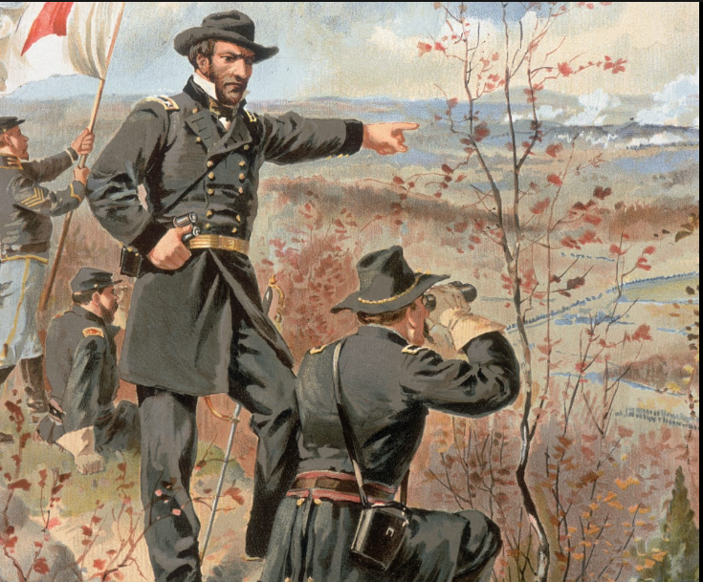
Sherman's March to the Sea (1864 CE)
From November 15 until December 21, 1864, Union General William T Sherman led some 60,000 soldiers on a 285-mile march from Atlanta to Savannah, Georgia.
Sherman's March to the Sea sought to shock Georgia's civilian population into leaving the Confederate cause.
Sherman's soldiers did not demolish any of the towns in their path, but they stole food and livestock and torched the houses and barns of people who tried to fight back.
General Sherman's troops seized Atlanta on September 2, 1864.
This was a notable victory because Atlanta was a railroad hub and the industrial center of the Confederacy: It had munitions factories, foundries, and warehouses that kept the Confederate Army equipped with food, weapons, and other goods.
It was also a sign of Confederate pride and strength, and its fall made even the most loyal Southerners question whether they could win the war.

Slide 3
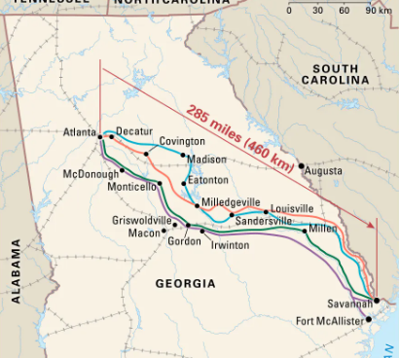
Sherman's March to the Sea (1864 CE)
Sherman thought the Confederacy stemmed its power, not from its fighting forces but from compassionate Southern whites' material and moral support.
He maintained that factories, farms, and railroads supplied Confederate troops with the needed things; if he could destroy those things, the Confederate war effort would crumble.
Meanwhile, his troops could damage Southern morale by making life so distasteful for Georgia's civilians that they would demand an end to the war.
To that end, Sherman's troops marched south toward Savannah in two wings, about 30 miles apart.
On November 22, 3,500 Confederate cavalries started a scuffle with the Union soldiers at Griswoldville, but that ended badly–650 Confederate soldiers were killed or wounded, compared to 62 Yankee casualties.
Southern troops began no more battles.

Slide 4
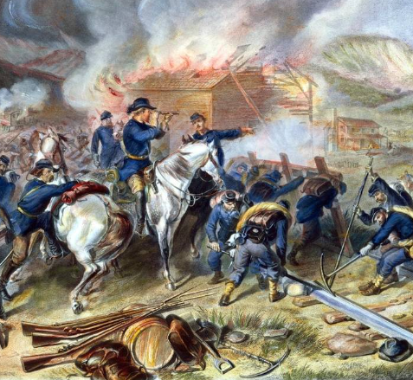
Sherman's March to the Sea (1864 CE)
Instead, they fled South ahead of Sherman's troops, wreaking havoc as they went: They destroyed bridges, chopped down trees, and burned barns filled with provisions before the Union army could reach them.
The Union soldiers were just as unsparing.
They plundered farms and plantations, stealing and butchering livestock and taking as much food as they could carry, specifically bread and potatoes.
These groups of foraging soldiers were nicknamed "bummers," They burned whatever they could not take.
Sherman's troops reached Savannah on December 21, 1864, about three weeks after leaving Atlanta. The city was unprotected when they got there.
Sherman offered the city of Savannah 25,000 bales of cotton to President Lincoln as a Christmas gift.
Early in 1865, Sherman and his men left Savannah, looting and torching their way through South Carolina to Charleston.

Slide 5
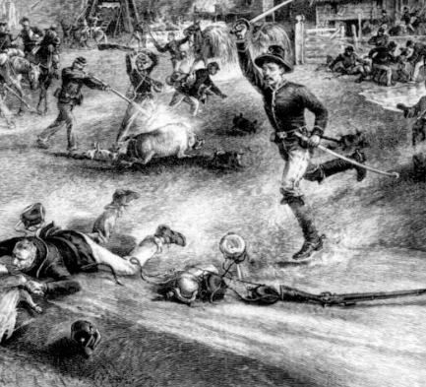
Sherman's March to the Sea (1864 CE)
In April, the Confederacy relinquished, and the war was over.
Sherman's "total war" in Georgia was fierce and damaging.
Still, it did just what it was supposed to do: it hurt Southern enthusiasm, made it inconceivable for the Confederates to fight at total capacity, and likely hastened the war's end.
Sherman calculated that the campaign had inflicted about $1.6 billion in current dollars in destruction
The Army wrecked 300 miles of railroad, numerous bridges, and miles of telegraph lines.
It seized 5,000 horses, 4,000 mules, and 13,000 head of cattle. It confiscated 9.5 million pounds of corn and 10.5 million pounds of fodder and destroyed innumerable cotton gins and mills.
He had disregarded military principles by operating deep within enemy territory and without lines of supply or communication.
Elements of the reduction in agriculture endured through 1920.

Slide 6
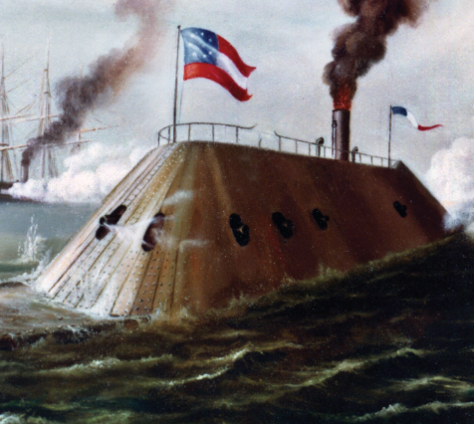
Ironclads (1862 CE)
An ironclad is a steam-propelled warship shielded by iron or steel armor plates, assembled from 1859 to the early 1890s.
The ironclad was developed due to the susceptibility of wooden warships to explosive or incendiary shells.
After the first clashes of ironclads took place in 1862 during the Civil War, it became clear that the ironclad had superseded the unarmored ship of the line as the most mighty warship afloat.
The rapid growth of warship design in the late 19th century changed the ironclad from a wooden-hulled vessel that carried sails to supplement its steam engines into the steel-built, turreted battleships and cruisers familiar in the 20th century.
This change was moved forward by the evolution of heavier naval guns, more sophisticated steam engines, and advancements in metallurgy which made steel shipbuilding conceivable.
The quick pace of change meant that many ships were outdated almost as soon as they were completed, and those naval tactics were in flux.

Slide 7
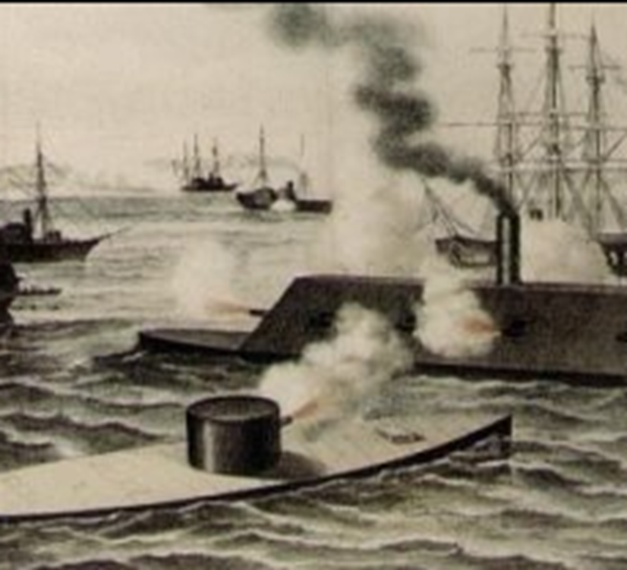
Ironclads (1862 CE)
In May 1861, the Confederate Congress appropriated $2 million for the purchase of ironclads from overseas, and in July and August 1861, the Confederacy started work on construction and converting wooden ships.
On 12 October 1861, CSS Manassas became the first ironclad to enter combat when she fought Union warships on the Mississippi during the Battle of the Head of Passes.
In February 1862, the more prominent CSS Virginia joined the Confederate Navy, having been rebuilt at Norfolk.
By this time, the Union had completed seven ironclad gunboats.
The Union also built a sizeable armored frigate, USS New Ironsides, and the smaller USS Galena
The first battle between ironclads happened on 9 March 1862, as The North deployed the armored Monitor to protect the Union's wooden fleet from the ironclad ram Virginia and other Confederate warships.
In this engagement, on the second day of the Battle of Hampton Roads, the two ironclads repeatedly tried to ram one another while shells bounced off their armor.

Slide 8
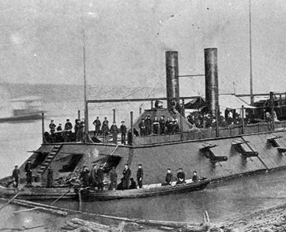
Ironclads (1862 CE)
The battle attracted attention worldwide, making it clear that the wooden warship was now out of date, with the ironclads destroying them quickly.
On the western front, the Union built a problematic force of river ironclads, beginning with several converted riverboats and then contracting engineer James Eads of Saint Louis, Missouri, to build the City-class ironclads. Builders built these excellent ships with twin engines and a central paddle wheel, all protected by an armored casement.
The Union ironclads played an integral role in the Mississippi and tributaries by providing enormous fire upon Confederate forts, installations, and vessels with relative impunity to enemy fire.
They were not as heavily armored as the ocean-going monitors of the Union, but they were acceptable for their intended use.
Torpedoes sank more Western Flotilla Union ironclads than enemy fire, and the most damaging fire for the Union ironclads was from shore installations, not Confederate vessels.

Slide 9
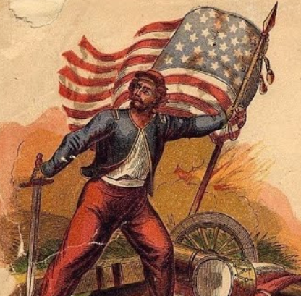
Piracy Part Four (1861 CE)
At the beginning of the American Civil War, the Confederate government sought to counter the United States Navy by appealing to private businesses worldwide to engage in privateering against United States shipping.
The seized ships and cargo fell under customary prize rules at sea.
Pirates would take prizes to the jurisdiction of a competent court, which could be in the sponsoring country or theoretically in any neutral port.
If the court found that the capture was legal, the ship and cargo would be relinquished and sold at a prize auction.
According to a contractual arrangement, the profits would be dispersed among owners and crew.
Privateers were also permitted to attack an enemy's navy warships and then apply to the sponsoring government for direct financial reward, usually gold or gold coins.
In the early days of the war, the morale of The Confederacy was high, and many ship owners reacted to the appeal by applying for letters of marque.

Slide 10
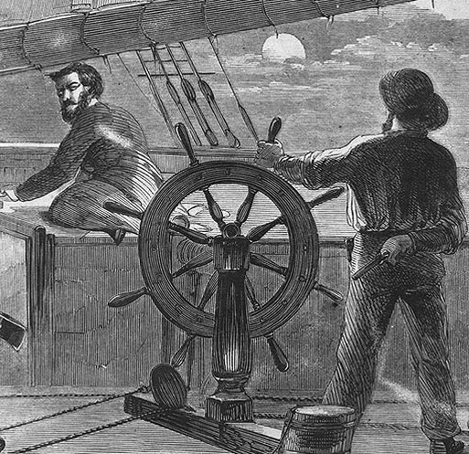
Piracy Part Four (1861 CE)
By the end of the first year of the war, the risks far surpassed the benefits in the minds of most owners and crews.
The Civil War was the last time a hostile power seriously resorted to privateering.
President Lincoln's Secretary of the Navy, Gideon Welles, ordered the Blockading Squadron to secure the primary privateering ports of the South, which was accomplished quickly by joint Army/Navy actions against Forts Hatteras and Clark at the bay to the NC Sounds, Forts Beauregard and Walker at Port Royal Sound, and Ship Island near New Orleans—all by the end of 1861, while other military efforts, that is, purely Army efforts, stalled.
Through much of the first year of the war, the government in Washington continued to regard the conflict as merely an insurrection and that the Confederate government had no legal standing.
According to the view of the Lincoln administration, the letters of marque issued by Jefferson Davis or the seceded states had no legal force, and the privateersmen who depended upon them did not symbolize a legitimate authority.
Therefore, taking merchant vessels on the high seas was piracy, with the death penalty upon conviction.

Slide 11
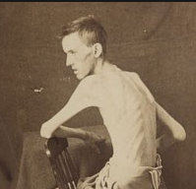
Andersonville Prison (1864 CE)
Andersonville held more prisoners at any time than the other Confederate military prisons.
It was built in early 1864 after Confederate officials determined to move many Federal prisoners in and around Richmond to a place of greater security and ample food.
During the 14 months it existed, more than 45,000 Union soldiers were imprisoned here.
Of these, nearly 13,000 died from illness, poor sanitation, malnutrition, overcrowding, or exposure to the elements.
The Confederate government could not supply sufficient housing, food, clothing, or medical care to their Federal captives because of worsening economic circumstances in the South, a poor transportation system, and the desperate need of the Confederate army for food and supplies.
The first prisoners were brought to Andersonville in late February 1864. During the next few months, approximately 400 more arrived each day.

Slide 12
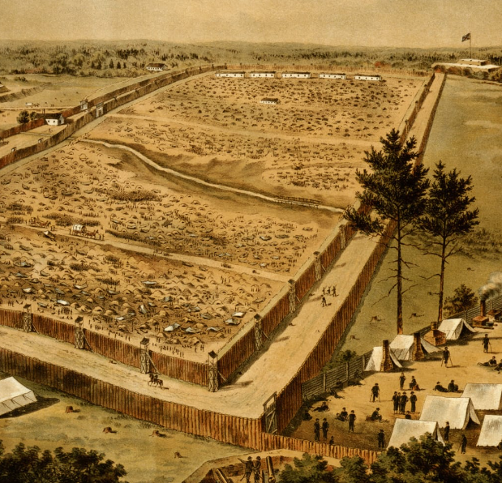
Andersonville Prison (1864 CE)
By August, 33,000 men were penned in an area initially meant for only 10,000 prisoners.
These conditions, along with a deterioration of the prisoner exchange system between the North and the South, caused much misery and a high mortality rate.
When the war finished, Captain Henry Wirz, the prison's commandant, was arrested and charged with plotting with high Confederate officials to "impair and injure the health and destroy the lives…of Federal prisoners" and "murder in violation of the laws of war."
Such a scheme never existed, but public anger and bitterness throughout the North over the conditions at Andersonville required appeasement.
Tried and found guilty by a military tribunal, Wirz was hanged in Washington, DC, on November 10, 1865. Wirz was the only person executed for war crimes during the Civil War.
Andersonville prison ceased to exist when the war ended in April 1865.

Slide 13
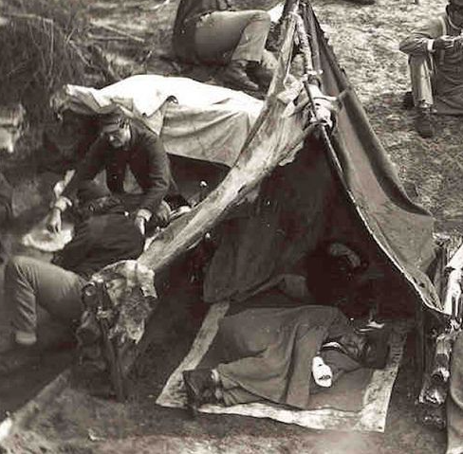
Andersonville Prison (1864 CE)
Some former prisoners stayed in Federal service, but most returned to their civilian careers before the war.
During July and August 1865, Clara Barton, a detachment of laborers and soldiers, and former prisoner Dorence Atwater came to Andersonville cemetery to remember and mark the graves of the Union dead.
As a prisoner at Andersonville, Atwater had been assigned to record the names of deceased Union soldiers for Confederate prison officials.
Fearing the loss of the death records at the war's end, Atwater made his copy of the record in hopes of informing the relatives of the more than 12,000 dead interred at Andersonville.
Thanks to Atwater's list and the Confederate death records apprehended at the war's end, only 460 of the Andersonville graves had to be labeled "Unknown US soldier."

Slide 14
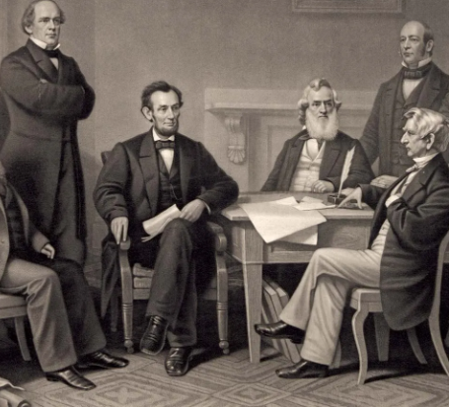
Emancipation Proclamation (1862 CE)
On September 22, 1862, President Abraham Lincoln issued the initial Emancipation Proclamation, which announced that as of January 1, 1863, all enslaved people in the states presently engaged in rebellion against the Union "shall be then, thenceforward, and forever free."
Lincoln didn't free all the roughly 4 million men, women, and children held in slavery in the United States when he signed the formal Emancipation Proclamation in January.
At the same time, however, Lincoln's cabinet pondered over the document that would become the Emancipation Proclamation.
Lincoln had written a draft in late July, and while some of his counsels defended it, others were apprehensive.
William H Seward, Lincoln's secretary of state, advised the president to wait to declare emancipation until the Union won a significant victory on the battlefield, and Lincoln took his guidance.
On September 17, 1862, Union troops suspended the advance of Confederate forces led by Gen. Robert E Lee at the Battle of Antietam.

Slide 15
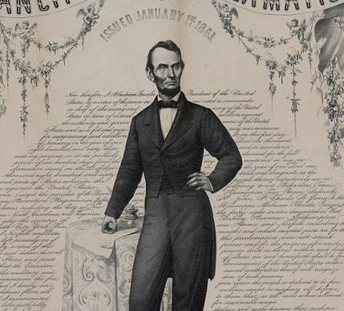
Emancipation Proclamation (1862 CE)
Days later, Lincoln went public with the preliminary Emancipation Proclamation, which called on all Confederate states to rejoin the Union within 100 days—by January 1, 1863—or their slaves would be declared "thenceforward, and forever free."
On January 1, Lincoln signed the Emancipation Proclamation, which included nothing about gradual emancipation, payment for enslavers, or Black emigration and colonization, an approach Lincoln had kept in the past.
Exempt from the Proclamation were the four border slave states and all or parts of three Confederate states controlled by the Union Army.
As Lincoln's decree applied only to territory beyond his control, the Emancipation Proclamation had little genuine effect on freeing any of the nation's enslaved people.
But its metaphoric power was tremendous, as it proclaimed freedom for enslaved people as one of the North's war aims, alongside maintaining the Union itself.
It also had practical effects: Nations like Britain and France, which had formerly believed defending the Confederacy to expand their power and influence, backed off due to their firm resistance to slavery.
Finally, the Emancipation Proclamation paved the way for the endless nullification of slavery in the United States.

Slide 16
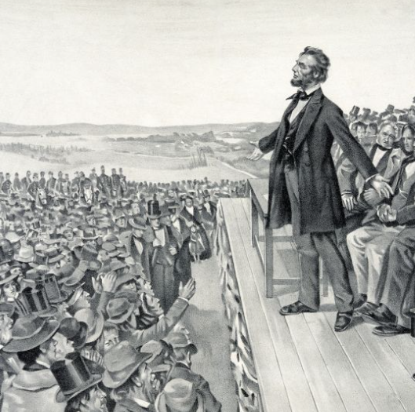
Gettysburg Address (1863 CE)
On November 19, 1863, President Abraham Lincoln gave statements, later known as the Gettysburg Address, at the official dedication ceremony for the National Cemetery of Gettysburg in Pennsylvania, on the site of one of the most bloodstained and most decisive conflicts of the Civil War.
Though he was not the featured orator that day, Americans would recognize Lincoln's brief address as one of the most influential speeches in American history.
In it, he conjured the tenets of human parity in the Declaration of Independence. He bound the sacrifices of the Civil War with the desire for "a new birth of freedom," the all-important conserving of the Union created in 1776, and its ideal of self-government.
From July 1 to July 3, 1863, the invading forces of General Robert E Lee's Confederate Army fought with the Army of the Potomac in Gettysburg,
After previous battles, thousands of Union soldiers killed at Gettysburg were quickly buried, many in poorly marked graves.
In the subsequent months, local attorney David Wills spearheaded steps to create a national cemetery at Gettysburg.

Slide 17
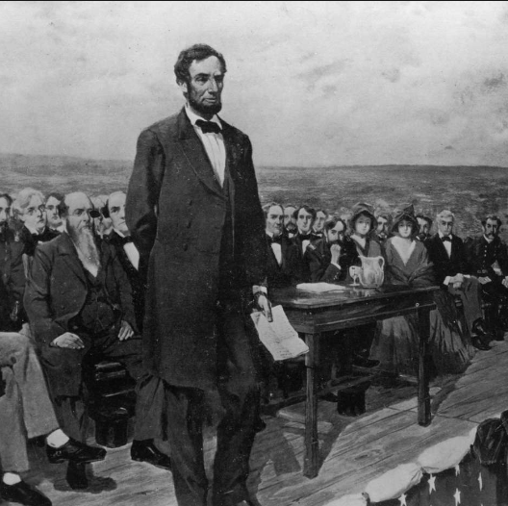
Gettysburg Address (1863 CE)
Wills and the Gettysburg Cemetery Commission initially set October 23 as the date for the cemetery's dedication.
On November 2, just weeks before the event, Wills extended an invitation to President Lincoln, asking him "formally to set apart these grounds to their sacred use by a few appropriate remarks."
When he accepted the invitation to make the comments at Gettysburg, Lincoln saw a chance to make a broad statement to the American people on the tremendous importance of the war, and he formulated it carefully.
Though long-running popular legend holds that he wrote the speech on the train while traveling to Pennsylvania, he probably wrote about half before leaving the White House on November 18.
On the morning of November 19, Lincoln rose to the podium and addressed the crowd of some 15,000 people.
He spoke for less than two minutes, and the full address was fewer than 275 words long. Beginning by summoning the image of the founding fathers and the new nation, Lincoln eloquently voiced his belief that the Civil War was the greatest trial of whether the Union built in 1776 would endure or whether it would "perish from the earth."

Slide 18
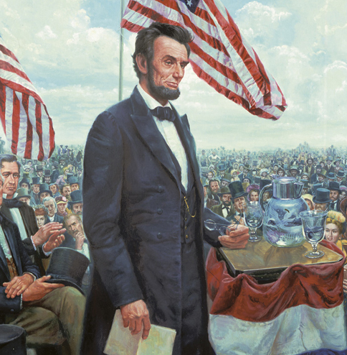
Gettysburg Address (1863 CE)
The dead at Gettysburg had laid down their lives for this noble cause, he said, and it was up to the living to confront the "great task" before them: confirming that "government of the people, by the people, for the people, shall not perish from the earth."
The primary themes and even some of the language of the Gettysburg Address were not new; Lincoln, in his July 1861 message to Congress, had referred to the United States as "a democracy–a government of the people, by the same people.“
Nevertheless, the radical facet of the speech began with Lincoln's claim that the Declaration of Independence–and not the Constitution–was the true expression of the founding fathers' intentions for their new nation.
In a revolutionary understanding at the time–but is now taken for granted–Lincoln's historic address redefined the Civil War as a struggle not just for the Union but also for the lodestar of human equality.
In the years to come, the Gettysburg Address would survive as arguably the most-quoted, most-memorized piece of bombast in American history.

Slide 19
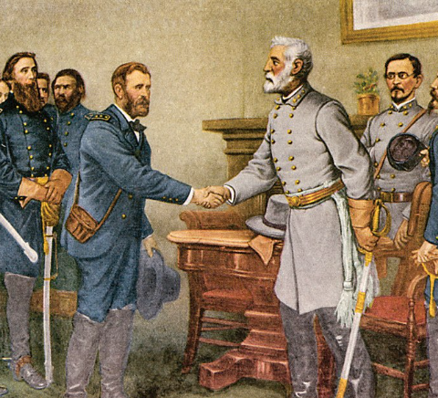
Appomattox Courthouse (1865 CE)
Lee's formal capitulation to Grant at Appomattox Court House on April 9, 1865, brought the war in Virginia to an end.
General Lee's final campaign began on March 25, 1865, with a Confederate attack on Fort Stedman.
General Grant's forces counterattacked a week later on April 1 at Five Forks, propelling Lee to leave Richmond and Petersburg the following day.
General Robert E Lee heads west along the Appomattox River, eventually arriving in Appomattox County on April 8.
His objective is the South Side Railroad at Appomattox Station, where critical food supplies have been sent up from Lynchburg.
Union cavalry under Brigadier General George A Custer reaches them first, capturing and burning three supply trains.

Slide 20
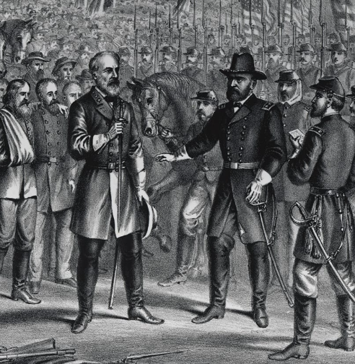
Appomattox Courthouse (1865 CE)
Aware that Lee's army was out of options, Grant had written to Lee on April 7, requesting the Confederate general's surrender.
But Lee still hopes to access more supplies further west at Lynchburg and does not capitulate.
He does, however, ask what terms Grant is offering. The two generals continue their correspondence throughout the next day.
Bowing to the inevitable, Lee orders his troops to exit through the village and back across the Appomattox River.
Small pockets of resistance continue to explode until flags of truce are sent out from the Confederate lines between 10:00 and 11:00 a.m.
Lee and Grant exchange messages and agree to meet at the Wilmer McLean home at Appomattox Court House that afternoon.
Rather than eradicate his army and sacrifice the lives of his soldiers for no purpose, Lee chose to surrender the Army of Northern Virginia.

Slide 21
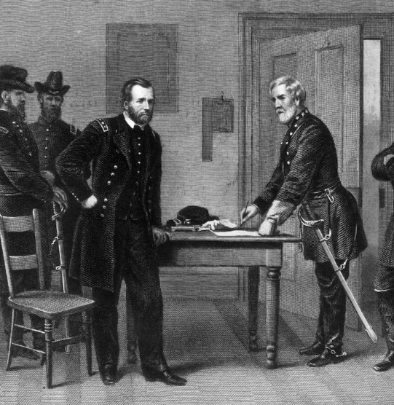
Appomattox Courthouse (1865 CE)
The Grant-Lee understanding served as a sign that the South had lost the battle and as a model for the rest of the surrendered. Three days later, a proper ceremony marked Lee's army's dispersal and his men's parole, ending the war in Virginia.
The surrender of Lee's Army of Northern Virginia sets the stage for the close of the Civil War.
Through the forgiving terms, Confederate troops are paroled and permitted to return to their homes, while Union soldiers are instructed to abstain from overt revelry or taunting.
These measures serve as a blueprint for yielding the remaining Confederate forces throughout the South.
Although the soldiers never signed a formal peace treaty, the surrender of the Confederate armies ended the war.

Slide 22
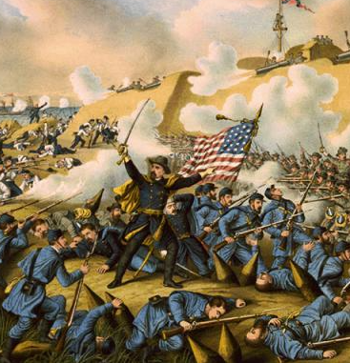
Battle of Palmito Ranch (1865 CE)
The Battle of Palmito Ranch is believed to be the final battle of the American Civil War by some measures.
Ex-Confederates fought it on May 12 and 13, 1865, on the banks of the Rio Grande east of Brownsville, Texas at the southern tip of Texas.
The battle took place more than a month after the general surrender of Confederate forces to Union forces at Appomattox Court House
Union and Confederate forces in southern Texas had been heeding an unofficial ceasefire since the beginning of 1865.
Still, Union Colonel Theodore H Barrett, newly assigned to oversee an all-black unit and never having been involved in combat, ordered an attack on a Confederate camp near Fort Brown for undisclosed reasons.
The Union attackers apprehended a few prisoners. Still, the following day the attack was repelled near Palmito Ranch by Colonel John Salmon Ford, and the battle resulted in a Confederate victory.

Slide 23
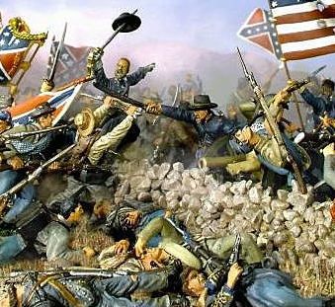
Battle of Palmito Ranch (1865 CE)
Union forces were stunned by artillery said to have been furnished by the French Army garrison occupying the up-river Mexican town of Matamoros.
Casualty estimations are unreliable, but Union Private John J Williams of the 34th Indiana Infantry Regiment is thought to have been the last man killed during the engagement and war.
Brownsville's Confederate and Union officers knew that Lee had surrendered, virtually finalizing the war.
Barrett needed horses for the 300 unmounted cavalrymen in his brigade and was determined to take them from his enemy.
Brigadier General Egbert B Brown of the US Volunteers had ordered the expedition to seize as contraband 2,000 bales of cotton stored in Brownsville and sell them for profit.
Many senior Confederate commanders in Texas and many troops with their equipment fled across the border to Mexico.

Slide 24
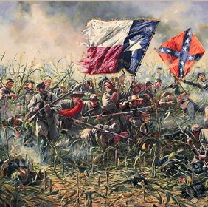
Battle of Palmito Ranch (1865 CE)
Wanting to defy capture, they may also have planned to ally with French Imperial forces or with Mexican forces under ousted President Benito Juárez.
The Military Division of the Southwest occupied Texas between June and August.
It consisted of an aggregated 50,000-man force on the Gulf Coast along the Rio Grande to pressure the French intervention in Mexico and garrison the Reconstruction Department of Texas.
In July 1865, Barrett favored charges of disobedience of orders, neglect of duty, abandoning his colors, and conduct prejudicial to good order and military discipline against Morrison for actions in the battle, resulting in the latter's court-martial.
Confederate Colonel Ford, who had returned from Mexico at the request of Union General Frederick Steele to act as parole commissioner for dissolving Confederate forces, emerged as a defense witness and helped in pardoning Morrison of accountability for the thrashing at Palmito Ranch.

Slide 25
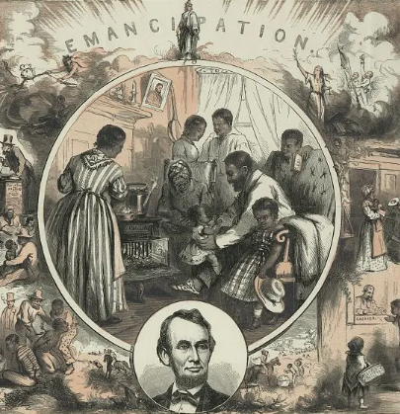
The 13th Amendment (1865 CE)
The 13th Amendment to the US Constitution, ratified in 1865 in the aftermath of the Civil War, abolished slavery in the United States.
The 13th Amendment states: “Neither slavery nor involuntary servitude, except as a punishment for the crime of which the party shall have been duly convicted, shall exist within the United States, or any place subject to their jurisdiction.”
Despite a long past of slavery in the British colonies in North America and the continued presence of slavery in America until 1865, the Amendment was the first straightforward observation of the institution of slavery in the US Constitution.
While America’s founding fathers glorified the significance of freedom and equality in the nation’s founding documents—including the Declaration of Independence and the Constitution—they failed to note slavery, which was permitted in all 13 colonies in 1776.
In April 1864, the US Senate enacted a proposed amendment banning slavery with a two-thirds majority.
But the Amendment faltered in the House of Representatives as more and more Democrats declined to support it, especially during an election year.

Slide 26
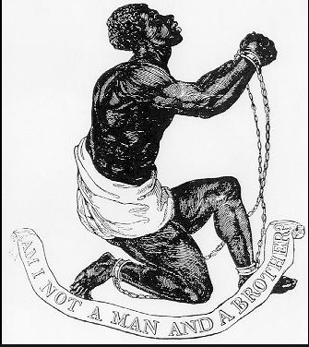
The 13th Amendment (1865 CE)
As November loomed, Lincoln’s reelection looked far from guaranteed.
Regardless, Union military victories significantly helped his cause, and he defeated his Democratic opponent, General George McClellan, by a deep margin.
When Congress reconvened in December 1864, they encouraged Republicans put a vote on the submitted Amendment at the top of their agenda.
Lincoln permitted his allies to entice House members with appointments and other incentives, reportedly telling them: “I leave it to you to determine how it shall be done; but remember that I am President of the United States, clothed with immense power, and I expect you to procure those votes.”
Last-minute drama occurred when rumors started flying that Confederate peace commissioners were en route to Washington, putting the future of the Amendment in serious doubt.

Slide 27
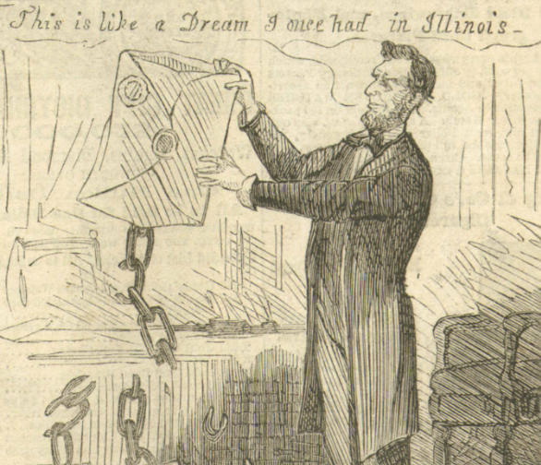
The 13th Amendment (1865 CE)
But Lincoln guaranteed Congressman James Ashley, who had introduced the bill into the House, that no peace commissioners were in the city, and the vote went ahead.
As it turned out, there were, in fact, Confederate representatives on their way to Union headquarters in Virginia.
On February 3, at the Hampton Roads Conference, Lincoln met with them aboard a steamboat called the River Queen, but the conference ended quickly after he declined to bestow any concessions.
On January 31, 1865, the House of Representatives passed the proposed Amendment 119-56, just over the required two-thirds majority.
The next day, Lincoln backed a joint resolution of Congress, presenting it to the state legislatures for ratification.
But he would not see final ratification: Lincoln was assassinated on April 14, 1865, and the required number of states did not ratify the 13th Amendment until December 6.

Slide 28
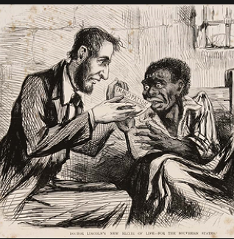
The 13th Amendment (1865 CE)
At the same time, Section 1 of the 13th Amendment outlawed chattel slavery and involuntary servitude, excluding them as a punishment for a crime.
The year after the Amendment’s passage, Congress used this power to pass the nation’s first civil rights bill, the Civil Rights Act of 1866.
The law invalidated the so-called black codes, those laws put into place in the former Confederate states that governed the conduct of Black people, virtually keeping them dependent on their former owners.
Congress also mandated the former Confederate states to ratify the 13th Amendment to regain representation in the federal government.
Together with the 14th and 15th Amendments, ratified during Reconstruction, the 13th Amendment sought to demonstrate equality for black Americans.
Despite these measures, the struggle to achieve full equality and ensure the civil rights of all Americans has continued well into the 21st century.

Slide 29
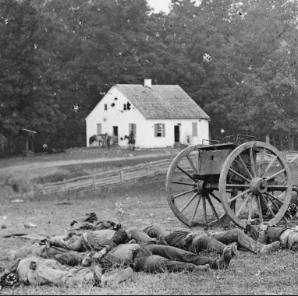
Photojournalism (1861 CE)
For the first time in history, citizens on the home front could view the butchery wrought on battlefields hundreds of miles away from their homes. These images robbed much of the Victorian-era romance around war.
To capture images on a battlefield was a strict, unwieldy, and time-consuming procedure.
In 1861, the newest technology was wet-plate photography, a technique in which an image is captured on chemically coated pieces of plate glass.
A photographer began by carrying his wagonload of equipment — which also served as his darkroom — onto the field and set up the bulky camera.
A calculated 70 percent of all Civil War documentary photographs were shot as "stereoviews" — the 19th-century counterpart of 3D.
These were made using a twin-lens camera that captured the same image from two separate lenses, in much the same way that two human eyes capture the same image from slightly different angles on the head.
The photos were developed using the same wet-plate process, but stereoscopic photography produced two of the same image on one plate glass.

Slide 30
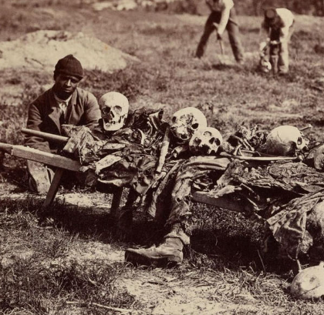
Photojournalism (1861 CE)
Once processed, the photographer would print the paired images onto a viewing card that photographers could easily insert into widely available viewers that created a 3D image.
Over time, this type of presentation has been forgotten.
Although Mathew Brady is the most famous photographer of the era, by the time of the Civil War, his vision was lacking, and he did little work in the field, utilizing others to visit battlefields on behalf of his studio.
Unfortunately, many photos have been mistakenly credited to him over time instead of the actual artist, including images by Alexander Gardner and Timothy O'Sullivan.
Located close to his Washington headquarters and in Union-held territory, it was an excellent strategy for Alexander Gardner, a photographer in the hire of Mathew Brady.
He reached Antietam two days after the fighting and captured images of the massacre for four days.

Slide 31
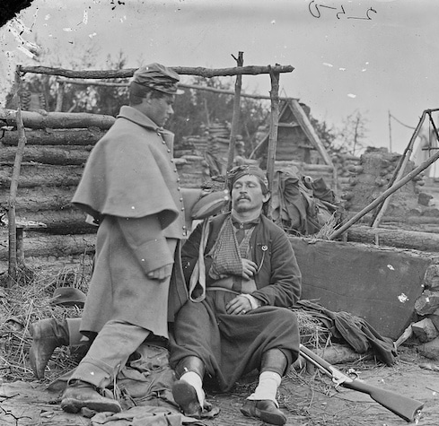
Photojournalism (1861 CE)
The images were displayed at Brady's New York studio just a month after the battle and were a smash.
"Mr. Brady has done something to bring us the terrible reality and earnestness of war," wrote the New York Times. "If he has not brought bodies and laid them in our dooryards and along the streets, he has done something very like it."
Photographic historians have shown that in at least one instance at that site, Gardner posed a body to achieve incredible pathos in his image; however, there is insufficient evidence to indicate this was common practice for him or others.
The long exposure times required on images meant that Civil War-era photographers could not capture the action of the battle itself and had to confine their work to its aftermath.
But their influential photos were acceptable to change the public discourse on the nature of war.

Slide 32
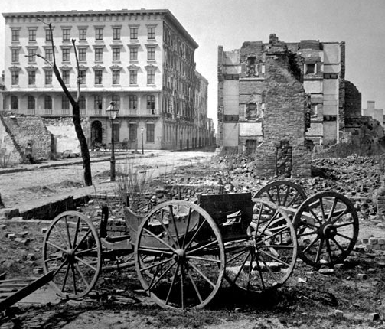
The Aftermath of War (1865 CE)
The North and West grew rich while the once-rich South became poor for a century.
The national political power of the enslavers and wealthy Southerners ended.
Historians assert that the North's advantage in population and resources made Northern success likely.
Confederates did not need to invade and hold enemy territory to win but were only required to fight a defensive war to convince the North that the cost of winning was too high.
The North needed to conquer and hold vast stretches of enemy territory and defeat Confederate armies to win.
Lincoln was not a military dictator and could continue to fight the war only if the American public supported a continuation of the war.

Slide 33
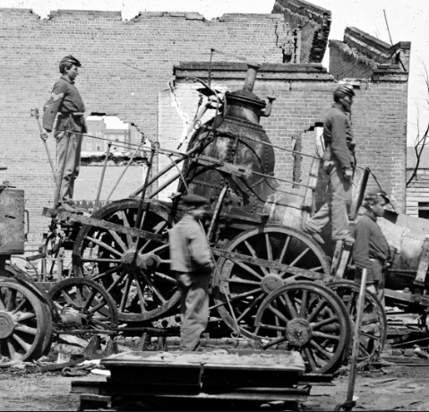
The Aftermath of War (1865 CE)
The war resulted in at least 1,030,000 casualties (3 percent of the population), including about 620,000 soldier deaths—two-thirds by disease—and 50,000 civilians.
The war's cost on American lives was as great as in all the nation's other wars combined through the Vietnam War.
Black troops made up 10 percent of the Union death toll — 15 percent of Union deaths from disease and less than 3 percent of those killed in battle.
Losses among African Americans were high. In the last year and a half and from all reported casualties, approximately 20 percent of all African Americans in the military died during the Civil War.
Notably, their mortality rate was significantly higher than that of white soldiers.
While the figures of 360,000 army deaths for the Union and 260,000 for the Confederacy remained commonly cited, they are incomplete.

Slide 34
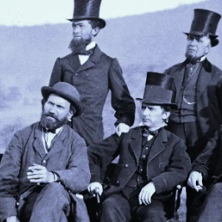
Pinkertons (1861 CE)
Pinkerton National Detective Agency is a private security guard and detective agency established around 1850 in the United States by Scottish-born Allan Pinkerton and Chicago attorney Edward Rucker
Pinkerton became famous when he claimed to have foiled a plot to assassinate president-elect Abraham Lincoln in 1861.
Lincoln later hired Pinkerton agents to conduct espionage against the Confederacy and act as his personal security during the Civil War.
The Pinkerton National Detective Agency hired women and minorities from its founding, a practice uncommon at the time, as they were useful as spies.
At the height of its power, the Pinkerton Detective Agency was the world's largest private enforcement organization.

Slide 35
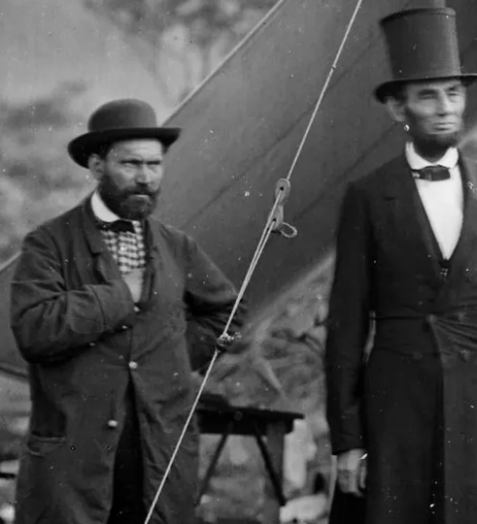
Pinkertons (1861 CE)
One of the many ways the Pinkertons revolutionized law enforcement was with their so-called "Rogues' Gallery," a collection of mug shots and case histories that the agency used to research and keep track of wanted men.
Along with noting suspects' distinguishing marks and scars, agents collected newspaper clippings and generated rap sheets detailing their previous arrests, known associates, and areas of expertise.
Government officials wouldn't assemble a more sophisticated criminal library until the early 20th century and the birth of the FBI.
During frontier expansion, express companies and railroads often employed the Pinkertons as Wild West bounty hunters.
The agency famously infiltrated the Reno gang—perpetrators of the nation's first train robbery—and later chased after Butch Cassidy and his Wild Bunch.
The Pinkertons usually got their man, but in the 1870s, they spent months engaged in a fruitless hunt for the bank robbers Jesse and Frank James.

Slide 36
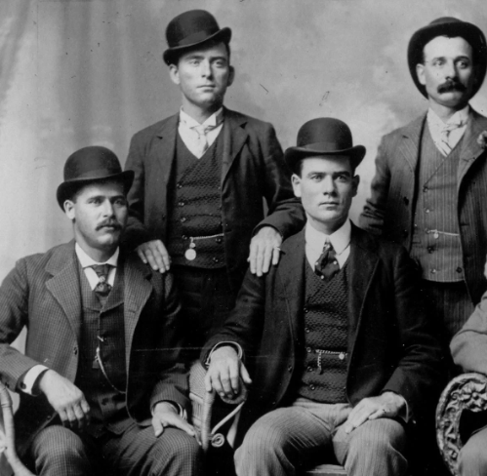
Pinkertons (1861 CE)
Along with their exploits in the Wild West, the Pinkertons also had a more sinister reputation as the paramilitary wing of big business.
Industrialists used them to spy on unions or act as guards and strikebreakers, and detectives clashed with workers on several occasions.
After Allan Pinkerton died in 1884, control of his agency fell to his two sons, Robert and William.
The company continued to grow under their watch, and by the 1890s, it boasted 2,000 detectives and 30,000 reserves—more men than the standing army of the United States.
Fearful that the agency could be hired as a private mercenary army, the state of Ohio later outlawed the Pinkertons altogether.
By the early 20th century, the Pinkertons' crime-fighting duties had primarily been absorbed by local police forces and agencies like the FBI.

Slide 37
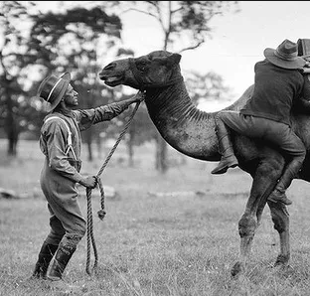
The Camel Corps (1855 CE)
he United States Camel Corps was a mid-19th-century experiment by the United States Army using camels as pack animals in the Southwestern United States.
Although the camels proved hardy and well suited to travel through the region, the Army declined to adopt them for military use.
The Civil War interfered with the experiment, which was eventually abandoned; they sold the animals at auction.
In 1836, Major George H. Crosman, United States Army, who was convinced from his experiences in the Indian wars in Florida that camels would be useful as beasts of burden, encouraged the War Department to use camels for transportation.
In 1848 or earlier, Major Henry C Wayne conducted a more detailed study and recommended the importation of camels to the War Department.
Wayne's opinions agreed with those of then-Senator Jefferson Davis of Mississippi.
Davis was unsuccessful until he was appointed as Secretary of War in 1853 by President Franklin Pierce.

Slide 38
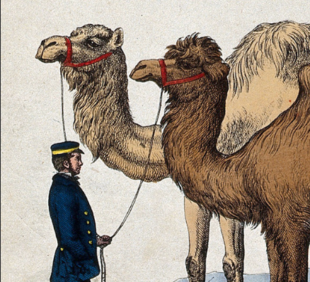
The Camel Corps (1855 CE)
When US forces were required to operate in arid and desert regions, the President and Congress began to take the idea seriously.
Davis found the Army needed to improve transportation in the southwestern US, which he and most observers thought a great desert.
In his annual report for 1854, Davis wrote, "I again invite attention to the advantages to be anticipated from the use of camels and dromedaries for military and other purposes ..." On March 3, 1855, the US Congress appropriated $30,000 (equivalent to $872,464 in 2021) for the project.
A report entitled "Purchase of Camels for the Purpose of Military Transportation" was issued by Davis in 1857.
In later years, Edward Fitzgerald Beale reportedly told his son, Truxtun, that the idea of using camels came when he explored Death Valley with Kit Carson.
Jefferson Davis, then Secretary of War, sympathized with Beale. Beale persuaded his friend and kinsman Lieutenant David Dixon Porter to apply for command of the expedition to acquire the camels. Beale's diaries or papers do not support the account.
Major Wayne was assigned to procure the camels.

Slide 39
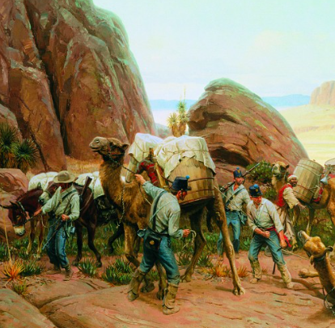
The Camel Corps (1855 CE)
On June 4, 1855, Wayne departed New York City on board the USS Supply, under the command of then Lieutenant David Dixon Porter.
After arriving in the Mediterranean Sea, Wayne and Porter began procuring camels. Stops included Goletta (Tunisia), Malta, Greece, Turkey, and Egypt. They acquired 33 animals (19 females and 14 males), including two Bactrian, 29 dromedaries, one dromedary calf, and one booghdee (a cross between a male Bactrian and a female dromedary).
The two officers also acquired pack saddles and covers, confident they could not purchase proper harnesses in the United States.
Wayne and Porter hired five camel drivers, some Arab and some Turkish, and on February 15, 1856, USS Supply set sail for Texas.
Porter established strict rules for the care, watering, and feeding of the animals in his charge; no experiments were conducted regarding how long a camel could survive without water.
During the crossing, one male camel died, but two calves were born and survived the trip. On May 14, 1856, 34 camels were safely unloaded at Indianola, Texas.
All the surviving animals were in better health than when the vessel sailed for the United States. Porter sailed again for Egypt to acquire more camels on Davis's orders.
While Porter was on the second voyage, Wayne marched the camels from the first voyage to Camp Verde, Texas, by way of San Antonio.

Slide 40
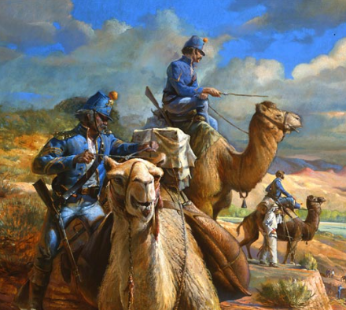
The Camel Corps (1855 CE)
On February 10, 1857, USS Supply returned with a herd of 41 camels.
At the same time, Porter was on his second mission.
The newly acquired animals joined the first herd at Camp Verde, which had been officially designated as the camel station. The Army had 70 camels.
Wayne attempted a breeding program for the camels.
Still, his plans were put aside when Secretary Davis wrote that the animals were to be tested to determine if the corps could use them to accomplish a military objective.
Early in the Civil War, an attempt was made to use the camels to carry mail between Fort Mohave, New Mexico Territory, on the Colorado River and New San Pedro, California.

Slide 41
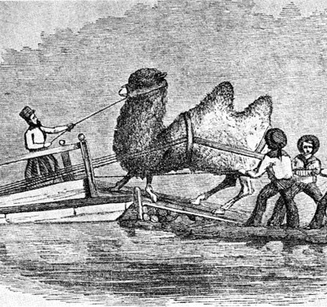
The Camel Corps (1855 CE)
Still, the attempt was unsuccessful after the commanders of both posts objected. Later in the war, the Army had no further interest in the animals and sold them at auction in 1864.
The last animals from California were reportedly seen in Arizona in 1891.
In the spring of 1861, Camp Verde fell into Confederate hands until recaptured in 1865.
The Confederate commander issued a receipt to the United States for 12 mules, 80 camels, and two Egyptian camel drivers.
There were reports of the animals being used to transport baggage but no evidence of their being assigned to Confederate units
When Union troops reoccupied Camp Verde, there were estimated to be more than 100 camels at the camp, but there may have been others roaming the countryside.

Slide 42
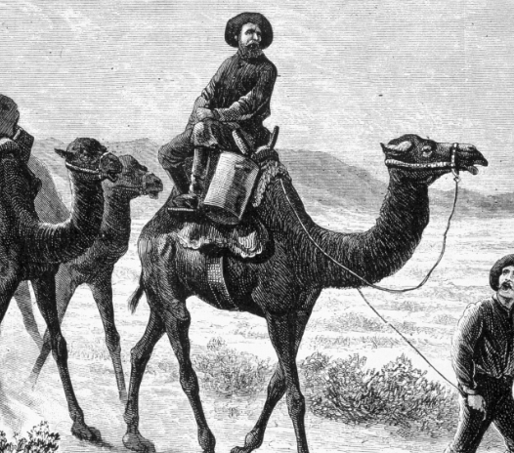
The Camel Corps (1855 CE)
In 1866, the Government was able to round up 66 camels, which it sold to Bethel Coopwood.
The US Army's camel experiment was complete.
The last year a camel was seen in the vicinity of Camp Verde was 1875; the animal's fate is unknown.
The camel experiment failed because it was supported by Jefferson Davis, who left the United States to become President of the Confederate States of America.
The US Army was a horse-and-mule organization whose soldiers did not have the skills to control a foreign asset.
One of the male animals at Fort Tejon was killed by another male during the rutting season.
Lieutenant Sylvester Mowry forwarded the dead animal's bones to the Smithsonian Institution, where they were placed on display

Slide 43
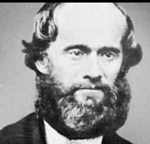
The King of Beaver Island (1856 CE)
In the 1840s, James Jesse Strang was a lawyer in the Wisconsin Territory who converted to Mormonism just five months before Joseph Smith, the architect of the Mormon faith, was slain by a mob in Illinois.
Smith's death formed a predicament for the church, with a handful of people vying to succeed him.
Brigham Young is the most well-known. But Strang produced a letter penned by Smith, postmarked days before Smith's assassination in 1844, which named Strang his successor.
Strang also declared an angel came to him to ordain him as ruler of God's people.
Brigham Young took his followers to Salt Lake City, where the Church of Jesus Christ of Latter-Day Saints is now headquartered.
James Strang took his followers first to Voree, Wisconsin.
When Strang and his followers came to Beaver Island in Lake Michigan, The year-round residents included: Three white families, A handful of white men had Indian wives, and thirty other men had families elsewhere.

Slide 44
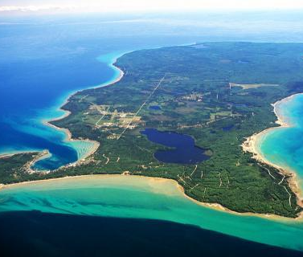
The King of Beaver Island (1856 CE)
Most of the men were fishermen, and the fishing business helped increase the number of men – and boys – on the island to about 100 in the summer.
And on the island's northern side, there were forty to fifty Indian families, predominately Chippewas, who also lived mainly through fishing.
Over the next nine years, Strang would change the island into a bustling outpost.
He and his followers-built roads and homes and printed a newspaper, The Northern Islander, which started weekly and became a daily.
It was the only daily newspaper north of Grand Rapids, Michigan, during the time.
In the mid-19th century, the lakes were like a financial highway, and the Mormons made money selling cordwood to passing steamers.

Slide 45
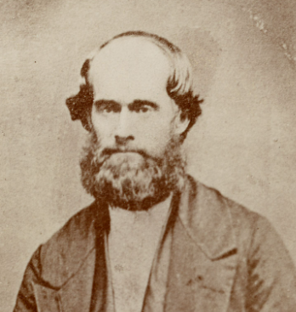
The King of Beaver Island (1856 CE)
There was a lot of hostility toward the Mormon faith in the United States then.
But there were increasing tensions between Strang and his followers and the non-Mormons on Beaver Island.
In 1850, Strang was crowned king in a coronation rite choreographed by a man in his inner circle who'd been an actor.
Strang supposedly wore a red robe and had a cardboard crown.
Strang never evidently claimed authority over anything but his church. But it seems his control over islanders did grow beyond just his supporters.
Some Mormons did buy property, but a lot of it was blessed for the church and portioned out by Strang to the different Mormon families living there.
Strang also wooed dissension among his followers when he changed his views about marriage and became a polygamist, ultimately marrying five women.
A few years later, he was elected to his first of two terms in the Michigan Legislature.

Slide 46
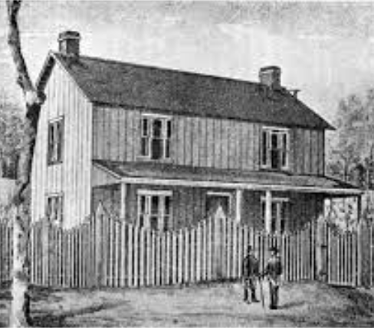
The King of Beaver Island (1856 CE)
While Strang held many progressive ideas, such as preserving woodlands, many judged his tyrannical rule insufferable.
One declaration, for example, stipulated the clothing of women.
Two women refused compliance, and Strang had their husbands beaten, an act rendered more bearable after learning one of them in the act of adultery.
On June 16, 1856, the US naval gunboat USS Michigan entered the harbor of St. James, and Strang was requested aboard.
As Strang walked along the dock, the two conspirators shot him from behind and then ran in the gunboat, which departed and disembarked the men on Mackinac Island. Neither man was charged or sentenced for the murder.
After Strang died of his wounds on July 9, 1856, mobs from Mackinac Island and Saint Helena Island arrived and expelled the Strangites.
They then numbered roughly 2,600 from Beaver Island and reclaimed the island. Upon the removal of the Strangites, local government in Manitou County, which included Beaver Island, almost discontinued.
Court sessions and elections were seldom held, county offices were often empty, and the region developed a lawless reputation.

Slide 47
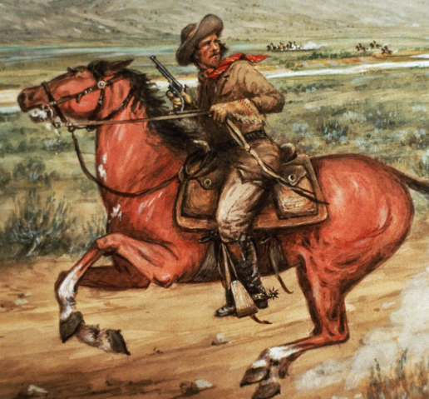
The Pony Express (1860 CE)
The Pony Express was an American express mail service that used relays of horse-mounted riders.
It operated between Missouri and California from April 3, 1860, to October 26, 1861.
It was conducted by Central Overland California and Pikes Peak Express Company.
During its 18 months of operation, the Pony Express reduced the time for messages to travel between the east and west US coast to about ten days.
It was vital for tying the new US state of California with the rest of the United States.
It became the west's most direct means of east-west communication before the first transcontinental telegraph was established.

Slide 48
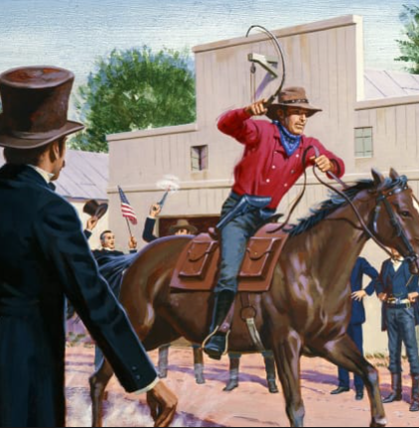
The Pony Express (1860 CE)
Despite a heavy subsidy, the Pony Express was not a financial success and went bankrupt in 18 months when they established a faster telegraph service.
Nevertheless, it demonstrated that a unified transcontinental communications system could be installed and operated year-round.
When replaced by the telegraph, the Pony Express quickly became romanticized and became part of the lore of the American West.
Its reliance on the ability and endurance, hardy riders, and fast horses was seen as evidence of the rugged American individualism of the frontier times.
In the mid-19th century, California-bound mail had to either be taken overland by a 25-day stagecoach or spend months inside a ship during a long sea voyage.
The Pony Express had an average delivery time of just ten days. To achieve this remarkable speed, the company set up nearly 200 relief stations across Missouri, Kansas, Nebraska, Colorado, Wyoming, Utah, Nevada, and California.

Slide 49
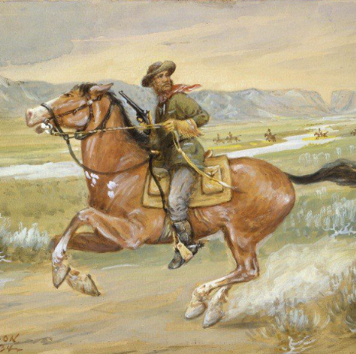
The Pony Express (1860 CE)
Lone horseback riders would ride between stations at a breakneck pace, switching mounts every 10-15 miles and then handing their cargo off to a new courier after 75-100 miles.
Since speed was its primary goal, the Pony Express went to great lengths to keep its horses' loads as light as possible.
Rather than burly cowboys, most riders were small, wiry men who weighed between 100 and 125 pounds—roughly the same size as a modern horseracing jockey.
Their average age was around 20, but it wasn't unusual for teenagers as young as 14 to be hired.
One man named "Bronco" Charlie Miller claimed he was only 11 years old when he first joined the Pony Express.

Slide 50
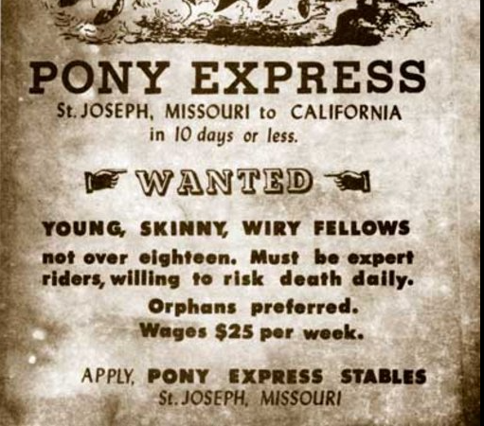
The Pony Express (1860 CE)
The relay system allowed mail to crisscross the frontier in record time.
The company’s personal best came in March 1861, when riders carried the inaugural address of Abraham Lincoln from Nebraska to California in just seven days, 17 hours.
Pony Express riders had to deal with extreme weather conditions, harsh terrain, and the threat of attacks by bandits and Indians.
Their outposts were usually crude, dirt floor hovels equipped with little more than sleeping quarters and corrals for the horses.
Many were in remote sections of the frontier, making them highly vulnerable to ambush.
Only a handful of riders—six, according to the National Park Service—died in the line of duty during the entire history of the Pony Express.
Despite operating for 19 months, its riders had successfully delivered 35,000 pieces of mail and traveled more than half a million miles across the American frontier.

Slide 51
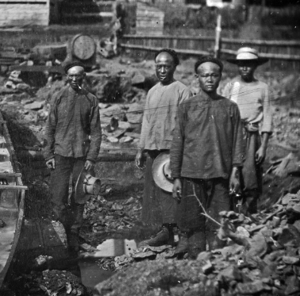
California Police Tax (1862 CE)
Officials wanted the revenue from the new tax, which targeted Chinese people – hundreds of whom happened to be working in the mining industry.
In that era, most white residents see the Chinese as unfair labor competition, tools of the capitalists, and other cultural factors.
European settlers falsely believed the Chinese couldn't assimilate; they were anti-religion, filthy, and their intelligence was below the whites.
It was in California where the legislature in April 1862 passed a law creating a race-based targeted tax.
The legislation's title included the word "coolie," a derogatory term for Chinese laborers in that era, and the law required all Chinese men and women 18 and older to pay $7.50 a quarter – what it called a "Chinese Police Tax."
This amounted to $30 annually or about $500 today.

Slide 52
California Police Tax (1862 CE)
That same year – 1862 – Oregon lawmakers imposed a $5 annual tax on Black people, Chinese, those of mixed-race heritage, and Hawaiians
In 1864, Washington's Territorial Legislature passed a law with almost precisely the same title as California's: AN ACT TO PROTECT FREE WHITE LABOR AGAINST COMPETITION WITH CHINESE COOLIE LABOR, AND TO DISCOURAGE THE IMMIGRATION OF THE CHINESE INTO THIS TERRITORY.
The territorial law in Washington is almost a verbatim copy of the California law, though there are some key differences.
In Washington Territory, the tax was $6 per quarter – much more than in Oregon and a little less than in California.
In each county, the tax was to be collected by the sheriff, and the individual officer was allowed to keep a 25% cut of whatever he collected.

Slide 53
California Police Tax (1862 CE)
The remainder was split between each county and the territory.
The premise and mechanics of enforcement seemed ripe for corruption.
It's also unclear how much enforcement – that is, tax collection – there was and how much it might have varied from county to county.
One thing that does survive without further evidence is the race-based, discriminatory reality of the Chinese Police Tax; that's clear and clearly stated right there in the enabling legislation's title.
Oddly enough, California's Chinese Police Tax didn't last very long.
The law was struck down as discriminatory by the California Supreme Court in 1862, the same year it was enacted.

Slide 54
Cochise (1860 CE)
Little is known about the early life of Apache chief Cochise. He was captured and charged with abducting a rancher’s son in 1861, kindling friction between his people and the US government.
By the mid-19th century, he had become a recognized leader of Apache Indians living in southern Arizona and northern Mexico.
Like many other Apache, Cochise resented the encroachment of Mexican and American homesteaders on their traditional lands.
Cochise led multiple raids on the settlers living on both sides of the border, and Mexicans and Americans started to call for military defense and retaliation.
In October 1860, a band of Apache attacked the ranch of an Irish-American named John Ward and abducted his adopted son, Felix Tellez.
Although Ward had been away at the time of the raid, he thought Cochise had been the leader of the raiding Apache.
Ward urged the US Army to rescue the commandeered boy and bring Cochise to justice.

Slide 55
Cochise (1860 CE)
The military obliged by sending a force under the authority of Lieutenant George Bascom. Unknowing that they were in trouble, Cochise and many of his top men responded to Bascom’s invitation to join him for a night of recreation at a nearby stage station.
When the Apache arrived, Bascom’s soldiers apprehended them.
Cochise told Bascom that he had not been responsible for the kidnapping of Felix Tellez, but the lieutenant refused to believe him.
He ordered Cochise to be kept as a captive until the boy was returned. Cochise would not accept being detained unjustly.
He used his knife to cut a hole in the tent he was held in and fled.
During the next decade, Cochise and his warriors boosted their raids on American settlements and resisted periodic scuffles with soldiers.

Slide 56
Cochise (1860 CE)
Panicked settlers deserted their homes, and the Apache raids took hundreds of lives and caused hundreds of thousands of dollars in property damages.
By 1872, The government presented Cochise and his people with a huge reservation in the southeastern corner of Arizona Territory if they would cease aggressiveness.
Cochise consented, saying, “The white man and the Indian are to drink of the same water, eat of the same bread, and be at peace.”
The great chief did not have the benefit of enjoying his hard-won peace for long. In 1874, he became seriously ill, possibly with stomach cancer.
About a decade after Cochise died, Felix Tellez–the boy whose abduction had started the war–resurfaced as an Apache-speaking scout for the US Army.
He noted that a group of Western Apache, not Cochise, had abducted him.

Slide 57
1860s Fashion
During the 1860s, the hoop-shaped frame made the skirt stand out, making the waist look smaller.
The upper-class ladies and the elite were the ones who could afford so many costumes.
The women wore more vibrant colors in the winter, and their overcoats were fur-lined.
The sleeves became wider, and the neckline changed according to the time of the day.
During the day, it was high; at night, they were low-cut.
A traditional ensemble had many layers under the dress itself.
A loose petticoat was first worn over a long, very loose undergarment that extends to the knees.
A corset is also worn

Slide 58
1860s Fashion
Men during this time typically wore dark-colored three-piece suits with a collar, vest, and overcoat.
The younger men went for more colors while the older ones had a more traditional practice of dressing.
They had different outfits for walking, smoking, and a more formal suit for formal occasions.
Hats were trendy.These hats can be made of straw or, often, made from horsehair.
The men wore bell hats with brim curves on the sides.
The caps were kept very straightforward for young children with tiny bows and decorated with either daisies or small flowers.
They were made of different colors and materials to go with their outfit.
Hairstyles for ladies differed according to their age and the class they belonged to. The hair is slightly waved and tied in the back for a young lady.

Slide 59
Ex Parte Merryman (1861 CE)
Ex parte Merryman is a prominent and contentious US federal court case from the American Civil War.
It was a test of the power of the President to suspend "the privilege of the writ of habeas corpus" under the Constitution's Suspension Clause when Congress was in recess and thus unreachable to do so.
More typically, the case presented queries about the executive branch's power to refuse enforcement of judicial decisions when the executive considers them to be wrong and damaging to its legal authorities.
On May 28, 1861, Supreme Court Chief Justice Roger Taney questioned President Abraham Lincoln's wartime suspension of the writ of habeas corpus in a national constitutional showdown.
Lincoln and Taney had not been on good terms before Taney determined the habeas question in Ex Parte Merryman, which he issued while serving as a circuit judge.

Slide 60
Ex Parte Merryman (1861 CE)
About three months later, Taney had his opportunity to address Lincoln's notion of executive power in Ex Parte Merryman.
Article 1, Section 9 of the Constitution states that "the Privilege of the Writ of Habeas Corpus shall not be suspended, unless when in Cases of Rebellion or Invasion the public Safety may require it.“
The Great Writ's roots went back to the signing of the Magna Carta in England in 1215, and the writ drove the government to show cause to a judge for the arrest or imprisonment of a person.
After the start of the Civil War, President Lincoln instructed General Winfield Scott to suspend habeas corpus near railroad lines that linked Philadelphia to Washington amid apprehensions of a rebellion in Maryland that would jeopardize Washington.
On May 25, 1861, federal troops arrested a Maryland planter, John Merryman, on suspicion that he was involved in a scheme as part of an armed secessionist group.
Merryman was confined at Fort McHenry without a warrant.

Slide 61
Ex Parte Merryman (1861 CE)
Merryman's attorney petitioned the US Circuit Court for Maryland, which Taney oversaw, for his client's freedom.
On May 26, Taney issued a writ of habeas corpus and ordered the Fort McHenry's commander to appear in the circuit courtroom along with Merryman and to explain his reasoning for jailing Merryman.
The commander didn't comply with the writ and sent a letter back to Taney on May 27, illustrating that Lincoln had permitted military officers to suspend the writ when they felt public safety matters.
Taney then tried to notify the commander that he was in contempt of court, but soldiers at Fort McHenry rejected the notice.
On May 28, Taney issued an oral opinion, followed by a written statement a few days later.
He noted that the Constitution intended for Congress, not the President, to have the power to suspend the writ during emergencies.

Slide 62
Ex Parte Merryman (1861 CE)
Nevertheless, Taney mentioned that he didn't have the physical power to implement the writ in this case because of the core of the dispute.
But Taney requested a copy of his opinion sent straight to President Lincoln.
Lincoln didn't answer directly to the Ex Parte Merryman decision.
Instead, he delayed until a July 4th address to engage Taney at a special session of Congress.
Lincoln then delivered his famous comeback to Taney. "Are all the laws but one to go unexecuted, and the government itself go to pieces lest that one is violated? Even in such a case, would not the official oath be broken if the government should be overthrown when it was believed that disregarding the single law would tend to preserve it?"

Slide 63
Ex Parte Merryman (1861 CE)
The President also confronted Taney's assertion that only Congress could suspend the writ.
"Now it is insisted that Congress, and not the Executive, is vested with this power; but the Constitution itself is silent as to which or who is to exercise power; and as the provision was made for a dangerous emergency, it can not be believed the framers of the instrument intended that in every case the danger should run its course until Congress could be called together, the very assembling of which might be prevented, as was intended in this case, by the rebellion," Lincoln asserted.
After the Merryman incident, Lincoln suspended the writ in other situations. He obtained permission from Congress in March 1863 to stop the writ for the course of the conflict when "the public safety may require it."

Slide 64
The Homestead Act (1862 CE)
The Homestead Acts were several laws in the United States by which an applicant could obtain ownership of government land or the public domain, generally called a homestead.
In all, more than 160 million acres of public land, or nearly 10 percent of the total area of the United States, was given away free to 1.6 million homesteaders.
Most of the homesteads were west of the Mississippi River.
An extension of the homestead principle in law, the Homestead Acts were an indication of the Free Soil policy of Northerners who wanted separate farmers to own and manage their farms, as opposed to Southern slave-owners who tried to purchase up large parcels of land and use slave labor, thereby barring free white farmers.
The first of the acts, the Homestead Act of 1862, unlocked millions of acres.
Any adult who had never taken up arms against the United States Federal government could apply.
Women and immigrants who had applied for citizenship were qualified.

Slide 65
The Homestead Act (1862 CE)
The "yeoman farmer" ideal of Jeffersonian democracy still strongly influenced American politics during the 1850s.
Many politicians considered a homestead act would help boost the number of "virtuous yeomen.“
Southern Democrats had often resisted and defeated earlier homestead law proposals, as they worried free land would entice European immigrants and poor Southern whites to the west.
The Free Soil Party, and the new Republican Party after 1854, insisted that the new lands opening up in the west be made known to autonomous farmers rather than wealthy planters who would develop it with enslaved people pushing the yeomen farmers onto marginal lands.
The Homestead Act of 1862 intended to lower the cost of homesteading under the Preemption Act; after the South seceded and their delegates left Congress in 1861, the Republicans and proponents from the upper South passed a homestead act signed by Abraham Lincoln on May 20, 1862, which went into effect on January 1, 1863.
In addition to the previous prerequisite in the Preemption Act of being either 21 years old or the head of a family, the 1862 act also permitted persons under 21 who had served in the regular or volunteer forces of the US army or navy for at least 14 days during "the existence of an actual war domestic or foreign."

Slide 66
The Homestead Act (1862 CE)
The new act also mandated that the person "has never borne arms against the United States Government or given aid and comfort to its enemies" it did not have any provision mentioning race.
The Homestead act grew, rather than revised, the 1841 Preemption Act.
The claimed homestead could include the same land they had previously filed a pre-emption claim on up to 160 acres at $1.25 per acre.
They could grow their existing ownership to contiguous adjoining land up to 160 acres.
Nevertheless, the homestead application must be "made for his or her exclusive use and benefit, and that said entry onto public land is made for actual settlement and cultivation, and not directly or indirectly for the use or benefit of any other person or persons whomsoever."
The obtained land would not be responsible for any debts incurred before the issuance of the patent for it.

Slide 67
The Homestead Act (1862 CE)
Officials set the time needed for residence or cultivation at five years; if it was proven "after due notice" that they moved residence or abandoned the land for more than six months at a time, then the land reverted to the government.
A homesteader could also pay the $1.25 per acre price after proof of the less-stringent conditions in the Preemption Act.
After filing an affidavit with the government's agent and paying him a $10 fee, the homesteader could begin inhabiting their claim.
The government agent welcomed the same fee for homestead land as he would have accepted if they sold that land for cash, 1/2 from the homesteader's filing fee and the other half from the certificate fee.
After five years, the homesteader did not get a certificate until they or their heirs filed further affidavits from two neighbors or "credible witnesses" and an additional $8 fee.
Those affidavits established the five years of residence or cultivation and that "no part of said land has been alienated transferred or mortgaged, and that he the homesteader has borne true allegiance to the Government of the United States."

Slide 68
The Homestead Act (1862 CE)
If both parents died and all the children were under 21, an agent under state law could sell for the advantage of the children and not the estate an absolute title to the land within two years of the parent's death.
The purchaser would pay office fees for a patent to the land.
Unfortunately, the act was framed so ambiguously that it appeared to invite scam, and early changes by Congress only compounded the problem.
The act proved to be no elixir for destitution. Comparatively few laborers and farmers could afford to build a farm or obtain the necessary tools, seeds, and livestock.
Most of those who bought land under the act came from areas close to their new homesteads. Iowans moved to Nebraska, Minnesotans to South Dakota, and so on.
Most of the land went to speculators, cattle owners, miners, loggers, and railroads.
Of some 500 million acres distributed by the General Land Office between 1862 and 1904, only 80 million acres went to homesteaders.

Slide 69
Sioux Uprising (1862 CE)
The Dakota War of 1862 was an armed conflict between the United States and several bands of eastern Dakota, also known as the Santee Sioux. On August 18, 1862, it began at the Lower Sioux Agency along the Minnesota River in southwest Minnesota.
The eastern Dakota were pressured into surrendering large parcels of land to the United States in treaties signed in 1837, 1851, and 1858 for cash allowances, debt payments, and other conditions.
All four bands of eastern Dakota were ousted and reluctantly moved to a reservation twenty miles wide, ten on both sides of the Minnesota River.
There, they were pressed by US Indian agents to become farmers rather than continue their hunting practices.
Meanwhile, the settler population in Minnesota Territory had grown from 6,077 in 1850 to 172,072 in 1860, after it had become a state.
A crop failure in 1861, followed by a brutal winter and poor hunting due to a deficit of wild game, led to starvation and extreme adversity for many eastern Dakota.

Slide 70
Sioux Uprising (1862 CE)
In 1862, strains between the east Dakota, the traders, and the Indian agents reached a breaking point because the Indian agents were late with the US government annuity payments owed to the eastern Dakota.
The traders refused to extend credit to the tribe members for food because the traders presumed the payments might not arrive due to the American Civil War.
On August 17, 1862, four young native men killed five white settlers in Acton, Minnesota.
That night, Little Crow's people coalition determined to attack the Lower Sioux Agency the next day to drive all immigrants out of the Minnesota River valley.
Dakota warriors struck and killed hundreds of settlers in the ensuing weeks, rendering thousands to flee the area.
The Dakota was led by Chief Little Crow and took hundreds of "mixed-blood" and white captives, almost all women and children. The demands of the Civil War slowed the US government's reaction.

Slide 71
Sioux Uprising (1862 CE)
Regardless, on September 23, 1862, an army of volunteer infantry, artillery, and citizen militia formed by Governor Alexander Ramsey and led by Colonel Henry Hastings Sibley finally overpowered Little Crow at the Battle of Wood Lake.
By the war's end, 358 settlers had been killed, in addition to 77 soldiers and 29 volunteer militia.
The total number of Dakota deaths is unknown. On September 26, they freed 1862, 269 "mixed-blood" and white hostages to Sibley's troops at Camp Release.
Roughly 2,000 Dakota surrendered or were taken into custody, including at least 1,658 non-combatants and those who had resisted the war and helped to free the captives.
Meanwhile, Little Crow and a group of 150 to 250 followers escaped to the northern plains of Dakota Territory and Canada.
In less than six weeks, a military commission comprised of officers from the Minnesota Volunteer Infantry condemned 303 Dakota men to death. President Abraham Lincoln reviewed the convictions and supported death sentences for 39 out of the 303.

Slide 72
Sioux Uprising (1862 CE)
On December 26, 1862, US officials hung 38 in Mankato, Minnesota, with one getting a reprieve. This was the largest one-day mass execution in American history.
The execution was public on a square platform conceived to drop from under the convicted.
The gallows were built outside the square with ten nooses per side.
When the platform lowered, the rope of one native broke. Despite seeming dead, he was dragged back up with a new rope.
After the regimental surgeons pronounced the men dead, they were buried en masse in an unfrozen sand bar of the Minnesota River.
Before they were buried, an unknown person nicknamed "Dr. Sheardown" perhaps removed some of the prisoners' skin.

Slide 73
Sioux Uprising (1862 CE)
Despite having a large guard force posted at the gravesite, all bodies were exhumed and taken away the first night.
William Worrall Mayo acquired the body of Stands on Clouds, also known as "Cut Nose." because of the high demand for cadavers for anatomical study, several doctors wanted to acquire the bodies after the execution.
The grave was reopened at night, and the bodies were distributed among the doctors, a method standard in the era.
In the late 20th century, the identifiable remains of Stands on Clouds and other Dakota were returned by the Mayo Clinic to a Dakota tribe for reburial per the Native American Graves Protection and Repatriation Act.
The Mayo Clinic created a scholarship for a Native American student as an apology for having misused the chief's body.

