Slide 1
Module Fourteen: Stay Together for the Kids
(1863 CE - 1870 CE)

Slide 2
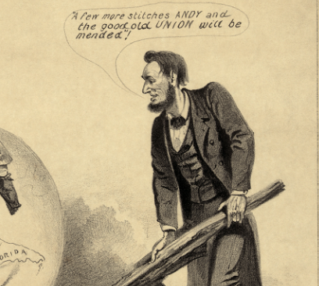
Ten Percent Plan (1863 CE)
The ten percent plan was a presidential proclamation administered by President Abraham Lincoln on December 8, 1863, during the Civil War.
By 1863, the Union Army had forced the Confederate Army out of several parts of the South, and some Confederate states were ready to revive their governments.
Lincoln's plan set a process through which this postwar reconstruction could come about.
A part of President Lincoln's objectives for the postwar Reconstruction of the South, this proclamation legislated that a state in rebellion against the US federal government could be reintegrated into the Union when 10% of the 1860 vote count from that state had taken an oath of allegiance to the US and committed to accept Emancipation.
Voters could then select representatives to draft rectified state constitutions and designate new state governments.

Slide 3
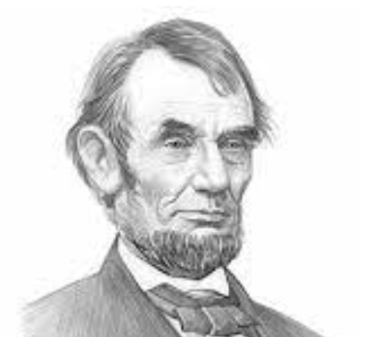
Ten Percent Plan (1863 CE)
All Southerners save for high-ranking Confederate army officers and government officials would be awarded full amnesty.
Lincoln assured Southerners that he would defend their private property, not their slaves.
By 1864, Louisiana, Tennessee, and Arkansas had appointed fully functioning Unionist governments.
This policy was meant to curtail the war by presenting a sensible peace plan.
They also planned to advance their emancipation policy by pressing the new governments to abolish slavery.
Most moderate Republicans in Congress backed the president's proposal for Reconstruction because they wanted to bring a speedy end to the war.

Slide 4
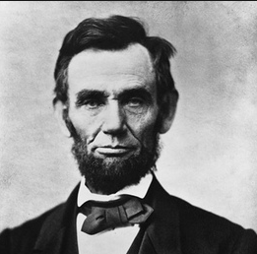
Ten Percent Plan (1863 CE)
Yet, other Republicans worried that they would resurrect the planter aristocracy and the blacks would be pushed back into slavery.
Radical Republicans felt Lincoln's plan for Reconstruction was not harsh enough because, from their point of view, the South was guilty of starting the war and earned to be disciplined. Radical Republicans hoped to retain the Reconstruction process, remake Southern society, dissolve the planter aristocracy, redistribute land, grow the industry, and ensure civil liberties for one-time enslaved people.
Although the Radical Republicans were the minority party in Congress, they managed to sway many moderates in the postwar years and came to monopolize Congress in later sessions.
In the summer of 1864, the Radical Republicans enacted a new bill to oppose the plan, known as the Wade–Davis Bill.
The Bill stated that for a state to be readmitted, the bulk of the state would have to take a loyalty oath, not just ten percent. Lincoln later pocket-vetoed this new Bill.

Slide 5
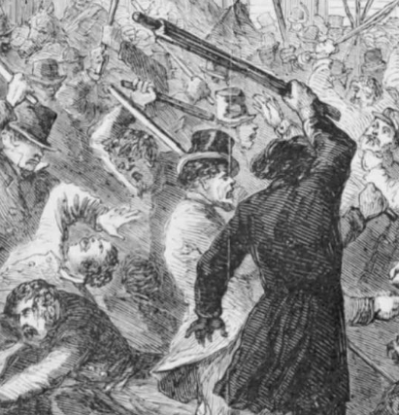
Detroit Race Riot (1863 CE)
The Detroit race riot of 1863 transpired on March 6, 1863, in Detroit, Michigan, during the Civil War.
It began due to turmoil among the working class related to bigotry and the military draft and intensified after President Abraham Lincoln issued the Emancipation Proclamation.
Established in a free state, some recent immigrants and other workers resented being drafted for a war that they believed was waged for the benefit of enslaved people in the Southern United States.
At least two civilians were killed, one white and one Black, and numerous others, mostly African Americans, were severely beaten and wounded.
In total, 35 buildings were demolished by fire, with many others damaged, and Black citizens lost property and cash to the looting and pilfering of the mob.
Historians evaluated losses of at least $15,000 to as much as $20,000.

Slide 6
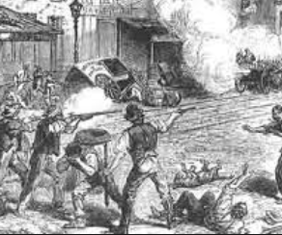
Detroit Race Riot (1863 CE)
More than 200 people, especially Black, were left homeless.
Although the Michigan Legislature suggested recompense, the Detroit City Council declined to approve it.
During the months foregoing the riot, social tensions climbed in the city.
Located across from Canada, which had abolished slavery in 1834, Detroit was a central "station" on the Underground Railroad in the antebellum years.
It had a white majority, but a thriving black community made up of free black people who had relocated there and refugee slaves who escaped the South. Some fugitive slaves settled in Detroit since Michigan was a non-slave state.
Democrats monopolized the City Council, and many Irish and German expatriates belonged to that party.
The Detroit Free Press was a Democratic Party paper that resisted President Abraham Lincoln's conduct during the American Civil War and its increasing need for recruits.

Slide 7
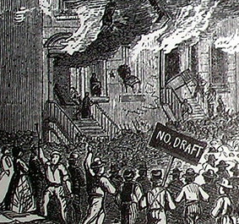
Detroit Race Riot (1863 CE)
The newspaper endorsed white supremacy and was pro-labor
In the months leading up to the riot, the newspaper often published articles connecting "blacks to labor issues, blacks to citizenship problems, blacks to the war, and blacks to crime and an all-around degradation of the moral order," stressing how they were a threat to working-class white men and their limited power.
Three days before the beginning of the riots, Congress passed the Enrollment Act, which required single men aged 20 to 45 and married men up to age 35 to register for the draft.
This act outraged many northern whites, mainly Irish immigrants who had received US citizenship, not acknowledging that citizenship also made immigrants responsible for the draft.
Fuel was added to the fire of their anger when black men, mostly freed enslaved people, were banned from this same draft.

Slide 8
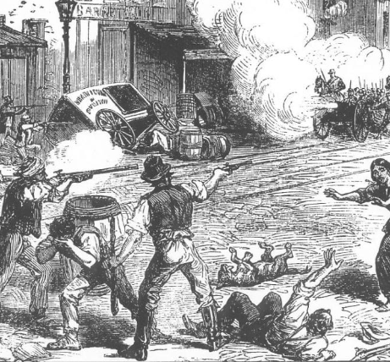
Detroit Race Riot (1863 CE)
The Irish feared that newly freed slaves from the South would migrate to the North, creating additional competition in the labor market.
Many Irish saw this as a "rich man's war, and a poor man's fight" since the substitution policies were contentious methods that allowed drafted citizens to opt-out of service by either furnishing a proper replacement for taking the place of those recruited or paying $300 each.
A mixed-race man, Thomas Faulkner, was apprehended for allegedly molesting a young white girl and tried in court.
Although Faulkner had voted regularly and identified as Spanish-Indian, both newspapers portrayed him as "negro", which was how the whites viewed him.
The trial drew incendiary crowds of whites, who threw items at Faulkner and guards as they accompanied him to and from the court.
On the second day of the trial, whites started to attack blacks outside the courthouse.

Slide 9
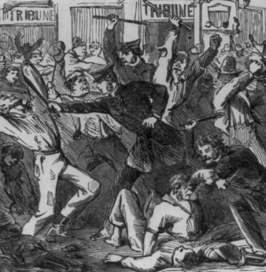
Detroit Race Riot (1863 CE)
The guard’s commander, chaperoning Faulkner, ordered the firing of blanks to push back the crowd.
Next, they fired live ammunition. They inflamed the group that killed a German man named Charles Langer, whom they considered less worthy.
The mob started bombarding black civilians on the street and went to a nearby known black business.
Workers attempted to defend it, but the mob burned the shop and adjoining house, intimidating black women and children.
They assailed the five men who fled the flames, severely injuring Joshua Boyd (an escaped enslaved person from the South).

Slide 10
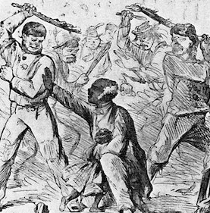
Detroit Race Riot (1863 CE)
He was later beaten more by the mob and died four days later. Although grievously hurt, the other four men persisted, as did the women and children.
Survivors said the mob attacked black businesses and houses, looting them and thieving them from the tenants.
The whites ultimately moved past the black area into poor white neighborhoods, resuming the defacement.
Some blacks fled the area, crossing the Detroit River to Canada.
The city finally summoned troops from Ypsilanti and Fort Wayne and, by 11 p.m., had quelled the violence. More than 200 blacks and some whites had lost their homes to the destruction—an assessed $20,000 property damage suffered primarily by blacks.
Faulkner was condemned and sentenced to prison for life.

Slide 11
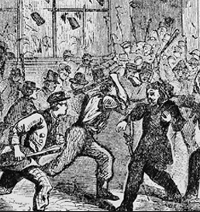
Detroit Race Riot (1863 CE)
Several years later, the two girls who testified against him recanted their story, and Faulkner was pardoned.
He returned to Detroit, where some white businessmen helped him start a produce business.
The city investigated the death of Boyd, but no one was charged with his death.
Although the Michigan Legislature urged payment for the riot victims, the Detroit City Council, dominated by Democrats, declined to do so.
These citizens, who had not been protected and whose property had been stolen and destroyed, were left to recuperate and remake their lives on their own. Due to the riot, the city founded a full-time police force.

Slide 12
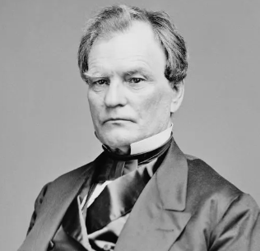
Wade Davis Bill (1864 CE)
The Wade–Davis Bill of 1864 was a bill to guarantee certain States whose governments had been usurped or overthrown a republican form of government, suggested for the Reconstruction of the South.
In resistance to President Abraham Lincoln's more forgiving ten percent plan, the bill made re-admittance to the Union for former Confederate states contingent on a majority in each ex-Confederate state to take the Ironclad Oath to the effect they had never in the past helped the Confederacy.
The bill passed both houses of Congress on July 2, 1864, but was pocket vetoed by Lincoln and never took effect.
The Radical Republicans were incensed that Lincoln did not sign the bill.
Lincoln desired to restore the Union by carrying out the ten percent plan. He felt it would be too challenging to fix all of the ties within the Union if the Wade–Davis bill passed.
The Wade–Davis Bill emerged from a plan in the Senate by Ira Harris of New York in February 1863.

Slide 13
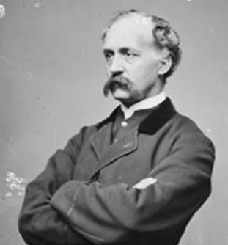
Wade Davis Bill (1864 CE)
It was written by two Radical Republicans, Senator Benjamin Wade of Ohio and Representative Henry Winter Davis of Maryland.
They submitted to base the Reconstruction of the South on the federal government's power to ensure a republican form of government.
The conditions, critics grumbled, were almost unattainable to meet, thus making it likely to have enduring national control over the previously rebellious states.
Although federally levied reconstruction conditions retrospectively appear rational, there was an overall view that southern Unionism would return the seceded states to the Union after they broke the Confederacy's military power.
They did not wholly forsake this idea until later in 1863. Lincoln's perspective of the war was that states were not constitutionally entitled to secede in the first place.
Thus, the so-called Confederate states were still part of the Union, even though their return to full participation would demand the fulfillment of some conditions. But he didn't think the war was being waged against "treasonous" States as such but to "compel the obedience of rebellious individuals."

Slide 14
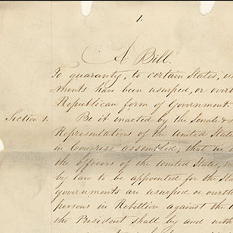
Wade Davis Bill (1864 CE)
The problem was that the bill’s language damaged the Union's motivation for the war by declaring that states in rebellion were no longer part of the Union.
Moreover, the bill pushed those states to draft new Constitutions banning slavery, which was unconstitutional at the time since, in the then-absence of a Constitutional amendment on the issue, Congress had no power to deal with slavery within each state.
On a more practical level, Lincoln also feared the bill would sabotage his reconstruction actions in states like Louisiana, Arkansas, and Tennessee, all of which had passed decrees of secession but were under Federal occupation and management of pro-Union governments.
It highlighted how Lincoln and Radical Republicans regarded the Confederates differently.
The President thought they needed to be goaded back into peaceful coexistence, while Wade–Davis treated them as turncoats that needed discipline. Lincoln killed the bill with a pocket veto, which was not resurrected.
Davis was a bitter enemy of Lincoln because he felt the President was too tolerant in his policies for the South.

Slide 15
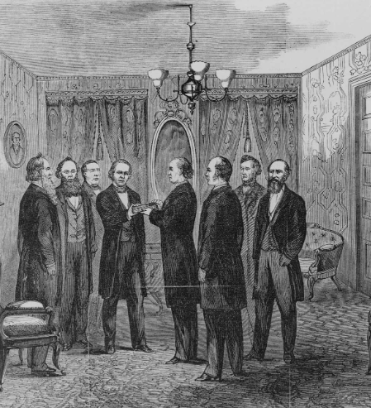
Wade Davis Bill (1864 CE)
After Lincoln's death, Radical Republicans combated President Andrew Johnson, who tried to enforce a version of Lincoln's plan.
Lincoln weathered their attacks and fortified his position with a landslide victory in the 1864 election and national passage of the 13th Amendment in February 1865.
He momentarily marginalized the Radicals in terms of shaping the Reconstruction procedure. The midterm elections of 1866 turned into a referendum on the 14th amendment and the course of Reconstruction policy.
With the Republicans' victory, Congress took control of reconstruction.
The radicals desired a much meaner plan, but they did not try to reimpose the terms of Wade-Davis.
Instead, they executed the Reconstruction Acts. They took control of the former rebel states with the United States Army, which registered black men as voters and blocked some former Confederate leaders from running for office.

Slide 16
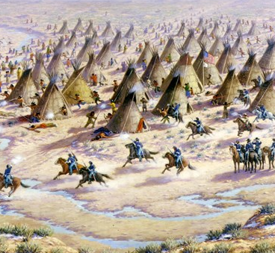
Sand Creek Massacre (1864 CE)
The Sand Creek massacre was a massacre of Cheyenne and Arapaho people by the US Army in the American Indian Wars that occurred on November 29, 1864, when the Third Colorado Cavalry under the command of US Volunteers Colonel John Chivington attacked and destroyed a village of Cheyenne and Arapaho people in southeastern Colorado Territory, killing and mutilating Native American people.
At the end of 1863 and the beginning of 1864, they received word that a coalition was to be formed among the plains tribes to "drive the whites out of the country."
In the spring and summer of 1864, the Sioux, Comanches, Kiowas, Cheyennes, and Arapahos were immersed in active aggressiveness, which led to the murder of numerous civilians, the destruction of livestock and crops, supplies to the region being cut off, and the Colorado settlers in jeopardy of starvation or murder at the hands of the plains tribes.
On April 13, a herdsman reported that Cheyennes and Arapahos had driven off 60 oxen and 12 horses and mules from their camp south of Denver.
They sent a small contingent of soldiers to repossess the livestock. The following conflict resulted in the death of four of the soldiers, and the tribes retained custody of the stolen livestock.

Slide 17
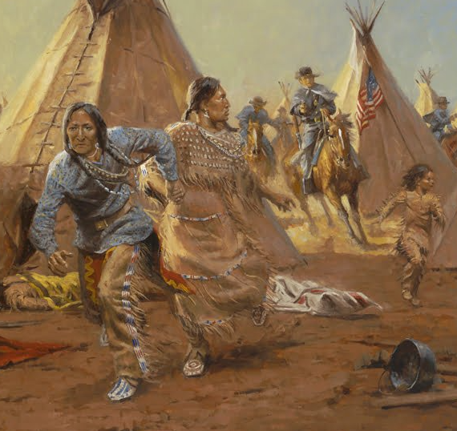
Sand Creek Massacre (1864 CE)
At dawn on November 29, 1864, approximately 675 US volunteer soldiers commanded by Colonel John M Chivington attacked a village of about 750 Cheyenne and Arapaho Indians along Sand Creek in the southeastern Colorado Territory.
The troops drove the people out of their camp with small arms and howitzer fire.
While many escaped the initial onslaught, others, particularly noncombatant women, children, and the elderly, fled into and up the bottom of the dry stream bed.
The soldiers followed, shooting at them as they struggled through the sandy earth.
Several hundred yards above the village, the women and children frantically excavated pits and trenches along either side of the streambed to protect themselves.
Some adult men attempted to hold back the Army with whatever weapons they had managed to retrieve from the camp.

Slide 18
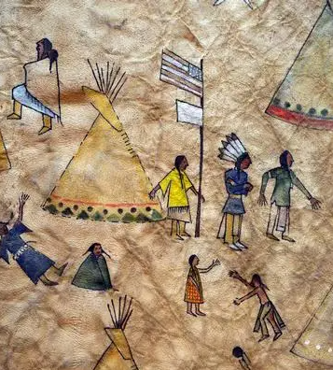
Sand Creek Massacre (1864 CE)
At several places along Sand Creek, the soldiers shot people from opposite banks and brought forward the howitzers to assault their improvised defenses.
Over eight hours, the troops killed around 230 Cheyenne and Arapaho people, primarily women, children, and the elderly.
During the afternoon and following day, the soldiers wandered over the field, committing atrocities on the dead before departing the scene on December 1 to resume campaigning.
The militia scalped its victims, mutilated them, and stuck the women's genitals on poles.
Soldiers cut fingers and ears off the bodies for the jewelry they carried.
Chivington and his men dressed their weapons, hats, and gear with scalps and other body parts, including human fetuses and male and female genitalia.
They publicly displayed these battle trophies in Denver's Apollo Theater and area saloons.
A local newspaper praised the militia for its "brilliant feat of arms," saying that the soldiers "covered themselves with glory."

Slide 19
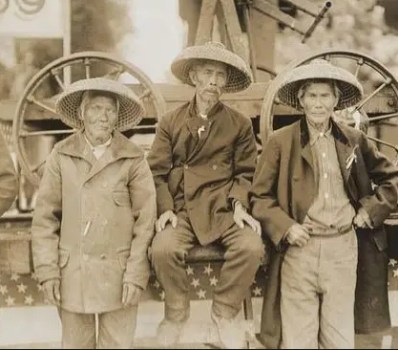
Chinese Workers (1864 CE)
The Chinese, who began arriving in the United States in significant numbers during the California Gold Rush, were considered too weak for the dangerous, strenuous job of building the railroad east from California.
Central Pacific Railroad director Charles Crocker suggested hiring Chinese workers after a job ad resulted in only a few hundred responses from white laborers.
But Crocker's plan hit opposition amid anti-Chinese sentiment from the California Gold Rush that gripped the state.
The construction superintendent James Strobridge didn't think the immigrants were strong enough to do the job.
Nonetheless, Central Pacific Railroad was desperate. White workers, whom the company wanted, did not sign on in numbers anything close to what was required.
It appears that the idea of hiring Chinese might have been raised first by Crocker's Chinese manservant.
Crocker's associates initially opposed it because of prejudice but then relented as they had few other options.
Central Pacific started with a crew of 21 Chinese workers in January 1864.
In January 1865, convinced that Chinese workers were skilled, the railroad hired 50 Chinese workers and 50 more.

Slide 20
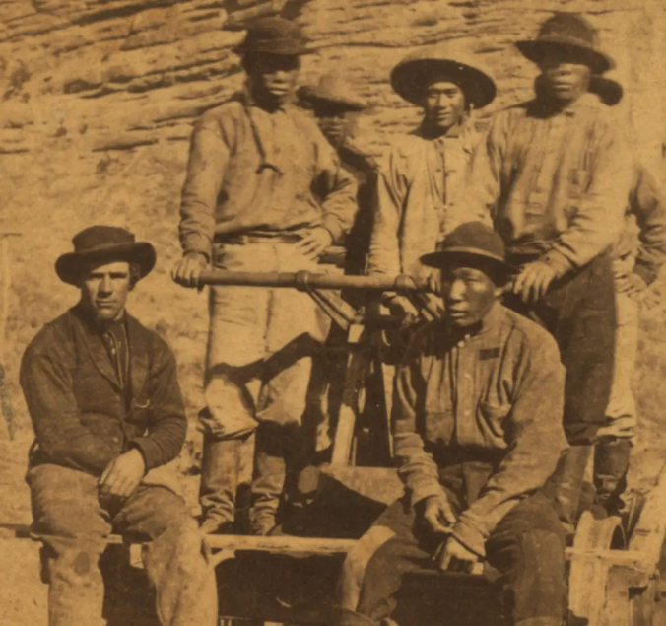
Chinese Workers (1864 CE)
But the need for labor increased, and white workers were reluctant to do such backbreaking, hazardous work.
Leland Stanford, president of Central Pacific, former California governor, and founder of Stanford University told Congress in 1865 that most of the railroad labor force were Chinese.
Without them," he said, "it would be unthinkable to complete the western portion of this great national enterprise within the time required by the Acts of Congress."
Hong Kong and China were as close in travel time as the eastern U.S. The Irish, who made up most of the Union Pacific workforce, which was laying tracks westward from Omaha, did not come out to California in large numbers until after the fruition of the Transcontinental.
Their duties included everything from unskilled labor to blacksmithing, tunneling, and carpentry, according to the Project, with most work done with hand tools.
Of course, the large number of immigrants working for Central Pacific and their hard work didn't mean they were well-treated or well-compensated for their actions.
Chinese workers hired in 1864 were paid $26 a month, working six days a week.
They eventually held an eight-day strike in June of 1867.

Slide 21
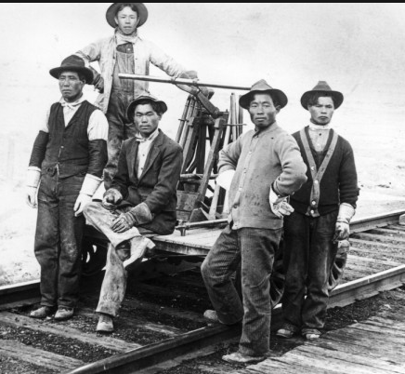
Chinese Workers (1864 CE)
Chinese received 30-50 percent lower wages than whites for the same job and had to pay for their foodstuffs.
They also had the most complex and risky work, including tunneling and using explosives.
They protested these and the long hours and used their collective strength to challenge the company.
There is also evidence they faced physical abuse at times from some supervisors.
The strike ended without pay parity after Central Pacific cut off food, transportation, and supplies to the Chinese living in camps, but, Chang says, they did not hold the strike in vain.
Working conditions improved following the strike. They scared the pants off the company leaders.
Despite Chinese workers' contributions to building America's historic infrastructure project, their history is often overlooked.

Slide 22
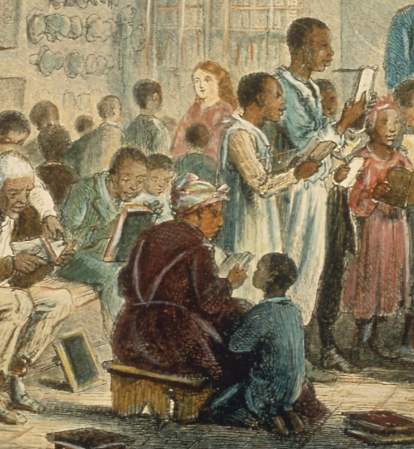
Freedmen's Bureau 1865 CE)
The Freedmen's Bureau was established in 1865 by Congress to help millions of formerly enslaved Black people and poor whites in the South in the aftermath of the Civil War.
The Freedmen's Bureau provided food, housing, and medical aid, established schools, and offered legal assistance.
It also attempted to settle formerly enslaved people on land confiscated or abandoned during the war.
However, they prevented the Bureau from fully carrying out its programs due to a shortage of funds and personnel and the politics of race and Reconstruction.
Congress established the Freedmen's Bureau on March 3, 1865, two months before Confederate General Robert E Lee surrendered to the Union's Ulysses S Grant at Appomattox Court House, Virginia, effectively ending the Civil War.
Intended as a temporary agency to last the duration of the war and one year afterward, the Bureau was placed under the authority of the War Department, and most of its original employees were Civil War soldiers.

Slide 23
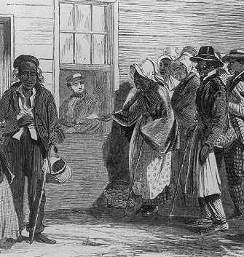
Freedmen's Bureau 1865 CE)
America's Reconstruction era was turbulent, as the nation struggled to rebuild the South and transition the 4 million newly freed blacks from slavery to a free-labor society.
There was no tradition of government responsibility for a huge refugee population and no bureaucracy to administer significant welfare, employment, and land reform program.
From the start, the Bureau faced resistance from various sources, including many white Southerners.
Another leading opponent was President Andrew Johnson, who assumed office in April 1865 following the assassination of Abraham Lincoln.
When Congress introduced a bill in February 1866 to extend the Bureau's tenure and give it new legal powers, Johnson vetoed the proposed legislation because it interfered with states' rights, gave preference to one group of citizens over another, and would impose a substantial financial burden on the federal government, among other issues.
In July that same year, Congress overrode the president's veto and passed a revised bill version.

Slide 24
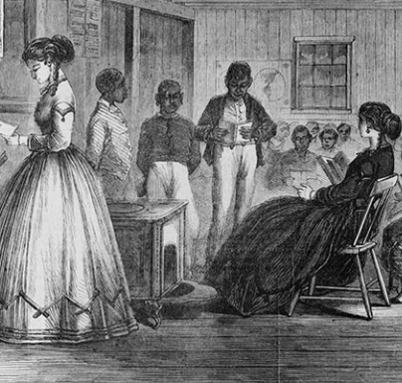
Freedmen's Bureau 1865 CE)
However, Johnson became embroiled in a bitter fight with the Radical Republicans in Congress, who viewed the president's Reconstruction policies as too lenient, and the Freedmen's Bureau suffered as a result.
Johnson's actions, which included pardoning many former Confederates, restoring their land, and removing bureau employees he thought were too sympathetic to blacks, undermined the Bureau's authority.
The Bureau's mission was further muddled by the fact that even among the agency's supporters in Congress and its personnel, there was disagreement over what type of assistance the government should provide and for how long.
The Freedmen's Bureau was organized into districts covering the 11 former rebel states, the border states of Maryland, Kentucky, and West Virginia, and Washington, D.C. Each section was headed by an assistant commissioner.
The Bureau's achievements varied from one location to another and from one agent to the next.
Over its course of existence, the Bureau was underfunded and understaffed, with just 900 agents at its peak.

Slide 25
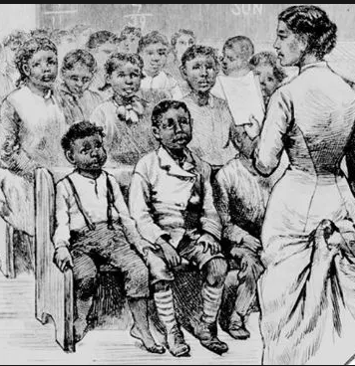
Freedmen's Bureau 1865 CE)
Bureau agents, who acted essentially as social workers and were frequently the only federal representatives in Southern communities, were subjected to ridicule and violence from whites, who viewed the agents as interfering in local affairs by trying to assist blacks.
While some agents were corrupt or incompetent, others were hardworking and brave people who made significant contributions.
During its years of operation, the Freedmen's Bureau fed millions of people, built hospitals and provided medical aid, negotiated labor contracts for ex-slaves, and settled labor disputes.
It also helped formerly enslaved people legalize marriages, locate lost relatives, and assist black veterans.
The Bureau also was instrumental in building thousands of schools for blacks and helped to found such colleges as Howard University in Washington DC.
The Bureau frequently worked with the American Missionary Association and other private charity organizations.

Slide 26
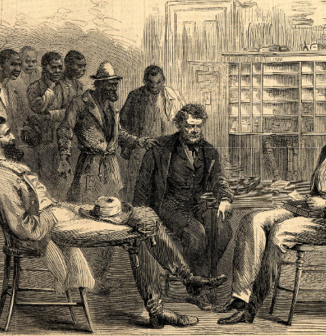
Freedmen's Bureau 1865 CE)
Additionally, with little success, the Bureau tried to promote land redistribution.
However, most of the confiscated or abandoned Confederate land was eventually restored to the original owners, so there was little opportunity for black land ownership, which was seen as a means to success in society.
In the summer of 1872, Congress, responding partly to pressure from white Southerners, dismantled the Freedmen's Bureau. Since that time, historians have debated the agency's effectiveness.
A lack of funding, coupled with the politics of race and Reconstruction, meant that the Bureau could not carry out all of its initiatives and failed to provide long-term protection for blacks or ensure any objective measure of racial equality.
However, the Bureau's efforts signal the federal government's introduction into social welfare and labor relations issues.

Slide 27
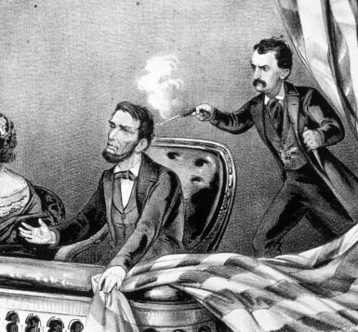
Lincoln Assassination (1865 CE)
On the evening of April 14, 1865, John Wilkes Booth, a famous actor and Confederate supporter assassinated President Abraham Lincoln at Ford's Theatre in Washington, DC.
The attack came only five days after Confederate General Robert E. Lee surrendered his massive army at Appomattox Court House, Virginia, effectively ending the American Civil War.
John Wilkes Booth was a Maryland native born in 1838 into a household of prominent actors.
Booth would ultimately take the stage, appearing in 1855 in Shakespeare's Richard III in Baltimore.
Despite his Confederate compassion, Booth stayed in the North during the Civil War, pursuing a thriving career as an actor.
But as the war entered its final stages, he and several associates hatched a plot to kidnap the president and take him to Richmond, the Confederate capital.
On March 20, 1865, the day of the planned kidnapping, Abraham Lincoln failed to appear at the spot where Booth and his six fellow schemers lay in wait, hindering their planned abduction.

Slide 28
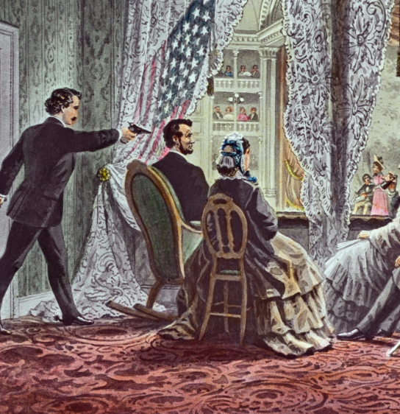
Lincoln Assassination (1865 CE)
Two weeks later, Richmond fell to Union forces, and on April 9, General Robert E Lee surrendered at Appomattox Court House.
Learning that Lincoln was to attend Laura Keene's acclaimed performance of "Our American Cousin" at Ford's Theatre in Washington, DC, on April 14, Booth masterminded a plan even more sinister than abduction.
He and his co-conspirators considered the simultaneous assassination of Lincoln, Vice President, and Secretary of State —the president and two of his possible successors—would throw the US government into disarray.
The Lincolns arrived late for the comedy, but the president was reportedly in a fine mood and laughed jovially during the production.
Lincoln occupied a private box above the stage with his wife Mary Todd Lincoln, a young army officer named Henry Rathbone, and Rathbone's fiancé, Clara Harris, the daughter of New York Senator Ira Harris.

Slide 29
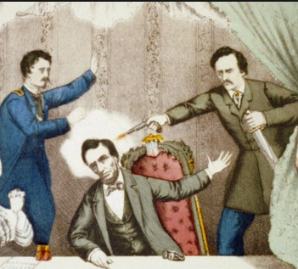
Lincoln Assassination (1865 CE)
At 10:15, Booth slipped into the box and fired his .44-caliber single-shot derringer pistol into the back of Lincoln's head.
After stabbing Rathbone, who instantly rushed at him in the shoulder, Booth jumped onto the stage and shouted, "Sic Semper tyrannis!" or "Thus ever to tyrants!"—the Virginia state motto).
At first, the crowd diagnosed the unfolding drama as part of the production, but a scream from the first lady told them otherwise.
Although Booth broke his leg in the fall, he managed to leave the theater and flee from Washington on horseback.
A 23-year-old doctor named Charles Leale was in the audience and hurried to the presidential box immediately upon hearing the shot and Mary Lincoln's scream.
He found the president slouched in his chair, paralyzed and laboring to breathe.

Slide 30
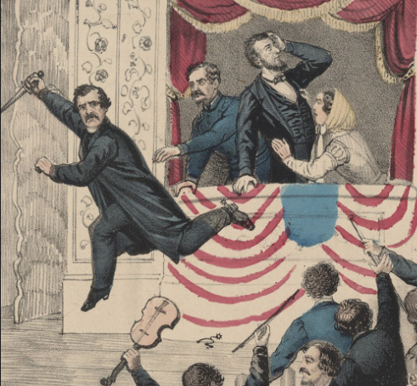
Lincoln Assassination (1865 CE)
Several soldiers carried Lincoln to a boardinghouse across the street and placed him on a bed.
When the surgeon general reached the house, he deduced that Lincoln could not be saved and would probably die at night.
Vice President Andrew Johnson, members of Lincoln's cabinet, and several of his closest friends stood guard by the president's bedside in the boardinghouse.
The first lady lay on a bed in an adjacent room with her eldest son, Robert Todd Lincoln, at her side, overcome with shock and grief.
Ultimately, Lincoln was pronounced dead at 7:22 a.m. on April 15, 1865, at 56.
News of the president's death traveled quickly. By the end of the day, flags across the country flew at half-mast, businesses were shut, and people who had just delighted at the end of the Civil War now staggered from Lincoln's shocking assassination.

Slide 31
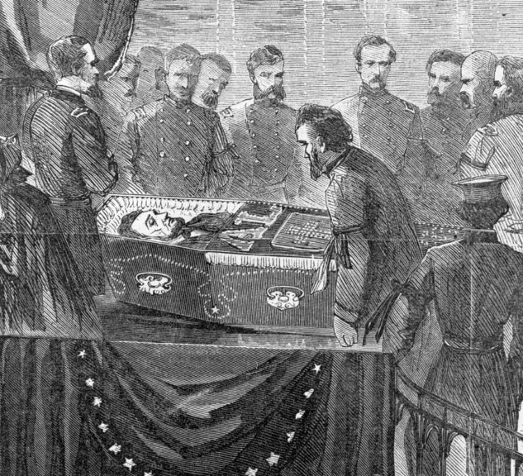
Lincoln Assassination (1865 CE)
On April 18, they carried Lincoln's body to the Capitol dome.
Three days later, his remains were boarded onto a train that brought him to Springfield, Illinois, where he had lived before becoming president.
Lincoln and his son, William Wallace Lincoln ("Willie"), who died in the White House of typhoid fever in 1862, were interred on May 4, 1865, at Oak Ridge Cemetery near Springfield.
Tens of thousands of Americans lined the railroad route and paid their respects to their fallen leader during the train's solemn progression through the North.
Mary Todd Lincoln was so overwhelmed that she took to her bed for weeks and missed the funeral. She was soon outcast from society for her vocal grief.
As the nation grieved, Union soldiers were hot on John Wilkes Booth's trail, which many in the audience had instantly recognized.
After fleeing the capital, he and an abettor, David Herold, made their way across the Anacostia River and headed toward southern Maryland.

Slide 32
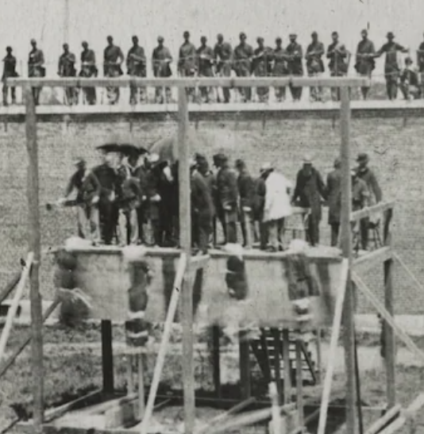
Lincoln Assassination (1865 CE)
They sought sanctuary from Thomas A Jones, a Confederate agent, before securing a boat to row across the Potomac to Virginia.
The pair stopped at the home of Samuel Mudd, a doctor who treated Booth's broken leg. Mudd's actions earned him a life sentence that was later commuted.
On April 26, Union troops encircled the Virginia barn where Booth and Herold were hiding and set fire to it, hoping to flush the fugitives out.
As the blaze intensified, a sergeant shot Booth in the neck, allegedly because the killer had lifted his gun as if to attack.
Herold yielded, but Booth stayed inside.
Carried out of the building alive, Booth remained for three hours before gazing at his hands and uttering his last words: "Useless, useless."
Four of Booth's co-conspirators were sentenced for their part in the assassination and executed by hanging on July 7, 1865.
They included David Herold and Mary Surratt, the first woman put to death by the federal government, whose boardinghouse had acted as a meeting place for the would-be kidnappers.

Slide 33
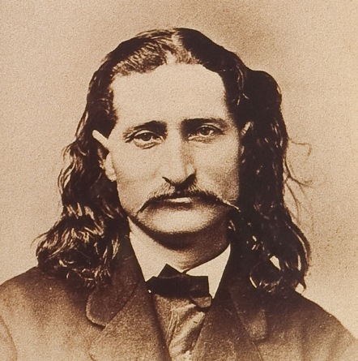
Wild Bill Hickok (1865 CE)
James Butler Hickok, better known as "Wild Bill" Hickok, was a folk hero of the American Old West known for his life on the frontier as a soldier, scout, lawman, gambler, showman, and actor, and for his involvement in many famous gunfights.
He earned much notoriety in his own time, much of it bolstered by the many outlandish and often fabricated tales he told about himself.
Some contemporary reports of his exploits are known to be fictitious, but they remain the basis of much of his fame and reputation.
Drawn to a ruffian lifestyle, he headed west at age 18 as a fugitive from justice, working as a stagecoach driver and later as a lawman in Kansas and Nebraska frontier territories.
He fought and spied for the Union Army during the American Civil War and gained publicity as a scout, marksman, actor, and professional gambler after the war.
He was involved in several notable shootouts during his life.
Much of his career is known to have been exaggerated by himself and contemporary mythmakers.

Slide 34
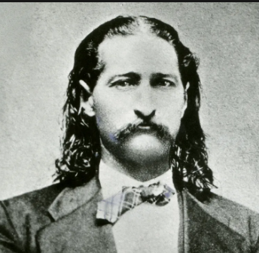
Wild Bill Hickok (1865 CE)
While in Springfield, Hickok and a local gambler named Davis Tutt had several disagreements over unpaid gambling debts and their common affection for the same women.
Hickok lost a gold watch to Tutt in a poker game.
The watch had great sentimental value to Hickok, so he asked Tutt not to wear it in public.
They initially agreed not to fight over the watch, but when Hickok saw Tutt wearing it, he warned him to stay away.
On July 21, 1865, the two men faced off in Springfield's town square, standing sideways before drawing and firing their weapons.
Their quick-draw duel was recorded as the first of its kind.
Tutt's shot missed, but Hickok's struck Tutt through the heart from about 75 yards away.
Tutt called out, "Boys, I'm killed", before he collapsed and died.

Slide 35
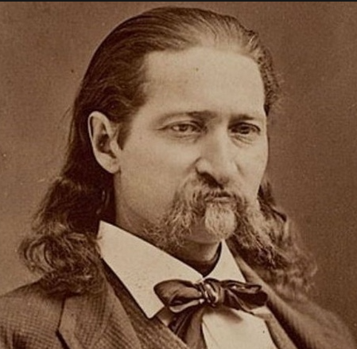
Wild Bill Hickok (1865 CE)
On August 1, 1876, Hickok played poker at Nuttal & Mann's Saloon No. 10 in Deadwood, Dakota Territory.
When a seat opened at the table, a drunk man named Jack McCall sat down to play.
McCall lost heavily.
Hickok encouraged McCall to quit the game until he could cover his losses and offered to give him money for breakfast.
Although McCall accepted the money, he was insulted. The next day, Hickok was playing poker again.
He usually sat with his back to a wall so he could see the entrance, but the only seat available when he joined the game was a chair facing away from the door.
He twice asked another man at the table, Charles Rich, to change seats with him, but Rich refused.

Slide 36
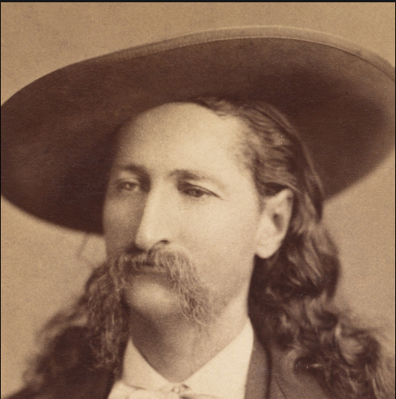
Wild Bill Hickok (1865 CE)
McCall entered the saloon, walked up behind Hickok, drew his Colt Model 1873 Single Action Army .45-caliber revolver, and shouted, "Damn you! Take that!" before shooting Hickok in the back of the head at point-blank range. Hickok died instantly.
The bullet emerged through his right cheek and struck another player, Captain William Massie, in the left wrist.
Hickok may have told his friend Charlie Utter and others traveling with them that he thought someone would kill him in Deadwood.
A 5-card stud poker hand lays on a table showing black aces and eights, with the hole-card face down.
The poker hand purportedly held by Hickok at his demise
Hickok was playing five-card stud or five-card draw when he was shot.
He was holding two pairs: black aces and black eights (although there is some dispute as to the suit of one of the aces, diamond vs. spade) as his "up cards," which has since become widely known as the "dead man's hand.“
The identity of the fifth card (his "hole card") is also the subject of debate.

Slide 37
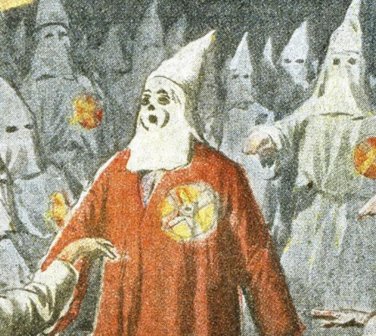
Ku Klux Klan (1865 CE)
Founded in 1865, the Ku Klux Klan spread into almost every southern state by 1870.
It became a conveyance for white southern resistance to the Republican Party’s Reconstruction-era policies to establish political and economic equality for Black Americans.
Its associates waged an underground campaign of coercion and brutality directed at white and Black Republican leaders.
Though Congress passed legislation designed to curb Klan terrorism, the organization saw its primary goal–the reestablishment of white supremacy–fulfilled through Democratic victories in state legislatures across the South in the 1870s.
A group including many former Confederate veterans founded the first branch of the Ku Klux Klan as a social club in Pulaski, Tennessee, in 1865.
The first two words of the organization’s name are stemmed from the Greek word “kyklos,” meaning circle.
In the summer of 1867, local branches of the Klan met in a general organizing convention and specified what they called an “Invisible Empire of the South.”

Slide 38
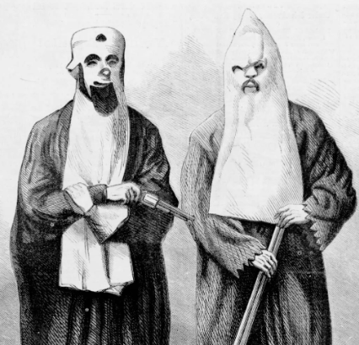
Ku Klux Klan (1865 CE)
Leading Confederate general Nathan Bedford Forrest was chosen as the first leader, or “grand wizard,” of the Klan; he presided over a hierarchy of grand dragons, grand titans, and grand cyclopses.
The organization of the Ku Klux Klan coincided with the beginning of the second phase of post-Civil War Reconstruction, put into place by the more radical members of the Republican Party in Congress.
After declining President Andrew Johnson’s relatively forgiving Reconstruction policies from 1865 to 1866, Congress passed the Reconstruction Act over the presidential veto. Under its provisions, the South was divided into five military districts.
Each state was required to approve the 14th Amendment, which granted “equal protection” of the Constitution to formerly enslaved people and enacted universal male suffrage.
From 1867 onward, Black participation in public life in the South became one of the most extreme elements of Reconstruction, as Black people won elections to southern state governments and even to the US Congress.
For its part, the Ku Klux Klan dedicated itself to an underground campaign of violence against Republican leaders and voters (both Black and white) to reverse the policies of Radical Reconstruction and restore white supremacy in the South.
At least 10 percent of the Black legislators elected during the 1867-1868 constitutional conventions became victims of violence during Reconstruction, including seven killed.

Slide 39
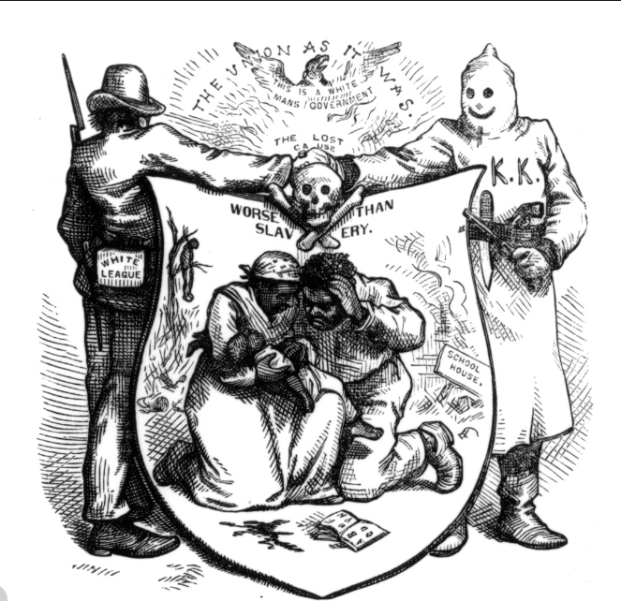
Ku Klux Klan (1865 CE)
White Republicans were criticized as “carpetbaggers” and “scalawags,” Black institutions such as schools and churches—symbols of Black liberation—were also marks for Klan attacks.
By 1870, the Ku Klux Klan had branches in nearly every southern state. Even at its height, the Klan did not boast a well-organized structure or clear leadership.
Local Klan members–often wearing masks and dressed in the organization’s signature long white robes and hoods–usually carried out their attacks at night, acting on their own but defending the common goals of defeating Radical Reconstruction and repairing white supremacy in the South.
Klan activity grew mainly in the regions of the South where Black people were a minority or a slight majority of the population and were relatively limited in others.
Among the most notorious zones of Klan activity was South Carolina, where in January 1871, 500 masked men attacked the Union county jail and lynched eight Black prisoners.
Democratic leaders would later attribute Ku Klux Klan violence to poorer southern white people.
Yet, the organization’s membership crossed class lines, from small farmers and laborers to planters, lawyers, merchants, physicians, and ministers.

Slide 40
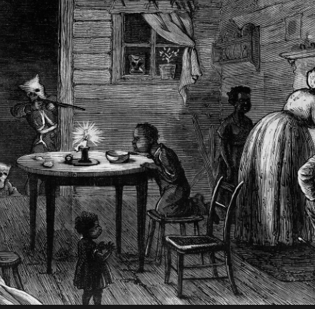
Ku Klux Klan (1865 CE)
In the regions where most Klan activity occurred, local law enforcement officials either belonged to the Klan or refused to act against it.
Even those who arrested accused Klansmen found it difficult to find witnesses willing to testify against them.
Other leading white citizens in the South declined to speak out against the group’s actions, giving them implied approval.
After 1870, Republican state governments in the South turned to Congress for help, resulting in the passage of three Enforcement Acts, the strongest of which was the Ku Klux Klan Act of 1871.
For the first time, the Ku Klux Klan Act designated certain crimes committed by individuals as federal offenses, including conspiracies to deny citizens the right to hold office, serve on juries and enjoy the equal protection of the law.
The act authorized the president to suspend the writ of habeas corpus, arrest accused individuals without charge, and send federal forces to suppress Klan violence.
This expansion of federal authority–which Ulysses S. Grant promptly used in 1871 to crush Klan activity in South Carolina and other areas of the South–outraged Democrats and even alarmed many Republicans.
From the early 1870s onward, white supremacy gradually reasserted its hold on the South as support for Reconstruction weakened; by 1876, the entire South was under Democratic control once again.

Slide 41
Civil Rights Act of 1866
The Civil Rights Act of 1866 was the first United States federal law to define citizenship and affirm that the law equally protects all citizens.
The Act was passed by Congress in 1866 and vetoed by United States President Andrew Johnson.
In April 1866, Congress again passed the bill to back the Thirteenth Amendment, and Johnson again vetoed it.
Still, a two-thirds majority in each chamber overrode the veto to allow it to become law without a presidential signature.
John Bingham and other members of Congress asserted that Congress did not yet have sufficient constitutional power to enact this law.
Following the passage of the Fourteenth Amendment in 1868, Congress ratified the 1866 Act in 1870.

Slide 42
Civil Rights Act of 1866
The Act had three primary goals for the integration of African Americans into American society following the Civil War:
A definition of American citizenship.
The rights which come with this citizenship.
The unlawfulness of depriving any person of citizenship rights "based on race, color, or prior condition of slavery or involuntary servitude" The Act accomplished these three primary objectives.
The author of the Civil Rights Act of 1866 was United States Senator Lyman Trumbull.
On April 5, 1866, the Senate overrode President Andrew Johnson's veto.
This marked the first time the US Congress ever overrode a presidential veto for a substantial piece of legislation.
Senator Lyman Trumbull claimed that Congress had the power to enact it to eliminate a discriminatory "badge of servitude" prohibited by the Thirteenth Amendment.

Slide 43
Civil Rights Act of 1866
After the enactment of the Civil Rights Act of 1866 by overriding a presidential veto, some members of Congress supported the Fourteenth Amendment to eradicate doubts about the constitutionality of the Civil Rights Act of 1866 or to ensure that no ensuing Congress could later repeal or alter the main provisions of that Act.
Ratification of the Fourteenth Amendment was completed in 1868, 2 years after officials reenacted the 1866 Act as Section 18 of the Enforcement Act of 1870.
After officials overrode Johnson's veto, the measure became law.
Despite this accomplishment, even some Republicans who had supported the goals of the Civil Rights Act began to doubt that Congress possessed the constitutional power to turn those goals into laws.
The experience provoked radical and moderate Republicans to seek Constitutional guarantees for black rights rather than relying on temporary political majorities.
The actions of groups such as the Ku Klux Klan undermined the Act, meaning it failed to instantly secure African Americans' civil rights.
While it has been illegal in the US to discriminate in employment and housing based on race since 1866, they did not provide federal penalties until the second half of the 20th century

Slide 44
Black Codes
The Black Codes were laws governing the conduct of African Americans.
Although Black Codes existed before the Civil War and many Northern states had them; Southern US states codified such laws in everyday practice.
The best known of them were passed in 1865 and 1866 by Southern states after the American Civil War to restrict African Americans' autonomy and to force them to work for low or no wages.
In the first two years after the Civil War, white-dominated Southern legislatures passed Black Codes modeled after the earlier slave codes.
Black Codes were part of the more effective practice of whites trying to preserve political dominance and suppress the freedmen, newly emancipated African Americans.
They were primarily concerned with controlling the movement and labor of freedmen, as a free labor system had replaced slavery.
Although freedmen had been liberated, their lives were greatly restricted by the Black Codes.

Slide 45
Black Codes
The defining feature of the Black Codes was broad vagrancy law, which permitted local authorities to arrest freed people for minor infractions and commit them to involuntary labor.
This period started the convict lease system, also described as "slavery by another name."
As the Civil War ended, the US Army enforced Black Codes to regulate the behavior of black people in general society.
Although the Freedmen's Bureau had the mandate to protect blacks from a hostile Southern environment, it also sought to keep blacks in their place as laborers to allow production on the plantations to resume so the South could revive its economy.
The Freedmen's Bureau cooperated with Southern authorities in rounding up black "vagrants" and placing them in contract work.
In some places, it supported owners in maintaining control of young, enslaved people as apprentices.

Slide 46
Black Codes
In all, twenty-one states put in place Jim Crow laws against miscegenation.
Free whites could no longer marry an enslaved person and thereby emancipate her and her children, and no freedman could accept a donation or inheritance from a white person.
Soon after the end of slavery, white planters faced a labor shortage and sought a way to manage it.
Although blacks did not all unexpectedly stop working, they did try to work less.
In particular, many sought to reduce their Saturday work hours, and women wanted to spend more time on childcare.
Southern Whites also perceived Black vagrancy as a sudden and dangerous social problem.

Slide 47
Black Codes
Preexisting White American belief of Black inferiority informed post-war attitudes.
White racial dominance continued to be culturally entrenched; Whites believed that Black people were destined for servitude and that they would not work unless physically compelled.
For their part, free Blacks no longer felt obligated to show apparent deference to White people.
The enslaved also strove to create a semi-autonomous social world, removed from the plantation and the gaze of the enslaver.
The racial divisions that slavery had created directly became more apparent.
Blacks also bore the brunt of Southern anger over defeat in the War.

Slide 48
Black Codes
Legislation on the status of freed people was often required by constitutional conventions held in 1865.
Mississippi, South Carolina, and Georgia included language in their new state constitutions which instructed the legislature to "guard them and the State against any evils that may arise from their sudden emancipation."
The Florida convention of October 1865 included a vagrancy ordinance that was in effect until lawmakers could pass Black Codes through the standard legislative process.
Nine Southern states updated their vagrancy laws in 1866.
Of these, eight allowed convict leasing (a system in which state prisons hired convicts for labor), and five qualified prisoner labor for public works projects.
This created a system that established motivations to arrest black men, as convicts were supplied to local governments and planters as free workers.
The farmers or other supervisors were responsible for their board and food, and black convicts were kept in unfortunate conditions.

Slide 49
Black Codes
Because they relied on convict leasing, Southern states did not build any prisons until the late 19th century.
Another essential part of the Codes was the annual labor contracts, which Black people had to keep and present to leaders to avoid vagrancy charges.
Strict punishments against theft also trap many people in the legal system.
Previously, Blacks had been part of the domestic economy on a plantation and were able to use available supplies.
After emancipation, the same act perpetrated by someone working the same land might be labeled theft, leading to arrest and involuntary labor.
Some states explicitly curtailed Black people's right to bear arms, justifying these laws with claims of imminent insurrection. In Mississippi and Alabama, legislatures enforced these laws by creating special militias.
During Reconstruction, state legislatures passed laws that established positive rights for freedmen. States legalized Black marriages and, in some cases, increased freedmen's rights to own property and conduct commerce.

Slide 50
Reconstruction Acts (1867 CE)
The Reconstruction Acts or the Military Reconstruction Acts were four statutes passed during the Reconstruction Era by the 40th United States Congress addressing the provision for the Southern States to be readmitted to the Union.
The actual title of the initial legislation was "An act to provide for the more efficient government of the Rebel States," passed on March 4, 1867.
Completion of the Acts required the former Confederate States to be readmitted to the Union from military and Federal control imposed during and after the American Civil War.
The Acts excluded Tennessee, which had already ratified the 14th Amendment and had been readmitted to the Union on July 24, 1866.
The succession of Andrew Johnson to the Presidency following the assassination of Abraham Lincoln was initially supported by Radicals in Congress, who thought Johnson's policies would be more punitive and far-reaching than Lincoln’s.
However, Johnson took a conciliatory approach and inflicted almost no punishment on the South, even as Southern states passed the Black Codes and sent Confederates to Congress.
Reconstruction began under the Union Army, which enforced policies helping their military goals. Johnson sought to finish Reconstruction by December 1865, before Congress would meet again.
He was unsuccessful at this goal, and when Congress met in 1866, they passed the Freedmen's Bureau Bill and the Civil Rights Act of 1866, both over Johnson's veto.
Johnson's hostility to Congressional plans led to growing discontent in Congress with his administration.
The midterm elections of 1866 produced a resounding acceptance of Radical policy and rejection of Johnson’s.
Support grew among Congressional Republicans to wipe away the current Johnson state governments and their abuses and to create new governments.

Slide 51
Reconstruction Acts (1867 CE)
The passage of the Reconstruction Acts marks the advent of Congressional Reconstruction.
The Acts set forth the conditions for the late rebel states to regain entry into the Union.
For reentry, each state had to draft a new state constitution, which would have to be authorized by Congress. These constitutions would have to enfranchise the freedmen and abolish the Black Codes.
A vital addition of the Acts included the creation of five military districts in the South, each commanded by a general, which would serve as the highest authority for the region.
However, few generals were involved in the day-to-day affairs, notably, after officials passed new constitutions.
The states were also required to ratify the Fourteenth Amendment to the United States Constitution. Congress overrode President Andrew Johnson's vetoes of these measures.
General George Meade of the Third Military District appointed Brigadier General Thomas H Ruger to replace Governor of Georgia Charles J Jenkins, who had been elected as the only candidate in 1865 to succeed James Johnson, who President Andrew Johnson had appointed.
After Ex parte McCardle came before the United States Supreme Court, Congress feared that the Court might strike the Reconstruction Acts unconstitutional.
To avert this, Congress rescinded the Habeas Corpus Act of 1867, stopping the Supreme Court's jurisdiction over the case.

Slide 52
14th Amendment (1868 CE)
The 14th Amendment to the US Constitution, ratified in 1868, granted citizenship to all persons born or naturalized in the United States—including formerly enslaved people—and assured all citizens "equal protection of the laws."
One of three amendments passed during the Reconstruction era to abolish slavery and establish civil and legal rights for Black Americans would become the basis for many landmark Supreme Court decisions over the years.
In its later sections, the 14th Amendment allowed the federal government to punish states that violated or abridged their citizens' right to vote by proportionally lessening the states' representation in Congress and mandated that anyone who "engaged in insurrection" against the United States could not hold civil, military or elected office (without the approval of two-thirds of the House and Senate).
Abraham Lincoln's assassination in April 1865 left his successor, President Andrew Johnson, to handle the complex process of integrating former Confederate states back into the Union after the Civil War and establishing formerly enslaved people as free and equal citizens.

Slide 53
14th Amendment (1868 CE)
Johnson, a Democrat from Tennessee, supported emancipation, but he differed significantly from the Republican-controlled Congress in his view of how Reconstruction should proceed.
Johnson showed comparable leniency toward the former Confederate states as they were reintroduced into the Union.
But many northerners were outraged when the newly elected southern state legislatures—largely dominated by former Confederate leaders—enacted black codes, which were repressive laws that strictly regulated the behavior of Black citizens and virtually kept them conditional on white planters.
In creating the Civil Rights Act of 1866, Congress used the power given to enforce the newly ratified 13th Amendment, which abolished slavery and defended the rights of Black Americans.
Johnson vetoed the bill, and though Congress successfully overrode his veto and made it into law in April 1866—the first time in history that Congress overrode a presidential veto of a substantial bill—even some Republicans thought another amendment was critical to provide firm constitutional grounds for the new legislation.

Slide 54
14th Amendment (1868 CE)
In late April, Representative Thaddeus Stevens introduced a plan that combined several different legislative proposals (civil rights for Black people, how to apportion representatives in Congress, punitive measures against the former Confederate States of America, and repudiation of Confederate war debt) into a single constitutional amendment.
After the House and Senate voted on the Amendment by June 1866, they submitted it to the states for ratification.
President Johnson fought the 14th Amendment as it made its way through the ratification process, but Congressional elections in late 1866 gave Republicans veto-proof majorities in both the House and Senate.
Southern states also opposed it, but Congress needed them to ratify the 13th and 14th Amendments as a condition of regaining representation in Congress.
The ongoing presence of the Union Army in the former Confederate states ensured their compliance.

Slide 55
14th Amendment (1868 CE)
On July 9, 1868, Louisiana and South Carolina voted to ratify the 14th Amendment, making up the necessary three-fourths majority.
The opening sentence of Section One of the 14th Amendment defined US citizenship: "All persons born or naturalized in the United States and subject to the jurisdiction thereof, are citizens of the United States and the State wherein they reside."
This repudiated the Supreme Court's notorious 1857 Dred Scott decision.
Chief Justice Roger Taney wrote that a Black man could not claim citizenship rights under the federal Constitution, even if born free.

Slide 56
The Treaty of Fort Laramie (1868 CE)
The Treaty of Fort Laramie is an agreement between the United States and the Oglala, Miniconjou, and Brulé bands of Lakota people, Yanktonai Dakota and Arapaho Nation, following the failure of the first Fort Laramie treaty, signed in 1851.
The Treaty was forged to end a two-year campaign of raids and ambushes along the Bozeman trail, a shortcut thousands of white migrants were using to reach the gold mines in Montana Territory.
The Treaty is divided into 17 articles. It established the Great Sioux Reservation, including ownership of the Black Hills, and set aside additional lands as "unceded Indian territory" in South Dakota, Wyoming, Nebraska, and possibly Montana.
It established that the US government would hold the authority to punish white settlers who committed crimes against the tribes and tribe members who committed crimes and were to be delivered to the government rather than to face charges in tribal courts.
It stipulated that the government would abandon forts along the Bozeman Trail.
It included several provisions designed to encourage a transition to farming and move the tribes "closer to the white man's way of life."
The Treaty protected specified rights of third parties not partaking in the negotiations and effectively ended Red Cloud's War.
That provision did not include the Ponca, who was not a party to the Treaty and so had no opportunity to object when the American treaty negotiators "inadvertently" broke a separate treaty with the Ponca by unlawfully selling the entirety of the Ponca Reservation to the Lakota, according to Article II of this Treaty.
The United States never intervened to return the Ponca land. Instead, the Lakota claimed the Ponca land as their own and set about attacking and demanding tribute from the Ponca until 1876, when US President Ulysses S. Grant chose to resolve the situation unilaterally by ordering the Ponca removed to the Indian Territory.
The removal, known as the Ponca Trail of Tears, was carried out by force the following year and resulted in over 200 deaths.
The Treaty was negotiated by government-appointed Indian Peace Commission members and signed between April and November 1868 at and near Fort Laramie in the Wyoming Territory.
The final signatories were Red Cloud himself and others who accompanied him. Animosities over the agreement arose quickly, with neither side fully honoring the terms.
Open war again broke out in 1876, and the US government unilaterally annexed native land protected under the Treaty in 1877.

Slide 57
The Treaty of Fort Laramie (1868 CE)
Although the Treaty required the consent of three-fourths of the men of the tribes, many did not sign or recognize the results.
Others would later complain that the Treaty contained complex language that was not well explained to avoid arousing suspicion.
Yet others would not thoroughly learn the terms of the agreement until 1870, when Red Cloud returned from a trip to Washington, DC.
The Treaty overall, and in comparison with the 1851 agreement, represented a departure from earlier considerations of tribal customs and demonstrated the government's "more heavy-handed position concerning tribal nations, and ... desire to assimilate the Sioux into American property arrangements and social customs."
According to one source, "animosities over the treaty arose almost immediately" when a group of Miniconjou was informed they were no longer welcome to trade at Fort Laramie, south of their newly established Territory.
This was notwithstanding that the Treaty did not stipulate that the tribes could not travel outside their land, only that they would not permanently occupy outside land.
The only travel expressly forbidden by the Treaty was that of white settlers onto the reservation.

Slide 58
The Treaty of Fort Laramie (1868 CE)
Although a treaty between the US and the Sioux, it profoundly affected the Crow tribe since it held the title to some of the territories set aside in the new Treaty.
By entering the peace talks, "... the government had betrayed the Crows, who had willingly helped the army to hold the [Bozeman Trail] posts ...".
When the Sioux Indians stopped the advance of the US in 1868, they quickly resumed their "own program of expansions" into the adjoining Indian territories.
Although all parties took and gave, the Sioux and their allies once again threatened the homeland of some of the Indian nations around them.
Attacks on the Crows and the Shoshones were "frequent, both by the Northern Cheyennes and by the Arapahos, as well as the Sioux, and by parties made up from all three tribes." The Crows reported Sioux Indians in the Bighorn area from 1871.
The Sioux took this eastern part of the Crow reservation a few years later in quest of buffalo.
When a force of Sioux warriors confronted a Crow reservation camp at Pryor Creek in 1873 throughout the day, Crow chief Blackfoot called for decisive actions against the Indian intruders by the US.
In 1876, the Crows (and the Eastern Shoshones) fought alongside the Army at the Rosebud. They scouted for Custer against the Sioux, "who were now in the old Crow country."

Slide 59
The Treaty of Fort Laramie (1868 CE)
The tribes and the government chose to ignore the Treaty portions or "comply only as long as conditions met their favor."
Between 1869 and 1876, at least seven separate skirmishes occurred near Fort Laramie. Before the Black Hills expedition, Army sources mentioned attacks in Montana north of Yellowstone.
They were north of the Sioux reservation in North Dakota, carried out by unidentified groups of Sioux.
Large war parties of Sioux Indians left their reservation to attack distant Indian enemies near Like-a-Fishhook Village.
The first talks of actions against the Sioux arose. In his 1873 report, the Commissioner of Indian Affairs advocated "that those [Sioux] Indians roaming west of the Dakota line be forced by the military to come into the Great Sioux Reservation."
The government eventually broke the Treaty's terms following the Black Hills Gold Rush and George Armstrong Custer's expedition into the area in 1874.
It failed to prevent white settlers from moving onto tribal lands.
Rising tensions eventually led to open conflict in the Great Sioux War of 1876.
The 1868 treaty would be modified three times by the US Congress between 1876 and 1889, taking more land originally granted, including unilaterally seizing the Black Hills in 1877.

Slide 60
Transcontinental Railroad (1869 CE)
In 1862, the Pacific Railroad Act chartered the Central Pacific and the Union Pacific Railroad Companies.
It tasked them with building a transcontinental railroad linking the United States from east to West.
Over the next seven years, the two companies would race from Sacramento, California, on the one side, to Omaha, Nebraska, on the other, struggling against significant risks before they met at Promontory, Utah, on May 10, 1869.
America’s first steam locomotive made its debut in 1830, and over the next two decades, railroad tracks linked many cities on the East Coast.
By 1850, some 9,000 miles of track had been laid east of the Missouri River.
During that same period, the first settlers began to move westward across the United States; this trend increased dramatically after the discovery of gold in California in 1848.
The overland journey–across mountains, plains, rivers, and deserts–was risky and challenging.
Many westward migrants traveled by sea, taking the six-month route around Cape Horn at the tip of South America or risking yellow fever and other diseases by crossing the Isthmus of Panama and traveling via ship to San Francisco.
In 1845, the New York entrepreneur Asa Whitney presented a resolution in Congress proposing the federal funding of a railroad that would stretch to the Pacific.
Over the next several years, lobbying efforts failed due to growing sectionalism in Congress, but the idea remained potent.
In 1860, a young engineer named Theodore Judah identified the infamous Donner Pass in northern California (where a group of westward emigrants had become trapped in 1846) as an ideal location for constructing a railroad through the formidable Sierra Nevada mountains.

Slide 61
Transcontinental Railroad (1869 CE)
By 1861, Judah had enlisted a group of investors in Sacramento to form the Central Pacific Railroad Company.
He then headed to Washington, where he could convince congressional leaders and President Abraham Lincoln, who signed the Pacific Railroad Act into law the following year.
The Pacific Railroad Act stipulated that the Central Pacific Railroad Company would start building in Sacramento and continue east across the Sierra Nevada.
In contrast, a second company, the Union Pacific Railroad, would make westward from the Missouri River, near the Iowa-Nebraska border.
The two lines of track would meet in the middle (the bill did not designate an exact location), and each company would receive 6,400 acres of land (later doubled to 12,800) and $48,000 in government bonds for every mile of track built.
From the beginning, the transcontinental railroad was set up to compete between the two companies.
In the West, the Central Pacific would be dominated by the “Big Four”–Charles Crocker, Leland Stanford, Collis Huntington, and Mark Hopkins. All were ambitious business people without prior experience with railroads, engineering, or construction.
They borrowed heavily to finance the project and exploited legal loopholes to get the possible funds from the government for their planned track construction.

Slide 62
Transcontinental Railroad (1869 CE)
Disillusioned with his partners, Judah planned to recruit new investors to buy them out.
Still, he caught yellow fever while crossing the Isthmus of Panama on his way east and died in November 1863, soon after the Central Pacific had spiked its first rails to ties in Sacramento.
Meanwhile, in Omaha, Dr. Thomas Durant had illegally achieved a controlling interest in the Union Pacific Railroad Company, giving him complete authority over the project.
(Durant would also illegally set up a company called Crédit Mobilier, which guaranteed him and other investors risk-free profits from the railroad’s construction.)
Though the Union Pacific celebrated its launch in early December 1863, little would be completed until the end of the Civil War in 1865.
After General Grenville Dodge, a hero of the Union Army, took control as a chief engineer, the Union Pacific finally began to move westward in May 1866.
The company suffered bloody attacks on its workers by Native Americans–including members of the Sioux, Arapaho, and Cheyenne tribes–who were understandably threatened by the progress of the white man and his “iron horse” across their native lands.
Still, the Union Pacific moved relatively quickly across the plains, compared to the slow progress of their rival company through the Sierra.
Ramshackle settlements popped up wherever the railroad went, turning into hotbeds of drinking, gambling, prostitution, and violence and producing the enduring mythology of the “Wild West.”

Slide 63
Transcontinental Railroad (1869 CE)
In 1865, after struggling with retaining workers due to the difficulty of labor, Charles Crocker (who was in charge of construction for the Central Pacific) began hiring Chinese laborers.
This was controversial at the time, as the Chinese were considered an inferior race due to pervasive racism.
By that time, some 50,000 Chinese immigrants were living on the West Coast, many having arrived during the Gold Rush.
The Chinese laborers proved to be tireless workers, and Crocker hired more; some 14,000 were toiling under brutal working conditions in the Sierra Nevada by early 1867.
(By contrast, the workforce of the Union Pacific was mainly Irish immigrants and Civil War veterans.) To blast through the mountains, the Central Pacific built massive wooden trestles on the western slopes and used gunpowder and nitroglycerine to blast tunnels through the granite.
By the summer of 1867, the Union Pacific was in Wyoming, covering nearly four times as much ground as the Central Pacific.
However, the Central Pacific broke through the mountains in late June, and the hard part was finally behind them.
Both companies then headed towards Salt Lake City, cutting many corners (including building shoddy bridges or sections of track that would have to be rebuilt later) in their race to get ahead.
By early 1869, the companies were working only miles from each other. In March, the newly inaugurated President Ulysses S. Grant announced he would withhold federal funds until the two railroad companies agreed on a meeting point.
They decided on Promontory Summit, north of the Great Salt Lake, some 690 track miles from Sacramento and 1,086 from Omaha.
On May 10, after several delays, a crowd of workers and dignitaries watched as the final spike was driven, linking the Central Pacific and Union Pacific in the “Golden Spike Ceremony.”

Slide 64
Transcontinental Railroad (1869 CE)
The golden spike was made of 17.6-karat gold and was a gift of David Hewes, a San Francisco contractor and friend of “Big Four” member Leland Stanford. Stanford took the first swing at the spike during the ceremony but accidentally struck the tie instead.
His attempt was followed by Union Pacific Thomas Durant’s. Durant swung and missed–likely because of a hangover he was suffering from the previous evening’s party in Ogden.
A railroad worker ultimately drove the final spike at 12:47 p.m. on May 10, 1869. Telegraph cables immediately went out to President Grant and the country with the news that the transcontinental railroad had been completed.
The golden spike was removed after the ceremony and replaced with traditional iron spikes.
Three other ties—one of gold, one of silver and gold, and one of silver, were also presented at the ceremony.
The original golden spike is now part of the Stanford University collection, founded by Leland Stanford and his wife, Jane, in 1885 in memory of their only son.
The transcontinental railroad building opened the American West to more rapid development.
With the completion of the track, the line cut the travel time for making the 3,000-mile journey across the United States from a matter of months to under a week.
Connecting the two American coasts made the economic export of Western resources to Eastern markets more accessible than ever before.
The railroad also facilitated westward expansion, escalating conflicts between Native American tribes and settlers who now had more accessible access to new territories.

Slide 65
Wyoming and Suffrage (1869 CE)
Wyoming was the first place in the world to give all women the ability to vote.
However, other jurisdictions had already given limited suffrage to women with various property qualifications.
A US territory in 1869, Wyoming's first territorial legislature voted to give women the right to vote and to hold public office. A legislature made entirely of men passed the woman's suffrage bill in 1869 entitled "An to Grant to the Women of Wyoming Territory the Right of Suffrage, and to Hold Office."
The Territory retained its woman suffrage law even when that law could have jeopardized the Wyoming Territory's application for statehood. In 1890, Wyoming became the first US state to allow its woman citizens to vote.
The push for voting in Wyoming began when Wyoming was still part of the Dakota Territory.
In 1867, the completion of the Union Pacific Railroad and the South Pass gold rush resulted in thousands of settlers pouring into the western Dakota Territory.
Wyoming Territory emerged just south of the mountains where the gold rush occurred. The new Territory included South Pass, the slow up and downhill rise where people crossed the continental divide for thousands of years along the Sweetwater River.
Initially, the Sweetwater camps were located in Carter County, Dakota Territory, with South Pass City as the county seat. These new mining towns grew quickly and were along the path of the Union Pacific Railroad that used South Pass but was still being built. Dakota Territory agreed to cede its western lands to form Wyoming Territory.
South Pass City remained the seat for the county that would be renamed Sweetwater several months later.
Since most early miners hoped to strike it rich and quickly leave, they had little interest in governance or community services such as street repairs, indigent care, or schools.
Attempts to erect a jail in South Pass City were defeated twice in special elections.
The arrival of businesses and the first families in 1868 brought stability, for these residents wanted to transform the South Pass gold camps into permanent towns. Because Wyoming was a territory, all officials were appointed, including the governor, county commissioners, county attorneys, justices of the peace, and town constables.
Wyoming legislators were aware of the discussion over woman suffrage, for many of them had moved from Midwestern states where the reform had been debated for several years.
In 1867, despite enormous pressure from women activists and a massive national effort, Kansas legislators failed to pass a law giving women the vote.
Early in 1869, Dakota Territory passed a so-called woman suffrage bill within one vote. In Congress, a senator introduced a bill after the Civil War to give women in all the territories the right to vote.
This failed, too, as did bills in 1868 that would have amended the US Constitution to provide all women in the United States and territories the right to vote.
Those failures led many advocates to believe the first woman suffrage bill would probably be adopted in a territory.
Territories only required a majority vote of the legislature and the governor's signature to pass a suffrage bill. States, on the other, required a constitutional amendment to add women's suffrage. That process required a 60% vote in both houses, the governor's acceptance, and the people's approval in a special election.

Slide 66
Wyoming and Suffrage (1869 CE)
Even so, Wyoming's territorial legislature, made up entirely of men, had to be persuaded that votes for women were a good idea.
In addition to men willing to consider allowing women to vote, local women activists worked on behalf of the issue.
Two women had recently delivered speeches in Cheyenne in support of woman suffrage: Anna Dickinson at the courthouse in the fall and Redelia Bates to new legislators in November.
However, neither the national woman suffrage organizations nor any grassroots movement in Wyoming lobbied for the passage of woman suffrage in the Territory.
Before the Wyoming delegates assembled in Cheyenne in October 1869, legislators had narrowly defeated woman suffrage bills in three Western legislatures—Washington in 1854, Nebraska in 1856, and Dakota in 1869—and Utah and Colorado lawmakers would soon be considering the issue.
After the Civil War, the two major political parties battled over expanding voting rights.
A particularly fierce battle over suffrage for women and Black men emerged in Kansas, where national suffrage organizations invested a lot of time and money.
The effort failed in 1867 when the new state legislature, primarily Republican, voted down woman suffrage but supported suffrage for black men.
The Republican Party had made suffrage for black men the heart of its political activity, but not all voters supported their views.
Northern Democrats were uncertain that the killing was worth the cost during the Civil War.
Many would have preferred compromising with the South instead of pursuing the fight to the bloody end.
After the war, Democrats continued to oppose some of the most significant changes the war had brought about.
In particular, they opposed full citizenship and voting rights for black people—both recently freed slaves and northern blacks who had already been more or less accessible.
In the fall of 1868, the famous Union Army General, Ulysses S. Grant, a Republican, was elected president.
Grant soon appointed many loyal Republicans to run the brand-new Wyoming Territory.
His appointees included the governor, John A. Campbell, Secretary of State Edward M. Lee, and Attorney General Joseph M. Carey, the top government lawyer in the state.
They arrived in May 1869
. Not long afterward, Carey issued an official legal opinion that no one in Wyoming could be denied the right to vote based on race.
The federal law that eventually created the Territory in 1868 banned voting and officeholding discrimination based on race.

Slide 67
Wyoming and Suffrage (1869 CE)
Many Democrats saw Carey's opinion as a move to make sure Wyoming's black people voted Republican and the issue continued to be controversial.
When a territory-wide election was held in early September, only Democrats were elected.
The Territory's new delegate to Congress was a Democrat, and all 22 members of the new territorial legislature were Democrats. One of those Democrats, William Bright, a saloonkeeper at South Pass City in what became Wyoming Territory, lobbied hard for Wyoming Territory to become the first government in the world to guarantee women the right to vote.
All white and male legislators had several reasons for supporting women's suffrage when they met for the first time in October 1869.
They passed a resolution allowing women to sit inside the unique space where the lawmakers sat.
They gave a law guaranteeing that teachers—most of whom were women—would be paid the same whether they were men or women.
And they passed a bill ensuring married women's property rights are separate from their husbands.
They were willing to go even further to get Wyoming good publicity that would draw more settlers to the new Territory.
Positive news stories published throughout the nation, legislators thought, might also bring more women.
There were six adult men in the Territory for every adult woman and very few children.
American Indians were not counted in these numbers, but Chinese workers—most of whom had come to work on the railroad—and black people were counted.
Their decision was also about party politics.
Democrats in the legislature hoped that once these women came to Wyoming, they would continue to vote for the party that had given them the vote in the first place.
Democrats in the Legislature wanted to make John Campbell, the Republican governor, look bad.
As a man publicly supported rights for ex-slaves, they hoped to push him too far with a vote for women. If they passed the bill, many assumed Campbell would veto it.
The bill passed the Legislative Council six votes to two. In the House, lawmakers tried and failed to attach various amendments. Some potential amendments were attempts to make the bill so unattractive to other legislators that it would fail. One such amendment that failed would have extended the vote to "all colored women and squaws.“
The House raised the voting age for women from 18 to 21.
The House then passed the woman suffrage bill seven votes to four, with one abstention.
Governor Campbell took several days to decide what to do. He signed the bill into law on December 10, 1869.
Wyoming was one of four US states that fully enfranchised their women by the end of the century, with Colorado, Utah, and Idaho.

Slide 68
National Women's Suffrage Association (1869 CE)
The National Woman Suffrage Association was formed on May 15, 1869, to work for women's suffrage in the United States.
Its prominent leaders were Susan B Anthony and Elizabeth Cady Stanton. It was created after the women's rights movement split over the proposed Fifteenth Amendment to the US Constitution, which would, in effect, extend voting rights to black men.
One wing of the campaign supported the amendment.
In contrast, the other, the wing that formed the NWSA, opposed it, insisting that voting rights be extended to all women and all African Americans simultaneously.
The NWSA worked primarily at the federal level in its campaign for women's right to vote.
In the early 1870s, it encouraged women to attempt to vote and to file lawsuits if prevented, arguing that the constitution implicitly enfranchised women through its guarantees of equal protection for all citizens.
Many women tried to vote, notably Susan B Anthony, who was arrested and found guilty in a widely publicized trial.
After the Supreme Court ruled that the constitution did not implicitly enfranchise women, the NWSA worked for an amendment that would do so explicitly.
Women's suffrage in the US emerged as a significant issue in the mid-1800s.
A key event was the first women's rights convention, the Seneca Falls Convention, in 1848, which Elizabeth Cady Stanton initiated.
Women's right to vote was endorsed at the convention only after a vigorous debate about a controversial idea, even within the women's movement.
Soon after the convention, however, it became a central tenant of the campaign.

Slide 69
National Women's Suffrage Association (1869 CE)
In 1866, Anthony and Stanton organized the Eleventh National Women's Rights Convention, the first since the Civil War began.
Its members consisted mainly of activists in the women's rights and abolitionist movements, and its leadership included such prominent activists as Lucretia Mott, Lucy Stone, and Frederick Douglass.
The convention voted to transform itself into the American Equal Rights Association, whose purpose was to campaign for the equal rights of all citizens, especially the right to suffrage.
Over time, the American Equal Rights Association members, whose primary interest was women's suffrage, began to divide into two wings.
One wing, whose leading figure was Lucy Stone, was willing for black men to achieve suffrage first, as the abolitionist movement insisted, and wanted to maintain close ties with the Republican Party.
The other, whose leading figures were Stanton and Anthony, wanted women and black men to be enfranchised at the same time and worked toward a politically independent women's movement that would no longer be dependent on abolitionists for financial and other resources.
In 1868, Anthony and Stanton began publishing The Revolution, a weekly women's rights newspaper in New York City that became an essential tool for supporting their wing of the movement.
The dispute became increasingly bitter after the Fifteenth Amendment to the US Constitution was introduced, which would prohibit the denial of suffrage because of race.
Stanton and Anthony opposed the amendment, which would enfranchise black men, insisting that they should enfranchise all women and all African Americans at the same time.
Stanton argued in the pages of The Revolution, sometimes using racially condescending language, that by enfranchising almost all men while excluding all women, the amendment would give constitutional authority to the idea that men were superior to women, creating an "aristocracy of sex.“
Lucy Stone supported the amendment while arguing that suffrage for women would be more beneficial to the country than suffrage for black men.

Slide 70
National Women's Suffrage Association (1869 CE)
The American Equal Rights Association essentially collapsed after an acrimonious convention in 1869, and it created two rival women's suffrage organizations in its wake.
The National Woman Suffrage Association was formed on May 15, 1869, two days after what turned out to be the American Equal Rights Association's last convention, with Anthony and Stanton as its primary leaders.
The American Woman Suffrage Association was formed in November 1869, with Lucy Stone as its primary leader.
The American Woman Suffrage Association was initially larger and better funded.
Still, Stanton and Anthony were more widely known as leaders of the women's suffrage movement and were more influential in setting its direction.
Many suffragists were appalled by the split and insisted on reunification.
Theodore Tilton, a newspaper editor, and women's rights advocate initiated a petition drive calling for an end to the division.
In April 1870, he convened a meeting of members of both organizations in an attempt to merge the two groups.
Anthony opposed the merger, as did her rival Lucy Stone.
The National Woman Suffrage Association sent three official representatives to the meeting who reported that their organization would agree to a merger only if the new organization agreed to work toward a Sixteenth Amendment to enfranchise women.
Lucy Stone and two other American Woman Suffrage Association members who were present as unofficial representatives of their organization left the meeting at that point.
Those remaining, including some non-affiliated activists, formed a new organization, the Union Woman Suffrage Association, with Tilton as president and a Sixteenth Amendment as its central goal.
Soon afterward, the executive committee of the moribund American Equal Rights Association met and voted, over Stone's objection, to merge into the Union Woman Suffrage Association.
The following month, the National Woman Suffrage Association integrated into the Union Woman Suffrage Association, essentially becoming the National Woman Suffrage Association under a new name.
In May 1870, Anthony was forced to sell The Revolution because of mounting debts, thereby losing the National Woman Suffrage Association's primary media voice.
The National Woman Suffrage Association afterward depended on smaller periodicals, such as The National Citizen and Ballot Box.

Slide 71
National Women's Suffrage Association (1869 CE)
The National Woman Suffrage Association benefited from the extensive lecture tours that Stanton and Anthony undertook, which brought recruits into the organization and strengthened it at the local, state, and national levels.
From 1869 to 1879, Stanton traveled eight months of the year on the lecture circuit, usually delivering one lecture per day, two on Sundays.
Their journeys during that period covered a distance unmatched by any other reformer or politician.
Anthony traveled 13,000 miles in one year alone and gave at least 170 lectures.
The National Woman Suffrage Association did not have a national office, its mailing address being simply that of one of the officers.
Anthony and Stanton did not receive a salary from the organization, supporting themselves with the money they earned by lecturing.
In Anthony's case, the money flowed the other way, with her lecture fees helping to fund the organization after she had paid The Revolution's debts.
The fact that Anthony was unmarried gave her a legal advantage in building the organization.
A married woman at that time had the legal status of feme covert, which, among other things, excluded her from signing contracts.
As Anthony had no husband, she had the legal status of a feme sole, enabling her to sign contracts for convention halls and printed materials.

Slide 72
Black Friday (1869 CE)
Ulysses S. Grant's popularity slipped as his presidency progressed, and scandals damaged his reputation.
None struck closer to home than Black Friday — the collapse of the U.S. gold market on September 24, 1869.
Two well-known scoundrels at the root of the scandal were Jay Gould and Jim Fisk.
The two financiers had worked together in 1868 when they used stock fraud and bribery to keep Cornelius Vanderbilt from taking control of the Erie Railroad they owned.
Now, they tried their hands at cheating Wall Street investors.
When Ulysses S. Grant took office, he seemed ready to continue Andrew Johnson's monetary policy.
Like Johnson, Grant tried to improve the economy by reducing the supply of greenbacks or paper dollars.
He did so by using gold to buy dollars from citizens at a discount and replacing them with currency backed by gold.

Slide 73
Black Friday (1869 CE)
If carried out, this policy would spoil Gould and Fisk's plans.
They hoped that the government would hold onto its gold.
Meanwhile, they would buy as much gold as possible and watch the value rise.
When the price of gold got high enough to gain them a considerable profit, they would sell.
But if Grant decided to put more gold on the market by trading it for greenbacks, the price would stay too low.
To convince Grant not to sell gold, the two schemers recruited a man named Abel Rathbone Corbin.
Corbin, also a financier, had married Grant's sister Virginia.
Gould and Fisk used Corbin to get close to Grant.
Again and again, the men arranged to meet Grant at social gatherings involving the Corbins.
Gould and Fisk used these occasions to talk about government monetary policy.
Corbin backed them in these discussions, in which the financiers argued against the government's sale of gold.
Grant's response to their ideas was ambivalent, but the men were encouraged by his hospitality and willingness to engage them in conversation.
They worked hard to minimize their risk.
Corbin convinced Grant to name General Daniel Butterfield as assistant treasurer of the United States.
Butterfield's job was to handle government gold sales on Wall Street.
In return for a piece of the action, Butterfield agreed to tip the schemers off when the government was ready to sell gold.

Slide 74
Black Friday (1869 CE)
The plan seemed like an easy way to get rich -- until it fell through.
Grant became suspicious of Corbin's sudden interest in the gold market.
And when he discovered a letter from his sister to his wife discussing the matter, he knew he was being conned.
Grant was furious. He sent word that Corbin should stop his plan immediately. Soon after, Grant ordered the sale of $4,000,000 in government gold.
Starting on September 20, Gould and Fisk bought as much gold as possible. Just as they planned, the price went higher.
At its highest point on September 24, the cost of an ounce of gold reached more than 30 dollars above what it was when Grant took office. But when the government gold hit the market, so did panic.
Within minutes, the price of gold plummeted, and investors scrambled to sell their holdings.
Many investors had obtained loans to buy their gold. With no money to repay the loans, they were ruined.

Slide 75
Black Friday (1869 CE)
Among those who lost big on Black Friday was Abel Corbin.
The wily Gould escaped disaster by selling his gold before the market began to fall.
In the Congressional investigation that followed, General Daniel Butterfield was removed from his post.
But loyal Republicans refused to allow the testimony of Virginia Corbin and First Lady Julia Grant.
Black Friday scarcely put a dent in Jay Gould's financial career. Within five years, he controlled the Union Pacific Railroad.
Gould managed several other interests, including the Western Union Telegraph Company and the Manhattan Elevated Railroad.
Fisk's luck — and Fisk himself — proved shorter lived. In 1872, after arguments over money and a Broadway showgirl named Josie Mansfield, a fellow financier named Edward Stokes shot Fisk dead.

Slide 76
The Knights of Labor (1869 CE)
The Knights of Labor was founded as a clandestine society of tailors in Philadelphia in 1869.
It grew and prestige in the early days of the American labor movement from the mid-to-late-1800s.
Uriah S Stephens, a descendant of early Quaker settlers in New Jersey, founded the Knights of Labor on Thanksgiving Day 1869 in Philadelphia.
When Stephens' family lost everything during the economic panic and depression of the late 1830s, he became an indentured worker, bound to work without pay in exchange for training as an apprentice mechanic.
Stephens' work experiences led him to believe that tremendous societal changes were crucial.
It wasn't just enough for a group of workers at one company to strike for higher wages, he thought.
Instead, all wage earners had to be brought together into a single organization, which could then fight for the interests of them all.

Slide 77
The Knights of Labor (1869 CE)
Stephens saw his chance when the local garment cutters union disbanded after failing to get better wages from local clothing companies.
He called a meeting at his home, and six garment cutters showed up. Stephens presented his concept for an organization, "The Noble and Holy Order of the Knights of Labor," whose members would be pledged to secrecy and follow rituals like Masonry.
Over the decade that followed, the Knights expanded across the nation, attracting a range of workers in different industries, from blacksmiths and boilermakers to bricklayers and carpet weavers.
The only occupations they banned were bankers, lawyers, gamblers, and saloon keepers.
In 1879, Stephens stepped down, and Terrence versus Powderly, a machinist of Irish Catholic ancestry from Carbondale, Pennsylvania, was elected to take his place.
Under Powderly's oversight, in 1881, the Knights asserted that women would be accepted as members and have equal rights in the organization as men did.
At the time, it was seen as a revolutionary stance.

Slide 78
The Knights of Labor (1869 CE)
At the height of the Knights' clout in the mid-1880s, the organization claimed a membership of 700,000.
At the apex of their power, the Knights achieved some significant successes.
In 1884, when the Union Pacific Railroad cut workers' wages by 10 percent, the Knights quickly organized a strike.
Led by organizer Joseph Buchanan, the Knights shut down every railroad shop from Omaha, Nebraska, to Ogden, Utah, and all the branch lines.
It only took four days for the railroad bosses to retract the pay reduction.
When the railroad tried the same move three months later, the Knights launched another strike, forcing the company to admit defeat in just five days and restore workers' pay.
Shortly afterward, the Knights waged even more significant successful strikes in 1884-85 against the Wabash Railroad and Southwest railroad system controlled by financier Jay Gould.
But it wasn't just better wages that the Knights campaigned for.
The organization supported broad-ranging social and economic reform, including an eight-hour workday, health, and safety laws to protect workers, and a system that would provide for them if they were injured on the job—an early version of workers' compensation insurance.

Slide 79
The Knights of Labor (1869 CE)
The Knights also backed an end to child and convict labor, equal pay for women, and laws requiring that employers participate in arbitration to resolve differences with workers.
They also advocated nationalizing railroads, telephone networks, and a graduated federal income tax.
Even more radically, the Knights defended cooperatively-run workshops—a forerunner of today's employee-owned companies—and cooperative stores.
The Knights also opened their organization to Black workers.
Black people ultimately formed most of the Knights membership in the South.
But not every position that the organization took was progressive.
The Knights saw Asian immigrants as contending employers would use to keep their wages.
They supported the Chinese Exclusion Act of 1882 and the Alien Contract Labor Law of 1885, which barred companies from bringing unskilled laborers into the United States to work under contract.
Even after lawmakers passed the laws, the Knights' members weren't happy.
In the Pacific Northwest, they attacked Chinese laborers and burned down the barracks where Chinese coal miners lived.

Slide 80
First Football Game (1869 CE)
The first football game was played between Princeton and Rutgers on November 6, 1869. For spectators, the game resembled soccer more closely than gridiron football.
The rules governing play were based on the London Football Association's 1863 rules that disallowed carrying or throwing the ball. Moreover, the match was played with a soccer ball.
As a result, it is considered the first collegiate soccer match and the birth of soccer in the United States.
Because gridiron football developed from the rules of association football and rugby football, many also consider the game played on November 6 to be the first gridiron game and the first collegiate football game.
Rutgers won the game 6–4
Part of the first season of college football, the game took place on November 6, 1869, at a field on College Avenue in New Brunswick, New Jersey.
Because the game was played at Rutgers, it was also played under Rutgers' rules. They were based on the Football Association's rules of the time, in which two teams of 25 players attempted to score by kicking the ball into the opposing team's goal.
The teams played 10 "games" against each other.
When a team scored a goal, it counted as the end of that game, and the team with the most goals after ten games was the winner.
This format did not resemble the game of college football as known today.
The first such game in the United States in which the ball is advanced by physically picking it up and running, where play is stopped by knocking down the ball carrier, and each team fields eleven members was played on June 4, 1875, between Tufts and Harvard colleges.

Slide 81
First Football Game (1869 CE)
William J Leggett, later a distinguished clergyman of the Dutch Reformed Church, was the Rutgers captain; William Gummere, who later became chief justice of the Supreme Court of New Jersey, captained the New Jersey squad.
The game was played in front of approximately 100 spectators. The players from Rutgers wore scarlet-colored turbans and handkerchiefs to distinguish themselves from the Princeton players.
The scarlet of the Rutgers Scarlet Knights came from this episode.
As the first of the ten games began, two players from each team positioned themselves near the opponent's goal.
This was presumably because the participants hoped to score quickly when the ball reached their territory on the field of play.
Eleven so-called "fielders" were assigned to defend their territorial area on each team.
Twelve participants on each team named "bulldogs" played in the other team's territory.
Rutgers was the first to score a goal, as S G Gano and G R Dixon successfully kicked the ball across the Princeton goal.
Early in the contest, the "flying wedge" play was first used as the team with the ball formed a wall-like formation of players, allowing them to charge at the defenders.
This flying wedge tactic was successful early on for Rutgers because of their size disadvantage over Princeton.
However, Princeton countered the tactic when J.E. Michael, better known as "Big Mike," broke up Rutgers' flying wedge during the fourth game.
Princeton took advantage and tied the score at 2–2.

Slide 82
First Football Game (1869 CE)
Whenever the ball entered Rutgers territory, the ball would get in front of it and use a heel-kick to prevent Princeton from scoring.
A Rutgers player named Madison M Ball, a wounded veteran of the American Civil War, used his speed and kicked the ball with the heel of his foot to again take the lead in the contest.
Ball successfully used that technique to set up Dixon to score another goal, giving Rutgers a 4–2 lead.
Rutgers then allowed Princeton to score a goal as one of their players, whose identity is unknown, had kicked a ball towards their own goal.
A Rutgers player blocked it, but Princeton soon took advantage to cut the lead down to 4–3.
The Tigers scored on their next possession when they used a flying wedge play led by Big Mike to march down the field to score to tie the game again at 4.
At this point, Rutgers captain John W Leggett had a strategy for his team.
He suggested that the Rutgers team keep the ball low on the ground to counter the much taller players on Princeton.
This plan appeared to work as Rutgers quickly scored the final two goals of the contest to win the first intercollegiate football game, playing six games to 4.

Slide 83
First Football Game (1869 CE)
Princeton had more size, which would generally be an advantage on a field with 50 players, but the Tigers had trouble kicking the ball as a team which is something Rutgers did very well.
In a 1933 account, a Rutgers player from the game named John W Herbert said that he thought Rutgers was the smaller team but that they had more speed than Princeton.
In what might be regarded as the birth of college football rivalries, immediately after Rutgers won this game, Princeton's players were run out of town by the winning Rutgers students.
The Princeton students reportedly jumped in their carriages and quickly made the 20-mile trip back to their campus.

Slide 84
The 15th Amendment (1870 CE)
The 15th Amendment, which sought to protect the voting rights of African American men after the Civil War, was adopted into the US Constitution in 1870.
Despite the Amendment, by the late 1870s, government officials used discriminatory practices to discourage Black citizens from wielding their right to vote, particularly in the South.
It wasn't until the Voting Rights Act of 1965 that legal barriers were outlawed at the state and local levels if they denied African Americans their right to vote under the 15th Amendment.
The 15th Amendment states: "The right of citizens of the United States to vote shall not be denied or abridged by the United States or by any State on account of race, color, or previous condition of servitude."
Despite the Amendment's passage, by the late 1870s, government officials used discriminatory practices to prevent Black citizens from exercising their right to vote, especially in the South.
It wasn't until the Voting Rights Act of 1965 that legal barriers were denied at the state and local levels if they denied African Americans their right to vote under the 15th Amendment."

Slide 85
The 15th Amendment (1870 CE)
In 1867, following the American Civil War and the abolishment of slavery, the Republican-dominated U.S. Congress passed the First Reconstruction Act over the veto of President Andrew Johnson.
The act divided the South into five military districts and outlined how new governments based on universal manhood suffrage were to be established.
With the adoption of the 15th Amendment in 1870, a politically mobilized African American community joined with white allies in the Southern states to elect the Republican Party to power, which brought about radical changes across the South.
By late 1870, all the former Confederate states had been readmitted to the Union, and most were controlled by the Republican Party, thanks to the support of Black voters.
In the same year, Hiram Rhodes Revels, a Republican from Natchez, Mississippi, became the first African American to sit in the US Congress when he was elected to the US Senate.
Although Black Republicans never got a political office in balance to their overwhelming electoral majority, Revels and a dozen other Black men served in Congress during Reconstruction, more than 600 served in state legislatures, and many more held local offices.

Slide 86
The 15th Amendment (1870 CE)
African Americans called the Amendment the nation's second birth and a more significant revolution than in 1776.
The first black person known to vote after the Amendment's adoption was Thomas Mundy Peterson. He cast his ballot on March 31, 1870, in a Perth Amboy, New Jersey referendum, adopting a revised city charter.
African Americans—many newly freed slaves—put their newfound freedom to use, voting in scores of black candidates.
During Reconstruction, 16 black men served in Congress, and 2,000 black men served in elected local, state, and federal positions.
In 1876, United States v. Reese, the first US Supreme Court decision interpreting the Fifteenth Amendment, the Court interpreted the Amendment narrowly, upholding ostensibly race-neutral limitations on voting, including poll taxes, literacy tests, and a grandfather clause that exempted citizens from other voting requirements if their grandfathers had been registered voters.
The Court also noted that the Amendment does not confer the right of suffrage.
Still, it invests citizens of the United States with the freedom of exemption from discrimination in the exercise of the elective franchise on account of their race, color, or previous condition of servitude and empowers Congress to enforce that right by "appropriate legislation."
White supremacists, such as the Ku Klux Klan, used paramilitary violence to prevent blacks from voting.
Several blacks were killed at the Colfax massacre of 1873 while attempting to defend their right to vote.
Congress passed the Enforcement Acts in 1870 to authorize federal prosecution of the KKK and others who violated the Amendment.
However, as Reconstruction neared its end and federal troops withdrew, prosecutions under the Enforcement Acts dropped considerably.

Slide 87
Force Acts (1870 CE)
In the five years following the Civil War, the US Congress passed, and the states ratified the Constitution's Thirteenth, Fourteenth, and Fifteenth Amendments. These amendments permanently ended slavery and granted African Americans entry to civil rights and suffrage as citizens of the United States.
Although these shifts were designed to assist the previously enslaved, violent opposition arose from white ex-Confederates who opposed them.
That violence led Congress to authorize President Ulysses S Grant to use military force to protect African Americans.
The three bills passed by Congress were the Enforcement Act of 1870, the Enforcement Act of 1871, and the Ku Klux Klan Act.
These acts were explicitly designed to protect African Americans' right to vote, hold office, serve on juries, and receive equal protection of laws.
The Enforcement Act was, in fact, three distinct laws that Congress passed between 1870 and 1871.
In May 1870, Congress enacted the Enforcement Act prohibiting the Ku Klux Klan and other terrorist organizations from taunting and tormenting African Americans.
The Act banned individuals from assembling or disguising themselves with intentions to violate African Americans' constitutional rights.
The Act outlined the penalties for those who chose to interfere with a citizen's right to vote.
In December of 1870, Indiana Republican Senator Oliver H P T Morton presented a resolution that mandated the President to convey information regarding incidents of resistance against the complete execution of the United States laws.
When Congress enacted adopted Morton's resolution, President Ulysses Grant was now obligated to report to Congress incidents of anti-black violence in the Southern states.

Slide 88
Force Acts (1870 CE)
In response to the first report, a committee of the Senate, chaired by Senator Henry Wilson of Massachusetts, opened an investigation of acts of violence against the freedpeople across the South.
The multiple incidents led to the enactment of the second Enforcement act, passed in February 1871.
The second Enforcement Act amended the first by adding more severe punishments to the revisions. The United States Government best enforced this Act.
Two months later, in April 1871, Congress passed the third and final measure known as the Ku Klux Klan Act.
This Act outlawed terrorist conspiracies by all racist vigilantes including but not limited to the Ku Klux Klan.
It allowed the President to suspend the writ of Habeas Corpus in regions prone to terrorist activities.
Overall, the acts undermined the organized violence of the Ku Klux Klan.
The Acts, unfortunately, did not stop all violent opposition to African American participation in voting across the South.
That violence helped overthrow Reconstruction governments in all but three ex-Confederate states by the end of President Grant's second term.
The US Supreme Court, in two rulings, also undermined the Acts. In United States v. Reese 1876 and United States v. Cruikshank 1876, opponents of the Enforcement Acts contested their constitutionality.
The Court agreed with the plaintiffs and concluded that state authorities best regulate voting rights without federal intervention.

