Slide 1
Module Fifteen: Save Room for the Sequel
(1873 CE-1877 CE)

Slide 2
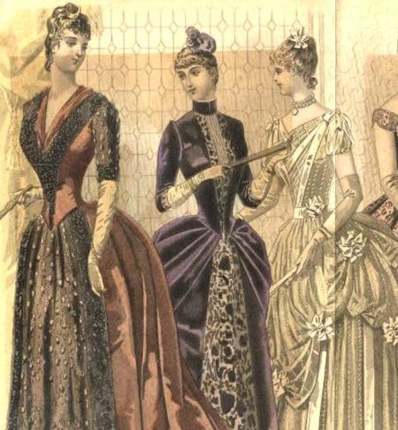
1870s Fashion
By 1870, Women often draped over overskirts to produce an apron-like effect from the front.
Evening gowns had low necklines and very short, off-the-shoulder sleeves and were worn with short (later mid-length) gloves.
Other characteristic fashions included a velvet ribbon tied high around the neck and trailing behind for evening in a similar style to Georgian era fashion (the origin of the modern choker necklace).
Smallish hats, some with veils, were perched on top of the head, and brimmed straw hats were worn for outdoor wear in summer.
Bonnets were smaller to allow for the elaborately piled hairstyles and resembled hats except for their ribbons tied under the chin.
Innovations in men's fashion of the 1870s included the acceptance of patterned or figured fabrics for shirts and the general replacement of neckties tied in bow knots with the four-in-hand and, later the ascot tie.

Slide 3
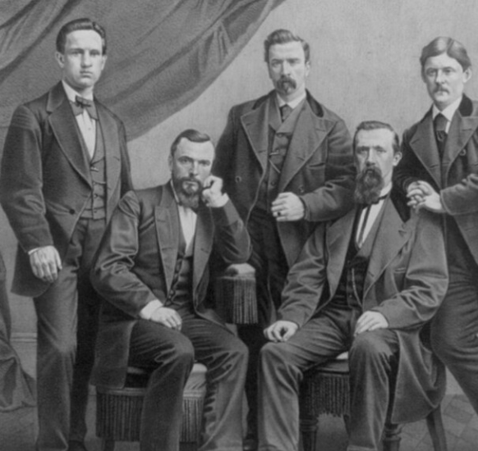
1870s Fashion
Frock coats remained fashionable, but shorter versions arose, distinguished from the sack coat by a waist seam. Waistcoats were cut straight across the front with collars and lapels, but collarless waistcoats were also worn.
Three-piece suits consisting of a high-buttoned sack coat with matching waistcoat and trousers, called ditto suits, grew in popularity; the sack coat might be cut away so that only the top button could be fastened.
Necktie fashions included the four-in-hand and, toward the end of the decade, the ascot tie, a tie with broad wings and a narrow neckband fastened with a jewel or stickpin.
Ties knotted in a bow remained conservative, and a white bowtie was required with formal evening wear.
A narrow ribbon tie was an alternative for tropical climates and was increasingly worn elsewhere, especially in the Americas.
Top hats remained required for upper-class formal wear; bowlers and soft felt hats in various shapes were worn for casual occasions, and flat straw boaters were worn for yachting and other nautical pastimes.
Infants continued to be dressed in flowing gowns, a style that continued into the early 20th century. Gender dress changes often did not occur until a child was five or six.

Slide 4
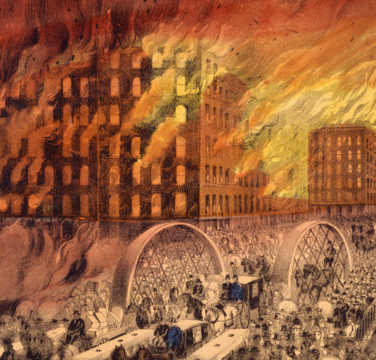
Great Chicago Fire (1871 CE)
The Great Chicago Fire was a conflagration that burned in the American city of Chicago during October 8–10, 1871.
The fire killed approximately 300 people, destroyed roughly 3.3 square miles of the city, including over 17,000 structures, and left more than 100,000 residents homeless.
City officials never determined the cause of the blaze.
The fire is claimed to have started at about 8:30 p.m. on October 8, in or around a small barn belonging to the O'Leary family that bordered the alley behind 137 DeKoven Street.
The shed next to the barn was the first building to be consumed by the fire.
The most famous tale blames Mrs. O'Leary's cow, who allegedly knocked over a lantern; others state that a group of men were gambling inside the barn and knocked over a lantern.
The rapid-fire spread due to a prolonged drought in that year's summer, strong winds from the southwest, and the immediate destruction of the water pumping system explain the extensive damage to the main wooden city structures.

Slide 5
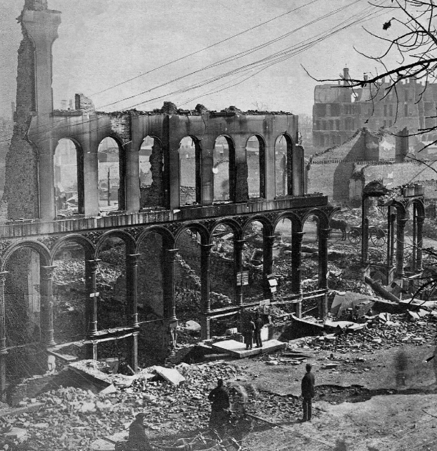
Great Chicago Fire (1871 CE)
More than two-thirds of the structures in Chicago at the time of the fire were made entirely of wood, with most houses and buildings being topped with highly flammable tar or shingle roofs.
The city's sidewalks and many roads were also made of wood. Compounding this problem, Chicago received only 1 inch of rain from July 4 to October 9, causing a severe drought before the fire.
Strong southwest winds helped to carry flying embers toward the city's heart.
In 1871, the Chicago Fire Department had 185 firefighters with just 17 horse-drawn steam pumpers to protect the entire city.
Still, due to an error, the firefighters were initially sent to the wrong place, allowing the fire to grow unchecked.
Firefighters had hoped that the South Branch of the Chicago River and an area previously thoroughly burned would act as a natural firebreak.
However, lumber yards, warehouses, coal yards, barges, and numerous bridges across the river.
Around midnight, flaming debris blew across the river and landed on roofs and the South Side Gas Works.

Slide 6
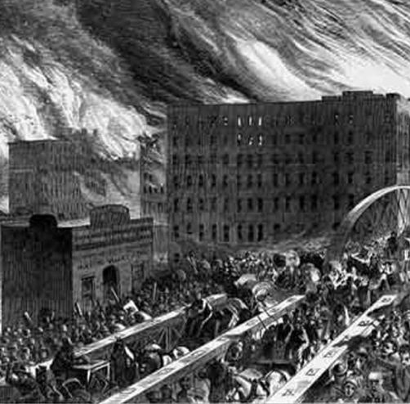
Great Chicago Fire (1871 CE)
As overheated air rises, it meets cooler air and begins to spin, creating a tornado-like effect.
These fire whirls likely drove flaming debris so high and so far. Such debris was blown across the main branch of the Chicago River to a railroad car carrying kerosene.
The fire had jumped the river and raged across the city's north side.
The fire burned unchecked from building to building, block to block.
Finally, late into the evening of October 9, it started to rain, but the fire had already started to burn itself out.
Once the fire had ended, the smoldering remains were still too hot for a survey of the damage to be completed for many days.
More than 73 miles of roads were damaged, 120 miles of sidewalk, 2,000 lampposts, 17,500 buildings, and $222 million in property, which was about a third of the city's valuation in 1871.

Slide 7
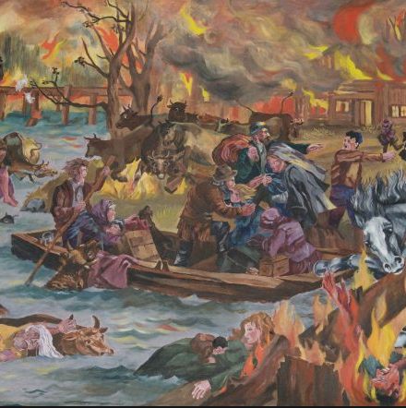
Peshtigo Fire (1871 CE)
The Peshtigo fire was a large forest fire on October 8, 1871, in northeastern Wisconsin, including much of the southern half of the Door Peninsula and adjacent parts of the Upper Peninsula of Michigan.
The fire burned about 1.2 million acres and is the deadliest wildfire in recorded history, with the number of deaths estimated between 1,500 and 2,500.
The Peshtigo fire was primarily forgotten on the same day as the more famous Great Chicago Fire, even though it killed far more people. The Great Chicago Fire took one-fifth as many lives as the Peshtigo Fire.
Several cities in Michigan, including Holland and Manistee (across Lake Michigan from Peshtigo) and Port Huron (at the southern end of Lake Huron), also had significant fires on the same day.
These and many other fires of the nineteenth century had the exact fundamental causes: small fires coupled with arid weather.

Slide 8
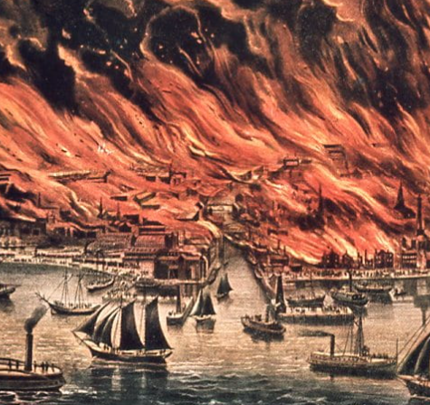
Peshtigo Fire (1871 CE)
Following the fire, it took days for help to arrive.
By the time that word got to Madison, most of the officials and their aid were going to Chicago, which was being called the Great Fire Food, clothing, and other aids were quickly sent to help survivors, many of whom went to Marinette.
All left of the Town of Peshtigo was a few buildings and ashes, with all personal items being destroyed.
It took years to rebuild, and many businesses never reopened.
Specifically, the large woodenware factory that supplied jobs to many was never rebuilt, leaving the town to never re-establish its lumber industry.

Slide 9
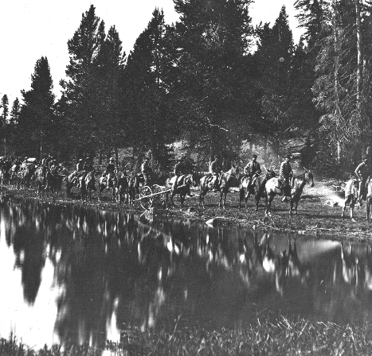
Yellowstone National Park (1872 CE)
President Grant signed the bill creating the nation’s first national park at Yellowstone on March 1, 1872.
Plenty of game and mountain streams teeming with fish lured the Indians to the region, though the geysers and canyons also fascinated them.
The famous mountain man, John Colter, was the first white person to travel through the area.
After touring with Lewis and Clark to the Pacific, Colter joined a party of fur trappers to explore the wilderness.
In 1807, he studied part of the Yellowstone plateau and returned with amazing stories of seething geysers and bubbling cauldrons.
Some skeptics accused the mountain man of telling tall tales and jokingly anointed the area “Colter’s Hell.”
Before the Civil War, only a handful of trappers and hunters embarked on the area, which remained largely a mystery.
The key to Yellowstone’s future as a national park was the 1871 exploration under the direction of the government geologist Ferdinand Hayden.

Slide 10
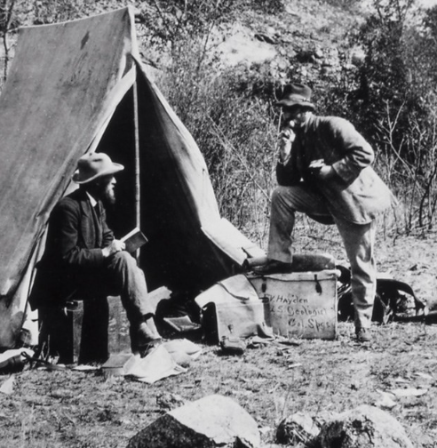
Yellowstone National Park (1872 CE)
Hayden brought along William Jackson, a photographer, and Thomas Moran, a landscape artist, to make a pictorial history of the expedition.
Their images delivered the first visual proof of Yellowstone’s awe and captured the attention of the U.S. Congress.
Early in 1872, Congress set aside some 2 million acres of public land, straddling the future states of Wyoming, Montana, and Idaho, as America’s first national park.
The Yellowstone Act of 1872 established the region as a public “pleasuring-ground,” which would be conserved. President Grant signed the bill into law in 1872.
Many members of Congress endorsed it entirely because they believed the wild and remote region was of little economic value.
Yet the Yellowstone Act of 1872 set a precedent and popularized the idea of conserving sections of the public domain for use as public parks.
Congress went on to designate dozens of other national parks, and the idea spread to other nations worldwide.

Slide 11
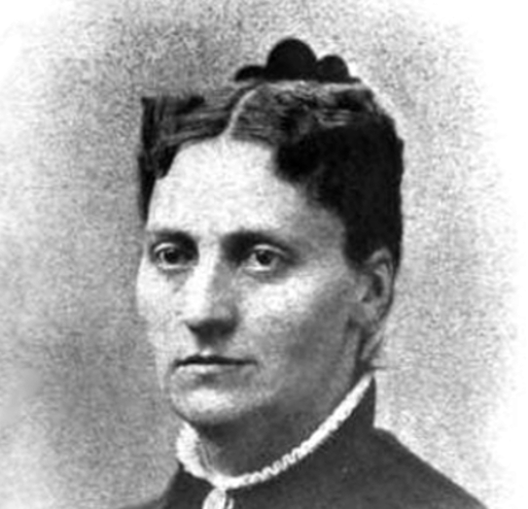
Linda Richards (1872 CE)
Linda Richards was the first professionally trained American nurse.
She established nursing training programs in the United States and Japan and created the first system for keeping individual medical records for hospitalized patients.
Linda Richards nursed her mother, who contracted tuberculosis until her death from the disease in 1854.
Her experience with nursing her dying mother roused Richards' interest in nursing.
Though, in 1856, at fifteen, Richards entered St. Johnsbury Academy for a year to become a teacher and taught for several years, she was never satisfied with that vocation.
In 1860, Richards met George Poole, to whom she became engaged.

Slide 12
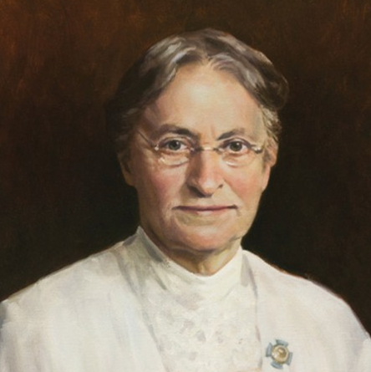
Linda Richards (1872 CE)
Not long after their engagement, Poole joined the Green Mountain Boys and left home to fight in the American Civil War.
He was severely injured in 1865, and when he returned home, Richards cared for him until his death in 1869.
Inspired by these personal losses, she moved to Boston, Massachusetts, to become a nurse.
Her first job was at Boston City Hospital, where she received almost no training and was subjected to overwork.
She left that hospital after only three months but was resolute by her experiences there.
In 1872, Linda Richards became the first student to enroll in the inaugural class of five nurses in the first American Nurse's training school.

Slide 13
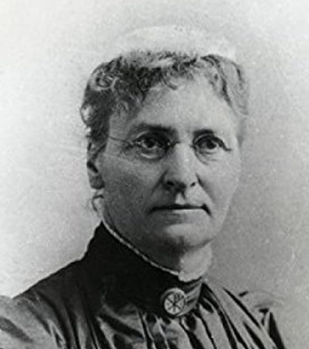
Linda Richards (1872 CE)
Linda describes her nursing training: "We rose at 5.30 a.m. and left the wards at 9 p.m. to go to our beds, which were in little rooms between the wards. I often got up nine times in the night and did not get to sleep before the next call came. We had no evenings out and no hours for study or recreation. Every second week we were off duty one afternoon from two to five. No monthly allowance was given for three months."
Upon graduating one year later, she moved to New York City, where she was hired as a night supervisor at Bellevue Hospital Center.
While working there, she formed a system for keeping individual records for each patient, widely embraced in the United States and the United Kingdom.

Slide 14
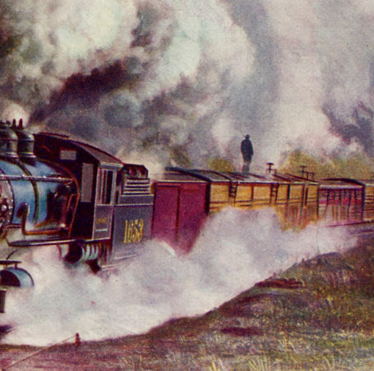
Credit Mobilier (1872 CE)
The Crédit Mobilier scandal was a two-part scam executed from 1864 to 1867 by the Union Pacific Railroad and the Crédit Mobilier of America construction company in the building of the eastern portion of the First Transcontinental Railroad.
Thomas Durant chartered an outfit named Crédit Mobilier of America to garner earnings from railroad construction, ensuring he and other insiders would realize wealth from the railroad without revealing themselves to the project's high-stake risks.
The New York Sun broke the story during the 1872 campaign of Ulysses S Grant.
Durant was convinced constructing a railroad would be more beneficial than running one.
He bought an inactive fiscal agency with partners. In simple terms, the new company welcomed a select group of investors while limiting their liability.
Before Crédit Mobilier, corporate law held investors liable for their entire personal holdings.

Slide 15
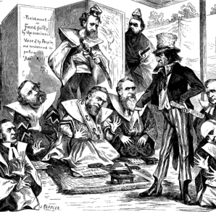
Credit Mobilier (1872 CE)
Durant paid crony Herbert M Hoxie to propose a construction bid to Union Pacific.
No one else got the call to bid, and as the only bid accepted, Hoxie's offer was unanimously endorsed.
Hoxie signed the contract over to his benefactor -- and Durant transferred it into the name of Crédit Mobilier.
Crédit Mobilier investors were only responsible for the extent of their investment.
Durant hired himself to complete the railroad, paying Crédit Mobilier with money given to the Union Pacific by government bonds and risk-taking investors.
He subcontracted railroad work to actual construction crews while using inflated estimates to guarantee substantial payoff.
Because there was no liability, it didn't matter whether the railroad got built. Durant could not lose the profit he had already made in case of forfeiture.
The money-making machine got off to a roaring start with a line out of Omaha, adding nine unneeded profit-generating miles to construction.

Slide 16
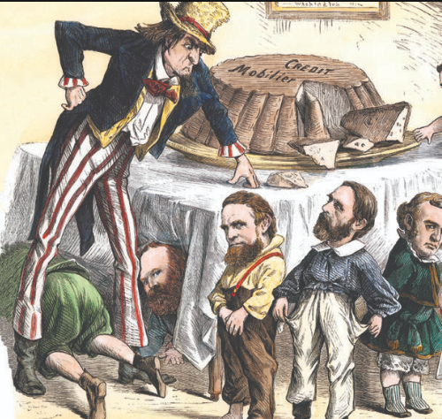
Credit Mobilier (1872 CE)
Three years later, conflict in the Crédit Mobilier boardroom brought construction to a standstill.
Investor Oliver Ames leaped over Durant to assume the Union Pacific's presidency; infuriated, Durant filed an injunction prohibiting Crédit Mobilier from appointing new construction contracts to replace the expiring Hoxie deal.
Oliver and his Congressman brother Oakes Ames managed to boot Durant from the Crédit Mobilier board, which divided into two factions.
More injunctions ensued, as did months of resentful deadlock. Crews waited for work at the end of the tracks.
The Ames brothers ultimately set them working without a contract, which meant each completed mile equaled unrealized returns.
That fixed the issue, if not apprehensions. In October 1867, Oliver and Oakes Ames reinstated Durant; he supported an Ames construction contract that retroactively sent money from those miles into their pockets.
On the strength of renewed profits and a declared dividend, Crédit Mobilier boomed.

Slide 17
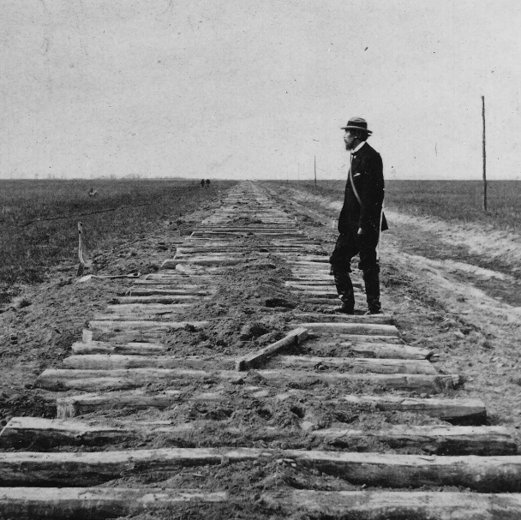
Credit Mobilier (1872 CE)
Congressman Oakes Ames, representing company interests on Capitol Hill, soon found himself swamped with legislators soliciting a piece of the action.
He distributed stock to two senators and nine representatives in 1867. Some ultimately returned the gift. Ames recorded his transactions in a ledger.
He often kept the stock in his name for discretion's sake and distributed earnings where necessary.
Under their posts, all the recipients held sway over railroad legislation, but none seemed to sense any conflict of interest in their investments. And Ames was intent on gaining their support.
The scandal erupted in election season 1872, as president and Union Pacific friend Ulysse Grant came up for his second term.
Deposition from a lawsuit against the Crédit Mobilier included a partial list of Oakes Ames's stock contacts of half a decade prior.
Mistaken for a listing of stock recipients, the itemized names contained incumbent Vice President Schuyler Colfax, Vice Presidential nominee Henry Wilson, Speaker of the House James G Blaine, and future president James Garfield.

Slide 18
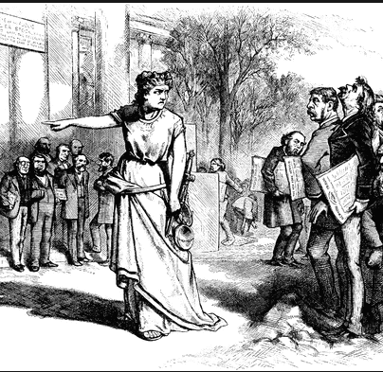
Credit Mobilier (1872 CE)
The anti-Grant press seized upon the revelation. The controversy dominated the public -- but had little effect on the elections.
Speaker Blaine, who had turned down Crédit Mobilier stock and nonetheless seen his name dragged through the mud, moved that Congress investigate the charges.
Called before a Capitol Hill committee, Oakes Ames insisted that nothing illegal had transpired. He was, therefore, willing to talk.
His colleagues turned on Ames, who in turn produced the ledger book.
It cleared Blaine and Wilson but implicated Colfax and 13 other legislators.
With a captivated public and incendiary press following its every move, the Committee chose not to take measures against those Ames named, choosing only to punish Ames himself and James Brooks with congressional condemnation.
No criminal or civil charges were filed against Crédit Mobilier's scoundrels.

Slide 19
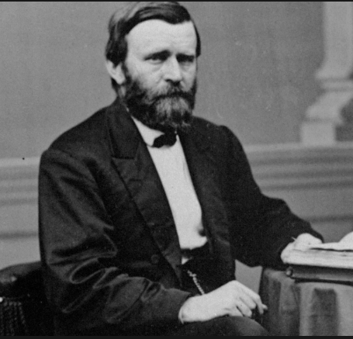
Amnesty Act (1872 CE)
The Amnesty Act of 1872 is a United States federal law passed on May 22, 1872, which removed most of the penalties imposed on former Confederates by the Fourteenth Amendment, adopted on July 9, 1868.
Section 3 of the Fourteenth Amendment prohibits the election or appointment to any federal or state office of any person who had held certain offices and then engaged in insurrection, rebellion, or treason.
However, the section provided that a two-thirds vote by each House of Congress could override this limitation.
The 42nd United States Congress passed the 1872 act, and the United States Congress passed the original restrictive Act in May 1866.
Even while the Civil War was in progress, the Union offered amnesty to Confederates to encourage loyalty to the Union and begin the reconstruction process.
The Confiscation Act of 1862 authorized the U.S. President to pardon anyone involved in the rebellion.
The Amnesty Proclamation of December 1863 offered pardons to those who had not held a Confederate civil office, had not mistreated Union prisoners, and would sign an oath of allegiance.
Another limited amnesty that targeted Southern civilians went into effect in May 1864.

Slide 20
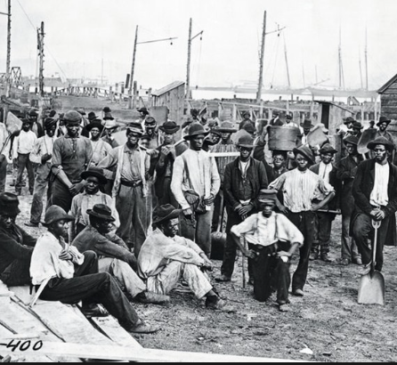
Amnesty Act (1872 CE)
In May 1865, President Andrew Johnson provided for amnesty and the return of property to those who would take an oath of allegiance.
Former high-ranking Confederate government and military officials, and people owning more than $20,000 worth of property, had to apply for individual pardons.
As a result of the 1872 Amnesty and the many that preceded it, the vast majority of former white Confederates in the South were free to own land, vote, hold office, and make laws in the Southern states, less than two decades after the war's end.
When Reconstruction ended in 1877, and federal troops left the region, these people who had so recently fought to maintain white supremacy and retain slavery were well-positioned to seize control of their state governments and orchestrate laws and policies to suppress the new civil rights of Black people.

Slide 21
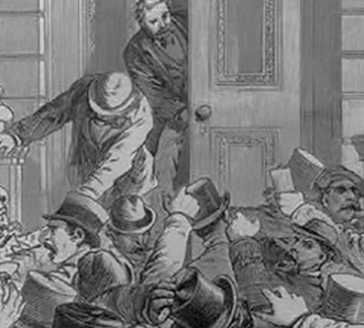
Panic of 1873
The Panic of 1873 was a financial crisis that triggered an economic depression in Europe and North America that lasted from 1873 to 1877 or 1879 in France and Britain.
In Britain, the Panic started two decades of stagnation known as the "Long Depression," which weakened the country's economic leadership.
In the United States, the Panic was known as the "Great Depression" until 1929 and the early 1930s set a new standard.
The Panic of 1873 and the subsequent depression had several underlying causes for which economic historians debate the relative importance.
American inflation, rampant speculative investments overwhelmingly in railroads, the demonetization of silver in Germany and the United States, ripples from economic dislocation in Europe resulting from the Franco-Prussian War, and significant property losses in the Great Chicago Fire and the Great Boston Fire helped to place a massive strain on bank reserves, which, in New York City, plummeted from $50 million to $17 million between September and October 1873.
A boom followed the American Civil War in railroad construction.

Slide 22
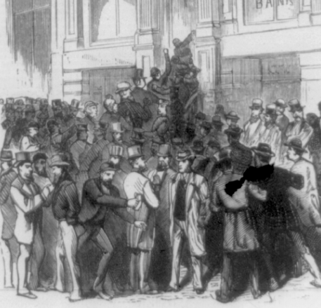
Panic of 1873
Thirty-three thousand miles of new track were laid across the country between 1868 and 1873, with much of the craze in railroad investment driven by government land grants and railroad subsidies.
The railroad industry was the largest employer outside agriculture in the US and involved large amounts of money and risk.
A large infusion of cash from speculators caused spectacular growth in the industry and the construction of docks, factories, and ancillary facilities.
Most capital was involved in projects offering no immediate or early returns.
A period of economic overexpansion arose from the northern railroad boom before a series of financial setbacks: The Black Friday panic of 1869, The Chicago fire of 1871, An outbreak of equine influenza, and the Boston fire of 1872
Many US insurance companies went out of business, as the deteriorating financial conditions created solvency problems for life insurers.

Slide 23
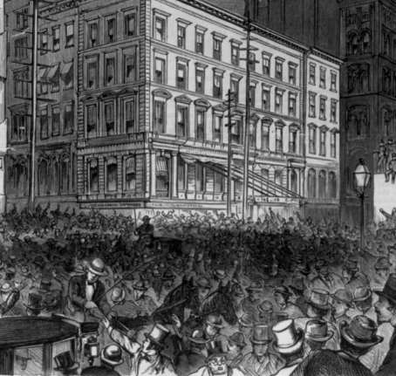
Panic of 1873
Factories began to lay off workers as the country slipped into depression.
The effects of the Panic were quickly felt in New York and more slowly in Chicago, Virginia City, Nevada, and San Francisco.
The New York Stock Exchange closed for ten days starting on 20 September.
By November 1873, some 55 of the nation's railroads had failed, and another 60 had gone bankrupt by the first anniversary of the crisis.
Construction of new rail lines, formerly one of the backbones of the economy, plummeted from 7,500 miles of track in 1872 to just 1,600 miles in 1875, and 18,000 businesses failed between 1873 and 1875. Unemployment peaked in 1878 at 8.25%.
Building construction was halted, wages were cut, real estate values fell, and corporate profits vanished
In 1874, Congress passed "the Ferry Bill" to allow for currency printing, increasing inflation and reducing the value of debts.

Slide 24
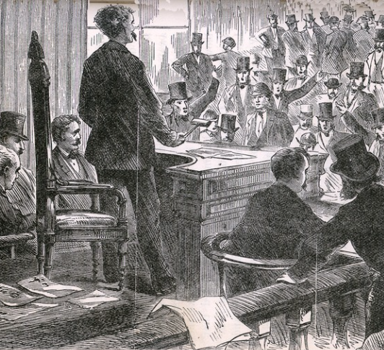
Panic of 1873
President Grant vetoed the bill.
The following year, Congress passed the Specie Resumption Act, which would back United States currency with gold. Backing American money with gold helped curb inflation and stabilize the dollar.
The railroad industry in the United States had seen significant growth in the decades before 1873, driven partly by solid European interest in bonds issued by railroad companies.
In Baltimore, Maryland, where strikers set fire to buildings owned by B.& O. Railroads, and an outnumbered militia guard division opened fire when they were surrounded by rioters, killing ten and injuring 25 more, leading to a days-long standoff at Camden Yards.
In New York, striking workers began pelting arriving trains with thrown objects, prompting a response from local police.

Slide 25
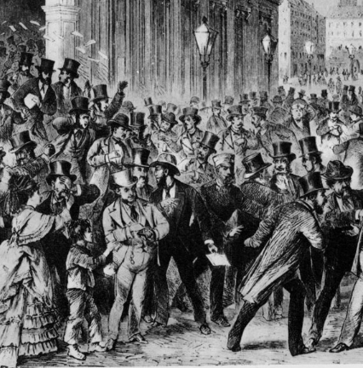
Panic of 1873
In July 1877, the market for lumber crashed, leading several Michigan lumber companies to go bankrupt. Within a year, the effects of this second business slump reached California.
The depression ended in the spring of 1879, but the tension between workers and the leaders of banking and manufacturing interests lingered on.
Poor economic conditions also caused voters to turn against the Republican Party.
In the 1874 congressional elections, the Democratic Party assumed control of the House for the first time since the Civil War.
Public opinion made it difficult for the Grant administration to develop a coherent policy on the Southern states, and the North began to steer away from Reconstruction.
With the depression, ambitious railroad-building programs crashed across the South, leaving most states in debt and burdened with heavy taxes.
Retrenchment was a typical response of the South to state debts during the depression.
One by one, each state fell to the Democrats in the South, and the Republicans lost power.
The end of the crisis coincided with the beginning of the great wave of immigration to the United States, which lasted until the early 1920s.

Slide 26
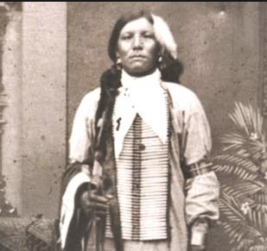
Crazy Horse (1872 CE)
Crazy Horse was born in the Black Hills of South Dakota in 1841
In 1854, Crazy Horse rode off into the prairies for a vision quest, purposefully ignoring the required rituals.
Fasting for two days, Crazy Horse had a vision of an unadorned horseman who directed him to present himself in the same way, with no more than one feather and never a war bonnet.
He was also told to toss dust over his horse before entering battle, place a stone behind his ear, and never to take anything for himself.
Crazy Horse followed these instructions until his death.
In 1866, the discovery of gold along the Bozeman Trail in Montana spurred General William Tecumseh Sherman to build several forts in Sioux territory.

Slide 27
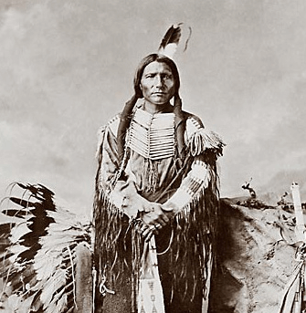
Crazy Horse (1872 CE)
Under the command of Captain William Fetterman, a troop clashed with Sioux and Cheyenne warriors after Crazy Horse acted as a decoy to lead the 80 white soldiers to their death in an ambush.
The soldiers' bodies were hacked up to send a message to Sherman. In 1867, Crazy Horse took part in an attack on a small fort.
Shortly after, Sherman toured the Native prairie lands to meet with leaders and seek peace.
By 1868, soldiers were pulled out of the disputed forts, and a treaty was signed that gave the native populations ownership of the Black Hills, areas west of Missouri, and land in Wyoming.
No whites would be allowed to enter that territory under threat of arrest.
Crazy Horse eschewed the treaty signing, preferring to conduct raids on enemy tribes.

Slide 28
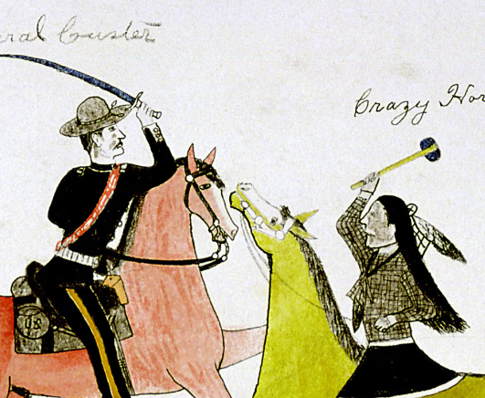
Crazy Horse (1872 CE)
As the railroads expanded west, tensions rose between Native Americans and soldiers.
In 1872, Crazy Horse took part in a raid with Sitting Bull against 400 soldiers, where his horse was shot out beneath him after he made a reckless dash ahead to meet the U.S. Army.
In 1873 General George Armstrong Custer crossed into Sioux territory.
Somewhere along the Yellowstone River, Crazy Horse encountered Custer for the first time, coming upon a contingent of napping soldiers.
The Sioux attempted to steal their horses but failed, and Crazy Horse retreated after a scuffle.
In September 1877, Crazy Horse was fatally wounded by a bayonet-wielding military guard while allegedly resisting imprisonment at Camp Robinson in present-day Nebraska.
Crazy Horse, even when dying, refused to lie on the white man's cot. He insisted on being placed on the floor. Armed soldiers stood by until he died.

Slide 29
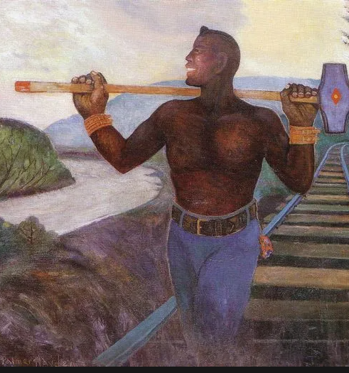
John Henry (1872 CE)
John Henry is an American folk hero.
An African American, he is said to have worked as a "steel-driving man"—a man tasked with hammering a steel drill into rock to make holes for explosives to blast the rock in constructing a railroad tunnel.
The story of John Henry is told in a classic blues folk song, which exists in many versions, and has been the subject of numerous reports, plays, books, and novels.
According to legend, John Henry's prowess as a steel driver was measured in a race against a steam-powered rock drilling machine, a race that he won only to die in victory with a hammer in hand as his heart gave out from stress.
Various locations, including Big Bend Tunnel in West Virginia, Lewis Tunnel in Virginia, and Coosa Mountain Tunnel in Alabama, have been suggested as the site of the contest.
The contest involved John Henry as the hammerman working in partnership with a shaker, holding a chisel-like drill against mountain rock while the hammerman struck a blow with a hammer.

Slide 30
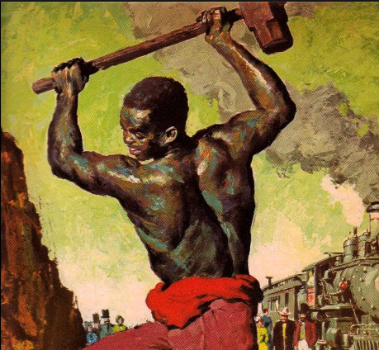
John Henry (1872 CE)
The historical accuracy of many aspects of the John Henry legend is subject to debate.
According to researchers, John Henry was born in 1848 in New Jersey and did not die due to exhaustion from work.
Several locations have been put forth for the tunnel on which John Henry died.
He concluded that John Henry might have worked on the Chesapeake and Ohio Railway's Big Bend Tunnel but that "one can make out a case either for or against" it.
That tunnel was built near Talcott, West Virginia, from 1870 to 1872 and named for the big bend in the Greenbrier River nearby.
Some versions of the song refer to the location of John Henry's death as "The Big Bend Tunnel on the C. & O."
Historians have detailed their discoveries of documentation of a 19-year-old African-American man alternately referred to as John Henry, John W. Henry, or John William Henry in previously unexplored prison records of the Virginia Penitentiary.

Slide 31
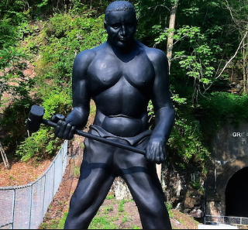
John Henry (1872 CE)
At the time, penitentiary inmates were hired as laborers by various contractors.
John Henry was noted as having headed the first prisoners to be assigned tunnel work. Henry, like many African Americans, might have come to Virginia to work on the clean-up of the battlefields after the Civil War.
Arrested and tried for burglary, John Henry was in the first group of convicts released by the warden to work as leased labor on the C&O Railway.
According to some historians, objectionable conditions at the Virginia prison led the warden to believe that the prisoners, many of whom had been arrested on trivial charges, would be better clothed and fed if released as laborers to private contractors.
Prison records for John William Henry stopped in 1873, suggesting that he was kept on the record books until it was clear that he was not coming back and had died.
John Henry demonstrates the dignity of man versus machine in his determination to succeed regardless of the cost.

Slide 32
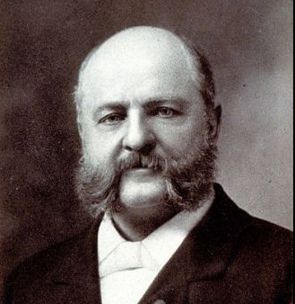
Comstock Law (1873 CE)
From the 1870s into the early 20th century, Anthony Comstock was on a mission—to impose his sense of morality on what Americans read, saw, and even did in their bedrooms.
Though not an elected legislator, the devout Protestant essentially rewrote federal postal laws "to prevent the mails from being used to corrupt the public morals."
While there were already laws on the books against obscenity, Comstock expanded the scope of "obscene, lewd or lascivious" material to include information on birth control and abortion.
The post office made him a special agent with the power to conduct raids and arrest suspected violators.
He exercised that authority with enthusiasm for the next 42 years, claiming credit for nearly 4,000 convictions, 160 tons of destroyed books and other materials, and at least 15 suspects driven to suicide.
In 1872, Comstock began visiting Washington, DC, to lobby lawmakers for stricter vice laws. In one celebrated show-and-tell presentation, he wowed Senators with a selection of dirty books, pornographic playing cards, and contraceptive devices. He referred to the collection as his "Chamber of Horrors."

Slide 33
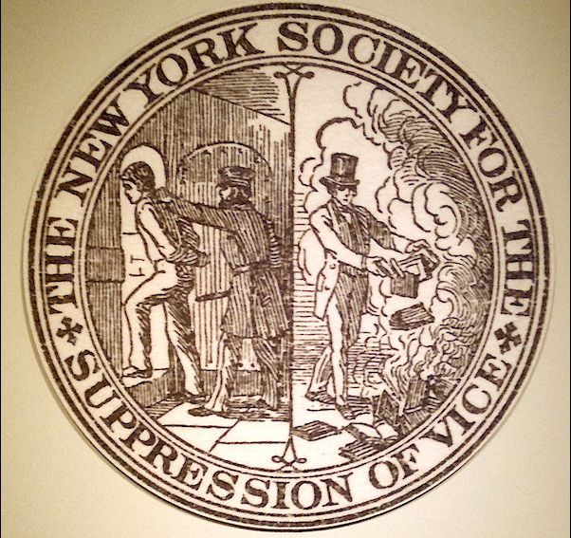
Comstock Law (1873 CE)
Comstock had already made a name for himself in New York as the YMCA's Committee for the Suppression of Vice leader.
He used his position to confiscate and destroy books, and other materials he believed could corrupt the morals of young men.
The law that allowed him to carry out his raids, New York's Obscene Literature Act of 1868, also gave him a cut of any fines.
In 1873, he got his way when Congress passed An Act for the Suppression of Trade in, and Circulation of, Obscene Literature and Articles of Immoral Use. It became commonly known as the Comstock Act.
Days after the law passed, the post office gave him the authority to enforce his rules.
While other obscenity laws allowed Comstock to conduct raids on booksellers and publishers and harass art gallery owners with nude paintings on exhibit, the Comstock laws technically required that the material passes through the mail before he could take action.

Slide 34
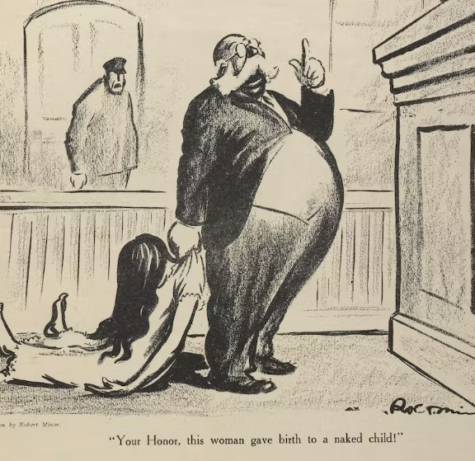
Comstock Law (1873 CE)
Rather than wait for that to happen, Comstock would send away materials on contraception and other forbidden topics using assumed names. When the packages arrived, he pounced.
In some cases, he concocted entire families, individuals sharing a last name, living in the same town. The federal Comstock laws weren't universally loved, and there were numerous attempts to repeal them on the national level. Some were harsher than the federal original.
However, many state legislatures embraced them enthusiastically, and more than half the states enacted their own Comstock laws in succeeding years.
Comstock's contraception attacks coincided with the growing women's rights movement, for which family planning and women's control of their bodies were core issues.
The anarchist activist Emma Goldman and birth-control advocate Margaret Sanger were two of his more prominent targets.
They returned the favor by denouncing him in their publications and from the lecture stage.

Slide 35
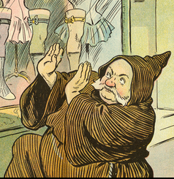
Comstock Law (1873 CE)
In 1914, he arranged to have Sanger indicted over the contents of her magazine The Woman Rebel, which he called "obscene, lewd and lascivious."
She fled the country, threatened with a possible 45-year prison term, but returned to face trial in 1915.
The case was dismissed the following year when the government dropped the charges.
Comstock died of pneumonia in September 1915 at age 71.

Slide 36
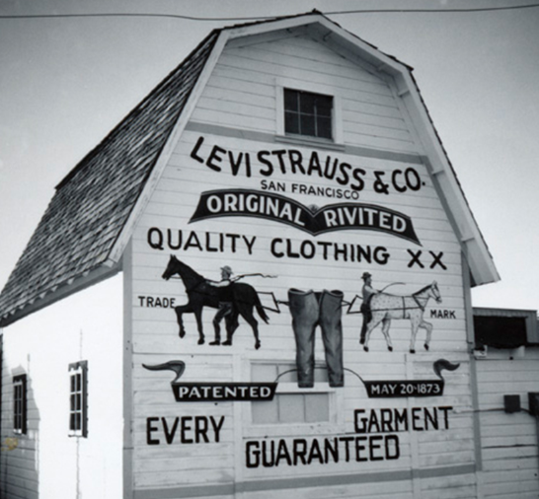
Levi Strauss (1873 CE)
On May 20, 1873, San Francisco businessman Levi Strauss and Reno, Nevada, tailor Jacob Davis are given a patent to create work pants reinforced with metal rivets, marking the birth of one of the world's most famous garments: blue jeans.
In San Francisco, Strauss established a wholesale dry goods business under his name and worked as the West Coast representative of his family's firm.
His new company imported clothing, fabric, and other dry goods to sell in the small stores opening all over California and other Western states to supply the rapidly expanding communities of gold miners and other settlers.
By 1866, Strauss had moved his company to expanded headquarters and was a well-known businessman and supporter of the Jewish community in San Francisco.
Jacob Davis, a tailor in Reno, Nevada, was one of Levi Strauss' regular customers.
In 1872, he wrote a letter to Strauss about his method of making work pants with metal rivets on the stress points—at the corners of the pockets and the base of the button fly—to make them stronger.

Slide 37
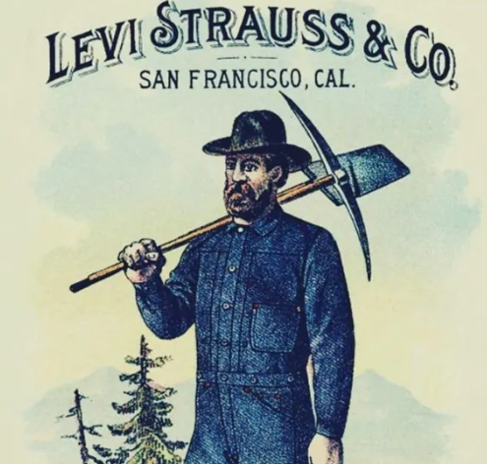
Levi Strauss (1873 CE)
As Davis didn't have the money for the necessary paperwork, he suggested that Strauss provide the funds and that the two men get the patent together.
Strauss agreed enthusiastically, and the patent for "Improvement in Fastening Pocket-Openings"–the innovation that would produce blue jeans as we know them–was granted to both men on May 20, 1873.
Strauss brought Davis to San Francisco to oversee the first manufacturing facility for "waist overalls," as the original jeans were known.
At first, they employed sewists working out of their homes, but by the 1880s, Strauss had opened his factory.
The famous 501 brand jeans—known until 1890 as "XX"—were soon a bestseller, and the company multiplied.
By the 1920s, Levi's denim waist overalls were the top-selling men's work pants in the United States.

Slide 38
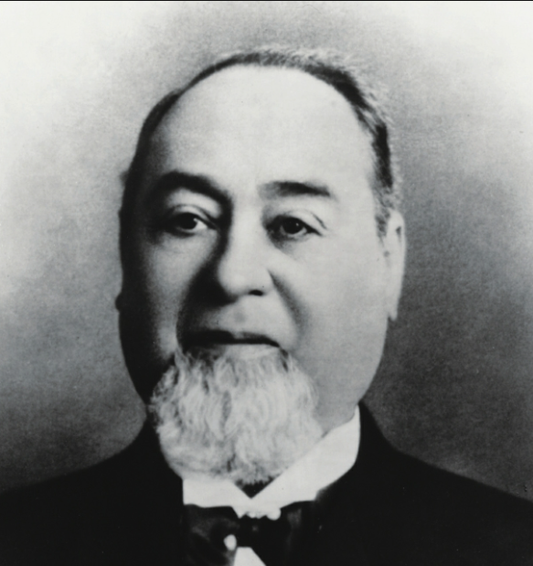
Levi Strauss (1873 CE)
As decades passed, the craze only grew, and now blue jeans are worn and beloved by men and women, young and old, worldwide.
Strauss's jeans were initially simply sturdy trousers worn by factory workers, miners, farmers, and cattlemen throughout the North American West.
During this period, men's jeans had the fly down the front, whereas women's jeans had the fly down the left side.
When Levi Strauss & Co. patented the modern, mass-produced prototype in 1873, there were two pockets in the front and one on the back right with copper rivets. Levi Strauss first added the small riveted watch pocket to their jeans in the late 1870s.
In 1901 Levi Strauss added the back-left pocket to their 501 models.
This created the now familiar and industry-standard five-pocket configuration with two large pockets and a small watch pocket in the front with two pockets on the rear.

Slide 39
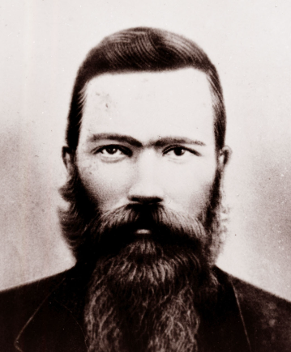
Lowry War 1874 CE)
The Lowry War was a conflict in and around Robeson County, North Carolina, from 1864 to 1874 between a group of primarily Native American outlaws and civil local, state, and federal authorities.
The conflict is named for Henry Berry Lowry, who led a gang of American Indian, white and black men who robbed area farms and killed public officials who pursued them.
Banditry in Robeson County emerged during the later stages of the American Civil War, as free persons of color hid in local swamps to avoid being conscripted for labor to support the war effort and stole food to survive.
In 1864 and 1865, local Confederate officials came into conflict with the prominent Lumbee Lowry family, and two former were murdered. A Confederate Home Guard detachment subsequently executed two Lowrys for alleged possession of stolen goods and arrested Henry Berry Lowry on murder charges.
He later broke out of jail and avoided the authorities by hiding in swamps with a group of associates known as the Lowry Gang.
Over the following years, the gang committed various robberies, often targeting plantations.
Declared outlaws by the state government were pursued by posses and county militiamen, typically eluding them in swamps and killing some of their pursuers.
The state of North Carolina ultimately placed large bounties on the core gang members, with a reward of $12,000 being offered for the capture or killing of Lowry.

Slide 40
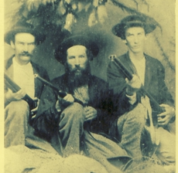
Lowry War 1874 CE)
Throughout the conflict, the Lowry Gang, was implicated in the deaths of 22 people, while one of its members was arrested and executed, and several others were killed.
The affair attracted significant regional and national media attention.
Following the end of the Lowry War and Reconstruction in North Carolina, the Lumbee Indians lacked state recognition as a unique group.
The Democrats, now in control of the state, created Jim Crow segregation laws.
The Lumbees resisted being treated the same as blacks under the new social order, and in 1885 the General Assembly voted to recognize them as Croatan Indians.
The Lumbees refused to attend black schools, and the General Assembly, partly hoping to avoid a reprisal of the Lowry War, created a state-supported school for them in 1887.
The establishment of other Lumbee institutions, such as churches and other schools, led the state and local government to recognize a tripartite system of segregation in Robeson County.

Slide 41
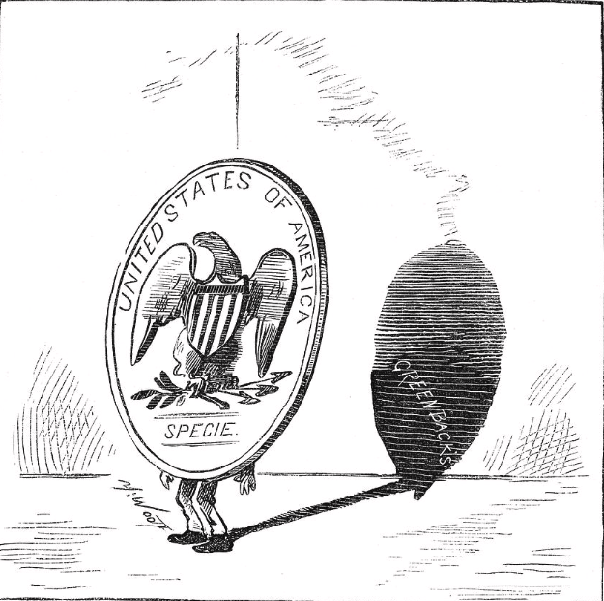
Resumption Act (1875 CE)
The Resumption Act of January 14, 1875, was a law in the United States that restored the nation to the gold standard through the redemption of previously-unbacked United States Notes and reversed inflationary government policies promoted directly after the American Civil War.
Late in 1861, seeking to raise revenue for the American Civil War effort without exhausting its reserves of gold and silver, the United States federal government suspended specie payments, or the payments made in gold and silver to redeem currency notes.
Early in 1862, the United States issued legal-tender notices called greenbacks.
By the war's end, a total of $431 million in greenbacks had been given, and authorization had been given for another $50 million in small denominations, known as the fractional currency or "shin-plasters."
The issuance of greenbacks caused inflation during the period.
Supporters of the Resumption Act argued that the Panic of 1873 might not have occurred if there had been sufficient reserves of gold in the United States Treasury as would have been the case if specie payments were resumed.
Opposed to resumption, a new coalition of agrarian and labor interests found a common cause during Reconstruction in advocating for "soft money" or the promotion of inflationary monetary policies.

Slide 42
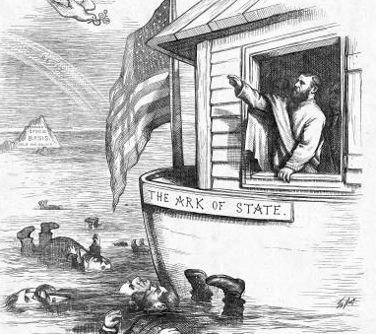
Resumption Act (1875 CE)
These groups viewed the Panic of 1873 as the result of insufficient currency that should have been used to fuel the growth in production that occurred in the South and the West.
These regions relied on cheap money – that is, low-interest rates – to continue growing.
Opponents of the Resumption Act also argued that many debt obligations were made in an environment in which a premium existed on gold; that is, inflation in the currency in the previous decade made gold relatively more valuable than currency.
The Resumption Act set no limit on the number of national bank notes that could be issued; this idea became known as "free banking.
“This provision led many conservatives to believe that the Act was inflationary.
However, the Resumption Act also required that greenbacks be retired in a proportion of 80% of new national bank note issues, which in theory aimed to contract the money supply and hence encourage dollar appreciation such that gold and currency might equate.
However, in practice, the effect was mild: the total quantity of greenbacks in circulation fell from $382 million at the end of 1874 to $300 million following the passage of the Resumption Act.
The Resumption Act was hotly debated during the 1880 presidential election, with most western politicians opposing it.

Slide 43
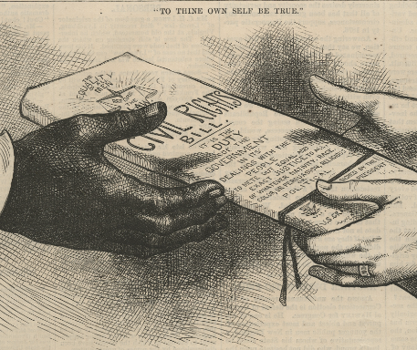
Civil Rights Act of 1875
The Civil Rights Act of 1875 was a United States federal law enacted during Reconstruction in response to civil rights violations against African Americans.
The act was designed to protect all citizens in their civil and legal rights, providing equal treatment in public accommodations and public transportation and prohibiting exclusion from jury service.
The law was not effectively enforced, partly because President Grant had favored different measures to help him suppress election-related violence against blacks and Republicans in the Southern United States.
The Civil Rights Act of 1875 was the last federal civil rights law enacted until the passage of the Civil Rights Act of 1957.
In 1883, the Supreme Court ruled in the Civil Rights Cases that the public accommodation sections of the act were unconstitutional, saying Congress was not afforded control over private persons or corporations under the Equal Protection Clause.

Slide 44
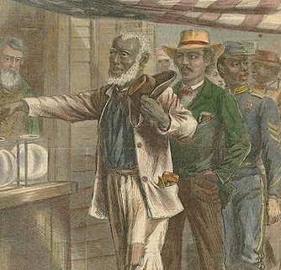
Civil Rights Act of 1875
The bill was drafted early in 1870 by the United States Senator Charles Sumner, a dominant Radical Republican in the Senate, with the assistance of John Mercer Langston, a prominent African American who established the law department at Howard University.
The act was passed by the 43rd Congress in February 1875 as a memorial to honor Sumner, who had just died. It was signed into law by United States President Ulysses S. Grant on March 1, 1875.
President Grant wanted an entirely different law to help him suppress election-related violence against blacks and Republicans in the South.
Grant never commented on the 1875 law and did nothing to enforce it. Grant's Justice Department ignored it and did not send copies to US attorneys, while many federal judges called it unconstitutional before the Supreme Court shut it down.
Public opinion was opposed, with the black community in support.

Slide 45
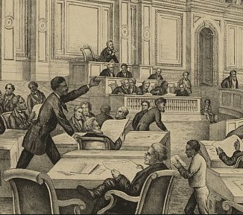
Civil Rights Act of 1875
The Supreme Court, in an 8–1 decision, declared sections of the act unconstitutional in the Civil Rights Cases on October 15, 1883.
The Court held the Equal Protection Clause within the Fourteenth Amendment prohibits discrimination by the state and local government. Still, it does not give the federal government the power to prohibit discrimination by private individuals and organizations.
The Court also held that the Thirteenth Amendment was meant to eliminate "the badge of slavery" but not to prohibit racial discrimination in public accommodations.
The Civil Rights Act of 1875 is notable as the last major piece of legislation related to Reconstruction that Congress passed during the Reconstruction era.
These include the Civil Rights Act of 1866, the four Reconstruction Acts of 1867 and 1868, the three Enforcement Acts of 1870 and 1871, and the three Constitutional Amendments adopted between 1865 and 1870.

Slide 46
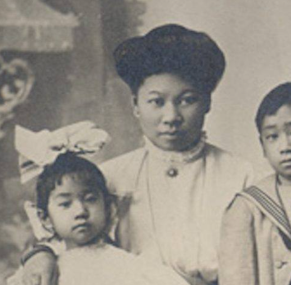
The Page Act (1875 CE)
The Page Act of 1875 was the first restrictive federal immigration law in the United States, which effectively prohibited the entry of Chinese women, marking the end of open borders.
Seven years later, the 1882 Chinese Exclusion Act also banned immigration by Chinese men.
The law was named after its sponsor, Representative Horace F. Page, a Republican representing California who introduced it to "end the danger of cheap Chinese labor and immoral Chinese women."
The law technically barred immigrants considered "undesirable," defining this as a person from East Asia coming to the United States to be a forced laborer, any East Asian woman who would engage in prostitution, and all people considered to be convicts in their own country.
Only the ban on female East Asian immigrants was effectively and heavily enforced and proved to be a barrier for all East Asian women trying to immigrate, especially Chinese women.
Moreover, the Page Act created the policing of immigrants around sexuality which gradually became extended to every immigrant who sought to enter America.

Slide 47
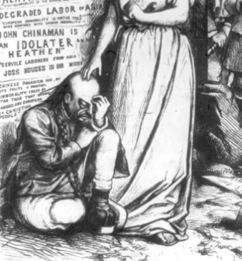
The Page Act (1875 CE)
Male laborers were central to the anti-Chinese movement, so one might expect legislators to focus on excluding men from immigration.
Instead, they concentrated on women to protect the American system of monogamy. Both Chinese male "coolies" and Chinese female prostitutes were linked to slavery, which added to the American hatred toward them since slavery and The United States abolished involuntary servitude in 1865.
Furthermore, the American Medical Association believed that Chinese immigrants "carried distinct germs to which they were immune, but from which whites would die if exposed."
An additional concern was that the children of Chinese couples would become US citizens under the Fourteenth Amendment, and their cultural practices would become a part of American democracy.
As a result, the Page Law responded to "what were believed to be serious threats to white values, lives, and futures."

Slide 48
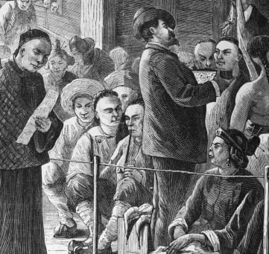
The Page Act (1875 CE)
Enforcement of the Page Act resulted not only in fewer prostitutes but also the "virtually complete exclusion of Chinese women from the United States."
In 1882 alone, during the few months before the enactment of the Chinese Exclusion Act of 1882 and the beginning of its enforcement, 39,579 Chinese entered the US, only 136 women.
Therefore, Chinese immigrants were unable to create families with each other within the US.
The Page Act was so successful in preventing Chinese women from immigrating and consequently keeping the ratio of females to males low that the law ironically encouraged the very vice it claimed to be fighting prostitution.
However, the Chinese Exclusion Act significantly transformed the Chinese American experience.

Slide 49
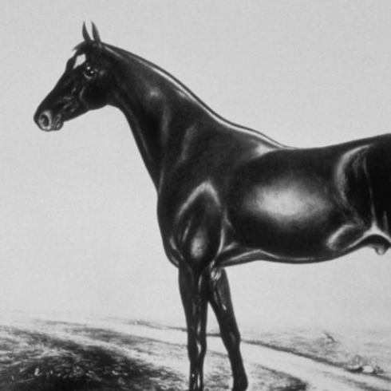
Kentucky Derby (1875 CE)
The Kentucky Derby, first held in 1875 at Churchill Downs racetrack in Louisville, is the longest-running sports event in the United States.
Dubbed the “Run for the Roses,” the Derby features three-year-old thoroughbreds racing 1.25 miles.
Today, some 150,000 spectators gather annually for the Kentucky Derby, sometimes referred to as “the greatest two minutes in sports.”
Besides placing bets on horses, Derby fans are famous for drinking mint juleps, singing “Old Kentucky Home,” and wearing flamboyant hats.
The Kentucky Derby was started by Meriwether Lewis Clark Jr., grandson of explorer William Clark, of Lewis and Clark Expedition fame.

Slide 50
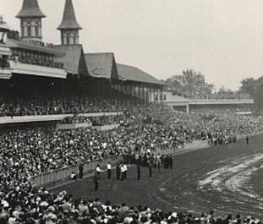
Kentucky Derby (1875 CE)
Clark, inspired by horse races he’d seen in Europe, raised the money to build Churchill Downs on land donated by his uncles.
In 1872, Clark traveled to Europe and visited leading horse-racing sites in England and France. He was inspired by England’s racecourses
Clark returned home to Kentucky, founded the Louisville Jockey Club, and raised money to construct a racetrack on land donated by his uncles, Henry and John Churchill.
Famed for throwing extravagant parties, Clark envisioned his racetrack as a place where the city’s stylish residents would gather.
On May 17, 1875, some 10,000 people attended the first Kentucky Derby, which featured a field of 15 three-year-old thoroughbreds racing 1.5 miles.
The winning horse, Aristides, finished with a time of 2:37.75 and was ridden by Oliver Lewis, an African-American jockey.

Slide 51
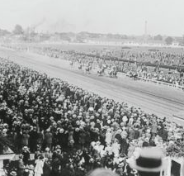
Kentucky Derby (1875 CE)
Thirteen of the fifteen jockeys in the inaugural Derby were black, and black riders played a dominant role in the race’s early years.
Between 1875 and 1902, eleven black jockeys rode 15 of the winning horses.
However, by the early 20th century, prejudice and jealousy of these jockeys’ success resulted in African-American riders largely disappearing from horse racing.
In 1896, following complaints by some members of the racing community that the distance was too long, the event was reduced from 1.5 miles to 1.25 miles, the length it remains today.

Slide 52
Calamity Jane (1876 CE)
Calamity Jane is one of the most notorious figures of the Old West.
A skilled sharpshooter equally adept in profanity, she was the embodiment of what many on the frontier considered "unladylike."
Her acquaintances include General Custer, Wild Bill Hickok, and Buffalo Bill Cody.
She was also known to spread salacious dime novel-worth rumors about herself. Calamity Jane's tale only grew after her death. She was a staple in western films.
Calamity Jane was born Martha Jane Canary in 1852 in Princeton, Missouri.
Canary was born a poor pioneer girl to a gambling addict father and a mother who had worked as a prostitute.
Her mother died while the family was en route to Blackfoot, Montana when Canary was 14.
She got a taste of the Wild West lifestyle in Wyoming, working as a dance hall girl, ox-team driver, and scout.
Shortly after, Canary began working as a prostitute at the Fort Laramie Three-Mile Hog Ranch.

Slide 53
Calamity Jane (1876 CE)
She became known for wearing what was considered men's attire, dressing in buckskins.
19th-century publications often described her as masculine and weather-beaten from her time riding the plains.
In 1876, Canary arrived on Wild Bill's wagon in the gold mining town of Deadwood, South Dakota.
Along with comrades such as Wild Bill and Charlie Utter, Canary rode out on stagecoach wagon expeditions in search of gold.
Her nickname derived from her frequent claims of helping folks out of "calamities."
It's also possible that the local Deadwood paper coined the Black Hills Pioneer nickname, which announced Canary's arrival with the headline "Calamity Jane has arrived!"
IWild Bill dressed Calamity in her signature buckskins when he found her nearly naked and extremely inebriated outside an army camp in Fort Laramie, Wyoming.

Slide 54
Calamity Jane (1876 CE)
Throughout her life, Canary claimed to be Wild Bill's lover, though most historians doubt the merit of her claims.
Among the likely untruths of Calamity Jane's life, she claimed to have gone after Hickok's murderer, Jack McCall, with a meat cleaver.
In addition to her tough-as-nails persona, there was a softer side to Calamity Jane.
She spent long hours in Deadwood nursing patients during a smallpox epidemic, and though she was often penniless, she didn't hesitate to help the poor and hungry.
Toward the end of her life, Canary joined Buffalo Bill Cody's Wild West Show (known as Buffalo Bill's Wild West Show), where her storytelling prowess could shine.
Calamity Jane died in 1903 at the age of 51. She is buried at Mount Moriah cemetery next to her old friend Wild Bill.

Slide 55
Catch Wrestling
Catch-as-Catch-Can, or catch wrestling is considered the ancestor of modern professional wrestling and mixed martial arts competitions.
In old Lancashire English, catch-as-catch-can is translated to "catch me if you can."
The British Navy exposed the young men of their day to many forms of grappling worldwide.
They brought these techniques back to England, adding to the dangerous arsenal of catch wrestling submissions.
In the late 1800s and early to mid-1900s, as part of local carnivals, catch wrestlers would take on all challengers as part of the "athletic show," where locals could stand a chance to win cash if they could pin or submit to the carnivals wrestler.
Submission wins were preferred so there would be no chance for a challenger to argue if the match was stopped prematurely. Often a challenger would argue with a referee over whether or not he was pinned, but the submission was always clear and decisive.

Slide 56
Catch Wrestling
Conditioning was also a primary weapon for a catch wrestler, who sometimes had to wrestle for several hours before winning a match.
The rules of the early matches were determined by the wrestlers and would usually change from city to city; negotiations could take forever.
Often, there were no time limits, with the winner having the best of 3 falls.
There are no points for a position in catch wrestling; the only ways to win a match are to pin or submit your opponent using one of the many fast and aggressive submissions.
Generally, chokes were not permitted unless the match was agreed upon as "no holds barred." Taping out, yelling "enough," or rolling to one back were considered a sign of defeat.
The term no holds barred initially used to describe the wrestling method prevalent in catch wrestling tournaments during the late 19th century.

Slide 57
Catch Wrestling
In the late 19th century, catch wrestling made its way to North America and spread like wildfire.
The North Americans already had a brutal rough and tumble style of fighting often referred to as "brawling" or "gouging," where grappling, strangling, limb twisting, head butting, punching, kicking, biting, and even eye gouging were legal.
Somehow, as touring catch wrestlers passed through competing against the American brawlers, the two styles merged, giving birth to the more aggressive "North American Catch-As-Catch-Can Wrestling."
Wrestlers participated in local carnivals or near coal mines or logging camps where they would take on all comers.
Local wrestlers could earn cash for winning, but the carnival wrestlers were often better prepared.
Gotch and Hackenschmidt fought for two hours in Chicago in 1908 and held a rematch in 1911 in front of 30,000 spectators. Gotch defeated Hackenschmidt in each contest.

Slide 58
Battle of the Little Big Horn (1876 CE)
The Battle of the Little Bighorn, fought on June 25, 1876, near the Little Bighorn River in Montana Territory, pitted federal troops led by Lieutenant Colonel George Armstrong Custer against a band of Lakota Sioux and Cheyenne warriors.
When several tribes missed a federal deadline to move to reservations, the US Army, including Custer and his 7th Cavalry, was dispatched to confront them.
Sitting Bull and Crazy Horse, leaders of the Sioux on the Great Plains, strongly resisted the mid-19th-century efforts of the US government to confine their people to Indian reservations.
In 1875, after gold was discovered in South Dakota's Black Hills, the US Army ignored previous treaty agreements and invaded the region.
This betrayal led many Sioux and Cheyenne tribe members to leave their reservations and join Sitting Bull and Crazy Horse in Montana.
By the late spring of 1876, more than 10,000 Native Americans had gathered in a camp along the Little Bighorn River–the Greasy Grass–in defiance of a US War Department order to return to their reservations or risk being attacked.

Slide 59
Battle of the Little Big Horn (1876 CE)
On the morning of June 25, Custer, a West Point graduate, drew near the camp and decided to press forward rather than wait for reinforcements.
Among the Native Americans, word quickly spread of the impending attack.
The older Sitting Bull rallied the warriors and saw the safety of the women and children, while Crazy Horse set off with a large force to meet the attackers head-on.
Despite Custer's desperate attempts to regroup his men, they were quickly overwhelmed.
As many as 3,000 Native Americans attacked Custer and some 200 men in his battalion; within an hour, Custer and all his soldiers were dead.
The Battle of the Little Bighorn also called Custer's Last Stand, marked the most decisive Native American victory and the worst US Army defeat in the long Plains Indian War.

Slide 60
Battle of the Little Big Horn (1876 CE)
The demise of Custer and his men outraged many white Americans and confirmed their image of the Indians as wild and bloodthirsty.
Almost all Sioux and Cheyenne would be confined to reservations within five years.
Marcus Albert Reno was a United States military officer who served under George Armstrong Custer in the Great Sioux War.
Reno did not support Custer's position on the battlefield, remaining in a defensive formation with his troops about 4 miles away.
The Battle of the Little Bighorn was the subject of an 1879 US Army Court of Inquiry in Chicago, held at Reno's request, during which his conduct was scrutinized.
The court found Reno's conduct to be without fault. Some testimony by non-Army officers suggested that he was drunk and a coward.
Contemporary accounts also point to the fact that Reno's scout, Bloody Knife, was shot in the head, spraying him with blood, possibly increasing his panic and distress.

Slide 61
Mark Twain (1876 CE)
Samuel Langhorne Clemens, known by his pen name Mark Twain, was an American writer.
He was lauded as the "greatest humorist the United States has produced," and William Faulkner called him "the father of American literature.“
His novels include The Adventures of Tom Sawyer and its sequel, Adventures of Huckleberry Finn, the latter of which has often been called the "Great American Novel."
Twain was raised in Hannibal, Missouri, which later provided the setting for Tom Sawyer and Huckleberry Finn.
He served an apprenticeship with a printer and then worked as a typesetter, contributing articles to the newspaper of his older brother Orion Clemens.
His wit and satire, in prose and speech, earned praise from critics and peers, and he was a friend to presidents, artists, industrialists, and European royalty.

Slide 62
Mark Twain (1876 CE)
Twain was born shortly after the appearance of Halley's Comet, and he predicted that he would "go out with it" as well, dying the day after the comet made its closest approach to Earth.
Twain earned a great deal of money from his writings and lectures but invested in ventures that lost most of it—.
Twain's major publication was The Adventures of Tom Sawyer, which draws on his youth in Hannibal.
Tom Sawyer was modeled on Twain as a child, with traces of schoolmates John Briggs and Will Bowen.
The book also introduces Huckleberry Finn in a supporting role, based on Twain's boyhood friend Tom Blankenship.
Twain had started Adventures of Huckleberry Finn (which he consistently had problems completing) and had completed his travel book A Tramp Abroad, which describes his travels through central and southern Europe

Slide 63
Mark Twain (1876 CE)
Twain's subsequent major published work was the Adventures of Huckleberry Finn, which confirmed him as a noteworthy American writer.
Some have called it the first Great American Novel, and the book has become required reading in many schools throughout the United States.
While Twain is often depicted wearing a white suit, modern representations suggesting that he wore them throughout his life are unfounded.
Evidence suggests that Twain began wearing white suits on the lecture circuit after the death of his wife in 1904.
In 1882, he sent a photograph of himself in a white case to 18-year-old Edward W. Bok, later publisher of the Ladies Home Journal, with a handwritten note.
The white suit eventually became his trademark, as illustrated in anecdotes about this eccentricity (such as when he wore a white summer suit to a Congressional hearing during the winter).

Slide 64
Alexander Graham Bell (1876 CE)
Alexander Graham Bell, best known for his invention of the telephone, revolutionized communication as we know it.
While there’s some controversy over whether Bell was the true pioneer of the phone, he secured exclusive rights to the technology and launched the Bell Telephone Company in 1877.
His interest in sound technology was deep-rooted and personal, as both his wife and mother were deaf.
Bell’s father was a professor of speech elocution at the University of Edinburgh and his mother, despite being deaf, was an accomplished pianist.
Initially, Bell’s education consisted of homeschooling. Bell didn’t excel academically, but he was a problem solver from an early age.
At age 16, Bell began studying the mechanics of speech.
In 1871, Bell, settled in the United States.

Slide 65
Alexander Graham Bell (1876 CE)
In 1871, Bell started working on the harmonic telegraph — a device that simultaneously allowed multiple messages to be sent over a wire.
While trying to perfect this technology, backed by a group of investors, Bell became preoccupied with finding a way to communicate with human voice over wires.
By 1875, Bell, with the help of his associate Thomas Watson, had come up with an uncomplicated receiver that could turn electricity into sound.
It’s said that Bell raced to the patent office to be the first to secure the rights to the discovery.
On March 7, 1876, Bell was awarded his telephone patent.
A few days later, he made the first-ever telephone call to Watson, allegedly uttering the now-famous phrase, “Mr. Watson, come here. I want you.”

Slide 66
Alexander Graham Bell (1876 CE)
By 1877, the Bell Telephone Company, known as AT&T, was created.
In 1915, Bell made the first transcontinental phone call to Watson from New York City to San Francisco.
Bell developed multiple techniques to help teach speech to the deaf and even worked with well-known author and activist Helen Keller.
Bell died on August 2, 1922, at 75 in Nova Scotia, Canada.
During Bell’s funeral, every phone in North America was silenced to pay homage to the inventor.
Today, the famous scientist is remembered for his groundbreaking work in sound technology and improving education for the deaf.
His best-known invention, the telephone, forever changed the way humans communicate with each other.

Slide 67
Nez Percé War (1877 CE)
Throughout the summer and early fall of 1877, the fighting skill of the Nez Perce warriors and the military tactics of Nez Perce military leaders, such as Chief Looking Glass and Chief White Bird, helped the Nez Perce to evade almost certain defeat by superior U.S. Army forces.
Nez Perce's strength during the 1877 war was estimated to be a few hundred warriors.
They had no formal military training and traveled with many non-combatants.
The Army, however, would use several thousand soldiers during the 1877 Nez Perce campaign.
These were commanded by veterans of the Civil War with years of military training and experience.
The Nez Perce and the Army would engage several times as the Nez Perce traveled from their homeland in the Wallowa Valley through the Montana and Idaho Territories towards their goal of Canada.

Slide 68
Nez Percé War (1877 CE)
By October 1877, however, looming winter weather, lack of supplies, and the effects of traveling more than 1,500 miles over rough western territory had begun to take their toll.
The last engagement between the Nez Perce and the Army was fought at Bear Paw Mountain, Montana Territory on September 30, 1877.
After Bear Paw Mountain, when continuing to fight seemed futile, Chief Joseph surrendered his remaining forces.
Chief Joseph's surrender speech concluded with, "Hear me, my chiefs! I am tired. My heart is sick and sad. From where the sun now stands, I will fight no more forever?”
Captains Edward S Godfrey and Myles Moylan would be awarded the Medal of Honor for their efforts against the Nez Perce at Bear Paw Mountain.

Slide 69
Nez Percé War (1877 CE)
The Nez Perce war would not be the last conflict where the decisions and promises of battlefield commanders would be impacted by higher political forces and a physically remote command structure.
The Nez Perce were promised by General Miles a safe return to the Wallowa Valley.
General Miles was overruled, and the Nez Perce were instead sent to Kansas and Oklahoma, where the survivors of 1877 endured many more years of hardship.
It was not until the mid-1880s that the Nez Perce were allowed to return to their homelands.
Joseph and the other remaining tribal leaders spent their remaining years on the Colville Indian Reservation.

Slide 70
Compromise of 1877
The Compromise of 1877 was an unwritten deal informally arranged among United States Congressmen that settled the intensely disputed 1876 presidential election.
It resulted in the United States federal government pulling the last troops out of the Southern United States and ending the Reconstruction Era.
Through the Compromise, Republican Rutherford B Hayes was awarded the presidency over Democrat Samuel J Tilden on the understanding that Hayes would remove the federal troops whose support was essential for the survival of Republican state governments in South Carolina, Florida, and Louisiana.
Hayes received 185 electoral votes to Tilden's 184 electoral votes.
Despite losing the election, Tilden won the popular vote with 4,301,000 votes to 4,036,000 votes for Hayes.
Under the compromise, Democrats who controlled the House of Representatives permitted the decision of the Electoral Commission to take effect

Slide 71
Compromise of 1877
Some black Republicans felt betrayed as they lost their power in the South that the federal military had propped up, and by 1905 most black people were effectively disenfranchised in every Southern state.
With the end of the political role of Northern troops, the president had no method to enforce Reconstruction; thus, this "back room" deal signaled the end of American Reconstruction.
The compromise essentially stated that Southern Democrats would acknowledge Hayes as president, but only on the understanding that Republicans would meet specific demands.
The following elements are generally said to be the points of the compromise:
The removal of all remaining U.S. military forces from the former Confederate states. U.S. troops remained only in Louisiana, South Carolina, and Florida then, but the compromise completed their withdrawal from the region.
The appointment of at least one Southern Democrat to Hayes' cabinet. (David M. Key of Tennessee was appointed as Postmaster General.)

Slide 72
Compromise of 1877
The construction of another transcontinental railroad using the Texas and Pacific in the South (this had been part of the "Scott Plan" proposed by Thomas A. Scott of the Pennsylvania Railroad; he had initiated negotiations resulting in the final compromise).
Legislation to help industrialize the South and restore its economy following the Civil War and Reconstruction.
The right to deal with black people without northern interference.
In exchange, Democrats would accept Republican Hayes as president by not employing the filibuster during the joint session of Congress needed to confirm the election

Slide 73
Compromise of 1877
After the compromise, a few Democrats complained loudly that Tilden had been cheated.
There was talk of forming armed units that would march on Washington, but President Grant was ready for that.
Hayes was peacefully inaugurated. Points 1 and 2 of the compromise took effect.
Points 3 and 4 were never enacted; it is possible there was no firm agreement about them.

