Slide 1
​Module Two: A Brave New World
(1528CE-1620CE)

Slide 2
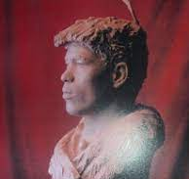
Al Zammouri (1528 CE)
One of the first Arabs in the Americas may have been Moroccan slave Al-Zammouri, brought in 1528.
Zammouri was probably captured in 1511 by the Portuguese. He was then sold into slavery.
After 16 years of captivity, Zammouri was taken to Florida as part of a Spanish expedition.
He journeyed over 6,000 miles between 1528 and 1536, trekking across the American Southwest.
He was acquired as a servant by a Spanish nobleman
He had undoubtedly been raised as a Muslim. Still, because Spain did not allow non-Catholics to travel to the New World, most historians believe that he was required to convert to Roman Catholicism to join the expedition.
His Christian name, Esteban, suggests that he may have been baptized.
Whether he remained secretly a Muslim cannot be known from historical records.

Slide 3
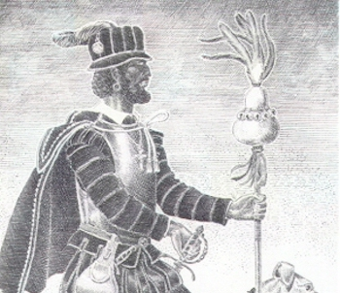
Al Zammouri (1528 CE)
As a Slave, Zammouri was taken on an expedition of 1527 to colonize Florida and the Gulf Coast.
They landed in April 1528.
After failing to locate villages with gold near present-day Tampa Bay and after enduring numerous attacks by Native Americans, the explorers split their forces, hoping to find a better place for settlement at a large bay to the North.
There is no large harbor north of their landing site, and the ships and the land expedition did not meet again. After traveling 300 miles north , they determined they could reach main Spanish settlement at Pánuco by sailing westward along the coast.
The estimated 250 survivors slaughtered their horses, melted down metals from bridles and stirrups, and made five boats to try to sail along the coast Gulf of Mexico to reach Pánuco.
The ships wrecked off Texas's coast, and most of the men aboard the boats were lost at sea.
About 80 surviving men washed ashore. Most were killed or died in the ensuing six years of captivity by native Indians
Eventually, only Zammouri and three others remained alive. The four spent years enslaved on the Texas barrier islands.

Slide 4
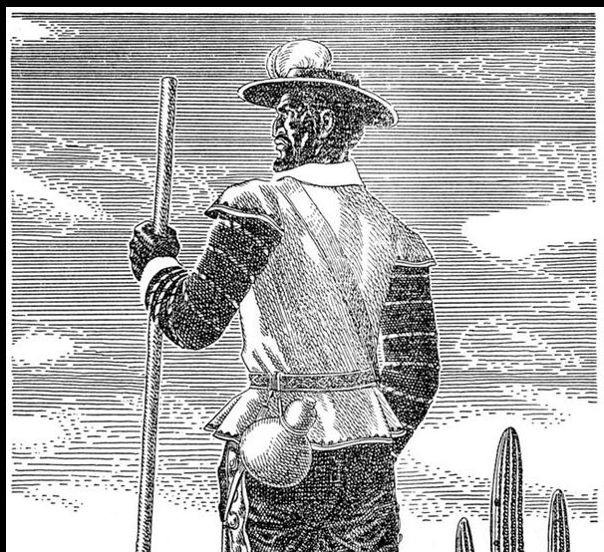
Al Zammouri (1528 CE)
In 1534 the four survivors escaped into the American interior and became medicine men.
As medicine men, they were treated with great respect and offered food, shelter, gifts, and villages to hold celebrations in their honor.
When they decided they wanted to leave, the host village would guide them to the next town.
Sometimes as many as 3,000 people would follow them to the next town.
The party traversed the continent as far as western Mexico, into the Sonoran Desert to the region of Sonora in present-day Mexico.
After finding a small Spanish settlement, the four survivors traveled 1,000 miles to the south to Mexico City, arriving in July 1536.
In Mexico City, the four survivors told stories of wealthy indigenous tribes to the North which created a stir among Spaniards in Mexico.
When the three Spaniards declined to lead an expedition to the North, Zammouri was sold or given to Antonio de Mendoza, the Viceroy of New Spain.
He appointed Zammouri as the guide in expeditions to the North.

Slide 5
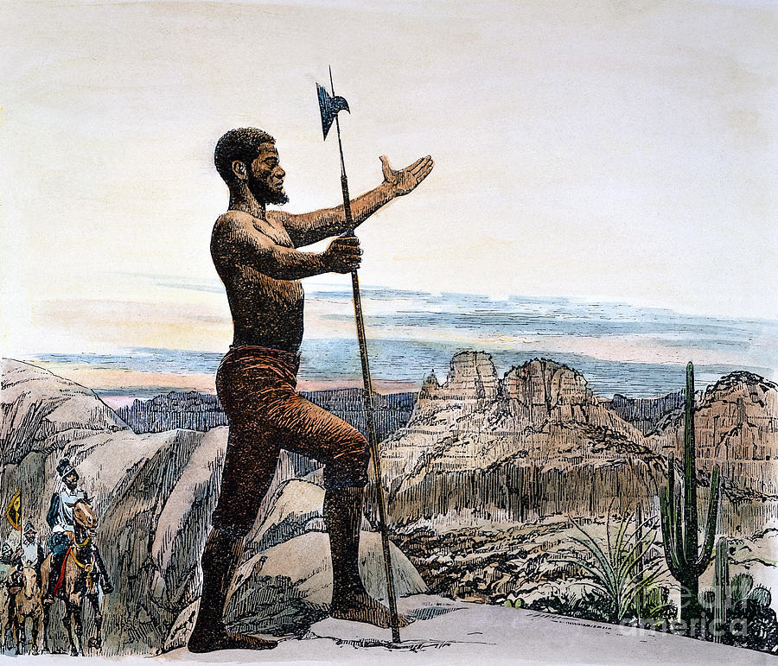
Al Zammouri (1528 CE)
In 1539, Zammouri left Mexico City, traveled to Sinaloa,
Zammouri traveled ahead of the main party with a group of Sonoran Indians.
Virtually all stories of his death are based on legend or speculation.
Some historians suggest that Zammouri was killed because Zuni did not believe Zammouri's report represented a white party that was to follow him.
Others speculate that he was killed for demanding turquoise and women.
Others suggest that since Zammouri, who was black and wore owl feathers and carried a medicine-man's gourd", the Zuni may have determined that he was pretending to be a medicine man, which was punishable by death.

Slide 6
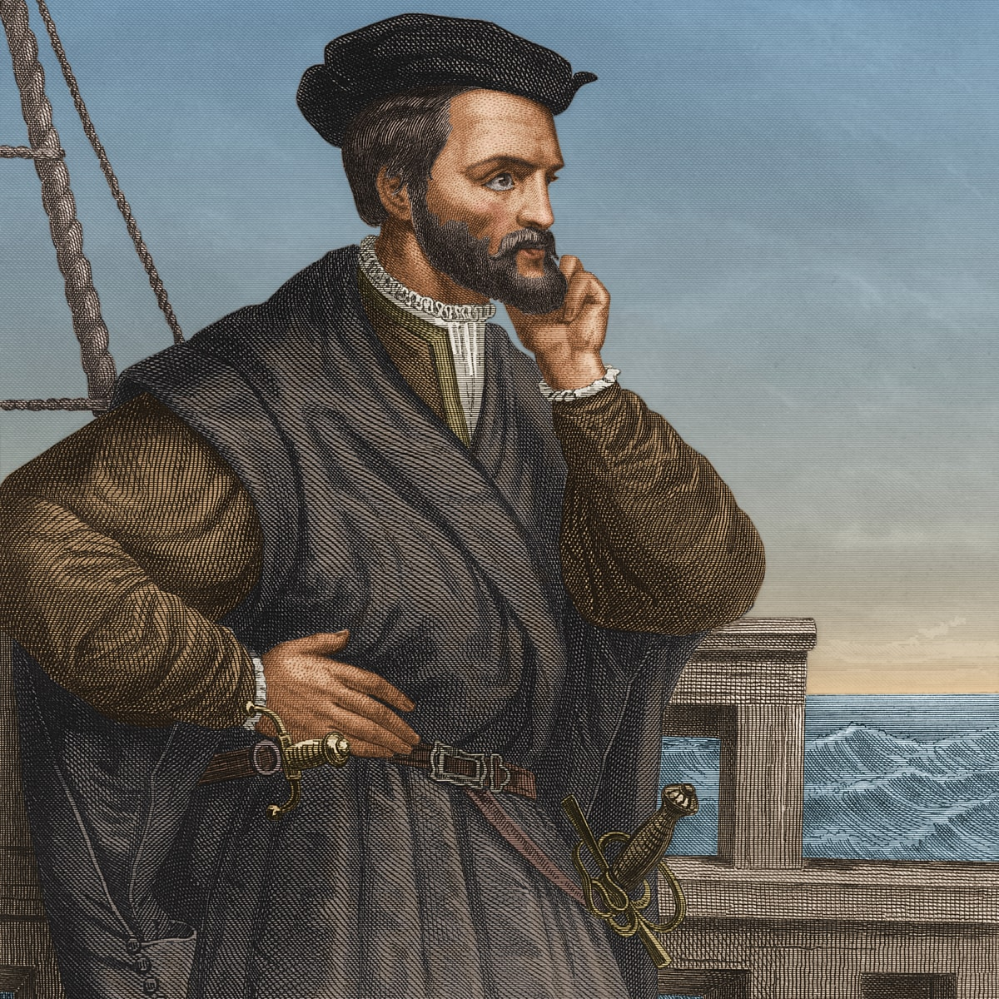
French Colonization Part One (1534 CE)
In 1534, Francis I of France sent Jacques Cartier on the first three voyages to explore Newfoundland's coast and the St. Lawrence River.
The French subsequently tried to establish several colonies throughout North America that failed due to weather, disease, or conflict with other European powers.
Cartier attempted to create the first permanent European settlement in North America at Quebec City in 1541, with 400 settlers.
Still, the settlement was abandoned the next year after bad weather and attacks from Native Americans.
A small group of French troops were left on Parris Island, South Carolina in 1562 to build Charlesfort, but left after a year when they were not resupplied by France.
Fort Caroline, established in present-day Jacksonville, Florida, in 1564, lasted only a year before being destroyed by the Spanish from St. Augustine.

Slide 7
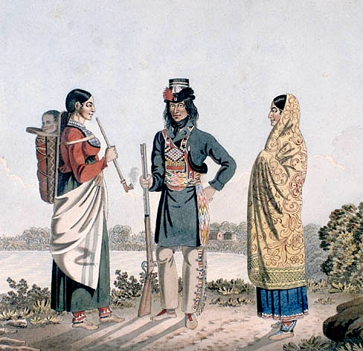
French Colonization Part One (1534 CE)
Samuel de Champlain founded Quebec in 1608 and explored the Great Lakes.
In 1634, Jean Nicolet founded present-day Green Bay, one of America's oldest permanent European settlements.
Louis Jolliet and Jacques Marquette founded Sault Sainte Marie (1668) and Saint Ignace (1671) and explored the Mississippi River.
The French were eager to explore North America, but New France remained largely unpopulated.
Due to the lack of women, intermarriages between French and Indians were frequent, giving rise to the Métis people.
Relations between the French and Indians were usually peaceful.

Slide 8
French Colonization Part One (1534 CE)
To boost the French population, France issued an act declaring that Indians converted to Catholicism was considered "natural Frenchmen" by the Ordonnance of 1627
Louis XIV also tried to increase the population by sending approximately 800 young women nicknamed the "King's Daughters." However, the low density of the population in New France remained a very persistent problem.
At the beginning of the French and Indian War, the British people in North America outnumbered the French 20 to 1.
France fought a total of six colonial wars in North America, and their time in the New World ended up being a pan Atlantic game of king of the hill.
1665

Slide 9
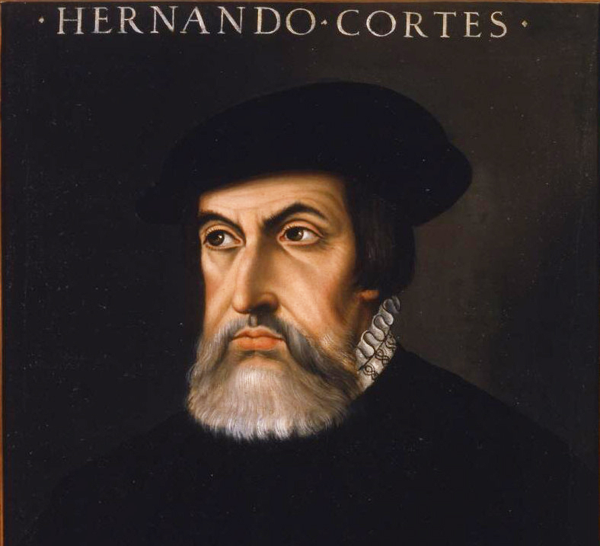
Hernan Cortes (1519 CE)
In 1519, Hernan Cortés' ships reached the Mexican coast at Yucatan.
Cortés was also interested in converting natives to Christianity.
His view on the indigenous people was like many Europeans of that day — they were inferior culturally, technologically, and religiously.
While in Cozumel, he was astounded to learn of the gruesome rituals, including human sacrifice, of the natives to their many gods.
He and his men removed and destroyed the pagan idols and replaced them with crosses and figures of the Virgin Mary.
At Tabasco, Cortés was met with resistance from natives. He quickly overpowered them, and the natives surrendered. hey provided the Europeans with food, supplies, and 20 women, including an interpreter called La Malinche.
La Malinche became bilingual, speaking Aztec and Mayan languages, which made her very useful to Cortés.
She eventually learned Spanish and became Cortés' personal interpreter, guide, and mistress. She had a pretty high status for both a woman and a native during this time and place among the Spaniards.

Slide 10
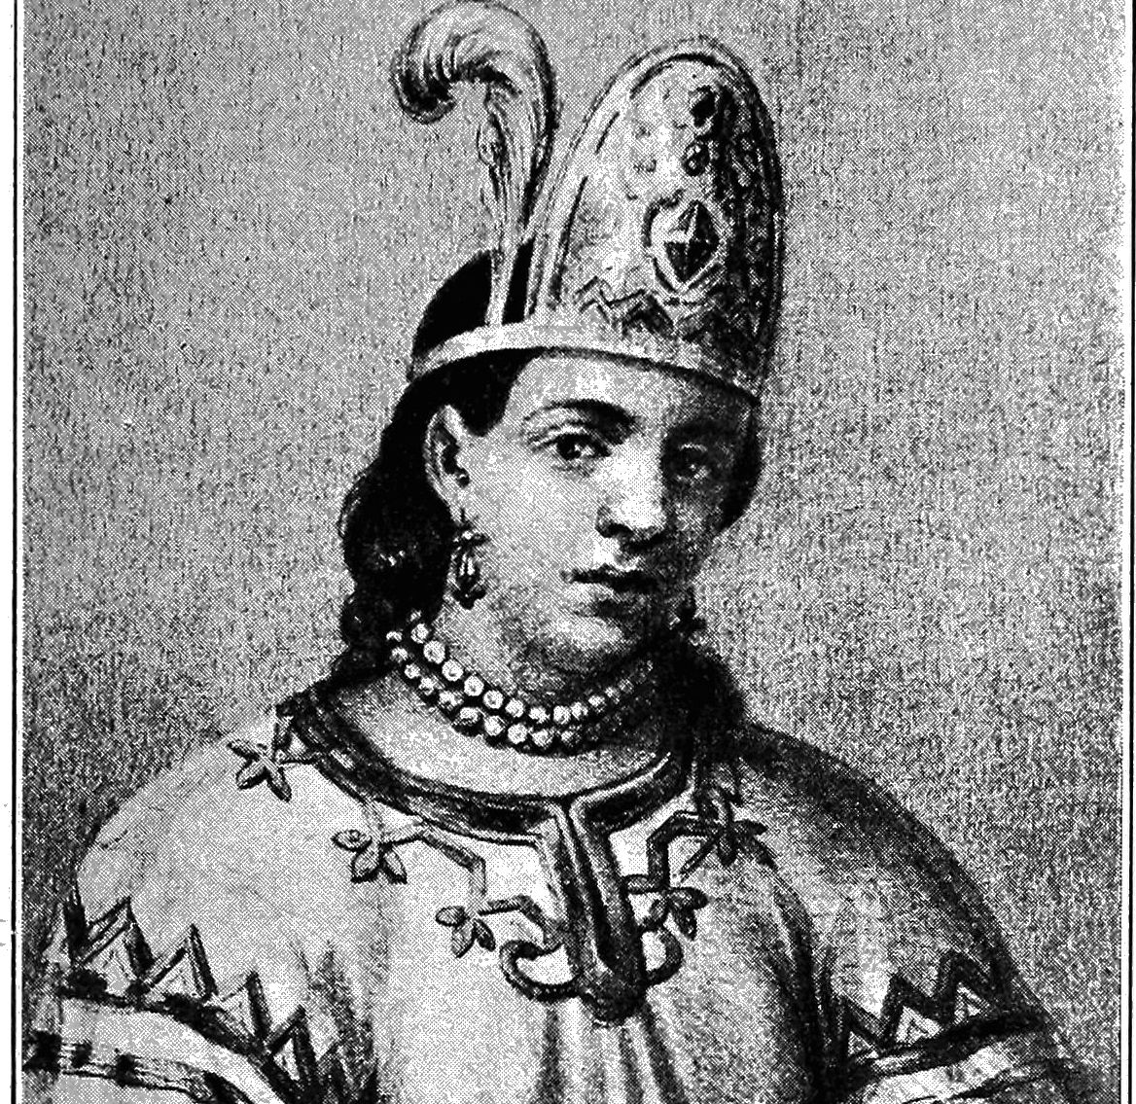
Hernan Cortes (1519 CE)
Cortés and La Malinche had a child together named Martin.
He was one of the first children of mixed indigenous and Spanish heritage.
Eventually, Cortés' Spanish wife came to Mexico.
After her arrival, historians are unsure if Cortés continued to acknowledge La Malinche or Martin.
His desire to maintain his reputation and stand among the Spanish community was more substantial than his need to be a husband and father to Malinche and Martin.
After a few months in Yucatan, Cortés headed west.
On the southeastern coast, he founded Veracruz.
He disciplined his men and trained them to act as a cohesive unit of soldiers. He also burned his ships to make retreat impossible.

Slide 11
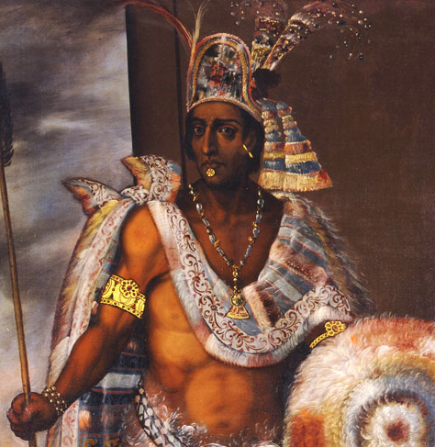
Hernan Cortes (1519 CE)
Cortés had heard of the Aztecs and knew that they, and their leader Montezuma II, was a primary force in Mexico.
He arrived in the great Aztec capital of Tenochtitlán in 1519.
Although he was kindly received by the Aztec emperor Montezuma, Cortés' intentions were less benevolent.
Unbeknownst to Cortés, his arrival coincided with a critical prophecy. The Aztec god Quetzalcoatl, whom among other notable feats, was set to return to Earth.
Thinking that Cortés could be Quetzalcoatl, Montezuma greeted the party.
The Aztecs were fascinated by the Spaniards' light skin and men's sight on horseback, which they described as beasts with two heads and six legs.
The Spanish fired shots, which stunned the natives and further intimidated them.
Cortés entered the city, sacked it, and took Montezuma hostage.
La Malinche helped Cortés manipulate Montezuma and rule Tenochtitlán through him. It is also said that she informed Cortés of an Aztec plot to destroy his army.

Slide 12
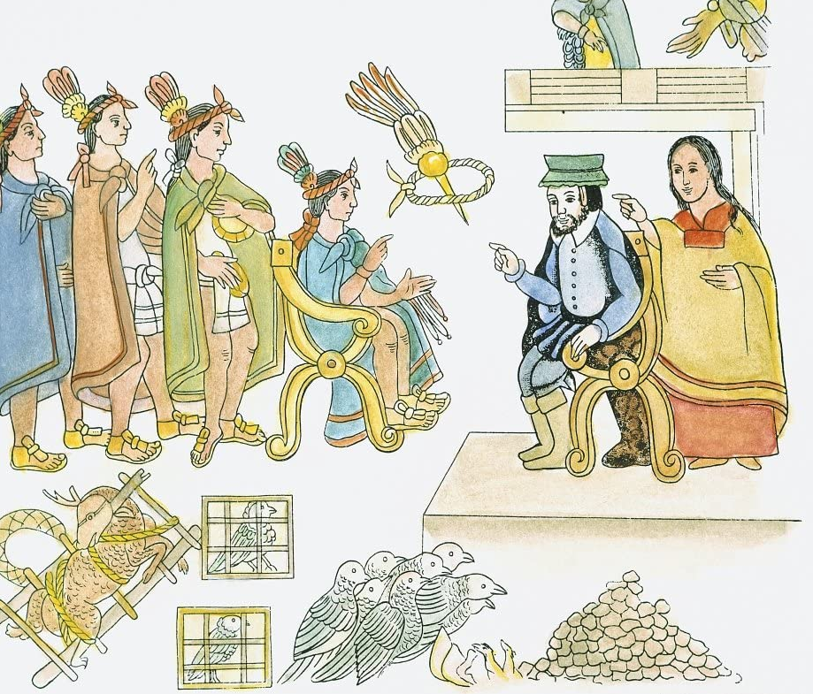
Hernan Cortes (1519 CE)
Though Cortés enslaved much of the native population, other indigenous groups were fundamental to his success.
The Aztecs were not always great rulers among their subjected cities. When Cortés learned of this, he was able to use this to his advantage.
They formed an allegiance, and Cortés was given several thousand warriors to add to his ranks.
While the Spaniards had superior weaponry — cannons, guns, swords, and additional men.
While Cortés held Tenochtitlán through Montezuma, a Spanish force from Cuba landed on the coast of Mexico. They had been sent to unseat Cortés.
Cortés defeated the Spanish force, but when he returned to Tenochtitlán, the Aztecs were amid a full rebellion. Cortés and his men fled the city.
One of Cortés' men contracted smallpox from a member of the force from Cuba. That soldier died during the Aztec rebellion. When his body was looted, an Aztec caught the disease, which spread like wildfire because the Aztec people had no immunity to it.

Slide 13
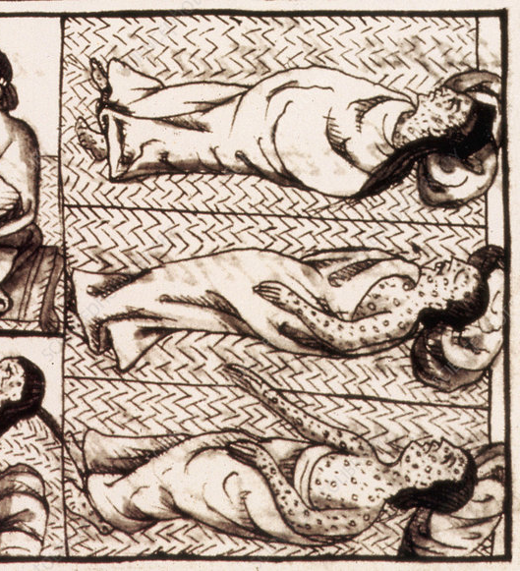
Hernan Cortes (1519 CE)
More than 3 million Aztecs died from smallpox.
With such a severely weakened population, it was easy for the Spanish to take Tenochtitlán.
It is uncertain how Montezuma died. Some scholars state that disgusted with him, the Aztecs stoned him to death. Others assert that the Spanish killed him.
Once the city had fallen, Cortés began building Mexico City on the ruins.
It quickly became a pre-eminent town in the Spanish colonies, and many Europeans came to live there.
As a result of his success, King Charles I of Spain appointed Cortés governor of New Spain.

Slide 14
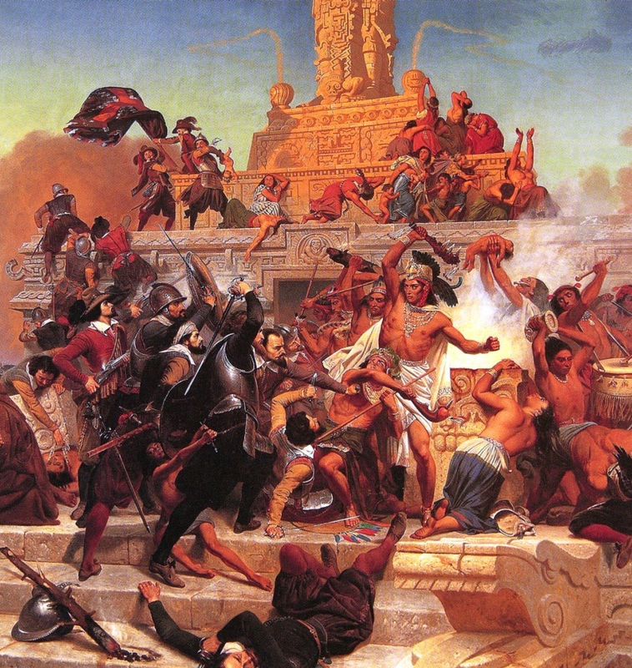
Hernan Cortes (1519 CE)
Cortés is a controversial figure, especially in Mexico, because of his treatment of natives.
Unfortunately, Cortés was not unique in his treatment and mindset when it came to the indigenous people.
He enslaved much of the native population. Many of the indigenous people were wiped out from European diseases such as smallpox.
Both scenarios would, unfortunately, become a common theme among many explorers' interactions with natives.
Cortés was, nevertheless, prominent in his reshaping of the world.
Cortés' victory secured new and profitable land and opportunities for the Spanish monarch.
He helped oversee the building of Mexico City, which is still Mexico's capital today.
He opened the door for further exploration and conquest of Central America to the south.

Slide 15
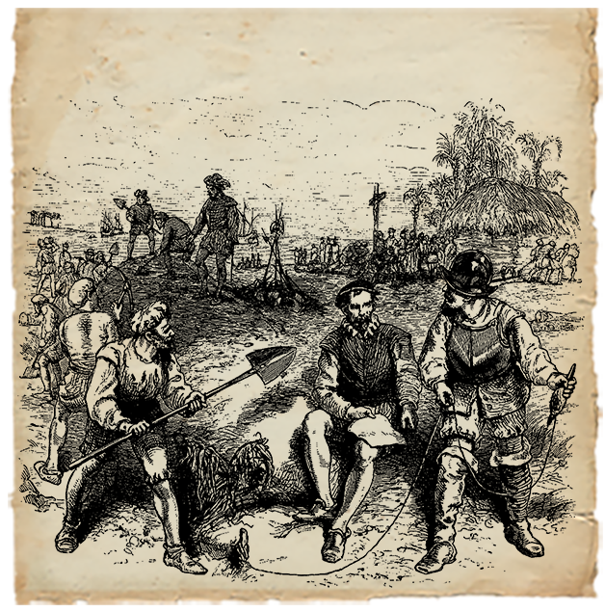
St. Augustine (1565 CE)
St. Augustine was founded in 1565
It is the oldest continuously occupied European origin settlement in the United States.
The Crown approached Pedro Menéndez to fit out an expedition to Florida on the condition that he explore and settle the region as King Philip's conquistador, and eliminate the Huguenot French, whom the Catholic Spanish considered to be dangerous heretics.
Menéndez was in a race to reach Florida before the French captain Jean Ribault, who was on a mission to secure Fort Caroline.
The two fleets met in a brief skirmish off the coast, but it was not decisive.
On August 28 1565 Menéndez's crew finally sighted land.
Menéndez landed on September 8 and founded the settlement they named San Agustín.
They celebrated the first Catholic mass offered in the colony at the landing spot.
The settlement was built in the former native village; its location was chosen for its defensibility and proximity to a freshwater spring.

Slide 16
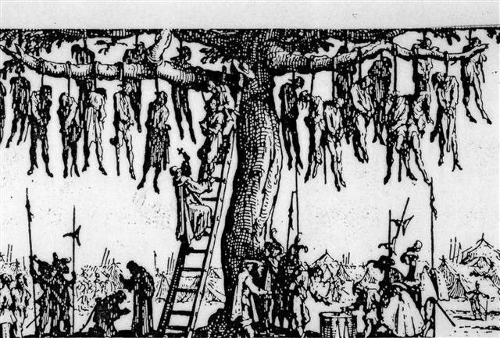
St. Augustine (1565 CE)
A French attack on St. Augustine was thwarted by a violent storm that ravaged the French naval forces.
Taking advantage of this, Menéndez marched his troops overland to Fort Caroline about 30 miles north.
The Spanish quickly overwhelmed the lightly defended French garrison, killing most men and sparing about 60 women and children.
The bodies of the victims were hung in trees with the inscription: "Hanged, not as Frenchmen, but as "Lutherans" (heretics).“
He discovered that the shipwrecked survivors from the French ships had come ashore to the south of the settlement.
A Spanish patrol encountered the remnants of the French force and took them, prisoner.
Menéndez accepted their surrender but then executed all of them except a few professing Catholics and some Protestant workers with useful skills.

Slide 17
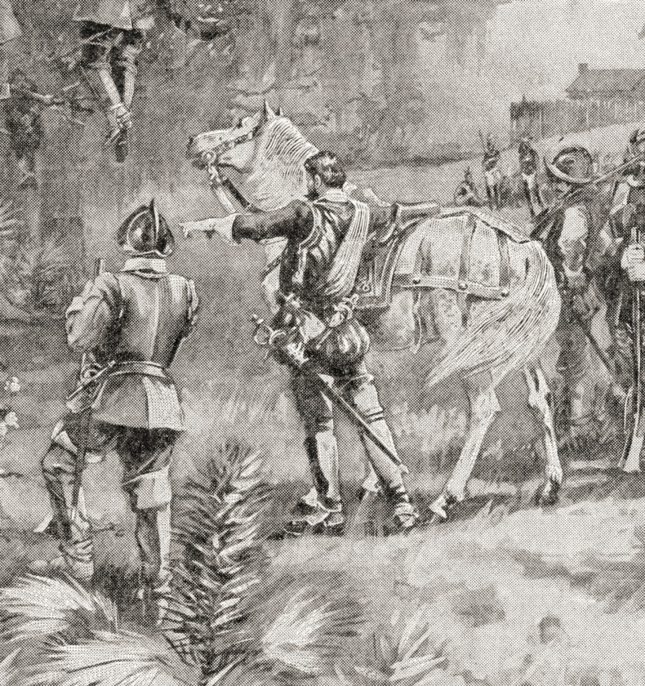
St. Augustine (1565 CE)
Succeeding governors of the province maintained a peaceful coexistence with the local Native Americans, allowing the isolated outpost of St. Augustine some stability for a few years.
On May 28, 1586, soon after the Anglo-Spanish War began between England and Spain, the English pirate Sir Francis Drake sacked and burned St. Augustine.
His large fleet's approach obliged Governor Pedro Menéndez Márquez and the townspeople to flee for their safety.
When the English got ashore, they seized some artillery pieces and a royal strongbox containing the garrison payroll.
The killing of their sergeant major by the Spanish rearguard caused Drake to order the town burnt.
In 1609 and 1611, expeditions were sent out from St. Augustine against the English colony at Jamestown, Virginia.
In the second half of the 17th century, unsettled Indians forced southward by the expanding English colony in Carolina, made raids into Florida, and killed the Franciscan priests who served at the Catholic missions.
Requests by successive governors of the province to strengthen the presidio's garrison and fortifications were ignored by the Spanish Crown, which had other priorities in its vast empire.
The charter of 1663 for the new Province of Carolina, issued by King Charles II of England, was revised in 1665, claiming lands as far southward as 29 degrees north latitude, about 65 miles south of the existing settlement at St. Augustine.

Slide 18
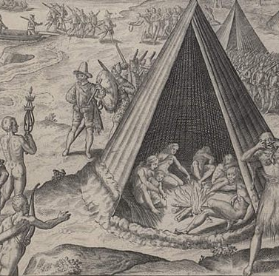
Luzonians (1587 CE)
On 18 October 1587, the first Filipinos landed in what is now the Continental United States at Morro Bay in Upper California.
They sailed from Portuguese Macao, as part of the Manila galleon trade.
In the mid-16th century, Spain conducted its campaign to conquer the Philippines, led by Miguel López de Legazpi.
Because of the Philippines' conquest, in 1565, the Manila galleon trade began,
These ships were primarily crewed by Filipinos, or "Indios Luzones" as they were known.

Slide 19
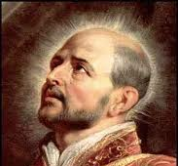
Luzonians (1587 CE)
From 1582 until he died in 1586, Francisco Gali worked the Manila galleon route, initially as a navigator.
In 1585, a mission to survey the Californian coast and avoid China was given to Gali.
He died in Manila later that year, leaving the mission to one Pedro de Unamuno.
Spanish Captain Pedro de Unamuno, who had sailed with Gali from Acapulco, had paid merchants to acquire goods in China.
Upon reaching Macao, Portuguese authorities seized his two galleons, leaving him and his crew trapped in China.
Hearing of this, Manila sought Unamuno's arrest for disobeying the instructions to avoid China.
Fortunately for Unamuno, who could have received the death penalty for his insubordination, Franciscans, who wanted to return to Mexico, provided funds to purchase a ship, a frigate.
One of those Franciscans was Martín Ignacio de Loyola; another person who came aboard for the eastward journey was a Japanese boy.

Slide 20
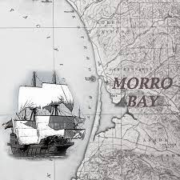
Luzonians (1587 CE)
Leaving the Far East in mid-July 1587, their sailed eastward across the Pacific Ocean for a mostly uneventful trip.
Initial reconnaissance led to the discovery of Morro Bay, which had resources that could replenish the ship's provisions; there were also trees which could be utilized for masts.
When people were observed on a hill looking at their boat, it was decided that a landing party should go ashore and claim the bay.
On October 18, the initial landing parties came ashore. One party consisted of Unamuno and a dozen soldiers
Another party of "Luzon Indians" and a priest was Father Martín Ignacio de Loyola, nephew of Ignatius of Loyola.
Two of the Filipinos went ahead of the parties, scouting for the locals observed from the ship. Initial attempts to contact local people were unsuccessful.

Slide 21
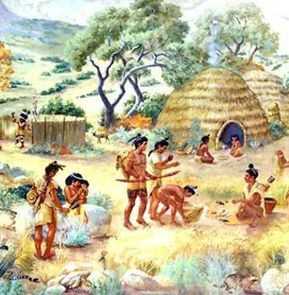
Luzonians (1587 CE)
When a group of nine Native Americans was observed; they ran off before the landing party could communicate with them.
After taking possession of the land by placing a cross atop a hill as a sign of their claim, the landing party returned to the ship.
The 1587 event marks the first documented instance of Asians in California, or anywhere in the United States, North America, and the Americas.
The landing of the Filipinos at Morro Bay, which occurred 33 years before the events at Plymouth Rock, is often overlooked by Filipino Americans.
For instance, the Filipinos who landed in 1587 have been described as "invading troops."

Slide 22
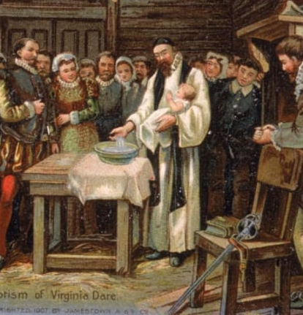
Roanoke Colony 1587 CE)
The first English people to arrive in America were the members of the Roanoke Colony who came to North Carolina in July 1587, with 17 women, 91 men, and 9 boys as the founding colonists.
On August 18, 1587, Virginia Dare was born; she was the first English child born in the territory of the United States. Her mother was Eleanor Dare, the daughter of John White, governor of the Roanoke colony.
White returned to England, intending to bring more supplies back to his colony in 1588. Instead, the Anglo-Spanish War delayed his return to Roanoke until 1590.
Upon his arrival, he found the settlement fortified but abandoned.
The word "CROATOAN" was found carved into the palisade, which White interpreted to mean the colonists had relocated to Croatoan Island.

Slide 23
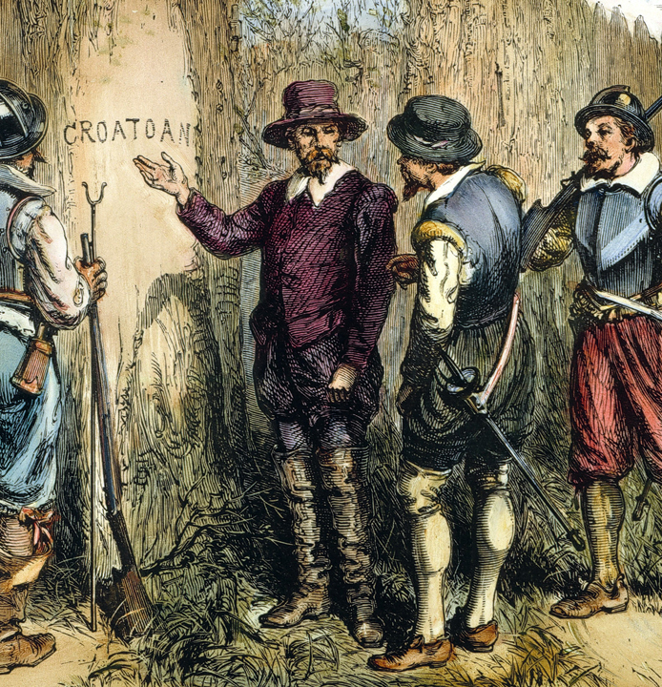
Roanoke Colony (1587 CE)
The fate of the 1587 colonists remains unknown. Speculation that they may have assimilated with nearby Native American communities appears as early as 1605.
Investigations by the Jamestown colonists produced reports that the Roanoke settlers were massacred, as well as stories of people with European features in Native American villages, but no hard evidence.
Interest in the matter fell into decline until 1834, when George Bancroft published his account of the events in A History of the United States.
Bancroft's description of the colonists, particularly White's infant granddaughter Virginia Dare, cast them as foundational figures in American culture and captured the public imagination.
Despite this renewed interest, modern research still has not produced the archaeological evidence necessary to solve the mystery.

Slide 24
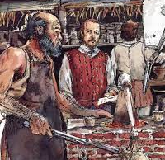
Joachim Gans (1585 CE)
Joachim Gans was a Bohemian mining expert, renowned for being the first Jew in North America.
Gans was born in Prague, Kingdom of Bohemia.
Gans's most dramatic scientific discovery was to reduce the time to purify a batch of copper ore from sixteen weeks to just four days.
Gans became the first Bohemian and the first recorded Jew in colonial America when, in 1585, Sir Walter Raleigh recruited him for an expedition to found a permanent settlement in the Virginia territory of the New World.
Sir Ralph Lane, Governor of Raleigh's expedition, led the Roanoke Colony on Roanoke Island off the coast of modern North Carolina in 1585.
Among the ruins at the Roanoke site, archaeologists have discovered lumps of smelted copper and a goldsmith’s crucible attributed to Gans's work at the colony.
Because the royal mining company failed to resupply colonists who were also becoming increasingly fearful of conflicts with the Native Americans, they accepted an offer from Sir Francis Drake in June 1586 to sail them to England.
Each of the colonists, including Gans, left North America.

Slide 25
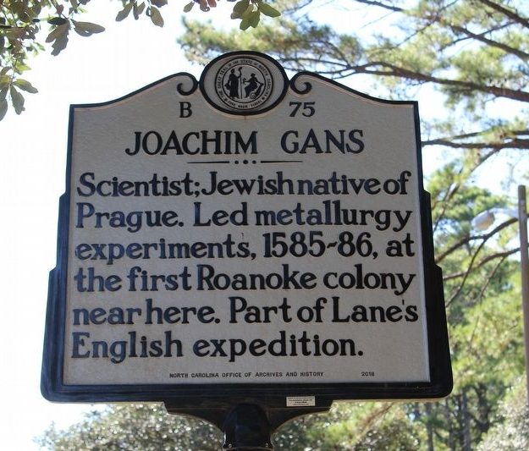
Joachim Gans (1585 CE)
Gans moved to the town of Bristol where he gave Hebrew lessons to English gentlemen who wanted to read the Bible in its original tongue.
In 1589, Gans who in speaking "in the Hebrew tongue," proclaimed himself a Jew.
Gans was asked, "Do you deny Jesus Christ to be the Son of God?" Gans replied, "What needeth the almighty God to have a son? Is he not almighty?“
Gans was brought before the mayor and aldermen of Bristol for blasphemy.
Rather than embarrass an associate of the Royal Mining Company, Bristol’s town fathers referred his case to the Queen’s Privy Council, which included major investors of the Royal Mining Company.
Gans was transported back to London to face their judgment.
The council appears to have taken no hostile action, however, although the trial's outcome and all subsequent history of Gans is unknown, as no information is available.

Slide 26
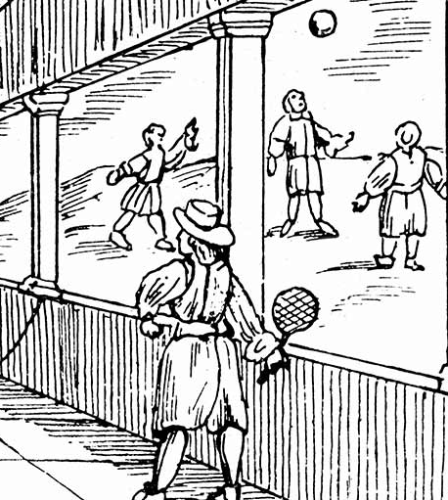
Colonials and Fitness (1537 CE)
Hardships of colonial life ensured that regular physical activity continued to be a lifestyle priority, however during this period no organized exercise or fitness programs existed.
Colonial America remained an undeveloped country characterized by much unexplored land and wilderness.
Lifestyles during this era consisted largely of plowing the land for crops, hunting for food, and herding cattle.
This lifestyle provided sufficient levels of physical activity with no additional need or demand for exercise to maintain fitness levels.

Slide 27
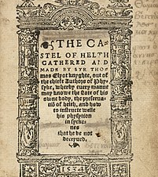
Colonials and Fitness (1537 CE)
‘The Castle of Health’, First published around 1537 by Sir Thomas Elyot looked to educate those who could not understand Greek or Latin on medicine and health and it includes the sort of exercise regimes recommended at the time.
Like health professionals today, Elyot appreciated that people have different fitness levels and requirements, though, in line with early modern medicine, he placed a heavy focus on personality types.
Four categories of exercise are outlined in The Castle of Health with activities recommended in each section:

Slide 28
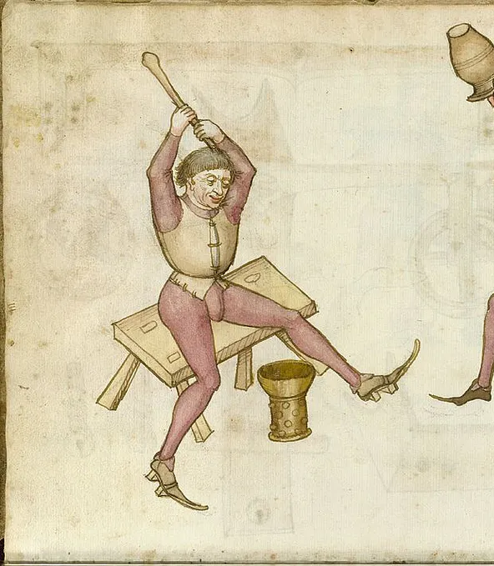
Colonials and Fitness (1537 CE)
The strong or violent exercises:
Digging in heavy, clay soil
Carrying something heavy
Climbing or walking against a steep, upright hill
Hanging by the hands on anything above a man's reach
Raising your arms above your head whilst making a fist with your hands and holding this pose
Swift exercise (without violence)
Running
Playing with weapons
Tennis or throwing of the ball
Trotting back and forth
Moving the arms up and down without using weights

Slide 29
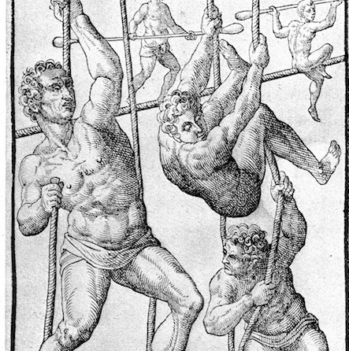
Colonials and Fitness (1537 CE)
Vehement exercise
Dancing
Throwing of the ball and the running after it
Football play
Throwing of the long dart (javelin
Running in harness
Moderate exercise
Long walking or going a tourney
Exercises in combat on horseback.
For the elderly or infirm.

Slide 30
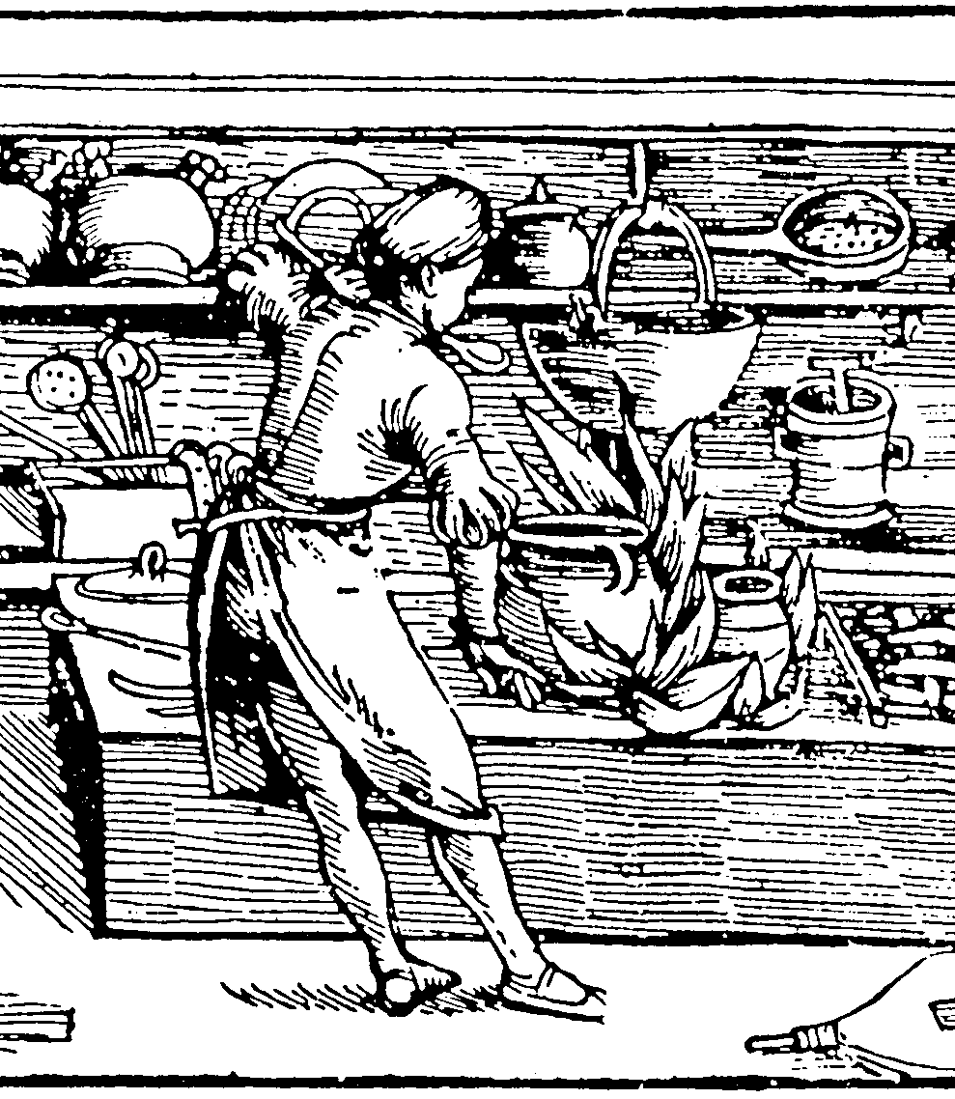
Food in the New World
European countries were racing each other to the New World in the middle of the 16th century.
Spain, England, and France all attempted to establish settlements in the Americas during the mid- to late-1500s, but to no avail.
Finally, some settlements began to stick in the 17th century
Learning to farm, hunt, and cook within their new environment was vital.
The colonists ate three times a day around 6 a.m., 12 p.m., and 6 p.m.
Forks and spoons rarely made appearances at the table. Most people ate from bowls and used knives to scoop up their food.
Eating wasn’t necessarily about enjoyment. The colonists ate food mostly for sustenance and survival.
Gluttony was discouraged and most people ate their food boiled.

Slide 31
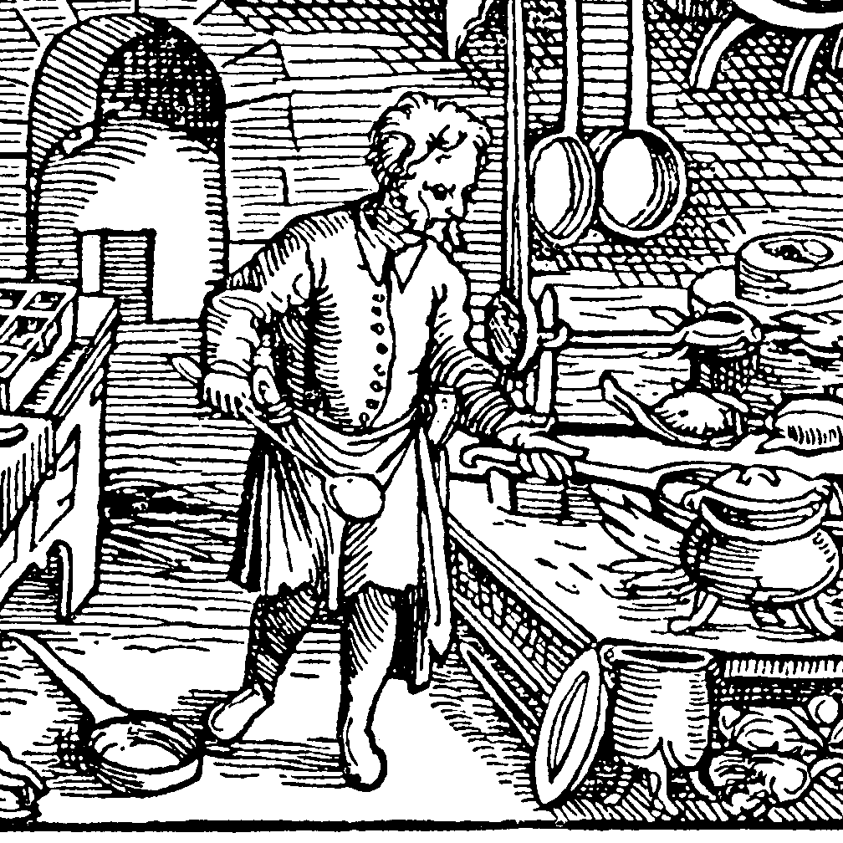
Food in the New World
When the colonists came to Virginia, Pennsylvania, Massachusetts, or any of the other English colonies on the eastern seaboard of North America, their initial attempts at survival included planting crops familiar to them from back home in England.
In the same way, they farmed animals for clothing and meat in a similar fashion.
Through hardships and eventual establishment of trade with Britain, the West Indies and other regions, the colonists were able to establish themselves in the American colonies with a cuisine like their previous British cuisine.
There were some exceptions to the diet, such as local vegetation and animals, but the colonists attempted to use these items in the same fashion as they had their equivalents or ignore them entirely if they could.

Slide 32
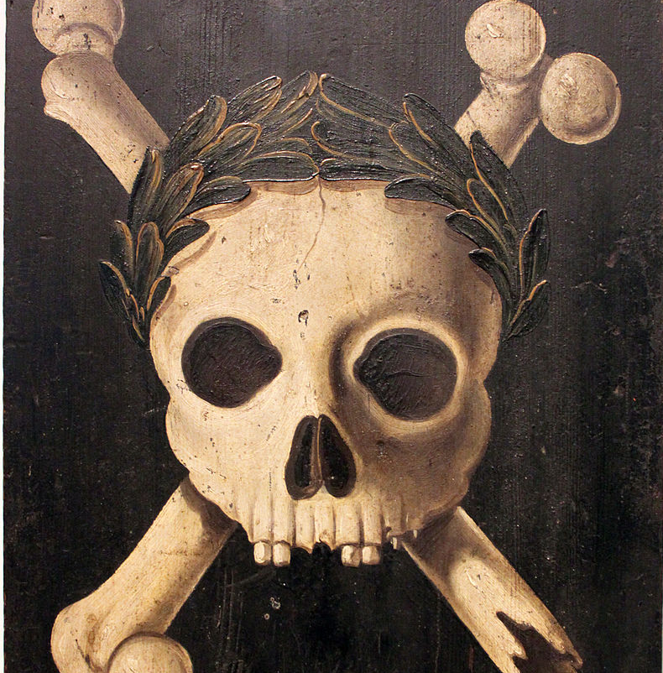
Epidemic Disease
From the 16th through the 19th centuries, the population of Native Americans declined in the following ways: epidemic diseases brought from Europe; violence and warfare at the hands of European explorers and colonists, as well as between tribes; displacement from their lands; internal warfare, enslavement; and a high rate of intermarriage.
Epidemic disease was the overwhelming cause of the population decline of the American natives because of their lack of immunity to new diseases brought from Europe.
With the rapid declines of some populations and continuing rivalries among their nations, Native Americans sometimes re-organized to form new cultural groups, such as the Seminoles of Florida and the Mission Indians of Alta California.
Estimating the number of Native Americans living in what is today the United States of America before the arrival of the European explorers and settlers has been the subject of much debate.
While it is difficult to determine exactly how many Natives lived in North America before Columbus, estimates range from a low of 2.1 million to a high of 18 million.

Slide 33
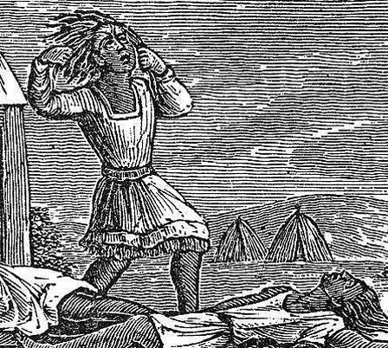
Epidemic Disease
By 1800, the Native population of the present-day United States had declined to approximately 600,000, and only 250,000 Native Americans remained in the 1890s.
Chicken pox and measles, endemic but rarely fatal among Europeans (long after being introduced from Asia), often proved deadly to Native Americans.
Smallpox epidemics often immediately followed European exploration and sometimes destroyed entire village populations.
While precise figures are difficult to determine, some historians estimate that at least 30% of some Native populations died after first contact due to Eurasian smallpox.
One element of the Columbian exchange suggests explorers from the Christopher Columbus expedition contracted syphilis from indigenous peoples and carried it back to Europe, where it spread widely.

Slide 34
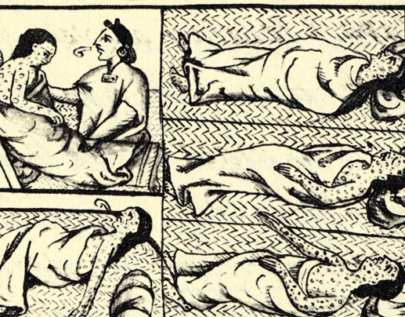
Epidemic Disease
Other researchers believe that the disease existed in Europe and Asia before Columbus and his men returned from exposure to indigenous peoples of the Americas, but that they brought back a more virulent form.
In the 100 years following the arrival of the Spanish to the Americas, large disease epidemics depopulated large parts of the Eastern Woodlands in the 15th century.
In 1618–1619, smallpox killed 90% of the Native Americans in the area of the Massachusetts Bay.
Historians believe many Mohawk in present-day New York became infected after contact with children of Dutch traders in Albany in 1634.
The disease swept through Mohawk villages, reaching the Onondaga at Lake Ontario by 1636, and the lands of the western Iroquois by 1679, as it was carried by Mohawk and other Native Americans who traveled the trading routes.
The high rate of fatalities caused breakdowns in Native American societies and disrupted generational exchange of culture.

Slide 35
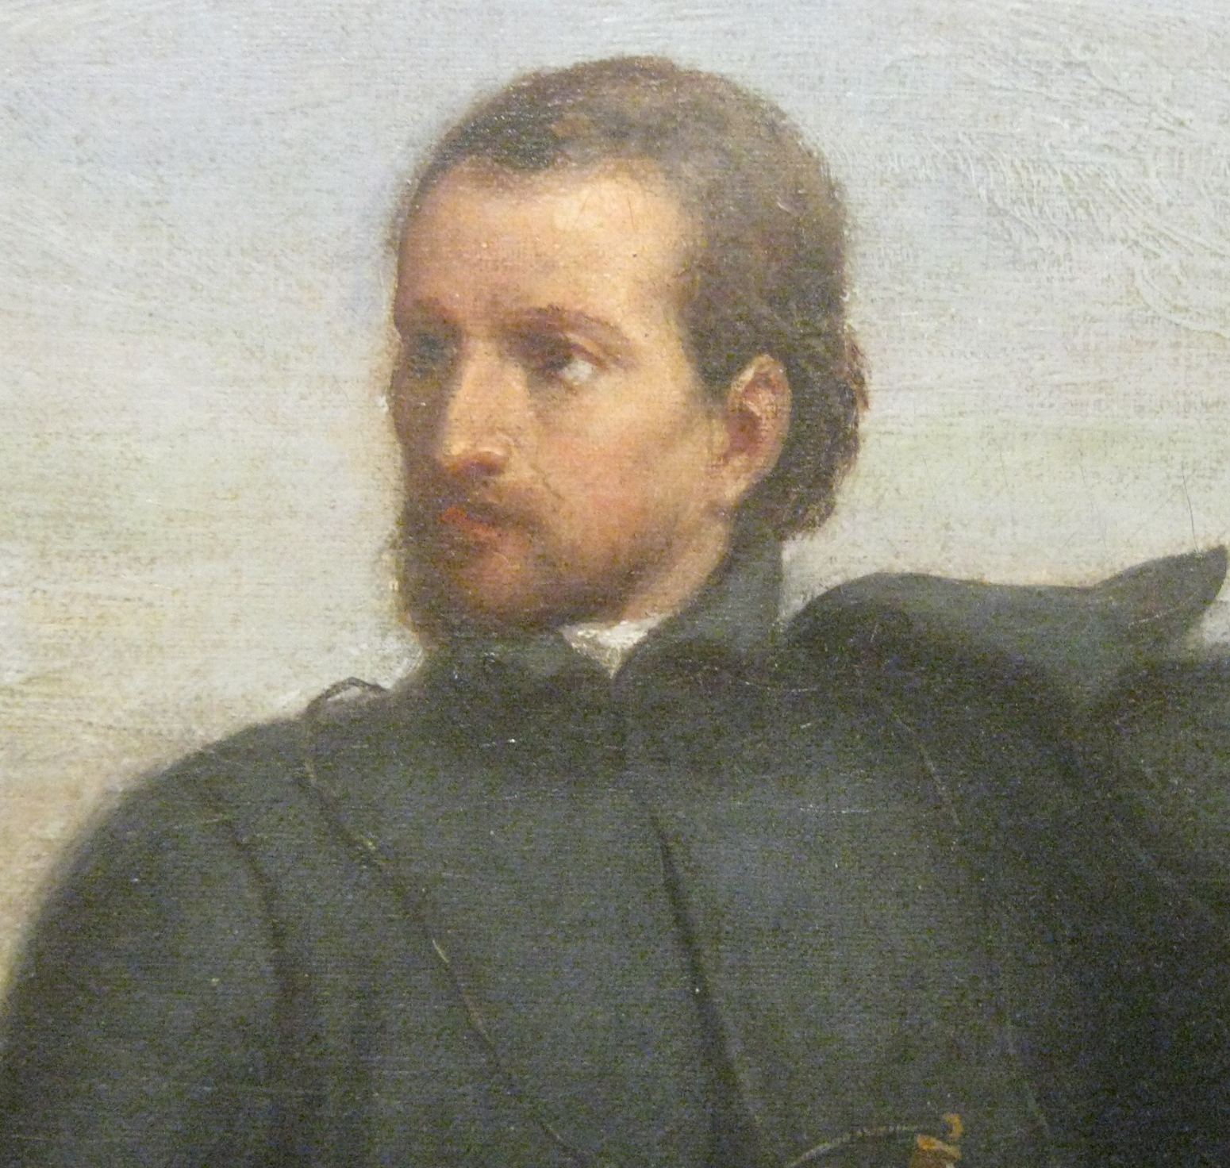
French Colonization Part 2 (1666 CE)
Jacques Marquette, was a French Jesuit missionary explorer who, with Louis Jolliet, travelled down the Mississippi River and reported the first accurate data on its course.
Marquette arrived in Quebec in 1666.
After a study of Indian languages, he assisted in founding a mission at Sault Ste. Marie in 1668, and another at St. Ignace in 1671.
In mid-May 1673 he left St. Ignace with Jolliet, who had been commissioned by the governor of New France, to find the direction and the mouth of the Mississippi.
They travelled westward to Green Bay, ascended the Fox River to a portage that crossed to the Wisconsin River, and entered the Mississippi near Prairie du Chien on June 17.

Slide 36
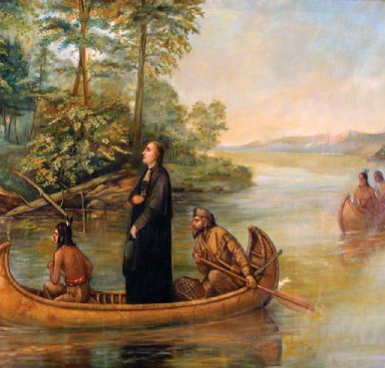
French Colonization Part 2 (1666 CE)
Following it to the mouth of the Arkansas River, they learned that the Mississippi flowed through hostile Spanish domains, and in mid-July they turned homeward by way of the Illinois River.
Marquette was exhausted when he reached Green Bay, and he remained there while Jolliet continued to Canada.
In 1674 Marquette set out to found a mission among the Illinois Indians, but caught by the winter, he and two companions camped near the site of the city of Chicago, and thus became the first Europeans to live there.
Marquette reached the Indians in the spring, but illness forced his return.
While en route to St. Ignace he died at the mouth of a river now known as Père Marquette.

Slide 37
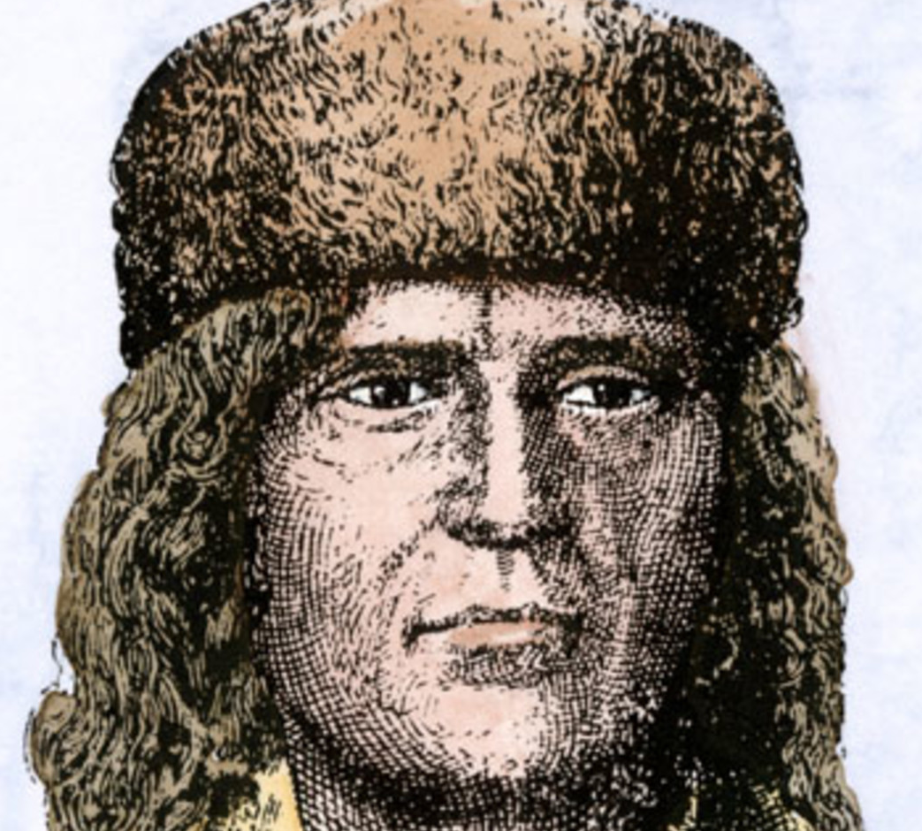
French Colonization Part 2 (1666 CE)
Louis Jolliet was the first white man to traverse the Mississippi River from its confluence with the Wisconsin to the mouth of the Arkansas River in Arkansas.
Jolliet received a Jesuit education in New France (now in Canada) but left his seminary in 1667 and went to France.
The following year he returned to New France to work in the fur trade.
In 1672 he was commissioned by the governor of New France to explore the Mississippi, and he was joined by Marquette.
On May 17, 1673, the party set out in two birchbark canoes from Michilimackinac for Green Bay, on Lake Michigan.
Continuing up the Fox River in central Wisconsin and down the Wisconsin River, they entered the Mississippi about a month later.

Slide 38
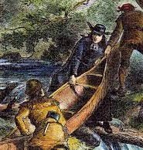
French Colonization Part 2 (1666 CE)
Pausing along the way to make notes, to hunt, and to glean scraps of information from Indians, they arrived in July at the Quapaw Indian village at the mouth of the Arkansas River.
From personal observations and from the friendly Quapaw Indians, they concluded that the Mississippi flowed south into the Gulf of Mexico—not, as they had hoped, into the Pacific Ocean.
In July the party returned homeward via the Illinois River and Green Bay.
Their journey is described in Marquette’s journal, which has survived.
Jolliet later travelled to Hudson Bay, the Labrador coast, and a number of Canadian rivers.
In 1697 he was made royal hydrographer of New France.

Slide 39
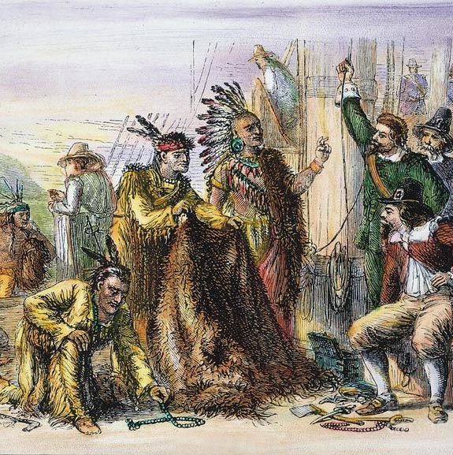
Dutch Mid-Atlantic (1609 CE)
The Dutch West India Company sent explorer Henry Hudson to search for a Northwest Passage to Asia in 1609.
New Netherland was established in 1621 by the company to capitalize on the North American fur trade.
Growth was slow at first due to mismanagement by the Dutch and Native American conflicts.
After the Dutch purchased the island of Manhattan from the Native Americans for a reported price of US$24, the land was named New Amsterdam and became the capital of New Netherland.
The town rapidly expanded and in the mid 1600s it became an important trading center and port.

Slide 40
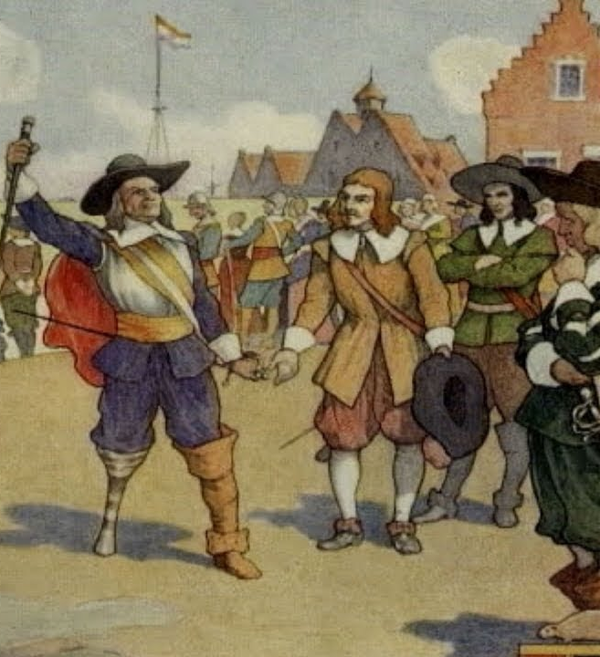
Dutch Mid-Atlantic (1609 CE)
Despite being Calvinists and building the Reformed Church in America, the Dutch were tolerant of other religions and cultures and traded with the Iroquois to the north.
The colony served as a barrier to British expansion from New England, and as a result a series of wars were fought.
The colony was taken over by Britain in 1664 and its capital was renamed New York City.
New Netherland left an enduring legacy on American cultural and political life of religious tolerance and sensible trade in urban areas and rural traditionalism in the countryside.
Notable Americans of Dutch descent include Martin Van Buren, Theodore Roosevelt, Franklin D. Roosevelt,and Eleanor Roosevelt.

Slide 41
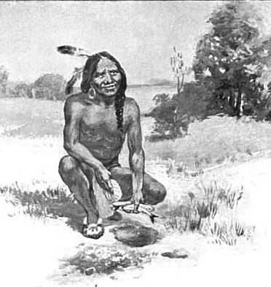
Squanto (1621 CE)
Squanto, also called Tisquantum was a Native American interpreter and guide.
Squanto was born into the Pawtuxet people who occupied lands in present-day Massachusetts and Rhode Island.
Little is known about his early life. He was, in any event, seized with other Indians by Thomas Hunt, who took them to the Mediterranean port of Málaga, Spain, to be sold into slavery.
Squanto somehow escaped to England and joined the Newfoundland Company.
He returned home in 1619 on his second trip back to North America only to find that his people had been wiped out by disease.
During the spring of 1621, Squanto was brought to the newly founded Pilgrim settlement of Plymouth by Samoset, an Indian who had been befriended by the English settlers.
Squanto, who had been living with the Wampanoag people since his return from England, soon became a member of the Plymouth Colony.

Slide 42
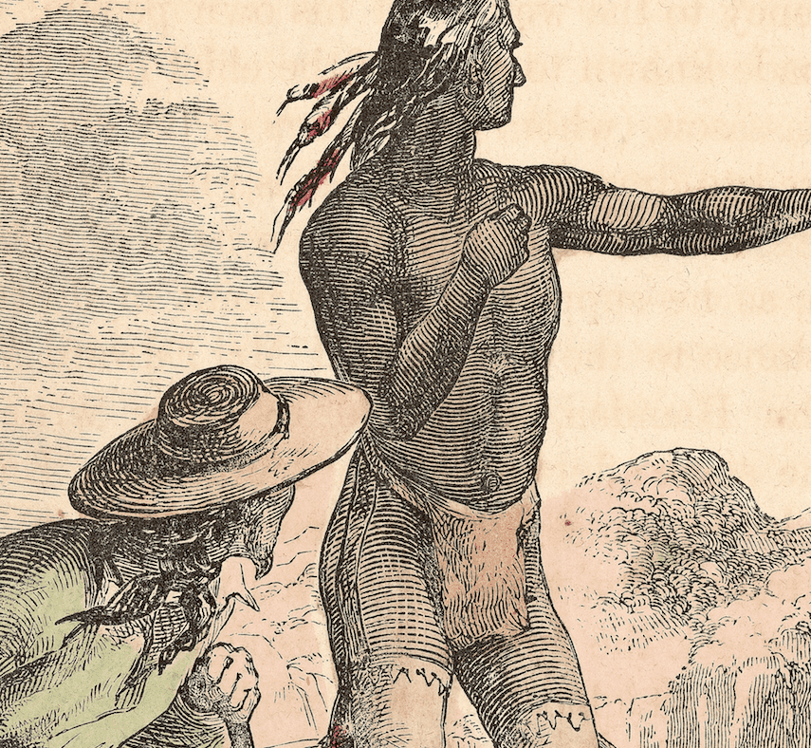
Squanto (1621 CE)
Because Squanto was fluent in English, Gov. William Bradford made him his Indian emissary, and he then served as interpreter for Edward Winslow, the Pilgrim representative, during his negotiations with Massasoit, chief of the Wampanoags.
Squanto died while serving as a guide to Governor Bradford on an expedition around Cape Cod.
Because almost all the historical records of Squanto were written by English Separatists and because most of that writing had the purpose to attract new settlers, give account of their actions to their financial sponsors or to justify themselves to co-religionists, they tended to relegate Native Americans to the role of assistant to them in their activities.
No real attempt was made to understand Squanto or Native culture, particularly religion.
The closest that Bradford got in analyzing him was to say "that Tisquantum sought his own ends and played his own game, ... to enrich himself.”

Slide 43
17th Century Music
The colonial era in America began in 1607 with the colonization of Jamestown, Virginia.
Music of all genres and origins emerged as the United States began to form.
From the Indigenous spiritual music to the African Banjos, music in the United States is as diverse as its people.
In New England, the music was very religious and vitally important in the rise of American music.
The migration of people southward lead to the settling of the Appalachian Mountains, where many poor Europeans inhabited and brought country blues and fiddling.
As music spread, the religious hymns were still just as popular.
The first New England School, Shakers, and Quakers, all religion-inspired music and dance groups, rose to fame.

Slide 44
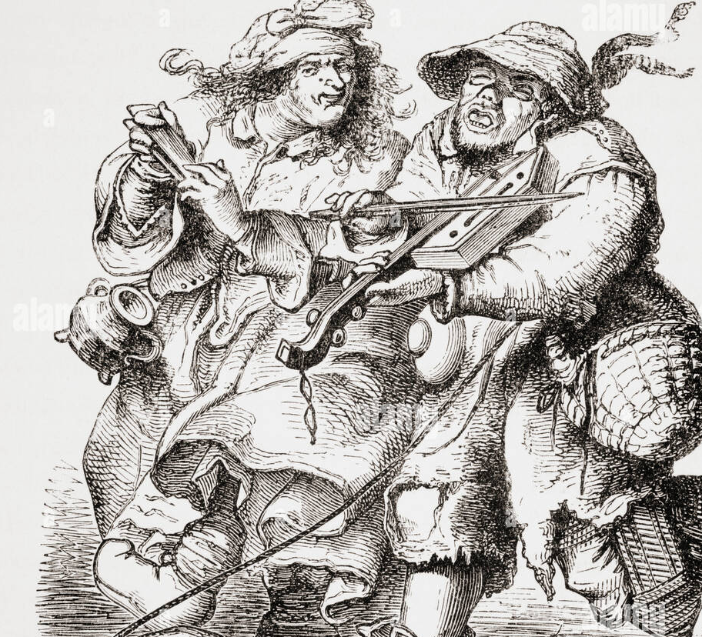
17th Century Music
African Slaves came to the United States and introduced the music world to instruments like the xylophone, drums, and banjo.
The diverse music of the United States comes from the different types of people who first colonized this country.
The religious singing traditions of New England played an essential role in the early evolution of American music.
Beginning with the Pilgrim colonists, who brought the Ainsworth Psalter with them to the New World, church hymns were widespread across the region.
Common New Englanders soon developed their own traditions, which were viewed by some as immoral.

Slide 45
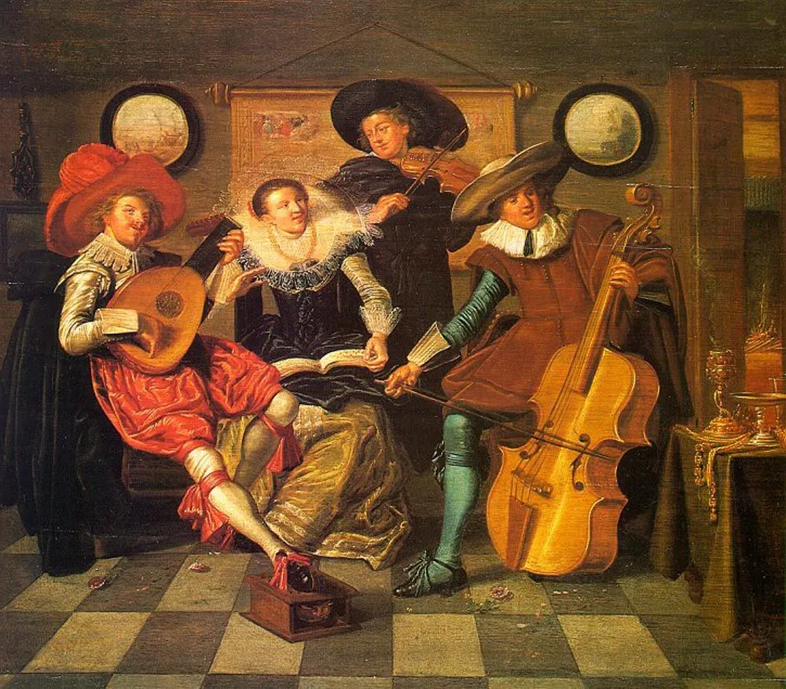
17th Century Music
The original Puritan immigrants to New England sang several spiritual psalms, but generally disliked secular music, or at least those varieties which they viewed as encouraging immorality and disorder.
The Bay Psalme Book was published in Cambridge, Massachusetts, in 1640; it was the first book of any kind printed in the English colonies of North America.
It became the standard used by New England churches for many years. However, it contained no music itself, merely providing psalms and pointing readers to other prominent publications.
The Bay Psalm Book was faithful to its source but did not produce beautiful singing. In 1651, then, a third edition was created, and became known as the New England Psalm Book; this became the standard for many years.

Slide 46
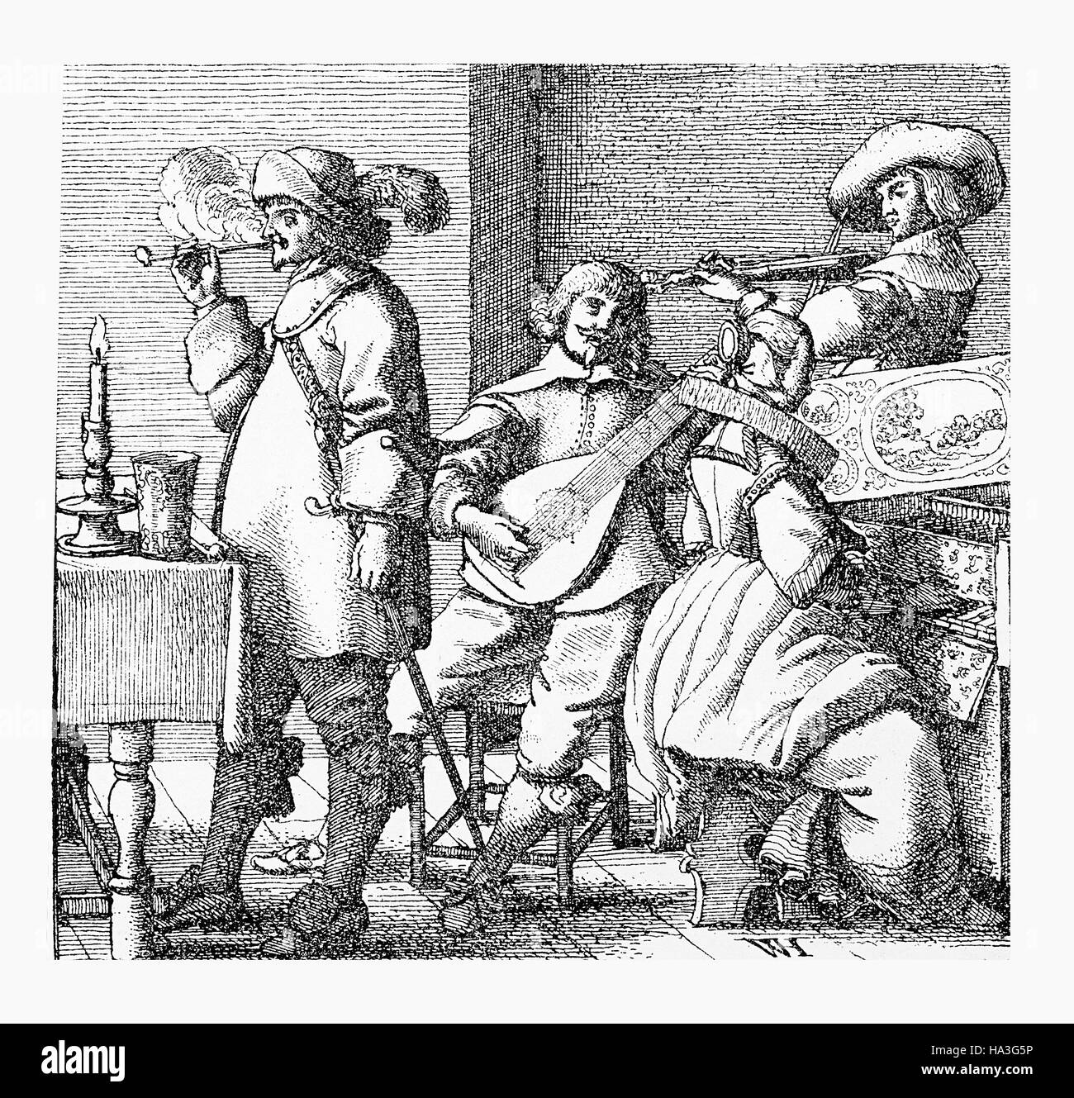
17th Century Music
Organs were the only instrument in church music during this era
Organs, however, were expensive and difficult to play. Only the largest churches could afford an organ and organist.
So many used more portable instruments, such as the bass fiddle, which was called "God's fiddle" to distinguish it from the much-maligned "Devil's fiddle" (violin).
Though there is much in primary sources referring to the folk music of the time, it is virtually all written by those who condemned the songs as uncouth. As such, little is objectively known.
Brought to the United States as early as 1619, African slaves were from a variety of tribes from West Africa.
They spoke hundreds of languages; some came from rival tribes, or isolated communities with little connection to anyone else until the arrival of the slave traders.
Some of the larger groups had extensive contact with the Muslims of North Africa and the distant East and Southern Africa cultures.

Slide 47
17th Century Music
Slaves brought with them work songs, religious music and dance, and a wide variety of instruments, including kalimba, xylophone, flutes, and rattles.
The most distinctive component of African music, however, is the focus on the rhythm.
In this respect, African folk styles are far more complex than anything developed anywhere else.
African music is usually polyrhythmic.
It is made by a wide variety of percussion instruments, both pitched and unpitched, using numerous kinds of natural materials.
Polyrhythms were imported along with slaves to the New World. It has found its way to genres ranging from African American gospel to pop and rock and roll.

Slide 48
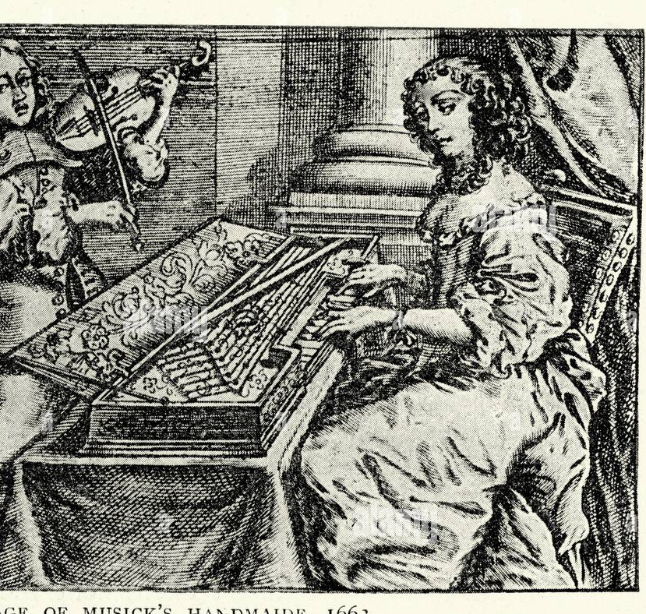
17th Century Music
Many slave owners encouraged their slaves to sing as they work, believing that its improved morale and made the slaves work harder.
They generally required that all tunes remain cheerful and pleasant in tone to ensure that this occurred.
Since they were often without instruments, clapping and foot-stomping became an integral part of slave music.
The banjo and various kinds of drums were the most important instruments.
African slaves in places like Haiti, Brazil, and the Dominican Republic retained the use of drums.
Their percussion has formed an integral part of Afro-Caribbean and Latin music.
In the British North American colonies, however, drums were prohibited; colonial masters had feared drums would be used as communication between slaves. The drums use may aid uprisings and rebellions.
Drums did, however, remain a prominent part of the music of the French colony of Louisiana.

Slide 49
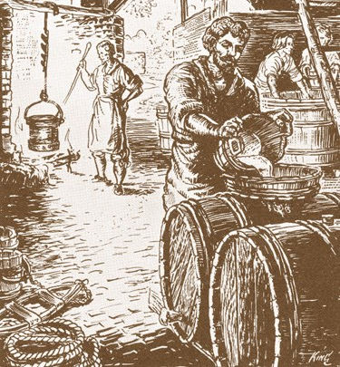
Alcohol
As the Pilgrims set out for America, they brought a considerable amount of alcohol to the voyage (more than 7,560 gallons). The Mayflower shipped more beer than water when it departed for the New World in 1620.
Once settled, they served alcohol at "virtually all functions, including ordinations, funerals, and regular Sabbath meals.
Colonists had assimilated alcohol use, based on Old World patterns, into their community lifestyles.
That local brewing began almost as soon as the colonists were safely ashore."
Increase Mather, a prominent colonial clergyman and president of Harvard, expressed the standard view in a sermon against drunkenness: "Drink is in itself a good creature of God, and to be received with thankfulness, but the abuse of drink is from Satan; the wine is from God, but the drunkard is from the Devil."
While this may seem strange viewed from the modern context, note that drinking wine and beer was safer than drinking water - which was usually taken from sources also used to dispose of sewage and garbage.
Alcohol was also an effective painkiller, provided the energy necessary for hard work, and generally enhanced life quality.

Slide 50
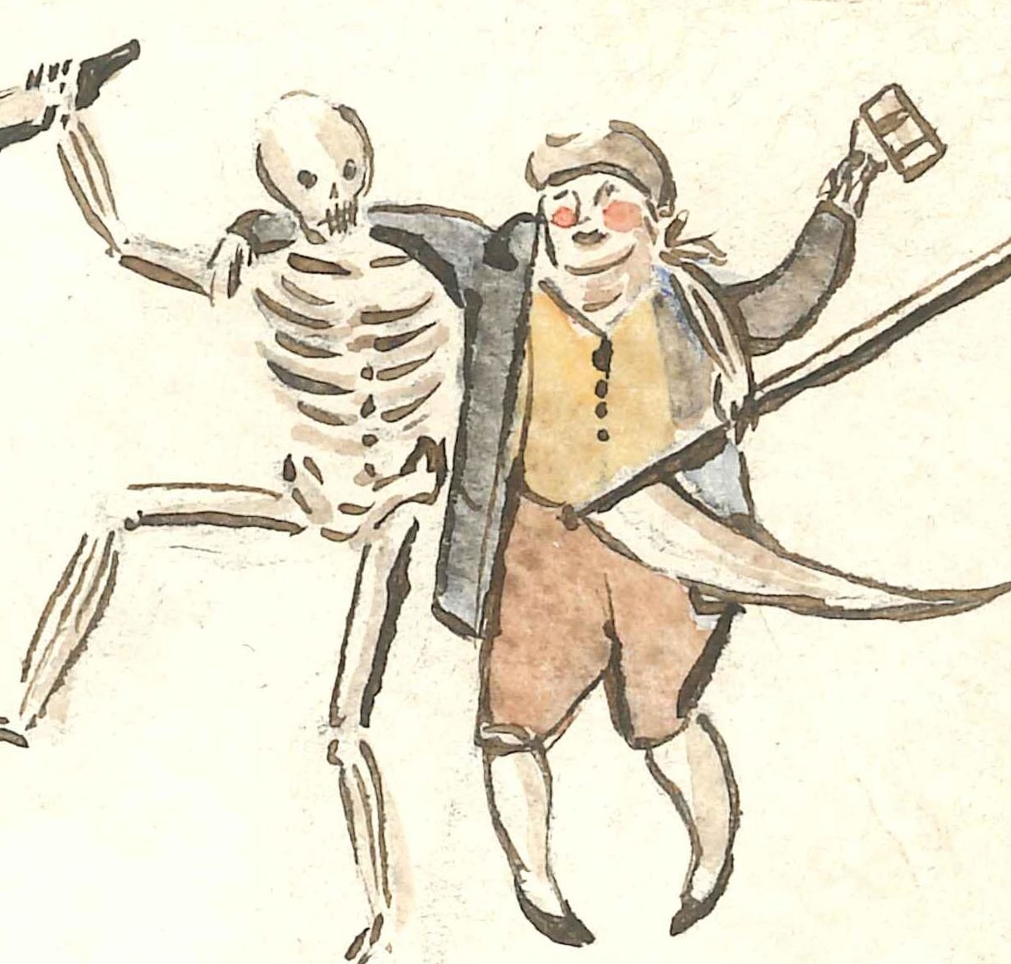
Alcohol
Both in England and in the New World, people of both sexes and all ages typically drank beer with their meals.
Because importing a continuing supply of beer was expensive, the early settlers brewed their own.
Although wild hops grew in New England, hop seeds were ordered from England to cultivate an adequate supply for traditional beer.
Beer was designated X, XX, or XXX according to its alcohol content.
The colonists also learned to make a wide variety of wine from fruits.
They additionally made wine from such products as flowers, herbs, and even oak leaves.

Slide 51
Alcohol
By 1657, a rum distillery was operating in Boston.
It was highly successful. Within a generation, the production of rum became colonial New England's largest and most prosperous industry.
Almost every important town from Massachusetts to the Carolinas had a rum distillery to meet the local demand, which had increased dramatically.
Rum was often enjoyed in mixed drinks, including flip. This was a popular winter beverage made of rum and beer sweetened with sugar and warmed by plunging a red-hot fireplace poker into the serving mug.
Except for several nations in the Southwest, Native Americans did not have alcoholic beverages.
The Apache and Zuni drank alcoholic drinks, which they produced for secular consumption. The Pima made alcohol for religious ceremonial consumption. And the other tribes' drinking was also infrequent and didn't cause problems.

Slide 52
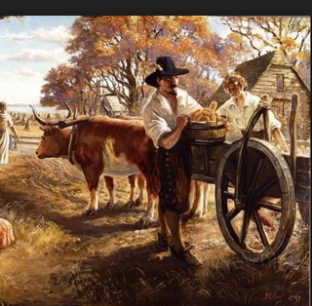
Headright System (1618 CE)
International travel is steep financial, especially in the 17th century. People needed a way to pay for their way to the new world, and the free market found a solution.
The headright system began in Jamestown, Virginia in 1618 to solve labor shortages due to the advent of the tobacco economy, which required large plots of land with many workers.
The disproportion between the amount of land available and the population led to a situation with a low supply of labor, resulting in the growth of indentured servitude and slavery.
Colonists who had already been living in Virginia were each given two headrights of 50 acres; immigrant colonists who paid for their passage were given one headright, and individuals would subsequently receive one headright each time they paid for the transportation of another individual.
This last mechanism increased the division between the wealthy landowners and the working poor.
Headrights were given to heads-of-households.
Because 50 acres were accumulated for each household member, families had an incentive to make the passage to the colonies together.

Slide 53
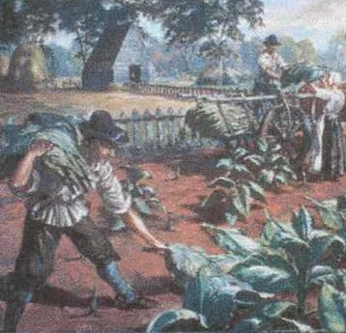
Headright System (1618 CE)
Poor individuals would become workers for a specified number of years and provide labor to repay the landowners who had sponsored their transportation to the colonies.
The applicants to headrights could receive grants for men, women, and children since anyone could become an indentured servant.
Early documentation from the Virginia Company suggests that a landowner could receive a headright even if the indentured servant whose trip they sponsored did not make it to Virginia alive.
According to records, in the 1670s, over 400 enslaved people were used as headrights in Virginia.
This number increased in the 1680s and 1690s. Many families grew in power in the colonies by receiving large tracts of land when they imported enslaved people.
For example, George Menefie purchased sixty enslaved people and received a total of 3,000 acres in 1638.
In 1699, it was decided that headrights would only be granted for English citizens and that transporting an enslaved person would no longer guarantee land.

Slide 54
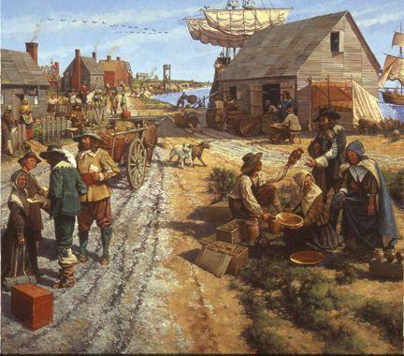
Headright System (1618 CE)
There were few regulations in place to keep the headright system in check.
Thus, several headrights were claimed multiple times, and people took advantage of the lack of governance.
For instance, when a person was brought to the colonies, both the ship captain and the individual paying the transportation costs may have attempted to receive land patents or headrights for the same person.
Another problem was that secretaries sometimes issued headrights for fictitious people.
During the 1660s and 1670s, the number of headrights was about four times more than the population increase.
Indentured servants were granted land inland, which was near the natives.
This migration produced conflict between the natives and the indentured servants.
Later, Bacon's Rebellion was sparked by tensions between the natives, settlers, and indentured servants.

Slide 55
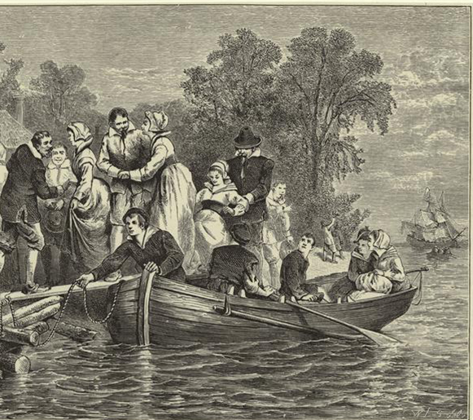
Tobacco Brides (1619 CE)
In 1619, 90 young single women from England went to Jamestown to become wives of the men there, with the women being auctioned off for 150 pounds of tobacco each (to be paid to the shipping company), as that was the cost of each woman's travel to America.
All 90 of them did indeed become wives. The youngest had been fifteen or sixteen years old when she left, and one of the oldest was twenty-eight.
Tobacco brides were often sent to America against their will and often sent at very young ages.
144 tobacco brides were brought to Jamestown by the Virginia Company between 1619 and 1622.
Without these women the Virginia Company was concerned that the 12-year-old colony wouldn't survive.
Unlike the Puritans who would soon settle in New England colonies with their families, the men in Jamestown didn't have families to keep them in the Americas permanently.
Many Jamestown settlers would come to the colony, make their fortune, and go home to get married.
A small portion abandoned the colony to go live in the Indian villages, where there were plenty of women, and life was better.
This latter outcome was especially troubling to English religious leaders. They preached sermons about the sexual availability of the Indian women.

Slide 56
Tobacco Brides (1619 CE)
The Virginia Company advertised that if English women agreed to come to Jamestown searching for a husband, the company would loan them clothing, transportation, and a plot of land.
In Jamestown, they could have their pick of wealthy bachelors.
Once they chose a husband, he would reimburse the Virginia Company for her expenses with 120 to 150 pounds of "good leaf" tobacco.
It led to allegations that the Virginia Company "sold" these women.
However, unlike the Africans who began arriving in Jamestown in 1619, no one bought or sold these English women.
For women who couldn't afford an excellent dowry to attract a husband, becoming a tobacco wife was an attractive option.
Women of all classes except the vagrant poor attempted to amass a dowry to attract a husband.
However, it seems that if a family sent their daughter overseas, they absolved themselves of the need to provide a dowry for her.

Slide 57
African Slavery (1619 CE)
On August 20, 1619, roughly 20 Angolans, kidnapped by the Portuguese, arrive in the British colony of Virginia and are then bought by English colonists.
The arrival of the enslaved Africans in the New World marks two and a half centuries of slavery in North America.
Founded at Jamestown in 1607, the Virginia Colony was home to about 700 people by 1619.
The first enslaved Africans to arrive there disembarked at Point Comfort, today known as Hampton Roads.
Most of their names, as well as the exact number who remained at Point Comfort, have been lost to history, but much is known about their journey.

Slide 58
African Slavery (1619 CE)
They were initially kidnapped by Portuguese colonial forces, who sent captured members of the native Kongo and Ndongo kingdoms on a forced march to Luanda's port, the capital of modern-day Angola.
They were ordered on the ship San Juan Bautista, which set sail for Veracruz in the colony of New Spain.
As was quite common, about 150 of the 350 captives aboard the ship died during the crossing.
Then, as it approached its destination, the ship was attacked by two privateer ships, the White Lion and the Treasurer.
Crews from the two boats stole up to 60 of the Bautista's slaves.
It was the White Lion which docked at Virginia Colony's Point Comfort and traded some of the prisoners for food on August 20, 1619.
Scholars note that the arrivals were technically sold as indentured servants.
Indentured servants agreed, or in many cases were forced, to work with no pay for a set amount of time, often to pay off debt and could legally expect to become free at the end of the contract.

Slide 59
African Slavery (1619 CE)
Two of the Africans who arrived aboard the White Lion, Antonio and Isabella, became "servants" of Captain William Tucker, commander of Point Comfort.
Their son William is the first known African child to have been born in America, and under the law of the time, he was born a freeman.
In the coming decades, however, slavery became codified.
Servants of African origin were often forced to continue working after the end of their contract, and in 1640 a Virginia court sentenced rebellious servant John Punch to a lifetime of slavery.
With fewer white indentured servants arriving from England, a racial caste system developed, and African servants were increasingly held for life.
In 1662, a Virginia court ruled that children born to enslaved mothers were the mother's owner's property.
As cash crops like tobacco, cotton, and sugar became pillars of the colonial economy, slavery became its engine.
Though the slave trade was outlawed in 1807, chattel slavery and the plantation economy it made possible flourished in the South.

Slide 60
Pocahontas (1607 CE)
Pocahontas wasn't even her actual name. Pocahontas was her nickname, depending on who you ask, which means "playful one" or "ill-behaved child.“
Pocahontas was the daughter of Chief Powhatan, paramount chief of an alliance of about 30 Algonquian-speaking groups and petty chiefdoms in Tidewater, Virginia.
Pocahontas is frequently viewed as a princess in popular culture. Still, she was not in line to inherit a position as a sub-chief.
Pocahontas is most famously linked to colonist Captain John Smith who arrived in Virginia with 100 other settlers in April 1607.
The colonists had numerous encounters over the next several months with the natives—some of them friendly, some hostile.
A hunting party captured Smith in December 1607 while he was exploring the Chickahominy River and brought him to Powhatan's capital.

Slide 61
Pocahontas (1603 CE)
In his 1608 account, Smith describes a great feast followed by a long talk with Powhatan. He does not mention Pocahontas in relation to his capture and claims that they first met some months later.
In 1616, Smith wrote a letter to Queen Anne of Denmark in anticipation of Pocahontas's visit to England. In this new account, his capture included the threat of his own death: "at the minute of my execution, she hazarded the beating out of her own brains to save mine; and not only that but so prevailed with her father, that I was safely conducted to Jamestown.“
Early histories did establish that Pocahontas befriended Smith and the Jamestown colony. She often went to the settlement and played games with the boys there.
When the colonists were starving, "every once in four or five days, Pocahontas with her attendants brought him [Smith] so much provision that saved many of their lives that else for all this had starved with hunger“
In late 1609, an injury from a gunpowder explosion forced Smith to return to England for medical care.
The colonists told the Powhatans that he was dead. Pocahontas believed that account and stopped visiting Jamestown. Still, she learned that he was living in England when she traveled there with her husband, John Rolfe.
She and Smith are frequently portrayed as romantically involved. Contemporaneous sources, however, substantiate claims of their friendship but not romance

Slide 62
Cecily Jordan Farrar (1623 CE)
Cecily Jordan Farrar was an early women settler of colonial Jamestown.
She came to the colony as a child aboard the Swan in 1610.
Arriving in the middle of the first Anglo-Powhatan war, she established herself as one of the few female ancient planters.
She married Samuel Jordan sometime before 1620.
After Samuel died in 1623, Cecily found herself as one of the household heads at Jordan's Journey, Virginia.
In the same year, Cecily became the defendant in the first breach of promise lawsuit in English North America when she chose the marriage proposal of William Farrar over that of Grivell Pooley.
Cecily Jordan v. Greville Pooley dispute was the first known prosecution for breach of promise in colonial America and the first in which the defendant was a woman.
Women - spinster or widow - could own property and could transfer it in a will.
However, they could not patent, purchase, or sell land in their own name and own right: for that, a woman needed a male family member.
However, a woman's marriage options were limited to her social class, which produced limited choices if she was "of quality."

Slide 63
Cecily Jordan Farrar (1623 CE)
According to one account, three or four days after the funeral, Pooley took hold of Mrs. Jordan's hand and pledged himself to her in marriage.
She protested that it would not look right because it was too soon after the funeral.
Mrs. Jordan, fearful of gossip, asked Pooley to keep the affair a secret.
Still, Pooley began to brag of the proposal and upcoming marriage.
This angered Mrs. Jordan, and she said, as sworn to by Mrs. Mary Madison, "that if he had not revealed it, he might have fared better."
Instead, Mrs. Jordan accepted the proposal of William Farrar.
Rev Pooley, upon learning that Mrs. Jordan had contracted herself to Farrar, filed suit with the Virginia Company.
The company could not decide if Rev Pooley's relationship with Mrs. Jordan was a formal or legal contract and deferred it to civil lawyers.
Before the matter could be taken further, Rev Pooley met another widow and dropped the suit.
Subsequently, Pooley was the defendant in another lawsuit, where Pooley was accused of insulting a person. Later, Pooley and his family were all killed in 1629 in an Indian massacre.

Slide 64
The Mayflower (1620 CE)
In September 1620, a merchant ship called the Mayflower set sail from Plymouth, a port on England's southern coast.
Nearly 40 of these passengers were Protestant Separatists–they called themselves "Saints"–who hoped to establish a new church in the New World.
Today, we often refer to the colonists who crossed the Atlantic on the Mayflower as "Pilgrims."
In 1608, a congregation of disgruntled English Protestants left England and moved to Leyden, a town in Holland.
These "Separatists" did not want to pledge allegiance to the Church of England, which they believed was nearly as corrupt as the Catholic Church it had replaced, any longer.
They were not the same as the Puritans, who had many of the same objections to the English church but wanted to reform it from within.
The Separatists hoped that in Holland, they would be free to worship as they liked.

Slide 65
The Mayflower (1620 CE)
Still, they also found a secular life that was more difficult to navigate than they'd anticipated. Even worse was Holland's easygoing, cosmopolitan atmosphere, which proved alarmingly seductive to some of the Saints' children.
They decided to move again, this time to a place without government interference or worldly distraction: the "New World" across the Atlantic Ocean.
First, the Separatists returned to London to get organized. The Virginia Company gave them permission to establish a settlement, or "plantation," on the East Coast roughly between the Chesapeake Bay and the Hudson River.
The Mayflower had to cross the Atlantic at the height of the storm season. As a result, the journey was horribly unpleasant.
Many of the passengers were so seasick they could scarcely get up, and the waves were so rough that one person was swept overboard.

Slide 66
The Mayflower (1620 CE)
After two miserable months at sea, the ship finally reached the New World. There, the Mayflower's passengers found an abandoned Indian village and not much else.
They also found that they were in the wrong place: Cape Cod was located at 42 degrees north latitude, well north of the Virginia Company's territory.
They drafted and signed a document they called the Mayflower Compact. This Compact promised to create elected officials and "just and equal laws.“ It also swore allegiance to the English king. It was the first document to establish self-government in the New World.
The colonists spent the first winter living onboard the Mayflower. Only 53 passengers and half the crew survived.
During their first winter in America, more than half of the Plymouth colonists died from malnutrition, disease, and exposure to the harsh New England weather.

Slide 67
The Mayflower (1620 CE)
An English-speaking Abenaki named Samoset helped the colonists form an alliance with the local Wampanoags, who taught them how to hunt local animals, gather shellfish, and grow corn, beans, and squash.
At the end of the next summer, the Plymouth colonists celebrated their first successful harvest with a three-day Thanksgiving festival.
We still commemorate this feast and remember it as the first Thanksgiving, though it did not occur on the fourth Thursday in November like it does today, but sometime between late September and mid-November 1621.
The colonists were outnumbered two to one by their guests.
Eventually, the Plymouth colonists were absorbed into the Puritan Massachusetts Bay Colony.

Slide 68
New Sweden (1637 CE)
By the middle of the 17th century, the Realm of Sweden had reached its greatest territorial extent. It was one of the great powers of Europe.
The Swedes sought to expand their influence by creating a tobacco and fur-trading colony to circumvent French and English merchants.
The first Swedish expedition to America sailed from the port of Gothenburg in late 1637.
They anchored on March 29 at a rocky point on known today as Swedes' Landing.
They built a fort in Wilmington, which they named Fort Christina after Queen Christina.
In the following years, the area was settled by 600 Swedes and Finns, several Dutchmen, a few Germans, a Dane, and at least one Estonian.
Peter Minuit became the first governor of the colony of New Sweden.

Slide 69
New Sweden (1637 CE)
In 1655, the Dutch marched an army to the Delaware River, quickly capturing Fort Trinity and Fort Christina.
The Swedish settlement was formally incorporated into Dutch New Netherland on September 15, 1655.
However, the Swedish and Finnish settlers were allowed local autonomy.
They retained their own militia, religion, court, and lands.
This lasted until the English conquest of New Netherland launched on June 24, 1664.
The Duke of York sold New Jersey to John Berkeley and George Carteret to become a proprietary colony, separate from the projected settlement of New York.
The invasion began on August 29, 1664, with the capture of New Amsterdam and ended with the capture of Fort Casimir in Delaware in October.
This took place at the beginning of the Second Anglo-Dutch War.

Slide 70
New Sweden (1637 CE)
New Sweden continued to exist unofficially, and some immigration and expansion continued.
The first settlement began with a Swedish log blockhouse located on Society Hill in Philadelphia in 1669.
It was later used as a church until about 1700 when Gloria Dei Church of Philadelphia was built.
New Sweden finally came to an end when its land was included in William Penn's charter for Pennsylvania on August 24, 1682.
The most tremendous significance of New Sweden was the strong and lasting interest in America that the colony generated in Sweden.
However, significant Swedish immigration did not occur until the late 19th century.
Perhaps the most significant contribution of New Sweden to the New World's development is the traditional Finnish forest house building technique.
The colonists of New Sweden brought the log cabin with them, which became such an icon of the American frontier that it is thought of as an American structure.

Slide 71
Indentured Servitude (1620 CE)
Indentured servitude in British America was the central labor system in British American colonies until it was eventually overcome by slavery.
During its time, the plan was so prominent that more than half of all immigrants to British colonies south of New England were white servants.
Nearly half of total white immigration to the Thirteen Colonies came under indenture.
By the beginning of the American Revolutionary War in 1775, only 2 to 3 percent of the colonial labor force was composed of indentured servants.
Before the rise of indentured servitude, a great demand for labor existed in the colonies to help build settlements, farm crops, and serve as tradesmen.
Still, many laborers in Europe could not afford the transatlantic crossing, costing roughly half a worker's annual wage.
European financial institutions could not easily lend to the workers since there was no practical way to enforce a loan from across the Atlantic.

Slide 72
Indentured Servitude (1620 CE)
By 1620, the Virginia Company began selling contracts of "one hundred servants to be disposed among the old Planters" as soon as the servants reached the colonies.
This minimized risk on its investment to the 2–3 months of a transatlantic voyage.
As the system gained in popularity, individual farmers and tradesmen would eventually begin investing in indentured servants.
Indentures could not marry without their owner's permission, were subject to physical punishment (like many young ordinary servants) and saw their obligation to labor enforced by the courts.
To ensure uninterrupted work by the female servants, the law lengthened their indenture term if they became pregnant.
But unlike slaves, servants were guaranteed to be eventually released from bondage.
At the end of their time, they received a payment known as "freedom dues" and became free society members.
One could buy and sell indentured servants' contracts, and the right to their labor would change hands, but not the person as a piece of property.

Slide 73
Indentured Servitude (1620 CE)
Both male and female laborers could be subject to violence, occasionally even resulting in death.
As slaves arrived in more significant numbers after 1700, white laborers in Virginia became a privileged stratum, assigned to lighter work and more skilled tasks.
Runaways were regularly advertised in the newspapers, rewards were offered, and both sheriffs and the public were enlisted to secure their return.
The standard penalty in the North, not always rigorously enforced, was extra service of twice the time the master had lost, though whipping was also common.
The end of debtors' prisons may have created a limited commitment pitfall in which indentured servants could agree to contracts with ship captains and then refuse to sell themselves once they arrived in the colonies. Increased lobbying from immigrant aid societies led to increased regulation of the indentured labor market, further increasing the difficulty of enforcing contracts.
With less ability to implement the contracts, demand for indentured servants may have fallen.
However, most debtor prisons were still in service when indentured servitude disappeared.
Many regulations on indentured servitude were put in place well before the practice's disappearance.

Slide 74
Indentured Servitude (1620 CE)
The rise in the affordability of immigration reduced the emigrants' need for external financing in the form of indentures. the cost of immigration from Britain to the United States over the 18th century dropped from 50% of per capita income to less than 10%. This is attributable and a sharp decline in transportation costs. Innovation had a substantial impact on the ease and cost of passenger transportation, reducing indentures' need.
The British Navy's efforts against piracy also reduced transportation costs. Safer seas implied smaller crews (for there was no need to man weapons onboard) and reduced insurance costs (ships were at lower risk of being captured).
The composition of immigrants also shifted from single males towards entire families.
Single males usually left their homes with little, if any, savings. Instead, families generally liquidated assets in Europe to finance their venture.

Slide 75
Housewives in the New World
Under legal rules of "coverture," a wife had no separate legal identity; everything she did was under her husband's authority.
He controlled all the money, including any dowry or inheritance she might have brought to the marriage.
She had certain legal rights to a share of the family property when the husband died.
She oversaw feeding, cleaning, and medical care for everyone in the household and supervising the servants.
She was responsible for the home manufacturing of clothing, candles, and foodstuffs.
At harvest time, she helped the men gather the crops.
She typically kept a vegetable garden and cared for the poultry and milked the cows.
Mothers were responsible for the spiritual and civic wellbeing of her children.

Slide 76
Housewives in the New World
In New England, for example, the Puritan settlers brought their strong religious values with them to the New World, which dictated that a woman be subordinate to her husband and dedicate herself to rearing "God-fearing" children to the best of her ability.
Among Puritan settlers in New England, wives rarely worked in the fields with their husbands.
In German communities in Pennsylvania, however, many women worked in fields and stables.
German and Dutch immigrants granted women more control over property, which was not permitted in the local English law.
Unlike English colonial wives, German and Dutch wives owned their own clothes and other items.
They were also given the ability to write wills disposing of the property brought into the marriage.
Often, women were taught to read to learn the Bible, but few were taught to write

Slide 77
Housewives in the New World
A colonial woman was expected to be subservient to her father until she married. At that point, she became subservient to her husband.
Ministers often told their congregations that women were inferior to men and more inclined to sin and err.
Families tended to be large, and childbearing could be dangerous before advancements in medicine and health care.
Home manufactured goods such as dairy products and textiles were usually created by women.
In contrast, the woman's husband was the owner of the goods and received whatever money they sold for.
When necessary, it was the colonial housewife's responsibility to help her husband in agriculture or artisanal endeavors.
In the colonial era, the commonly held idea was that excellent housewives would raise good children who would become upstanding citizens in the community.
Some housewives were able to file for divorces, but these instances were not the norm.

Slide 78
17th Century Literature
Because of the massive immigration to New England in the 1630s, the articulation of Puritan ideals, and the early establishment of a college and a printing press in Cambridge, the British colonies have often been regarded as the center of early American literature.
During the colonial period, the printing press was active in many areas, from Cambridge and Boston to New York, Philadelphia, and Annapolis.
The first item printed in Pennsylvania was in German. It was the most massive book published in any of the colonies before the American Revolution.
London printers published materials written by New England authors, so American literature was more extensive than what was published in North America.
However, printing was established in the American colonies before it was allowed in most of England. In England, restrictive laws had long confined printing to four locations.
The government could monitor what has been published: London, York, Oxford, and Cambridge.
Because of this, the colonies ventured into the modern world earlier than their provincial English counterparts.

Slide 79
17th Century Literature
The religious disputes that prompted settlement in America were important topics of early American literature.
A journal written by John Winthrop, The History of New England, discussed the Massachusetts Bay Colony's religious foundations.
Edward Winslow also recorded a diary of the first years after the Mayflower's arrival.
"A model of Christian Charity" by John Winthrop, the first governor of Massachusetts, was a Sermon preached on the Arbella (the flagship of the Winthrop Fleet) in 1630. This work outlined the ideal society that he and the other Separatists would build to realize a "Puritan utopia.“
Others like Roger Williams and Nathaniel Ward more fiercely argued state and church separation.
Thomas Morton cared little for the church; Morton's The New English Canaan mocked the religious settlers and declared that the Native Americans were better people than the British.
Puritan poetry was highly religious.
One of the earliest books of poetry published was the Bay Psalm Book, a set of translations of the biblical Psalms; however, the translators' intention was not to create literature but to create hymns that could be used in worship.

Slide 80
17th Century Philosophy
The American philosophical tradition began at the time of the European colonization of the New World.
The Puritan's arrival in New England set the earliest American philosophy into religious practice.
There was also an emphasis on the relationship between the individual and the community.
The Massachusetts Body of Liberties was the first legal code established in New England, compiled by Puritan minister Nathaniel Ward in 1641.
The Body of Liberties begins by establishing the General Court's exclusive right to legislate and dictate the "Countenance of Authority".
The Body of Liberties was one of the earliest protections of individual rights in America.
Unlike many of the English sources of the time, the Body of Liberties was express in many of their grants and far more supportive of individual rights.

Slide 81
17th Century Philosophy
To varying degrees, the document contained rights that would later be included in the Bill of Rights.
Many other rights are now considered fundamental components of procedural due process, such as rights to notice and hearing before the court.
The justification for the slavery of Africans in Passage 91 of the Body of Liberties was likely based on an interpretation of scriptural passages of the New Testament, such as Ephesians 6:5 and Titus 2:9.
Liberties were only extended to Caucasian Northern Europeans, mainly Protestant Christian men.
Native Americans taken prisoner during wars were shipped to the West Indies to be slaves on the sugar cane plantations.
Returning ships brought African born and descended slaves to New England.
Slavery was legal in Massachusetts from 1641 to 1780, ending with the passage of Massachusetts's Constitution.

Slide 82
17th Century Philosophy
Governor John Winthrop emphasized public life over the private.
Winthrop's reference to the "city upon a hill" in A Modell of Christian Charity has become an enduring symbol in American political discourse.
Many modern politicians refer to Winthrop's writings in their speeches, people as diverse as John F. Kennedy, Ronald Reagan, Michael Dukakis, and Sarah Palin.
Winthrop gave a speech to the General Court in July 1645, stating that there are two kinds of liberty: natural liberty to do as one wished, "evil, as well as good," liberty that he believed should be restrained; and civil right to do good.
Winthrop strongly it was the government's duty to be selfless for the people and promote justice instead of promoting the general welfare.
He supported this point of view by his actions, such as when he passed laws requiring the heads of households to make sure that their children and servants received the proper education and teachers' support from public funds.
Winthrop's actions were for the colony's unity because he believed that nothing was more crucial for a settlement than working as a single unit that wouldn't be split by any force.

Slide 83
17th Century Philosophy
Roger Williams was a Puritan minister
He was a staunch advocate for religious freedom, separation of church and state, and fair dealings with Native Americans.
He was one of the first abolitionists.
Williams was expelled by the Puritan leaders from the Massachusetts Bay Colony for spreading "new and dangerous ideas."
He established the Providence Plantations in 1636 as a refuge offering what he called "liberty of conscience".
Williams was a staunch advocate of separation of church and state. He was convinced that the civil government had no basis for meddling in matters of religious belief.
He declared that the state should concern itself only with civil order issues, not with spiritual devotion.
He rejected any attempt by civil authorities to enforce the "first Table" of the Ten Commandments, those commandments that deal with an individual's relationship with and belief in God.
Williams believed that the state must confine itself to the commandments dealing with people's relations: murder, theft, adultery, lying, and honoring parents.
He wrote of a "hedge or wall of Separation between the Garden of the Church and the Wilderness of the world."

Slide 84
17th Century Philosophy
Williams considered it "forced worship" if the state attempted to promote any religious idea or practice, and he declared, "Forced worship stinks in God's nostrils.“
He considered Constantine the Great to be a worse enemy to Christianity than Nero because the subsequent state involvement in religious matters corrupted Christianity and led to the Christian church's death.
He described the state's attempt to pass laws concerning an individual's religious beliefs as "rape of the soul" and spoke of the "oceans of blood" shed because of trying to command conformity. The moral principles in the Scriptures ought to inform the civil magistrates, he believed. Still, he observed that well-ordered, just, and civil governments existed even where Christianity was not present. Thus, all governments had to maintain civil order and justice. Still, Williams decided that none had a warrant to promote or repress any religious views. Most of his contemporaries criticized his ideas as a prescription for chaos and anarchy. The vast majority believed that each nation must have its national church and could require that dissenters conform.
Williams' defense of the Native Americans, his accusations that Puritans had reproduced the "evils" of the Anglican Church, and his insistence that England pays the Indians for their land all put him at the center of many political debates during his life. He was considered an important historical figure of religious liberty at the time of American independence. He was a key influence on the founding fathers' thinking.

