Slide 1
Module Four: Death and Taxes
(1740 CE - 1776 CE)

Slide 2
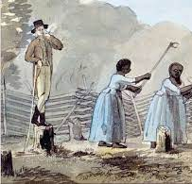
Plantation Act (1740 CE)
The Act became effective on 1 June 1740 and allowed any Protestant alien residing in any of their American colonies for seven years, without being absent from that colony for more than two months, to be deemed ""is Majesty's natural-born subjects of this Kingdom.“
The Act also required making specific declarations concerning royal allegiance and succession, the Christian faith profession, and the payment of two shillings.
Compared to other alternatives available at the time, the Act provided a cheap and easy method of imperial naturalization, and the length of residency was not unreasonable.
The Plantation Act was enacted to systematize naturalization procedures in all localities and encourage immigration to the American colonies.
It provided a workable naturalization procedure by empowering colonial courts to administer the oath of allegiance to aliens.

Slide 3
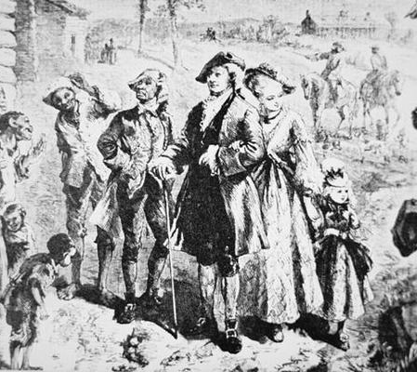
Plantation Act (1740 CE)
Britain began withdrawing support to promote immigration to the colonies at the end of the French and Indian War.
Colonial implementation before the Plantation Act tended to ignore, evade, and reshape English regulations, thus vitiating many policy decisions and generating a chaotic array of citizenship procedures.
Colonial naturalization of aliens was outright forbidden in December 1773, under any conditions.
A ban on royal land grants, initiated earlier in 1773, was made final in February 1774.
The law expressly permitted Jews and other nonconformists to be naturalized in their American colonies to regularize and encourage immigration.
By the time of the American Revolution, the Jewish population in America was still small, with only 1,000 to 2,000, in a colonial population of about 2.5 million.

Slide 4
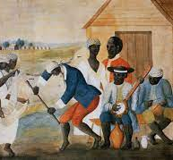
Plantation Act (1740 CE)
In England during the 17th and 18th centuries, several necessary statutes applied to naturalization.
Still, these statutes would not include many aliens in the colonies who were considered an integral part of the colonial communities.
Over the same time, the American provinces (except New Hampshire) passed their own naturalization laws, which granted citizenship to people living within their area.
These laws were based more on local colonial interpretations of community citizenship than on stricter considerations in the mother-country.
But they gave no rights beyond their borders.
This situation was initially accepted as positive and workable in England but proved to be too inconsistent with and broader imperial intentions as time passed.

Slide 5
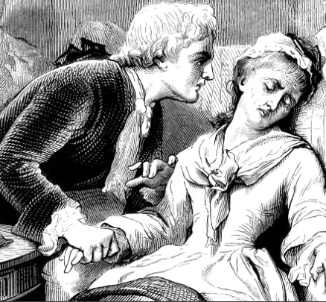
Colonial Era Medicine (1750 CE)
Colonial-era health care was based primarily on traditional medicines and traditional cures.
Professionalization was very slow before 1750.
There were a handful of cities of more than 20,000 population, each of which had physicians trained in England and Scotland and a growing number of locally trained men.
Mortality was very high for new arrivals and high for children in the colonial era.
The disease environment was very hostile to European settlers, especially in all the Southern colonies.
Malaria was endemic in the South, with very high mortality rates for new arrivals.
Children born in the new world had some immunity—they suffered mild recurrent forms of malaria but survived.
Over one-fourth of the Anglican missionaries died within five years of their arrival in the Carolinas.
Mortality was high for infants and small children, mostly from yellow fever and malaria.
Most sick people turn to local healers and used folk remedies. Others relied upon the minister-physicians, barber-surgeons, apothecaries, midwives, and ministers; a few employed colonial physicians trained either in Britain or an apprenticeship in the colonies.
By the 18th century, Colonial physicians, following the models in England and Scotland, introduced modern medicine to the cities. This allowed some advances in vaccination, pathology, anatomy, and pharmacology.

Slide 6
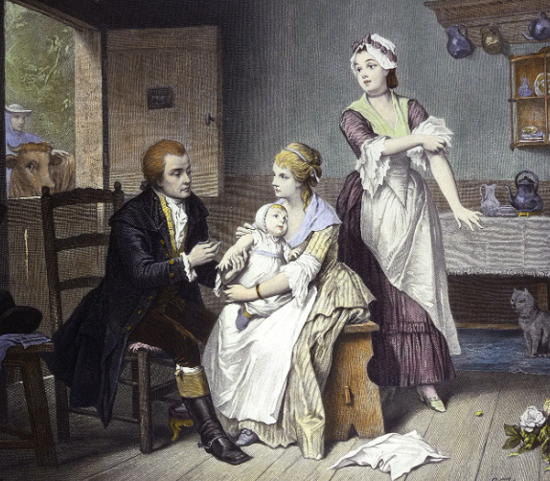
Colonial Era Medicine (1750 CE)
In most American colonies, medicine was rudimentary for the first few generations, as few upper-class British physicians emigrated to the colonies.
The early medical society was organized in Boston in 1735.
In the 18th century, 117 Americans from wealthy families had graduated in medicine in Edinburgh, Scotland.
Still, most physicians learned as apprentices in the colonies.
In Philadelphia, the Medical College of Philadelphia was founded in 1765 and became affiliated with the university in 1791.
In New York, the medical department of King's College was established in 1767, and in 1770, awarded the first American M.D. degree.
Smallpox inoculation was introduced 1700s, well before it was accepted in Europe.
The first textbook appeared in 1775, though physicians had easy access to British texts.
The European populations had historical exposure and partial immunity to smallpox. Still, the Native American people did not. Their death rates were high enough for one epidemic to virtually destroy a small tribe.

Slide 7
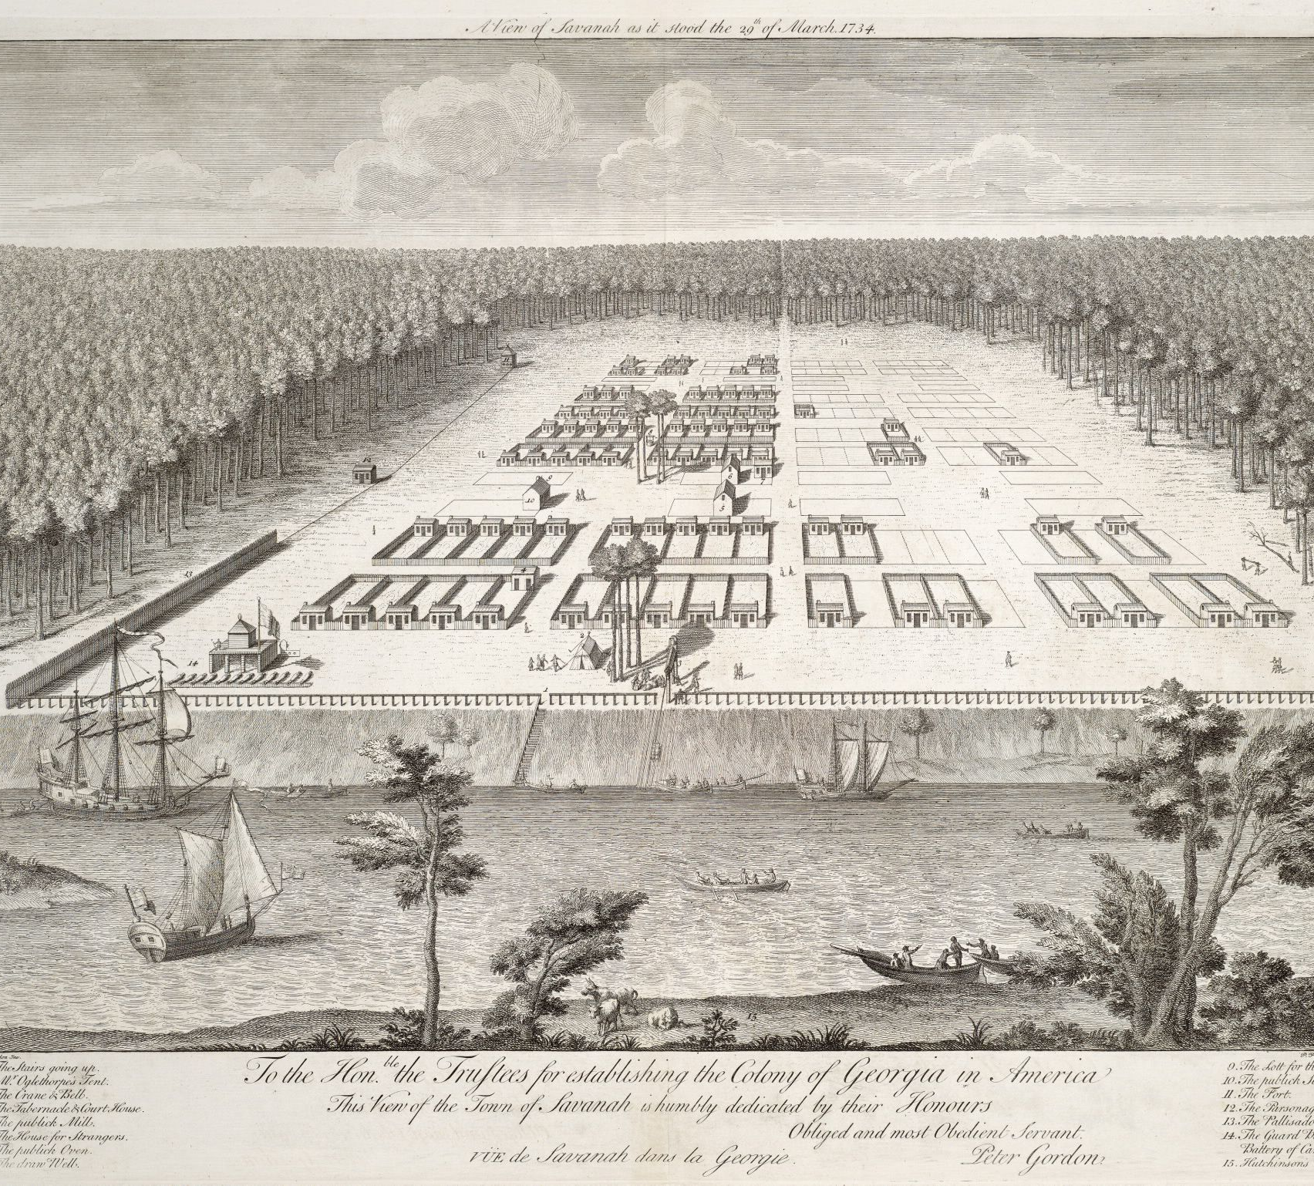
Georgia Plan (1733 CE)
When he founded Savannah, the capital of his newly chartered Georgia colony, James Oglethorpe had some utopian ideas. His planned city would be built around four squares and four simple prohibitions. No rum. No slavery. No lawyers. No Papists.
Georgia was founded in 1733, 126 years after Jamestown was successfully planted.
Enlightened thinkers championed the causes of liberty and progress. Many believed in the innate goodness of human beings. They asserted that even the worst elements of society might prosper if given the right set of circumstances.
Oglethorpe and charitable investors asked King George to create a utopian experiment for English citizens imprisoned for debt.
England's prison population could be decreased, and thousands of individuals could be given a new chance at life. With these lofty goals, Georgia was created.
King George was not concerned with the plight of the English debtor.
His advisers pointed out that such a colony in Georgia might provide defense for the South Carolina rice plantations from Spanish Florida.
He gave his consent to a charter, and Oglethorpe acted.

Slide 8
Georgia Plan (1733 CE)
In the words of Oglethorpe back in 1737:
"...And this would turn out very well indeed in that it would encourage very many good families of average means to go to settle there as well as some excellent workmen as carpenters, masons, tile makers, blacksmiths, farriers, locksmiths, wheelwrights, coopers, vine growers, shepherds, laborers, and others who would be most useful there. Instead of this, the greatest part of those who have already gone there is nothing but miserable ones both as to their manners and as to their fortunes..."
Here, the settlers would have to conform to Oglethorpe's plan, in which there was no elected assembly.
Three significant laws governed the colony.
No slavery was permitted in Georgia, and the possession of alcohol was prohibited.
Each debtor was to receive 50 acres of land to farm. This land could not be sold.
Silkworms were transported from Europe with the hope of developing a silk industry in Georgia's mulberry trees.

Slide 9
Georgia Plan (1733 CE)
The plan itself was a miserable failure.
Georgia residents complained that some citizens received fertile land while others were forced to work uncooperative soil.
Since they could not buy or sell their land, they felt trapped.
The mulberry tree plan failed because the trees in Georgia were the wrong type for cultivating silk.
The alcohol ban was openly flouted.
Cries to permit slavery followed as the Georgians envied the success of their neighbors.
Eventually, many fled the colony for the Carolinas.
King George revoked the charter in 1752, and Georgia became a royal colony. One of the world's best-organized utopian experiments ended abruptly.
The ban on slavery was noble but sadly ahead of its time.
Slavery was legal in South Carolina, and nearby Charleston was flourishing. Jealous of their neighbor's wealth, it didn't take long for Georgians to revolt against their leader's decree.
The ban on Catholics is more curious, considering Savannah's tolerance toward other religions. But Georgia was initially founded as a buffer zone between the Carolinas and Spanish Florida.
It wasn't the Catholic belief in conversion that earned Oglethorpe's distrust, but because they might be Spanish spies. This was another law that would be relaxed soon after the colony's founding.

Slide 10
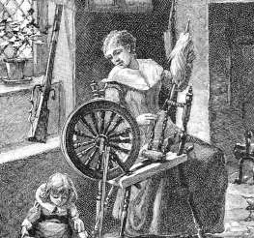
Women’s First Vote (1756 CE)
Lydia Chapin Taft was an early forerunner in Colonial America who could vote in three New England town meetings, beginning in 1756.
Lydia and her husband Josiah settled in Uxbridge.
According to Proprietors Records, Josiah Taft was on his way to becoming a large landholder in Uxbridge.
As Josiah purchased and sold land, Lydia set up housekeeping to play all the skills she had been mastering.
Josiah was a farmer and soldier, and Lydia was a colonial mother and homemaker
. They were members of a new village and helped to form a town that became a respected community.
The old town meeting books list an Ensign Josiah Taft as continuously being elected the moderator for town meetings (noting his militia title change to Captain after a few years).
Josiah was in the Uxbridge militia; enrollment in the military was compulsory, with training in the local fort or training fields in each town.
Every man was required to have a weapon and ammunition and be prepared to act when called upon.
In 1756, Josiah and Lydia's 18-year-old son, Caleb, became ill while studying at Harvard and died on September 19.

Slide 11
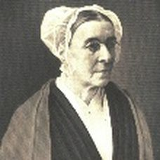
Women’s First Vote (1756 CE)
Josiah went to Boston to bury Caleb. After returning home, Josiah himself became sick and died on September 30, at age 47.
This happened immediately before a critical vote concerning the town's financial support of the French and Indian War.
The only individuals allowed to vote were freeholders – free male property holders – and Josiah's estate was valued as one of the largest in the town.
Josiah's untimely death opened the door for Lydia's giant step into America's history of women's suffrage.
Given the critical nature of the vote, the landowner and taxpayer status of Josiah's estate, and that Lydia's oldest surviving son was still a minor, the townspeople voted to allow Lydia, the widow Josiah Taft, to vote at this critical meeting on October 30, 1756.
Lydia cast her vote in favor of appropriating funds for the regiments engaged in the French and Indian War, thereby giving herself the distinction of being the first woman to vote in America.
The early town records demonstrated at least two other occasions when Lydia voted in official Uxbridge Town meetings in 1758 and 1765.
Lydia Chapin Taft died at Uxbridge on November 9, 1778, at the age of 65, after the United States had officially declared its independence and was engaged in the Revolutionary War.
Her historic vote would precede the Constitutional Amendment for women's suffrage by 164 years and would elevate her from the role of wife and mother to a symbol of women's suffrage.

Slide 12
Saint Malo (1763 CE)
Saint-Malo was a small fishing village that existed in St. Bernard Parish, Louisiana, as early as the mid-eighteenth century until the 1915 New Orleans hurricane destroyed it.
Located along Bayou Saint-Malo, about 6 miles east of Shell Beach, it was the first permanent settlement of Filipinos and perhaps the first Asian-American settlement in the United States.
The exact date of the establishment of Saint-Malo is disputed. The settlement may have been formed as early as 1763 or 1765 by Filipino deserters and escaped slaves of the Spanish Manila galleon trade.
The community members were commonly referred to as Manila men.
Small communities of criminals, fugitive slaves, and Filipinos commonly found refuge along Lake Borgne in the eighteenth and nineteenth centuries.
Manilamen settled in the marshlands of Louisiana, where no Spanish officials could reach them.
Reasons for their desertion varied; however, their desire to escape brutalities dealt with by the Spanish is generally regarded as the main reason.
Beginning in 1784, Juan San Maló led a group of fugitive slaves below New Orleans and in St. Bernard Parish, who stole livestock, destroyed property, and seeded other chaos.
In May of that year, the Spanish government began preparing for an expedition to capture San Maló and his maroons after a group of Americans was murdered.
San Maló retreated with his group to live in the extensive marshland surrounding Lake Borgne, but Spanish eventually captured him along with sixty maroons. On June 19, 1784, he was hanged in Jackson Square.

Slide 13
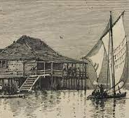
Saint Malo (1763 CE)
The Manilamen lived in small houses supported above the water by stilts in a similar style to the Philippines' nipa huts.
Wood needed to construct dwellings had to be acquired elsewhere as it could not be easily found in the swamps.
The palmetto and woven-cane construction often did not withstand the harsh climate of marsh and had to be repaired or replaced frequently.
Windows were draped with netting to protect from mosquitoes and other biting insects.
Dwellings lacked furniture, including tables, chairs, and bed frames.
The fishermen slept at night among barrels of flour and folded sails and smoked fish.
The diet of the community consisted mainly of seafood, principally raw fish with oil and vinegar. Fish was also smoked and hung for later consumption.
Chickens and pigs were raised among the dwellings, and depictions illustrated small gardens along the walkways and porches.
The Manilamen of Saint-Malo were entirely devoted to a subsistence lifestyle based upon fishing and trapping.
Rarely did women live in the village.
Manilamen often courted and married, Cajun, and American Indian women.

Slide 14
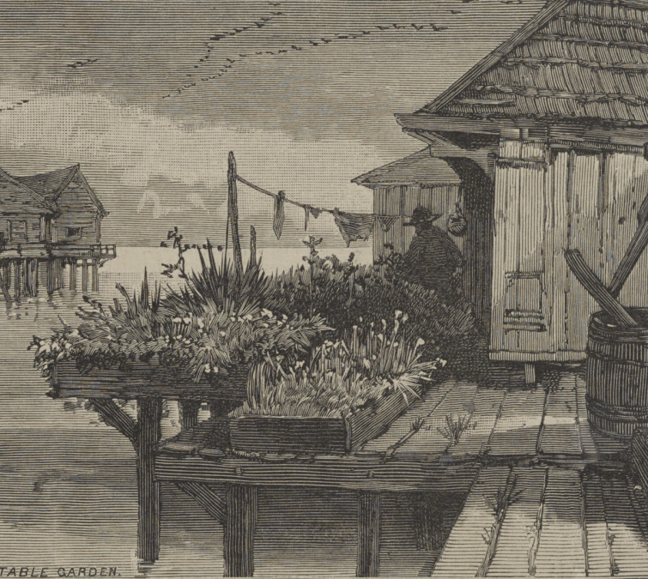
Saint Malo (1763 CE)
Due to the isolation of Saint-Malo, the Manila men paid no taxes, and the community lacked law enforcement officials. As a result, the community governed itself.
In extreme cases, the eldest man of the community would consider disputes and mediate over the situation.
In the rare case that a given verdict is not accepted, the individual was imprisoned in a "fish-car," which was a makeshift prison cell.
The predominant religion of the Manila men was Roman Catholicism. Priests rarely went to visit the settlement due to its isolation.
Filipino-Americans residing in the region were recruited by local pirate Jean Lafitte to join his group of privately recruited soldiers serving under the American forces under the command of Andrew Jackson, in defense of New Orleans.
The same area that San Maló and his group found refuge became known by his name.
It wasn't until March 31, 1883, that the journalist published an article in Harper's Weekly which documented the community firsthand.
The report is the first published article about Filipinos in the United States.
Saint-Malo was destroyed, along with much of the region, by the New Orleans hurricane of 1915, and consequently, the remnants of the community assimilated into New Orleans.

Slide 15
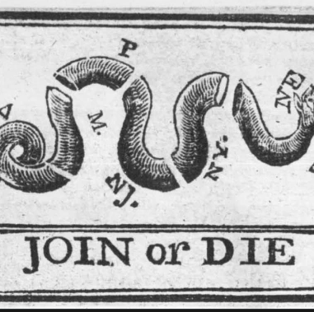
Albany Plan of the Union (1754 CE)
The Albany Plan of Union was a plan to place the British North American colonies under a more centralized government.
On July 10, 1754, representatives from seven of the British North American colonies adopted the plan.
Although never carried out, the Albany Plan was the first vital proposal to conceive the colonies as a collective whole united under one Government.
Join, or Die. is a political cartoon attributed to Benjamin Franklin.
The original publication by the Pennsylvania Gazette on May 9, 1754, is the earliest known pictorial representation of colonial union produced by an American colonist in Colonial America.
It is a woodcut showing a snake cut into eighths, with each segment labeled with one of the American colonies or regions' initials.
New England was represented as one segment, rather than the four colonies it was at that time. Delaware was not listed separately as it was part of Pennsylvania.
Georgia, however, was omitted entirely.
Thus, it has eight segments of a snake rather than the traditional 13 colonies.
The poster focused solely on the colonies that would make up the present-day United States due to Americans' shared identities.
The cartoon appeared along with Franklin's editorial about the "disunited state" of the colonies and helped make his point about the importance of colonial unity.
It later became a symbol of colonial freedom during the American Revolutionary War.

Slide 16
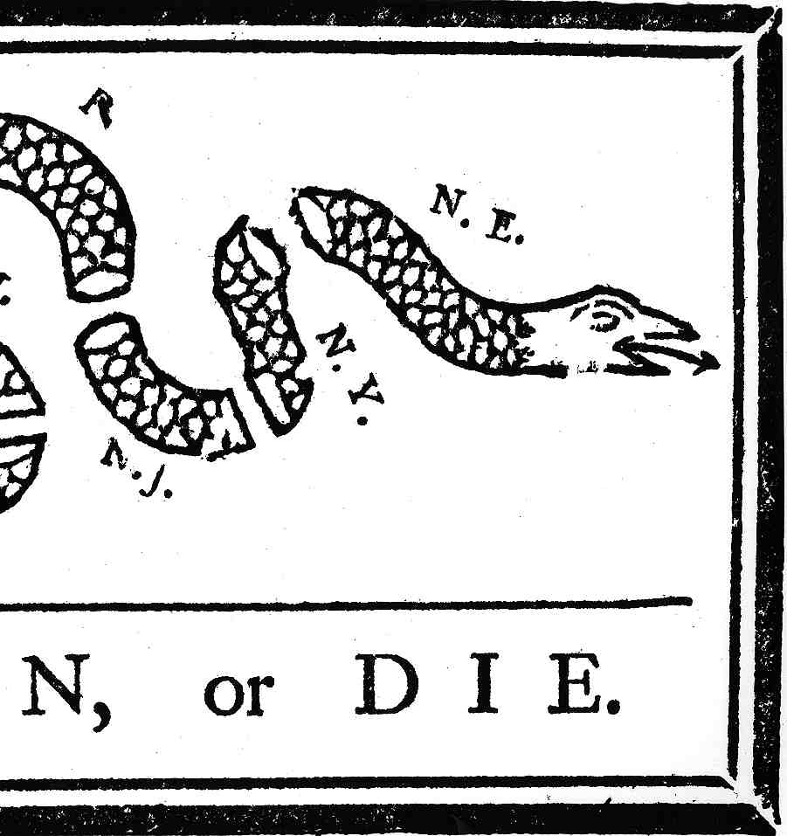
Albany Plan of the Union (1754 CE)
The cartoon has been reprinted and redrawn widely throughout American history.
Variants of the cartoon have different texts and differently labeled segments, depending on the political bodies being appealed to.
During the American Revolutionary War, the image became a potent symbol of the American colonists' unity and resistance to Parliament and the Crown.
It returned to service, suitably redrawn, for both sides of the American Civil War, as both Union and Confederacy held differing views on the Federal Government's nature.
Representatives of the colonial governments adopted the Albany Plan during a more extensive meeting known as the Albany Congress.
The British Government in London had ordered the colonial governments to meet in 1754, initially because of a breakdown in negotiations between the colony of New York and the Mohawk nation, which was part of the Iroquois Confederation.
More generally, imperial officials wanted a treaty between the territories and the Iroquois that would articulate a clear colonial-Indian relations policy.
The colonial governments of Maryland, Pennsylvania, New York, Connecticut, Rhode Island, Massachusetts, and New Hampshire all sent commissioners to the Congress.
With the French and Indian War looming, the need for collaboration was urgent, especially for colonies likely to come under attack or invasion.

Slide 17
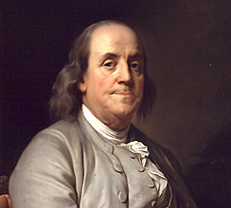
Albany Plan of the Union (1754 CE)
Before the Albany Congress, several intellectuals and government officials had formulated and published several tentative plans for centralizing North America's colonial governments.
Imperial officials saw the advantages of bringing the colonies under closer authority and supervision, while colonists saw the need to organize and defend common interests.
One figure of emerging prominence among this group of intellectuals was Pennsylvanian Benjamin Franklin.
Earlier, Franklin had written to friends and colleagues proposing a plan of voluntary union for the colonies.
Upon hearing of the Albany Congress, his newspaper, The Pennsylvania Gazette, published the political cartoon "Join or Die," which illustrated the importance of union by comparing the colonies to pieces of a snake's body.
The Pennsylvania government-appointed Franklin as a commissioner to Congress.
On his way, Franklin wrote to several New York commissioners outlining 'short hints towards a scheme for uniting the Northern Colonies' using an act of the British Parliament.
The Albany Congress began on June 19, 1754, and the commissioners voted unanimously to discuss the possibility of the union on June 24.
The union committee submitted a draft of the plan on June 28, and commissioners debated it until they adopted a final version on July 10.

Slide 18
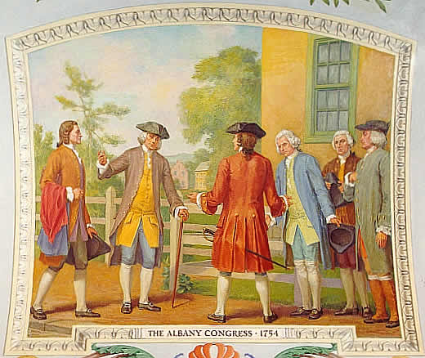
Albany Plan of the Union (1754 CE)
The Albany Plan was not conceived out of a desire to secure independence from Great Britain.
Many colonial commissioners wished to increase imperial authority in the colonies.
Instead, its framers saw it reform colonial-imperial relations and recognize that the colonies collectively shared specific shared interests.
However, the colonial governments' fears of losing power, territory, and commerce, both to other colonies and the British Parliament, ensured the Albany Plan's failure.
Despite the Albany Plan's failure, it served as a model for future attempts at union: it attempted to establish the division between the executive and legislative branches of Government while establishing a joint governmental authority to deal with external relations.
More importantly, it conceived of the colonies of mainland North America as a collective unit, separate from the mother country and the other British colonies in the West Indies and elsewhere.

Slide 19
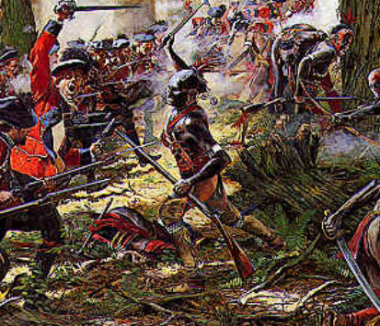
French and Indian War (1754 CE)
The French and Indian War was a global conflict involving Europe's major powers.
Though War was not formally declared until 1756, the armed conflict began in 1754 as disputes over land claims in the Ohio Valley lead to a series of frontier battles between the French and British.
Both received support from various Native American tribes, though the outnumbered French became far more dependent on these allies as the War progressed.
The French saw several early victories, most notably over George Washington and Edward Braddock in Western Pennsylvania.
The tide turned in favor of the British in 1757 when King George II appointed Secretary of State William Pitt to wartime operations.
Pitt believed that securing victories in North America would ensure Britain's global success and reinvigorated the war effort by reorganizing military leadership and strengthening the Crown's relationship with its colonists in America.
British assaults on strategic outposts such as Ticonderoga, Niagara, and Quebec in 1759, followed by Montreal's successful siege in September of 1760, prompted the French surrender.
Though Britain's victory in the French and Indian War expelled France from North America and secured massive territorial gains for the Empire, following Crown policies concerning taxation and westward expansion resulted in widespread colonial discontent.
The conflict and its aftermath produced substantial ideological divisions between Britain and her North American colonies that ultimately contributed to the American Revolution's outbreak.

Slide 20
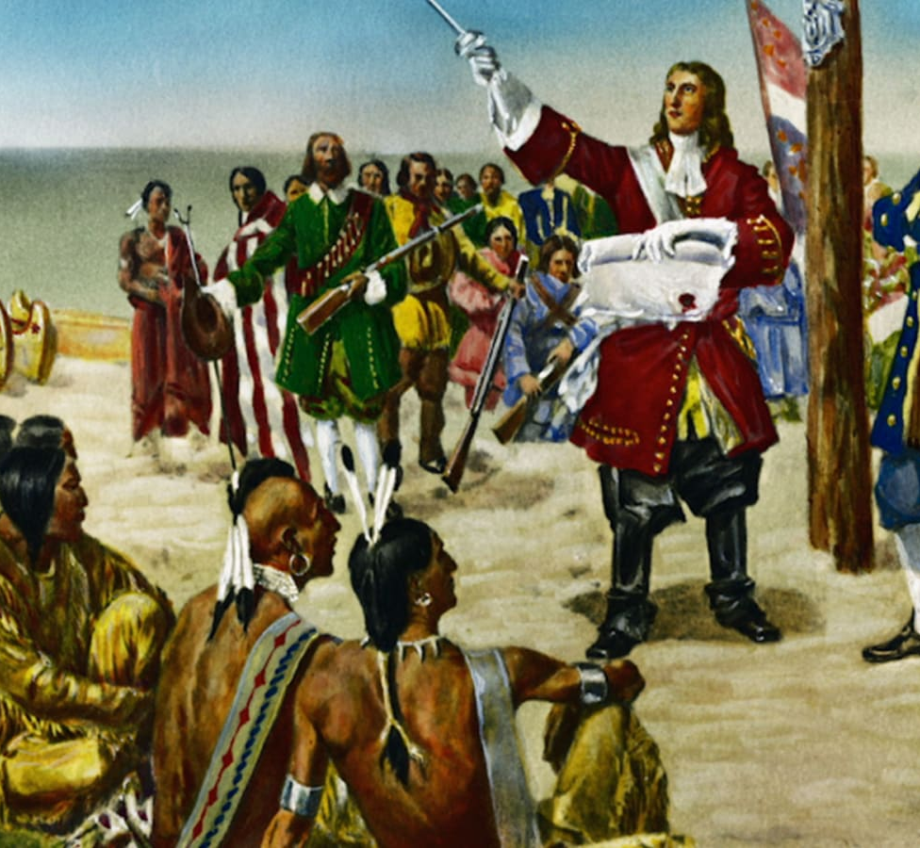
French and Indian War (1754 CE)
The struggle for control over North America that developed into the French and Indian War materialized in the mid-eighteenth century due to a dispute over French land claims in North America.
Between 1700 and 1750, Canada and Louisiana's colonial populations increased significantly, forcing expansion into the Ohio River Valley region.
As settlement in this area and the Lower Mississippi Valley increased, New France increased her agricultural output and invested heavily in Louisiana's sugar economy.
During this period, the French strengthened military ties, and existing trade relationships with numerous Indian societies, sparking competition with the British for Indigenous allies.
By 1749, population growth in the East and a desire for landed wealth from colonial elites prompted the Virginia House of Burgesses to issue large grants of territory in the West to private land companies, such as the Ohio Company.
However, competing claims from the French challenged the Ohio Company's plan sale of these lands, prompting the colony of Virginia to initiate efforts toward halting French forts in western Pennsylvania and removing these rivals from the region.
In late October of 1753, twenty-one-year-old George Washington, a major in the Virginia Militia, volunteered to deliver a message to the French on behalf of the colony's governor.
The injunction ordered that the French halt construction on Fort LeBoeuf in Western Pennsylvania and evacuate lands in the Ohio Valley or face an armed attack.

Slide 21
French and Indian War (1754 CE)
Washington did not manage to expel the French on his expedition to Fort LeBoeuf.
His lack of a formal military education revealed itself in several tactical blunders during the War's early years.
Washington's most infamous mistake took place in July of 1754 following the Battle of Fort Necessity, where his surrender unwittingly included an admission that British troops had assassinated a French officer.
While these events prompted Washington to resign his commission from the Virginia militia, his errors gained the attention of officials in London, who shortly after dispatched two regiments to North America under the command of Major General Edward Braddock.
Furthermore, the publication of Washington's journals from the LeBeouf expedition, titled The Journal of Major George Washington, illuminated the importance of controlling the Ohio Valley and the necessity of this region in securing Britain's North American Empire.
This account convinced governmental officials that military force was necessary to remove the French from the Western frontier and gained Washington's acclaim on both sides of the Atlantic.
This notoriety prompted Washington to return to military service in 1755 as an aide-de-camp for Braddock's summer expedition to Fort Duquesne.
Though this mission ended in defeat at the Battle of the Monongahela, his distinguished services earned Washington a promotion to Commander in Chief of the Virginia Militia Forces, a post he held until his resignation in 1758.

Slide 22
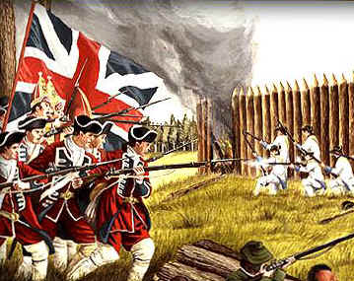
French and Indian War (1754 CE)
Weak leadership and disagreements within the British army plagued Washington's military tenure in the two years following the Braddock expedition.
Proposals to attack forts in Canada, were dismissed by colonial governors, who often voiced concerns over their commanders' collective lack of active military experience, particularly when compared to their French counterparts.
Between 1755 and 1757, these disputes allowed French forces and their Indian allies to capture numerous British forts in New York and Pennsylvania while wreaking havoc in the Southern backcountry.
Upon taking office in 1757, Secretary of State William Pitt assumed control over British military operations, developing a plan to reinvigorate the North American war effort.
Pitt's strategy called for the British to finance Prussia's army's expansion, increasing hostilities in Europe and diverting French attention from the colonies.
By weakening France's military effort in the territories and bolstering the number of regular soldiers fighting in North America, the British regained control of the War by 1759, swaying many Indigenous groups from their French allegiances and capturing most of the vital outposts protecting Canada.
Furthermore, between 1760 and 1762, the British Empire seized nearly every French territory in the Caribbean, adding Cuba in August of 1762 following Spain's official declaration of War.

Slide 23
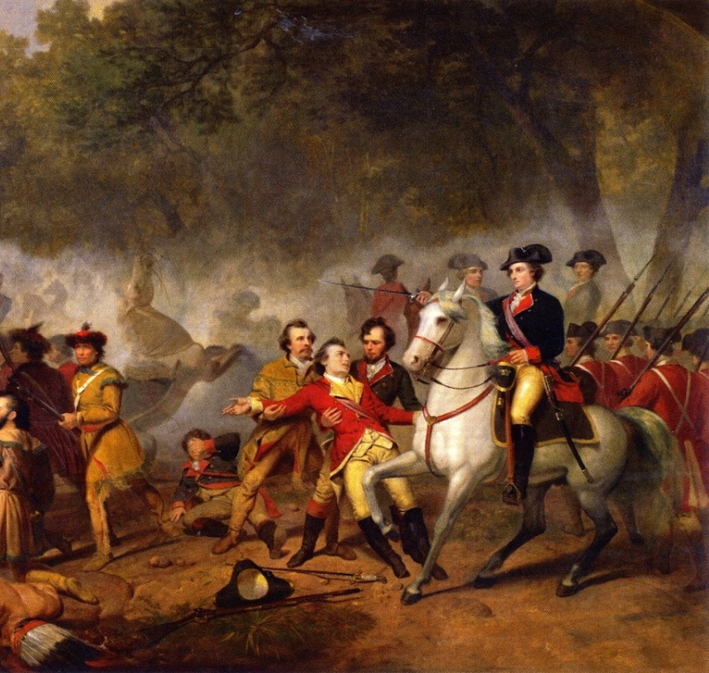
French and Indian War (1754 CE)
Faced with imminent defeat, France and her allies agreed to negotiations with the British, signing the Treaty of Paris on February 10, 1763.
By the conditions of the treaty, France ceded all North American land claims east of the Mississippi River to Great Britain and a few her West Indian islands and Canada. Spain, France's ally by the Family Compact, received trans-Mississippi Louisiana and control over New Orleans.
In turn, the Spanish ceded Florida to Great Britain in return for Cuba, which the British had seized in June of the previous year.
While these territorial shifts put the whole of eastern North America under British control, much of the populace criticized the terms of the treaty.
Objectors argued that by restoring to France the valuable sugar islands of Martinique, St. Lucia, and Guadeloupe, Britain had allowed her to recover, rebuild, and potentially emerge as a military threat in the future.
However, supporters praised Britain's treaty negotiations, declaring her Empire in North America to be secure and complete finally.
Britain's extensive territorial gains often overshadow the complicated legacies and consequences of the French and Indian War.
These geographic shifts triggered an era of social and political change that estranged the Crown from much of her colonial citizenry.
The British had amassed a substantial amount of debt in fighting the War and consequently implemented several taxation measures upon the colonies to alleviate the Empire's financial burden.

Slide 24
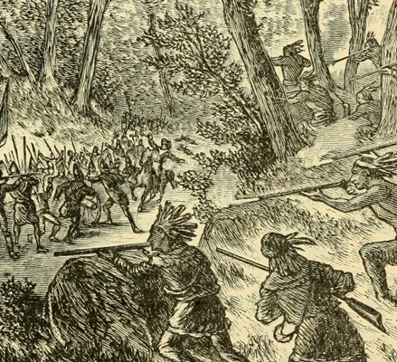
French and Indian War (1754 CE)
These parliamentary taxes, including the Stamp Act and the Townshend Acts, incited protests throughout North America and lead many colonials to assert that the British Empire threatened their fundamental rights and liberties.
Accompanied by discontent over the Proclamation Line of 1763 and changes made to the management of Indian affairs, tensions between colonists and the Crown evolved into outright acts of opposition and rebellion.
For the continent's Native populations, French removal altered carefully crafted diplomatic practices, particularly the balance-of-power strategy that had come to define Indigenous-European political relations over the eighteenth century.
The British-French rivalry had previously provided North American Indians with opportunities to play European nations off and control cross-cultural trade relationships.
However, to limit Native autonomy and increase Indigenous dependence following the Treaty of Paris, the British government used their nearly unchallenged control over North American trade to force Native land cessions and adherence to British governmental interests.
Such measures eroded relations between the two groups, leading to an alarming increase in Anglo-Indian violence following 1763.

Slide 25
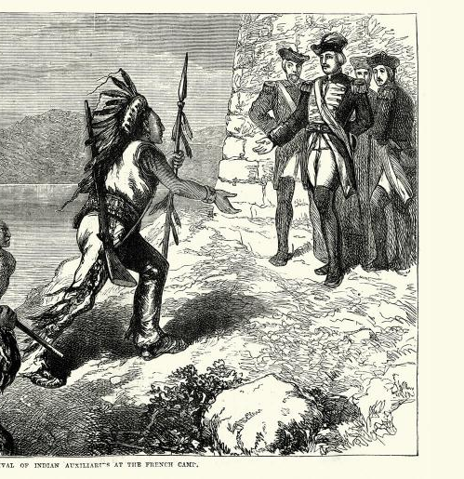
French and Indian War (1754 CE)
Washington's service in the Virginia Militia during the French and Indian War provided him with an invaluable education in leadership and military strategy, lessons he relied on the American Revolution.
However, Washington's French and Indian War experience did more than teaching the future President about commanding troops; it reshaped his way of thinking about Britain and her colonies' relationship.
Washington had dedicated his career in the Virginia Militia toward achieving an equal commission in the British Army.
This aspiration never came to fruition by the time of his resignation in 1758.
Washington's military experience led him to believe that his commission rejection was not due to a lack of capability but because the British Armed Forces regarded colonial militia men as inferior.
Like many of his Virginia counterparts, Washington's political and economic beliefs continued to clash with Crown policies throughout the 1760s, particularly following the Proclamation Line's establishment.
His French and Indian War experience reveals the early stages of ideological divergence between specific groups of colonials and the mother country.
This division ultimately leads to the outbreak of the American Revolution.

Slide 26
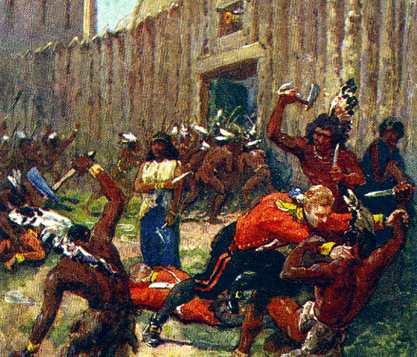
Fort Michilimackinac (1763 CE)
On a June day in 1763, the commandant of Fort Michilimackinac was invited to watch a game of baggatiway between the Ojibwe and Sauk.
On a late spring day on the Straits of Mackinac, British Major George Etherington, commandant of Fort Michilimackinac, relaxed at the sidelines of a rousing game of baggatiway (similar to lacrosse) outside the fort, the major should have seen the danger signs in this Ojibwe versus Sauk contest.
He'd even served in the just-ending French and Indian War, in which the English had gained control of North America from the French—a victory that had put this previously French fort in Etherington's care.
Though well-armed, his garrison of 35 or so soldiers was vastly outnumbered by the hundreds of Indians encamped around it, there to exchange furs for wares—steel tomahawks and knives included—from French Canadian traders.
Many French Canadians who lived at the fort warned him that the Indians were planning an uprising. He threatened to have the next person who spread similar gossip locked up down at Fort Detroit.
The unwitting Etherington had not yet heard that Fort Detroit was under siege, attacked several weeks before by a coalition of tribes led by Pontiac, the Odawa chief.
Foreseeing that English domination spelled the end of his people's lifestyle, Pontiac had just begun his famous rebellion.

Slide 27
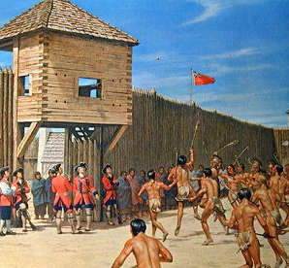
Fort Michilimackinac (1763 CE)
Oblivious to all the foreshadowing, when the Ojibwe invited him and his soldiers to watch their match outside the fort, a game they said was in celebration of the King's birthday, Etherington accepted.
He then gathered most of the garrison to watch with him.
According to the major's accounts written later, they left the gates open and their weapons back in the fort.
Etherington cheered for the Ojibwe along with the two chiefs of that tribe.
With some 500 players, the game must have looked more like a battle.
Etherington barely noticed the Indian women lingering at the fort gates, wrapped tightly in bulky blankets as if the day was cold and not June 2, 1763.
A frenzy chased the ball as it fell at the mouth of the open gate. The women opening their blankets and handing off knives and tomahawks to the athletes-turned-warriors.
Etherington and his lieutenant, whisked off to the woods—as the other fort officer was killed.

Slide 28
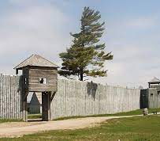
Fort Michilimackinac (1763 CE)
Survivors observed that the Indians were killing only English and sparing the French Canadians.
at least 27 Englishmen were killed in the attack and its aftermath, and another dozen or so were still held captive.
Among the captured was Etherington, who had been stripped and locked in the fort. When the Odawa, they allowed Etherington to send an Odawa canoe-courier, a plea for help to James Gorrell, commandant at the fort at what is now Green Bay, Wisconsin.
The Odawa cooperation with Etherington was probably calculated that a major would bring an excellent ransom.
By mid-July, Etherington, and the other prisoners were headed for Montreal, escorted by a brigade of Odawa.
After their departure, Fort Michilimackinac emptied except for a handful of French traders.
The Indians had dissolved into the Northwoods, both to head to their winter hunting grounds and to hide from British retribution.
Brilliant as it was, the Ojibwe coup at Fort Michilimackinac was an empty victory. Though they took the fort, the Indians never wanted it. Their goal, like Pontiac's, was to drive the English and their settlements out of Native American hunting, fishing, and trapping grounds—a defiant attempt to save their doomed lifestyle.

Slide 29
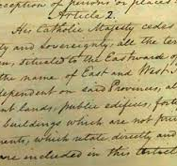
Louisiana (1762 CE)
The Treaty of Fontainebleau was a secret agreement of 1762 in which the Kingdom of France ceded Louisiana to Spain.
The treaty followed the last battle in the French and Indian War in North America, the Battle of Signal Hill in September 1762, which confirmed Canada's British control.
In Europe, the associated Seven Years War continued to rage.
Having lost Canada, King Louis XV of France proposed to King Charles III of Spain that France should give Spain "the country known as Louisiana, as well as New Orleans and the island in which the city is situated."
Charles accepted on November 13, 1762.
This agreement covered all of Louisiana: the Mississippi River's entire valley, from the Appalachians to the Rockies.
The Treaty of Fontainebleau was kept secret even during the French negotiation and signing of the Treaty of Paris, which ended the war with Britain.
The Treaty of Paris between France and Great Britain following the Seven Years' War divided Louisiana at the Mississippi.
The eastern half was ceded to Britain, and France nominally retained the western half and New Orleans.
Spain did not contest Britain's control of east Louisiana, as it already knew that it would rule west Louisiana.
Also, under the Treaty of Paris, Spain had ceded Florida to Britain, for which western Louisiana was its compensation.

Slide 30
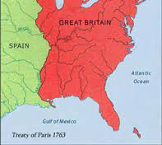
Louisiana (1762 CE)
The Treaty of Paris provided 18 months in which French colonists who did not want to live under British rule could freely emigrate to other French colonies.
Many emigrants moved to Louisiana, where they discovered later that France had ceded Louisiana to Spain. The colonists in western Louisiana did not accept the transition and expelled the first Spanish governor in 1768.
The acquisition of Louisiana consolidated the Spanish Empire in North America.
When Great Britain returned Florida to Spain in 1783, Spanish territory completely encircled the Gulf of Mexico after the American Revolutionary War.
It stretched from Florida west to the Pacific Ocean and north to Canada west of the Mississippi River.
During the Louisiana's Spanish period, many Spanish settlers emigrated to this region.
The more known Spanish emigration happened between 1778 and 1783 when the Governor of Louisiana recruited groups from the Canary Islands and Malaga's Spanish regions and sent them to Louisiana to populate New Orleans.
So, more than 2,700 Canaries and 500 Malaga's natives emigrated to Louisiana in these periods. In 1800, Spain returned Louisiana to France, although it sold it to the U.S. in 1803.
The descendants of Spanish settlers still living there.

Slide 31
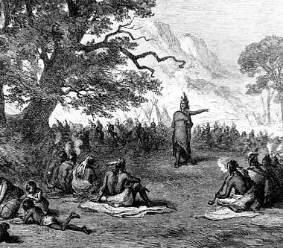
Pontiac's War (1763 CE)
As the French and Indian Wars ended in the early 1760s, tribes living in former French territory found the new British authorities far less conciliatory than their predecessors.
In 1762, Pontiac enlisted support from every tribe from Lake Superior to the lower Mississippi for a joint campaign to expel the British from the formerly French-occupied lands.
According to Pontiac’s plan, each tribe would seize the nearest fort and then join forces to wipe out the undefended settlements.
In April, Pontiac convened a war council on the banks of the Ecorse River near Detroit. It was decided that Pontiac and his warriors would gain access to the British fort at Detroit under the pretense of negotiating a peace treaty, allowing them to seize the arsenal there forcibly.
However, British Major Henry Gladwin learned of the plot, and the British were ready when Pontiac arrived in early May, and Pontiac was forced to begin a siege.
At the same time, his allies in Pennsylvania started a siege of Fort Pitt.
Other sympathetic tribes, such as Delaware, the Shawnees, and the Seneca, prepared to move against various British forts and outposts in Michigan, New York, Pennsylvania, Maryland, and Virginia.

Slide 32
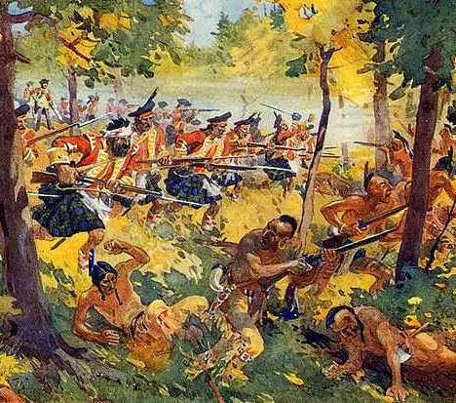
Pontiac's War (1763 CE)
On July 31, a British relief expedition attacked Pontiac’s camp but suffered heavy losses and was repelled in the Battle of Bloody Run.
Nevertheless, they had succeeded in providing the fort at Detroit with reinforcements and supplies, which allowed it to hold out against the Indians into the fall.
The significant forts at Pitt and Niagara likewise held on, but the united tribes captured eight other fortified posts.
The garrisons were wiped out at these forts, relief expeditions were repulsed, and nearby frontier settlements were destroyed.
In the spring of 1764, two British armies were sent out, one into Pennsylvania and Ohio under Colonel Bouquet and the other to the Great Lakes under Colonel John Bradstreet. Bouquet’s campaign met with success, and the Delawares and the Shawnees were forced to sue for peace, breaking Pontiac’s alliance.
Failing to persuade tribes in the West to join his Rebellion and lacking the hoped-for support from the French, Pontiac finally signed a treaty with the British in 1766.
In 1769, he was murdered by a Peoria tribesman while visiting Illinois. His death led to bitter warfare among the tribes, and the Peorias were nearly wiped out.

Slide 33
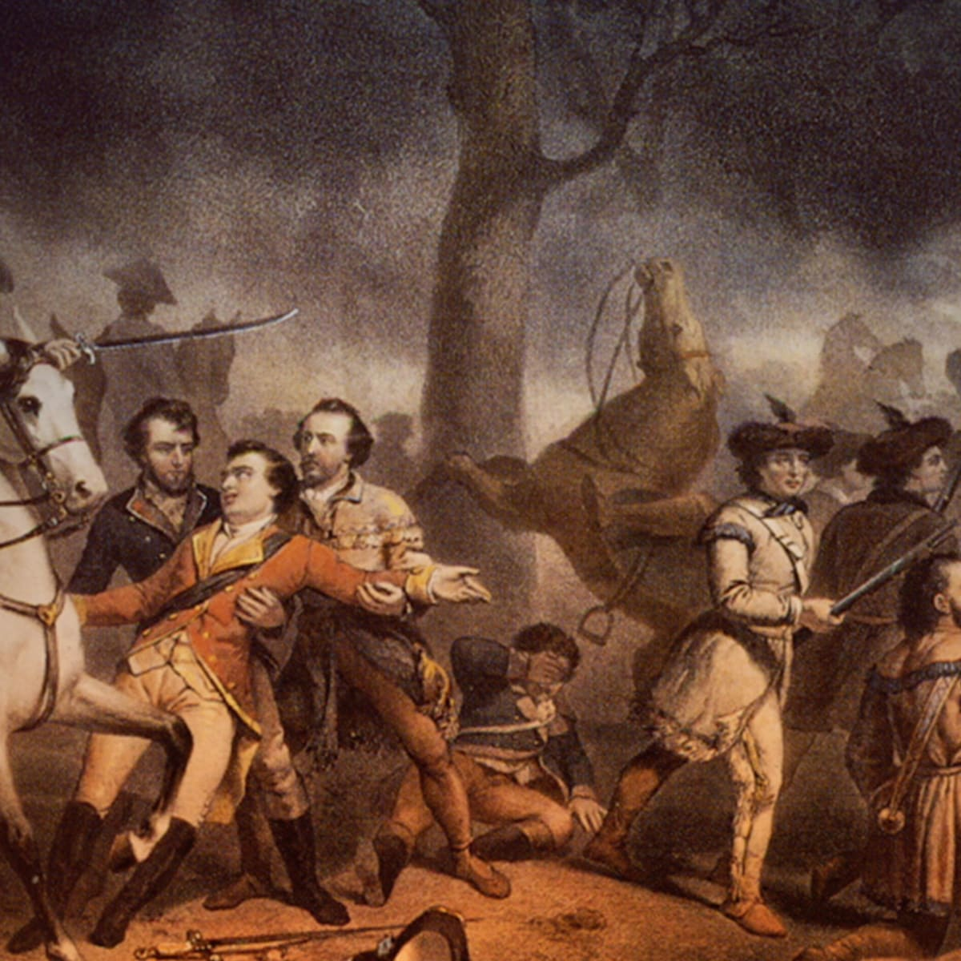
Proclamation Line of 1763
The Proclamation of 1763 was issued by the British at the end of the French and Indian War to appease Native Americans by checking the encroachment of European settlers on their lands.
It created a boundary known as the proclamation line, separating the British colonies on the Atlantic coast from American Indian lands west of the Appalachian Mountains.
In the centuries since the proclamation, it has become one of the cornerstones of Native American law in the United States and Canada.
After the French and Indian War in America, the British Empire began tightening control over its relatively autonomous colonies.
In response to Pontiac's Rebellion, a revolt of Native Americans led by Pontiac, an Ottawa chief, King George III declared all lands west of the Appalachian Divide off-limits to colonial settlers.
This royal proclamation, issued on October 7, 1763, closed colonial expansion westward beyond Appalachia. It was the first measure to affect all thirteen colonies.
The edict forbade private citizens and colonial governments from buying land or making any agreements with natives; the empire would conduct all official relations.

Slide 34
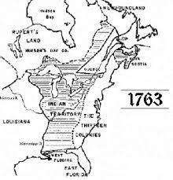
Proclamation Line of 1763
Furthermore, only licensed traders would be allowed to travel west or deal with Indians.
Theoretically protecting colonists from Indian rampages, the measure was also intended to shield Native Americans from increasingly frequent attacks by white settlers.
The proclamation also established three new mainland colonies: Quebec, West Florida, and East Florida, while extending Georgia's southern border and granting land to soldiers who had fought in the Seven Year's War.
Although the proclamation was introduced as a temporary measure, its economic benefits for Britain prompted ministers to keep it until the eve of the Revolutionary War.
A desire for good farmland caused many colonists to defy the proclamation; others merely resented the royal restrictions on trade and migration.
Ultimately, the Proclamation of 1763 failed to stem the tide of westward expansion.

Slide 35
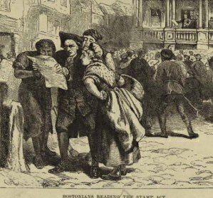
The Stamp Act (1765 CE)
The Stamp Act of 1765 was the first internal tax levied directly on American colonists by the British Parliament.
The act, which imposed a tax on all paper documents in the colonies, came when the British Empire was deep in debt from the Seven Years' War and looking to its North American colonies as a revenue source.
Arguing that only their representative assemblies could tax them, the colonists insisted that the act was unconstitutional, and they resorted to mob violence to intimidate stamp collectors into resigning.
The issues of taxation and representation raised by the Stamp Act strained relations with the colonies to the point that, ten years later, the colonists rose in armed rebellion against the British.
Part of the Stamp Act revenue would be used to maintain several regiments of British soldiers in North America to maintain peace between Native Americans and the colonists.
Moreover, since colonial juries had proven notoriously reluctant to find smugglers guilty of their crimes, violators of the Stamp Act could be tried and convicted without juries in the vice-admiralty courts.

Slide 36
The Stamp Act (1765 CE)
The Seven Years' War ended the long rivalry between France and Britain for North America's control, leaving Britain in possession of Canada and France without a footing on the continent.
Since the war benefited the American colonists as much as anyone else in the British Empire, the British government decided that those colonists should shoulder part of the war's cost.
Britain had long regulated colonial trade through a system of restrictions and duties on imports and exports.
In the first half of the 18th century, however, British enforcement of this system had been lax.
Starting with the Sugar Act of 1764, which imposed new duties on sugar and other goods, the British government began to tighten its reins on the colonies.
Shortly after that, George Grenville, the British first lord of the treasury and prime minister, proposed the Stamp Act; Parliament passed the act without debate in 1765.
Stamp Act opponent Patrick Henry is known for his "Give me liberty, or give me death!" speech, delivered before a meeting of Virginia's colonial leaders in 1775 to mobilize a militia against a possible British attack. He later served as Virginia's governor.

Slide 37
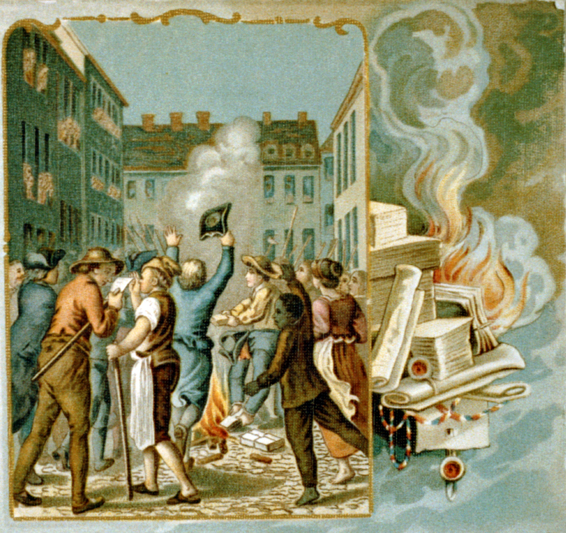
The Stamp Act (1765 CE)
Instead of levying a duty on trade goods, the Stamp Act imposed a direct tax on the colonists.
Specifically, the act required that starting in the fall of 1765, legal documents and printed materials must bear a tax stamp provided by commissioned distributors who would collect the tax in exchange for the stamp.
The law applied to wills, deeds, newspapers, pamphlets, and even playing cards and dice.
Although most colonists continued to accept Parliament's authority to regulate their trade, they insisted that only their representative assemblies could levy direct, internal taxes, such as the one imposed by the Stamp Act.
They rejected the British government's argument that all British subjects enjoyed virtual representation in Parliament, even if they could not vote for Parliament members.
The colonists also took exception to the provision denying offenders trials by jury.
Radical voices warned that the tax was part of a gradual plot to deprive the colonists of their freedoms and enslave them beneath an authoritarian regime.
Playing off traditional fears of peacetime armies, they wondered aloud why Parliament saw fit to garrison troops in North America only after the French threat had been removed.
These concerns provided an ideological basis that intensified colonial resistance.

Slide 38
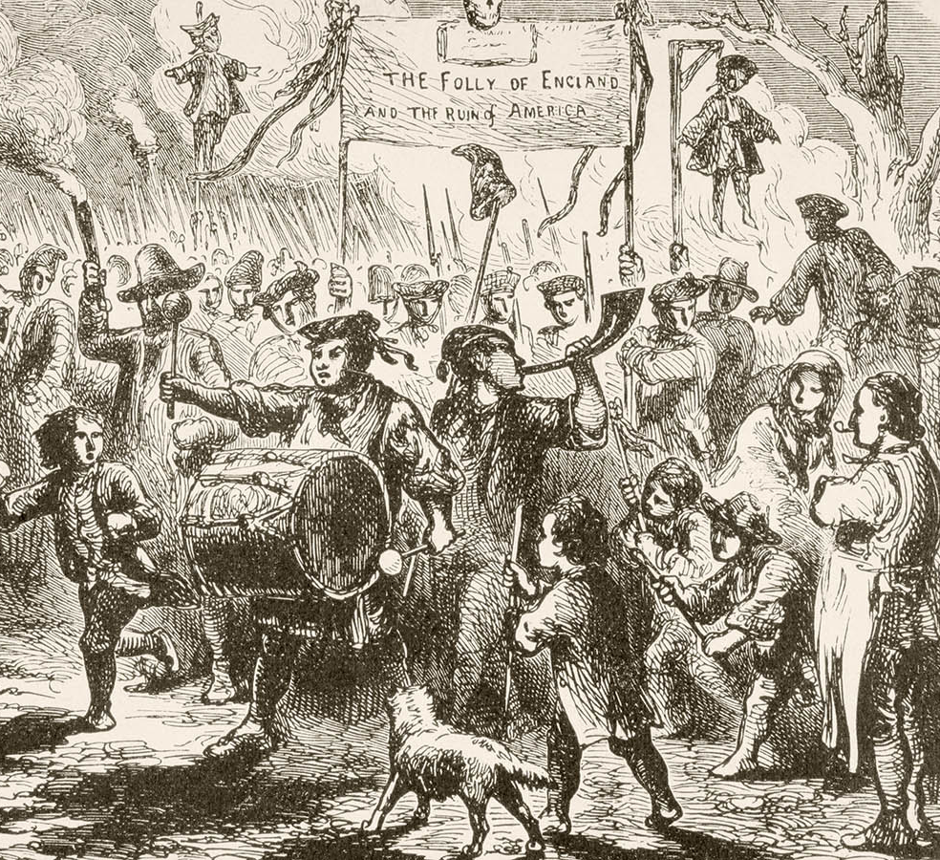
The Stamp Act (1765 CE)
Parliament pushed forward with the Stamp Act despite the colonists' objections.
Colonial resistance to the act mounted slowly at first but gained momentum as its implementation's planned date drew near.
In Virginia, Patrick Henry submitted a series of resolutions to his colony's assembly, the House of Burgesses. These resolutions denied Parliament's right to tax the colonies and called on the colonists to resist the Stamp Act.
Newspapers throughout the colonies reprinted the resolutions, spreading their radical message to a broad audience.
The resolutions provided the tenor for the Stamp Act Congress's proclamations, an extralegal convention composed of delegates from nine colonies that met in October 1765.
While the Congress and the colonial assemblies passed resolutions and issued petitions against the Stamp Act, the colonists took matters into their own hands.
The most famous popular resistance took place in Boston, where opponents of the Stamp Act, calling themselves the Sons of Liberty, enlisted Boston's rabble in opposition to the new law.
This mob paraded through the streets with an effigy of Andrew Oliver, Boston's stamp distributor, which they hung from the Liberty Tree and beheaded before ransacking Oliver's home.
Oliver agreed to resign his commission as a stamp distributor.

Slide 39
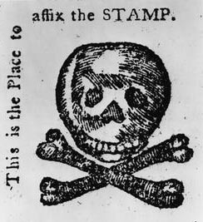
The Stamp Act (1765 CE)
Similar events transpired in other colonial towns, as crowds mobbed the stamp distributors and threatened their physical well-being and property.
By the beginning of 1766, most of the stamp distributors had resigned their commissions, many of them under duress.
Mobs in seaport towns turned away ships carrying the stamp papers from England without allowing them to discharge their cargoes.
Determined colonial resistance made it impossible for the British government to bring the Stamp Act into effect.
In 1766, Parliament repealed it.
The end of the Stamp Act did not end Parliament's conviction that it had the authority to impose taxes on the colonists.
The British government coupled the repeal of the Stamp Act with the Declaratory Act, a reaffirmation of its power to pass any laws over the colonists that it saw fit.
The issues raised by the Stamp Act festered for ten years before giving rise to the Revolutionary War and, ultimately, American independence.

Slide 40
Colonial Education
The 18th century was a period of massive growth for the United States, and education was swept along with the tide.
A slow shift to an emphasis on science in the curriculum emerged at the beginning of the 18th century.
Religious explanations of natural phenomena were slowly being questioned.
There was a growing perception that the Latin-focused grammar school was too elitist and provided little of the practical education needed for an economy based on business and other vocations.
The pressure was placed on the education system to provide a more practical education that would offer vocational and trade skills to young men.
This was especially evident in the middle colonies, which had a sizeable middle-class business population.

Slide 41
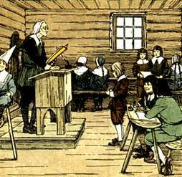
Colonial Education
The emergence of English grammar schools was one response to the call for a more practical education system.
A second outcome of the need for more practical education was the academy's growth, a school for higher learning, and the precursor of the modern university.
Benjamin Franklin established the first academy, which was chartered in 1749 and opened in 1751. In 1791, it became the University of Pennsylvania.
Academies were essentially private secondary schools that offered a broad range of subjects and practical training.
Because academies were not bound by religious influence, they were free to evolve unfettered. They admitted both boys and girls.
The education of ethnic minorities, namely African Americans and Native Americans, was limited in the 18th century, and the teaching of slaves in America was strictly forbidden by law.

Slide 42
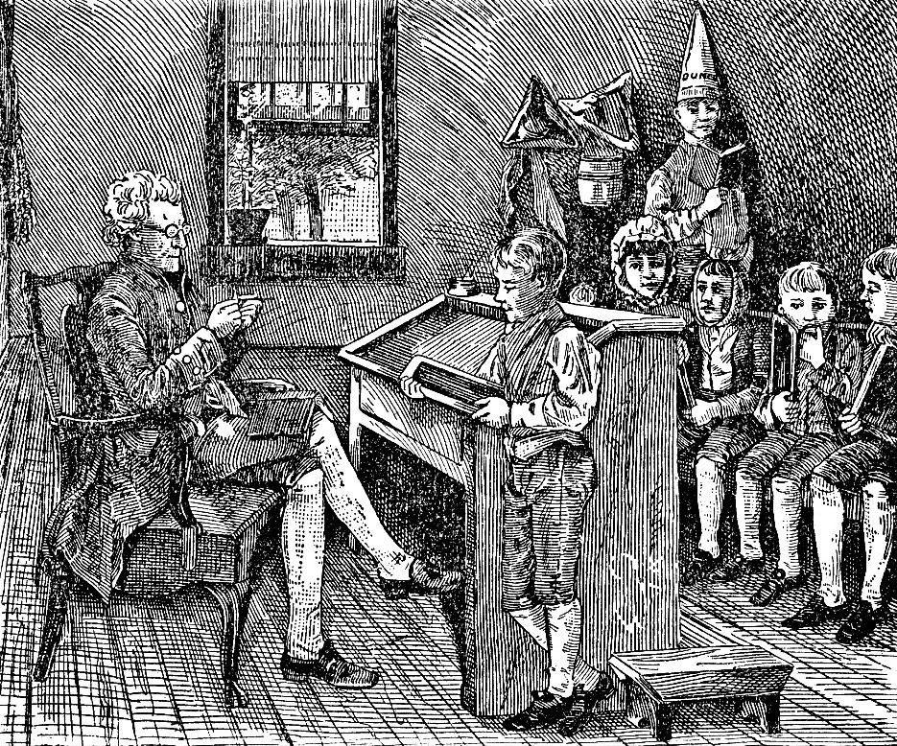
Colonial Education
These schools served students who needed education beyond elementary school but did not intend to go to college.
In addition to courses that led to the world of work in business, students were also taught courses in the "social graces" (e.g., dance, art, music). English grammar schools were the first secondary schools to accept both girls and boys.
The Anglican Church did establish schools for the religious education of minorities as early as 1704. But even these efforts were sporadic, unsupported, or not sustained.
The 18th century planted the seeds that would grow into the structures of the Industrial Revolution and beyond.
Tax-supported schooling for girls began as early as 1767 in New England.
It was optional, and some towns proved reluctant.
Historians point out that reading and writing were different skills in the colonial era.
School taught both, but in places without schools, a lesson was mainly taught to boys and a few privileged girls.
Men handled worldly affairs and needed to read and write.
Girls only needed to read (mostly religious materials).
This educational disparity between reading and writing explains why colonial women often could read but could not write, so they used an "X" to sign their names.

Slide 43
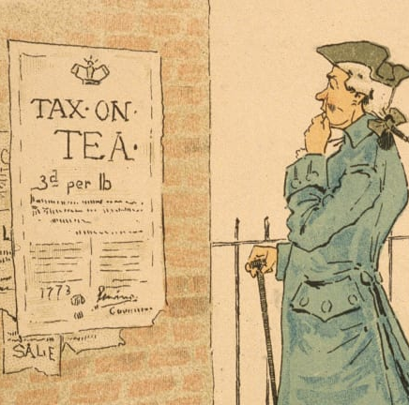
The Townshend Acts (1767 CE)
The Townshend Acts were a series of measures passed by the British Parliament in 1767 that taxed goods imported to the American colonies.
But American colonists, who had no representation in Parliament, saw the Acts as an abuse of power.
The British sent troops to America to enforce the unpopular new laws, further heightening tensions between Great Britain and the American colonies in the American Revolutionary War.
The British Crown emerged victorious from the French and Indian War in 1763 but defending the North American colonies from French expansion had proved tremendously costly to England.
The colonists—who arguably enjoyed a higher standard of living at the time than their British counterparts—paid less than one-twentieth the taxes of British citizens living in England.
The British government thought the colonists should help pay the cost of their protection.
The British Parliament enacted a series of taxes on the colonies to raise revenue.
Early attempts, such as the Stamp Act of 1765—which taxed colonists for every piece of paper they used—were met with widespread protests in America.

Slide 44
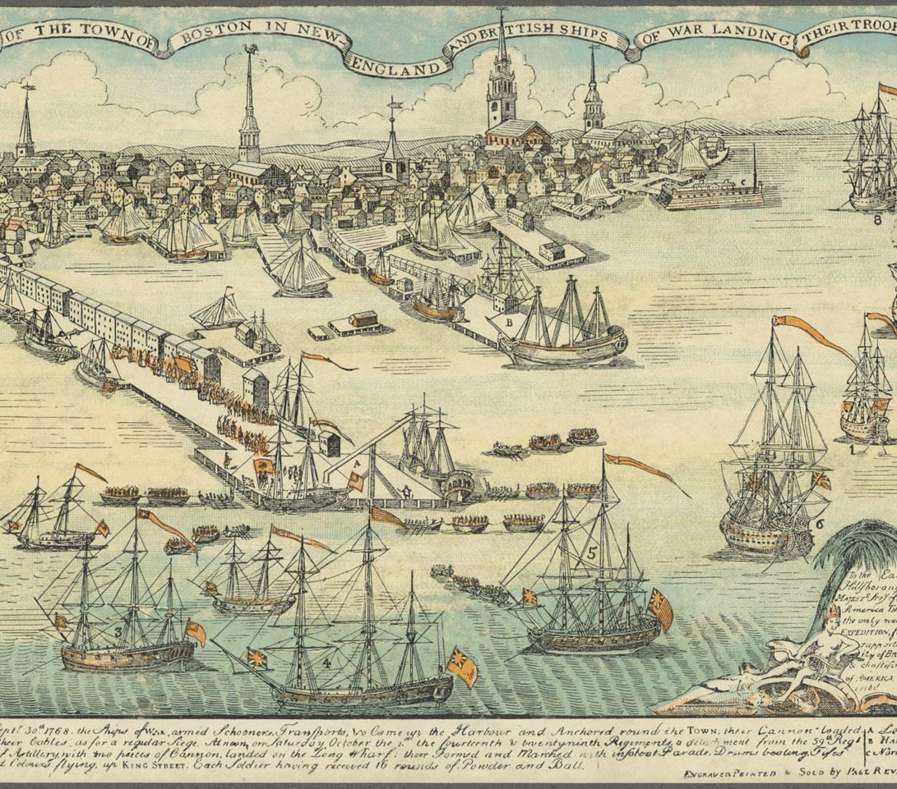
The Townshend Acts (1767 CE)
The Townshend Acts, named after Charles Townshend, British chancellor of the Exchequer, imposed British china, glass, lead, paint, paper, and tea imported to the colonies.
These items were chosen for taxation because Townshend thought they would be difficult for the colonists to produce independently.
He estimated the duties would raise approximately 40,000 pounds, with most of the tea's revenue.
The Townshend Acts would use the revenue raised by the duties to pay the salaries of colonial governors and judges, ensuring America's governmental officials' loyalty to the British Crown.
However, these policies prompted colonists to act by boycotting British goods. Charles Townshend didn't live to see the measures enacted.
He died suddenly in September 1767, before the detrimental effects of his signature rules could materialize.
The Townshend duties went into effect on November 20, 1767, close on the heels of the Declaratory Act of 1766, which stated that the British Parliament had the same authority to tax the American colonies as they did in Great Britain.
By December, two widely circulated documents had united colonists in favor of a boycott of British goods. These influential pamphlets included "Letters from a Farmer in Pennsylvania," a series of essays written by Pennsylvania legislator John Dickinson and the "Massachusetts Circular Letter," a statement written by Samuel Adams and James Otis Jr. and passed by the Massachusetts House of Representatives to other colonial legislatures.

Slide 45
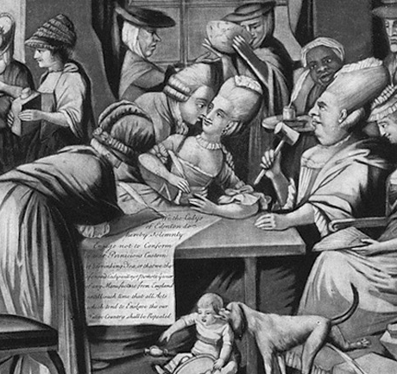
The Townshend Acts (1767 CE)
With the Sons of Liberty's help—a secret society of American business leaders who coined the phrase "taxation without representation" —24 towns in Massachusetts, Connecticut, and Rhode Island agreed to boycott British goods in January 1768.
Except for necessities, such as fishing hooks and wire, New England merchants agreed not to import British goods for one year.
In response to protests and boycotts, the British sent troops to occupy Boston and quell the unrest.
By 1769, more than 2,000 British troops had arrived in Boston to restore order—a large number considering only about 16,000 people lived in Boston at the time.
To protest taxes, patriots often vandalized stores selling British goods and intimidated store merchants and their customers.
All the Townshend Acts—except for the tax on tea—were repealed in April 1770. The tax on tea would remain a flashpoint and a contributing factor to the Boston Tea Party of 1773, in which angry colonists destroyed an entire shipment of tea in Boston Harbor.
To quell resistance and punish the colonists—particularly the demonstrators in Boston—Parliament passed The Coercive Acts of 1774, which colonists referred to as the Intolerable Acts.
The four Intolerable Acts included the Massachusetts Government Act, instituting an appointed government over the previously-elected, local one; the Boston Port Bill closing Boston Harbor; the Administration of Justice Act, which dictated that British officials could be tried in another colony or England if charged with capital offenses; and the Quartering Act, which said unoccupied buildings could be used to quarter British troops.
The combined force of these acts culminated in the American Revolution, which was kicked off when the "shot heard around the world" was fired on April 19, 1775, at Lexington and Concord's Battles.

Slide 46
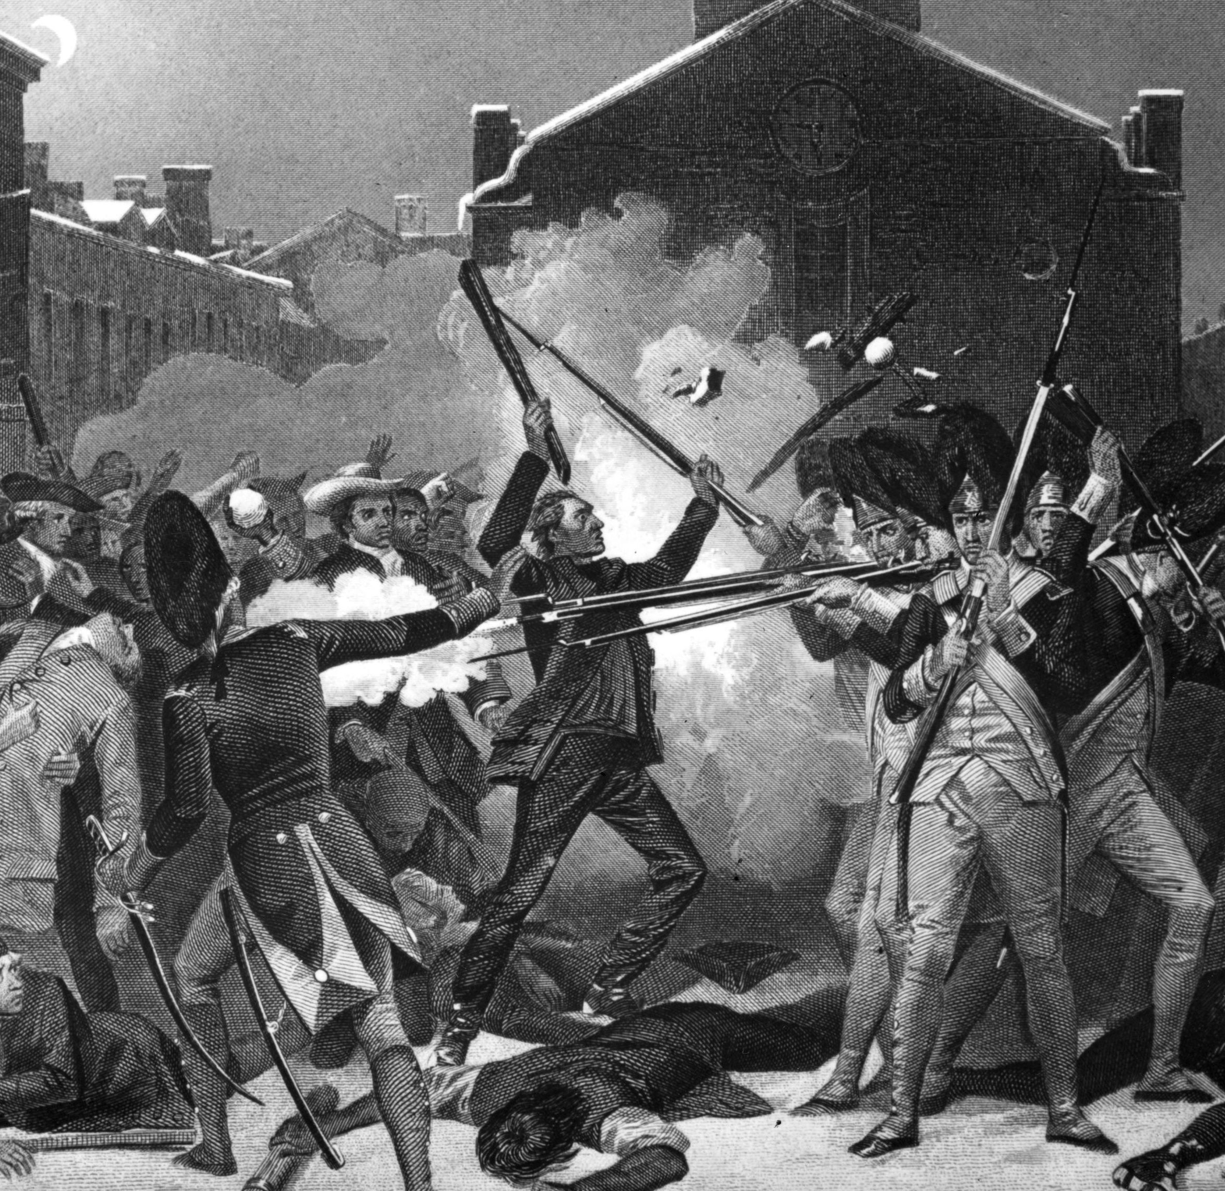
The Boston Massacre (1770 CE)
The Boston Massacre was a deadly riot on March 5, 1770, on King Street in Boston.
It began as a street brawl between American colonists and a lone British soldier but quickly escalated to a chaotic, bloody slaughter.
The conflict energized anti-British sentiment and paved the way for the American Revolution.
Tensions ran high in Boston in early 1770.
More than 2,000 British soldiers occupied the city of 16,000 colonists and tried to enforce Britain's tax laws, like the Stamp Act and Townshend Acts.
American colonists rebelled against the taxes they found repressive, rallying around the cry, "no taxation without representation.“
Skirmishes between colonists and soldiers—and between patriot colonists and colonists loyal to Britain (loyalists)—were increasingly common.
To protest taxes, patriots often vandalized stores selling British goods and intimidated store merchants and their customers.
On February 22, a mob of patriots attacked a known loyalist's store.
Customs officer Ebenezer Richardson lived near the store and tried to break up the rock-pelting crowd by firing his gun through his home's window.
His gunfire struck and killed an 11-year-old boy named Christopher Seider and further enraged the patriots. Several days later, a fight broke out between local workers and British soldiers.

Slide 47
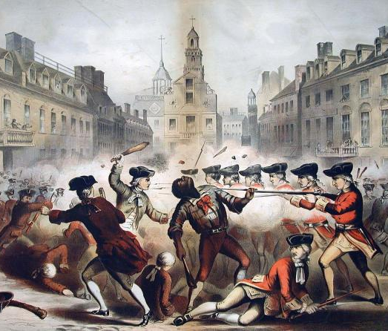
The Boston Massacre (1770 CE)
On the frigid, snowy evening of March 5, 1770, Private Hugh White was the only soldier guarding the King's money stored inside the Custom House on King Street.
It wasn't long before angry colonists joined him and insulted him and threatened violence. At some point, White fought back and struck a colonist with his bayonet. In retaliation, the colonists pelted him with snowballs, ice, and stones.
In response to White's plea and fearing mass riots and the loss of the King's money, Captain Thomas Preston arrived on the scene with several soldiers and took up a defensive position in front of the Custom House.
Worried that bloodshed was inevitable, some colonists reportedly pleaded with the soldiers to hold their fire as others dared them to shoot.
The violence escalated, and the colonists struck the soldiers with clubs and sticks. Reports differ of exactly what happened next, but after someone supposedly said the word "fire," a soldier fired his gun, although it's unclear if the discharge was intentional.
Once the first shot rang out, other soldiers opened fire, killing five colonists–including Crispus Attucks, a local dockworker of mixed racial heritage–and wounding six.
Among the other casualties of the Boston Massacre was Samuel Gray, a rope maker who was left with a hole the size of a fist in his head.

Slide 48
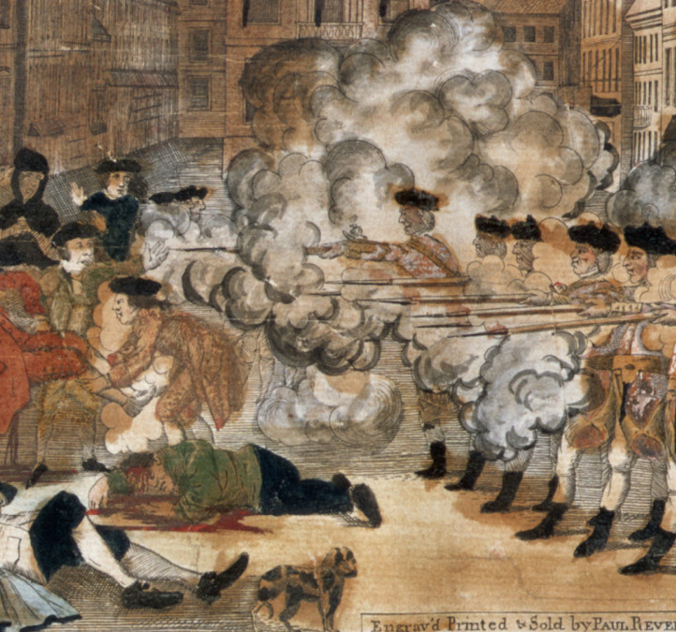
The Boston Massacre (1770 CE)
Preston and his soldiers were arrested and jailed within hours, and the propaganda machine was in full force on both sides of the conflict. Preston wrote his version of his jail cell events for publication, while Sons of Liberty leaders such as John Hancock and Samuel Adams incited colonists to keep fighting the British.
As tensions rose, British troops retreated from Boston to Fort William.
Paul Revere encouraged anti-British attitudes by etching a now-famous engraving depicting British soldiers callously murdering American colonists.
It showed the British as the instigators though the colonists had started the fight.
It took seven months to arraign Preston and the other soldiers involved in the Boston Massacre and bring them to trial.
Ironically, American colonists, lawyers, and future President of the United States, John Adams, defended them.
Adams was no fan of the British but wanted Preston and his men to receive a fair trial.
Confident that impartial jurors were nonexistent in Boston, Adams convinced the judge to seat a jury of non-Bostonians.

Slide 49
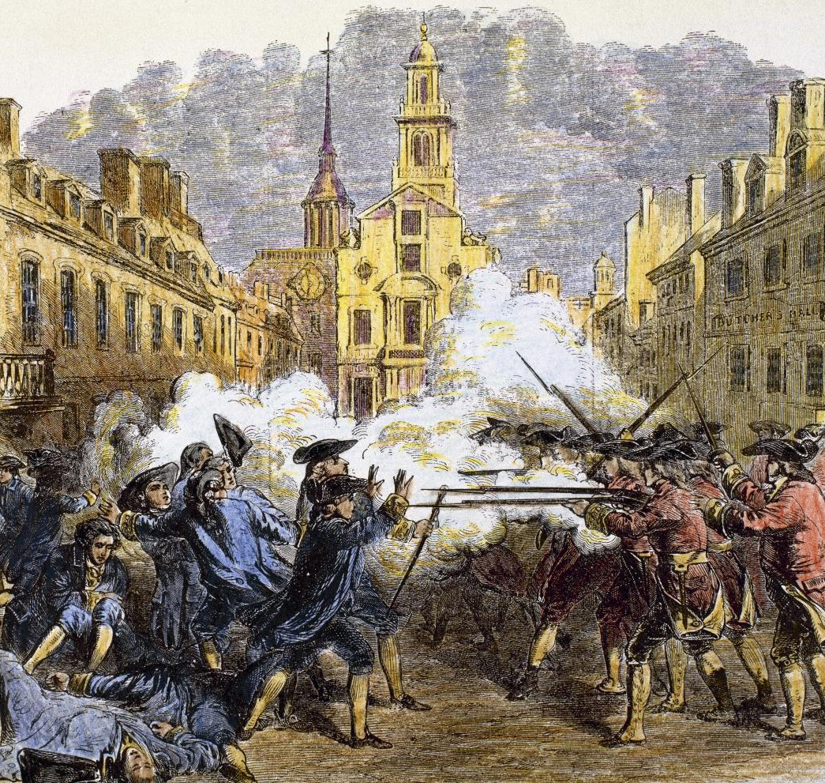
The Boston Massacre (1770 CE)
During Preston's trial, Adams argued that confusion that night was rampant.
Eyewitnesses presented contradictory evidence on whether Preston had ordered his men to fire on the colonists.
Preston was found not guilty.
The remaining soldiers claimed self-defense and were all found not guilty of murder.
Two were found guilty of manslaughter and were branded on the thumbs as first offenders per English law.
To Adams' and the jury's credit, the British soldiers received a fair trial despite the vitriol felt towards them and their country.
The Boston Massacre had a significant impact on relations between Britain and the American colonists.
It further incensed colonists already weary of British rule and unfair taxation and roused them to fight for independence.
Over the next five years, the colonists continued their rebellion, staged the Boston Tea Party, formed the First Continental Congress, and defended their militia arsenal at Concord against the redcoats, effectively launching the American Revolution.
Today, Boston's city has a Boston Massacre site marker at the intersection of Congress Street and State Street, a few yards from where the first shots were fired.

Slide 50
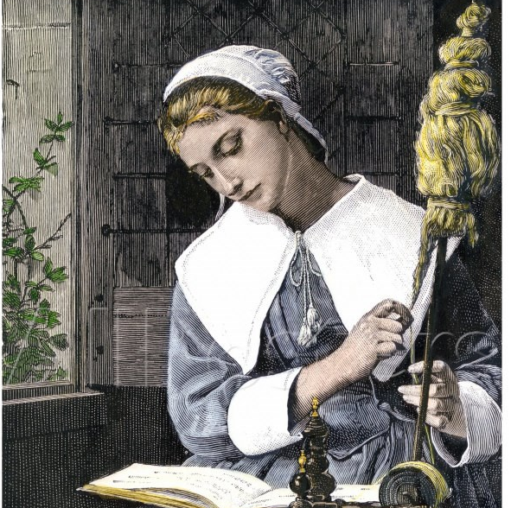
Late Colonial Women
Colonial women would be married by the time they were twenty and bore large numbers of children - 8 children were expected, but as the child mortality rate was too high, up to 5 of the children would have died before they reached their teens.
The men held traditional views and attitudes about the status and roles of women.
However, women were in short supply in the colonies, so they tended to be more highly valued than the women in Europe were still viewed as the weaker sex, lacking the physical and mental strength of men, and were emotionally less stable.
Colonial Women were expected to give total respect to the men and to obey them without question.
The life of women was focused on the home.
Colonial women's homes were invariably drafty, badly heated, had no running water, no bathrooms, or indoor toilets.
Lighting was dim and provided by candles and whale-oil lamps.
Travel was difficult as there initially were no roads.
Towns were generally dirty without garbage collection and proper sewers. This led to various diseases with few doctors and limited medical knowledge to heal the sick.

Slide 51
Late Colonial Women
The legal rights of Colonial women were few.
Divorce was practically unknown as Colonial America was essentially a divorce-free society: Colonial Women did not have the right to vote.
Colonial Women did not have the right to hold and form public office.
Widows and available women could: Make a will Buy or sell property Act as a guardian or had the right to sue or be sued.
A widow received a one-third interest in the personal property of her deceased husband (one-half if there were no children)
When a Colonial woman married, her legal identity virtually disappeared.
Any property or goods, including livestock and money left to a married woman in a will, also was owned by the husband.
A husband owned whatever belonged to his wife, except for personal items such as clothes and jewelry.
Children legally belonged to their fathers.
Married women had fewer rights than unmarried women or widows.
Married women: Could not make a will without the explicit consent of her husband. Could not buy property Could not create a contract Could not sue or be sued in court.

Slide 52
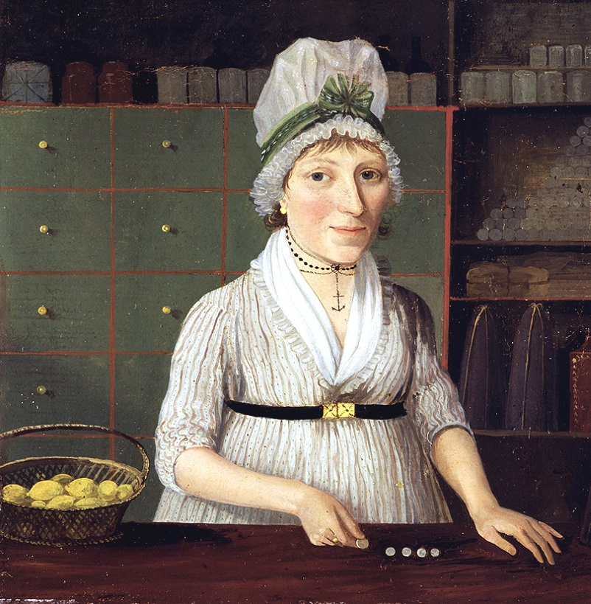
Late Colonial Women
In Puritan society, the crime of adultery was abhorred.
Two known adulterers were executed in the Massachusetts Bay Colony, and others were publicly whipped.
Adulterers might have been forced to wear a scarlet "A" if they were lucky.
At least two known adulterers were executed in Massachusetts Bay Colony, and punishment by public whippings was commonplace and generally took place on the 'Punishing Scaffold’.
The Puritans believed that the scaffold was inhabited by the devil "where evil-doers were set up for public shame".
The wealthy Colonial Women from Europe of the later colonial years enjoyed life like that they would have experienced in Europe.
Wealth enabled them to live in grand townhouses and colonial mansions. Their clothes were highly elaborate and made of velvets, satins, and silks.
Their lifestyle was centered around the house, ensuring the servants and slaves performed the tasks necessary to run such a stylish home.
The social life of Colonial women who lived in towns was focused on visiting other women and arranging special social events where their husbands could meet with their contemporaries.

Slide 53
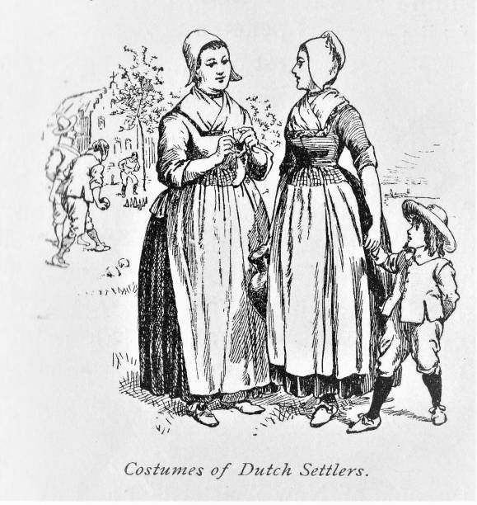
Late Colonial Women
A massive 80% of the total British and continental emigration to America before the American Revolutionary War were Indentured Servants.
A woman who became pregnant as an Indentured servant often had years added on to the end of her service time.
Unmarried women were expected to marry by the time they were 20.
Widows tended to re-marry very quickly.
Unmarried women and widows who had no money worked in the houses and farms of other people.
Women who did not marry were deemed unnatural and called "spinsters" or "thornbacks.
Despite the legal restrictions on colonial women, widows who had money owned their businesses such as taverns, printers, shops, and apothecaries and managed lands they inherited.
The slaves in Colonial America had no rights at all.
The first actual definition by the colonies of slavery defined slaves as those of "lifelong, inheritable, racial status."
20% of North America's population were slaves, and 90% lived in the Southern Colonies.

Slide 54
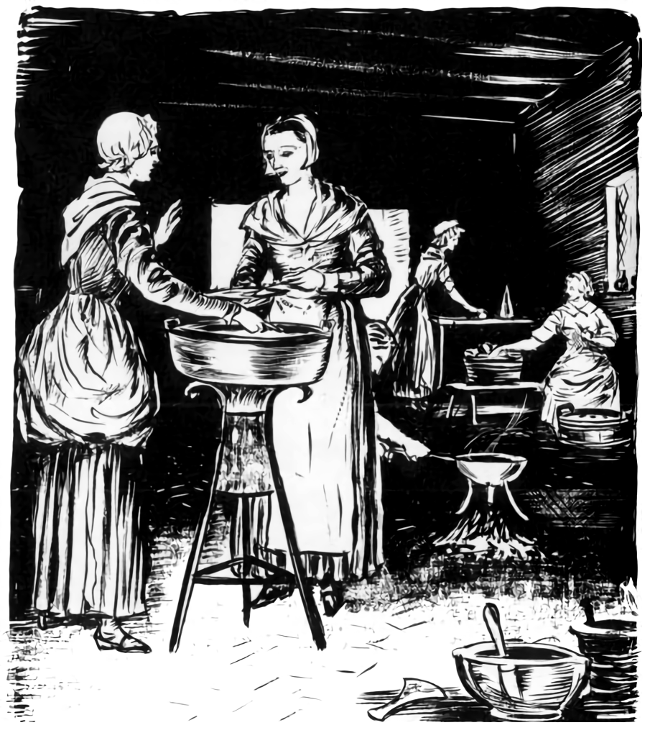
Late Colonial Women
They were bought and sold at the whim of their owners. Cheap labor was essential for the Slave Plantations to become profitable.
Slaves, both men, and women worked all year round, undertaking back-breaking work for up to eighteen hours every day.
The women were compelled to do as much work as men, even if they were pregnant.
The colonial women who were plantation slaves lived in bare, crude wooden cabins consisting of one or two rooms, often with a dirt floor, in the slave quarters.
Their children became the property of their owners.
Native Indian women were viewed as "Nothing more than slaves" by many new European settlers.
However, the woman's role in Native American society was deemed equally necessary to that of the men, and Native American women had powers such as deciding when war should start and when war should end.
Native American women's work varied according to the environment in which they lived but included processing and preparing food, moving camp, making clothes, bedding, utensils, and tools.
Many Native American women were also responsible for collecting herbs, fruit, and nuts, educating the children, preparing medicines, and nursing the sick.

Slide 55
Late Colonial Diet
Local cuisine patterns had been established by the mid-18th century.
A striking difference for the colonists in New England compared to other regions was seasonality.
While in the southern colonies, they could farm almost year-round, the growing seasons were very restricted in the northern colonies.
Wheat, however, the grain used to bake bread back in England, was almost impossible to grow, and imports of wheat were far from cost productive.
Substitutes in cases such as this included cornmeal.
The Johnnycake was a poor substitute for wheaten bread, but acceptance by both the northern and southern colonies seems evident.
The commonly hunted game included deer, bear, buffalo, and wild turkey.
The animals' larger muscles were roasted and served with currant sauce, while the other smaller portions went into soups, stews, sausages, pies, and pastries.
In addition to game, colonists' protein intake was supplemented by mutton.
The Spanish in Florida originally introduced sheep to the New World, but this development never quite reached the North, and there they were introduced by the Dutch and English.

Slide 56
Late Colonial Diet
Many homes had a sack made of deerskin filled with bear oil for cooking, while solidified bear fat resembled shortening.
Rendered pork fat made the most popular cooking medium, especially from the cuisine of bacon.
Pork fat was used more often in the southern colonies than the northern territories as the Spanish introduced pigs earlier to the South.
The colonists enjoyed butter in cooking, but it was rare before the American Revolution, as cattle were not yet plentiful.
Before the Revolution, New Englanders consumed large quantities of rum and beer, as maritime trade provided them relatively easy access to the goods needed to produce these items.
Rum was the distilled spirit of choice, as the main ingredient, molasses, was readily available from trade with the West Indies.
Further into the interior, however, one would often find colonists consuming whiskey, as they did not have equal access to sugar cane.
They did have ready access to corn and rye, which they used to produce their whiskey.

Slide 57
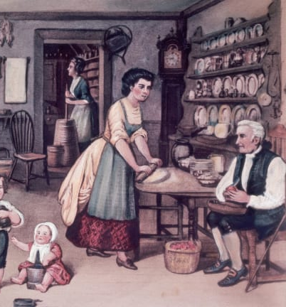
Late Colonial Diet
However, until the Revolution, many considered whiskey to be coarse alcohol unfit for human consumption, as many believed that it caused the poor to become raucous and unkempt drunkards.
In addition to these alcohol-based products produced in America, imports were seen on merchant shelves, including wine and brandy.
In comparison to the northern colonies, the Southern Colonies were quite diverse in their agricultural diet.
The uplands of Piedmont and the coastal lowlands made up the two main parts of the southern colonies.
The uplands' diet often included wild game, cabbage, string beans, corn, squashes, and white potatoes.
People had biscuits as part of their breakfast, along with healthy portions of pork.
Louisiana's lowlands included a varied diet heavily influenced by the French, Spanish, Acadians, Germans, Native Americans, Africans, and Caribbeans.
Rice played a large part of the diet in Louisiana. Also, unlike the uplands, the lowlands subsistence of protein came mostly from coastal seafood.
Much of the diet involved the use of peppers, as it still does to this day.

Slide 58
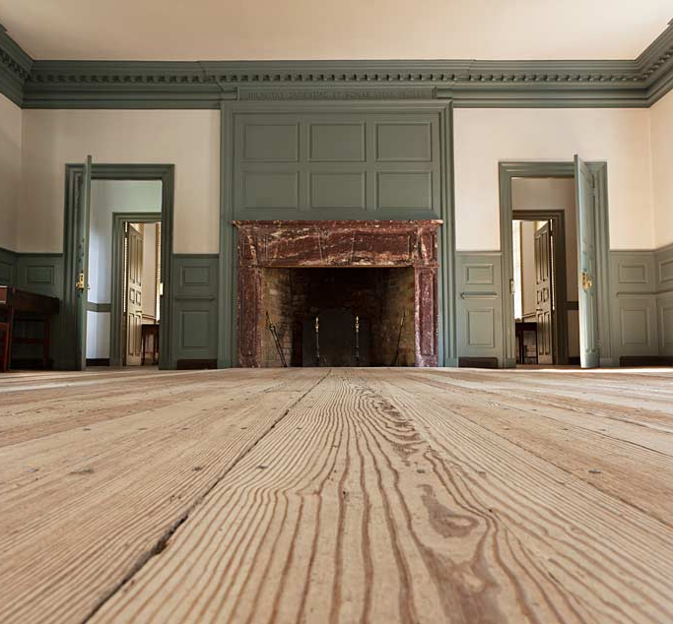
Greek Life
The North American fraternity and sorority system began with students who wanted to meet secretly, usually for discussions and debates not thought appropriately by their schools' faculty.
Before 1776 in what would become the United States of America, collegiate student fraternal organizations that promoted scholarship existed only at Yale, the College of William and Mary, and The College of New Jersey.
After that, literary societies came into existence at virtually all the colleges and universities in America.
The Latin Societies were formal organizations, often with large assembly rooms.
These organizations typically existed in pairs (two competing organizations on campus) and took roughly half the students as members.
At some colleges, students would even be assigned to society by a lot.
These societies' literary exercises usually consisted of a debate, and the meetings were open to the public.
In addition to a discussion, members could be assigned original poems, essays, and fiction to compose and deliver. Each society had distinctive meetings, with political, social, or religious discussion.
These organizations also often adopted mottoes in Greek or Latin, and some had Greek letter names, such as Phi Kappa society at the University of Georgia.

Slide 59
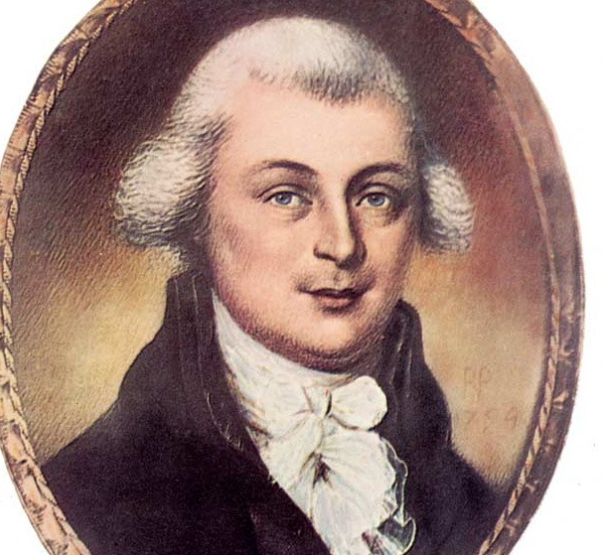
Greek Life
These organizations figure prominently in fraternities and sororities development because many early fraternities were considered 'private' versions of the 'open' Latin societies.
The Phi Beta Kappa Society, founded on December 5, 1776, at the College of William and Mary in Williamsburg, Virginia, was the first fraternal organization in the United States of America, established the precedent for naming American college societies after the Greek letters.
There were Latin-named literary societies at William & Mary, which were large debating societies, which had lost all reputation for letters, and were noted only for the debauchery & hospitality of their members.
The founders of Phi Beta Kappa declared that the society was formed for congeniality and promoted good fellowship, with "friendship as its basis and benevolence and literature as its pillars."
At first, the only secrets were the mysterious letters used on the badge.
the society initiated a Yale student before disbanding at British forces' advance. This student brought Phi Beta Kappa to Yale and Harvard, and from there, the society was able to continue.
The chapters became larger and focused on rhetoric and class elections while abandoning the close social bond that had defined the first chapter.
Membership was becoming more of an honor and less part of a functioning society.
No other Greek-letter student society was formed until the inception of Chi Delta Theta, a senior class society at Yale, in 1821.
John Heath, Founder of Phi Beta Kappa

Slide 60
Boston Tea Party (1773 CE)
For years, Americans refused to buy British tea because it included a tax levied on tea drinkers.
This thought repulsed colonists who didn’t believe they should be taxed without a representative sitting in the British Parliament to voice their concerns.
Instead, Americans bought tea smuggled into the colonies.
But in May 1773, Parliament gave the East India Company a tea monopoly in America that made British tea much cheaper than smuggled tea.
The hatred had been brewing among the American colonists for months.
On October 16, 1773, a group of Philadelphia patriots decided to tell the British Crown that it would mount a boycott of tea, months before a similar Boston act.
The publication of a document from the meeting called Philadelphia Resolutions triggered public protests in Boston and Philadelphia.
“The claim of parliament to tax America is, in other words, a claim of right to levy contributions on us at pleasure,” the Resolutions said.
“The duty, imposed by parliament upon tea landed in America, is a tax on the Americans, or levying contributions on them, without their consent.”
The Resolutions also made it clear that the group thought the Crown would use the money raised by the tea tax through the Townshend Acts to eliminate local governments run by the colonies.
The group called on Americans to prevent “a violent attack upon the liberties of America” by stopping the unloading of tea shipments and any tea sales.

Slide 61
Boston Tea Party (1773 CE)
Two months later, in Boston, three ships arrived with 342 chests of tea.
In what became known as the Boston Tea Party, a party of men dressed as Native Americans dumped the tea chest’s contents into Boston Harbor after the governor, Thomas Hutchinson, refused colonists’ demands for the ships to depart peacefully with their cargo unloaded.
In late December 1773, one ship with 698 cases of tea attempted to land in Philadelphia, but it was turned away.
A group of 6,000 Philadelphians met at the State House to discuss the situation in what was the largest mass gathering in the colonies.
The violent protests in Boston Harbor were met with a direct response from Great Britain.
In April 1774, the British Parliament passed the Intolerable Acts, which punished Massachusetts for the Tea Party incident.
The Acts took away home rule from Massachusetts and forced all Americans to board British troops in unoccupied buildings.
At the same time, Franklin wrote a public letter in London, under an assumed name, that made it clear how he felt about Parliament, “who appear to be no better acquainted with their History or Constitution than they are with the Inhabitants of the Moon.”
“The Flame of Liberty in North America shall not be extinguished. Cruelty and Oppression and Revenge shall only serve as Oil to increase the Fire,” Franklin added.

Slide 62
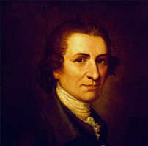
Thomas Paine (1776 CE)
Thomas Paine, an English-American writer whose Common Sense pamphlet was important influences on the American Revolution.
Other works that contributed to his reputation were Rights of Man, a defense of the French Revolution and republican principles, and The Age of Reason, an exposition of the place of religion in society.
Paine was born of a Quaker father and an Anglican mother. His formal education was meager, just enough to enable him to master reading, writing, and arithmetic.
At 13, he began work with his father as a corset maker and then tried various other occupations unsuccessfully, finally becoming an excise officer. His duties were to hunt for smugglers and collect the excise taxes on liquor and tobacco.
The pay was insufficient to cover living costs, but he used part of his earnings to purchase books and scientific apparatus.
Repeated failures marked Paine's life in England. He had two brief marriages. He was unsuccessful or unhappy in every job he tried.
He was dismissed from the excise office after he published a strong argument in 1772 for a raise in pay as the only way to end corruption in the service.
When his situation appeared hopeless, he met Benjamin Franklin in London, who advised him to seek his fortune in America and gave him letters of introduction.

Slide 63
Thomas Paine (1776 CE)
Paine arrived in Philadelphia on November 30, 1774. He helped found and edit the Pennsylvania Magazine for 18 months.
Paine had arrived in America when the conflict between the colonists and England was reaching its height.
After blood was spilled at the Battles of Lexington and Concord, Paine argued that America's cause should be not just a revolt against taxation but a demand for independence.
He put this idea into Common Sense, which came off the press on January 10, 1776.
The 50-page pamphlet sold more than 500,000 copies within a few months.
More than any other publication, Common Sense paved the way for the Declaration of Independence, unanimously ratified on July 4, 1776.
During the war that followed, Paine served as a volunteer aide-de-camp to Gen. Nathanael Greene.
"The American Crisis. The number I," published on December 19, 1776, when George Washington's army was on the verge of disintegration, so moved Washington that he ordered it read to all the troops at Valley Forge.
Its opening is among the most stirring passages in the literature of the American Revolution:

Slide 64
Thomas Paine (1776 CE)
These are the times that try men's souls. The summer soldier and the sunshine patriot will, in this crisis, shrink from the service of his country; but he that stands it now deserves the love and thanks of man and woman. Tyranny, like hell, is not easily conquered; yet we have this consolation with us—that the harder the conflict, the more glorious the triumph. What we obtain too cheap, we esteem too lightly: It is dearness only that gives everything its value. Heaven knows how to put a proper price upon its goods, and it would be strange indeed if so celestial an article as freedom should not be highly rated. Britain, with an army to enforce her tyranny, has declared that she has a right not only to tax but "to bind us in all cases whatsoever," and if being bound in that manner is not slavery, then is there not such a thing as slavery upon earth. Even the expression is impious, for so unlimited a power can belong only to God.
This paper, combined with the subsequent victory of Washington's army in the Battle of Trenton later in the month, had the probable effect of inspiring many soldiers, whose term of service would expire January 1, to reenlist.

Slide 65
Thomas Paine (1776 CE)
Paine's desperate need for employment was relieved when he was appointed clerk of the General Assembly of Pennsylvania on November 2, 1779.
In this capacity, he had frequent opportunity to observe that American troops were at the end of their patience because of lack of pay and scarcity of supplies.
Paine took $500 from his salary and started a subscription for the relief of the soldiers. In 1781, pursuing the same goal, he accompanied John Laurens to France.
The money, clothing, and ammunition they brought back with them were essential to the Revolution's final success.
In "Public Good", he included a call for a national convention to remedy the ineffectual Articles of Confederation and establish a strong central government under "a continental constitution."
At the end of the American Revolution, Paine again found himself poverty-stricken.
His patriotic writings had sold by the hundreds of thousands, but he had refused to accept any profits so that cheap editions might be widely circulated.
In a petition to Congress endorsed by Washington, he pleaded for financial assistance. Paine's opponents buried it in Congress, but Pennsylvania gave him £500 and New York a farm in New Rochelle.
Paine devoted his time to inventions, concentrating on an iron bridge without piers and a smokeless candle.
But it was the French Revolution that now filled Paine's thoughts. Rights of Man immediately created a sensation

Slide 66
Thomas Paine (1776 CE)
What began as a defense of the French Revolution evolved into an analysis of the fundamental reasons for discontent in European society and a remedy for the evils of arbitrary government, poverty, illiteracy, unemployment, and war.
Paine spoke out effectively in favor of republicanism as against monarchy and outlined a plan for popular education, relief of the poor, pensions for aged people, and public works for the unemployed, all to be financed by the levying of a progressive income tax.
Paine's proposals spelled "bloody revolution," and the government ordered the book banned and the publisher jailed to the ruling class.
Paine himself was indicted for treason, and an order went out for his arrest.
But he was en route to France, having been elected to a seat in the National Convention before the demand for his arrest could be delivered.
Paine was tried in absentia, found guilty of seditious libel, declared an outlaw, and the Rights of Man was ordered permanently suppressed.
While in prison, the first part of Paine's Age of Reason was published (1794), and Part II followed it after his release (1796).
Although Paine made it clear that he believed in a Supreme Being and, as a Deist, opposed only organized religion, the work won him a reputation as an atheist among the orthodox.

Slide 67
Thomas Paine (1776 CE)
Paine remained in France until September 1, 1802, when he sailed for the United States.
He quickly discovered that his services to the country had been all but forgotten and that he was widely regarded only as of the world's greatest infidel.
Despite his poverty and physical condition, worsened by occasional drunkenness, Paine continued his attacks on privilege and religious superstitions.
He died in New York City in 1809 and was buried in New Rochelle on the farm given to him by the state of New York as a reward for his Revolutionary writings.
Ten years later, William Cobbett, the political journalist, exhumed the bones and took them to England, where he hoped to give Paine a funeral worthy of his outstanding contributions to humanity. But the plan backfired, and the bones were lost, never to be recovered.
At Paine's death, most U.S. newspapers reprinted the obituary notice from the New York Citizen, which read in part: "He had lived long, did some good and much harm.“
This remained the verdict of history for more than a century following his death, but the tide has turned: on January 30, 1937, The Times of London referred to him as "the English Voltaire," and on May 18, 1952, Paine's bust was placed in the New York University Hall of Fame.

Slide 68
The American Revolution (1776 CE)
A group of colonial delegates (including George Washington of Virginia, John and Samuel Adams of Massachusetts, Patrick Henry of Virginia, and John Jay of New York) met in Philadelphia in September 1774 to voice their grievances against the British crown.
This First Continental Congress did not go so far as to demand independence from Britain. Still, it denounced taxation without representation and the maintenance of the British army in the colonies without their consent.
It issued a declaration of the rights due to every citizen, including life, liberty, property, assembly, and trial by jury.
The Continental Congress voted to meet again in May 1775 to consider further action, but violence had already broken out by that time.
On April 18, 1775, hundreds of British troops marched from Boston to nearby Concord, Massachusetts, to seize an arms cache.
Paul Revere and other riders sounded the alarm, and colonial militiamen began mobilizing to intercept the Redcoats.

Slide 69
The American Revolution (1776 CE)
On April 19, local militiamen clashed with British soldiers in the Battles of Lexington and Concord in Massachusetts, marking the "shot heard round the world" that signified the Revolutionary War.
When the Second Continental Congress convened in Philadelphia, delegates–including new additions Benjamin Franklin and Thomas Jefferson–voted to form a Continental Army, with Washington as its commander in chief.
On June 17, in the Revolution's first major battle, colonial forces inflicted heavy casualties on General William Howe's British regiment at Breed's Hill in Boston. The Battle of Bunker Hill, ended in a British victory but lent encouragement to the revolutionary cause.
Throughout that fall and winter, Washington's forces struggled to keep the British in Boston.
Still, artillery captured at Fort Ticonderoga in New York helped shift the balance of that struggle in late winter.
The British evacuated the city in March 1776, with Howe and his men retreating to Canada to prepare for a major invasion of New York.

Slide 70
The American Revolution (1776 CE)
By June 1776, with the Revolutionary War in full swing, a growing majority of the colonists had come to favor independence from Britain.
On July 4, the Continental Congress voted to adopt the Declaration of Independence, drafted by a five-person committee including Franklin and John Adams but written mainly by Jefferson.
That same month, determined to crush the rebellion, the British government sent a large fleet and more than 34,000 troops to New York.
In August, Howe's Redcoats routed the Continental Army on Long Island; Washington was forced to evacuate his troops from New York City by September.
Pushed across the Delaware River, Washington fought back with a surprise attack in Trenton, New Jersey, on Christmas night.
It won another victory at Princeton to revive the rebels' flagging hopes before making winter quarters at Morristown.
British strategy in 1777 involved two main prongs of attack aimed at separating New England (where the rebellion enjoyed the most popular support) from the other colonies.
To that end, General John Burgoyne's army marched south from Canada toward a planned meeting with Howe's forces on the Hudson River.
Burgoyne's men dealt a devastating loss to the Americans in July by retaking Fort Ticonderoga.
Howe decided to move his troops southward from New York to confront Washington's army near the Chesapeake Bay.
The British defeated the Americans at Brandywine Creek, Pennsylvania, on September 11 and entered Philadelphia on September 25.
Washington rebounded to strike Germantown in early October before withdrawing to winter quarters near Valley Forge.

Slide 71
The American Revolution (1776 CE)
During the long, hard winter at Valley Forge, Washington's troops benefited from the training and discipline of the Prussian military officer Baron Friedrich von Steuben (sent by the French) and the leadership of the French aristocrat Marquis de Lafayette.
On June 28, 1778, as British forces under Sir Henry Clinton (who had replaced Howe as supreme commander) attempted to withdraw from Philadelphia to New York, Washington's army attacked them near Monmouth, New Jersey.
The battle effectively ended in a draw, as the Americans held their ground, but Clinton could get his army and supplies safely to New York. On July 8, a French fleet arrived off the Atlantic coast, ready to battle with the British.
A joint attack on the British at Newport, Rhode Island, in late July, failed, and for the most part, the war settled into a stalemate phase in the North.
The Americans suffered several setbacks from 1779 to 1781, including General Benedict Arnold's defection to the British and the first serious mutinies within the Continental Army.
Under Lord Charles Cornwallis, British forces began an offensive in the region, crushing Gates' American troops at Camden in mid-August.

Slide 72
The American Revolution (1776 CE)
By the fall of 1781, Nathaniel Greene's American forces had managed to force Cornwallis and his men to withdraw to Virginia's Yorktown peninsula, near where the York River empties into the Chesapeake Bay.
Supported by a French army commanded by General Jean Baptiste de Rochambeau, Washington moved against Yorktown with around 14,000 soldiers.
In contrast, a fleet of 36 French warships offshore prevented British reinforcement or evacuation.
Trapped and overpowered, Cornwallis was forced to surrender his entire army on October 19.
Though the American independence movement effectively triumphed at the Battle of Yorktown, contemporary observers did not see that decisive victory yet.
British forces remained stationed around Charleston, and the powerful main army still resided in New York.
British and American negotiators in Paris signed preliminary peace terms in Paris late that November.
On September 3, 1783, Great Britain formally recognized the United States' independence in the Treaty of Paris.
At the same time, Britain signed separate peace treaties with France and Spain (which had entered the conflict in 1779), bringing the American Revolution to a close after eight years.

