Slide 1
Module Seven: New Arrivals
(1804 CE -1828 CE)

Slide 2
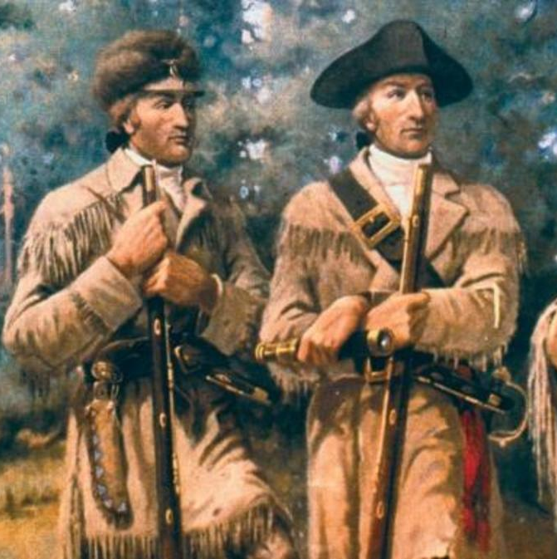
Lewis and Clark (1804 CE)
Lewis and Clark Expedition was a U.S. military expedition, led by Meriwether Lewis and William Clark, to explore the Louisiana Purchase and the Pacific Northwest.
On January 18, 1803, U.S. Pres. Thomas Jefferson sent a secret message to Congress asking for $2,500 to send an officer and a dozen soldiers to explore the Missouri River, make diplomatic contact with Indians, expand the American fur trade, and locate the Northwest Passage.
The proposed trip took on the added significance on May 2, when the United States agreed to the Louisiana Purchase.
Jefferson, who had already sponsored several attempts to explore the West, asked his secretary, Meriwether Lewis, to lead the expedition.
As his co-commander, he selected William Clark, who had been his military superior during the government's battles with the Northwest Indian Federation in the early 1790s.
For his part, Clark recruited men in Kentucky, oversaw their training that winter at Camp River Dubois in Illinois, and served as the expedition's principal waterman and cartographer.
Throughout the trip, from May 14, 1804, to September 23, 1806, traveled nearly 8,000 miles.
Numbering about four dozen men, the entourage covered 10 to 20 miles a day—pulling their 10-ton keelboat and two dugout boats up the Missouri River.
President Jefferson had instructed Lewis to observe latitude and longitude and take detailed notes about the soil, climate, animals, plants, and native peoples. Lewis identified 178 plants new to science, including prairie sagebrush, and Douglas fir, as well as 122 animals, such as grizzly bear, prairie dog, and pronghorn antelope.
They experienced dysentery, venereal disease, boils, tick bites, and injuries from prickly pear, yet only one man perished throughout the journey.

Slide 3
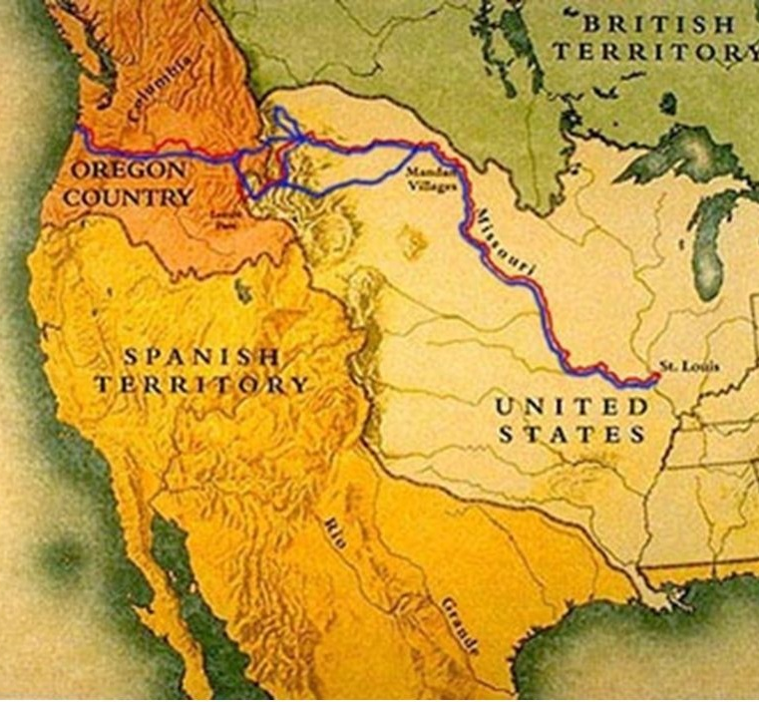
Lewis and Clark (1804 CE)
Another primary objective involved diplomacy with Native Americans.
Most tribes welcomed trading opportunities and provided the expedition with food, knowledge, guides, shelter, sex, and entertainment.
The expedition arrived at the Mandan and Hidatsa villages near present-day Bismarck, North Dakota, and constructed Fort Mandan to spend the winter.
The captains prepared maps, artifacts, mineral samples, plant specimens, and papers to send back in the spring.
On April 7, 1805, a small crew departed on a St. Louis-bound keelboat laden with boxes of materials for Jefferson that included live magpies and a prairie dog.
The party consisted of 33 people, including soldiers, civilians, Clark's slave York, and two newly hired interpreters—a French Canadian, Toussaint Charbonneau, and his Shoshone wife, Sacagawea, who had given birth to a boy, Jean Baptiste, that February.
On June 2, 1805, the expedition party arrived at a fork in the river.
The expedition arrived at the Great Falls almost two weeks later. An 18-mile portage around the falls was made even more difficult by broken terrain, prickly pear cactus, hailstorms, and numerous grizzly bears.

Slide 4
Lewis and Clark (1804 CE)
On July 4, 1805, the party finished the portage and, to celebrate Independence Day, consumed the last of their 120 gallons of alcohol and danced into the night.
Arriving at the Three Forks of the Missouri River, Sacagawea recognized Beaverhead Rock and informed the others they would soon encounter some Shoshones.
Fortunately, in mid-August, they met a Shoshone band led by Sacagawea's brother Cameahwait, who provided the expedition with horses.
They finally arrived at the Pacific Ocean in mid-November, with Clark recording in his journal, "Ocean in view! O! the joy."
Fierce storms delayed their progress for nearly a month.
The members conducted a democratic vote on where to spend the winter, with even York and Sacagawea casting votes.
Near present-day Astoria, Oregon, the corps-built Fort Clatsop and endured a wet, miserable winter by journal writing, drying meat, making salt, and traveling to see a beached whale.

Slide 5
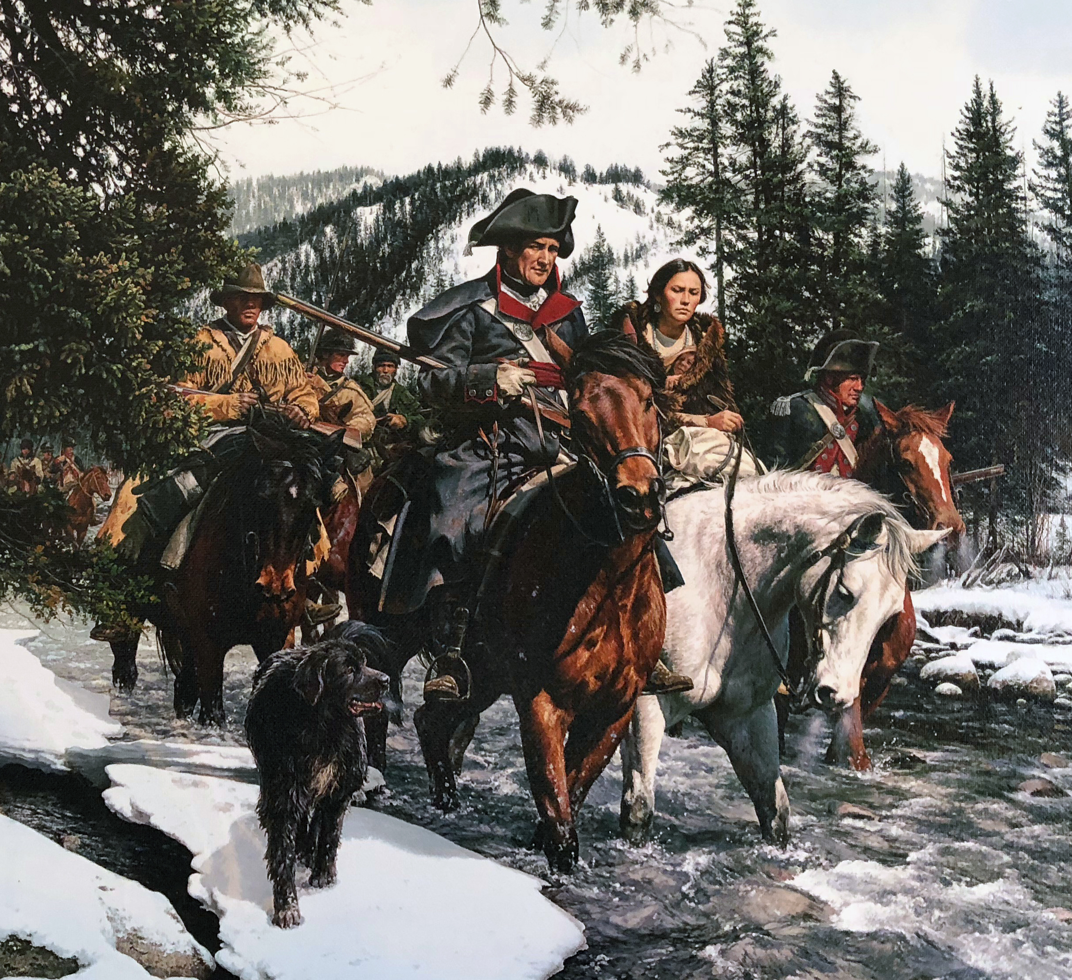
Lewis and Clark (1804 CE)
Several groups floated down to the Great Falls, digging up supplies they had cached on their outward journey. Meanwhile, Clark arrived at the Yellowstone River after crossing Bozeman Pass, the route suggested by Sacagawea.
The Corps of Discovery met with a grand reception at St. Louis on September 23.
Congress rewarded them with double pay and public land.
Each of the captains received 1,600 acres, and their men received 320 acres The final cost for the expedition totaled $38,000.
Jefferson appointed Lewis governor of Upper Louisiana Territory and appointed Clark, an Indian agent.
The expedition contributed significant geographic and scientific knowledge of the West, aided the expansion of the fur trade, and strengthened U.S. claims to the Pacific.
Clark's maps portraying the geography of the West, printed in 1810 and 1814, were the best available until the 1840s.

Slide 6
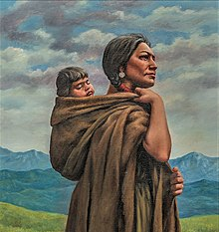
Sacagawea (1804 CE)
Sacagawea was an interpreter and guided Meriwether Lewis and William Clark's expedition westward from the Mississippi River to the Pacific Coast.
Sacagawea was born circa 1788 in what is now the state of Idaho.
When she was approximately 12 years old, Sacagawea was captured by an enemy tribe, the Hidatsa, and taken from her Lemhi Shoshone people to the Hidatsa villages near present-day Bismarck, North Dakota.
Following her capture, French-Canadian trader Toussaint Charbonneau, living among the Hidatsa, claimed Sacagawea as one of his wives.
In 1803, the Louisiana Purchase of western territory from France by President Thomas Jefferson nearly doubled the size of the United States.
With the acquisition of so much land, it was necessary to determine the actual boundaries of the country. Jefferson hired Virginia's Meriwether Lewis to explore the land.
Lewis sought out frontiersman William Clark, and together they led about 40 men in three boats up the Missouri River.
During the winter months, Lewis and Clark decided to build their encampment, Fort Mandan, near the Hidatsa-Mandan villages where Charbonneau and Sacagawea lived.
Charbonneau proposed that Lewis and Clark hire him as a guide and interpreter. Charbonneau knew Hidatsa and the sign languages common among the river tribes.
Additionally, his marriage to the Shoshone Sacagawea would be helpful as they traveled west, where they would likely encounter and need to trade with the Shoshone.
Lewis and Clark hired Charbonneau as a member of their expedition, the Corps of Discovery, while Sacagawea was expecting her first child.

Slide 7
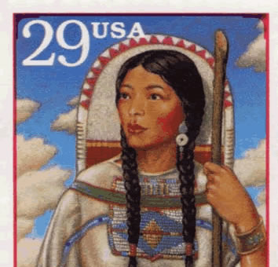
Sacagawea (1804 CE)
On February 11, 1805, Sacagawea gave birth to Jean-Baptiste Charbonneau, whom Clark later nicknamed "Pomp," meaning "firstborn" in Shoshone. Her baby on her back and her husband by her side, Sacagawea, and the men left Fort Mandan on April 7, 1805.
At about 17 years of age, she was the only woman among 31 older men on this expedition portion.
Her knowledge of the Shoshone and Hidatsa languages was a great help during their journey.
She communicated with other tribes and interpreted for Lewis and Clark. She was also skilled at finding edible plants, which proved crucial to supplementing their rations along the journey.
A group of men traveling with a woman and her baby appeared less menacing than an all-male group, which could be mistaken for a war party. Sacagawea and her baby helped those they encountered feel it was safe to befriend the newcomers.
However, only Sacagawea's husband ever received payment for work on the expedition despite all her contributions.
Sacagawea continued with the Corps of Discovery, and the expedition reached the Pacific Ocean on November 15, 1805.
Soon after, they needed to determine where they would establish their winter quarters.
Clark's journal shows that Sacagawea contributed to this decision, a sign of the respect the white male crewmembers held for her knowledge of the land.
They built Fort Clatsop near the Columbia River and stayed there until March 23, 1806.

Slide 8
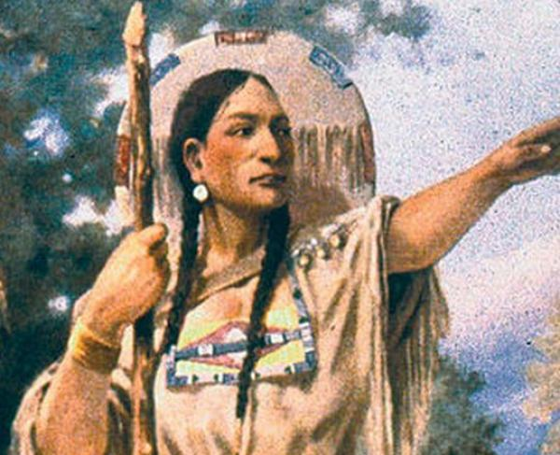
Sacagawea (1804 CE)
For the return journey, the Corps divided into two groups, one led by Lewis and the other by Clark.
Traveling with Clark, Sacagawea guided his group south of the Yellowstone River by recommending a route through the Rocky Mountains, known today as Bozeman Pass.
The two groups reunited on August 12, 1806. They arrived at the Hidatsa villages two days later, where Sacagawea and her family departed the expedition.
Lewis and Clark prepared for their journey back to St. Louis, but before they left, Clark offered to take Sacagawea's son Pomp back to St. Louis with him.
He would see that Pomp received a good education and would raise Pomp as his own. Sacagawea and Charbonneau felt Pomp was too young but indicated they would bring him to St. Louis when he was older.
When Pomp was five, Sacagawea and Charbonneau brought him to St. Louis and left him with Clark to oversee his education.
Sacagawea and Charbonneau then went back to the Upper Missouri River area and worked for Manuel Lisa, a Missouri Fur Company trader.
Sacagawea likely gave birth to a daughter named Lisette in 1812.
There is some ambiguity around Sacagawea's death.
Records from Fort Manuel indicate that she died of typhus in December 1812.
However, according to some Native American oral histories, Sacagawea lived for many more years in the Shoshone lands in Wyoming until she died in 1884.

Slide 9
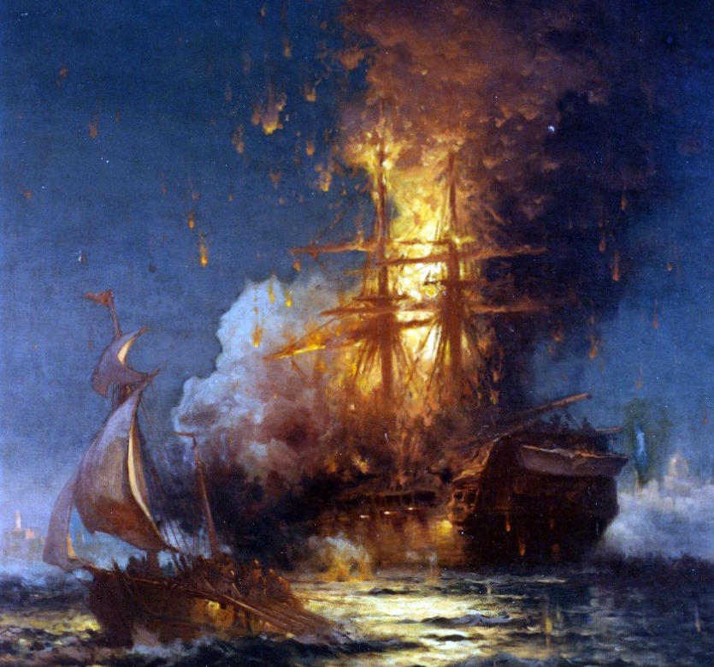
The Barbary Wars (1801 CE)
The First Barbary War was an undeclared war waged by the United States against the North African states of Morocco, Tripoli, Algiers, and Tunis.
The principal cause of the war was that those states harbored and supported pirates' actions against American shipping vessels in the Mediterranean Sea.
The war, which lasted from 1801 to 1805, did not ultimately end the acts of piracy against American ships, but it did prove that the United States could wage war, if necessary, in places far from its shores.
The four Barbary States of North Africa – Morocco, Algiers, Tunis, and Tripoli – had plundered seaborne commerce for centuries.
Surviving by blackmail, they received tremendous sums of money, ships, and arms yearly from foreign powers in return for allowing the foreigners to trade in African ports and sail unmolested through the Barbary waters.
They demanded tribute money, seized ships, and held crews for ransom or sold them into slavery.
American merchant ships, no longer covered by British protection, were seized by Barbary pirates after United States independence, and American crews were enslaved.
In 1799 the United States agreed to pay $18,000 a year in return to promise that Tripoli-based corsairs would not molest American ships.

Slide 10
The Barbary Wars (1801 CE)
In May 1801, the United States refused to succumb to the increasing demands of Tripoli; in return, Tripoli declared war against the States.
The United States sent naval squadrons into the Mediterranean under the slogan of "Millions for defense, but not one cent for tribute!"
Under the leadership of Commodores Richard Dale and Edward Preble, the Navy blockaded the enemy coast, bombarded his shore fortresses, and engaged in close, bitterly contested gunboat actions.
In 1805 Marines stormed the Barbary pirates' harbor fortress stronghold of Derna (Tripoli), commemorated in the Marine Corp Hymn invocation "To the Shores of Tripoli.“
Marines were the first U.S. forces to hoist the flag over territory in the Old World.
In June 1805, a peace settlement was negotiated with Tripoli.

Slide 11
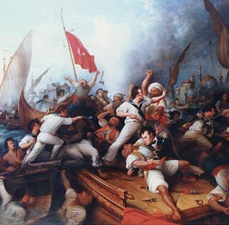
The Barbary Wars (1801 CE)
The Second Barbary War was the second of two wars fought between the United States and the Ottoman Empire's North African regencies of Tripoli, Tunis, and Algeria known collectively as the Barbary states.
The war between the Barbary States and the US ended in 1815; the international dispute would effectively be concluded the following year by the United Kingdom and the Netherlands.
The war brought an end to the American practice of paying tribute to the pirate states and helped mark the beginning of the end of piracy in that region, which had been rampant in the days of Ottoman domination.
Within decades, European powers built ever more sophisticated and expensive ships which the Barbary pirates could not match in numbers or technology.
Following the War of 1812, two naval squadrons under Commodores Decatur and Bainbridge returned to the Mediterranean.
Diplomacy backed by resolute force soon brought the rulers of Barbary to terms and gained widespread respect for the new American nation.
Treaties were signed that eliminated the United States from paying tribute.
In the years immediately after the Napoleonic wars, which ended in 1815, the European powers forced an end to piracy and the payment of tribute in the Barbary states.

Slide 12
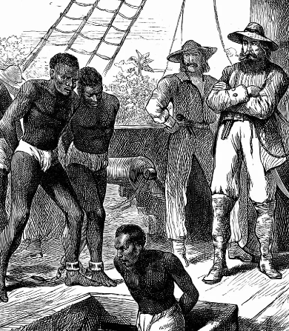
Trans-Atlantic Slave Trade (1808 CE)
The legal trans-Atlantic slave trade reached unprecedented levels in the late eighteenth century. By mid-nineteenth century, every national carrier in Europe and the Americas had formally abolished the traffic. Denmark was the first nation to repeal its trade in 1803.
Britain and the United States followed in 1807, with the U.S. ban going into effect in 1808.
During just three decades, every national trans-Atlantic carrier outlawed a massive system of forced migration that had lasted for three centuries.
The case of U.S. abolitionism indicates a blend of ideological, religious, and economic factors varied according to specific national contexts.
In Early America, black and white abolitionists channeled the spirit of both the Enlightenment and the American Revolution in their cries for "liberty." In addition, American anti-slavery evangelicals spread their message widely in the United States.
On the economic front, slavery and the slave trade had become increasingly marginal to the livelihoods of many northerners, which weakened their resistance to the abolition of the slave trade.
At the same time, in the Upper South, politically influential slaveholders supported repeal to strengthen the domestic slave trade to Lower South.
These planters believed that if they did not abolish the trans-Atlantic trade, it would compete with the domestic traffic in supplying slaves to the Lower South, where plantations were expected to flourish in the nineteenth century.

Slide 13
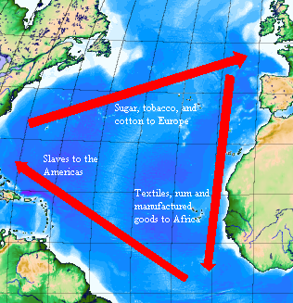
Trans-Atlantic Slave Trade (1808 CE)
Despite these efforts, abolition legislation and international cooperation did not end the trans-Atlantic slave trade.
Although abolition was primarily implemented in the British and French empires, and only a few slave ships are known to have arrived on U.S. shores after 1808, slave importations to Brazil, Cuba, and Puerto Rico increased after the trade was outlawed.
Underdeveloped plantation economies in these jurisdictions created a massive demand for slave labor and record profits for illegal slave traders.
Most Brazilian and Cuban policymakers linked economic growth with continued slave imports, and many tacitly supported the unlawful traffic.
Similarly, in Africa, organizations with long slave-trading were unwilling or unable to halt the supply of captives to the coast or expel foreign slave dealers resided there, despite commitments to do both.
Meanwhile, the illegal slave trade became increasingly difficult to suppress.
The U.S. government denied other nations the right to search U.S. ships suspected of slave trading, and soon a large portion of the total illegal trans-Atlantic slave traffic took place under the shield of the U.S. flag.
Suppression of the illegal trans-Atlantic slave trade only became effective when external pressures on slave-importing regions were bolstered by changing public opinions within those societies.
It was not until 1867, after widespread abolitionist pressure within the Spanish empire—and in light of emancipation in Cuba's much larger neighbor, the United States, after a violent civil war—that the Spanish government moved decisively against the illegal trans-Atlantic slave trade, ending the traffic for good.

Slide 14
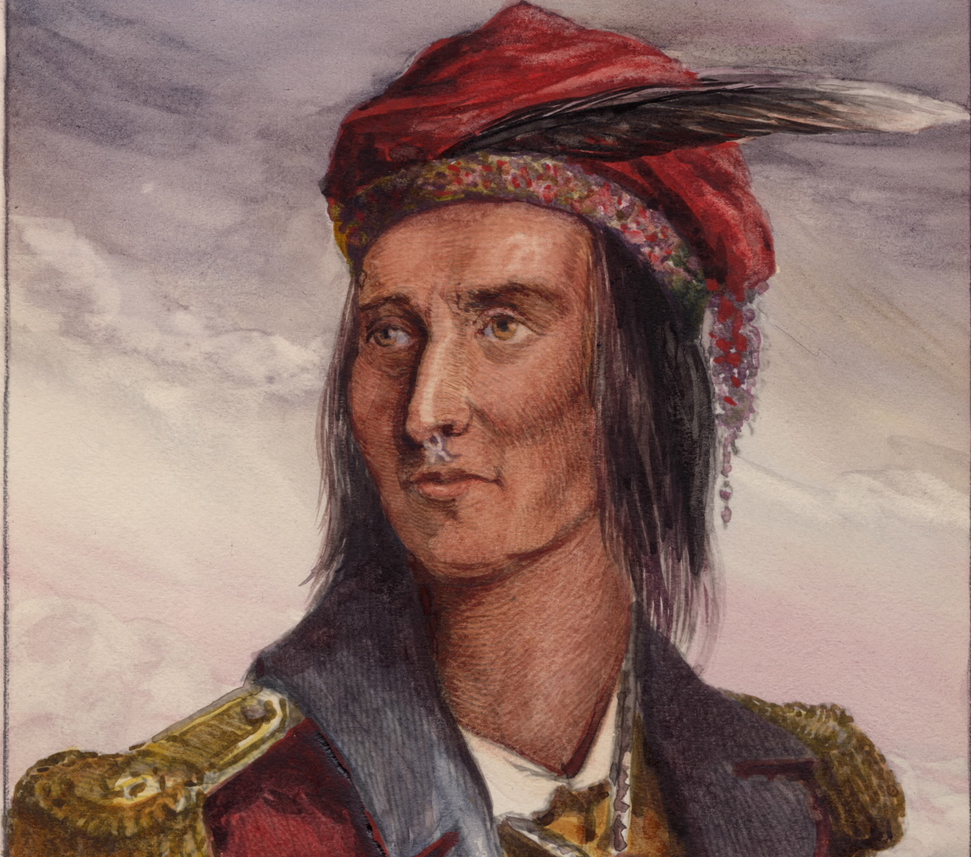
Tecumseh (1810 CE)
Although Great Britain abandoned its nominal claim to the region after American Independence, the tribal federations asserted their sovereignty over the territory. An alliance of tribes in Ohio took arms to resist American settlements on their land.
In 1790 and again in 1791, they inflicted two of the most severe defeats ever suffered by the United States Army.
Congress also responded with the Federal Non-Intercourse Act, taking Indian policy out of the hand of state governments who were blamed for inflaming hostilities.
But it established a line across the state, supposedly protecting Indians on the northern and western sides against further encroachment.
The treaty lines, however, couldn't control a flood of American immigrants into Ohio put constant pressure on Indian lands.
The British Indian Department, based in Ontario, closely monitored events, providing supplies and arms to the tribes through a network of traders fluent in their languages and often married into them.
After 1810, the War Party in Congress called more and more loudly for the invasion of Canada.

Slide 15
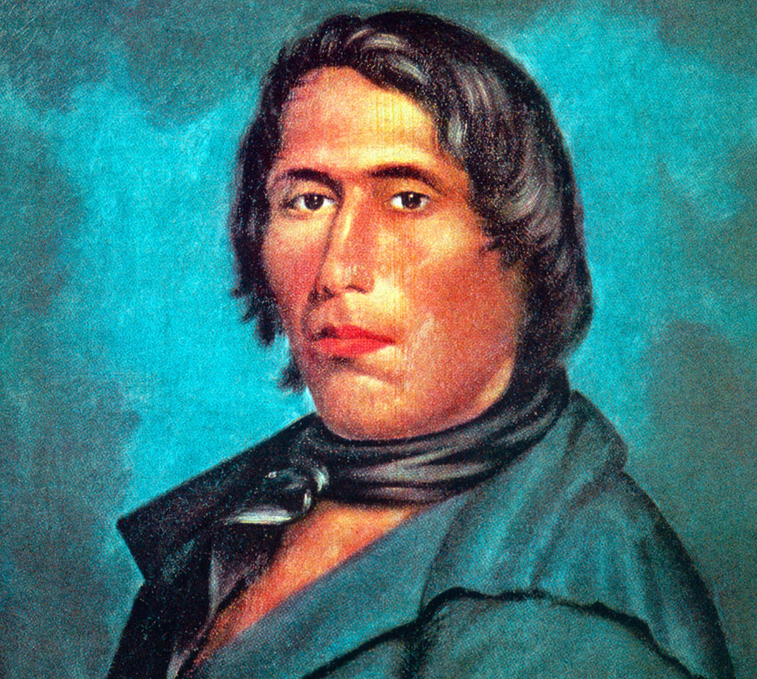
Tecumseh (1810 CE)
Tecumseh, the famed war leader, was a middle child in the large family of a Shawnee father, and a Creek mother.
Migration and warfare constantly disrupted the family.
The father was killed in battle before the birth of the last children, triplets.
After a Revolutionary War incursion in 1779, the mother returned home to her Creek village, leaving most of her children in Ohio to be raised by the older brother and sister.
Tecumseh, a well-favored, popular youth, seemed destined for a traditional career as a war leader, the role of his tribal division.
A failure in hunting and war, he developed into an overweight alcoholic before an event that changed the lives of the brothers and all Indians in the Old Northwest.
One evening in April 1805, while lighting his pipe, his brother collapsed in a trance. Taken for dead, he awoke as his family prepared for his funeral and reported a vision of heaven and hell.
Thus began his transformation into the Prophet. He preached a return to traditional ways, forbidding whiskey and American merchandise.
Americans, he said, had not been created by the Master of Life but by the Great Serpent, a water-being possibly with ancient roots in the Mississippian culture. By following the Master of Life, and himself, Indians would overthrow American power.

Slide 16
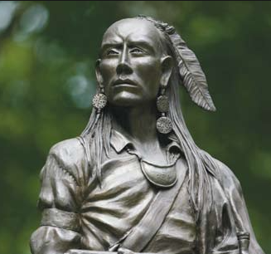
Tecumseh (1810 CE)
A great orator, Tecumseh began to travel far and wide to win tribes to his principles and create a grand confederacy to resist United States expansion.
In 1808, Tecumseh and the Prophet had relocated their religious settlement to the far side of the Indiana Territory by the conjunction of the Wabash and Tippecanoe rivers. As it was known, Prophetstown eventually drew nearly 3,000 Indian inhabitants, coming in from the west and Ohio.
In 1811, Tecumseh set off on his last incredible diplomatic journey to win support from the powerful tribes of the Southeast.
The Choctaw and Chickasaw rejected his confederacy, and he had only limited success among his mother's people, the Creek.
In November, Harrison marched a thousand troops to the outskirts of Prophetstown. The Prophet decided on a predawn attack, never a great warrior, relying on the Master of Life for victory.
The battle was a draw, but the unexpected casualties demoralized the Prophetstown defenders, and they abandoned the village. Harrison and his men burned the town and its food stores to the ground.
The Prophet's reputation never recovered. When Tecumseh returned, he saw his grand plan shattered and bitterly blamed his brother.

Slide 17
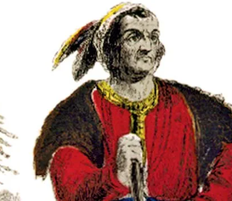
Tecumseh (1810 CE)
As Congress declared War on June 18, Tecumseh and a party of warriors were going to Ontario.
Tecumseh joined the defense of Fort Malden near Ontario under the command of Major General Isaac Brock, who badly needed reinforcements. A 2,000-strong U.S. force under Governor William Hull had crossed from Detroit into Canada, but the advance stalled.
The newly bolstered British-Indian force succeeded in driving the Americans back across the Detroit River and eventually capturing Fort Detroit.
Because of the village's strategic location, the victory was decisive, giving Brock, Tecumseh, and their men control over all of Michigan territory.
Three months after the siege of Detroit, Brock died in combat. Almost exactly a year after Brock's death, Americans reclaimed Detroit and invaded Canada.
Now under the command of William Henry Harrison, they were advancing on the British and Indian army near Moraviantown, just 80 miles northeast of the recovered fort. On the morning of October 5, 1813, Procter commanded his forces to flee. But Tecumseh refused to turn and run. It would be his last stand.

Slide 18
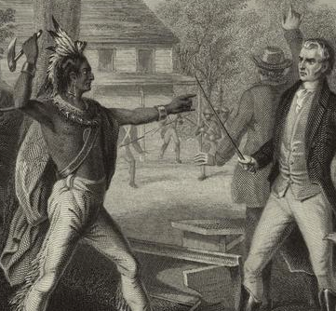
The Battle of Tippecanoe (1811 CE)
In 1811, the Battle of Tippecanoe was a significant defeat for Tecumseh's American Indian Confederation.
Tecumseh and the Prophet, were the American names of two Shawnee natives.
During the early 1800s, they devised separate plans to deal with the white settlers flooding onto their land.
Tecumseh believed that if the American Indians put aside their traditional differences and worked together, they would be able to stop white encroachment onto the American Indians' land.
In 1808, the brothers moved their followers to Prophetstown near the Tippecanoe River in the Indiana Territory.
The two men continued to spread their messages, and their followers continued to grow in number.
By 1811, many American Indians lived at Prophetstown, that white settlers in Ohio and the Indiana Territory demanded that the government do something to protect them.
William Henry Harrison, governor of the Indiana Territory and future president of the United States of America, led an army against Prophetstown

Slide 19
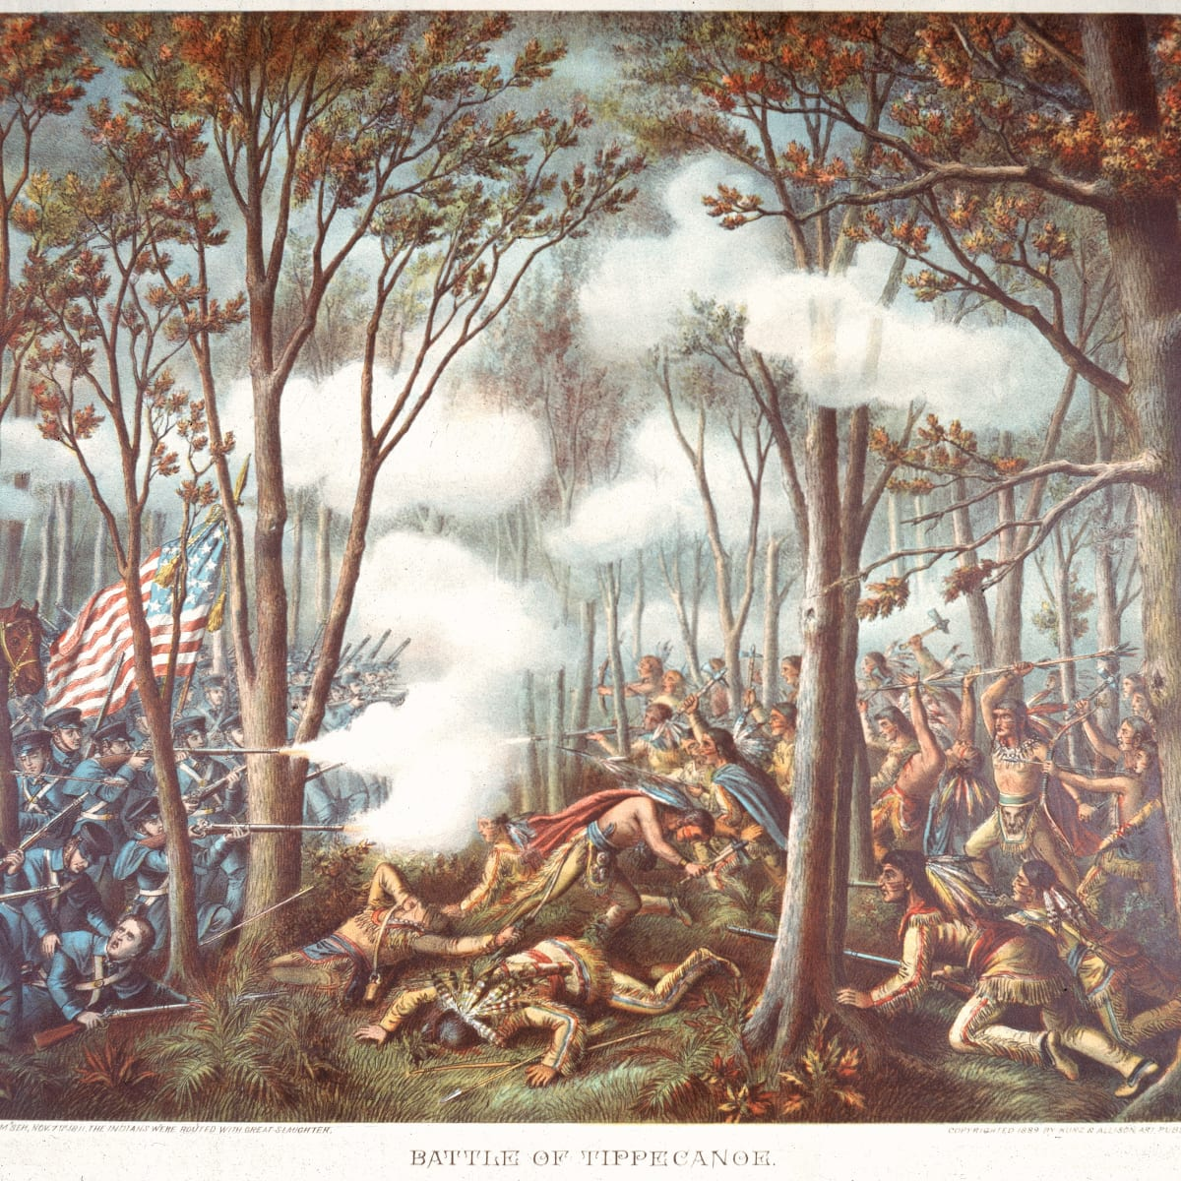
The Battle of Tippecanoe (1811 CE)
in the fall of 1811. He stopped his force a short distance from the American Indian village.
Tecumseh was away, recruiting other American Indians to join his Confederation. The Prophet decided to attack the Americans.
He claimed that the whites' bullets would not harm his people. The Prophet and his forces attacked Harrison's men before daybreak on the morning of November 7, 1811.
The American military defeated the American Indians, but they suffered heavy losses: sixty-two men killed and 126 wounded.
Harrison guessed that at least forty American Indians were killed.
This battle became known as the Battle of Tippecanoe, which occurred north of present-day West Lafayette, Indiana.
The American army drove off the American Indians and burned Prophetstown to the ground.
Most natives no longer believed in the Prophet.
His claims of invincibility contributed significantly to the collapse of Tecumseh's American Indian alliance.
While Tecumseh's Confederation was weakened after the Battle of Tippecanoe, Harrison's fortunes increased as he became known as "Old Tippecanoe.“
Many years later, he used his reputation to run for President of the United States. His campaign slogan was "Tippecanoe and Tyler too!"

Slide 20
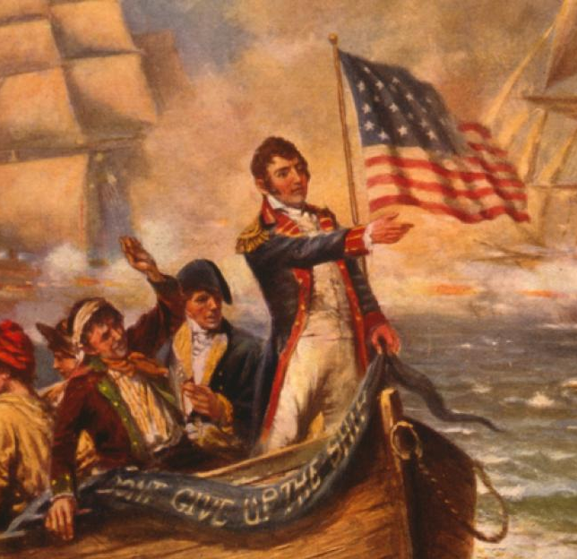
The War of 1812
In the War of 1812, the United States took on the most significant naval power in the world, Great Britain, in a conflict that would have an immense impact on the young country’s future.
Causes of the war included: British attempts to restrict U.S. trade, The Royal Navy’s impressment of American seamen, and America’s desire to expand its territory.
The United States suffered many costly defeats at the hands of British, Canadian, and Native American troops throughout the War of 1812, including the capture and burning of the nation’s capital, Washington, D.C., in August 1814.
Nonetheless, American troops could repulse British invasions in New York, Baltimore, and New Orleans, boosting national confidence and fostering a new spirit of patriotism.
The ratification of the Treaty of Ghent on February 17, 1815, ended the war but left many of the most contentious questions unresolved.
Nonetheless, many in the United States celebrated the War of 1812 as a “second war of independence,” beginning an era of partisan agreement and national pride.
At the outset of the 19th century, Great Britain was locked in a long and bitter conflict with Napoleon Bonaparte’s France.

Slide 21
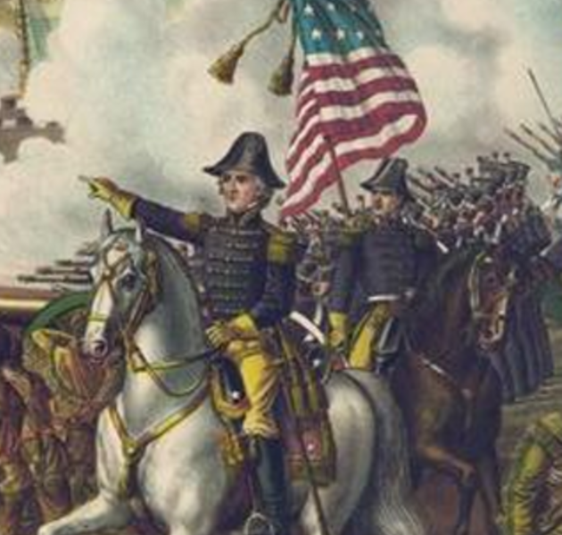
The War of 1812
To cut off supplies from reaching the enemy, both sides attempted to block the United States from trading with the other.
The Royal Navy also outraged Americans by its impressment or removing seamen from U.S. merchant vessels and forcing them to serve on behalf of the British.
In 1807, Britain passed the Orders in Council, which required neutral countries to obtain a license from its authorities before trading with France or French colonies.
In 1809, the U.S. Congress repealed Thomas Jefferson’s unpopular Embargo Act, which hurt Americans more than either Britain or France by restricting trade.
Its replacement, the Non-Intercourse Act, expressly prohibited trade with Britain and France.
Meanwhile, new members of Congress elected that year–led by Henry Clay and John C. Calhoun–had begun to agitate for war, based on their anger over British violations of maritime rights and Britain’s encouragement of Native American hostility against American westward expansion.
By late 1811 the so-called “War Hawks” in Congress were putting more and more pressure on Madison, and on June 18, 1812, the president signed a declaration of war against Britain.
Though Congress ultimately voted for the war, both House and Senate were bitterly divided on the issue. Most Western and Southern members of Congress supported the war. At the same time, Federalists (especially New Englanders who relied heavily on trade with Britain) accused war advocates of using the excuse of maritime rights to promote their expansionist agenda.
To strike at Great Britain, U.S. forces almost immediately attacked Canada, a British colony. American officials were overly optimistic about the invasion’s success, especially given how underprepared U.S. troops were at the time.

Slide 22
The War of 1812
With the defeat of Napoleon’s armies in April 1814, however, Britain was able to turn its full attention to the war effort in North America.
As large troops arrived, British forces raided the Chesapeake Bay. They moved in on the U.S. capital, capturing Washington, D.C., on August 24, 1814, and burning government buildings, including the Capitol and the White House.
By that time, peace talks had already begun at Ghent (modern Belgium), and Britain moved for an armistice after the failure of the assault on Baltimore.
In the negotiations that followed, the United States gave up its demands to end impressment.
At the same time, Britain promised to leave Canada’s borders unchanged and abandon efforts to create an Indian state in the Northwest.
On December 24, 1814, commissioners signed the Treaty of Ghent, ratified the following February.
Though the War of 1812 is remembered as a relatively minor conflict in the United States and Britain, it looms large for Canadians and Native Americans, who see it as a decisive turning point in their losing struggle to govern themselves.
The war also marked the demise of the Federalist Party, which had been accused of being unpatriotic for its antiwar stance.
It reinforced a tradition of Anglophobia that had begun during the Revolutionary War.
The war’s outcome boosted national self-confidence and encouraged the growing spirit of American expansionism that would shape the better part of the 19th century.

Slide 23
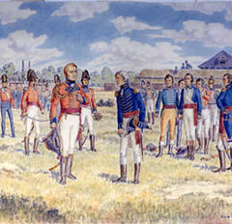
The Siege of Detroit (1812 CE)
The Siege of Detroit took place August 15-16, 1812, during the War of 1812, and was one of the opening actions of the conflict.
In July 1812, Brigadier General William Hull conducted an abortive invasion of Canada before withdrawing back to his base at Fort Detroit.
Hull was soon besieged by a smaller British and Native American force led by Major General Isaac Brock and Tecumseh, lacking in confidence despite superior numbers.
Through a mix of intimidation and deception, Brock and Tecumseh were able to compel Hull's surrender of over 2,000 men while only having two men wounded.
A humiliating defeat for the Americans, Fort Detroit would remain in British hands for over a year.
Overseen by the Governor of the Michigan Territory, William Hull, the region possessed few regular troops to defend against a British invasion or attacks by Native American tribes in the area.
Taking action, Madison directed that an army be formed and that it move to reinforce the critical outpost of Fort Detroit.
Though he initially refused, Hull, a veteran of the American Revolution, was given command of this force with brigadier general.
Unfortunately for Hull, the British in Upper Canada were aware that a state of war existed.

Slide 24
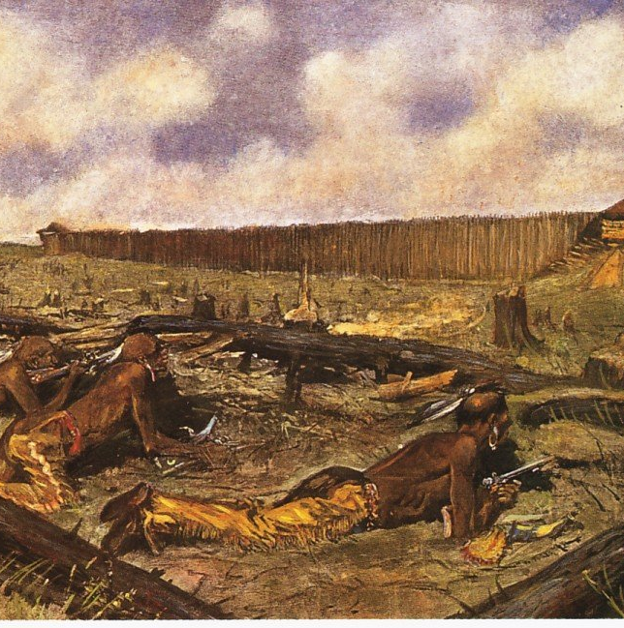
The Siege of Detroit (1812 CE)
Reaching Detroit on July 5, Hull was reinforced by around 140 Michigan militia bringing his total force to approximately 2,200 men.
Advancing on July 12, Hull's offensive was hampered by some of his militia who refused to serve outside of the United States.
As a result, he halted on the east bank even though Colonel Henry Proctor, commanding at Fort Malden, had only 300 regulars and 400 Native Americans.
Learning of this, Hull became increasingly hesitant as he believed large numbers of Native American warriors would descend from the north.
He was further concerned about dwindling provisions as his supply lines south of Detroit were under attack by British and Native American forces.
Possessing around 730 regulars and militia and Tecumseh's 600 warriors, Brock's army remained smaller than his opponent.
Brock also learned that its morale was low and that Hull was deeply afraid of Native American attack.
Playing on this fear, he drafted a letter requesting that no more Native Americans be sent to Ontario and stating that he had over 5,000 on hand. This letter was intentionally allowed to fall into American hands.
Shortly after that, Brock sent Hull a letter demanding his surrender and stating:

Slide 25
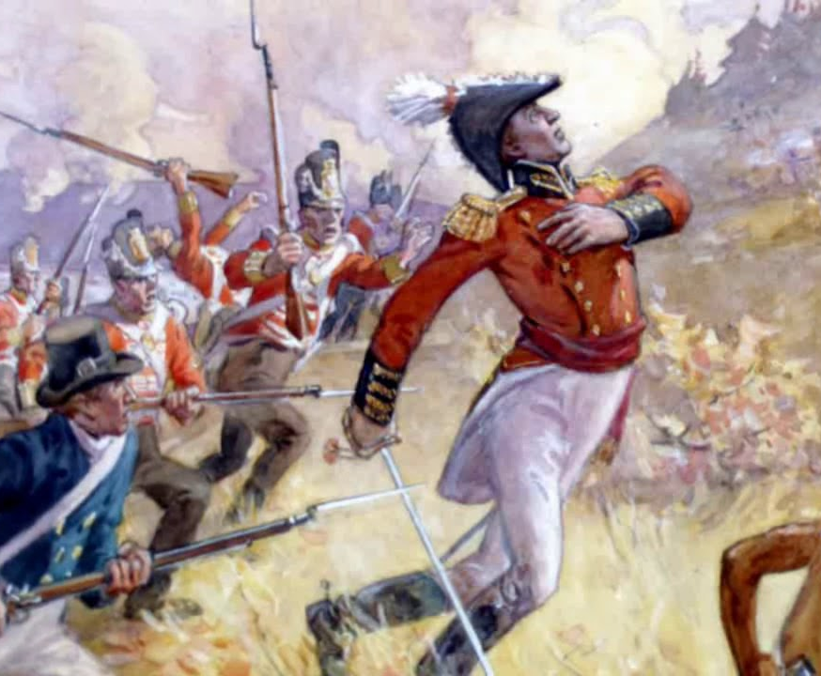
The Siege of Detroit (1812 CE)
Continuing the series of deceptions, Brock ordered extra uniforms belonging to 41st Regiment to be given to the militia to make his force appear more regular.
Soldiers were instructed to light individual campfires, and several marches were undertaken to make the British force appear larger.
These efforts worked to undermine Hull's already weakening confidence.
On August 15, Brock commenced a bombardment of Fort Detroit from batteries on the river's east bank. The next day, Brock and Tecumseh crossed the river intending to block the American supply lines and lay siege to the fort.
Brock was forced to change these plans immediately as Hull had dispatched MacArthur and Cass with 400 men to re-open communications to the south.
Rather than be caught between this force and the fort, Brock moved to assault Fort Detroit from the west.As his men moved, Tecumseh repeatedly marched his warriors through a gap in the forest as they emitted loud war cries.
This movement led the Americans to believe that the number of warriors present was much higher than in actuality.
As the British approached, a ball from one of the batteries hit the officer's mess in Fort Detroit, inflicting casualties.
Already badly unnerved by the situation and fearing a massacre at the hands of Tecumseh's men, Hull broke, and against the wishes of his officers, ordered a white flag hoisted and began surrender negotiations.
In the Siege of Detroit, Hull lost seven killed and 2,493 captured.
An embarrassing defeat, the loss of Detroit saw the situation in the Northwest radically transformed and quickly dashed American hopes of a triumphant march into Canada.

Slide 26
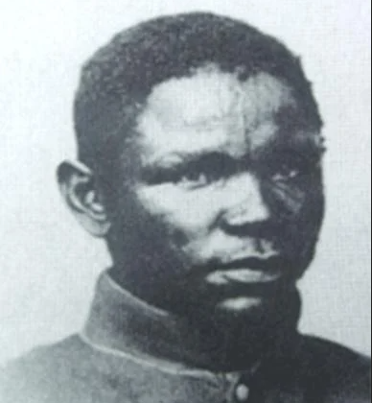
Ben Ali (1812 CE)
The first community of Muslims in America that have artifacts as proof of their Islamic practices are the descendants of Ben Ali, who lived on Sapelo Island, Georgia.
The barrier islands off the coast of Georgia and South Carolina were characterized by a slave culture that was unique to the area.
The geographic characteristics of the islands created isolation of these communities, which allowed the people to preserve a rich African culture.
For example the song, Kumbaya, Br'er Rabbit stories, and foods like gumbo and shrimp & grits.
The culture of the people of these islands came to be known as "Gullah" and "Geechee."
The Gullah people of Sapelo Island originally came from West Africa, where the people were experts at growing rice, indigo, and cotton.
They were the slaves of Thomas Spalding.
Spalding was a Georgia state senator and then a US congressman representing Georgia between 1798 and 1806.
He is reported to have owned 350 slaves but to have disliked slavery.

Slide 27
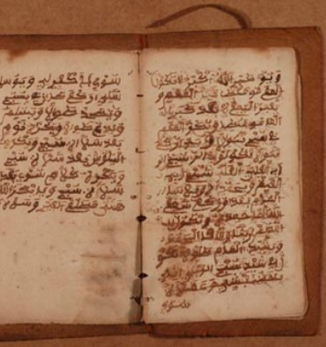
Ben Ali (1812 CE)
Unlike many slave owners, Spalding gave his slaves many rights that most slaves did not have. He required the slaves to work only 6 hours of hard labor a day.
He also allowed one of his most trusted slaves, Ben Ali, to supervise the other slaves and even gave him arms to defend the property when he left to serve in the War of 1812. In addition, he allowed Ben Ali to continue to practice Islam while serving as a slave on the property.
Ben Ali wrote fatwa's and scribed Quranic verses in documents now referred to as the "The Ben Ali Diary.“
These are regarded as the first set of Islamic American jurisprudence, making Ben Ali the first Muslim American scholar.
These documents are currently stored at the Hargrett Rare Book & Manuscript Library at the University of Georgia.
Until about the 1980s, a community of up to about 500 descendants of Ben Ali maintained their culture through their Creole Fula/English language, storytelling, and handicrafts.
However, currently, there are only about 50 of his descendants living in the Hog's Hammock area on the Island.

Slide 28
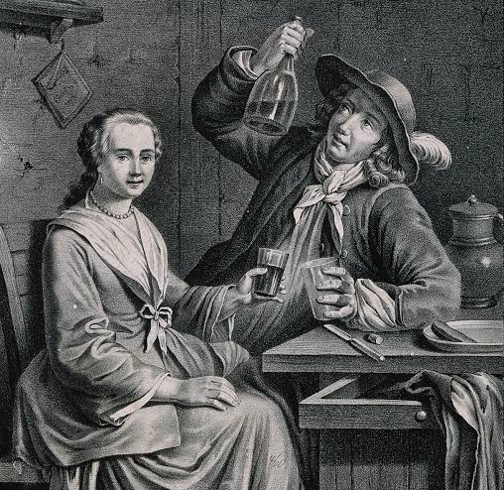
19th Century Alcohol
One reason for this heavy drinking was attributed to an overabundance of corn on the western frontier, which encouraged the widespread production of cheap whiskey.
Two means to ensure that waterborne illness, for example, typhoid and cholera, was not conveyed by water was to boil it in making tea or coffee or using it to make alcohol.
Before the construction of the Erie Canal, transportation of grain from the west was cost-prohibitive; farmers instead converted their grain to alcohol for shipping eastward.
While drunkenness was still an accepted part of life in the eighteenth century, the nineteenth century brought a change in attitudes due to increasing industrialization and the need for a reliable and punctual workforce.
Drunkenness would come to be defined as a threat to industrial efficiency and growth.
Problems commonly associated with industrialization and rapid urbanization were attributed to alcohol.
Thus, issues such as urban crime, poverty, and high infant mortality rates were blamed on alcohol.
However, likely, gross overcrowding and unemployment had much to do with these problems.

Slide 29
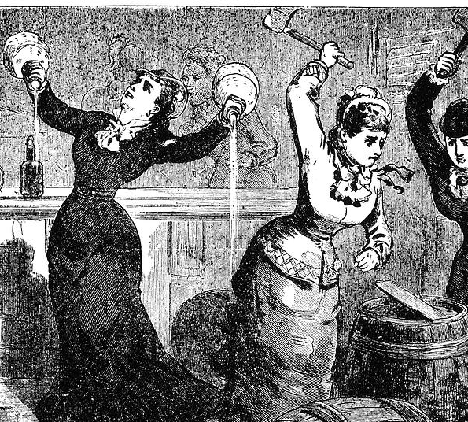
19th Century Alcohol
Groups that began by promoting temperance - the moderate use of alcohol - became abolitionists and pressed for the complete and total Prohibition of beverage alcohol production and distribution of beverage alcohol.
In 1801, on the recommendation of Thomas Jefferson, the federal duty of liquor was abolished.
Federal taxes on distilling and importing spirits were repealed. By 1803 cocktails appear to have been invented.
Lyman Beecher began his famous series of six sermons against the evils of selling or drinking alcohol and insisted that "Drunkenness is a sin which excludes [one] from Heaven."
They were published in pamphlet form and widely distributed.
The "Star-Spangled Banner" was set to the tune of an English drinking song.

Slide 30
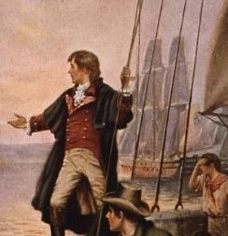
The Star-Spangled Banner (1814 CE)
“The Star-Spangled Banner” is the national anthem of the United States.
The anthem’s history began the morning of September 14, 1814, when an attorney and amateur poet named Francis Scott Key watched U.S. soldiers under bombardment from British naval forces during the War of 1812—raise a giant American flag over Fort McHenry in Baltimore, Maryland.
But after Napoleon’s defeat at the Battle of Waterloo in June 1815, the British turned their full attention to the war in North America.
The Royal Navy trained its sights on the vital seaport of Baltimore, Maryland.
On September 13, U.S. soldiers at Baltimore’s Fort McHenry withstood some 25 hours of British bombardment.
Early the following day, they hoisted a gigantic U.S. flag over the fort, marking a crucial victory and a turning point in what would be considered the second war of American independence.
A Maryland-born attorney with a thriving practice in Washington, D.C., Francis Scott Key watched the bombardment of Fort McHenry from a ship anchored in Baltimore’s harbor.
Key had been helping to negotiate the release of an American civilian, Dr. William Beanes, who had been captured in an earlier battle.
Francis Scott Key wrote “The Star-Spangled Banner” and its initial verse on the backside of a letter while watching the giant American flag waving over the fort that morning. In Baltimore, he continued working until he had completed four verses.

Slide 31
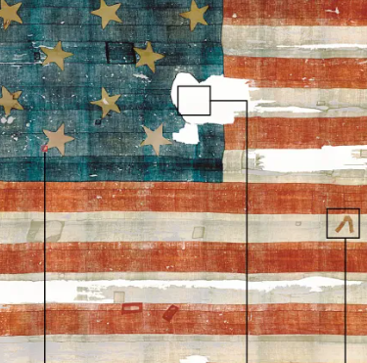
The Star-Spangled Banner (1814 CE)
After a local printer issued the song, originally called “Defence of Fort M’Henry,” two Baltimore newspapers printed it, and it spread quickly to various cities along the East Coast.
By November 1812, Key’s composition had appeared in print for the first time under the name “The Star-Spangled Banner.”
Key’s little-known third stanza includes these lines:
No refuge could save the hireling and slave
From the terror of flight or the gloom of the grave,
And the star-spangled banner in triumph doth wave
O’er the land of the free and the home of the brave.
By the time Key wrote these words, the British military had included a regiment of former slaves had called the Colonial Marines, whom the British had encouraged to escape and then trained and armed.
A look at his rarely examined life clarifies how difficult it is to separate the national anthem’s meaning from its author and his gross hypocrisy on the importance of freedom.

Slide 32
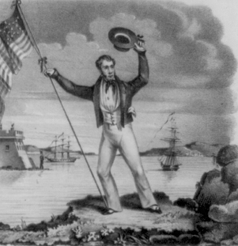
The Star-Spangled Banner (1814 CE)
Key strongly opposed international slave trafficking on humanitarian grounds and defended enslaved people and free blacks without charge in the D.C. courts.
During this period, Key also represented slaveholders attempting to retrieve their escaped “property.”
When President Jackson appointed Key to serve as district attorney for Washington in 1833, it was not least to enforce the law controlling African-Americans, both those enslaved and the city’s growing population of free blacks.
During Key’s seven years in office, he proved an energetic and moralistic prosecutor, taking on the dangers of fornication and abolitionism with equal enthusiasm. In 1833, Key tried to shut down the capital’s “bawdy houses,” the famous female-run brothels that served white and black customers.
The same year, Key indicted John Prout, a free, black schoolteacher who had forged papers for a young enslaved couple attempting to escape to freedom. Prout was convicted and was forced to leave town.
Key next prosecuted a New York doctor who had moved to Washington with a trunk of anti-slavery literature. The trial attracted attention across the nation. In the courtroom, Key emotionally denounced the abolitionists who wanted to free all enslaved people.
They “declare that every law which sanctions slavery is null and void and that obedience to it is a sin,” Key declaimed. “That we have no more rights over our slaves than they have over us. Does not this bring the Constitution and the laws under which we live into contempt? Is it not a plain invitation to resist them?”

Slide 33
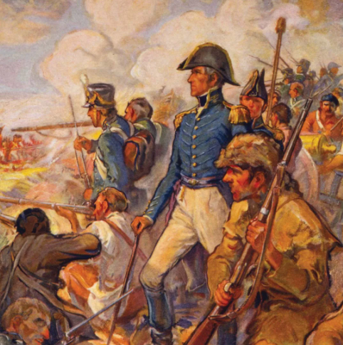
The Battle New Orleans (1815 CE)
On December 24, 1814, Great Britain and the United States signed a treaty in Ghent, Belgium, that effectively ended the War of 1812.
However, the news was slow to cross the pond, and on January 8, 1815, the two sides met in what is remembered as one of the conflict’s most prominent and most decisive engagements.
In the bloody Battle of New Orleans, future President Andrew Jackson and a motley assortment of militia fighters, frontiersmen, slaves, Indians, and even pirates weathered a frontal assault by a superior British force, inflicting devastating casualties along the way.
Nicknamed “Old Hickory” for his legendary toughness, Jackson had spent the last year subduing hostile Creek Indians in Alabama and harassing the redcoats’ operations along the Gulf Coast.
The General had no love for the British—he’d spent time as their prisoner during the Revolutionary War. “I owe Britain a debt of retaliatory vengeance,” he once told his wife, “should our forces meet, I trust I shall pay the debt.”
After British forces were sighted nearby, Jackson declared martial law in New Orleans.
He ordered that every available weapon and man be brought to bear in the city’s defense. His force soon grew into a 4,500-strong patchwork of army regulars, frontier militiamen, free blacks, New Orleans aristocrats, and Choctaw tribe members.
Old Hickory even accepted the help of Jean Lafitte, a dashing pirate who ran smuggling and privateering empire.
Jackson’s ramshackle army was to face off against some 8,000 British regulars, many of whom had served in the Napoleonic Wars.
The two sides first came to blows on December 23, when Jackson launched a daring nighttime attack on British forces camped nine miles south of New Orleans.
Jackson then fell back to Rodriguez Canal, a ten-foot-wide millrace located near Chalmette Plantation off the Mississippi River.
Using local slave labor, he widened the canal into a defensive trench and used the excess dirt to build a seven-foot-tall earthen rampart buttressed with timber.

Slide 34
The Battle New Orleans (1815 CE)
The British attacks descended into chaos. Their secondary assault on Jackson’s battery across the river had met with more success, but it was too little too late.
By the time the British seized the American artillery position, they could see the British already lost the day.
At Line Jackson, the British were retreating in droves, leaving behind a carpet of crumpled bodies.
American Major Howell Tatum later said the enemy casualties were “truly distressing…some had their heads shot off, some their legs, some their arms. Some were laughing, some crying…there was every variety of sight and sound.”
The assault on Jackson’s fortifications was a fiasco, costing the British some 2,000 casualties, including three generals and seven colonels—all of it in only 30 minutes.
Amazingly, Jackson’s ragtag outfit had lost fewer than 100 men.
Future President James Monroe would later praise the General by saying, “History records no example of so glorious a victory obtained with so little bloodshed on the part of the victorious.”

Slide 35
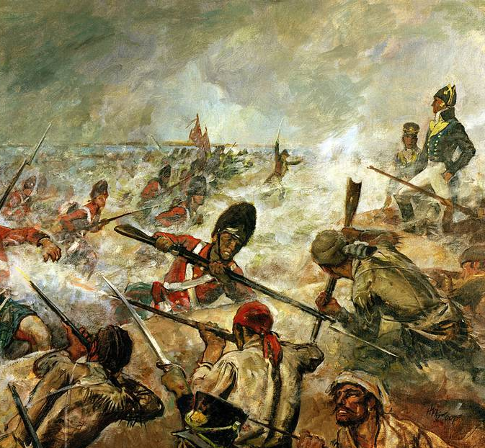
The Battle New Orleans (1815 CE)
The stunned British army lingered in Louisiana for the next several days, but its remaining officers knew that any chance of winning had slipped through their fingers.
After an abortive naval attack on nearby Fort St. Philip, the British boarded their ships and sailed back into the Gulf of Mexico.
Many Manilamen (Filipinos working as shrimp fishermen and smugglers in Louisiana) joined the U.S. Army commanded by General Andrew Jackson and fought against the British.
It was the first involvement of Filipinos in America’s war. Little is known about their role or about casualties they sustained.
Newspapers in the beleaguered city of Washington, D.C., labeled him the national savior.
The festivities only continued the following month as news of the Treaty of Ghent reached American shores.
The conflict is now considered to have concluded in a stalemate. Still, at the time, the victory at New Orleans had elevated national pride to such a level that many Americans chalked it up as a win.
Jackson, who would later ride his newfound celebrity to the White House

Slide 36
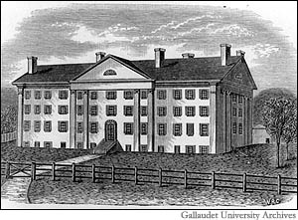
American School for the Deaf (1815 CE)
The first deaf school in the United States was short-lived: established in 1815 it closed in the fall of 1816.
During the winter of 1818–1819, the American School for the Deaf became the first primary and secondary education school to receive aid from the federal government when it was granted $300,000.
As a result of its pivotal role in American deaf history, it also hosts a museum containing numerous rare and old items.
While it is situated on a 54-acre campus, the ASD has a small enrollment — in its history, the ASD has graduated approximately 6000 graduates.
The impetus behind its founding was that Alice Cogswell, the daughter of a wealthy local surgeon, was deafened in childhood by fever.

Slide 37
American School for the Deaf (1815 CE)
Cogswell and nine other citizens decided that the known 84 deaf children in New England needed appropriate facilities.
However, competent teachers could not be found, so they sent an instructor in 1815 on a Europe tour, where deaf education was a much more developed art.
After being rebuffed by the Braidwoods, school leaders turned to the Parisian French schoolteachers of the famous school Deaf in Paris, where they successfully recruited Laurent Clerc.
On the strength of Clerc's reputation, the ASD was incorporated as the "Connecticut Asylum for the Education of Deaf and Dumb Persons," as it was initially known, in May 1816.
When it opened in 1817, seven students enrolled
The school's original name was: The Connecticut Asylum (at Hartford) for the Education and Instruction of Deaf and Dumb Persons.

Slide 38
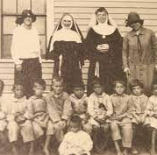
The Civilization Fund Act (1819 CE)
The Civilization Fund Act was an Act passed by the United States Congress on March 3, 1819.
The Act encouraged activities of benevolent societies in providing education for Native Americans and authorized an annuity to stimulate the "civilization process."
The Civilization Fund Act led to the formation of numerous Native American boarding schools towards the end of the 19th century.
The benevolent societies were a combination of Christian missions and the federal government.The Government allocated federal funds to schools designed to educate Native Americans in the ways of the white man.
The goal was to "civilize" Native Americans by getting rid of their traditions and customs and teaching them reading and writing in the missionary schools.
The passage of the Act helped define a class structure within Native American society. While traditional Native Americans opposed the schools, "progressive" ones accepted the schools.
Their education and command of the English language propelled them to leadership positions within tribes and ultimately led to policy shifts and treaties that ceded land to the United States government.
The Bureau of Indian Affairs was created in 1824 by the federal government and placed into the War Department.

Slide 39
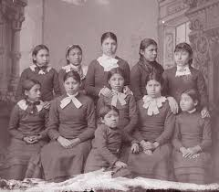
The Civilization Fund Act (1819 CE)
The Civilization Fund Act of 1819 aimed to infuse the country's indigenous people with "good moral character" and vocational skills.
The law tasked Christian missions and the federal Government with teaching young indigenous Americans subjects ranging from reading to math, eventually leading to a network of boarding schools designed to carry out this charge.
The Act was, in effect, an effort to stamp out America's original cultural identity and replace it with one that Europeans had, not long before, imported to the continent.
Over time, countless Native American children were taken from their families and homelands and placed in faraway boarding schools, a process that was often traumatic and degrading.
The Civilization Fund Act stressed that the boarding schools were only to enroll Native students whose families gave their consent.
Many others surrendered their kids to these institutions simply because they lacked a better alternative—perhaps they were so impoverished that the schools, where child labor and malnourishment were rampant, felt like an improvement.
It wasn't until the late 1970s that Congress outlawed the forced removal of Native children from their families.

Slide 40
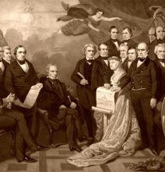
Missouri Compromise (1820 CE)
The Missouri Compromise of 1820 was an effort to maintain a balance of power between the slaveholding states and free states.
The slaveholding states feared that if they became outnumbered in Congressional representation, they would lack the ability to protect their interests in property and trade.
In 1819, the slaveholding territory of Missouri applied for admission to the Union. Northern states opposed it, feeling that Southern slaveholding states held too much power already.
Slavery had already been creeping into the Northwest Territory, even though the Northwest Ordinance of 1787 prohibited slavery.
Congressional debates on the issue raged for a year until the District of Maine, originally part of Massachusetts, sought statehood.
Henry Clay of Kentucky, the Speaker of the House, maintained that if Maine were to be admitted, Missouri should be. From this came the notion that states be admitted in pairs, one slave and one free.
Senator Jesse B. Thomas of Illinois proposed an amendment allowing slavery below the parallel 36 degrees, 30 minutes in the vast Louisiana Purchase territory, but prohibiting it above that line.
Officials chose that parallel because it ran approximately along the southern border of Missouri.

Slide 41
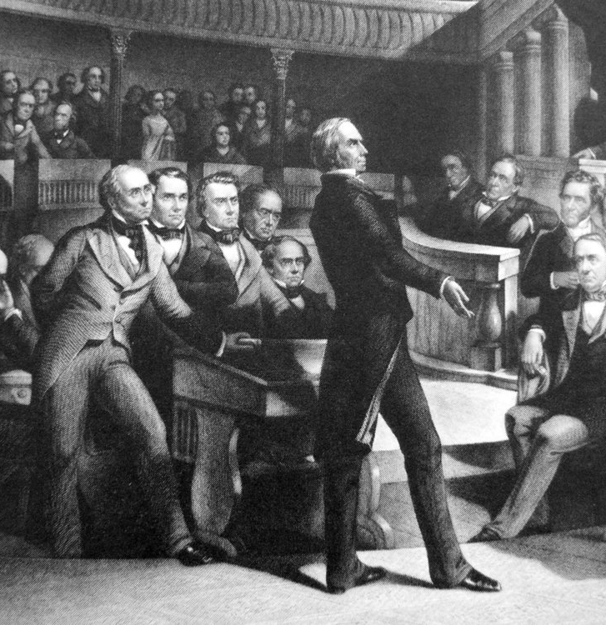
Missouri Compromise (1820 CE)
The Missouri Compromise, after much debate, passed the Senate on March 2, 1820, and the House on February 26, 1821.
It served as notice to the North that Southerners not only did not intend for slavery to end, they wanted to expand its presence.
For nearly 30 years, the compromise worked, with two states being admitted together, one slave, one free.
Then, in 1850, California was recognized as a stand-alone free state, upsetting the balance 16–15, in exchange for a guarantee Congress would place no restrictions on slavery on the territories of Utah or New Mexico and passage of the Fugitive Slave Act, which required citizens of all states to return any runaway slaves to their masters.
In 1857, the U.S. Supreme Court ruled Congress had no right to prohibit slavery in territories as part of the decision in the Dred Scott case.
The Kansas-Nebraska Act of 1854 repealed the 36-30 dividing line for slavery in the Louisiana Purchase area.

Slide 42
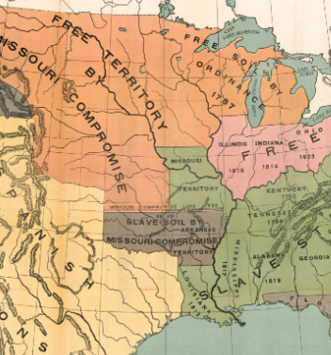
Missouri Compromise (1820 CE)
Southerners had been thrown on the defensive to justify their "peculiar institution," Northerners had fumed that "slave power" was trying to take up all the land.
The Missouri Compromise would prove to be only a temporary solution to the growing slavery crisis.
For 25 years, the situation regarding territorial settlement remained relatively calm.
But when the Mexican War in 1846-48 brought more land under the United States' control, the issue flared up again.
Once more, Henry Clay had to step in to hammer out a compromise—and once more, it would be only temporary, as more and more crises over slavery erupted.
In 1820 Thomas Jefferson wrote to a friend that the fight over slavery in Missouri "like a fire bell in the night, awakened me and filled me with terror."

Slide 43
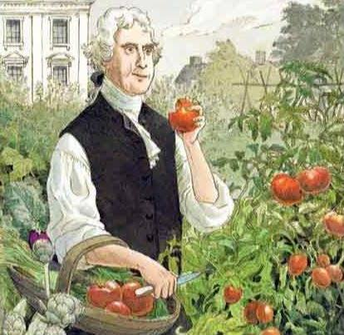
The Tomato (1820 CE)
To prove that a tomato is not poisonous, Colonel Robert Gibbon Johnson ate one in public in Salem, New Jersey.
Tomatoes became wildly popular in various European countries like Italy in the 1500s. Spaniards brought them to their colonized countries in Asia and the Caribbean.
John Gerard, a barber-surgeon, was the first to cultivate the tomato, and he believed that it contained tomatine, a toxic chemical. Gerard was correct, but the level of tomatine in the fruit was too low to be harmful.
Practically everyone in North America believed the rumor about the dangers of consuming tomatoes except Colonel Robert Gibbon Johnson.
On June 28, 1820, on the steps of the county courthouse in Salem City , Col. Johnson spoke to the crowd of 2,000 about the history of tomatoes.
He then picked one glistening red tomato and held it up for everyone to see. Col. Johnson took bite after bite until he finished one and picked up another.
There was even a doctor on standby just in case. But the only thing that died that day was the ridiculous rumor that tomatoes were poisonous.
It has been determined that is story is apocryphal

Slide 44
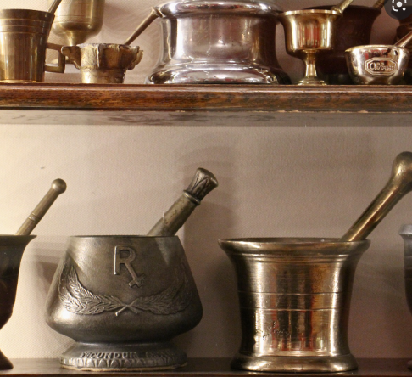
College of Pharmacy (1821 CE)
Like most urban centers in the early nineteenth-century trans-Atlantic world, Philadelphia routinely suffered through outbreaks of dysentery, yellow and scarlet fevers, cholera, and other infectious diseases.
So, in 1821, the College of Pharmacy and Science–now known as the University of the Sciences in Philadelphia–opened its doors.
The new institute reflected the growing sophistication of Philadelphia's medical college professors, who had warned of the "ignorance of Apothecaries unqualified for the exercise of their profession.“
It also reflected a professional rivalry between the physicians and area druggists.
Combining instruction in biology and chemistry with a progressive approach to treating illnesses, the College of Pharmacy advocated more rigorous standards and professional training for those licensed to dispense drugs, medicines, and other controlled substances.
The ever-evolving, science-based curriculum reflected the growing professionalization of apothecary and medical science in diagnosing and treating illness and disease.
As another sign of its continuing maturity, the College of Pharmacy became coeducational in 1876.

Slide 45
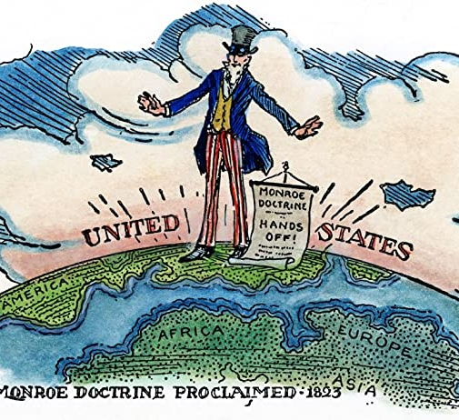
Monroe Doctrine (1823 CE)
By the early 1820s, many Latin American countries had won their independence from Spain or Portugal.
Both Britain and the United States worried that the powers of continental Europe would make future attempts to restore colonial regimes in the region.
Russia had also inspired concerns of imperialism, with Czar Alexander I claiming sovereignty over the territory in the Pacific Northwest and banning foreign ships from approaching that coast in 1821.
Though Monroe had initially supported the idea of a joint U.S.-British resolution against future colonization in Latin America, Secretary of State John Quincy Adams argued that joining forces with the British could limit future U.S. opportunities for expansion and that Britain might well have imperialist ambitions of its own.
He convinced Monroe to make a unilateral statement of U.S. policy that would set an independent course for the nation and claim a new role as protector of the Western Hemisphere.

Slide 46
Monroe Doctrine (1823 CE)
During the president’s customary message to Congress on December 2, 1823, Monroe expressed the basic tenets of what would later become known as the Monroe Doctrine.
According to Monroe’s message (drafted broadly by Adams), the Old World and the New World were fundamentally different and should be two separate spheres of influence.
The United States, for its part, would not interfere in the political affairs of Europe or with existing European colonies in the Western Hemisphere.
Any attempt by a European power to exert its influence in the Western Hemisphere would, from then on, be seen by the United States as a threat to its security.
In declaring separate spheres of influence and a policy of non-intervention in the foreign affairs of Europe, the Monroe Doctrine drew on past statements of American diplomatic ideals, including George Washington’s Farewell Address in 1796 and James Madison’s declaration of war with Britain in 1812.

Slide 47
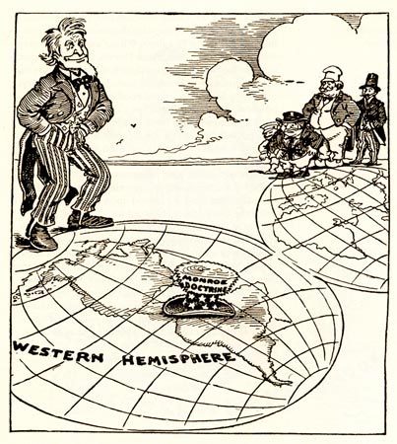
Monroe Doctrine (1823 CE)
Monroe’s bold policy statement was largely ignored outside U.S. borders.
In 1833, the United States did not invoke the Monroe Doctrine to oppose British occupation of the Falkland Islands; it also declined to act when Britain and France imposed a naval blockade against Argentina in 1845.
From 1870 onward, as the United States emerged as a significant world power, the Monroe Doctrine would be used to justify a long series of U.S. interventions in Latin America.
This was especially true after 1904 when President Theodore Roosevelt claimed the U.S. government’s right to intervene to stop European creditors threatening armed intervention to collect debts in Latin American countries.
“In the Western Hemisphere, the adherence of the United States to the Monroe Doctrine may force the United States, however reluctantly, in flagrant cases of such wrongdoing or impotence, to the exercise of an international police power.”
Known as the “Roosevelt Corollary” or the “Big Stick” policy, Roosevelt’s expansive interpretation was soon used to justify military interventions in Central America and the Caribbean.

Slide 48
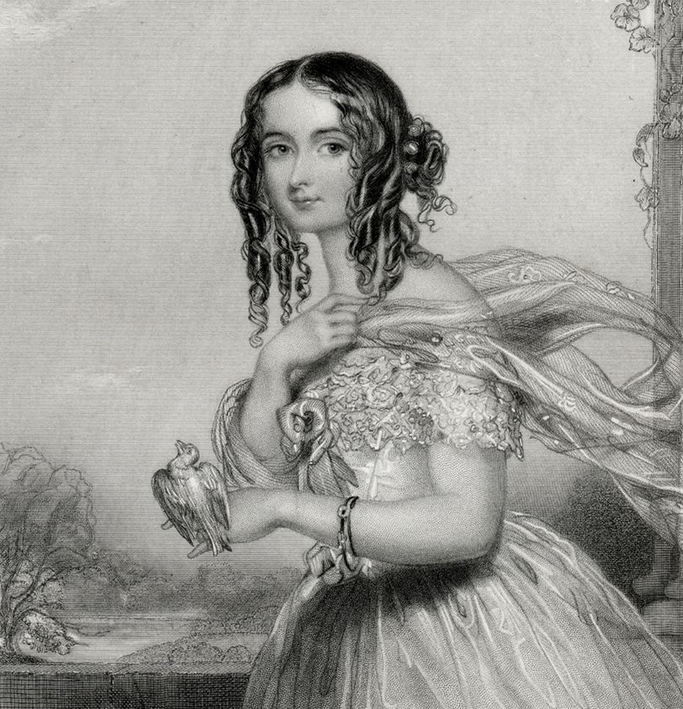
Fannie Hill (1821 CE)
A Massachusetts court outlaws the novel Fanny Hill by John Cleland and convicts publisher Peter Holmes for printing a "lewd and obscene" novel.
This was the first obscenity case in U.S. history.
The most famous pornographic novel in English literature is John Cleland's Memoirs of a Woman of Pleasure, published in 1748 and 1749.
It is the first-person narrative of a young woman's adventures as a prostitute after losing her virginity to a gentleman who claimed to be in love with her.
The novel describes scenes of lesbianism, flagellation, group sex, and male homosexuality, emphasizing the size and appearance of the male genitalia.
Some 70 years later, illustrations from later reprints of the book led to one of the earliest obscenity cases in the United States.

Slide 49
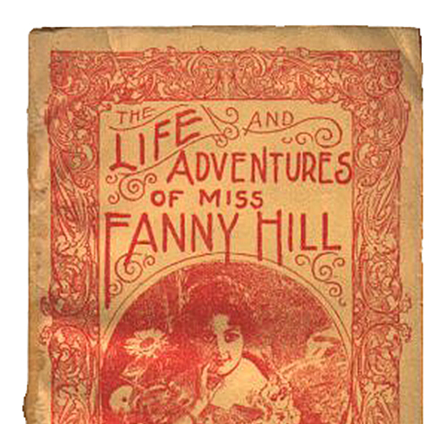
Fannie Hill (1821 CE)
Cleland reportedly sold the copyright to the book for 20 guineas to escape the debtor's prison.
Nevertheless, Ralph Griffiths's publisher made a significant profit to launch The Monthly Review, one of the first major literary works periodicals in England.
Although Memoirs was published anonymously and with a pseudonymous imprint, Cleland and Griffiths were prosecuted in Britain for obscenity in November 1749; they managed, however, to avoid punishment.
In 1750 Griffiths released an expurgated edition of the book, titled The Memoirs of Fanny Hill; the novel went through frequent illicit reprints (many illustrated) over the next two centuries.
In Commonwealth v. Holmes, the court upheld the conviction of the publisher of Memoirs of a Woman of Pleasure for publishing a "lewd and obscene print" contained in the book.

Slide 50
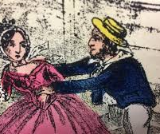
Fannie Hill (1821 CE)
According to the indictment, the publisher was guilty of being "a scandalous and evil-disposed person, and contriving, devising and intending the morals as well of youth as of other good citizens of said commonwealth to debauch and corrupt and to raise and create in their minds inordinate and lustful desires."
The concern for the morals of children frequently was stated explicitly in early nineteenth-century obscenity statutes.
The 1835 Massachusetts obscenity law is typical. It provided:
"If any person shall import, print, publish, sell or distribute any book, or any pamphlet, ballad, printed paper, or other thing, containing obscene language, or obscene prints, pictures, figures, or descriptions, manifestly tending to the corruption of the morals of youth, or shall introduce into any family, school, or place of education, or shall buy, procure, receive or have in his possession, any such book, pamphlet, ballad, printed paper or other thing, either for the purpose of sale, exhibition, loan, or circulation, or with intent to introduce the same into any family, school or place of education, he shall be punished by imprisonment in the county jail, not more than two years, and a fine not exceeding one thousand dollars."

Slide 51
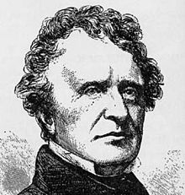
John Neal and the Gymnasium (1827 CE)
John Neal was an American writer, critic, editor, lecturer, and activist.
Neal advanced the development of American art, fought for women's rights, advocated the end of slavery and racial prejudice, and helped establish the American gymnastics movement.
John Neal is the first to use the phrase son-of-a-bitch in a work of fiction.
He was the first American to establish a public gymnasium in the US and championed athletics to regulate violent tendencies he struggled with throughout his life.
Neal became a proponent in the US of athletics he had practiced abroad, including gymnastics, boxing and fencing techniques he learned in Paris, London, and Baltimore.
He opened Maine's first gymnasium in 1827, making him the first American to establish a public gym in the US.
He offered lessons in boxing and fencing in his law office.
He published articles on German gymnastics in the American Journal of Education and urged Thomas Jefferson to include a gymnastics school at the University of Virginia.

Slide 52
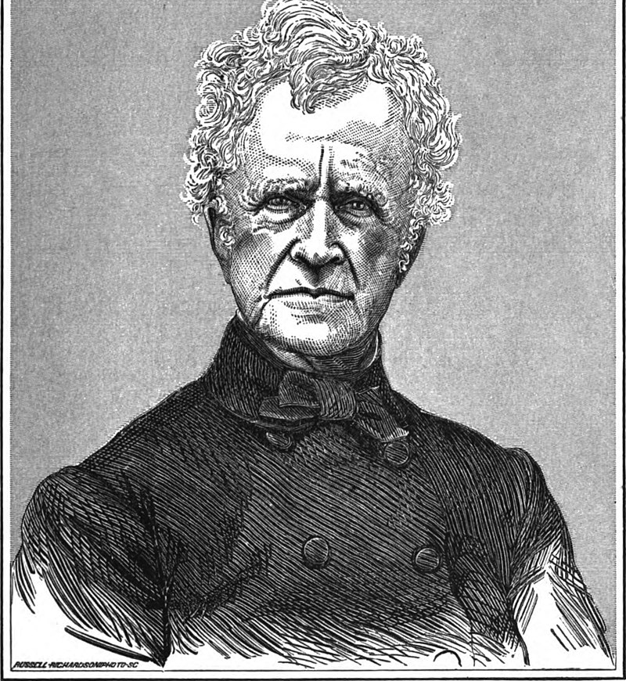
John Neal and the Gymnasium (1827 CE)
Neal's athletic pursuits modeled "a new sense of maleness" that favored "forbearance based on strength" and helped him regulate the violent tendencies he struggled with throughout his life.
Neal's body of literary work spans almost sixty years from the end of the War of 1812 to a decade following the Civil War.
His writing both reflects and challenges shifting American ways of life over those years.
He started his career as an American reading public, beginning to emerge, working immediately and consistently within the nation's developing "complex web of print culture.“
Throughout his adult life, especially in the 1830s, Neal was a prolific contributor to newspapers and magazines, writing essays on a wide variety of topics including but not limited to art criticism, literary criticism, phrenology, women's rights, early German gymnastics, and slavery.
His efforts to subvert the British academic elite's influence and develop rival American literature were credited mainly to his successors until more recent twenty-first-century scholarship shifted that credit to Neal.

Slide 53
John Neal and the Gymnasium (1823 CE)
His short stories are "his highest literary achievement" and are ranked with Nathaniel Hawthorne, Edgar Allan Poe, Herman Melville, and Rudyard Kipling.
John Neal is often considered an influential American literary figure with no masterpiece of his own.
Neal protested disfranchisement of free Black Americans by revealing how "free-born Americans, ... because of their color," not just in the slave states, "but in the states where slavery is regarded with horror ... are suffered even to vote, ... being either excluded by law ... or excluded, by fear".
He nevertheless believed in phrenological inferiority, explaining that "while we disregard color, we pay great attention to form, in our estimation of capacity. The negro head is very bad."
This led him to a proto-eugenicist argument for legalizing interracial marriage so that future generations of "the negroes of America would no longer be a separate, inferior class, without political power, without privilege, and without a share in the great commonwealth."

Slide 54
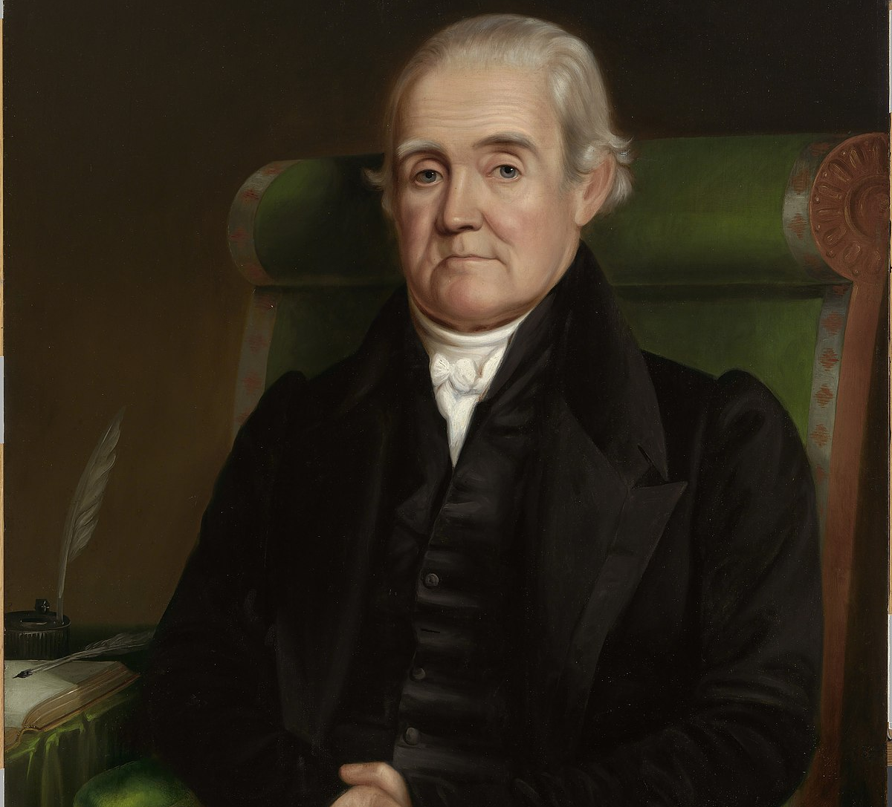
Noah Webster Jr. (1828 CE)
Noah Webster Jr. has been called the "Father of American Scholarship and Education.“
Webster's name has become synonymous with "dictionary" in the United States, especially the modern Merriam-Webster dictionary published in 1828 as An American Dictionary of the English Language.
Born in West Hartford, Connecticut, Webster graduated from Yale College in 1778.
He found some financial success by opening a private school and writing a series of educational books, including the "Blue-Backed Speller."
He believed that American nationalism was superior to Europe because American values were superior.
In 1793, Alexander Hamilton recruited Webster to move to New York City and become an editor for a Federalist Party newspaper.

Slide 55
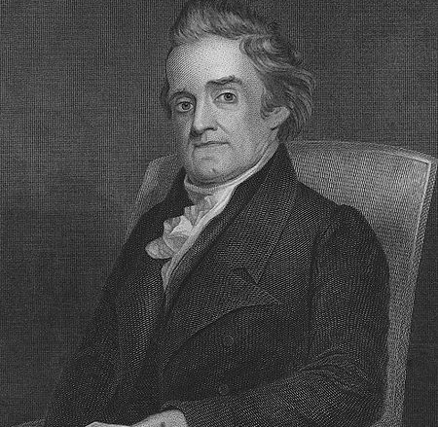
Noah Webster Jr. (1828 CE)
He returned to Connecticut in 1798 and served in the Connecticut House of Representatives.
In 1806, Webster published his first dictionary, A Compendious Dictionary of the English Language.
In total, it took twenty-eight years to complete.
To evaluate the etymology of words, Webster learned twenty-six languages, including Old English (Anglo-Saxon), Greek, Hebrew, and Latin.
His book contained seventy thousand words, of which twelve thousand had never appeared in a published dictionary before.
Webster believed that English spelling rules were unnecessarily complex as a spelling reformer.
Hence, his dictionary introduced American English spellings, replacing colour with color, substituting wagon for waggon, and printing center instead of centre. He also added American words, like skunk and squash, that did not appear in British dictionaries.

Slide 56
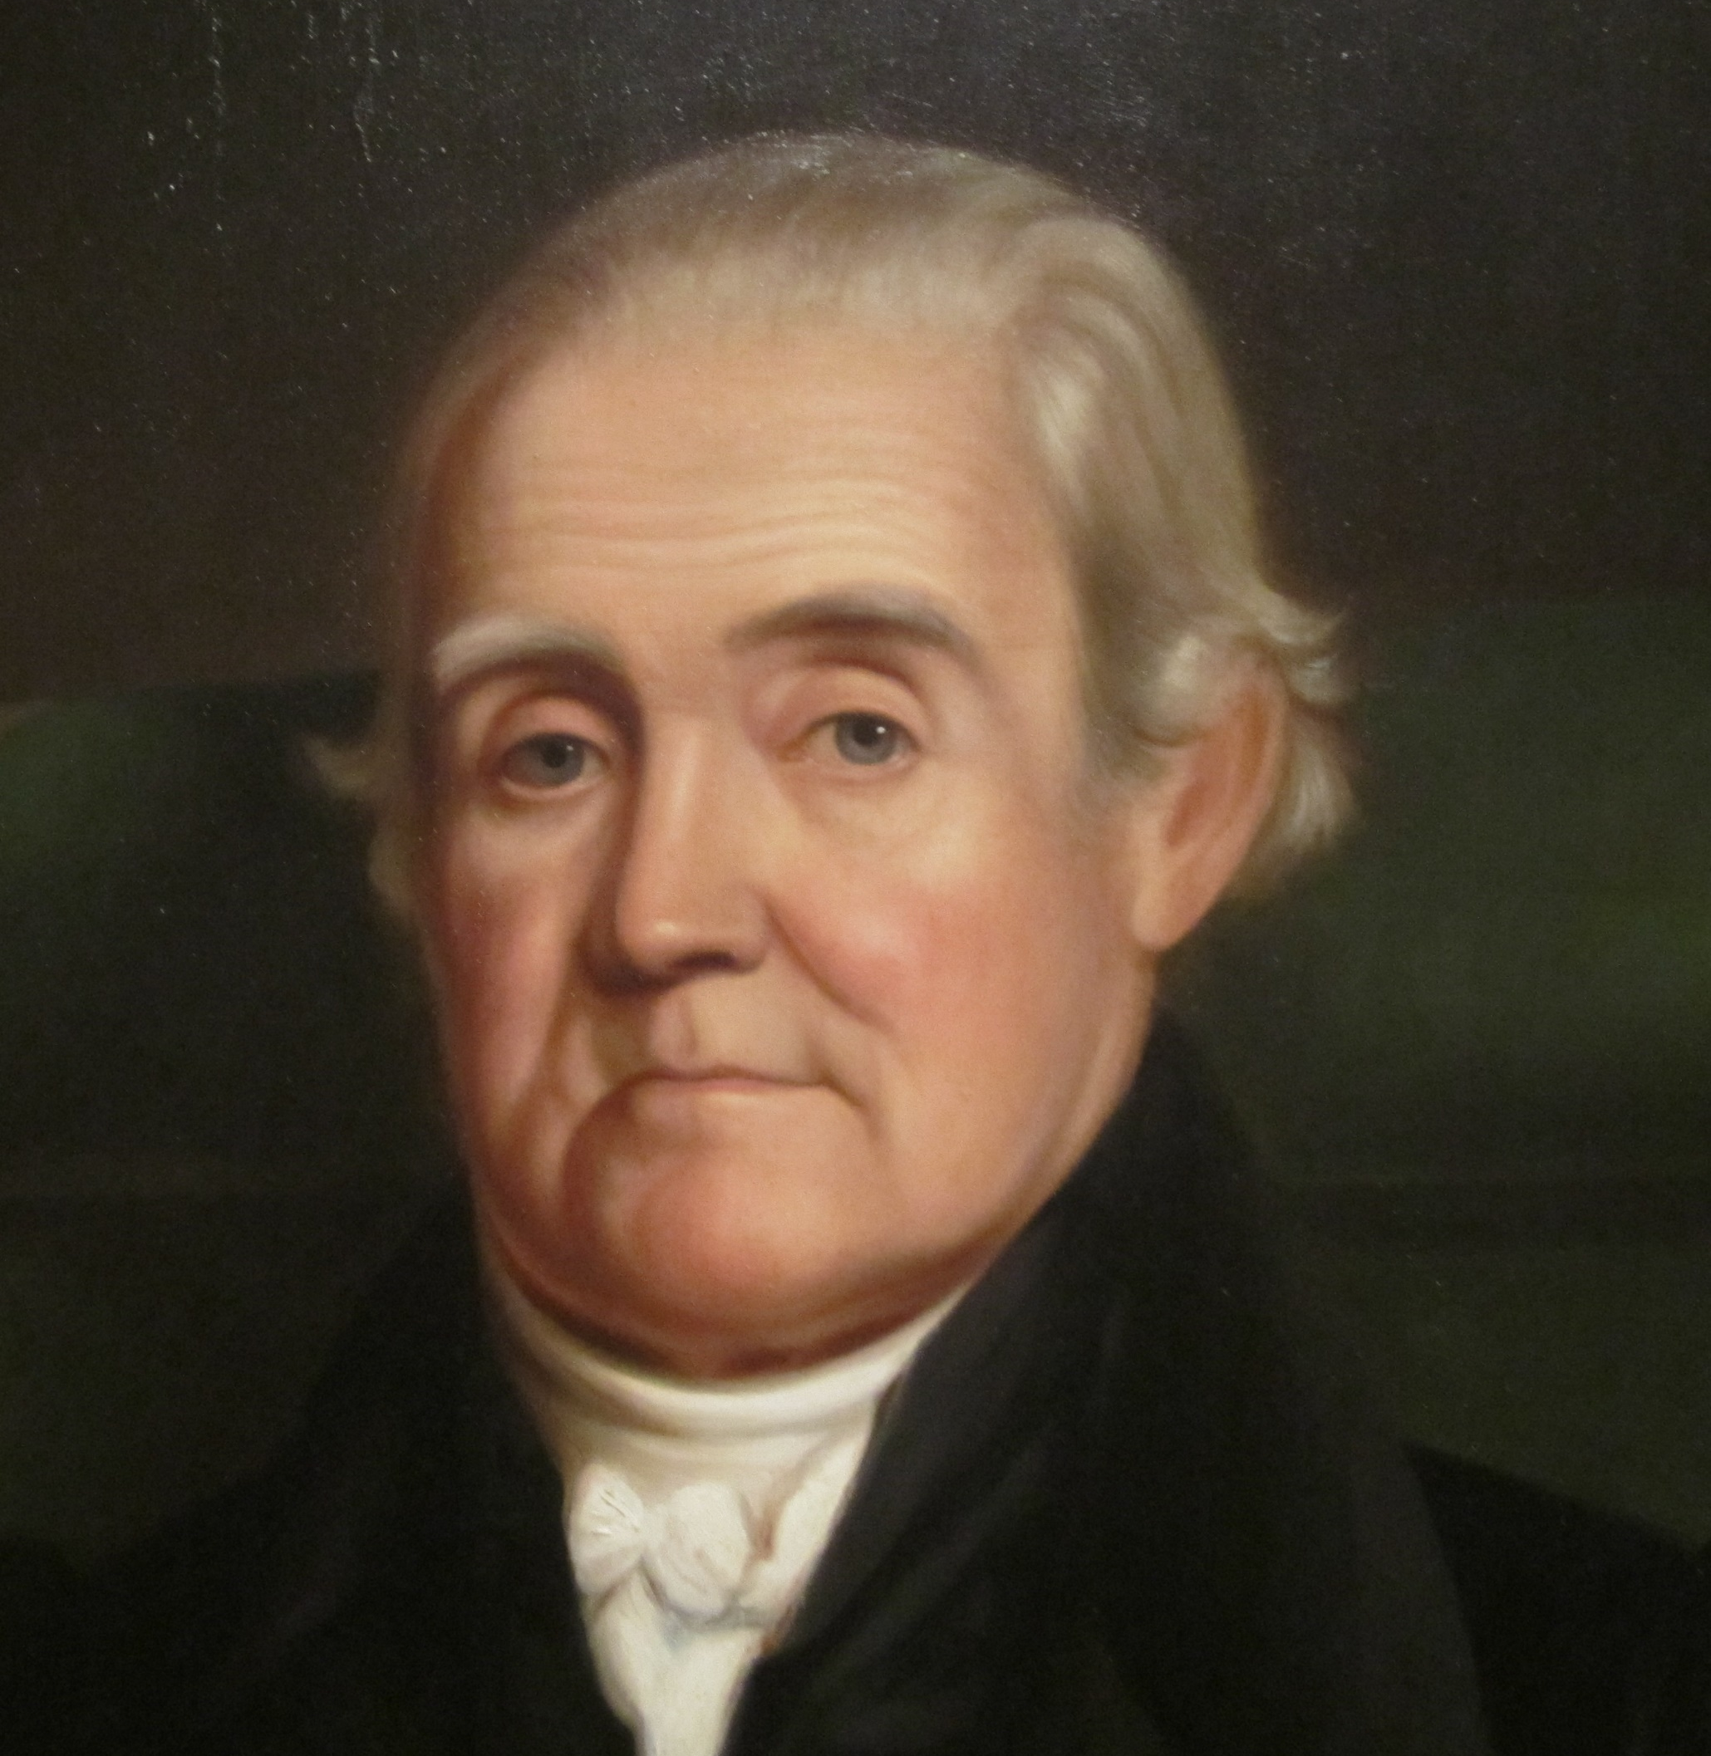
Noah Webster Jr. (1828 CE)
At the age of seventy, Webster published his dictionary in 1828, registering the copyright on April 14.
Webster did all this to standardize the American language.
He was also influential in establishing the Copyright Act of 1831, the first major statutory revision of U.S. copyright law.
When Noah Webster published the original Webster's American Dictionary of the English Language, He included several LGBT terms in his book.
Webster, however, focused on terms for gay sexual practices and ignored lesbian sexual practices: bugger, buggery, sodomy, and sodomite.
On May 28, 1843, a few days after he had completed revising an appendix to the second edition, Noah Webster died.

