Slide 1
Module Eight: The 19th Century
(1839 CE - 1850 CE)

Slide 2
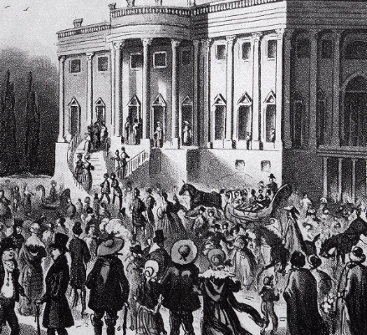
Jackson's Inaugural Party (1828 CE)
In 1828: Andrew Jackson's inaugural party nearly wrecks the White House.
President John Quincy Adams boycotted his successor's 1829 inauguration
The Adams supporters claimed that Jackson's father was biracial and his mother was a prostitute for good measure.
Jackson's supporters fired back with an allegation that, as ambassador to Russia, Adams had doubled as a pimp. They claimed he had American girls render sexual services to the czar.
Jackson and Adams represented different readings of an American president's specifications.
Jackson was an outsider, a precursor of presidents, who seemed to come out of political nowhere.
Adams was favored by the East Coast elite. Jackson's supporters were from the West and more rural areas.

Slide 3
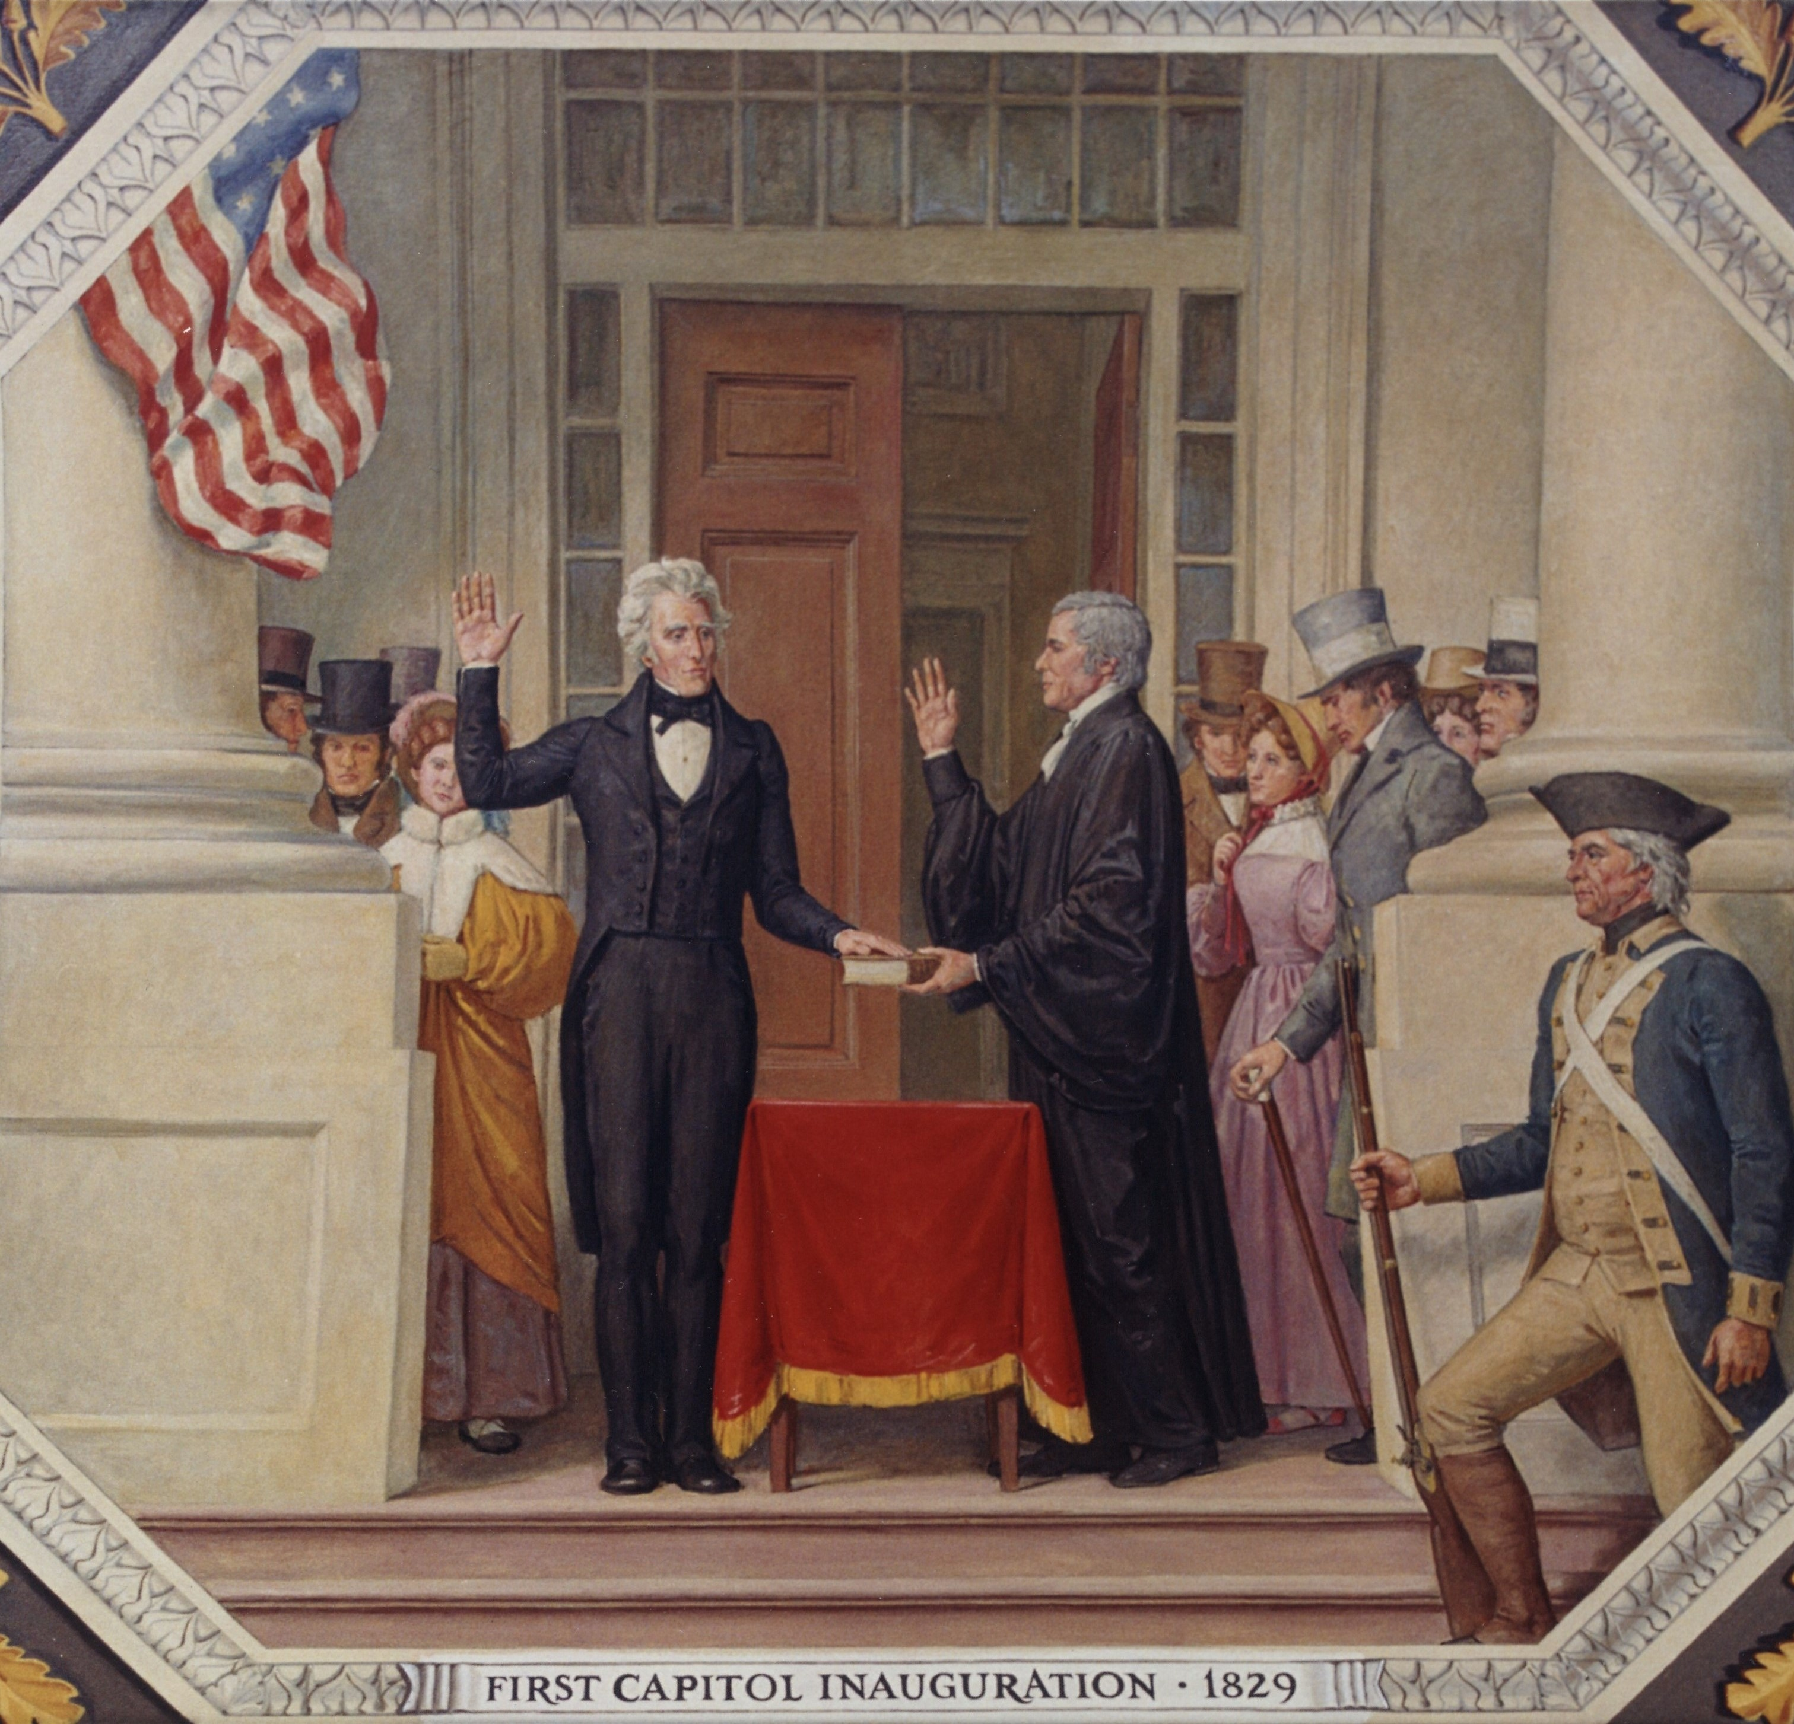
Jackson's Inaugural Party (1828 CE)
Jackson's nickname was "Old Hickory,” Every man carried a hickory stick. Horses were decorated in hickory bark. Women wore necklaces of hickory nuts.
In the U.S., voting initially had been limited to property owners. But that requirement was being dropped in states such as New York, doubling the number of voters in the years between the two Adams vs. Jackson contests.
Jackson's inauguration parade lacked the customary military detachment.
Adams, who left Washington a few days earlier, had refused to allow soldiers to participate. So Jackson's supporters improvised a militia.
He intended to skip the evening's inaugural balls and keep the other ceremonies to a minimum.
He delivered a short speech at the Capitol and was sworn in by Chief Justice John Marshall.

Slide 4
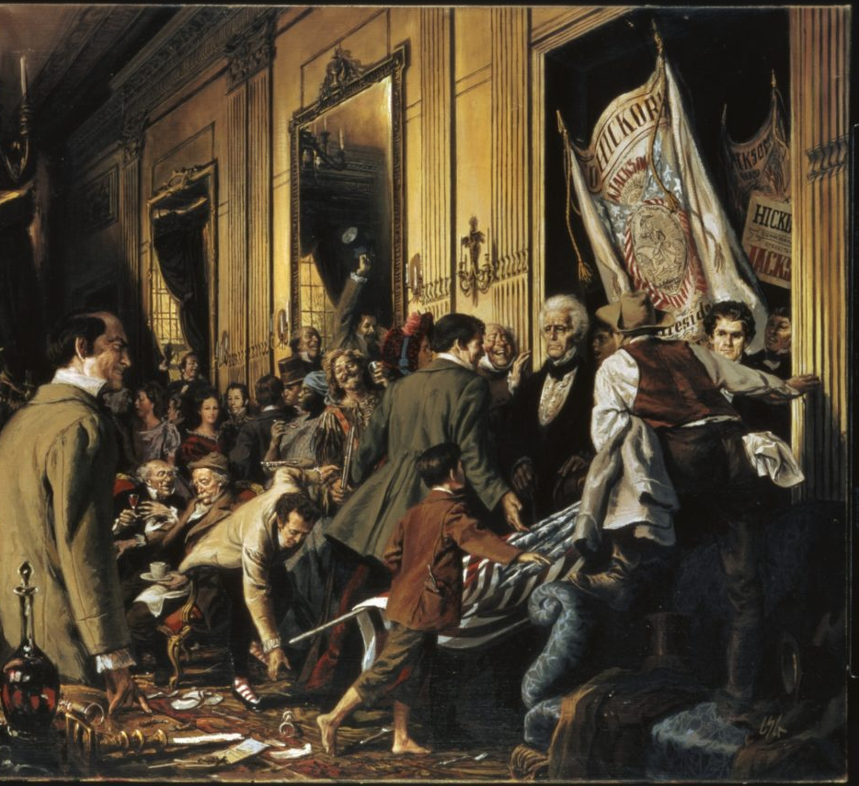
Jackson's Inaugural Party (1828 CE)
Thousands and thousands of people, without distinction of rank, collected in an immense mass around the Capitol
Three hours later, they resumed their journey to the White House. Jackson was already gone.
Fearing he'd be crushed, friends had spirited Jackson out a window and taken him to a hotel, where he remained until the party ended.
White House staff pushed the alcoholic beverages being served out a window, and the snickered guests followed.
Accounts of the damage done to the White House ranged from a few broken glasses to Oriental rugs ruined by guests who didn't know, or didn't care, to remove their muddy boots.
Jackson's opponents, and their present-day counterparts, say the moral of the story is we need to be vigilant against the possibility of mob rule.

Slide 5
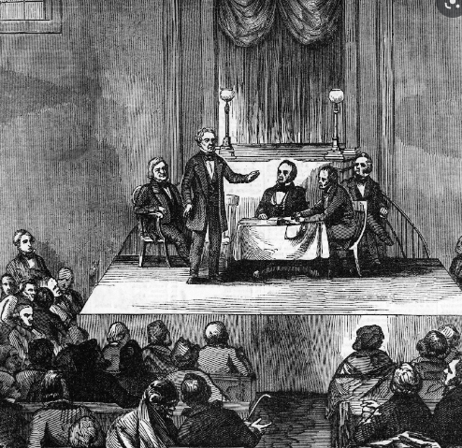
Liberia (1822 CE)
The first group of freed American slaves settles a black colony known as the Republic of Liberia when they arrived on African soil at Providence Island on January 7, 1822.
The biggest question facing the United States leaders in the early 19th century was what to do about slavery.
Many white people at this time thought the answer was to send free black Americans to Africa through "colonization."
Starting in 1816, the American Colonization Society sought to create a colony in Africa for this purpose.
This was 50 years before the U.S. would abolish slavery.
Over the next 40 years, upwards of 12,000 freeborn and formerly enslaved black Americans immigrated to Liberia.
The American Colonization Society was distinct from black-led "back to Africa" movements that argued black Americans could only escape slavery and discrimination by establishing their homeland.
Though some free black Americans may have supported the society's mission, there were also plenty who criticized it.
Once enslaved family, built this country; they had just as much right to be here and be a citizen.

Slide 6
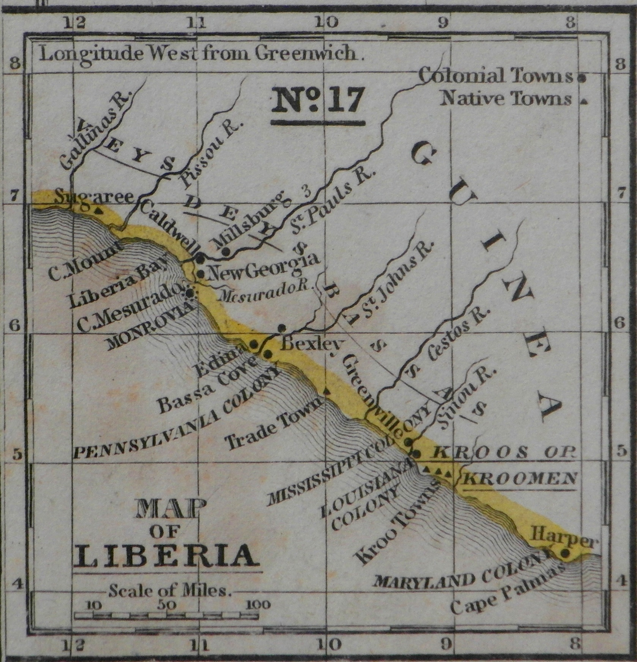
Liberia (1822 CE)
This was a slaveholder scheme to rid the nation of free blacks to make slavery more secure.
The society was made up of white men from the north and south, including slave owners who felt that free black people undermined the institution of slavery and should be sent away.
As the abolitionist movement grew in the early 1830s, abolitionists' criticism of society began to erode its support.
Unlike the white people in the American Colonization Society, who believed that slavery should gradually end, abolitionists called for an immediate end to slavery.
In 1854, future president Abraham Lincoln gave a speech that mentioned colonization as an appealing solution to the moral evils of slavery—but noted its logistical and ethical challenges:
"If all earthly power were given me, I should not know what to do as to the existing insti­tution. My first impulse would be to free all the slaves, send them to Liberia,–to their own native land. But a moment's reflection would convince me that whatever of high hope, (as I think there is) there may be in this, its sudden execution is impossible in the long run. If they were all landed there in a day, they would all perish in the next ten days; and there are not surplus shipping and surplus money enough in the world to carry them there in many times ten days."

Slide 7
Liberia (1822 CE)
Among people who already believed slavery should end at some point, abolitionists convince most people, particularly in the northeast, that the colonization movement is anti-black.
By the end of the next decade, The American Colonization Society began to support immediate abolition while still promoting its colony in Africa as a place for free black Americans to relocate.
This caused the society to lose support among southern slave owners who were committed to preserving slavery.
In its Declaration of Independence, Liberia accused the U.S. of injustices that made separation necessary and urged other countries to recognize its statehood.
Still, the United States did not recognize Liberia as an independent nation until 1862, during the American Civil War.

Slide 8
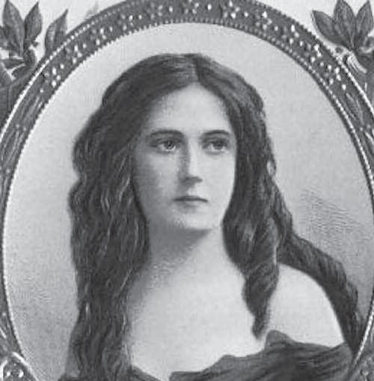
The Petticoat Affair (1829 CE)
The Petticoat affair was a U.S. scandal involving members of President Andrew Jackson's Cabinet and their wives.
Led by Floride Calhoun, wife of Vice President John C. Calhoun, these women (the "petticoats") socially ostracized John Eaton, the Secretary of War, and his wife Peggy Eaton over disapproval of the circumstances surrounding their marriage.
The affair shook up the Jackson administration and led to the resignation of all but one cabinet member.
It facilitated Martin Van Buren's rise to the presidency.
Peggy Eaton was well-educated; she studied French and was known for her ability to play the piano.
Her reputation was already under scrutiny as a young girl because she worked in a bar frequented by men and casually bantered with the boardinghouse clientele.

Slide 9
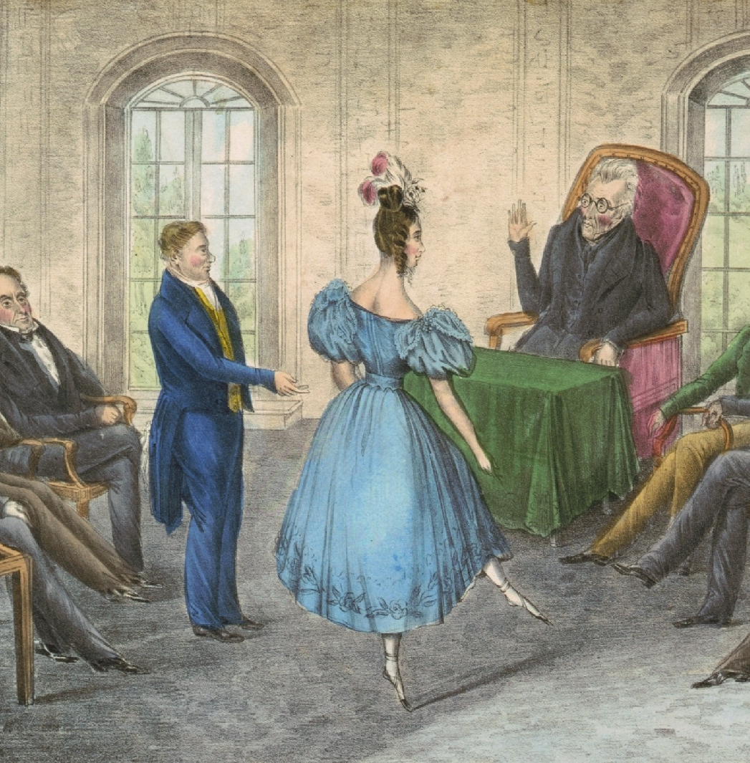
The Petticoat Affair (1829 CE)
With the encouragement of President Jackson John Eaton married on January 1, 1829, shortly after her husband’s first death.
However, according to custom, it would have been proper for them to wait until the end of a longer mourning period.
Floride Calhoun, the wife of Vice President John C. Calhoun and therefore Second Lady of the United States, led the wives of other Washington political figures, most notably Jackson's cabinet members, in an "anti-Peggy" coalition which shunned the Eatons in public, refused to pay courtesy calls on the Eatons at their home or receive them as visitors, and denied them invitations to parties and other social events.
Jackson was sympathetic to the Eatons because his late wife Rachel had been the subject of innuendo when questions arose during Jackson's campaign for President as to whether Rachel had legally ended her first marriage before she married Jackson.
Jackson appointed Eaton as his Secretary of War, and Eaton's entry into a high-profile cabinet post helped intensify the opposition of Floride Calhoun's group.
John C. Calhoun was becoming the focal point of opposition to Jackson; Calhoun's supporters opposed a second term for Jackson because they wanted to see Calhoun elected President.
Because Calhoun was the most visible opponent of the Jackson administration, Jackson felt that Calhoun and other anti-Jackson officials were fanning the flames of the Peggy Eaton controversy to gain political leverage.

Slide 10
The Petticoat Affair (1829 CE)
Eaton took his revenge on Calhoun. In 1830, reports had emerged accurately stating that Calhoun, while Secretary of War, had favored reprimanding Jackson for his 1818 invasion of Florida. These infuriated Jackson.
The dispute was finally resolved when Van Buren offered to resign, allowing Jackson to reorganize his Cabinet by asking for the resignations of the anti-Eaton cabinet members.
Postmaster General William T. Barry was the lone cabinet member to stay.
The episode influenced the emergence of feminism.
The Cabinet wives insisted that the interests and honor of all women were at stake.
They believed a responsible woman should never accord a man sexual favors without the assurance of marriage.
A woman who broke that code was dishonorable and unacceptable.

Slide 11
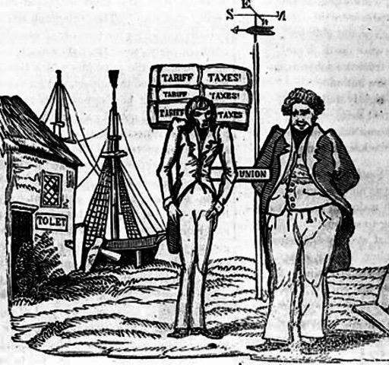
The Tariff of Abominations (1828 CE)
The Tariff of Abominations, was a protective tariff passed in the early 19th century to support growing domestic industries by raising the costs of imported goods.
This view came to be known as protectionism.
Many people in Southern states, especially South Carolina, opposed the tariff because they felt it hurt their state financially.
Instead, they supported the free trade of goods and threatened to nullify the Tariff of 1828 in a significant challenge to national authority.
The controversy over the Tariff of Abominations dragged on until 1833 and nearly sparked the armed conflict, although the debate between protectionists and free-traders never really ended.
Congress began using protective tariffs after the War of 1812.
Not only did Southerners end up paying more for imported goods, but they also often found themselves blocked from foreign markets or stuck with retaliatory tariffs on cotton and other raw agricultural products.
Because 1828 was an election year, a considerable amount of political deception was involved in the debate over the final bill.
Free trade Southerners ended up supporting much higher tariffs rates, ranging from 30-60% on over 90% of all imports, in the belief that the defeat of the bill would hurt incumbent president John Quincy Adams.
The plan backfired when the House of Representatives passed the bill on May 11, 1828.

Slide 12
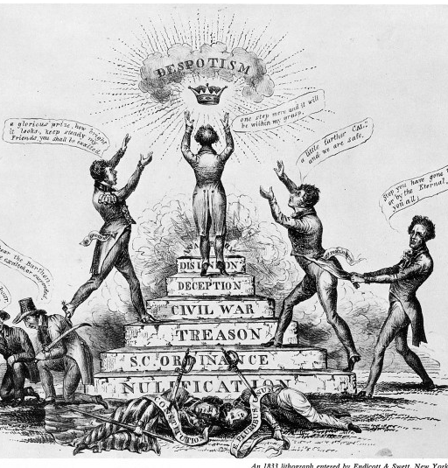
The Tariff of Abominations (1828 CE)
South Carolina’s congressional delegation met shortly after the bill was signed to debate their next steps, which included talk of seceding from the Union.
Vice President John C. Calhoun would soon join the ticket of Adams’ opponent, Andrew Jackson, and had some reason to believe Jackson might reduce or eliminate the tariff.
Calhoun anonymously wrote and published the “Calhoun’s Exposition.”
Calhoun’s main argument was that the tariff bill, which favored manufacturers in the North while hurting Southern agriculturalists, was unconstitutional and that states retained the sovereign right to reject or nullify unjust federal laws.
In December 1828, the South Carolina legislature ordered 5,000 copies of “Calhoun’s Exposition” be printed and distributed.
Despite Calhoun’s hopes, Andrew Jackson seemed reluctant to deal with the tariff issue when he took office.

Slide 13
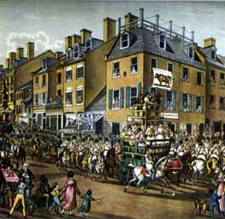
The Tariff of Abominations (1828 CE)
Jackson was firm that he would “rather die in the last ditch” than see the Union ripped apart.
The division came into full view at a Jefferson Day Dinner in the spring of 1830 during the traditional toasts.
Tensions between South Carolina and the federal authorities continued to rise for the next two years, and a war started to look like a real possibility.
To defuse the situation, Congress took up the tariff issue again in 1832, passing a new bill that marginally lowered the rates set by the Tariff of Abominations.
South Carolina found the changes insufficient and formally adopted an Ordinance of Nullification on November 24, 1832, declaring the Tariffs of 1828 and 1832 null and void as of February 1, 1833.
The ideological divide would continue to grow for the next thirty years, contributing to the secession of Southern states and the start of the American Civil War.

Slide 14
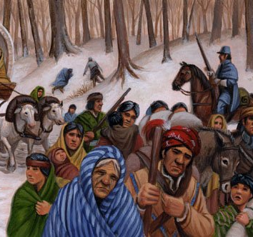
Indian Removal Act (1830 CE)
Early in the 19th century, while the rapidly growing United States expanded into the lower South, white settlers faced what they considered an obstacle.
This area was home to the Cherokee, Creek, Choctaw, Chickasaw, and Seminole nations.
These Indian nations, in the view of the settlers and many other white Americans, were standing in the way of progress.
Andrew Jackson was a forceful proponent of Indian removal.
From 1814 to 1824, Jackson was instrumental in negotiating nine out of eleven treaties that divested the southern tribes of their eastern lands in exchange for lands in the west.
The tribes agreed to the treaties for strategic reasons. They wanted to appease the government in the hopes of retaining some of their lands, and they tried to protect themselves from white harassment.
However, this was a period of voluntary Indian migration, and only a small number of Creeks, Cherokee, and Choctaws moved to the new lands.

Slide 15
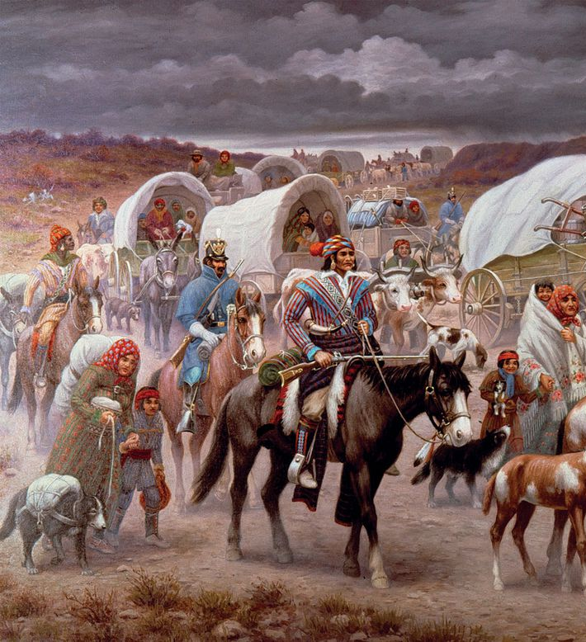
Indian Removal Act (1830 CE)
Some Indian nations refused to leave their land -- the Creeks and the Seminoles even waged war to protect their territory.
The First Seminole War lasted from 1817 to 1818. The Seminoles were aided by fugitive slaves who had found protection among them and lived with them for years.
The presence of the fugitives enraged white planters and fueled their desire to defeat the Seminoles.
The Cherokee used legal means in their attempt to safeguard their rights. They sought protection from land-hungry white settlers, who continually harassed them by stealing their livestock, burning their towns, and squatting on their land.
In 1827 the Cherokee adopted a written constitution declaring themselves to be a sovereign nation.
They based this on United States policy; in former treaties, Indian nations had been sovereign to be legally capable of ceding their lands.
Now the Cherokee hoped to use this status to their advantage. However, the state of Georgia did not recognize their sovereign status but saw them as tenants living on state land.

Slide 16
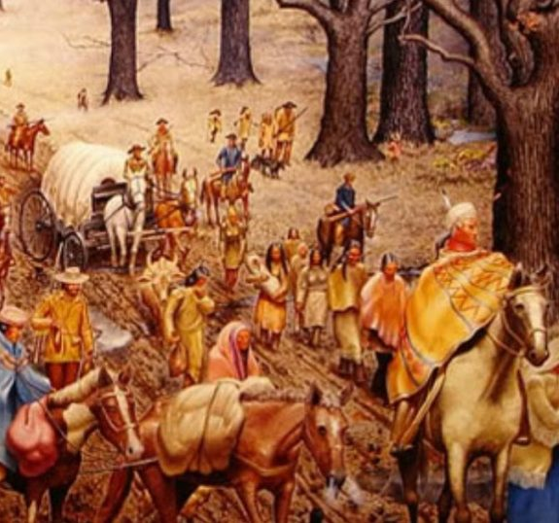
Indian Removal Act (1830 CE)
In 1830, just a year after taking office, Jackson pushed a new piece of legislation called the "Indian Removal Act" through both houses of Congress.
It gave the president power to negotiate removal treaties with Indian tribes living east of the Mississippi.
Under these treaties, the Indians were to give up their lands east of the Mississippi in exchange for lands to the west.
Those wishing to remain in the east would become citizens of their home state.
But the southeastern nations resisted, and Jackson forced them to leave.
Jackson's attitude toward Native Americans was paternalistic and patronizing -- he described them as children in need of guidance.
The Choctaws were the first to sign a removal treaty, which they did in September of 1830.

Slide 17
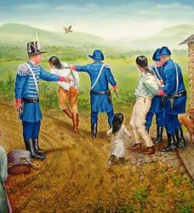
Indian Removal Act (1830 CE)
The United States coerced a small group of Seminoles into signing a removal treaty in 1833, but most of the tribe declared the treaty illegitimate and refused to leave. The resulting struggle was the Second Seminole War, which lasted from 1835 to 1842.
By 1838 only 2,000 had migrated; 16,000 remained on their land.
The U.S. government sent in 7,000 troops, who forced the Cherokees into stockades at bayonet point.
They were not allowed time to gather their belongings, and as they left, whites looted their homes.
Then began the march known as the Trail of Tears, in which 4,000 Cherokee people died of cold, hunger, and disease on their way to the western lands.
By 1837, the Jackson administration had removed 46,000 Native American people from their land east of the Mississippi and had secured treaties that led to removing a slightly larger number.
Most of the five southeastern nations had been relocated west, opening 25 million acres of land to white settlement and slavery.

Slide 18
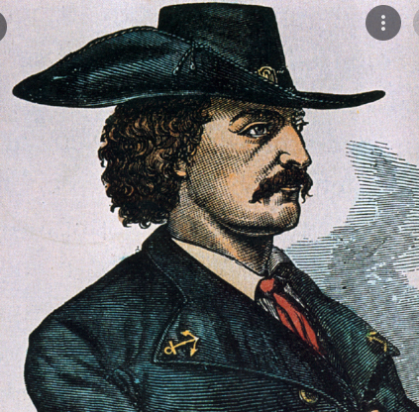
Piracy Part 3
In the early 19th century, piracy along the East and Gulf Coasts of North America and the Caribbean increased again.
Jean Lafitte was just one of the hundreds of pirates operating in American and Caribbean waters between 1820 and 1835.
By 1825, The U.S. Military had essentially eradicated piracy in the Gulf of Mexico.
Rumors abounded that he had changed his name after leaving Galveston and disappeared. Shortly after leaving Galveston, he was killed by his men, or that he had rescued Napoleon and that both had died in Louisiana.
Lafitte is rumored to have buried treasure at many locations, including Galveston and sites along with coastal Louisiana, such as Contraband Bayou in Lake Charles.
In 1909, a man was given a six-year prison sentence for fraud after swindling thousands of dollars from people by claiming that he knew where the Lafitte treasure was buried and taking their money for the promise to find it.

Slide 19
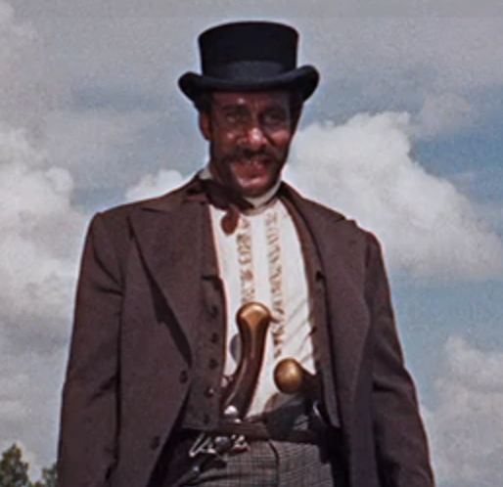
Piracy Part 3
In late 18th-mid-19th century America, River piracy was primarily concentrated along the Ohio River and Mississippi River valleys.
In 1803, the U.S. Army dragoons from the frontier army post upriver at Fort Kaskaskia, on the Illinois side opposite St. Louis, raided and drove out the river pirates.
In 1809, the last significant river pirate activity took place on the Upper Mississippi River, and river piracy in this area abruptly ended when a group of flatboat men raided the island, wiping out the river pirates.
From 1790–1834, Cave-In-Rock was the principal outlaw lair and headquarters of river pirate activity in the Ohio River region.
Samuel Mason led a gang of river pirates on the Ohio River.
According to Spanish colonial court records, Spanish government officials arrested Samuel Mason and his men, early in 1803, in southeastern Missouri.
Mason and his gang were taken to the Spanish Upper Louisiana Territory, along the Mississippi River, where Spanish Officials held a three-day hearing to determine whether Mason was genuinely involved in river piracy.

Slide 20
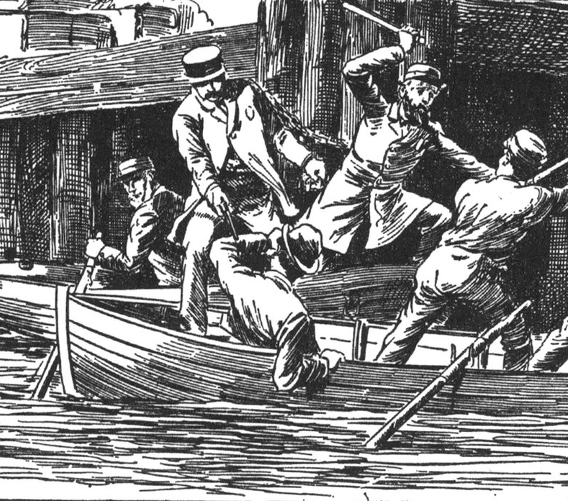
Piracy Part 3
Although he claimed he was simply a farmer, the presence of $7,000 in currency and twenty human scalps found in his baggage was the damning evidence that convinced the Spanish he indeed was a river pirate.
Mason was taken to New Orleans, where the Spanish colonial governor ordered them handed over to the American authorities in the Mississippi Territory, as all crimes they had been convicted of appeared to have taken place in American territory or against American riverboats
While being transported up the Mississippi River, Samuel Mason and his gang overpowered their guards and escaped, with Mason being shot in the head during the escape.
Whether they killed Mason or died from his wound suffered in the escape attempt has never been established.
River piracy continued on the lower Mississippi River from the early 1800s to the mid-1830s, declining due to direct military action and local law enforcement and regulator-vigilante groups that uprooted and swept out pockets of outlaw resistance.

Slide 21
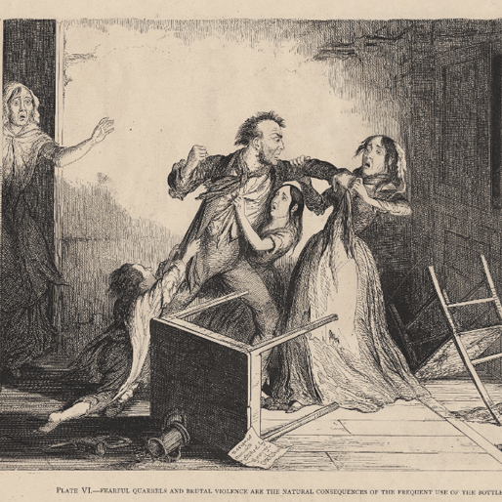
Temperance Movement Begins
As early as 1737, Native American temperance activists began to campaign against alcohol and for legislation to restrict the sale and distribution of alcoholic drinks in indigenous communities.
In the early 19th-century United States, alcohol was still regarded as a necessary part of the American diet for practical and social reasons.
Settlers often polluted water supplies, milk was not always available, and coffee and tea were expensive.
Social constructs made it impolite for people (particularly men) to refuse alcohol.
In 1810, Calvinist ministers met within a seminary in Massachusetts to write articles about abstinence from alcohol to preach to their congregations.
Small temperance societies appeared in the 1810s but had little impact outside their immediate regions, and they disbanded soon after.
The temperance movement in the United States began at a national level in the 1820s, popularized by evangelical temperance reformers and among the middle classes.
There was a concentration on advice against hard spirits rather than abstinence from all alcohol and moral reform rather than legal measures against alcohol.

Slide 22
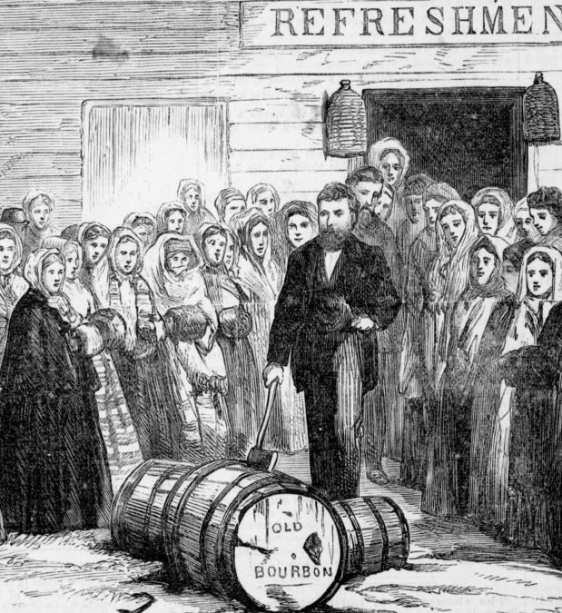
Temperance Movement Begins
By the 1830s, most temperance organizations became convinced that the only way to prevent alcohol abuse was to avoid alcohol consumption; that is, to impose prohibition.
Abraham Lincoln, who would later become President, held a liquor license in 1833 and operated several taverns.
In 1831, state temperance societies in every state except Alabama, Illinois, Maine, and Missouri.
In July 1832, Congress passed a law that banned alcohol in the Indian country and Temperance societies had been established in all but three states the same year.
The American Temperance Union published the Journal of the American Temperance Union for adults and Youth's Temperance Advocate for young people.
It published a variety of books, reports, pamphlets, and other materials promoting the temperance movement.

Slide 23
The Trail of Tears (1831 CE)
In Georgia on February 12, 1825, the Creek Indian tribe gives up their last lands to the United States government, leading to their move west.
As a military leader and as President, Jackson pursued a policy of removing Indian Tribes from their ancestral lands.
This relocation would make room for settlers and often for speculators who made enormous profits from purchasing and selling land.
While Jackson and other politicians put a favorable spin on Indian removal in their speeches, the removals were, in fact, often brutal.
Sequoyah, the child of a Native American woman and a white settler, came up with the first Cherokee alphabet in the early 1800s.
By 1821 the Cherokee Nation had officially recognized this form of writing, and thousands of Cherokee became literate.

Slide 24
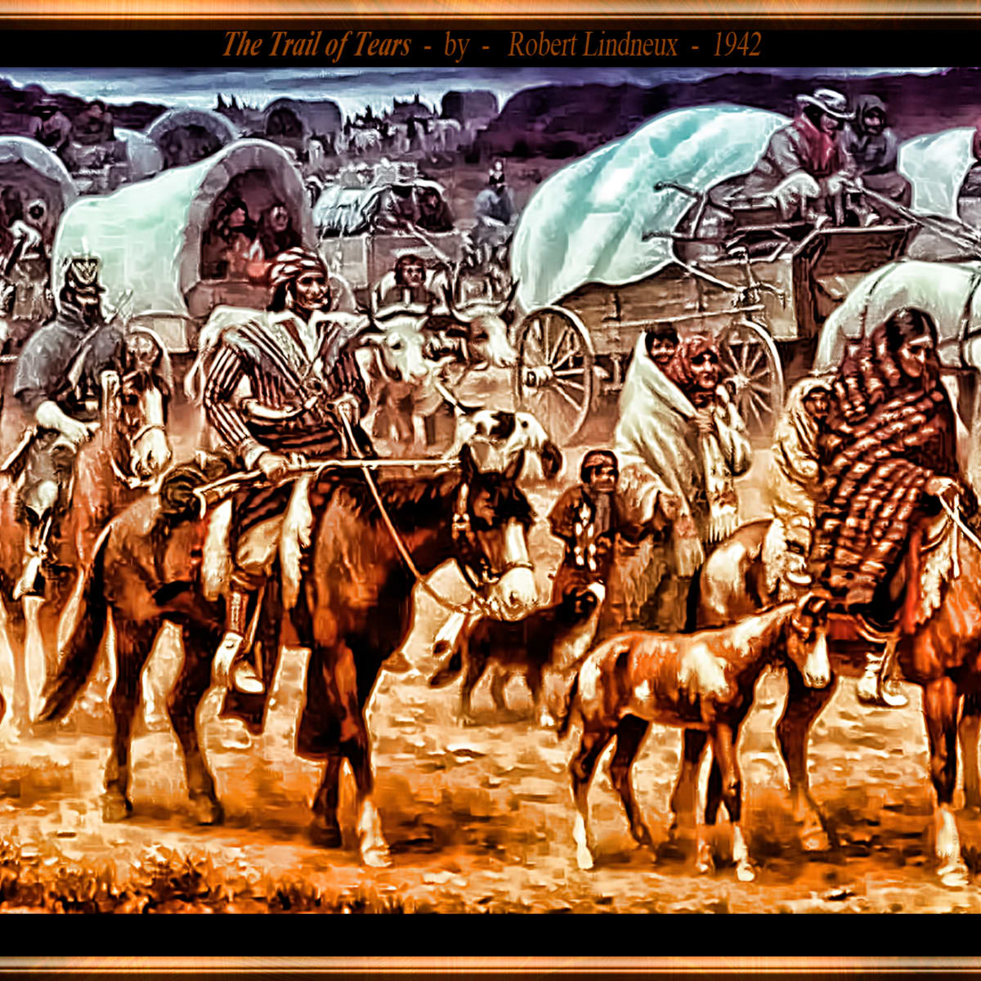
The Trail of Tears 1831 CE)
The Cherokees of Georgia used legal action to resist.
When the government of Georgia refused to recognize their autonomy and threatened to seize their lands, the Cherokees took their case to the US Supreme Court and won a favorable decision.
John Marshall's opinion for the Court majority in Cherokee Nation v. Georgia was essential that Georgia had no jurisdiction over the Cherokees and no claim to their lands.
But Georgia officials ignored the decision, and President Jackson refused to enforce it. Jackson was furious and personally affronted by the Marshall ruling, stating, "Mr. Marshall has made his decision. Now let him enforce it!"
Finally, federal troops came to Georgia to remove the tribes forcibly.
As early as 1831, the army began to push the Choctaws off their lands to march to Oklahoma.
In 1835, some Cherokee leaders agreed to accept western land and payment in exchange for relocation. .
In 1836, the federal government drove the Creeks from their land for the last time: 3,500 of the 15,000 Creeks who set out for Oklahoma did not survive the trip.
In 1835, a few self-appointed representatives of the Cherokee nation negotiated the Treaty of New Echota, which traded all Cherokee land east of the Mississippi for $5 million, relocation assistance, and compensation for lost property.
The treaty was a done deal to the federal government, but many of the Cherokee felt betrayed; after all, the negotiators did not represent the tribal government or anyone else.

Slide 25
The Trail of Tears (1831 CE)
By 1838, only about 2,000 Cherokees had left their Georgia homeland for Indian Territory.
President Martin Van Buren sent General Winfield Scott and 7,000 soldiers to expedite the removal process.
Scott and his troops forced the Cherokee into stockades at bayonet point while his men looted their homes and belongings.
Then, they marched the Indians more than 1,200 miles to Indian Territory.
Whooping cough, typhus, dysentery, cholera, and starvation were epidemics along the way, and historians estimate that more than 5,000 Cherokee died due to the journey.
By 1840, tens of thousands of Native Americans had been driven off of their land in the southeastern states and forced to move across the Mississippi to Indian Territory.
The federal government promised that their new land would remain unmolested forever, but as the line of white settlement pushed westward, “Indian Country” shrank and shrank.

Slide 26
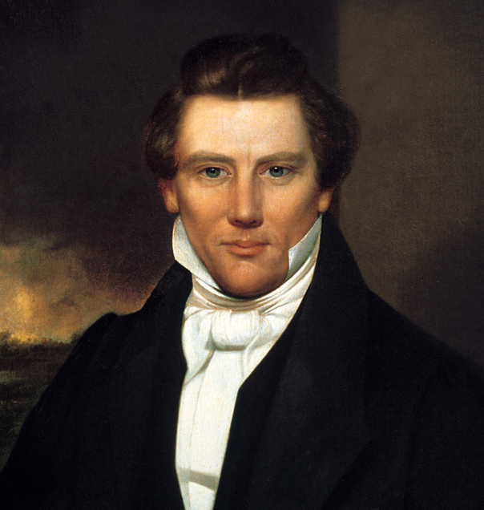
The Book of Mormon (1830 CE)
On April 6, 1830 Joseph Smith organizes the Mormon Church, known as the Church of Jesus Christ of Latter-Day Saints, in Fayette, New York.
He had published the Book of Mormon on March 26, 1830.
Born in Vermont in 1805, Smith claimed in 1823 that he had been visited by a Christian angel named Moroni, who spoke to him of an ancient text that had been lost for 1,500 years.
The holy text, supposedly engraved on gold plates by a Native American historian in the fourth century, related a story of Israelite peoples who had lived in America in ancient times.
During the next several years, Smith dictated an English translation of this text and in 1830 The Book of Mormon was published.
The religion rapidly gained converts, and Smith set up communities in Ohio, Missouri, and Illinois. However, the Christian sect was also heavily criticized for its unorthodox practices, such as polygamy.
In 1844, Smith announced his candidacy for the presidency of the United States. A group of dissenting Latter-day Saints began publishing a highly critical of the practice of polygamy and Smith’s leadership; Smith had the press destroyed.

Slide 27
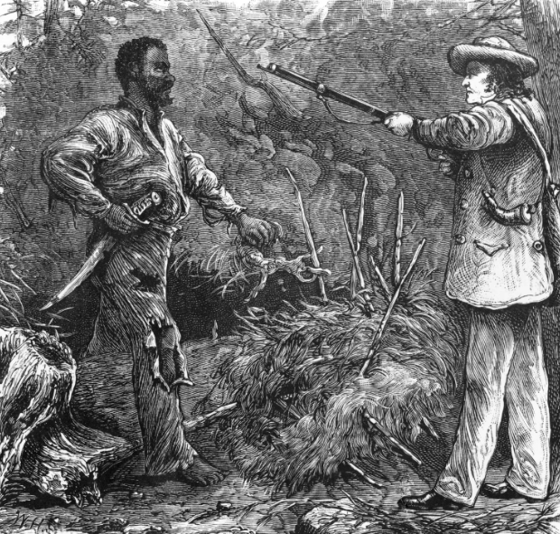
Nat Turner (1831 CE)
Nat Turner's Rebellion was a rebellion of enslaved Virginians that took place in Southampton County, Virginia, in August 1831, led by Nat Turner.
The rebels killed between 55 and 65 people, at least 51 of whom were white.
The rebellion was put down within a few days, but Turner survived in hiding for more than two months afterwards.
There was widespread fear in the aftermath, and militias organized in retaliation to the rebels.
The state executed 56 enslaved people accused of being part of the rebellion, and many non-participant enslaved individuals were punished in the frenzy.
Approximately 120 enslaved people and free African Americans were killed by militias and mobs in the area.
State legislatures passed new laws prohibiting education of enslaved people and free black people, restricting rights of assembly and other civil liberties for free black people, and requiring white ministers to be present at all worship services.
When the conspirators selected date to begin the revolution, initially, they picked the Fourth of July.

Slide 28
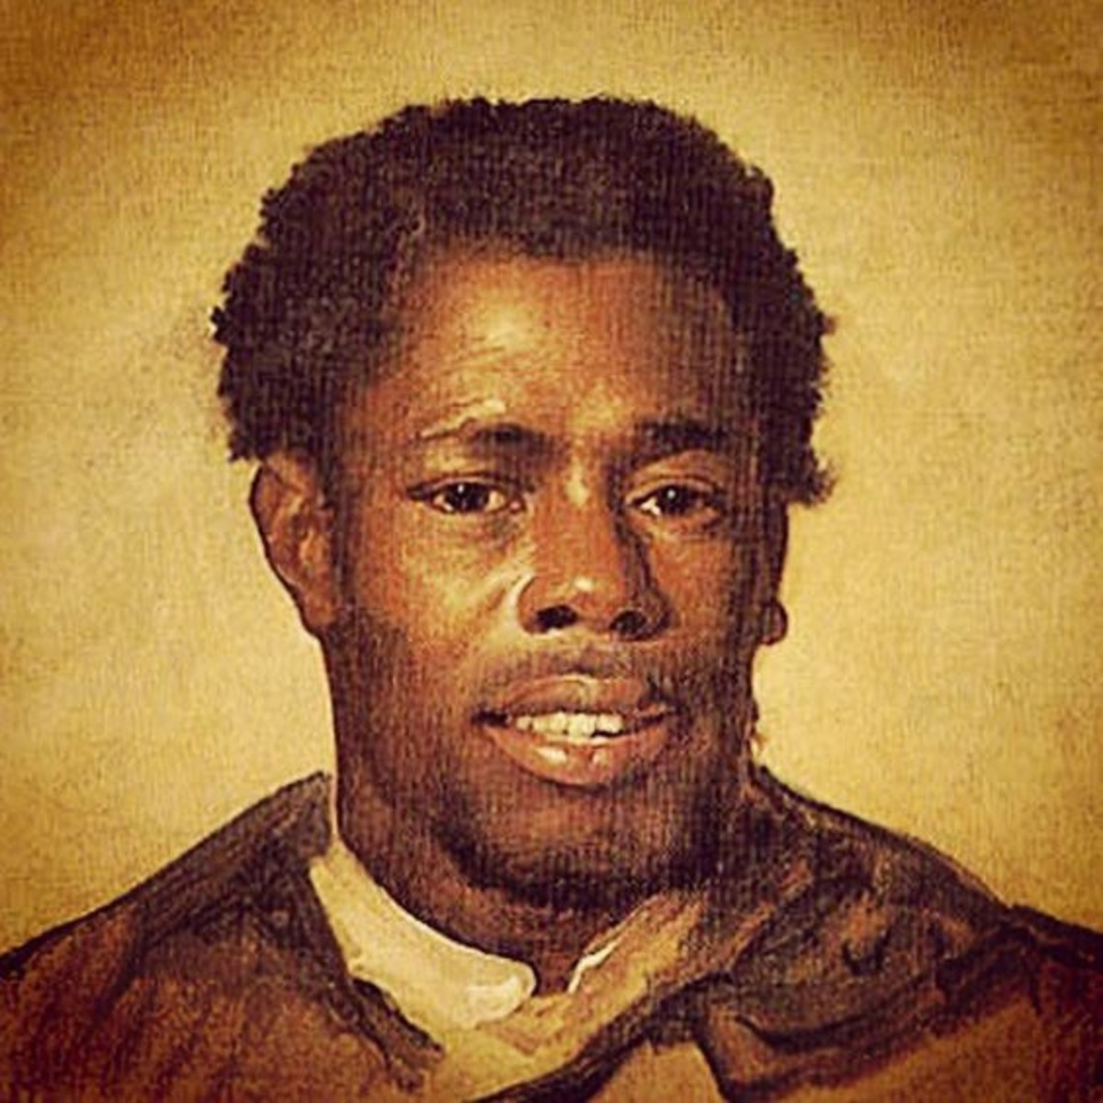
Nat Turner 1831 CE)
As dawn approached on the morning of August 22, the rebels moved stealthily and attacked in silence; during the day, they moved quickly and boldly.
They also separated into two squads: one on horseback, one traveling by foot.
This allowed the one on horseback to launch more and faster strikes. These attacks were successful in terms of killing whites.
As they marched on larger plantations, the rebels failed to gain a single recruit.
It was clear that the rebels would not inspire a mass movement by late morning as they had hoped. Nevertheless, at about forty slaves, the rebel army was a dangerous force.
The challenge of recruiting was compounded by a new problem for the rebels: news about the revolt had spread, making it harder for the rebels to find whites.
Most whites who heard of the revolt immediately fled to the woods, eluding the rebel army.
Turner and his men remained on the offensive, heading to were they hoped to procure arms and ammunition.
Still, they were being pursued by several groups of whites who had organized to suppress the revolt.

Slide 29
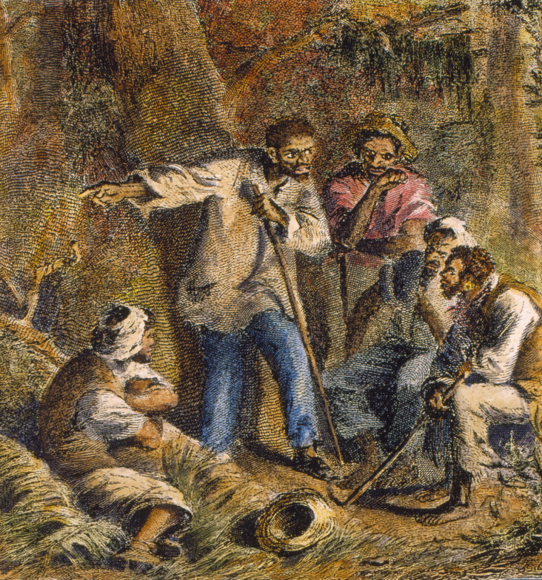
Nat Turner
Nat Turner lost contact with the other rebels, who broke up into ever-smaller groups, pursued by more and more whites.
Although some rebels remained at large for days—and Turner himself would not be captured for more than two months—the revolt was effectively over by midday on August 23,.
As the families gathered, whites organized paramilitary units to put down the revolt and get revenge.
Whites also tortured blacks, often by putting the suspected slave's feet in a fire. One white recounted how one suspect nearly had his foot "burnt off" before his interrogators "found at last that he was innocent."
After the uprising, anyone could freely kill a slave and escape punishment if the killer claimed that he thought that the slave was a suspected rebel.
The trials of suspected slave rebels began on August 31, 1831.
The trials were held in courts that slaves were tried without a jury before a panel of slaveholding judges.
Accused slaves all had paid appointed defense attorneys, and the judges tried to make sure that the trials were not show trials.
Every one of the convictions led to a death sentence.

Slide 30
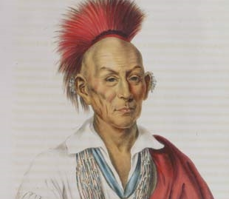
Black Hawk War (1832 CE)
The Black Hawk War was a series of skirmishes in 1832 between the U.S. Army and frontier militia units against the followers of Sauk Chief Black Hawk.
Fought in Illinois and Wisconsin, the war was one of many conflicts between Native Americans and white settlers over western land.
White Americans at that time were unsympathetic to the forced loss of land by Native Americans through numerous treaties always favoring the settlers.
In 1830 when Chief Black Hawk and about 1,000 tribe members returned from an annual hunting trip, they discovered white settlers occupying their village, located on the east bank of the Mississippi River near present-day Rock Island, Illinois.
Black Hawk expelled the white settlers from the village by threatening violence. US troops then removed the Sauks from the village in June 1831.
According to the “Corn Treaty” of June 30, 1831, the Sauks were instructed not to return to the east side of the Mississippi River without permission of the U.S. Government.

Slide 31
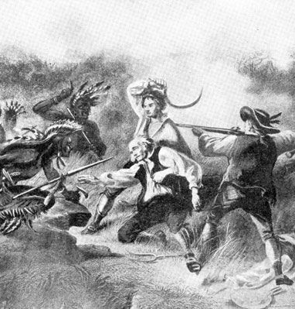
Black Hawk War (1832 CE)
By this late point in the year, Black Hawk’s people could not plant corn and crops. As a result, they suffered from shortages of food the following winter.
In April 1832, Black Hawk crossed the Mississippi River near his old village grounds headed for the Winnebago village at Prophets Town, Illinois.
The U.S. Army ordered the Sauks to return to the western bank of the Mississippi.
Black Hawk refused. He stated his peaceable intentions to grow a crop of corn. Illinois Governor Reynolds responded by calling out 1,600 Illinois Militiamen.
Among them was militia Captain Abraham Lincoln, future president of the United States.
The militia began pursuit of Black Hawk’s followers. Several skirmish ensued.

Slide 32
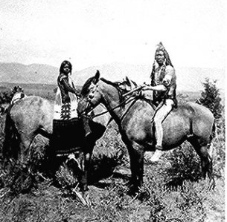
Black Hawk War (1832 CE)
By early June 1832, Illinois militia and U.S. Army troops renewed the pursuit of Black Hawk and his warriors through northern Illinois.
The climax of the Black Hawk War occurred on August 1-2. The Sauk suffered from a lack of food and supplies, and many were wounded.
The Sauk attempted to surrender and cross the Mississippi River in present-day Wisconsin, but the steamship Warrior fired cannon at their camp on the beach.
Approximately 300 reached the west bank, where their Sioux enemies attacked them. The Sioux killed about half of the surviving Sauk.
Black Hawk managed to escape but was later captured.
While a prisoner, he visited President Andrew Jackson and later toured several eastern states as a curiosity.
The Black Hawk War was the last armed resistance to white settlement in Illinois and Wisconsin and cost the lives of 70 settlers and soldiers and the lives of hundreds of Native Americans.

Slide 33
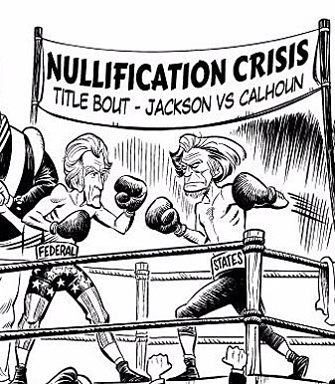
Nullification Crisis (1832 CE)
On November 24, 1832, South Carolina convention passed the Ordinance of Nullification, which was against the institution of permanent tariffs.
The state also, on this issue, threatened to withdraw from the union of the United States of America.
By the late 1820s, the north became increasingly industrialized, and the south remained predominately agricultural.
In 1828, Congress passed a high protective tariff that infuriated the southern states because they felt it only benefited the industrialized north.
It shrunk English demand for southern raw cotton and increased the final cost of finished goods to American buyers.
The southerners looked to Vice President John C. Calhoun from South Carolina for leadership against “the Tariff of Abominations.“
According to Calhoun, the federal government only existed at the will of the states.

Slide 34
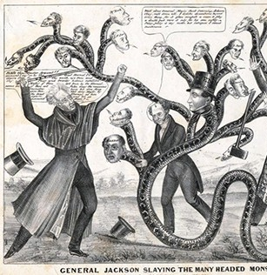
Nullification Crisis (1832 CE)
If a state found a federal law unconstitutional and detrimental to its sovereign interests, it would have the right to "nullify" that law within its borders.
Calhoun advanced the position that a state could declare a national law void.
The South Carolina Ordinance of Nullification was enacted into law on November 24, 1832.
As far as South Carolina was concerned, there was no tariff.
Jackson regarded this states rights challenge as so severe that he asked Congress to enact legislation permitting him to use federal troops to enforce federal laws in the face of nullification.
Fortunately, an armed confrontation was avoided when Congress, led by the efforts of Henry Clay, revised the tariff with a compromise bill.
This permitted the South Carolinians to back down without "losing face."

Slide 35
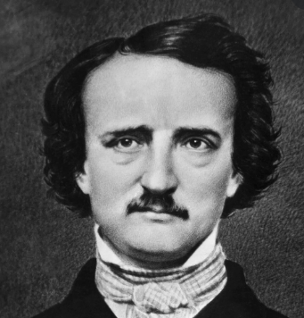
Unique American Style
Edgar Allan Poe was an American poet, short-story writer, editor, and critic. He also was one of the early writers of short stories, detective fiction, and crime fiction in the United States.
Edgar Allan Poe was born on January 19, 1809, in Boston, Massachusetts.
In 1839, the collection Tales of the Grotesque was published in two volumes. It was not a financial success but proved to be a milestone in the history of American literature, featuring such eerie, classic Poe tales as "The Fall of the House of Usher.”
On January 29, 1845, Poe's haunting poem, The Raven, appeared in the Evening Mirror newspaper and became a popular sensation.
The circumstances of Poe's death remain a mystery.
Following a visit to Norfolk and Richmond to give lectures, he was found in Baltimore in a pathetic condition and taken unconscious to Washington College Hospital, where he died early on October 7, 1849.
Poe was never coherent long enough to tell anyone what had happened to him — and why he was wearing clothes that were not his.

Slide 36
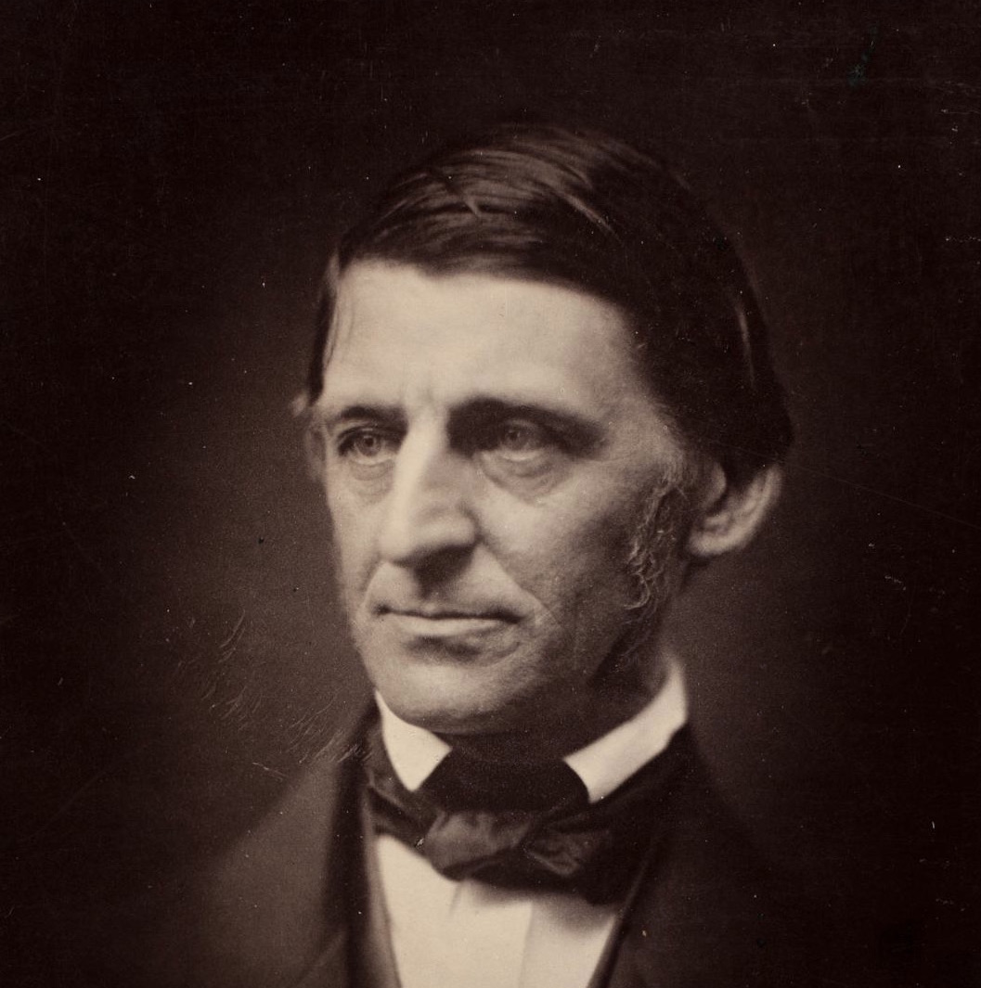
Unique American Style
Ralph Waldo Emerson was an American Transcendentalist poet, philosopher, and essayist during the 19th century.
He was born on May 25, 1803, in Boston, Massachusetts.
Emerson became known as the central figure of his literary and philosophical group, now known as the American Transcendentalists.
These writers shared an essential belief that everyone could transcend the physical world of the senses into a more profound spiritual experience through free will and intuition.
In this school of thought, God was not remote and unknowable; believers understood God and themselves by looking into their souls and feeling their connection to nature.
His "The American Scholar," based on a lecture that he gave in 1837, encouraged American authors to find their style instead of imitating their foreign predecessors.
Emerson continued to write and lecture into the late 1870s.

Slide 37
Unique American Style
New England writer Nathaniel Hawthorne was born in 1804 in Salem, Massachusetts, where his paternal ancestors had been prominent since the founding generation.
He would go on to write many American stories and novels, including "Young Goodman Brown" (1835) and the Scarlet Letter (1850).
In sketches, tales, and romances published in the second third of the 19th century, Hawthorne chose mainly American materials, drawing especially on the history of colonial New England and his native Salem in the time of his early American ancestors.
Heir to the Puritan tradition and alert to the transcendental thought prominent in his region and time, he subjected both to his skeptical, questioning scrutiny in the moral and psychological probing characteristic of his fictional works.
Considering guilt—actual or imagined, revealed or concealed—to be a universal human experience, he traced out in his characters the types and the effects of shame.
Through both direct statements and examples, he helped define for his age the literary sketch, the tale, and long fiction that fuses romance and psychological realism.

Slide 38
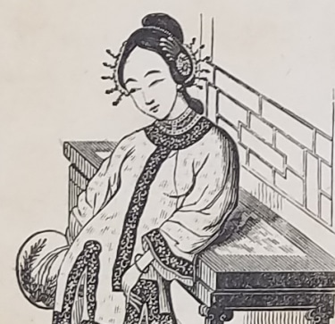
Afong Moy (1834 CE)
In 1834 Afong Moy became the first female Chinese immigrant to the United States; she was brought to New York City to be exhibited as "the Chinese Lady".
Moy was the first Chinese woman to achieve fame throughout the U.S. She toured the United States, was given press coverage, and met U.S. President Andrew Jackson.
When she first arrived, the public generally positively responded to China. The perceived "Orient" was one of exoticism, beauty, dignity, and revered history.
Her sponsors played on, controlled, and mediated the public's consciousness of her visual difference—her bound feet, Chinese clothing, and accessories—all to promote their goods.
On her three-year journey from 1834 to 1837 throughout the mid-Atlantic, New England, the South, Cuba, and up the Mississippi River, her race provided an occasion for ridicule, jingoism, religious proselytizing, and paternalistic control.

Slide 39
Afong Moy (1834 CE)
By the early 1850s, P. T. Barnum became her manager.
Though occasionally she required an interpreter, her language skills were likely sufficient for most audience interactions.
On stage, she provided evidence of her dissimilarity from chopsticks to the demonstration and explanation of Chinese religious rituals.
The public began to form stereotypical views of the Chinese as backward, arbitrary, undemocratic, and sometimes cruel.
Through her presentations, the contrasts and vast differences between the East and the West became evident, and the result often gave rise to an arrogant response from the public.
Her religious beliefs often characterized as heathen, gave rise to responses from moral reformers and other Christians.
Her explanation of the Chinese emperor's absolute power and governance compelled a contrast with American republicanism and its emphasis on virtue, self-government, education, and self-control.
A presentation of China's ancient ways reinforced the notion of America's progress.

Slide 40
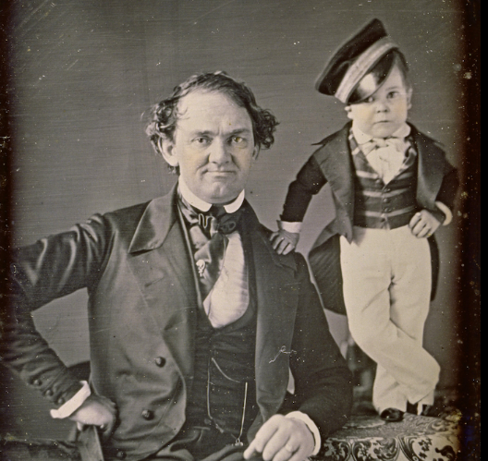
P.T. Barnum (1836 CE)
Phineas Taylor Barnum was an American showman remembered for promoting celebrated hoaxes and founding the Barnum & Bailey Circus with James Anthony Bailey.
His legacy in show business stretched from the American Museum to "P. T. Barnum's Grand Traveling Museum, Menagerie, Caravan & Hippodrome" near the end of his life.
Each was full of bigger-than-life ideas marketed to an audience interested in mass, and often crass, entertainment.
Barnum wrote of the term humbug "consists in putting on glittering appearances—outside show—novel expedients, by which to suddenly arrest public attention, and attract the public eye and ear… There are various trades and occupations which need only notoriety to ensure success
Growing up in the antebellum North, Barnum took his first natural dip into showmanship at age 25 when he purchased the right to "rent" an aged black woman named Joice Heth, whom an was being purported as the 161-year-old former nurse of George Washington.

Slide 41
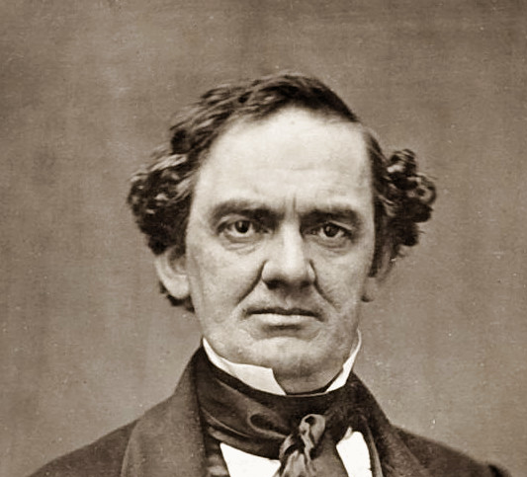
P.T. Barnum (1836 CE)
Though slavery was outlawed in Pennsylvania and New York at the time, a loophole allowed him to lease her for a year for $1,000, borrowing $500 to complete the sale.
Human curiosities were among the most popular traveling entertainments of the late eighteenth and early nineteenth centuries
By the 1830s, the display of odd human form was for some mainstream entertainment and to others an offense to refined sensibilities.
When she died in February 1836, rather than let her go in peace, Barnum hosted a live autopsy in a New York Saloon.
There, 1500 spectators paid 50 cents to see the dead woman cut up, "revealing" that she was likely half her purported age.

Slide 42
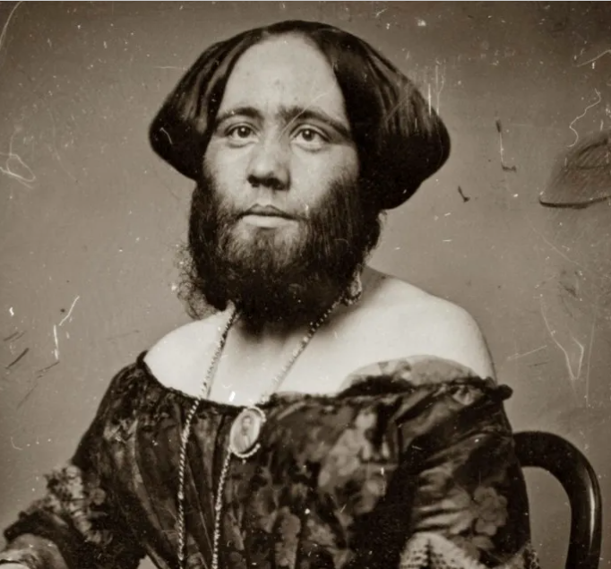
P.T. Barnum (1836 CE)
After Heth, Barnum found several other acts to tour—notably the world-famous Jenny Lind, "the Swedish Nightingale
More than 4,000 visitors poured per day to browse some 850,000 "interesting curiosities" at the price of 25 cents a trip at his facility called “the American museum.”
There were exotic live animals mixing alongside hoaxes like the so-called Feejee mermaid, a preserved monkey's head sewn onto the preserved tail of a fish.
Barnum preyed on ideas of African inferiority.
During his successful run for the Connecticut General Assembly in 1865, something changed, however. Suddenly Barnum "began to express a novel sympathy and regret about the subjugation of African-Americans—or at least to approach civil rights matters at the end of the Civil War with a new, somewhat softer vision of racial paternalism."
During a failed run for Congress, he even "confessed" during a campaign speech that while living in the South he had owned slaves himself, actions he since regretted.

Slide 43
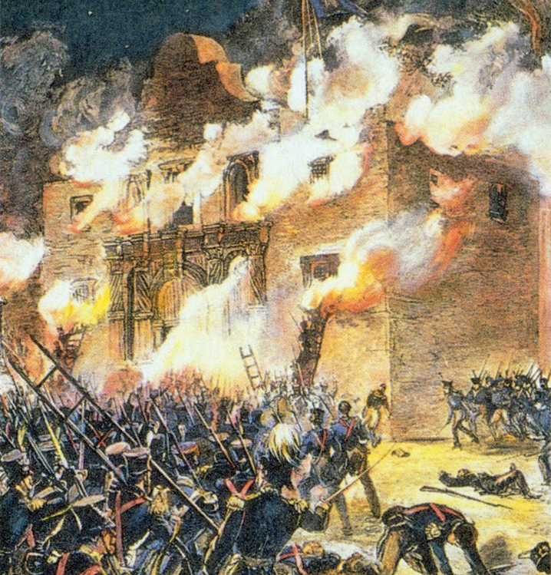
Texas Revolution (1836 CE)
The Texas Revolution was fought from October 2, 1835, through April 21, 1836.
After a decade of political and cultural clashes between the Mexican government and the increasingly large population of American settlers in Texas, the war began.
In the end, Texas won, resulting in its independence from Mexico and the founding of the Republic of Texas.
When the United States purchased Florida from Spain in 1819, the Spanish and American line on the southwest was fixed by the Sabine River.
Just across this line was the district of Texas, then a province of Mexico.
The Spanish government, anxious to develop this state, offered large tracts of land to anyone who would settle a certain number of families within a definite area.
It was not long after this that Mexico revolted from Spain and became an independent republic.
Dictators Antonio Lopez de Santa Anna succeeded in controlling all of the local state governments except Texas and made himself so unpopular that many of his enemies moved into the province of Texas.

Slide 44
Texas Revolution (1836 CE)
Santa Anna removed the capital of Texas from San Antonio to Saltillo, a town in a neighboring state.
This caused so much inconvenience that in April 1833, the Texans called a convention to discuss proposed changes in immigration, judicial, and other political policies.
The delegates advocated separate statehood for Tejas and elected Stephen Austin, son of the early pioneer, to carry a proposed state constitution to Mexico City.
Santa Anna, approved many of the proposals but refused to separate statehood.
Austin returned to Texas but wrote a letter in October that advocated Texans to act unilaterally on statehood.
As a result, he was arrested for treason and taken back to Mexico, and imprisoned, where he would stay for the next year and a half.

Slide 45
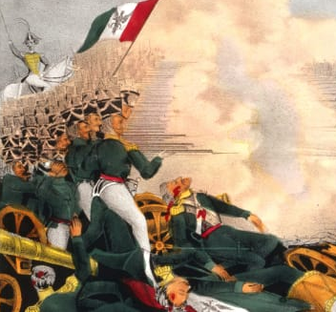
Texas Revolution (1836 CE)
Santa Anna to believe that the influx of American immigrants to Texas was part of a plot by the U.S. to take over the region.
Texans made plans for a revolt as a garrison of Mexican soldiers attempted to seize a cannon in Gonzales, Texas, on October 2, 1835.
Though the Texans resisted and forced the Mexicans to leave the field, this was the first official battle of the Texas Revolution.
During the next three months, the citizens of Texas formally declared war, and elected General Samuel Houston as commander of the army.
In the early morning hours of March 6, the full force of the Mexican Army advanced on the Alamo.
As the Texas soldiers fought bravely, they could repulse two attacks; however, they were unable to resist when a third came.
In the end, every last man within the Alamo would die – estimated to have been between 182 and 250 Texans.

Slide 46
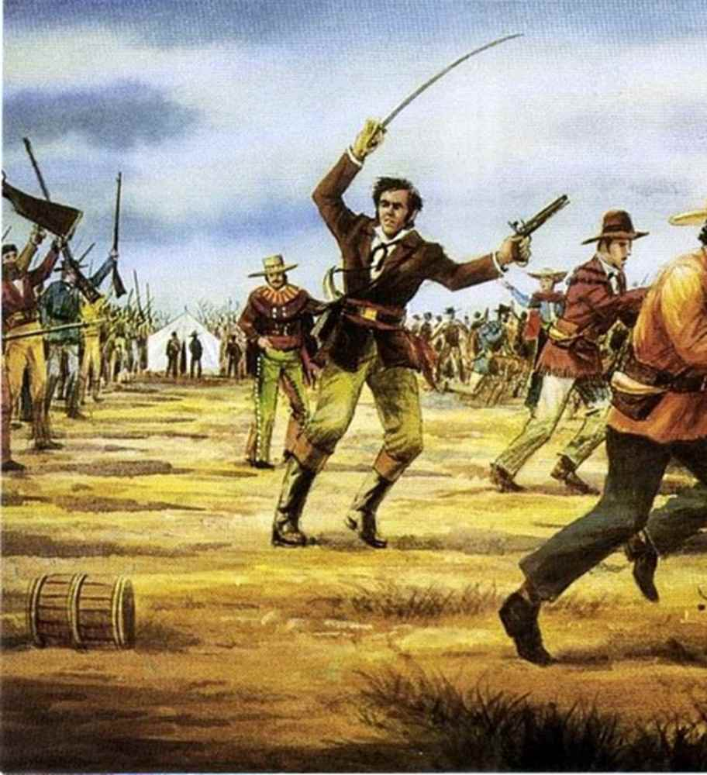
Texas Revolution (1836 CE)
Texans appointed five delegates to draft the document, completed it overnight, and signed it on March 2. David G. Burnett was made president, and Lorenzo de Zavala was chosen as vice president.
On April 20, 1836, both armies met at the San Jacinto River.
In a battle that lasted only about 18 minutes, Santa Anna’s entire force was killed or captured by Sam Houston’s heavily outnumbered army.
Santa Anna was captured the following day and held as a prisoner of war.
Three weeks later, Santa Anna was released after signing a treaty in which he agreed to discontinue war upon Texas; he was allowed to return to Mexico.
Afterward, the United States, France, and England recognized the new republic as independent, though Mexico never did.
Sam Houston became a national celebrity, and the Texans’ rallying cries, “Remember the Alamo!” and “Remember Goliad!” became etched into American history and legend.

Slide 47
Texas Revolution (1836 CE)
It was not long after the Texas Revolution that the people of the new republic began to consider the annexation of their state to the United States.
The majority of the population were Americans, whose interests had always been closely identified with the United States.
But, the biggest issue with annexing Texas as a state was the issue of slavery.
The Abolitionists of the North and East were especially opposed to annexation because Texas was a slaveholding republic.
The addition of this vast territory would significantly increase the area of the slaveholding states and slow the chances of abolition.
Though President John Tyler and some of his primary supporters were earnest advocates of annexation, he did not publicly make known his plans until April 1844, when he sent a message to the Senate proposing a treaty of annexation.
An enthusiastic advocate of Annexation, Texas became a state on December 29, 1845, which soon led to the Mexican-American War.

Slide 48
Samuel Colt (1836 CE)
In 1836, Connecticut-born gun manufacturer Samuel Colt received a U.S. patent for a revolver mechanism that enabled a gun to be fired multiple times without reloading. Colt founded a company to manufacture his revolving-cylinder pistol; however, sales were slow, and the business floundered.
On July 19, 1814, Samuel Colt was born in Hartford, Connecticut.
By visiting his father’s mill in Ware, Massachusetts, and helping out at a nearby farm, the young Colt became interested in all things mechanical and often dismantled objects–including his father’s firearms–to discover how they functioned.
His father then allowed the teen to study navigation firsthand, sending him out to sea on the Corvo, which embarked on a nearly yearlong voyage in 1830.
Colt became fascinated with the ship’s wheel, particularly the way it could alternately spin or be locked in a fixed position through the use of a clutch.
Colt carved a six-barrel cylinder, locking pin, and hammer out of wood during his time at sea.
After returning from his adventure at sea, Colt spent two years traveling North America under the name Dr. Coult, hosting a roadshow.
The profits he saved through his skill as a promoter enabled him to perfect his revolver mechanism, and he hired gunsmiths to create a series of prototypes.

Slide 49
Samuel Colt (1836 CE)
Colt’s Patent Arms Manufacturing Company began making the Paterson pistol in 1836 at its Paterson, New Jersey, factory using funds advanced by Colt’s family.
The ability to fire six shots without reloading–a task that required 20 seconds using a single-shot firearm–provided a crucial advantage to soldiers and settlers encountering danger in the nation’s frontier regions.
Seeking a government contract for his guns, Colt visited the office of the U.S. secretary of war.
Still, the Army judged using a percussion cap in Colt firearms too innovative and therefore potentially unreliable.
In 1846, with the Mexican War underway Colt collaborated on designing a new and improved gun, General Zachary Taylor ordered 1,000 Colt revolvers.
The guns were delivered to the Army in 1847.

Slide 50
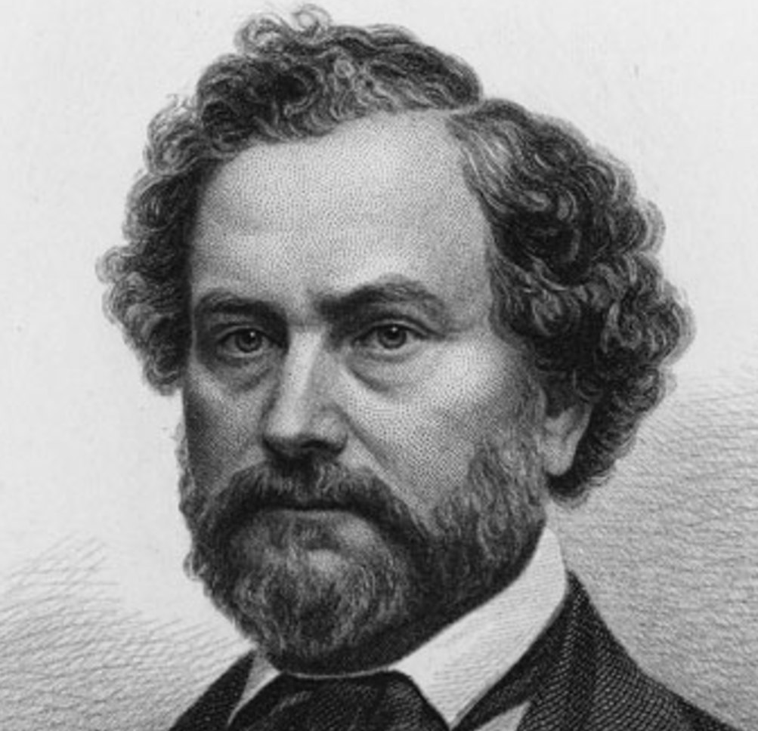
Samuel Colt (1836 CE)
By 1856, the company could produce 150 weapons per day using interchangeable parts, efficient production lines, and specially designed precision machinery.
The Colt brand was now recognized worldwide through savvy promotion and was associated with quality and dependability.
A masterful promoter, Colt positioned his firearms within the American mythos, even hiring artist and explorer George Catlin to create paintings depicting Colt guns used by sportsmen and explorers encountering exotic predatory animals in North and South America.
During the late 1850s, while tensions mounted between the North and South soon led to the American Civil War, Colt continued to do business with longstanding customers in Southern states.
However, when war was finally declared on April 12, 1861, he focused almost exclusively on supplying the Union army.
The company founded by Samuel Colt has produced more than 30 million pistols, guns, and rifles.

Slide 51
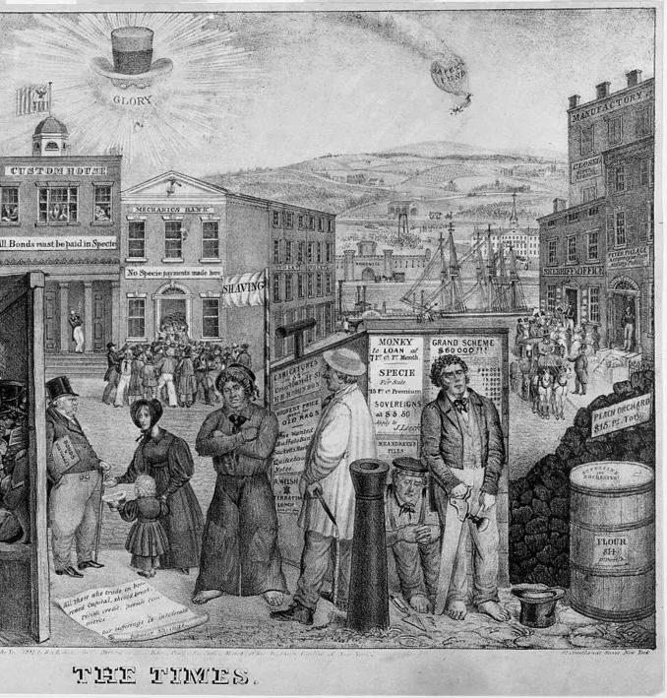
Panic of 1837
The Panic of 1837 was a financial crisis that had damaging effects on the national economies.
Following the War of 1812, the United States government recognized the need for a national bank to regulate the printing of currency and the issuance of government bonds.
Many in the U.S. public opposed the Bank of the United States, believing that it limited their ability to make land purchases and pay off other debts.
Jackson had opposed banks since the 1790s when he lost a sizable amount of money when he invested his money in a bank.
In 1816, the United States government had authorized the bank to operate for twenty years.
In 1832, Nicholas Biddle, the head of the Bank of the United States, asked to have the institution re-chartered.

Slide 52
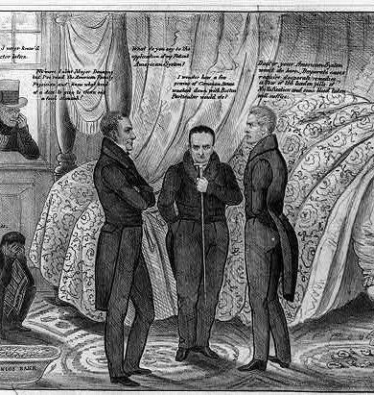
Panic of 1837
Congress agreed with the necessity for a national bank, but President Jackson vetoed the bill.
His action prevented the continued existence of the Bank of the United States after 1836.
Jackson was not happy with waiting until 1836 for the Bank of the United States to end.
In 1832, Jackson ordered the withdrawal of federal government funds, approximately ten million dollars, from the Bank of the United States.
The president deposited these funds in state banks and privately-owned financial institutions known as "pet banks."
Ohio had nine of these banks. Biddle tried to keep the national bank operational by calling in loans, yet many businesses did not have the funds to pay off their debts.
As a result of Biddle's actions, numerous companies had to close their doors due to the lack of funds during 1833 and 1834.

Slide 53
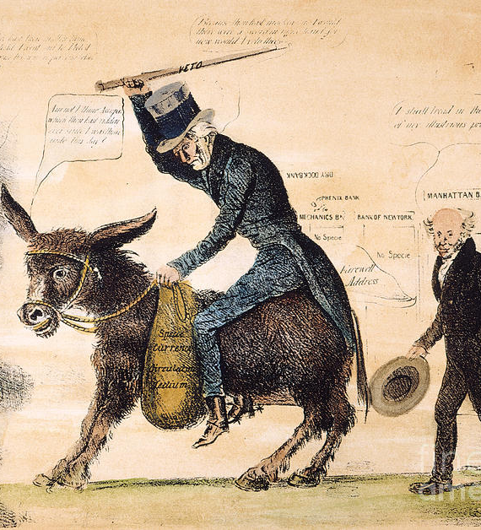
Panic of 1837
After this brief economic downturn, the United States economy boomed. State banks began loaning money to industrialists and farmers.
The banks also began printing excessive amounts of currency. This action led to high inflation.
At the same time that banks were printing currency and loaning out large sums of money, foreign governments and businesses, hoping to benefit from the United States' burgeoning economy, loaned large sums of money to U.S. businesspeople.
Unfortunately, many banks had loaned out too much money and did not have sufficient reserves on hand to meet the demands of their customers.
Approximately eight hundred banks closed their doors in 1837, stifling economic growth and bankrupting numerous businesses, including many of the banks.
During the Panic of 1837, approximately ten percent of U.S. workers were unemployed at any one time.

Slide 54
Panic of 1837
Mobs in New York City raided warehouses to secure food to eat.
Prominent businessmen, lost everything. Churches and other charitable organizations established soup kitchens and breadlines.
Stores refused to accept currency in payment of debts, as numerous banks printed unsecured (backed by neither gold nor silver) money. Some printed their own money, hoping business owners would accept it.
Thousands of workers lost their jobs, and many businesses reduced other workers' wages. It took until 1843 before the United States' economy truly began to recover.
The federal government's failure to assist the U.S. public led voters to turn against the Democratic Party, the party in control of government at the start of the Panic of 1837.
In 1840, voters elected William Henry Harrison, a member of the Whig Party over the Democratic candidate.

Slide 55
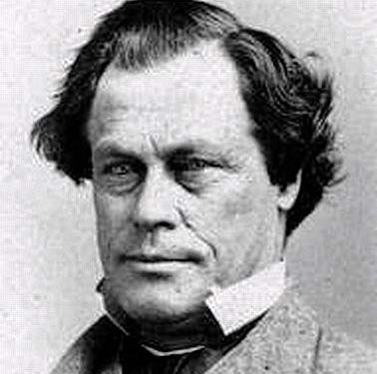
Elijah P. Lovejoy (1837 CE)
Elijah P. Lovejoy, an abolitionist printer, is killed by a mob of slavery supporters, when he was trying to protect his shop from its third destruction.
On April 28, 1836, a mob dragged a free black man from the St. Louis jail and burned him to death on a tree near 10th and Market streets.
The victim was Francis L. McIntosh, a steamboat cook who had stabbed a sheriff's deputy to death after being arrested in a scuffle on the levee.
Lovejoy's Observer described the lynching by fire as an "awful murder and savage barbarity."
It published gruesome details as local leaders sought to bury the story.
On July 21, a mob ransacked Lovejoy's office. Lovejoy obtained another one and resumed attacks on slavery.

Slide 56
Elijah P. Lovejoy (1837 CE)
On August 21, 1837, a mob wrecked his second press.
When men with torches climbed onto the roof, defenders of the press opened fire, killing one rioter and forcing others to retreat.
Lovejoy stepped outside for a look and was shot.
Lovejoy, known for righteous and unforgiving writing against slavery, was almost 35.
The mob tossed his press into the Mississippi River.He soon became a martyr to the nation's small but rising wave of abolitionism.
In Illinois, a young lawyer named Abraham Lincoln decried the mob violence.
The St. Louis Commercial, a pro-slavery newspaper, lamented accurately that every abolitionist in the land would celebrate Lovejoy's "martyrdom."

